Slide 1

WISE Workshop
Policy Development Kit
WISE Information Security for Collaborating E-Infrastructures
NSF Summit 2018
Uros Stevanovic - KIT
https://aarc-project.eu

Slide 2
Policy development kit
Establishing an Infrastructure (or Community) requires clear rules for security, membership management, data protection, etc.
Rules → Policies
Policies provide:
  Trust
  Manage and govern Infrastructure
  Legal compliance
AARC (and WISE) intends to provide templates, instructions, trainings

Slide 3
Policy impact on Infrastructure operation
Technical and operational considerations, early consideration
Possible impact points:
  Data protection, minimisation, storage, retrieval and deletion, fine grained access control
  Displaying policies during workflows (AUP, Privacy Policies)
  Limiting access, appropriate assurance
  Traceability
  User management (suspend, deletion, revoking credentials)

Slide 4
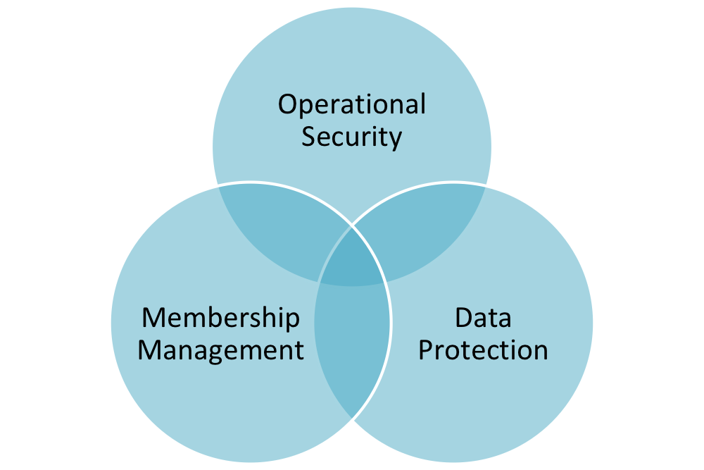
Which policies?
SCI paper (A Trust Framework for Security Collaboration among Infrastructures)
SNCTFI (Scalable Negotiator for a Community Trust Framework in Federated Infrastructures)
  Top level policy
    Operational Security
    Membership management
    Data protection
Consider current best practices (EGI, CERN, ELIXIR, TrustedCI, etc.)

Slide 5
SCI – main points
Operational Security
Incident Response
Traceability
Participant Responsibilities
  Individual users
  Collections of users
  Resource providers, service operators
Legal issues and Management procedures
Protection and processing of Personal Data/Personally Identifiable Information

Slide 6
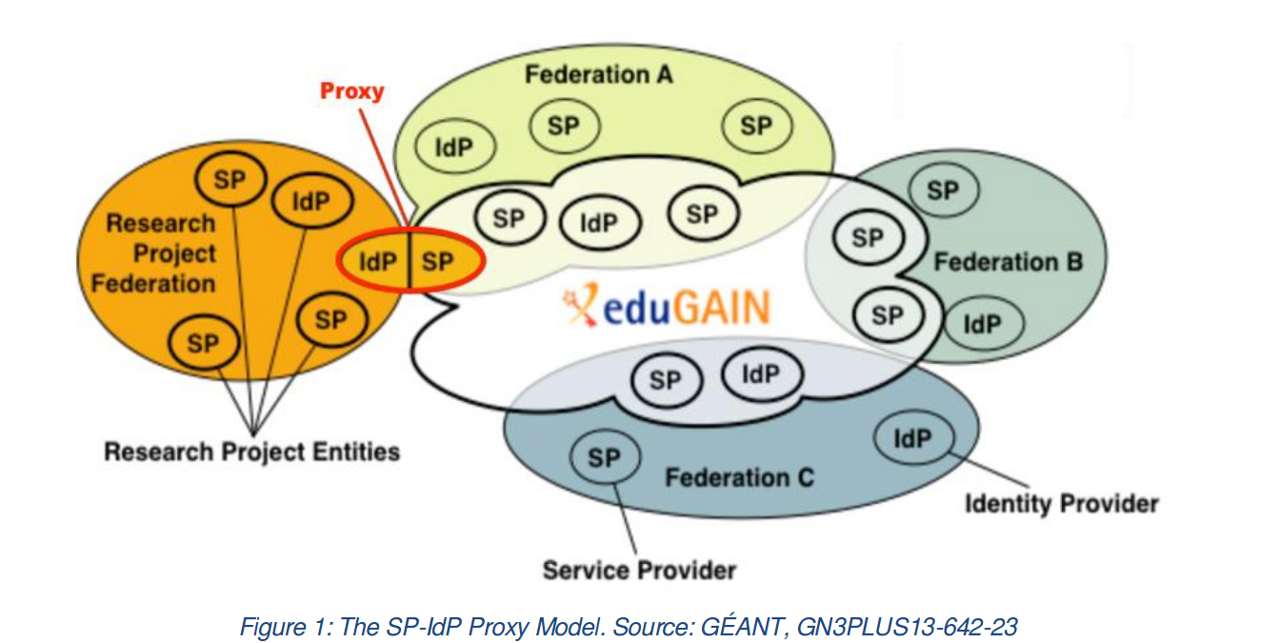
Current status – SNCTFI
Operational and policy requirements to establish trust between sources of identities (e.g. IdPs) and services connected via SP-IdP proxy

Slide 7
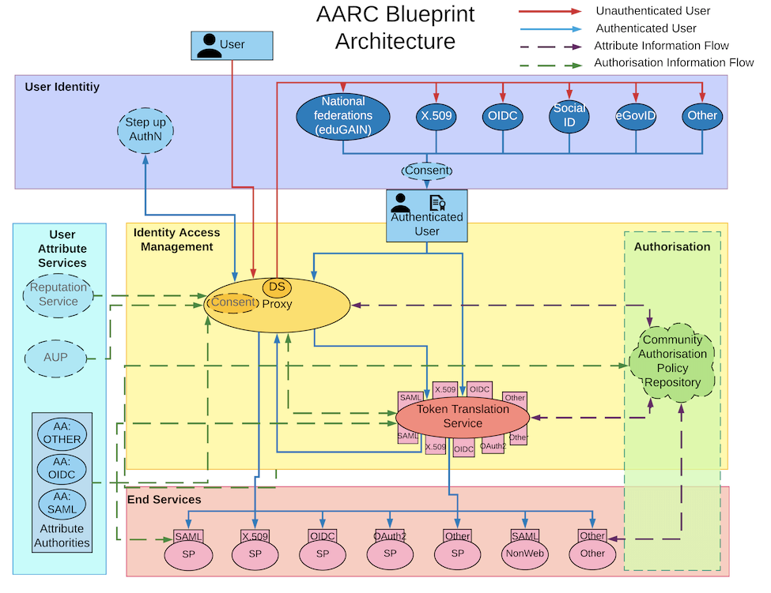
BPA

Slide 8
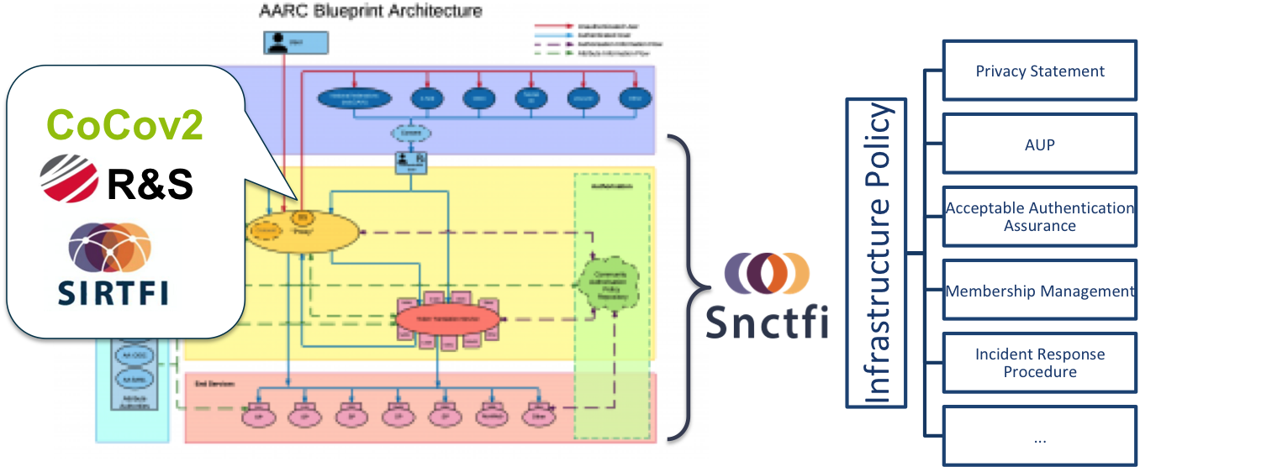
SNCTFI <-> Policy Frameworks
The GÉANT Data Protection Code of Conduct (CoCov2)
The Research and Scholarship Entity Category (R&S)
The Security Incident Response Framework for Federated Identity (Sirtfi)

Slide 9
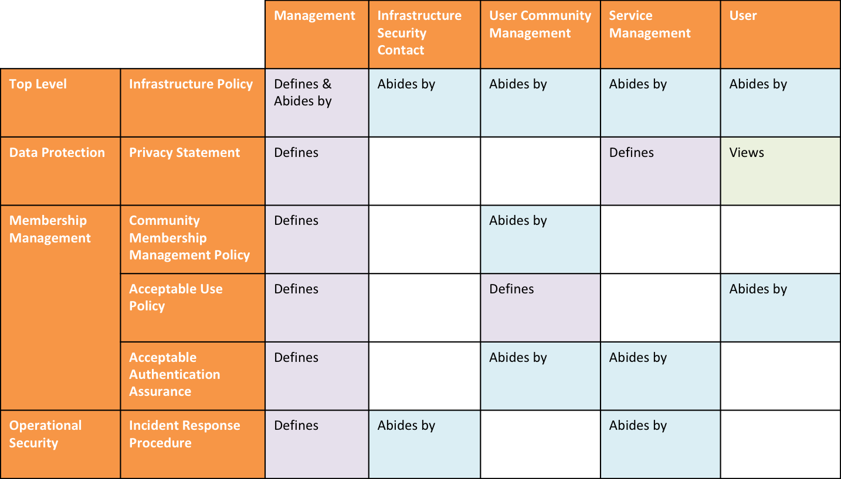
Policies

Slide 10
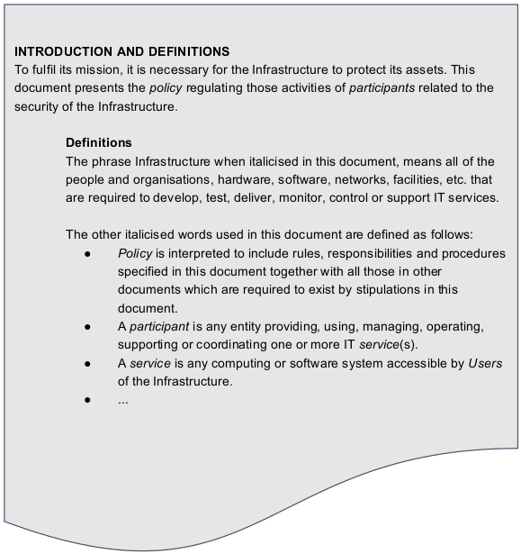
Top Level Infrastructure Policy
Top policy regulating activities and duties with all participants (with other policies..)
EGI Top Policy served as an input
Content:
Definitions
  Objectives
  Scope
Roles and Responsibilities
  Management
  Security Contacts
Security
Sanctions
Exceptions

Slide 11
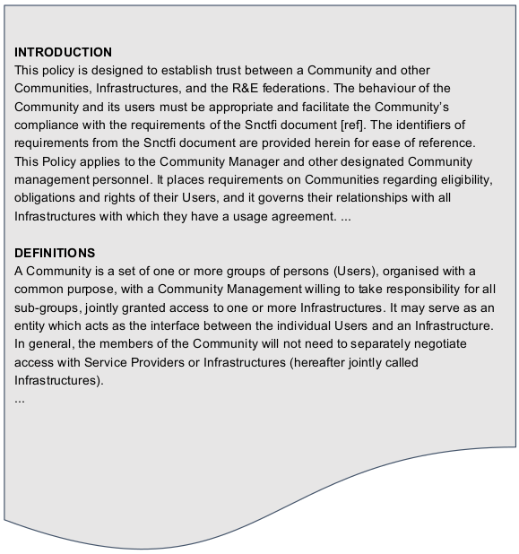
Membership Management Policy Template
Management of community users
EGI as a source
Content:
Definitions
Users (meaning and obligations)
Community manager and other roles
Community
  Aims and purposes
  Membership
  Membership Life Cycle
Data protection
Traceability
Registry and registration data

Slide 12
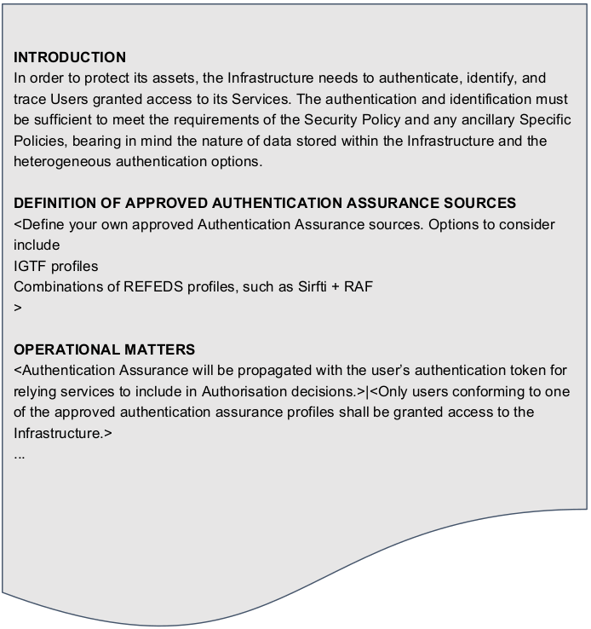
Acceptable Authentication Assurance Policy
Defining the required form and values for assurance
R&S, IGTF, REFEDS
Content:
Defining approved authentication sources
Operational matters
More specific policies (if necessary)

Slide 13
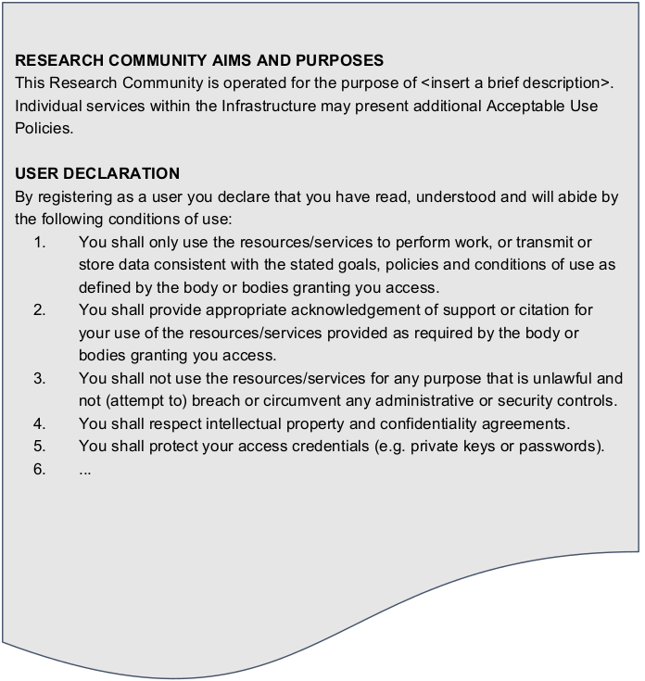
Acceptable Use Policy (AUP)
Presented to the user
User must accept it before accessing the services
Defining the goal and purpose of the community/infrastructure
Content:
User declaration
  Mostly expectations and obligations that user is taking on itself when using the resources

Slide 14
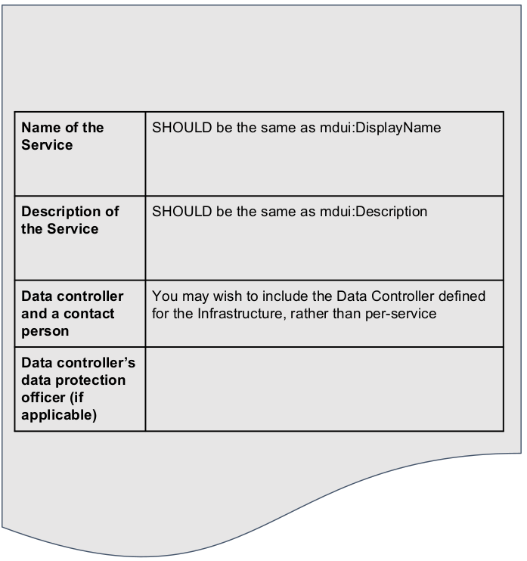
Privacy Policy
Privacy policy presented to the user
Info about processing of the user’s personal data
Per service (including Main Privacy Policy)
Content:
Which data are collected?
For what purpose?
DPO? Contact?
Jurisdiction?
Legal basis?
Disclosure of data?
Access, remedies
Retention
DP CoCo

Slide 15
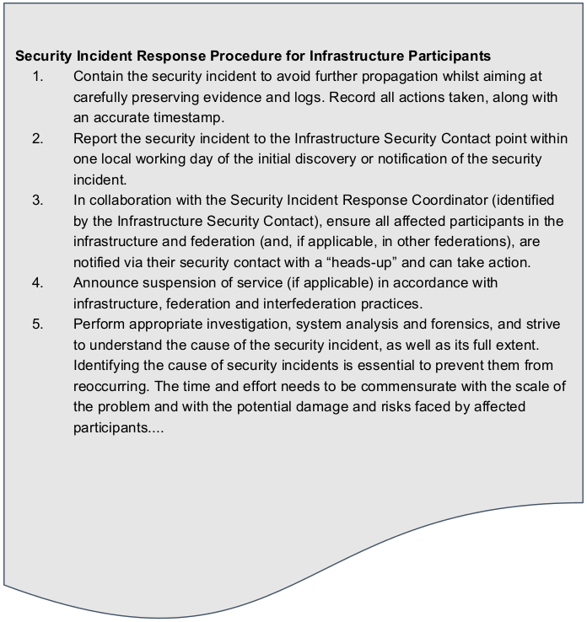
Incident Response Procedure
Description of the procedure how to handle an incident response
Duties and responsibilities
Content:
Procedure for Infrastructure Services:
  Timely reporting
  Suspension, investigation
  Sharing of necessary info
Procedure for the Infrastructure Security Contact:
  Assisting the participants
  Reporting the incident, notifications
  Suspension, investigation
  Corrective actions

Slide 16
Thank you
Questions?
wise@lists.wise-community.org

