Slide 1
23rd SIG-NOC
13-14 Oct 2025
GRNET NOC Flash Presentation
Antonis Lioumis
Head of GRNET Network Team
alioumis@grnet.gr

Slide 2
Who we are
GRNET S.A. – National Infrastructures for Research and Technology
  Operating since 1998
  Under the supervision of the Ministry of Digital Governance
  GEANT member
Connecting Educational and Research Community
  Networking, cloud computing, HPC, data management services and e-Infrastructures
Providing services to all Greek Citizens
  Hosting public facing services (gov.gr)
  Supporting digital transformation of Greece
Providing public health services
  Connecting all public hospitals
Supporting the interconnection of Greek IT companies
  Greek Internet Exchange administrator (www.gr-ix.gr)
  EURO-IX members

Slide 3
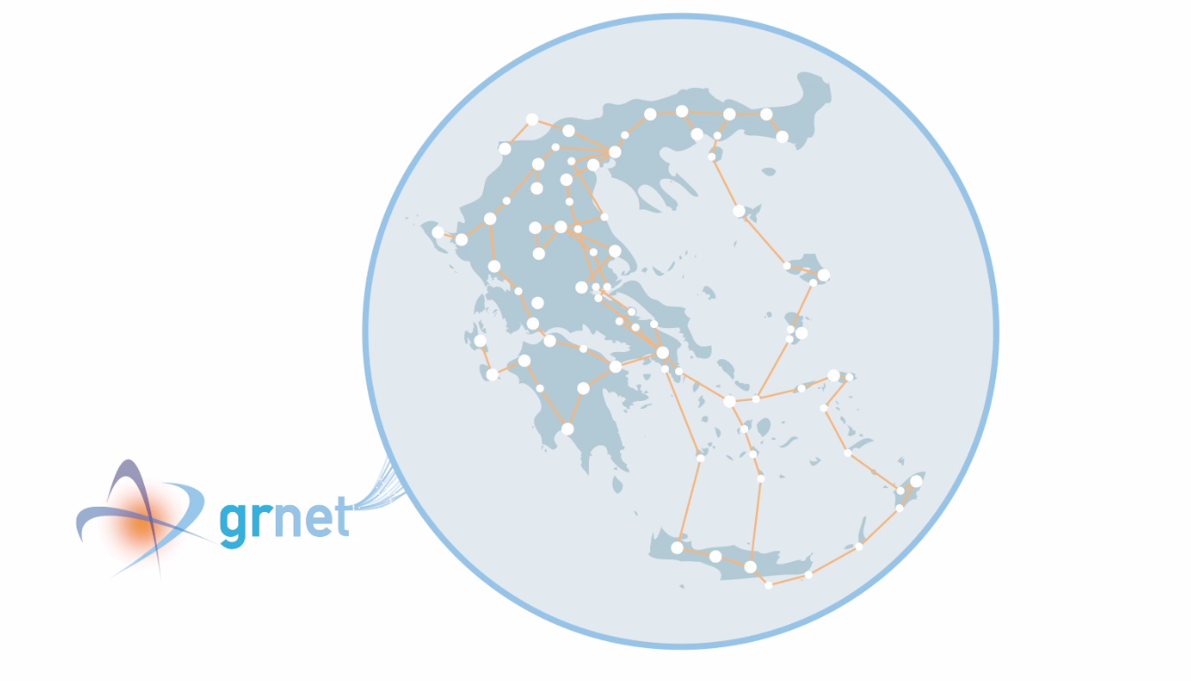
Numbers
Who we are
500K.
users
10,000 Km fiber
GRNET S.A. – National Infrastructures for Research and Technology
  Operating since 1998
  Under the supervision of the Ministry of Digital Governance
  GEANT member
Connecting Educational and Research Community
  Networking, cloud computing, HPC, data management services and e-Infrastructures
Providing services to all Greek Citizens (gov.gr)
  Supporting digital transformation
Public health services
  Connecting public hospitals
Greek Internet Exchange administrator (www.gr-ix.gr)
  EURO-IX members
340
PoPs
50
Cities
>150 Members
4
Data Centers

Slide 4
NOC Structure
Directorate of Reliability Engineering (GRE)
  SRE (Service Reliability Engineer Team)
  NRE (Network Reliability Engineer Team)
    Includes Optical and Network teams
  Infrastructure
  HPC
  IT security
  AAI
  GR-IX (Greek Internet Exchange)
  Helpdesk

Slide 5
Services (brief)
Network services
  L2/L3 connectivity
    1/10Gbps (soon 100Gbps, 400Gbps capable)
  Internet Access
    Two upstreams (GEANT, PCCW)
    Three exit points
Private Cloud Services
  VIMA, okeanos
    KVM/ganeti based
  Future Openstack deployments
Special projects
  Copernicus
  ARIS HPC

Slide 6
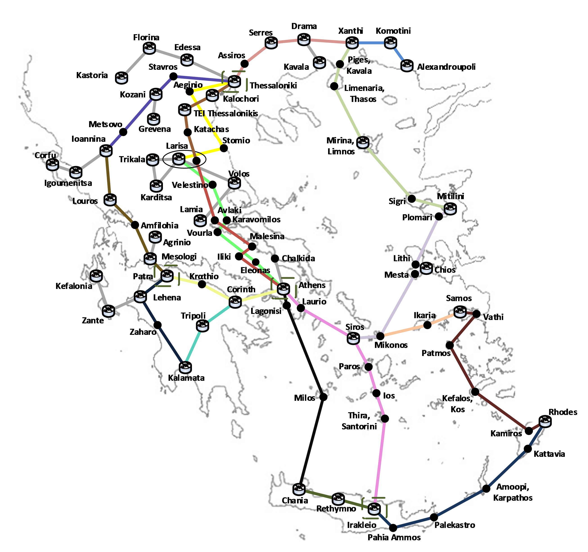
GRNET network
  Fiber
    15years lease (IRU)
    10,000 km
    Metro network in Athens and Thessaloniki
Backbone
Interconnecting Members

Slide 7
Infrastructure 1/2
Nation wide DWDM network
  15 year fiber lease
Connecting all major cities of Greece
IP/MPLS network
  Based on DWDM and dark fiber connections
4 Datacenters
  EVPN/VXLAN based
HPC
  ARIS (https://www.hpc.grnet.gr/)
  Soon to host Daedalus HPC (AI Factory)
Greek Internet Exchange (GR-IX, www.gr-ix.gr)

Slide 8
Infrastructure 2/2
New equipment expected
Replaces all IP/MPLS, DWDM, DC network and DC compute infrastructure
  Challenges
    Migration optical and network equipment at the same time
    Cloud services migration
    Tooling migration
New architecture considerations
  Introduce Segment Routing instead of LDP
  EVPN support instead of VPLS

Slide 9
GRNET Core Network
IP/MPLS
  Currently Juniper based (MX, EX series)
  ~150 access switches (EX series)
  75 mpls routers (MX series)
  3 IP/border routers (MX series)
Data center
  Currently Juniper Based (QFX series)
  8 spines (QFX10k)
  92 leaves (QFX5100)

Slide 10
Network Automation
Nornir framework for configuration management
    Pure Python environment
    Multi threading
    Better error handling
    Successor of Ansible
Orchestration
  Stackstorm currently
  WFO evaluation
For Automated workflows
  Netbox as source of truth
  Custom scripts for assigning resources and delivering services

Slide 11
Network Management and Monitoring
Based on open source tooling
  Icinga/thruck
    Alerting
  Telemetry
    Telegraf, Grafana, InfluxDB stack
    Alerting on incidents (link full, prefix drop, etc)
  IXP manager
    Managing GR-IX members
  In house DB
    Manging GRNET members

Slide 12
DDoS Mitigation 1/2
Currently in house solution based on open source tooling
Akvorado as flow detector
  Sampling on border routers
  Flow enrichment (BMP, Clickhouse, GEOIP DBs)
  Set of thresholds applied
  In case of violation bgp flowspec rules applied on border routers
  SYN, SYN-ACK, RST, ACK, UDP, HTTP/HTTPS detection
Mitigated Attack types
  SYN Flood
  Reflection Amplification
Actions
  Alerting (slack, mail)
  Rate limit
  Reporting
  Autodeletion of rules when attack ends

Slide 13
DDoS Mitigation 2/2
For Golden services (gov.gr) use of Cloudflare Magic Transit
Firewall on Demand (fod.grnet.gr)
  UI for members
  Apply their ruleset

Slide 14
NOC communication
Intra-communication
  Slack
  Jira for troubleticketing
  Mail
  Phone
Inter communication
  Autocreated Mailing lists with member NOCs
  Mainly helpdesk team
  Phone
Documentation
  Wiki

Slide 15
THANK YOU!
questions???
www.grnet.gr
info@grnet.gr
f: grnet.gr
X: grnet_gr
L: grnet sa
YT: grnet edyte
Inst: grnet.gr

