Slide 1
GREN Map
SIG-NOC
Gustavo Araújo - RNP
gustavo.araujo@rnp.br

Slide 2
Summary
Context and Mapping Initiatives
Challenges Faced by Mapping Iniciatives
GREN Map WC
On going proof of concepts
How to contribute and propose a new PoC

Slide 3
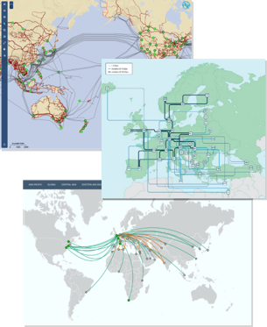
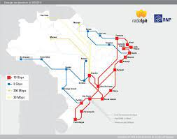
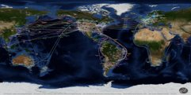
Context of mapping initiatives
Network topology is an important part of an NREN's identity
Several initiatives have been created to graphically demonstrate the reach of networks
However, maps quickly become outdated and the process of updating them can be costly

Slide 4
Challenges Faced by Mapping Iniciatives
Data Heterogeneity: Each NREN maintains topology data in its own unique format, creating significant integration barriers.
Lack of a Common Standard: Absence of a formalized, universal data model to represent and exchange network topology information consistently
Automation for Data Handling: Need for automated tools to efficiently collect data from heterogeneous sources and transform it into a standardized, usable format.
Unified Visualization Platform: Requirement for a reference visualization tool to consume and display the consolidated network map in a clear and interactive way
Centralized Repository: Requirement for a central, scalable repository to house complex and varied network data from around the world.
Secure Data Sharing Framework: Establishing clear rules, guidelines, and security protocols to govern how network data is shared, ensuring privacy and integrity.

Slide 5
Challenges Faced by Mapping Iniciatives
I need a highly detailed map that shows the physical topology, displaying various network parameters for each link.

Slide 6
Challenges Faced by Mapping Iniciatives
I need a highly detailed map that shows the physical topology, displaying various network parameters for each link.
I need a high-level, visually appealing map suitable for presentations to executives, government officials, etc.

Slide 7
Challenges Faced by Mapping Iniciatives
I need a highly detailed map that shows the physical topology, displaying various network parameters for each link.
I need a high-level, visually appealing map suitable for presentations to executives, government officials, etc.
I need a highly detailed map that shows the physical topology, but only visible to some persons

Slide 8
Challenges Faced by Mapping Iniciatives
I need a detailed Layer 1 map showing the physical fiber paths, including DWDM channels and amplifier sites connecting our Points of Presence (PoPs).
I need a highly detailed map that shows the physical topology, displaying various network parameters for each link.
I need a high-level, visually appealing map suitable for presentations to executives, government officials, etc.
"I would like an interactive map showing all network equipment by location, allowing us to filter by vendor, model, and software version for asset management.
I need a high-level, visually appealing map suitable for presentations to executives, government officials, etc.
I need a highly detailed map that shows the physical topology, but only visible to some persons
We need a live logical topology map that displays BGP peering sessions and real-time traffic flow between member institutions and international transit providers.
I need a high-level, polished map for the Ministry of Education, highlighting all connected universities, research centers, and schools to demonstrate our national reach.
We need a simple, clean map for our public website that visualizes the main redundant fiber rings ensuring high availability for our member institutions.
I would like a thematic map that shows the available bandwidth capacity across our backbone, using a color gradient to indicate upgrade priorities for the next fiscal year.

Slide 9
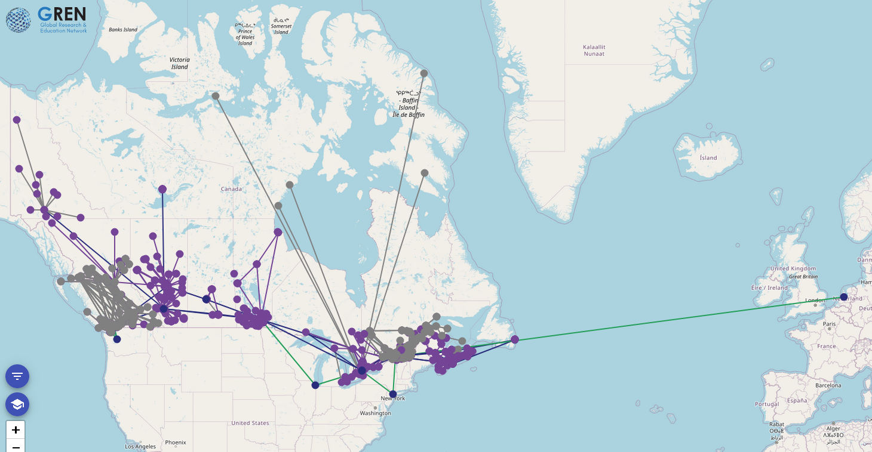
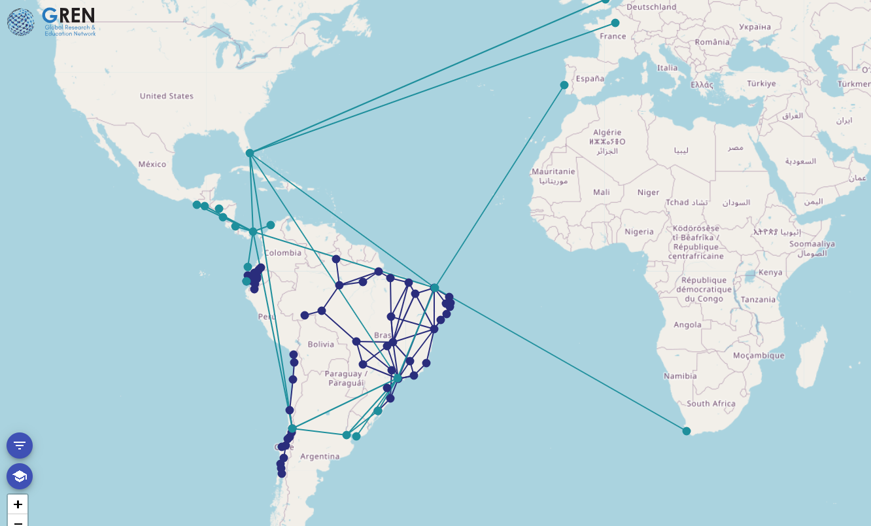
GREN Map WC
Develop a data standard for topology representation
Develop tools to help with the data transition/translation
Develop a distributed database system to store and manage this information and consolidate it on a single node
Develop a reference visualization
https://ca-map.apps.canarie.ca/
https://grenmap.rnp.br/

Slide 10





GREN Map WC
Standard data format
Storage and sharing
system
Data visualization

Slide 11
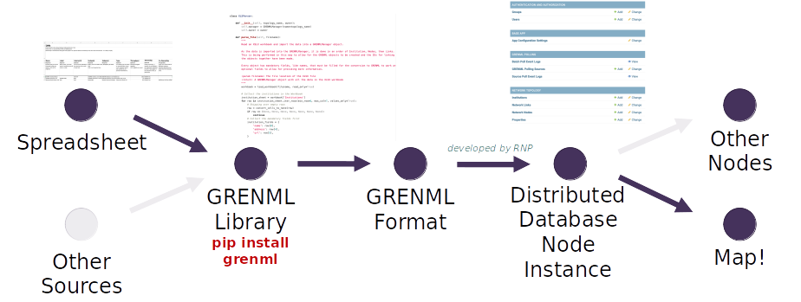
GREN Map WC

Slide 12
GREN Map WC
GREN
GREN
Hierarchical data sharing system
The advantage of this approach is that each network is responsible for keeping only its data up to date
PREN
AmLight
RedClara
NREN
RNP
RUENA
SREN
Rede Rio
MetroPOA

Slide 13
GREN Map WC
The Opportunity: What if we evolve from a group focused on one tool to a collaboration hub that enables various initiatives?

Slide 14
GREN Map WC
The Opportunity: What if we evolve from a group focused on one tool to a collaboration hub that enables various initiatives?
The New Vision: Working group focused on generating value through real proofs of concept, learning, and adapting based on them.
Empowering Working Groups: Assisting other working groups in building their own customized network maps.
GRENML Repositories: Creating shared GRENML repositories to facilitate data exchange and collaboration among working groups.
Secure Data Sharing Guidelines: Developing clear guidelines to ensure the secure and responsible sharing of network data.
Exploring Visualization Tools: Researching and presenting new tools to help build advanced and innovative network visualizations.

Slide 15
Security Guidelines for Data Sharing - Draft
1. Data provided will be public. Do not include any data that should not be public.
2. The geo-position of infrastructure (PoPs, equipment) should be obfuscated.
3. Due to DDoS security concerns, carefully consider if you want to provide link capacity values for core infrastructure.
4. It is not recommended to include capacity on links to end nodes / institutions (due to DDoS security concerns).
5. Consider whether infrastructure details are necessary e.g. multiple routers/switches in one location should be consolidated to a single generic node. Infrastructure details should not include equipment type or vendor name.

Slide 16
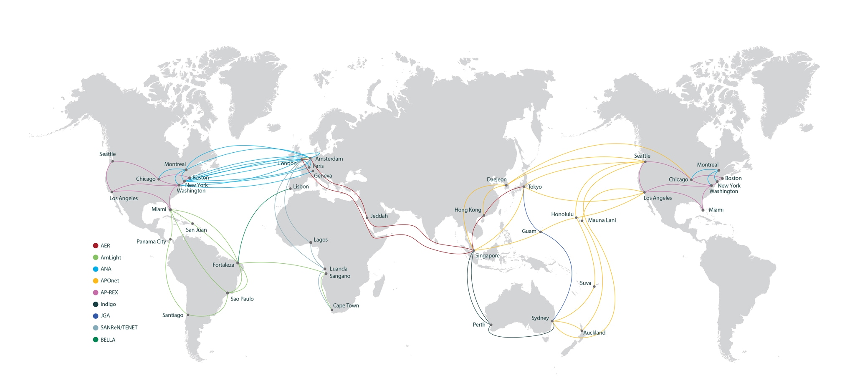
On going proof of concepts
https://www.gna-g.net/

Slide 17
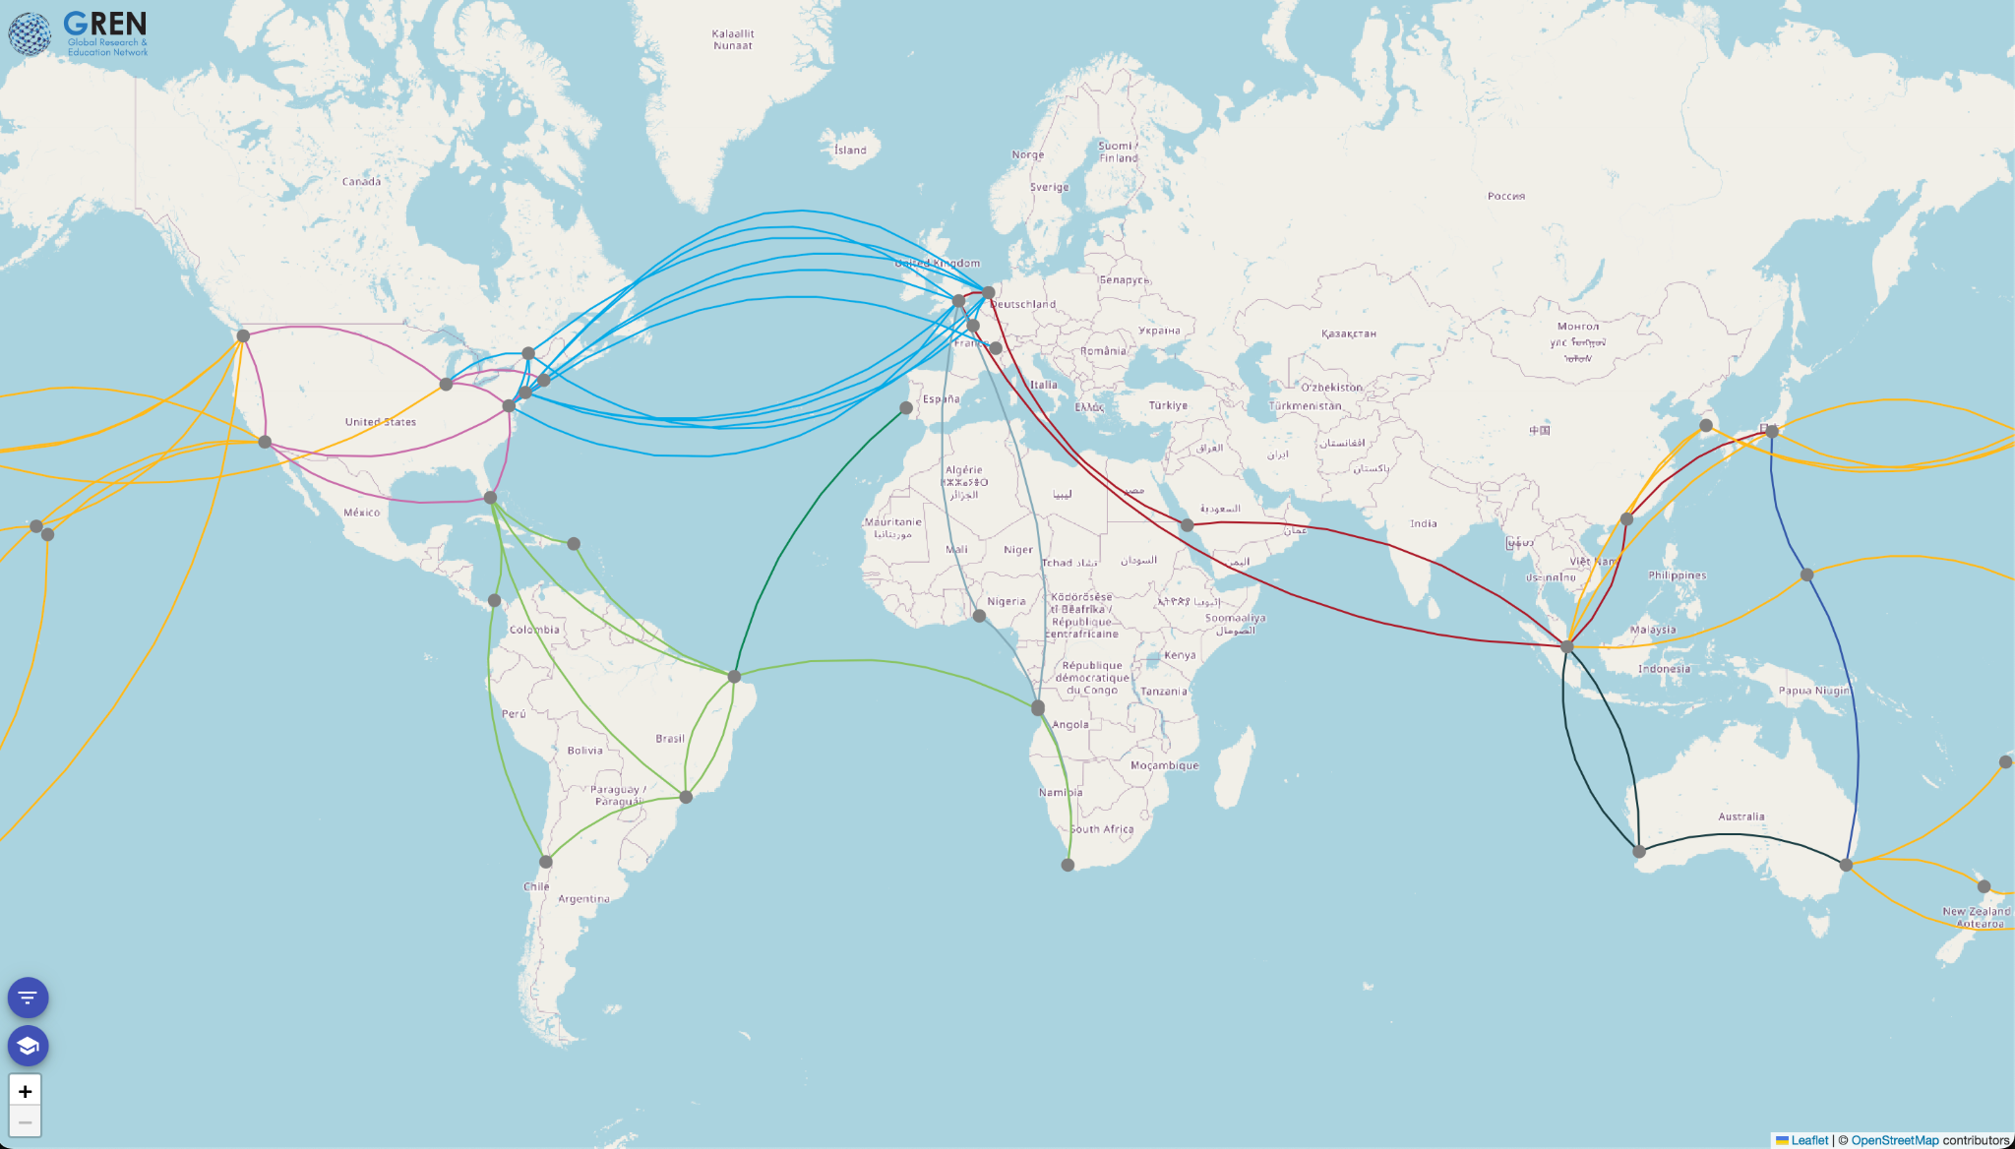
On going proof of concepts

Slide 18
How to contribute and propose a new PoC
To propose a new map or demonstration, email us at gren-mapping-wg@lists.nordu.net. Please describe the purpose of your project and the data you would require. We will then schedule a meeting to discuss how we can help.
GREN Map WC Drive: https://drive.google.com/drive/folders/1aRmY391bMvMBqHu6dPa_FnzUhMXIutT1?usp=sharing

Slide 19
Thanks! Questions?
Gustavo Araújo
gustavo.araujo@rnp.br
gren-mapping-wg@lists.nordu.net

