Slide 1
Maat – PIONIER Source of Truth
Tomasz Szewczyk
Poznańskie Centrum Superkomputerowo-Sieciowe
23rd SIG-NOC

Slide 2
INFRASTRUCTURE
Environment
21 MANs including 5 HPC centers
Optical DWDM transmission based on own fibers
MPLS based packet network
Transmission interfaces
  10Gbps
  100Gbps
  400Gbps
  800Gbps

Slide 3
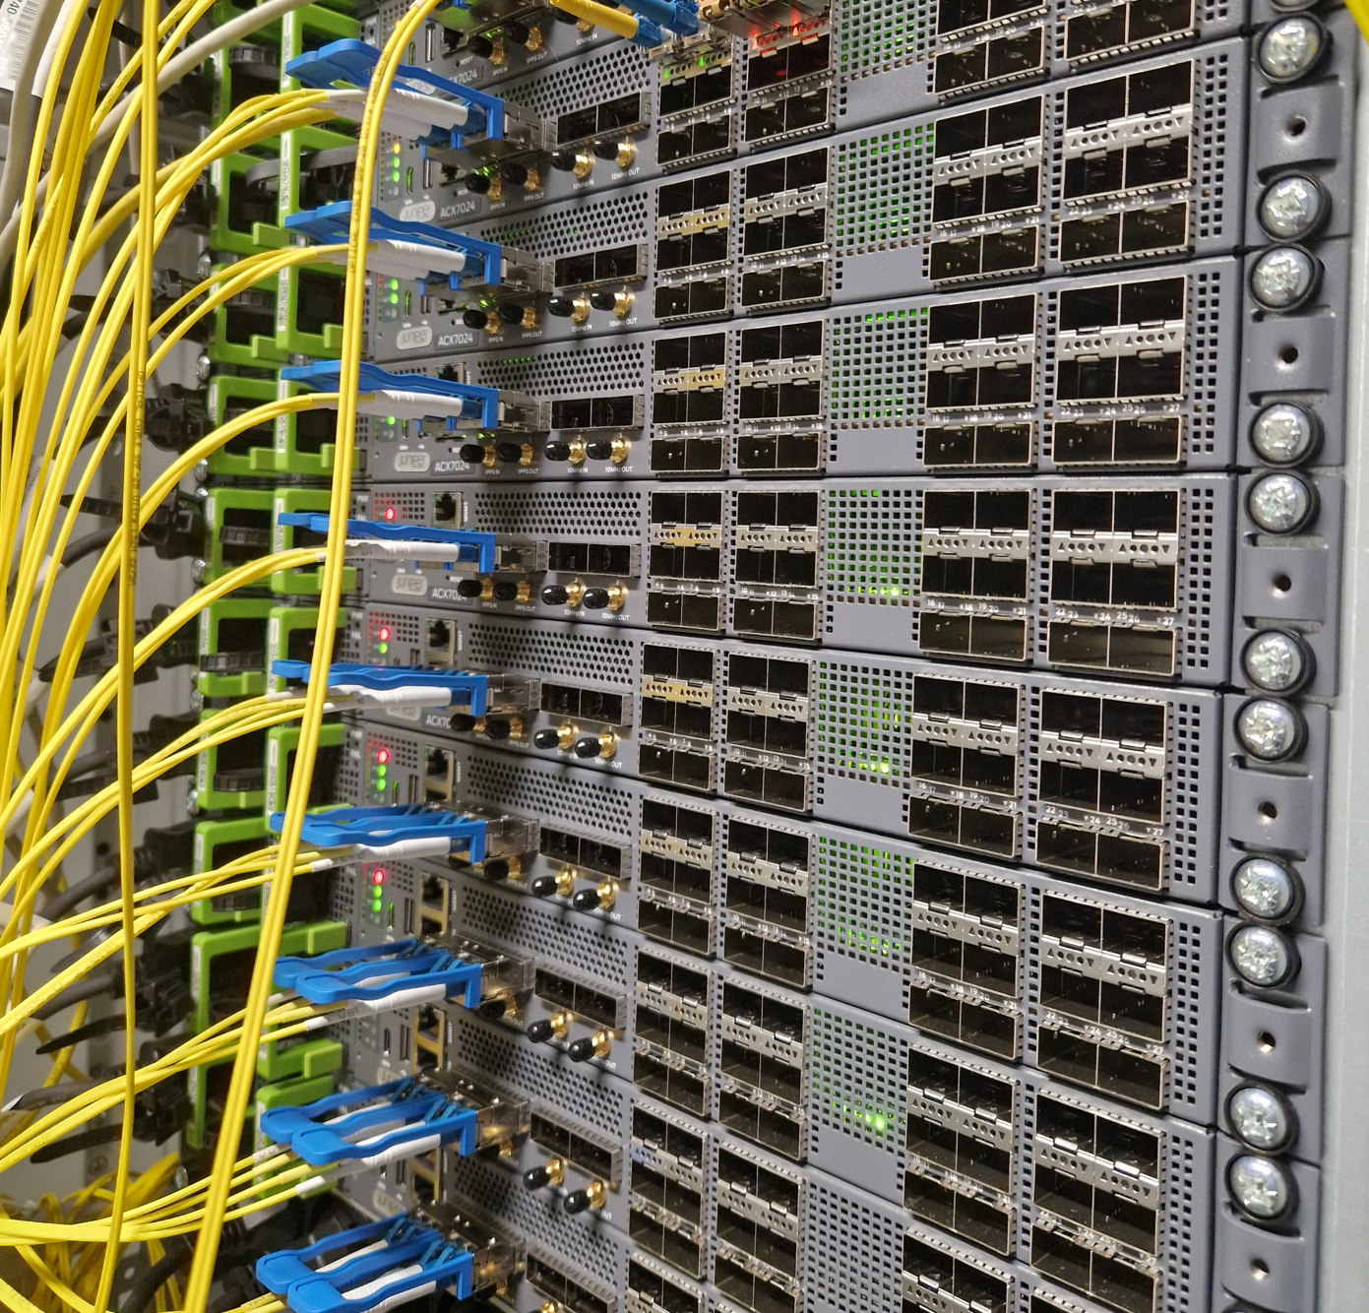
INFRASTRUCTURE
Need for automation
Many different software and hardware platforms, even if they come from the same vendor
  JunOS
    MX304
      Juniper Trio6
  Junos EVO
    PTX10001-36MR
      Juniper Express4
    ACX 7100 series
      Broadcom Jericho2
    ACX 7024
      Broadcom Qumran-2U
Avoid mistakes for repetitive instances
Use valid(ated) configuration for given platform

Slide 4

SERVICES
Need for orchestration
Wide set of services
  Internet access
  MPLS based
    Virtual networks (VRFs)
      Unicast
      Multicast
    Point to point circuits
      BGP based
      LDP based
    EVPN
Demanding users with different needs
Atomic development and deployment
Generic solution and tools for future development

Slide 5













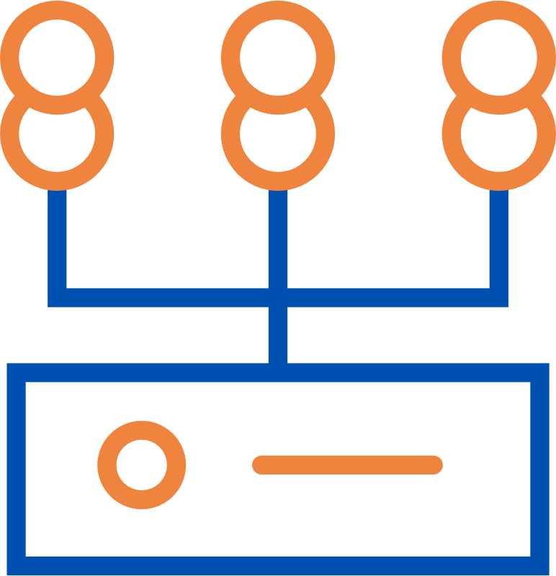
HOW IT WORKS
Resources and services modeling in Maat
  Describe resources and services
  Avoid data duplication
Workflows
  Collect user input
  Interact with Maat via REST API
    Read existing data
    Create new object
    Modify existing objects
  Control implementation on devices
Changelog

Slide 6

RESOURCES AND SERVICES MODELING
TMF based resources and services models

Slide 7
RESOURCES AND SERVICES MODELING
Ethernet point to point circuits (E-LINE)
@type – Service
category
  l2.circuit
  l2.circuit.sap
serviceCharacteristic
  Parameters specific to service instance
references
  serviceRelationship
  resourceRelationshp
identifier
  Register for available identifiers (eg. virtual circuit id, vrf target etc)

Slide 8
RESOURCES AND SERVICES MODELING
EVPN
@type – Service
category
  l2.evpn
  l2.evpn.bd
  l2.evpn.sap
serviceCharacteristic
  Parameters specific to service instance
references
  serviceRelationship
  resourceRelationshp
esi
  Ethernet segment identifiers

Slide 9
RESOURCES AND SERVICES MODELING
VRF
@type – Service
Category
  l3.vrf
  l3.vrf.sap
serviceCharacteristic
  Parameters specific to service instance
References
  serviceRelationship
  resourceRelationshp
protocol
  signaling protocol enabled for service instance (BGP, OSPF etc)
identifier
  Register for available identifiers (eg. Virtual circuit id, vrf target etc)

Slide 10
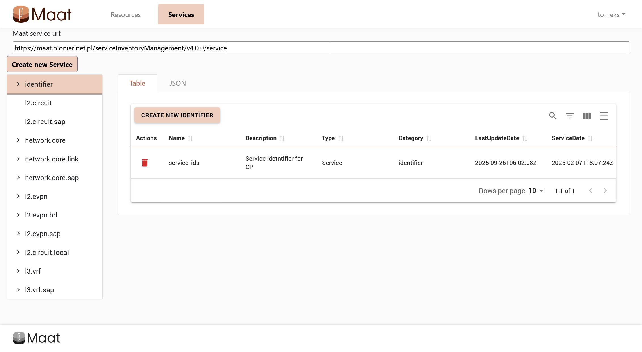
RESOURCES AND SERVICES MODELING
Maat GUI
Administrative (technical) purposes only
Quick browsing of database objects
Manual editing of selected objects
Fix missing entries or references for manually defined objects or properties on infrastructure

Slide 11
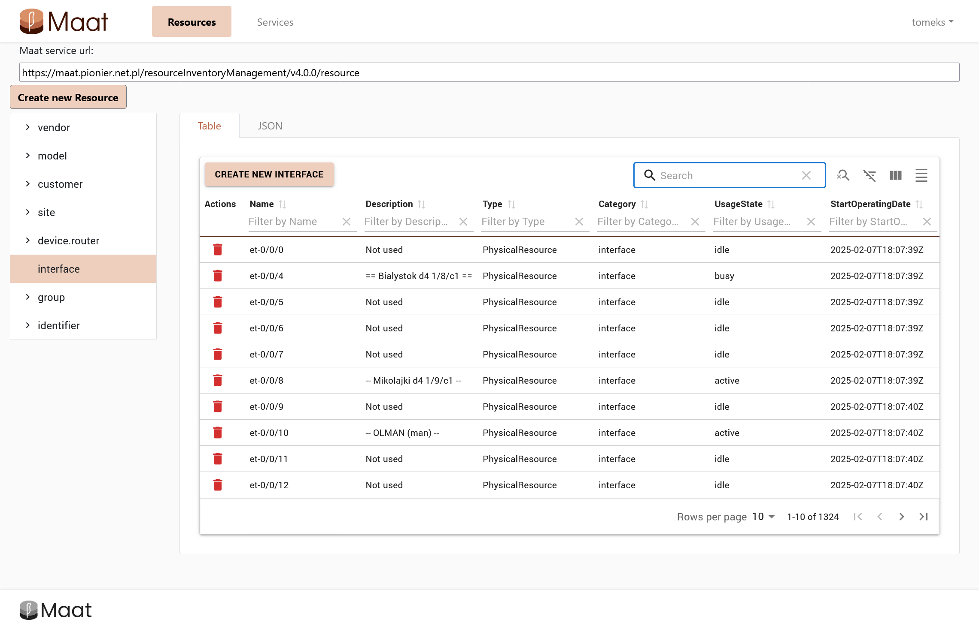
RESOURCES AND SERVICES MODELING
@type
Maat GUI
Resources and Services tabs
Category pane
Tabular list of objects
  Text search
  Filtering
  Property display selector
JSON object overview
category

Slide 12
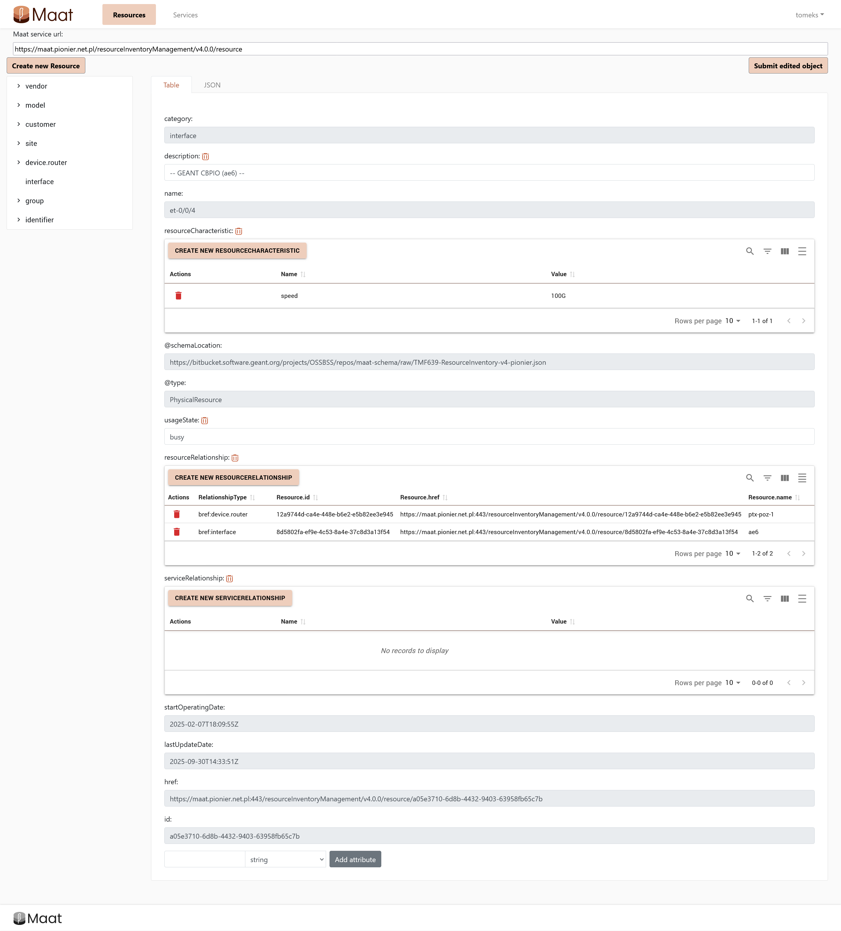
RESOURCES AND SERVICES MODELING
Maat GUI
Object attributes overview and editing
Define new attributes
  Schema validation applied by Maat API
Dynamic links to referenced objects

Slide 13
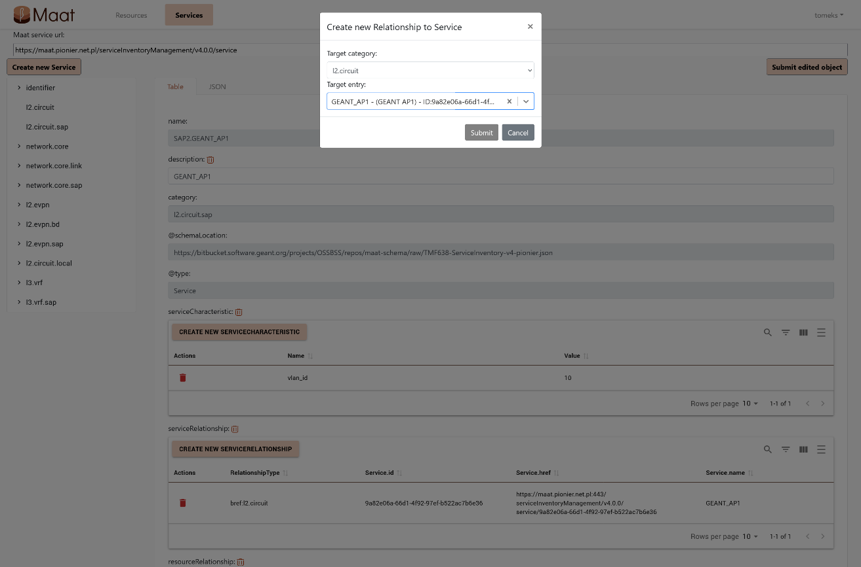
RESOURCES AND SERVICES MODELING
Maat GUI
Automatic creation of new references between objects
  “backward reference” (bref:) defined in Maat GUI
  Automatic reference (ref:) from target object created by Maat API

Slide 14
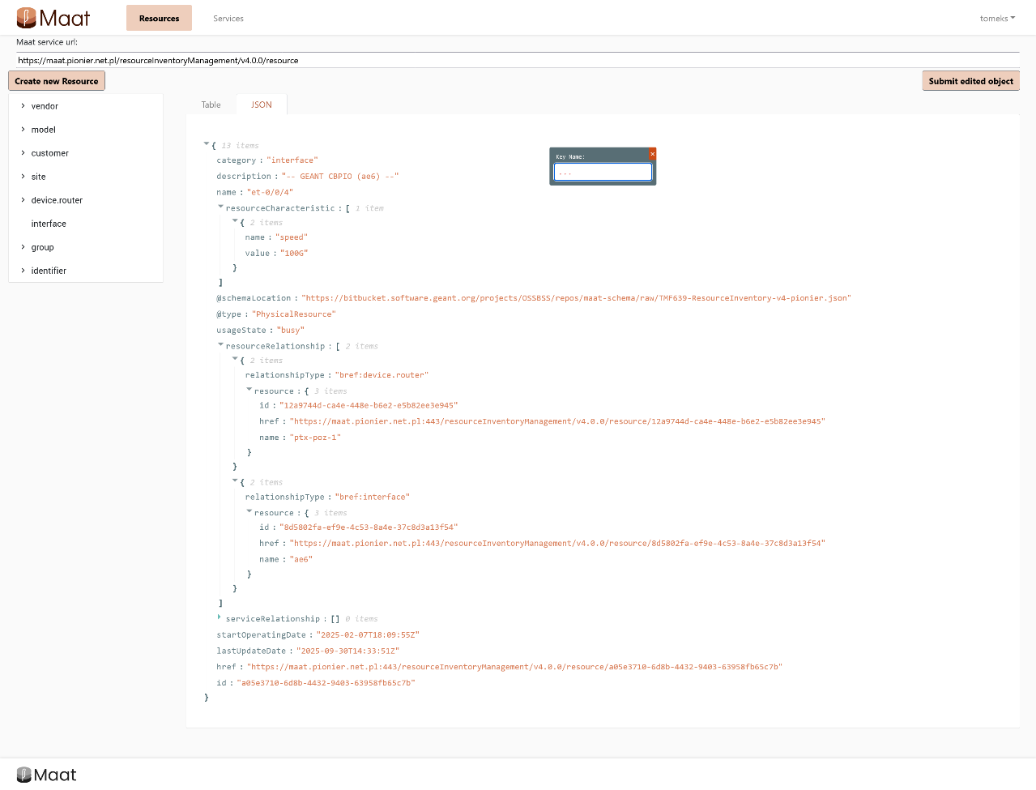
RESOURCES AND SERVICES MODELING
Maat GUI
JSON format overview and editing

Slide 15
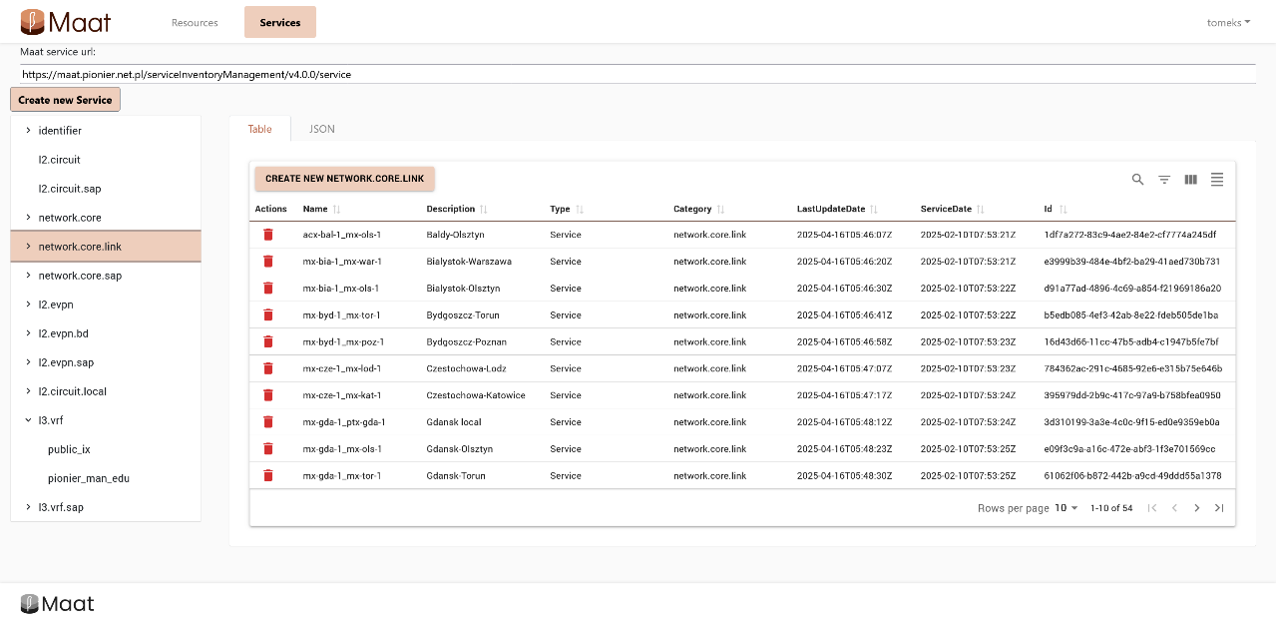
RESOURCES AND SERVICES MODELING
Maat GUI
Boost single source of truth development
  Add (develop) new services and resources not yet supported by workflows
  Include emergency fixes or changes for services and resources which are not yet supported by workflows
  Allow “atomic” automation and orchestration approach

Slide 16
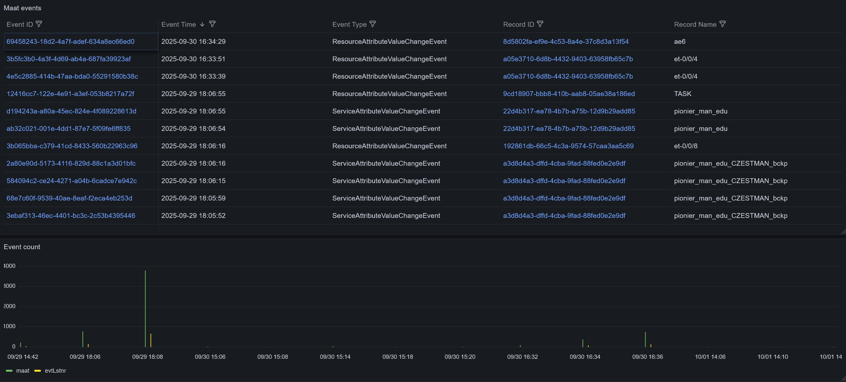
CHANGELOG
Maat EventListener

Slide 17
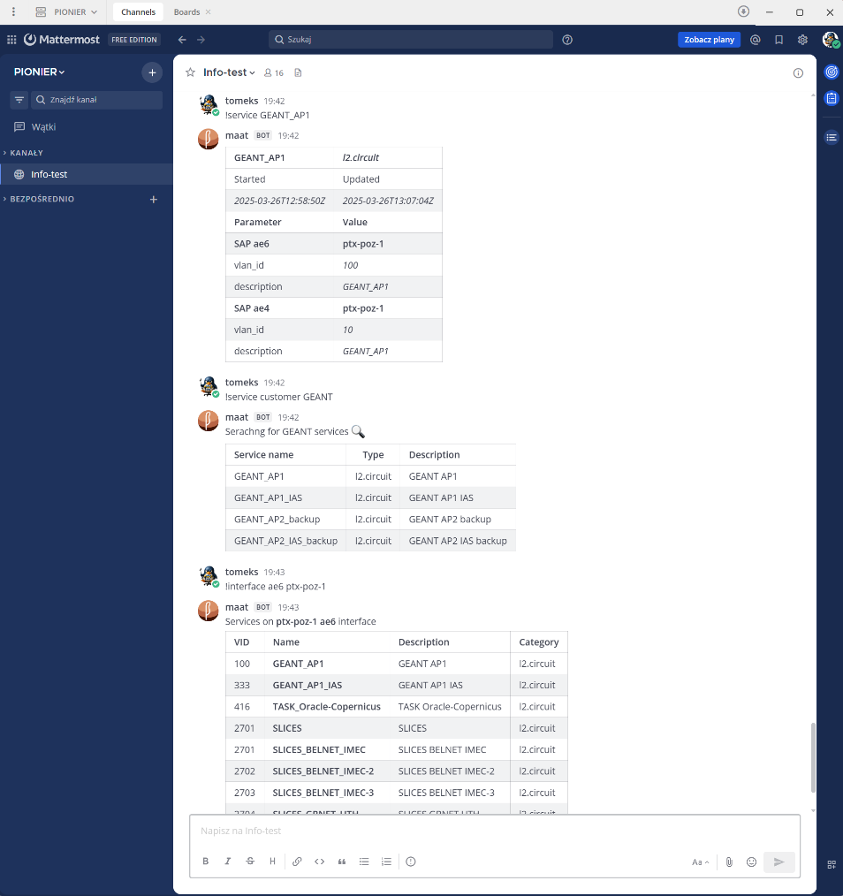

CHANGELOG
Mattermost integration
Interface between Mattermost channel and Maat database
  Quick lookup for services, resources and parameters
  Errbot based

Slide 18

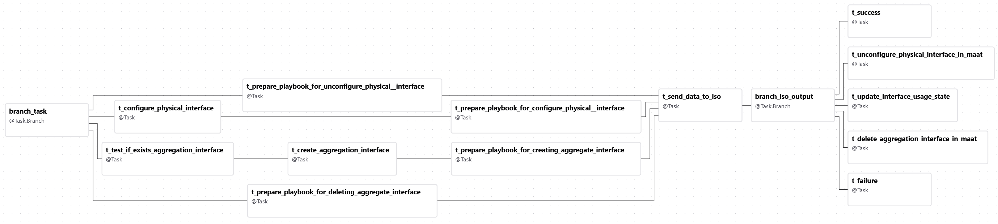
WORKFLOWS
Apache Airflow and GEANT LSO
Generalized workflows for use across multiple networks
  PIONIER
  GP4L
GÉANT LSO
  configuration changes on devices (resources)
  Ansible playbooks
  Jinja templates

Slide 19
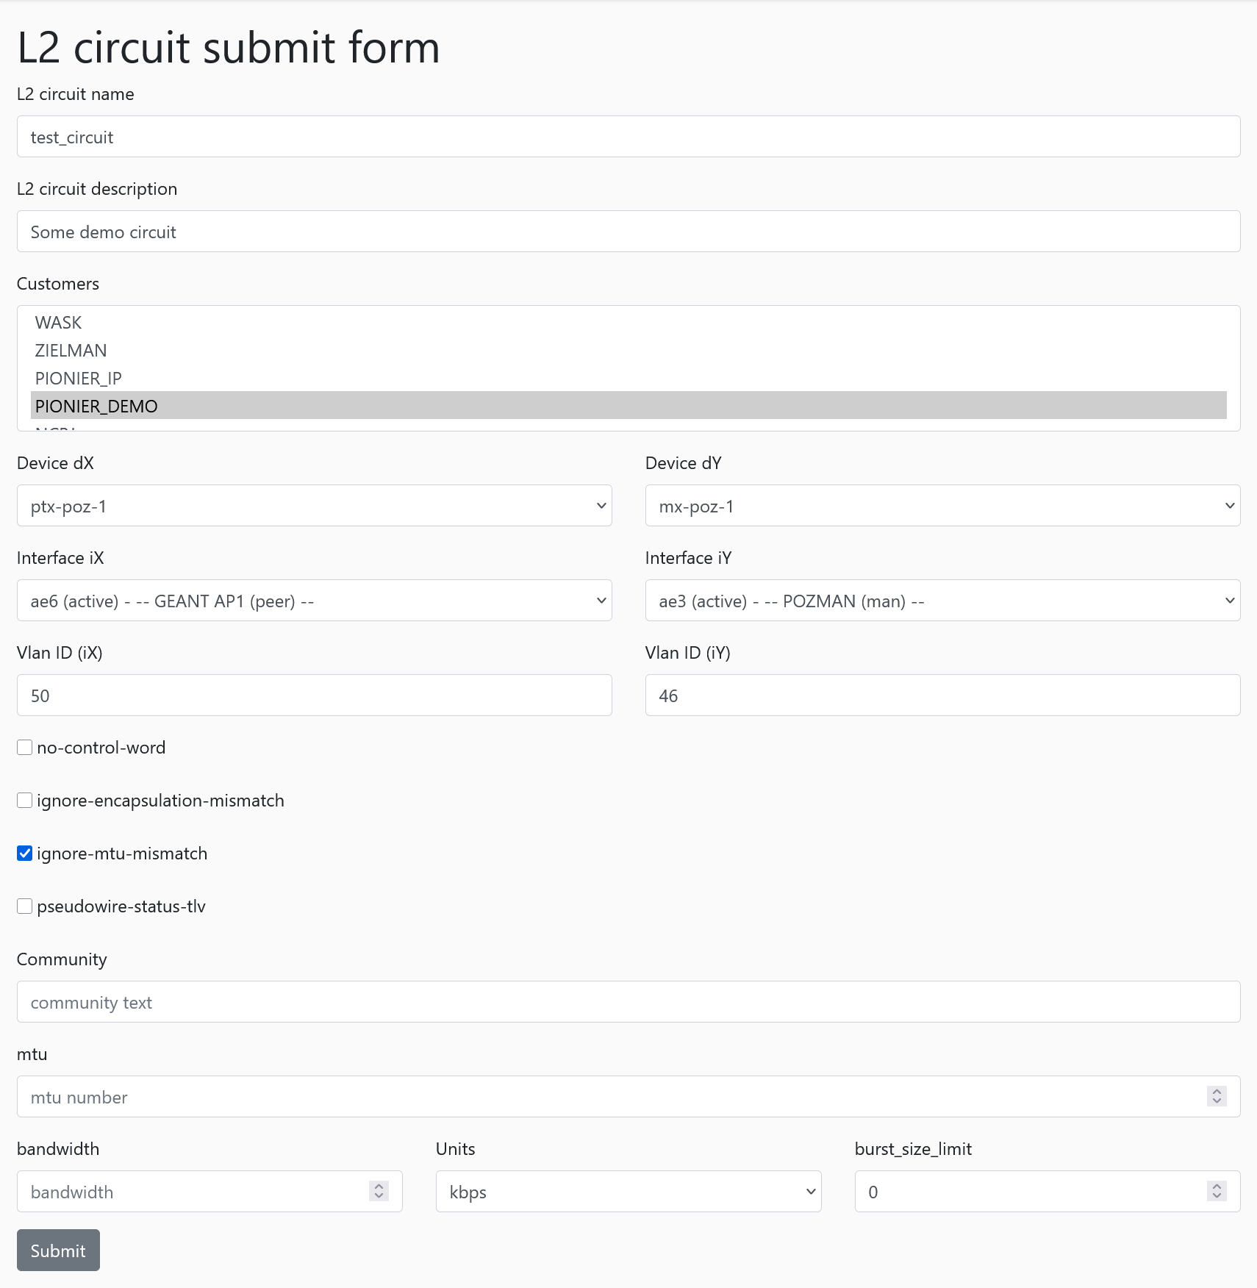
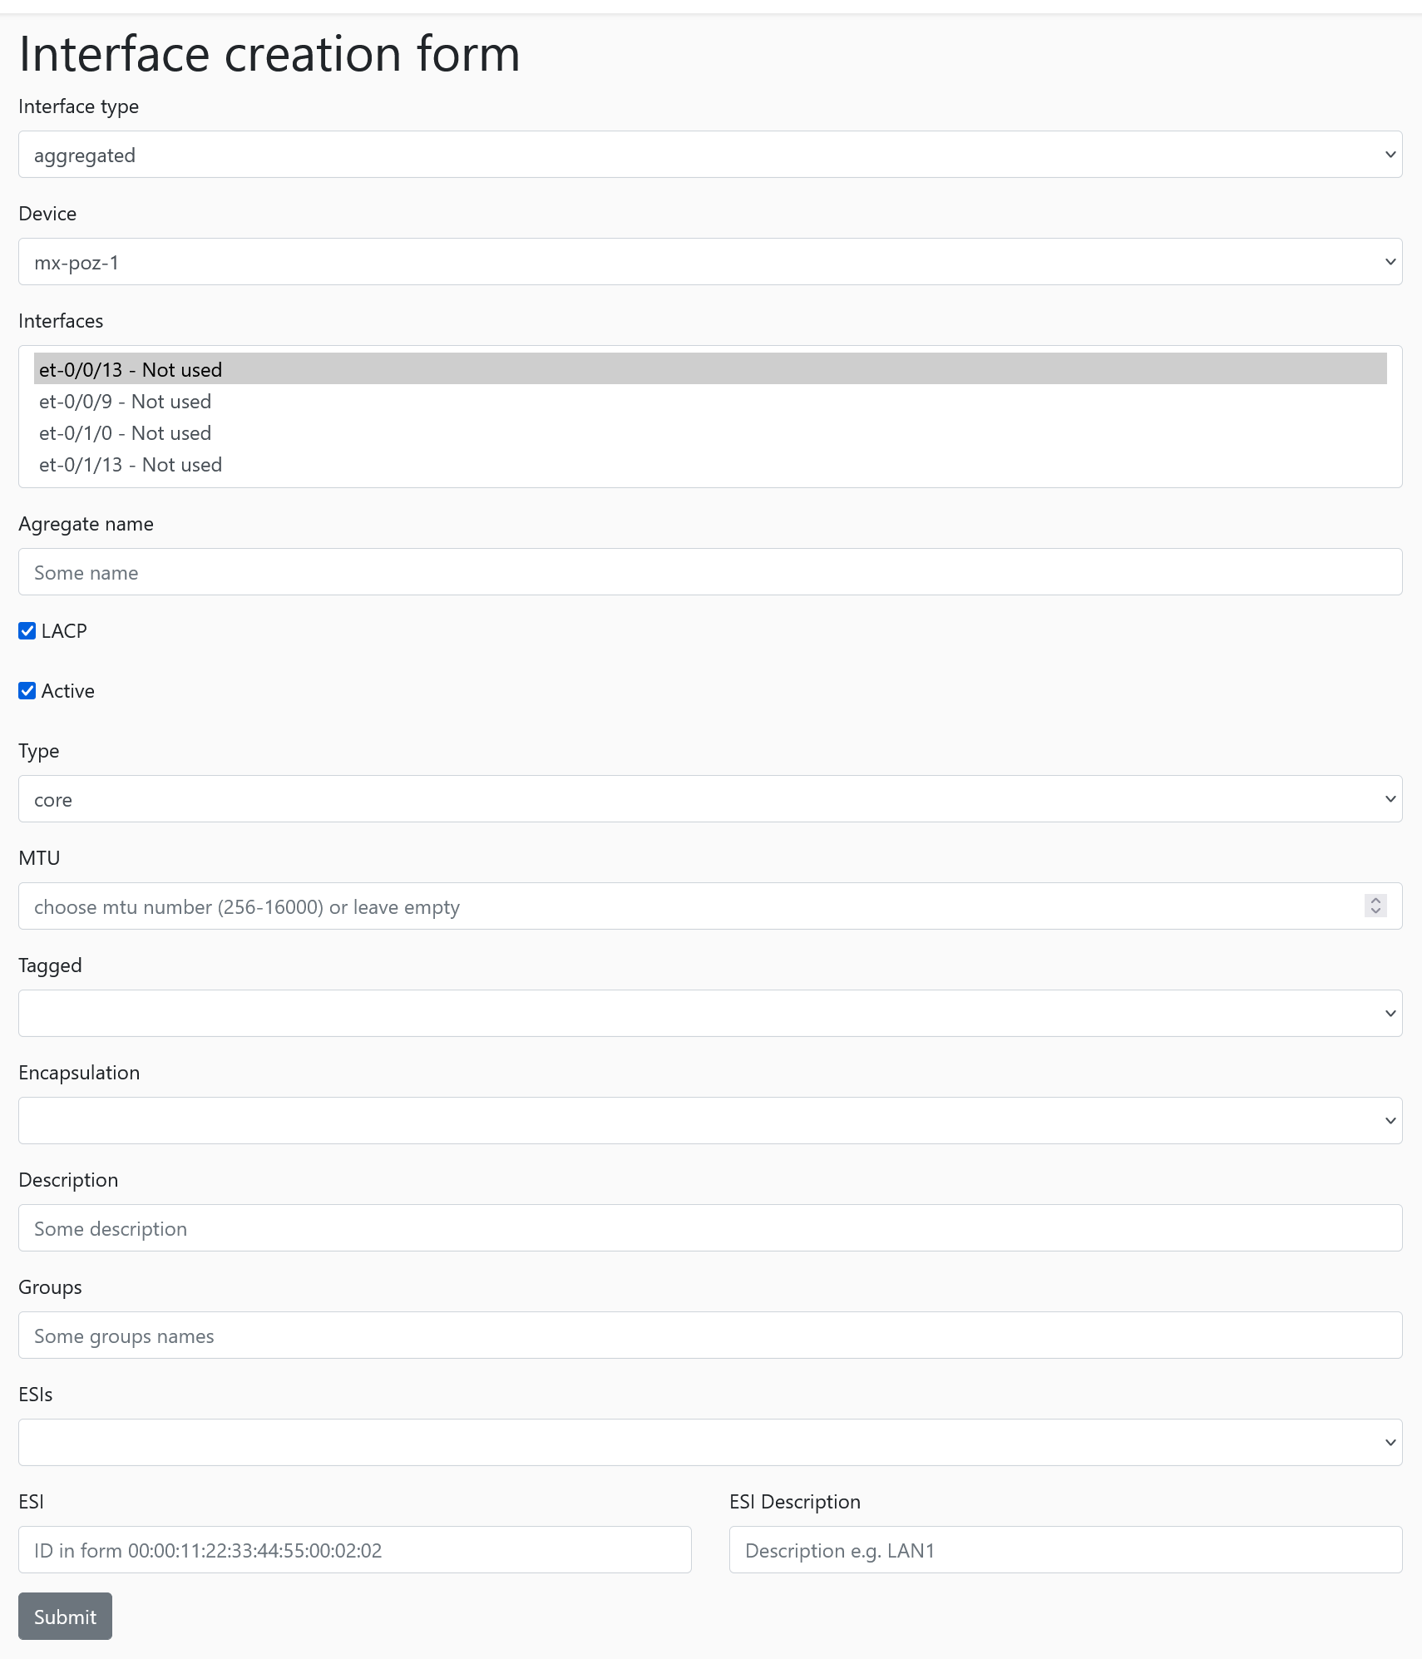
WORKFLOWS
Data/information acquisition
Predefined forms for specific workflows
Existing data retrived from Maat
  Devices
  Interfaces
  Identifiers

Slide 20
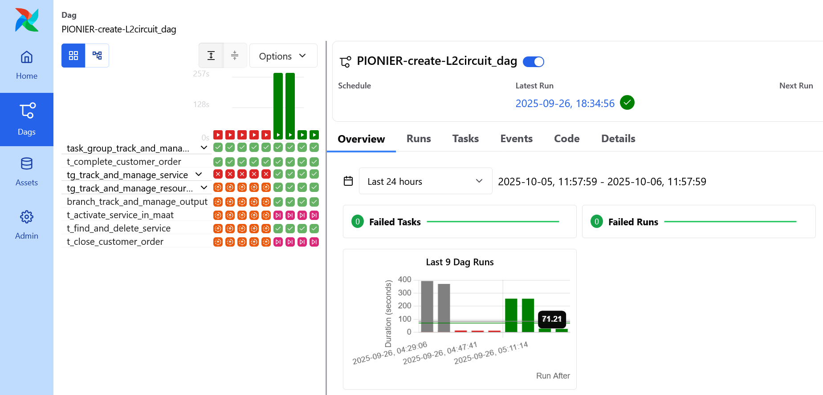
WORKFLOWS
Apache Airflow and GEANT LSO
Basing on Maat information verify if service is implementable on given set of resources
Update Maat database
Prepare inventory and set of parameters for LSO
Collect implementation resuls

Slide 21
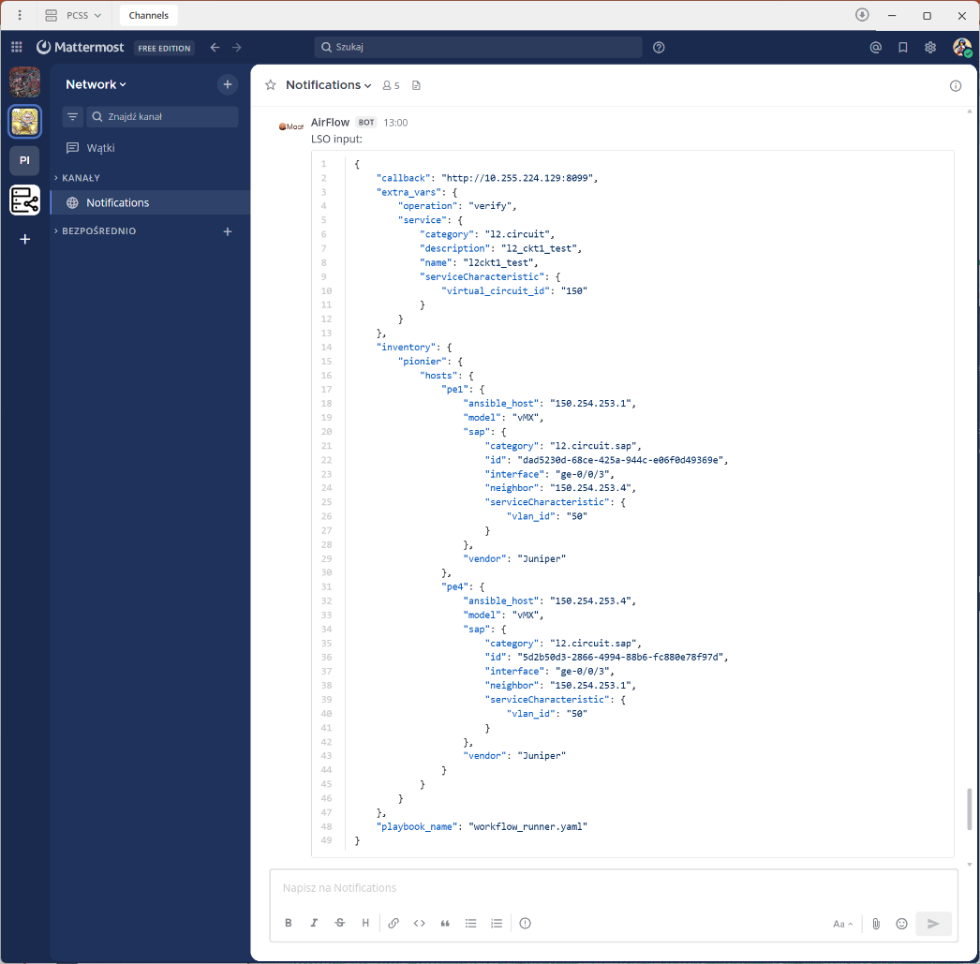
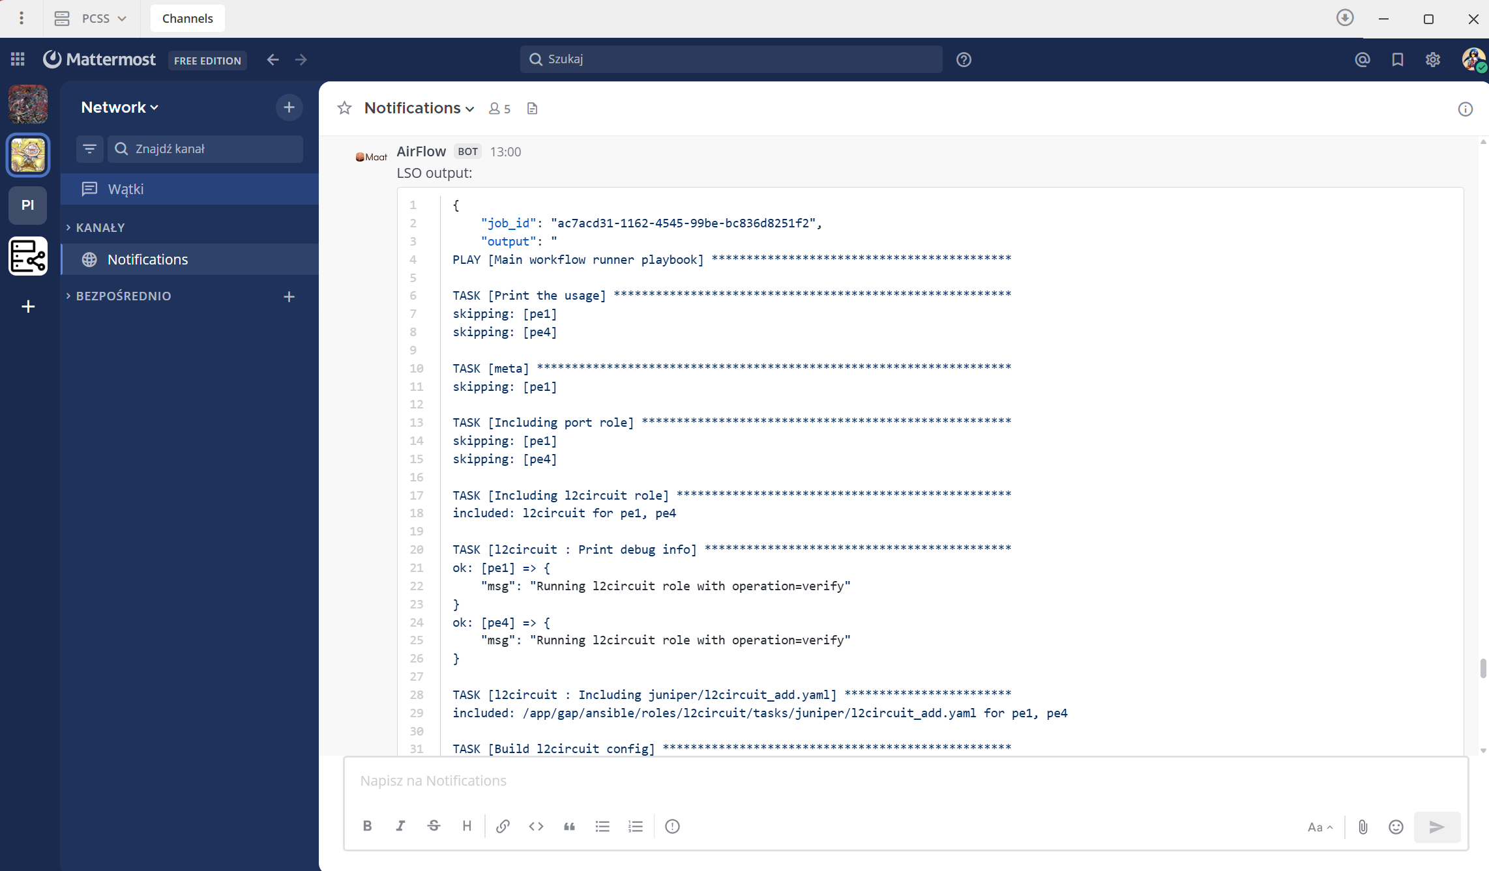
WORKFLOWS
Apache Airflow and GEANT LSO
Airflow Mattermost integration DAG
  LSO input
  LSO callback
playbook command
ansible role
service parameters
SAP referenced interface
SAP parameters
model name
vendor name
Playbook name

Slide 22
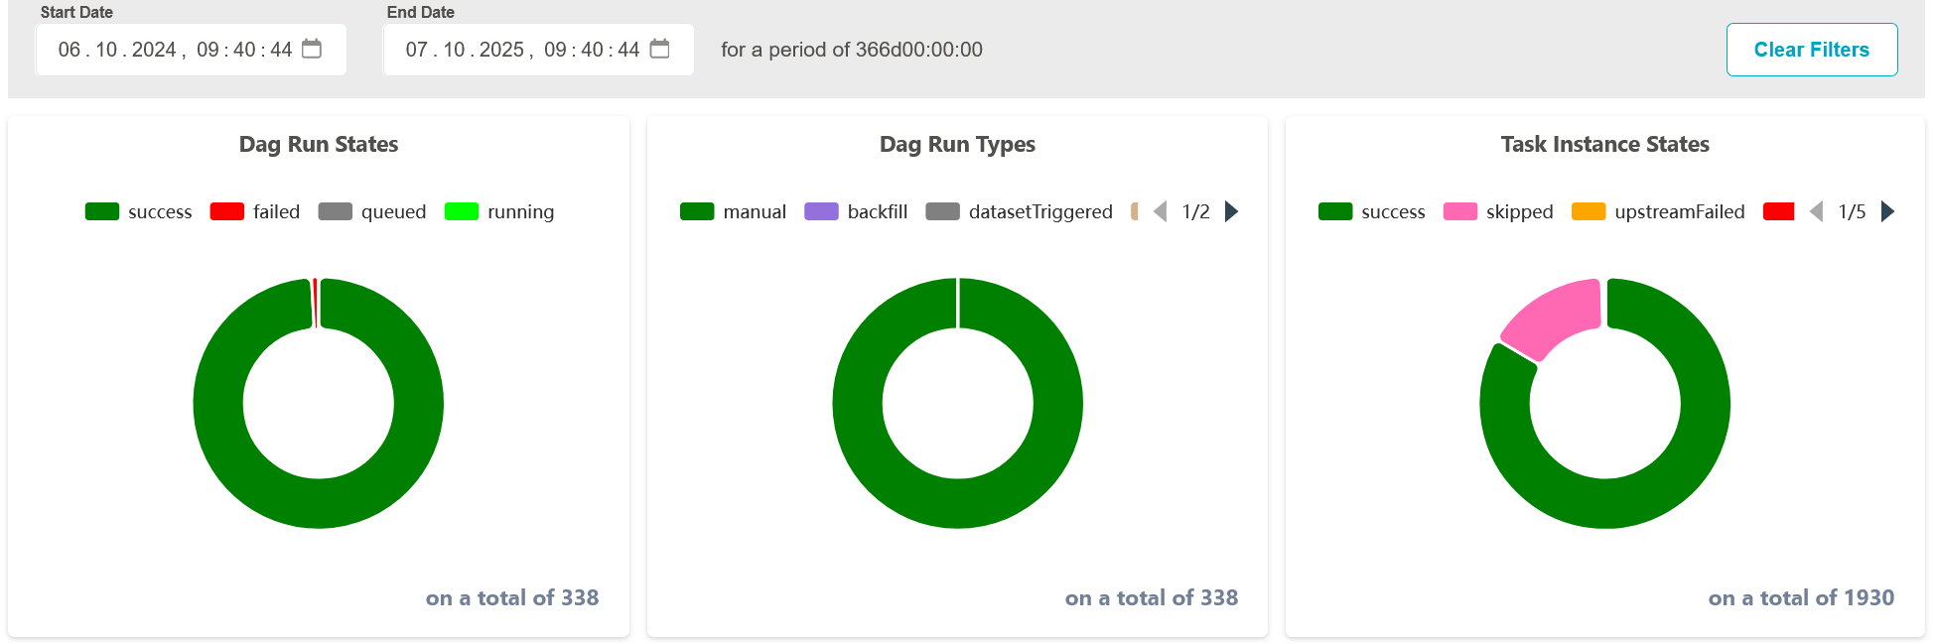
SUMMARY
Usage statistics
Maat / SSoT objects
  Resources – 1 400+
    1 300+ interface
    45 device.router
    50+ customer
  Services – 1 374
    ~370 l2.circuit
    2 l2.evpn
    2 l3.vrf
    50+ network.core.links
Airflow
  330+ DAG runs
  1930 task states

Slide 23
SUMMARY
Future works
New workflows development
  EVPN
    vlan-based
    vlan-bundle
    vlan-aware
  Network configuration consistency verification
  VRF
  Ingres bandwidth control on SAPs
    Maat UI ready
Enabling user roles and Maat object access filtering
  Development finished
  Lab testing phase
The use of LLM for advanced data search functionality and user interaction

Slide 24
The scientific work is published for the realization of the international project co-financed by Polish Ministry of Science and Higher Education from financial resources of the programme entitled "PMW”

