Slide 1

RHnet
The Icelandic research and university network
NORDUnet and RHnet
NOC collaboration
What to do when you have no one to run your NOC?
”Who you gonna call?”

Slide 2
RHnet - overview
RHnet – Rannsókna og háskólanet Íslands
  Established 2001
  14 Universities and research institutions
  University of Iceland holds 85% of the shares
  1 full time employee + 1 part time
  Working closely with University of Icelands IT department

Slide 3
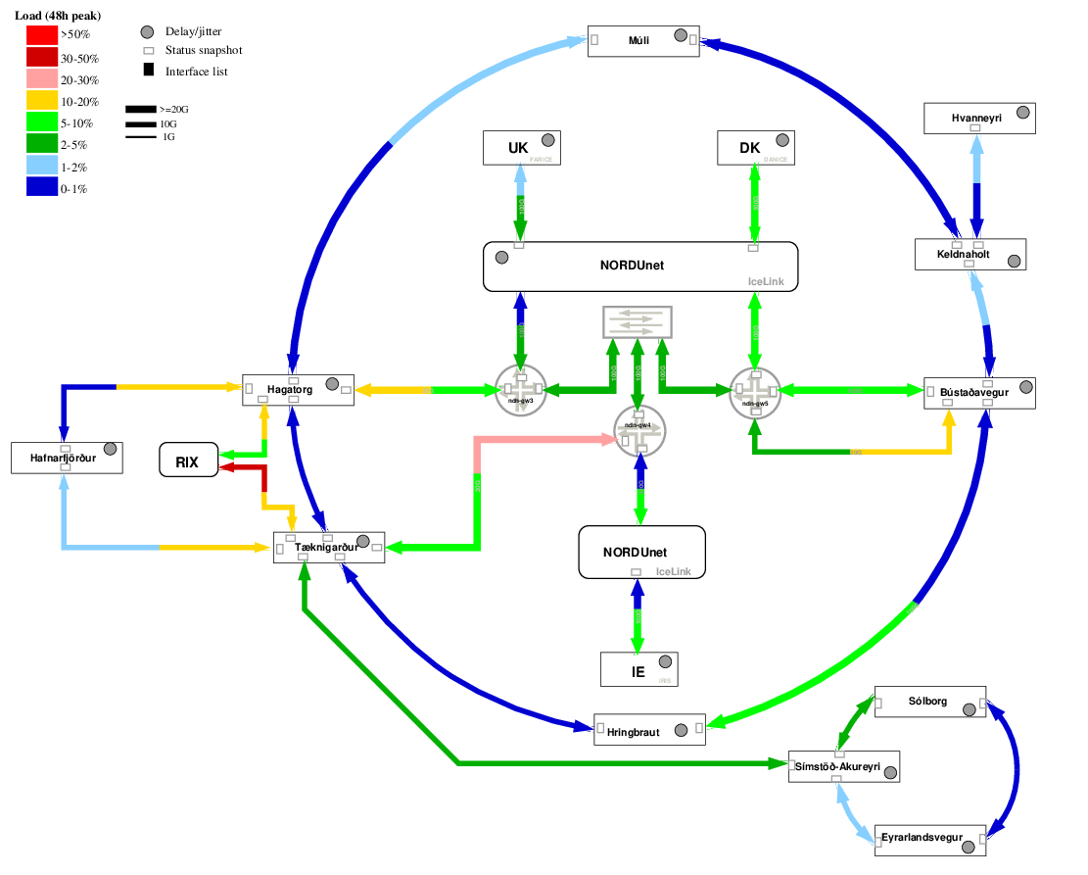
RHnet – overview of network

Slide 4
RHnet - NOC
RHnet – NOC center
  Developed by part time employee
  Run and maintained by same
  Open source and script
  RHnet’s web / NOC
  Link/connection monitoring done by autostatus, Smokeping, SNMP

Slide 5
RHnet – Challenges in 2024 and 2025
RHnet – Changes in staff 2024/2025
  2024 part time employee quits/retires
  NOC becomes orphaned
  2025 full time employee quits/retires
  NREN becomes orphaned
  No plan in place to replace them

Slide 6
RHnet – Plan B
RHnet & NORDUnet collaboration
  Informal agreement/contract signed 2024
  Work started in August to figure out the scope of the collaboration
  RHnets representative in the collaboration could not commit to the task, due to workload
  University of Iceland hosts RHnets equipment and had to relocate both offices and datacenter in 2025

Slide 7
RHnet – Plan B
RHnet & NORDUnet collaboration
  Work to commence on 1. of October
  Initial task is to set up new servers to run NORDUnets NOC system located in Iceland
  NORDUnet NOC will take care of monitoring equipment, traffic, environment etc.
  Employees from University of Iceland’s IT department will be hands and feet

Slide 8
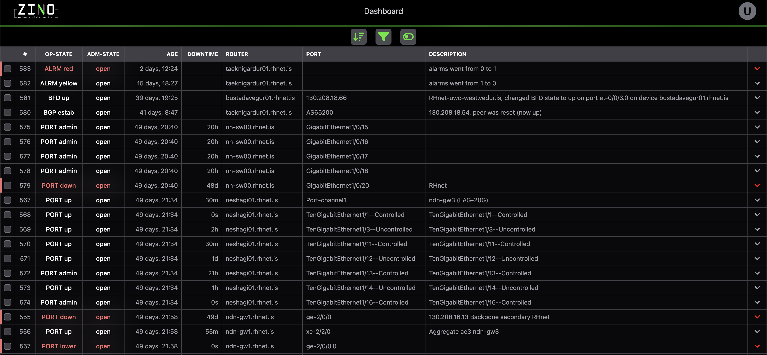
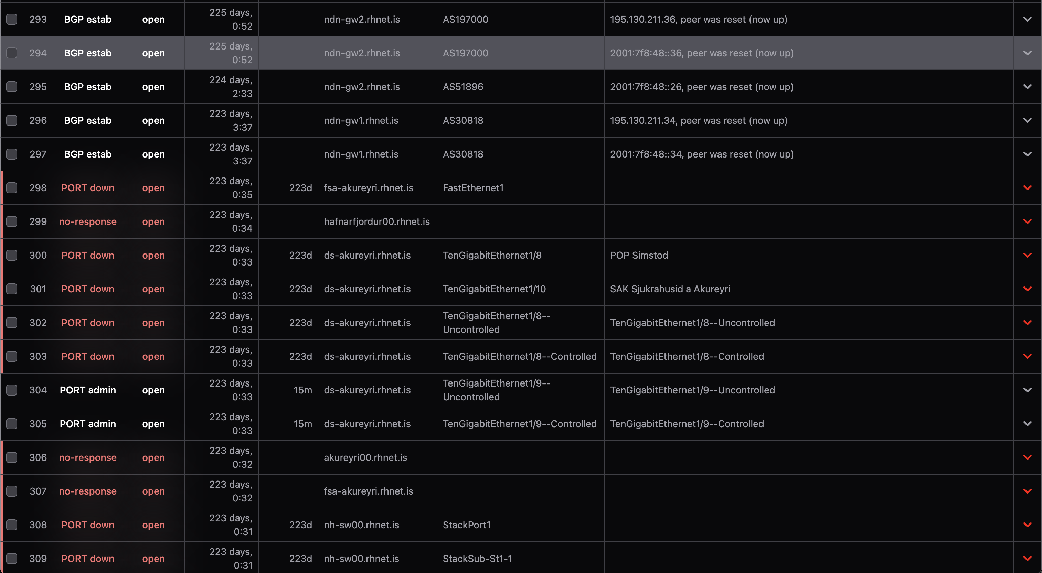
RHnet – Plan B

Slide 9
RHnet – What have we learned
  Never start a project like this unprepared
  Dedicate manpower
  See this as an oportunity
    To formalise procedures
    To get around to do the things you always delayed
    To document and document and document some more
    To learn new things

Slide 10
RHnet – Conclusion
  RHnet is in a way entering a new era – RHnet 2.0?
  RHnet has come to the attention of decision makers, as an oportunity for broader service scope for the constituency
  The need for RHnet to be more than just ISP has been acknowledged
  This has in many ways brought RHnet closer to NORDUnet and Nordic collaboration

Slide 11
End of presentation
Thank you for your attention!
☺

