Slide 1




2 Years on – Who’s using it now and for what?
SIG-NOC23 Meeting / Barcelona / 15th October 2025

Slide 2


Image Credit: Ann H / www.pexels.com

Slide 3


Slide 4

Started in SURF as an *INTERNAL* project in 2018!
Production ready Workflow Orchestration Framework to manage product lifecycle and workflows. Easy to use, Built on top of FastAPI.
The Workflow Orchestrator is a project developed by SURF to facilitate the orchestration of services.
Together with ESnet this project has been open-sourced in the commons conservancy to help facilitate collaboration.
https://workfloworchestrator.org/orchestrator-core
https://github.com/workfloworchestrator/orchestrator-core

Slide 5
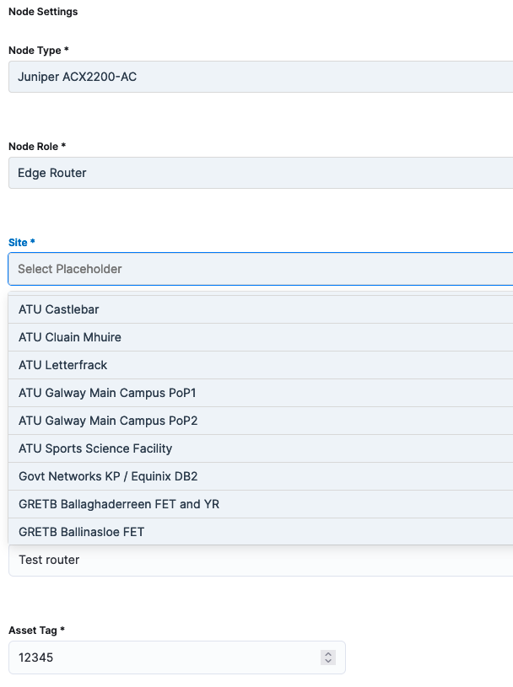
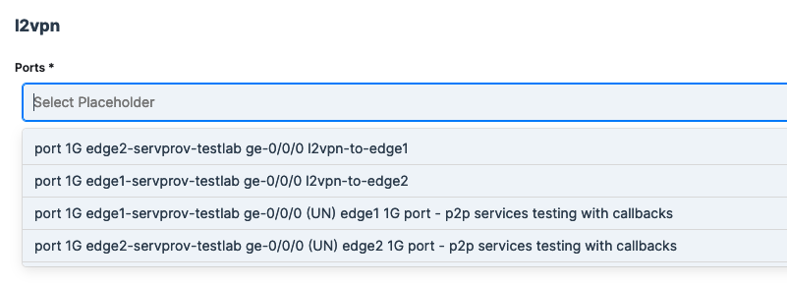

Slide 6
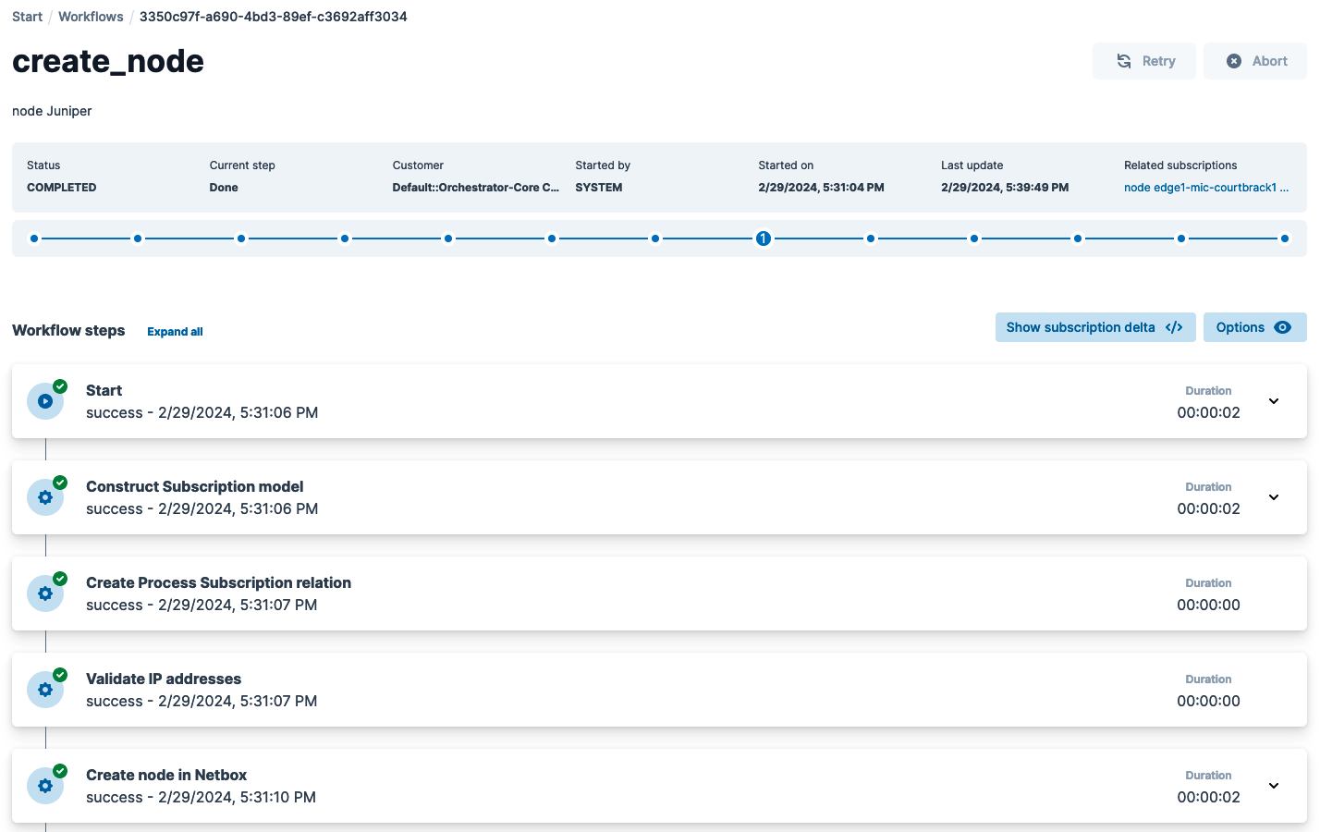
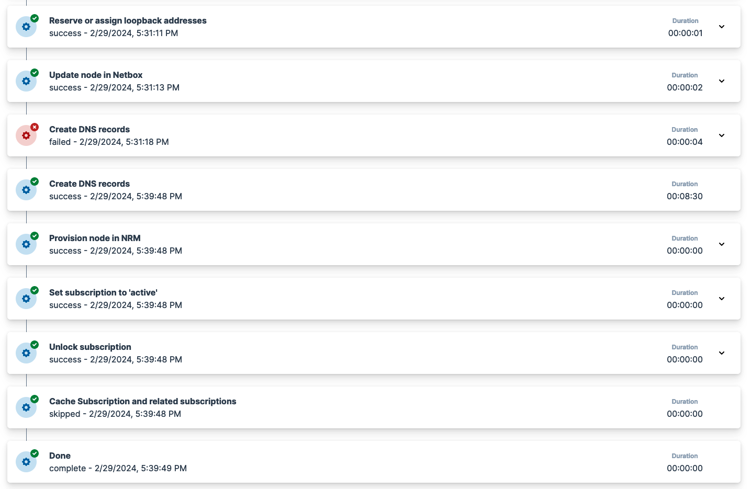
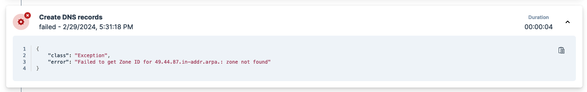
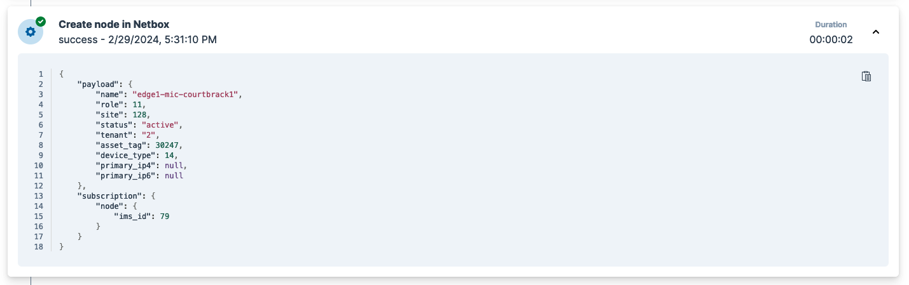

Slide 7
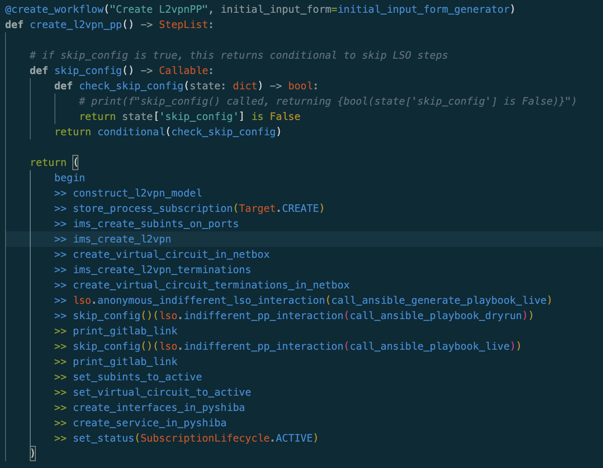
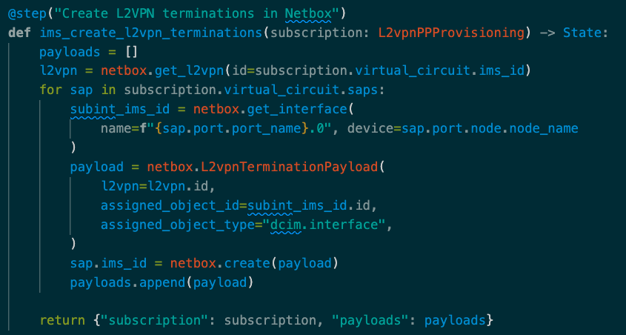
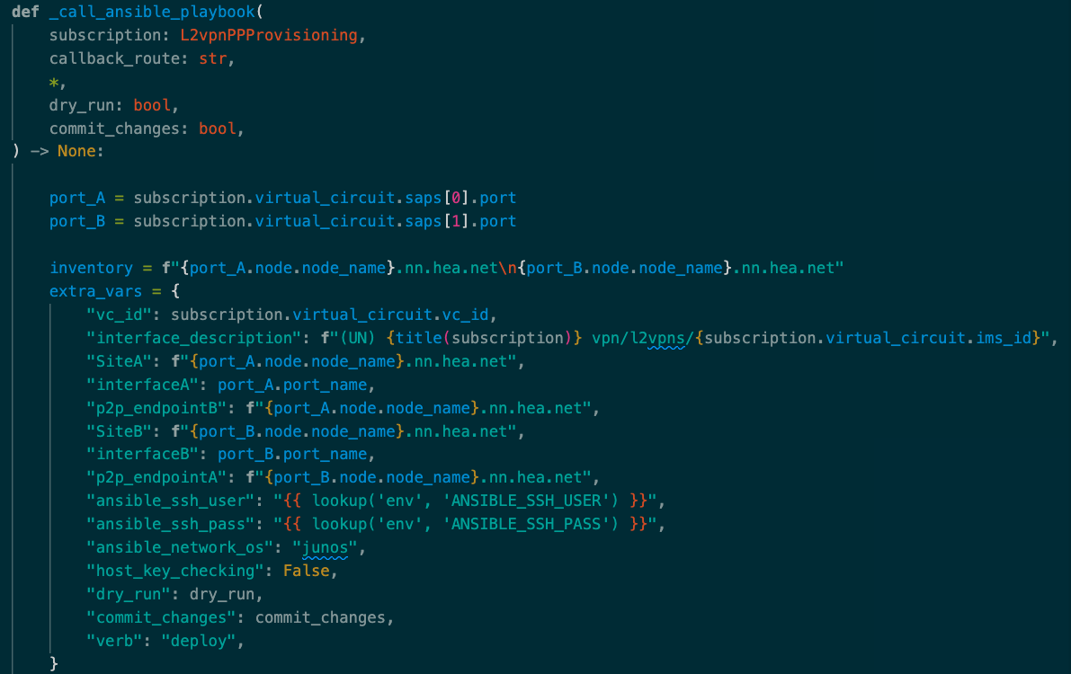

Slide 8
HEAnet OSS/BSS 2025
NOC facing CRUD GUI
Product Lifecycle Management
(Customer Facing)
Resource facing Lifecycle management
(service provisioning)
WFO
GÉANT LSO
GitLab /
Oxidized
Ticketing Management
Change Management
DNS Management
Inventory Management
IP Address Management
Customer Relationship Management
Ivanti
PowerDNS
NetBox
MS Dynamics
PySHIBA
Monitoring / Observation
DDoS Protection Management
Icinga
Arbor (via Jisc)

Slide 9
Key milestones for HEAnet
🗓️ March ‘23 - GÉANT and SURF introduce the platform at STF28 in Utrecht
🗓️ June ‘23 – SURF and ESnet run a tutorial/workshop at TNC23 in Tirana
🗓️ September ’23 – SURF host HEAnet for a 3 day deep-dive to assist us bootstrapping
🗓️ April ‘24 – HEAnet deploys our first workflows in production (L2VPN Pilot phase)
🗓️ November ’24 – Existing production services imported as “subscriptions” in WFO
🗓️ April ‘25 – All create and terminate workflows ready and in active use in production
🗓️ June ‘25 – Formally declared a “Graduate” user of WFO at TNC25 in Brighton
🗓️ July ‘25 – Validation workflows in product for node and port

Slide 10


HEAnet’s Workflow Orchestrator facts
UI version 5.3.3 in Production (as at end of September 2025)
Orchestrator Core version 4.4.2
26 different products
52 different workflows (All Create and Terminates in active use, Modify and Validate workflows are still a WIP)
2503 active subscriptions in PRODUCTION!

Slide 11
1st Workflow Orchestrator User Developer days
Peter Boers

Slide 12
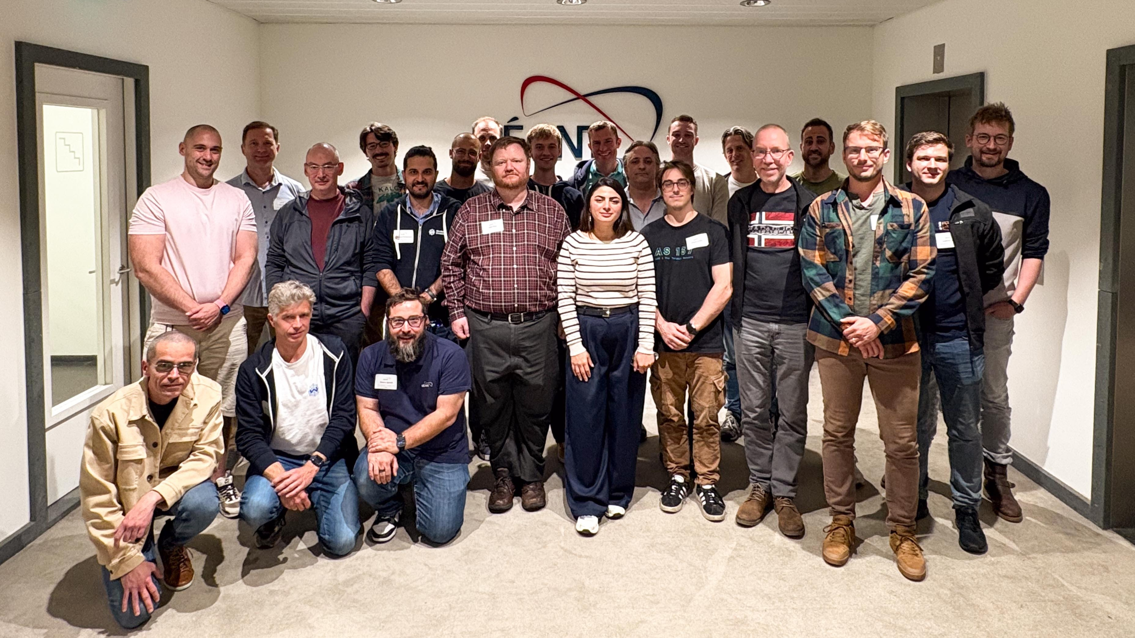

Slide 13













Who was in the room?
11 organisations
NRENs
Service providers
Government organisations
Private enterprise

Slide 14
What was discussed?
New developments in orchestrator-core since TNC25 and generally
Each participants use cases
Lessons from the trenches
Grip sessions and some breakouts to plan fixes
Deploying Role Based Account Controls (RBAC)
Future plans and developments in orchestrator-core – including AIOps !

Slide 15
Let’s pick some use cases

Slide 16


Image Credit: Etienne Giradet / unsplash.com

Slide 17

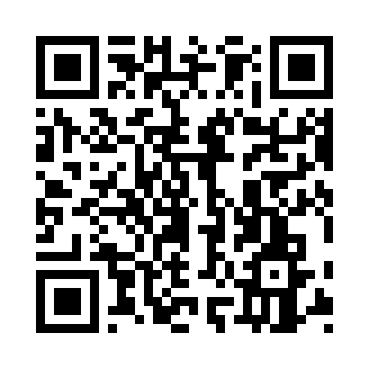
The example-orchestrator project
tinyurl.com/wfoeg

Slide 18


Discord

Slide 19
Where are we now?

Slide 20


THANK YOU

Slide 21
Workflow Orchestrator
https://workfloworchestrator.org
https://workfloworchestrator.org/orchestrator-core/
Beginner workshop: https://workfloworchestrator.org/orchestrator- core/workshops/beginner/overview/
Intermediate workshop: https://workfloworchestrator.org/orchestrator- core/workshops/advanced/overview/
GÉANT Lightweight Service Orchestrator (LSO)
https://gitlab.geant.org/goat/gap/lso
https://workfloworchestrator.org/lso/
NetBox
https://netboxlabs.com
https://netboxlabs.com/oss/netbox/

