Slide 1

AI-Ops &
IP-Optical integration
23rd SIG-NOC meeting
Barcelona, Spain
Oct 15, 2025

Slide 2
Operations are evolving
Comparing traditional and modern approaches
From traditional…
Proprietary management solution
…to modern
Model-driven, vendor agnostic approach
Manual
Automated
Fragmented
Integrated
Siloed
Universal
Imperative
Declarative
Notes:
While the traditional way using proprietary EMS works in siloes where you have to manually configure all the equipment down to the port level, modern operations uses one platform that leverages model modes and intent-based networking to automate abstracted multivendor networks. This platform combines every aspect of the operations, from provisioning to assurance and closed loop optimization.
In the traditional world:
Feature and equipment rollouts often impose a delay on service introduction and upgrades
Manual, vendor-specific equipment configuration and control processes are time consuming, error prone and costly
Vendor-specific management systems increase complexity for integration to orchestration/
OSS systems in multivendor networks
In the modern world:
More dynamic, programmable networks allow operators to quickly and easily introduce newer features and equipment
Abstracting service-specific configuration and vendor-specific configuration improves operational efficiency and enables automation
A single multivendor IP controller supporting standard models simplifies integration

Slide 3








TM Forum’s Autonomous Networks framework
From Reactive to Autonomous Operations
A Four-Step Enablement Model
Step 1: Quick Intro Assurance Automation
Step 2: Service & Process Automation
Step 3: AIOps
Step 4: Autonomous Networks
L5: Full Autonomous Operations
Closed loop automation across multiple services, domains & E2E lifecycle
L4: High Autonomous Operations
Closed loop automation for selected services
Decision based on predictive or active closed-loop management (AI)
Sense-think-act
L3: Conditional Autonomous Ops
Intent-based
Sense-act
L2: Partial Autonomous Operations
Closed-loop
L1: Assisted Operations & Maintenance
L0: Manual Operations & Maintenance
Notes:
The chart shown is adapted slightly from TM Forum’s own Autonomous Networks framework with small changes – e.g. “Operations” instead of “Networks” and simplification of the explanation of the levels L0-L5.
Official definitions below from TM Forum whitepaper:
• Level 0 - manual management: The system delivers assisted monitoring capabilities, which means all dynamic tasks have to be executed manually.
In Level 0 Zero X business capabilities are not applicable.
• Level 1 - assisted management: The system executes a certain repetitive sub-task based on pre-configured to increase execution efficiency. In Level 1 Zero X business capabilities are only available to individual case.
• Level 2 - partial Autonomous Networks: The system enables closed-loop O&M for certain units based on an AI model under certain external environments. In Level 2 Zero X business capabilities are available to individual Autonomous Networks cases but cannot be linked up to an Autonomous Networks.
• Level 3 - conditional Autonomous Networks: Building on L2 capabilities, the system with awareness can sense real-time environmental changes, and in certain network domains, optimize and adjust itself to the external environment to enable intent-based closed-loop management. In Level 3 Zero X business capabilities are available to select Autonomous Networks cases that can be linked up to an Autonomous Networks service.
• Level 4 - high Autonomous Networks: Building on L3 capabilities, in a more complicated cross-domain environment, the system enables analyses and makes decision based on predictive or active closed-loop management of service and customer experience-driven networks. In Level 4 Zero X business capabilities are available to end-to-end full lifecycle operations of select Autonomous Network services.
• Level 5 - full Autonomous Networks: This level is the goal for telecom network evolution. The system possesses closed loop automation capabilities across multiple services, multiple domains, and the entire lifecycle, achieving Autonomous Networks. In Level 5 Zero X business capabilities are available to end-to-end full lifecycle operations of any Autonomous Network services.

Slide 4


Automation use cases help accelerate TMF autonomous networks
Automation journey to “Fully autonomous operations”
L5: Full
autonomous operations
L4: High autonomous operations
From humans to AI agents
L3: Conditional autonomous operations
L2: Partial autonomous operations
AI-controlled
L1: Assisted operations and maintenance
L0: Manual operations and maintenance
AI-enabled
automation
Closed-loop automation
Rule-based automation
Manual
Traditional EMS/NMS
Source = TM Forum IG 1252
Notes:
The chart shown is adapted slightly from TM Forum’s own Autonomous Networks framework.
Official definitions below from TM Forum whitepaper:
• Level 0 - manual management: The system delivers assisted monitoring capabilities, which means all dynamic tasks have to be executed manually.
In Level 0 Zero X business capabilities are not applicable.
• Level 1 - assisted management: The system executes a certain repetitive sub-task based on pre-configured to increase execution efficiency. In Level 1 Zero X business capabilities are only available to individual case.
• Level 2 - partial Autonomous Networks: The system enables closed-loop O&M for certain units based on an AI model under certain external environments. In Level 2 Zero X business capabilities are available to individual Autonomous Networks cases but cannot be linked up to an Autonomous Networks.
• Level 3 - conditional Autonomous Networks: Building on L2 capabilities, the system with awareness can sense real-time environmental changes, and in certain network domains, optimize and adjust itself to the external environment to enable intent-based closed-loop management. In Level 3 Zero X business capabilities are available to select Autonomous Networks cases that can be linked up to an Autonomous Networks service.
• Level 4 - high Autonomous Networks: Building on L3 capabilities, in a more complicated cross-domain environment, the system enables analyzes and makes decision based on predictive or active closed-loop management of service and customer experience-driven networks. In Level 4 Zero X business capabilities are available to end-to-end full lifecycle operations of select Autonomous Network services.
• Level 5 - full Autonomous Networks: This level is the goal for telecom network evolution. The system possesses closed loop automation capabilities across multiple services, multiple domains, and the entire lifecycle, achieving Autonomous Networks. In Level 5 Zero X business capabilities are available to end-to-end full lifecycle operations of any Autonomous Network services.

Slide 5
Automation use cases help accelerate TMF autonomous networks
Automation journey to “Fully autonomous operations”
L5: Full
autonomous operations
L4: High autonomous operations
L3: Conditional autonomous operations
L2: Partial autonomous operations
LSP Enhanced Path Control (PCE)
Transport Slice Control
Network Slice Mgt across IP and FN domains
AI-controlled
L1: Assisted operations and maintenance
Bandwidth on Demand
Service Move - Port/LAG/Card
Service Move - Tunnels
Closed Loop Automation/Capacity Growth
Mass Scale NE Upgrade
Optical Aware IP Routing Enablement
IP Optical Diversity Analysis
Coordinated Maintenance
Floating Port Restoration
What-If Analysis
400ZR Point to Point
Elastic IP/Optical Bandwidth
Wavence Interference Notification
ZR+ Managed alien with ROADM
Packet Loss Optimization
L0: Manual operations and maintenance
E-Line, C-Line, VPLS, L3VPN
Internet Enhanced Service
Composite Services
NE Provisioning (ZTP)
NE Provisioning (Day 1)
NE Provisioning (Day 2)
Mass Scale NE Backup
Fault and Network Assurance
Service Assurance
Telemetry Enablement
LSP Path Placement
LSP Network Simulation
Analytics Reports
IP Optical Topology Discovery
Performance Monitoring
Custom Alarm Correlation
pLTE Day/Phase 0 Provisioning
Brownfield Discovery
Enterprise Bundle
AI-enabled use cases
Physical Topology Discovery
IGP Topology Discovery
IP/MPLS (LSP/path) Topology Discovery and Visualization
Brownfield Service Discovery
NE Migration from Classic to Model Mode
Manual
Notes:
Level 2:
Intent-based SF
ZTP
Mass scale upgrades
Event timeline
Alarm correlation
Level 3:
Congestion avoidance
Floating port restoration
Elastic bandwidth
Energy savings
Level 4:
Transport slicing LCM
Outlier detection
Baseline analytics

Slide 6



AI augmentation to networks that sense, think, and act
Assistance to humans
Analytics
Automation
Sense
Think
Act
Data
Web
Libraries
Network
Notes:
In the world of network operations, we're moving towards a closed-loop system where networks can sense, think, and act. This is where AI truly shines. By analyzing data from a multitude of sources, AI helps us make informed decisions and automate actions within the network. This isn't just about processing data; it's about transforming this data into actionable insights, thereby enhancing the agility and responsiveness of our networks.
Sense = we collect, store and curate huge variety and volume of data to sense what is happening in the network.
Think = we have already passed the point where humans alone can understand the full complexity of the network. AI and machine learning are now essential ingredients in the cognitive process, providing unique insights and next best recommendations.
Act = closed-loop automation is required to promptly turn insight into action.

Slide 7

Augmenting human intelligence to improve reasoning and decision making
Analyze
AI
Assist
Augment acuity of
operations staff
How: Traditional AI
Analyze vast data streams to help predict and mitigate potential disruptions before they escalate.
AI-driven analytics accelerate troubleshooting if issues happen.
Augment expertise of operations staff
How: Generative AI
GenAI powered by Large Language Models redefines the human-computer interface to simplify complex tasks such as network programming and troubleshooting.
aids in
Notes:
AI serves a dual purpose in our networks.
On one hand, it augments the capabilities of our operational staff, aiding in complex data analysis and decision-making. This is possible with ‘traditional’ ML algorithms that we’ve been using for a few years already.
Acuity = Increase or enhance the sharpness, insight, and decision-making ability of the operations staff using AI
On the other, it enhances how these staff interact with our network automation tools. Through advancements in generative AI and large language models, we're making our tools more intuitive, lowering the barrier for their effective use. This is about empowering our teams, making their jobs not just easier but also more impactful.

Slide 8


Augment human intelligence for network operations
Themes
Analyze
Augment acuity of
operations staff for troubleshooting
Leverage classical AI
Experimentation & exploration on
ML-based assurance using outlier detection, clustering , predictions to discover viable use cases
Prediction
Detection
Correlation
Aids in
Assist
Augment expertise of operations staff
Leverage Generative AI
Experimentation on targeted set of use cases to enable effective & efficient use of the NMS
AI
Knowledge assistance
Dashboard assistance
Artifact assistance
Notes:
AI serves a dual purpose in our networks.
1. On one hand, it augments the capabilities of our operational staff, aiding in complex data analysis and decision-making. This is possible with ‘traditional’ ML algorithms that we’ve been using for a few years already.
The themes to help with analysis & decision making for network operations are:
Prediction: Leverage data & machine learning to predict a network event or state.
Detection: Detect silent failures and anomalies from a sea of network data.
Correlation: Correlation of events & network state to help in reducing the Mean time to repair (MTTR) of network issues.
2. On the other, it enhances how these staff interact with our network automation tools. Through advancements in generative AI and large language models, we're making our tools more intuitive, lowering the barrier for their effective use. This is about empowering our teams, making their jobs not just easier but also more impactful.
The themes to help with assistance of the NSP users are:
Knowledge assistant = Explain functionalities and how to access them from the UI or API.
Artifact assistance = Makes it easier to create/explain artifacts (like intents, workflows), assist to translate and explain APIs, documentation of artifacts.
Troubleshooting assistance = Help troubleshoot the network & system.
Dashboard assistance = Intelligent dashboards for custom visualization.
Assist would help for prescriptive recommendations for ‘Analyze & decide’

Slide 9


Leveraging Generative AI for assistance in network operations
LLM
Large language models
AI assistant
?
Product knowledge
Provisioning, monitoring,
troubleshooting, optimizing…
AI assistant
Interacts in natural language
Efficiently summarizes knowledge based on product documentation and provides in context recommendations
Provides contextual suggestions based on network state
Network state
Notes:
This is where the AI assistant comes into play: the AI assistant uses LLM to interact with the user in natural language. It has a complete knowledge of the product capabilities (through its documentation) and can provide immediate recommendations on how to use the product. Finally, it also has a view on the network state, so that it can provide contextual suggestions (for troubleshooting or optimizing the network).

Slide 10
AI assistance for network operations
Knowledge assistant
Search, filtering and summarization
Explanations
Operator
Assistant
Artifact assistant
Artifact generation
API completion
?
Troubleshooting assistant
Log analysis
Prescriptive RCA & recommendation
Dashboard assistant
Health & system dashboards
Reports
Programing, provisioning, monitoring,
troubleshooting, optimizing, migrating…
Benefits
Improves operational efficiency
Lowers the barrier of entry for users
Notes:
A prototype of such an AI assistant exists for NSP – it’s called NSP Assistant It leverages ChatGPT and has a complete knowledge of the NSP documentation.
With NSP Assistant , the end user can quickly and efficiently operate the network by asking any questions on how the network state and how to do things. NSP Assistant will provide options available to the end user. This way of getting information actually lowers the barrier for operators that want to use NSP and are not familiar with it.
Knowledge assistant = Explains functionalities and how to access them from the UI or API.
Artifact assistance = Makes it easier to create draft artifacts (like intents, workflows), explain artifacts, assist to translate and explain APIs, documentation of artifacts & APIs.
Troubleshooting assistance = Help troubleshoot the network & system.
Dashboard assistance = Assist to generate drafts for customized dashboards for custom visualization.

Slide 11



IP/Optical integration: Objectives
Simplify operation
Multi-layer discovery and visibility
Easy troubleshooting by multi-layer visibility and inventory
Coordinate maintenance without error-prone manual processes
What-if analysis to ensure IP traffic is never affected
➔ OPEX reduction
Improve resiliency
Multi-layer traffic engineering
Ensure optical diversity for IP routing by SRLG sharing
Comprehensive correlation of topology (e.g., for latency)
Make IP layer aware of optical protection and restoration
➔ Better service quality
Increase utilization
Efficient use of IP resources
Automate setup of dynamic optical services with resiliency
Increase utilization of router ports by pooling
Avoid redundant resiliency and leverage optical protection (1:N)
➔ CAPEX saving
Coordinated maintenance
Primary
Diver-
sity
Backup
Pooling
Pooling

Slide 12
IP/Optical integration: Solutions
IP/MPLS
IP/MPLS
IP/MPLS
IP/MPLS
?
SRLG
Alarm
Optical
Optical
Optical
Optical
Optical
Optical
Optical
Optical
Discovery
Auto-discovery of UNI links from routers to optical switches
LLDP snooping for exact correlation
Detection and analysis of misconfiguration
Cross-layer correlation
Resiliency improvement by SRLG coordination
Multi-layer traffic engineering, e.g., for latency
“what-if” analysis and IP/optical coordinated maintenance
Infrastructure provisioning
Optical service setup from IP layer
Multi-layer policies e.g. for diversity
BoD possible e.g. by growing and shrinking of LAGs
Common assurance
Common alarm list for IP/MPLS and Optical
Alarm correlation and root cause analysis
Common API for OSS integration

Slide 13






Automation and coordination across and between network layers
IP
team
Optical team
End-to-end coordination
Cross-domain management with Domain Controllers automation framework
Cross-domain
coordinator
End-to-end assurance
Assure IP service connectivity across the photonic layer, including ZR(+) DCOs
Operational simplicity
Provisioning of ZR(+) DCOs in routers with
Intent-based model driven operation
IP Cont.
Optc. Contr
T-API
Openness – interworking
T-API (from ONF to Linux Foundation) for optical topology discovery
and service provisioning
Notes:
With the cross-domain coordination (CDC) app/tool on NSP & T-API connection of WS NOC/RC you enable basic feature set such as SSO, common topology map with end-to-end view (color coding on node/link alarms), common assurance web app & inventory overview
plus a set-of implemented use cases AND using our automation tools such as WFM you can also start creating custom use cases (alternatively created by Nokia PS team)
We must now consider HOW we deliver an end-to-end managed solution and automation to facilitate the operational aspects of integrating these DCO technologies into the routers. By using Nokia NSP & WaveSuite automation environment, we can support a true e2e network management solution that encompasses several application use cases, with a key focus for IP/Optical using Cross-layer / domain automated coordination encompassing multi-layer topology discovery and connectivity management, cooperation operations control and multi-layer alarm correlation and fault location.
The architecture is focused on using an open framework where the ONF TAPI is used to facilitate connectivity between domains (NSP & WaveSuite) using the NSP cross-domain coordinator as the glue to support the integration. The open standard TAPI will support the topology discovery but will also support extensions to address assurance through Nokia value added applications such as Open Terminal Control
ZR+ solution is an end-to-end Optical service
Bottom-up approach follows the same implementation of current B&W IP/Optical service provisioning model used by transponders
I wanted to emphasize here that we have maintained operational similarities between configuring optical services on transponders, as well as on pluggables

Slide 14

Automating IP/optical coordination with Coherent Routing
Enhancing scalability and simplicity in network capacity
TX power control & Flex-grid channel plan
Service Automation
Route Intelligence
Closed
Loop
(OTC)
T-API
IP Mgmt.
Optical Mgmt.
Optical Planner
Data
Optical Layer
IP & optical
teams
Route feasibility
Power mgmt.
Latency
Shared Risk
Bridging the domain silos in a unified and coordinated way
OSS/BSS
Network
Notes:
Complexities are removed using SDN open architectures
Streamlining provisioning with capacity aware closed-loop workflows
Coherent Routing IP/Optical coordination augmentation automated use cases to various signals that require to adapt to scaling network capacity in a deterministic and reliable connected approach
In the world of network operations, we're moving towards a closed-loop system where optical networks require to manage various wavelengths with a variety of baud rate/channel widths to optimize the paths for signals in SRG that travel across diverse paths . This is where Nokia IP/Optical coordinated truly shines. By analyzing data from a multitude of sources, a unified IP/Optical coordinated cross-domain management framework helps us make informed decisions and automate actions within the network. This isn't just about processing data; it's about transforming this data into actionable insights, thereby enhancing the agility and responsiveness of our networks.
Deployment of ZR+ 0dbm mixed with OTs requires TX power management to ensure the proper power spectrum density can be managed in a mixed environment to sustain performance in various add/drop SRG types leveraging the dynamic closed loop operations of Nokia SCOT line systems power algorithm to deliver the desired and precise setpoints to the ZR+ DCO where OTC new value-added capability enables the ability to mix any ZR+ and transponder to guarantee the best OSNR performance.

Slide 15
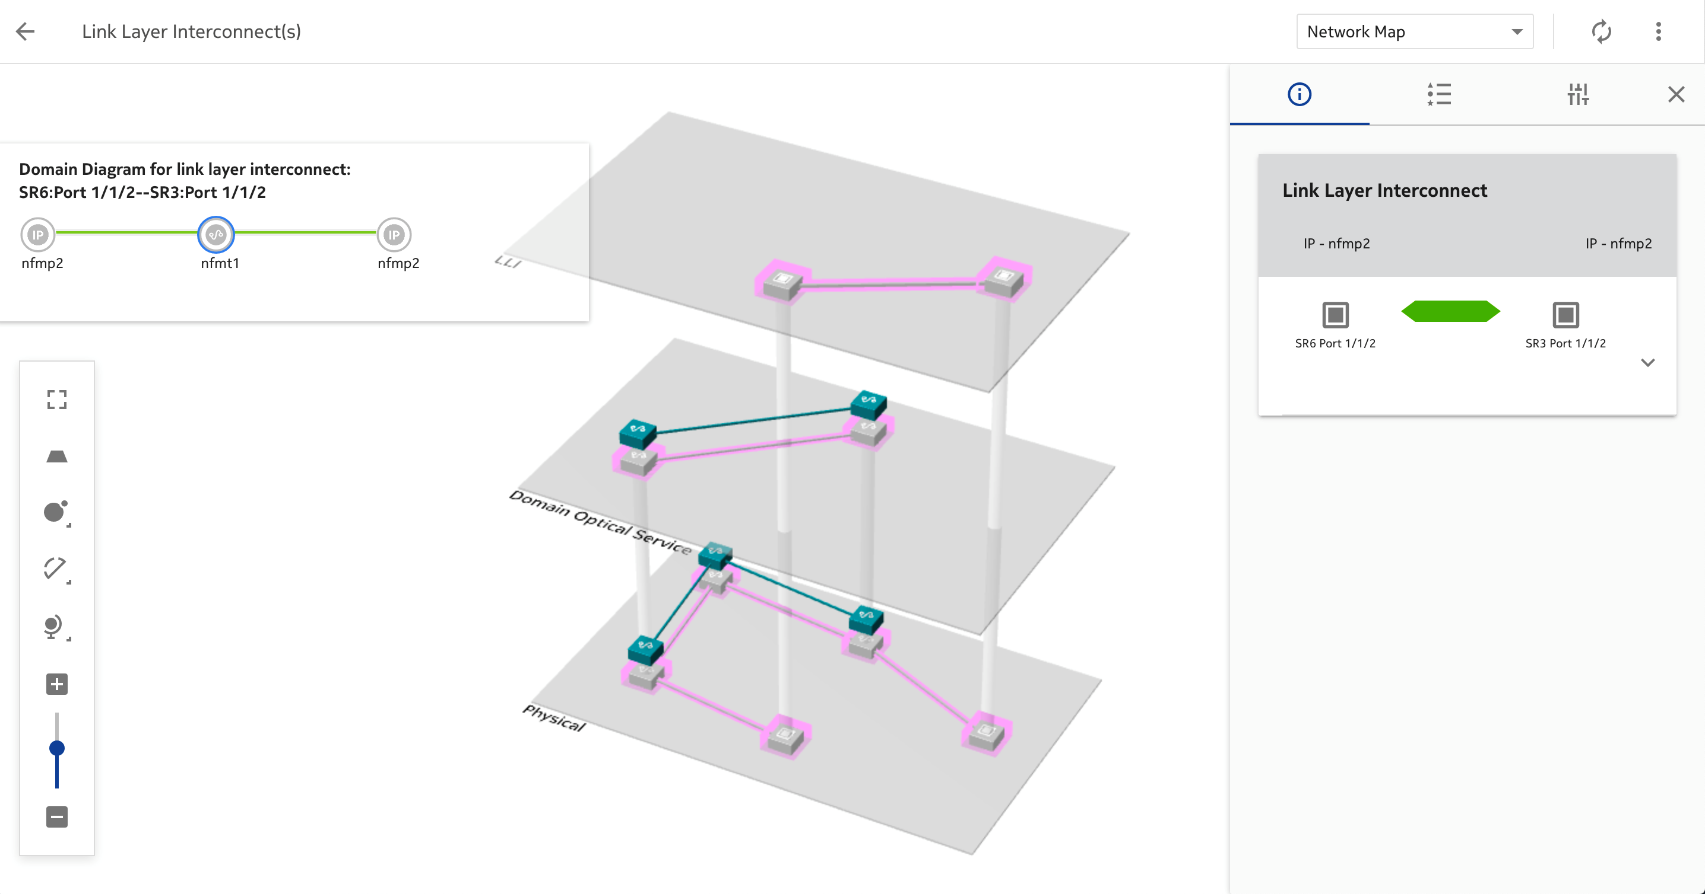
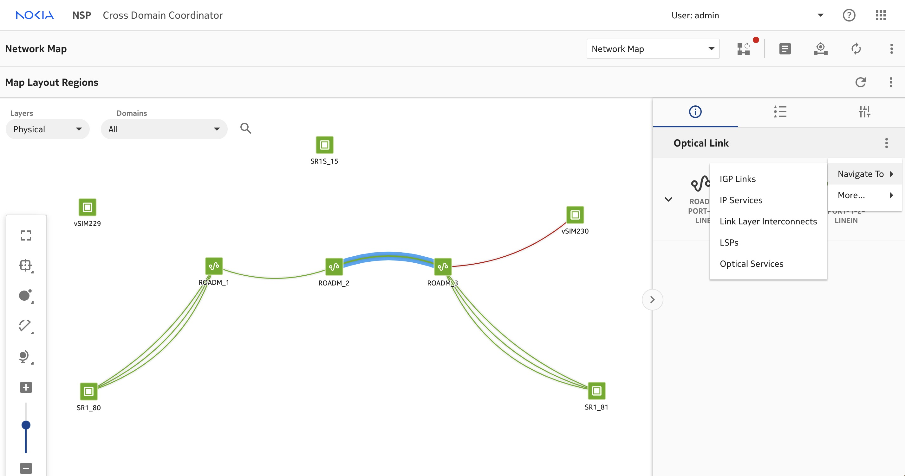



Automation Use cases
Correlate and Operate
1
Cross-Domain
Coordination
Provide end-to-end visibility through a single pane of glass with cross domain management coordination
2
Coordinated assurance & troubleshooting
Smart alarm correlation allows rapid root cause identification allowing for fault locus and associated alarms to the optical device
3
Coordinated Operations
Control
Move IP traffic away from faulted optical path - Maintenance Operations & Hitless optical reversion.
Error!
Error!
Error!
Error!
Root cause
Error!

Slide 16


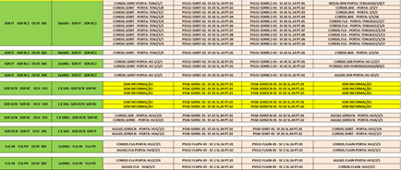


Automation Use cases
Discover and Visualize
4
Elastic IP/optical
bandwidth
Variable link needs in IP layer can leverage multi-layer network optimization by resizing optical link aggregation groups (LAG) dynamically to accommodate flows with correctly sized bandwidth
5
Multi-layer
Topology Discovery
Multi-layer topology discovery through both protocol based LLDP, packet counts & workflows for transponders or ZR+
6
Diversity
Analysis
Cross-domain coordinator perform real time diversity analysis for IP services traversing the optical network checking end-to-end path for two or more IP services transported over an optical domain.
Evening
Morning
?
Optical
IP

Slide 17





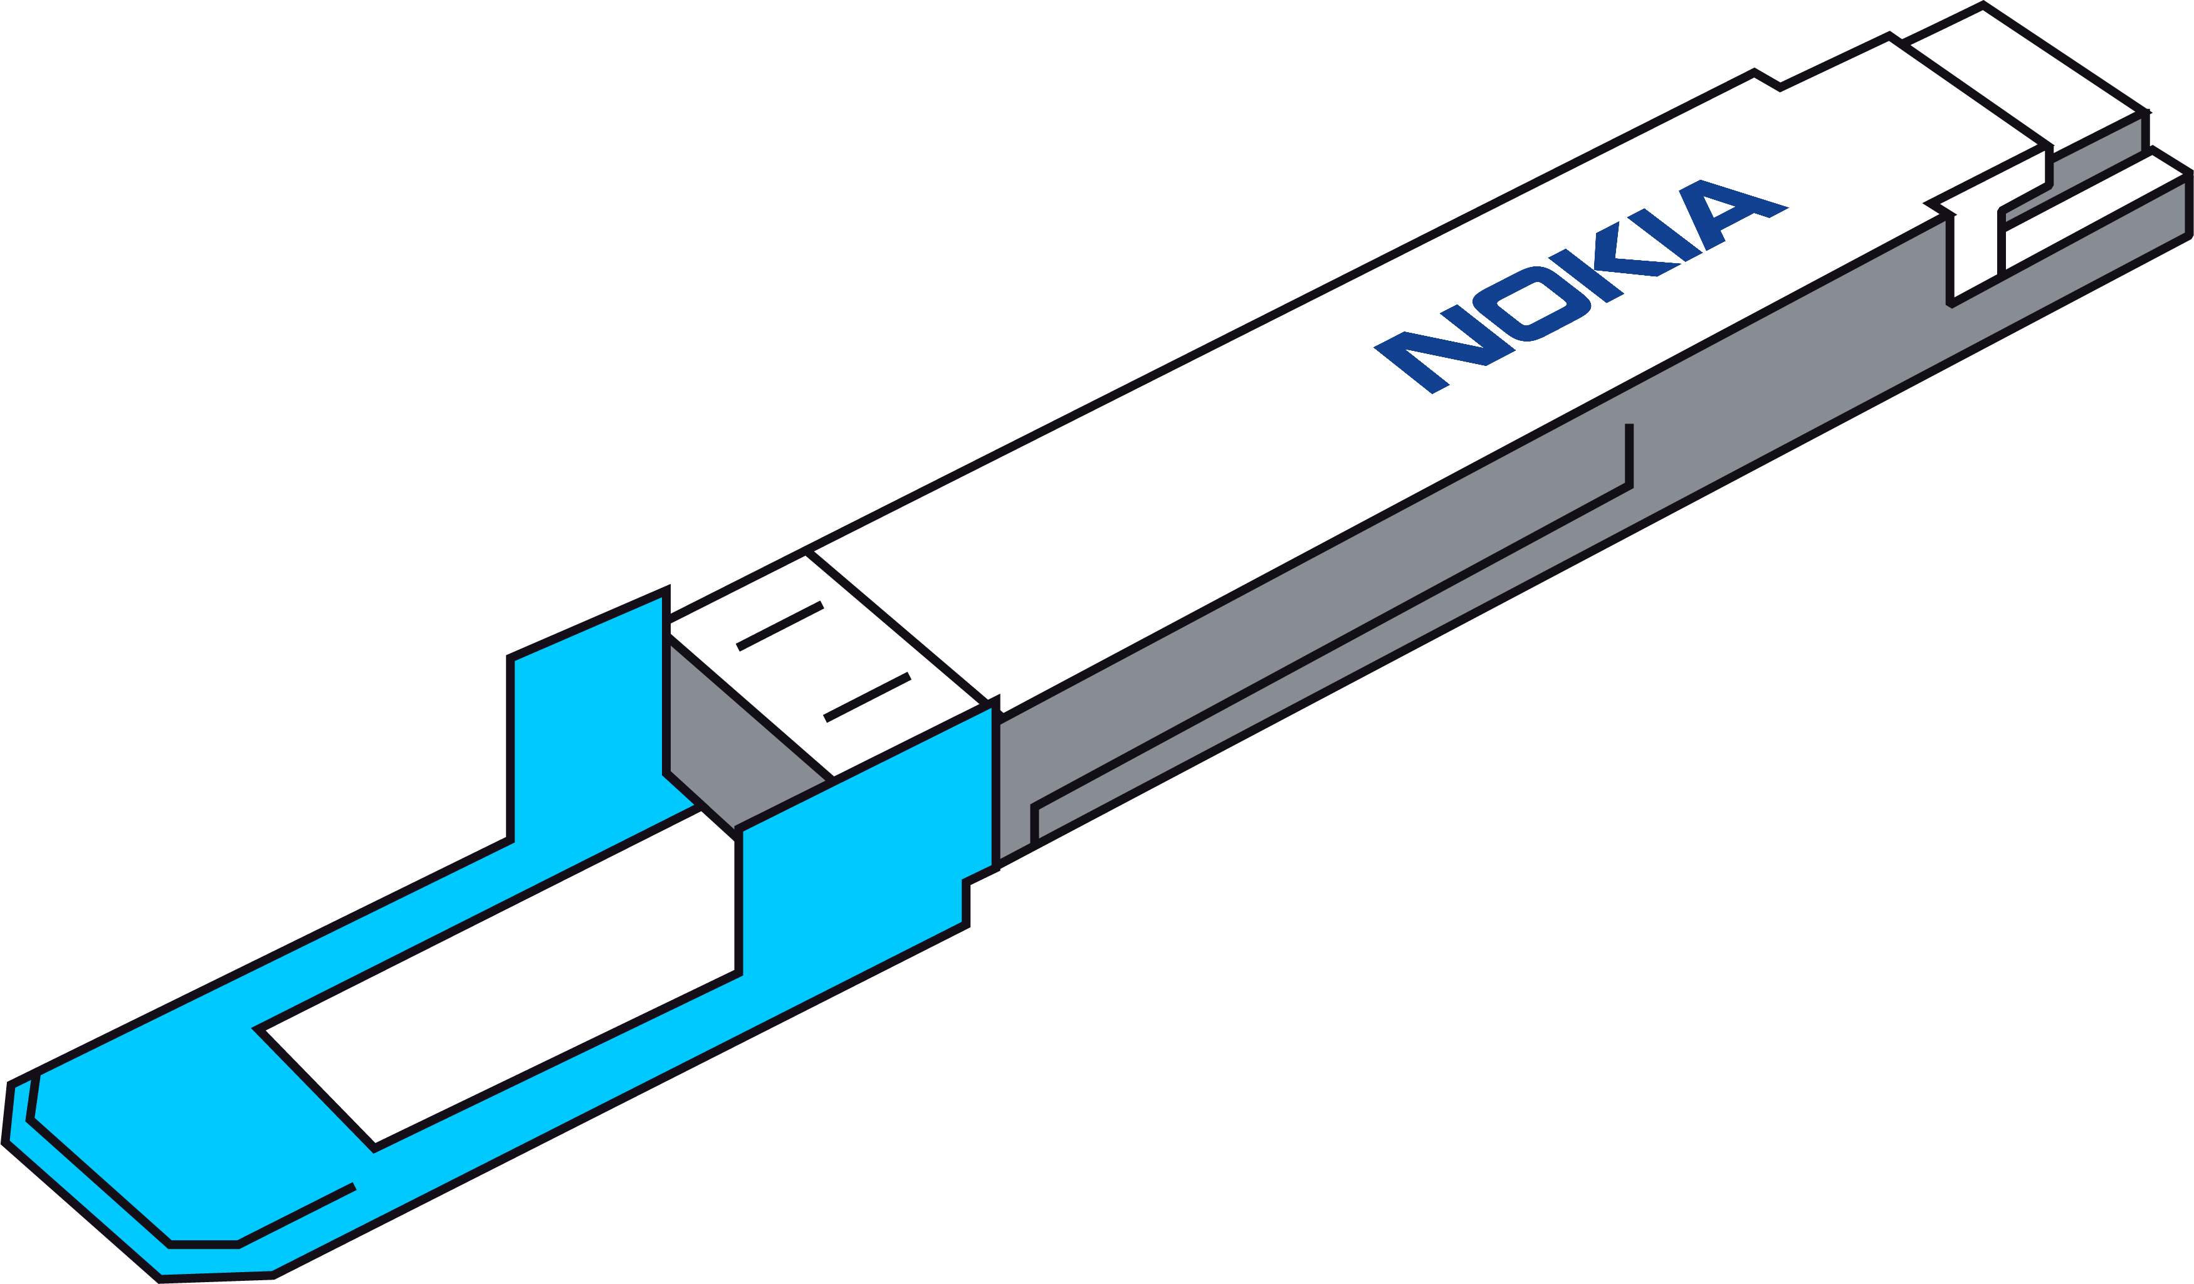



Automation Use cases
Optimize and Enhance
7
Optical aware
IP routing
Use shared risk information to compute optimal paths through the infrastructure for IP/MPLS transport networks that need diversity in the optical domain
8
What If
Analysis
Simulate failure modes for fiber cut or loss of an optical device where resulting impacts on IP services can be assessed to determine if there is sufficient redundant capacity in place or where more backup resources need to be added
9
Coherent
Routing
ZR(+) Coherent plug configuration and management across both linear and multi-degree network infrastructure with automated CDL discovery.
X
Optical network
X
OTC
Single span
(<120Km)
T-API
WaveSuite
WS Planner
IETF
OpenConfig
CMIS
Network

Slide 19
Copyright and confidentiality
The contents of this document are proprietary
and confidential property of Nokia. This document
is provided subject to confidentiality obligations of
the applicable agreement(s).
This document is intended for use by Nokia’s customers and collaborators only for the purpose for which this document is submitted by Nokia. No part of this document may be reproduced or made available to the public or to any third party in any form or means without the prior written permission of Nokia. This document is to be used by properly trained professional personnel. Any use of the contents in this document is limited strictly to the use(s) specifically created in the applicable agreement(s) under which the document is submitted. The user of this document may voluntarily provide suggestions, comments or
other feedback to Nokia in respect of the
contents of this document ("Feedback").
Such Feedback may be used in Nokia products and related specifications or other documentation. Accordingly, if the user of this document gives
Nokia Feedback on the contents of this document, Nokia may freely use, disclose, reproduce, license, distribute and otherwise commercialize the feedback in any Nokia product, technology, service, specification or other documentation.
Nokia operates a policy of ongoing development. Nokia reserves the right to make changes and improvements to any of the products and/or services described in this document or withdraw
this document at any time without prior notice.
The contents of this document are provided
"as is". Except as required by applicable law, no warranties of any kind, either express or implied, including, but not limited to, the implied warranties of merchantability and fitness for a particular purpose, are made in relation to the accuracy, reliability or contents of this document. NOKIA SHALL NOT BE RESPONSIBLE IN ANY EVENT FOR ERRORS IN THIS DOCUMENT or for any loss of data or income or any special, incidental, consequential, indirect or direct damages howsoever caused, that might arise from the use of this document or any contents of this document.
This document and the product(s) it describes
are protected by copyright according to the
applicable laws.
Nokia is a registered trademark of Nokia Corporation. Other product and company names mentioned herein may be trademarks or trade names of their respective owners.

