Slide 1

SURFcumulus evolution
Michel Wets

Slide 2





Roadmap
        2024 - 2026
        OCRE2024, extend technical expertise & start Sovereign movement
        2018 - 2020
        First usage, focus on training
        2022 - 2024
        Support growth and start offering own technical expertise
        2016 - 2018
        Explaining cloud and the validity of the tender
        2026 - 2028
        Support Sovereign and IT organisational changes
        2020 - 2022
        Focus on growth and governance

Slide 3

Title only

Slide 4

Professional Services
Supporting the digital transformation
Landing zones, migration, administration of cloud environments
Direct through OCRE2024 or through SURFcumulus Dynamic procurement System
1,8 mio euro in 2025, growing rapidly

Slide 5
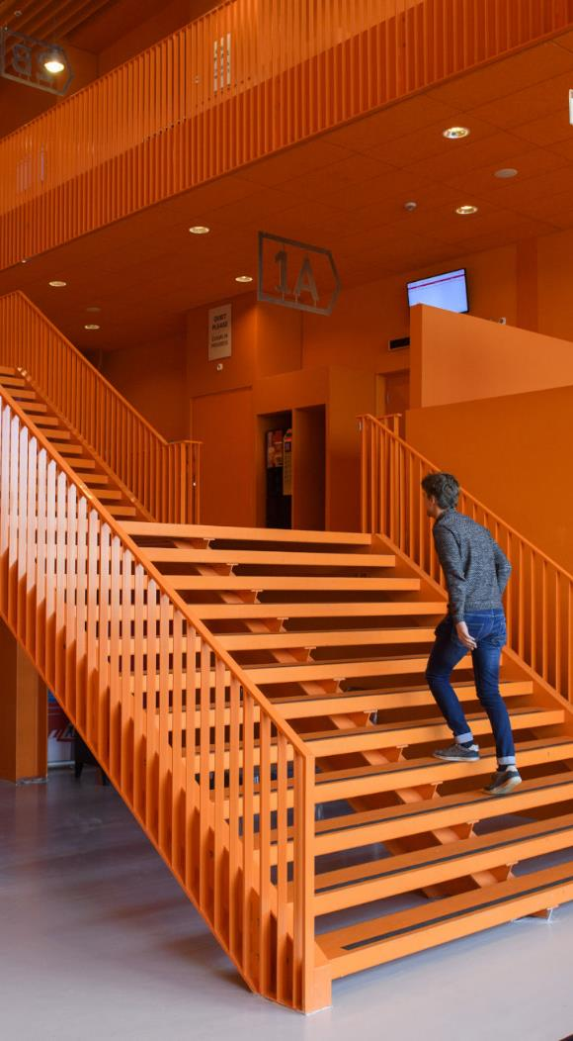
Cloud Delivery Services
Lowering barrier for additional platforms
Ready to use cloud environments
24/7 support from supplier
Start with AWS and T-Systems
Add other European platforms in 2026

Slide 6
SURFcumulus team composition
Role | FTE
Advisors | 2,7
Azure specialist | 0,9
AWS/Google Specialist | 1
Governance Specialist | 0,9
Security Specialist | 0,9
Product manager / technical coordinator | 1
Team lead/GEANT OCRE Strat. Vendor. Man. | 1
Compliance checks | 0,2
Contract management | 0,4
Total | 9

Slide 7
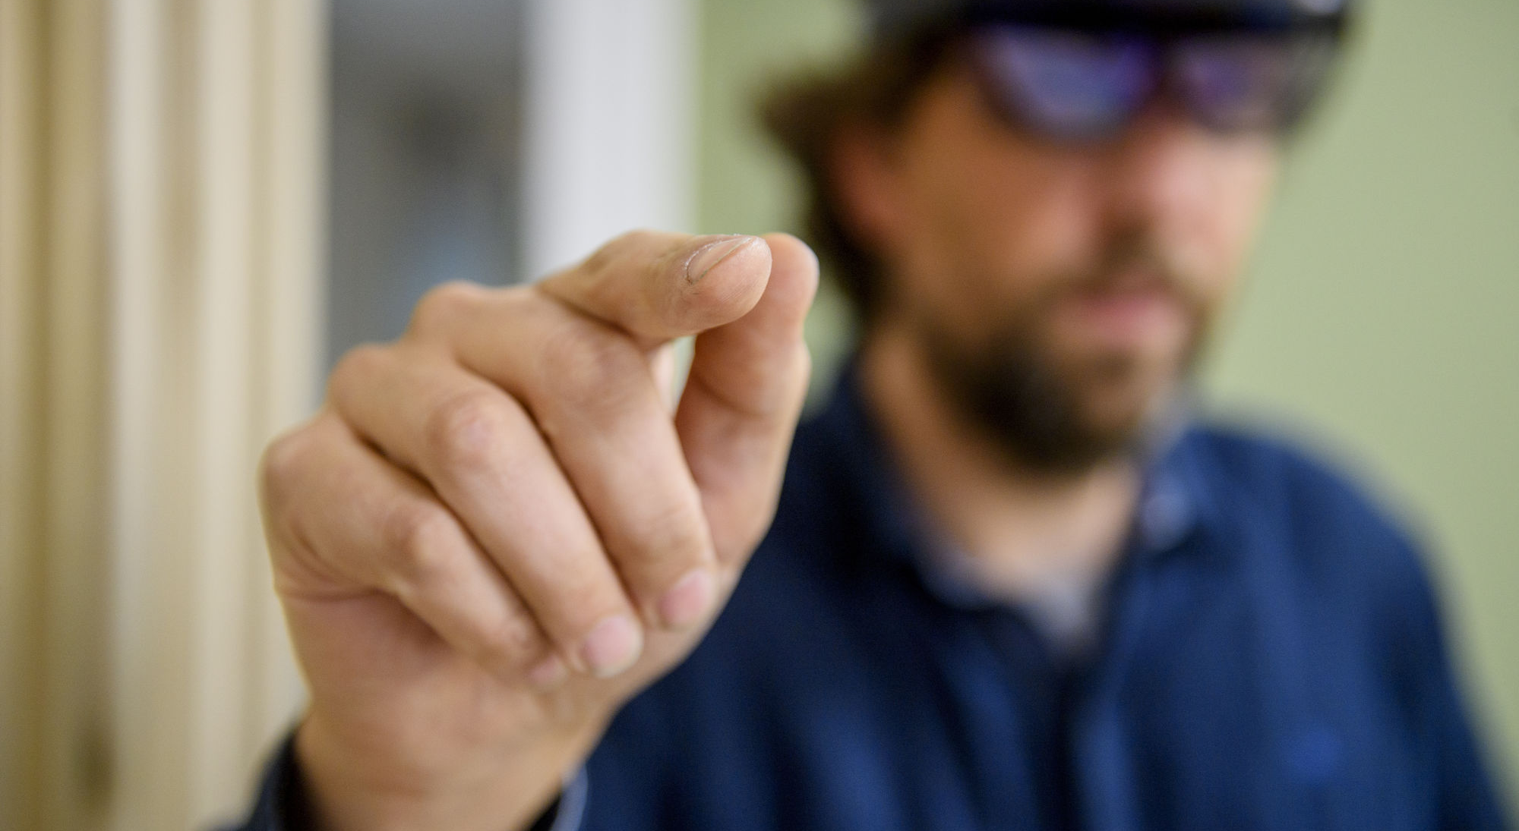
Closing slide
Thank you for
your attention!
Michel.wets@surf.nl

