Slide 1


ISO 27001 – HEAnet’s Journey so far
23 October 2025

Slide 2
Its all about the ISMS – whats that ?
A management system is based upon an organisation's business processes and their interaction with the aim at achieving planned ISMS performance criteria
Provides a systematic approach for managing your information security.
This centrally managed framework enables you to manage, monitor, review and improve your information security practices in one place.

Slide 3
Some key lessons & decisions so far
Developing an ISMS – Information Security Management System
NIS2 – original driver, certification will also include NIS2 if relevant
New IS027001 in 2026
Partial ISO27001 won’t be allowed in future
Merger
Management is at the centre
Project team
Culture change – ISO is for everyone, employee engagement
Auditor will look for evidence for everything
Activities so far – Gap analysis, Context of the organisation, Management, Risk, Information assets, training

Slide 4
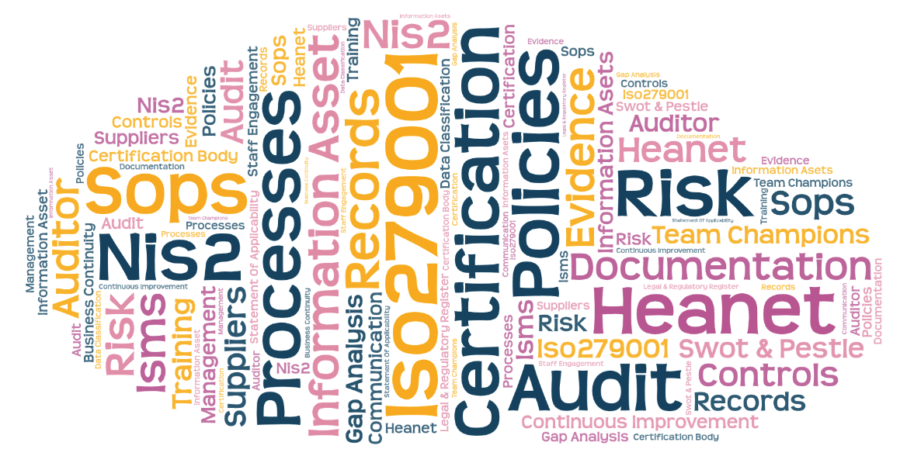
ISO 27001 Issues

Slide 5
ISO27001:2022 & the NIS2 Directive
Both address cybersecurity &
The EU NIS 2 Directive is ISO/IEC 27001:2022 is
The EU NIS 2 is a Directive and mandatory
Aimed at critical and essential industries across the EU
Aimed at ensuring a high common level of cyber security across the EU
Enforced by EU Regulators
Emphasis accountability at C-Level
Places greater emphasis on Cyber resilience
Certification possible at National level
Covers approx. 85% of NIS2
ISO/IEC 27001:2022 is a voluntary International standard
Aimed at organizations
Aimed at providing a framework for information security management covering information security, privacy and cyber security
Enforced by Certification Bodies
Loss of or withdrawal of certification
Places greater emphasis on management system and controls
Certification possible at International Level

