Slide 1
SANReN Connect
Proof of Concept (POC)
Dr Kasandra Pillay
SANReN Engineer and Project Manager
SIG-MSP meeting
23 October 2025

Slide 2
Background: NICIS
National Integrated Cyberinfrastructure System (NICIS)
Structure
  South African Research Network (SANReN)
  Centre for High Performance Computing (CHPC)
  Data Intensive Research Initiative of South African (DIRISA)
  HCD encompasses the 3 pillars
NICIS is a hosted programme of the DSI
Hosted at the CSIR as a centre in NGEI Cluster, Smart Society Division
SANReN
High-bandwidth Network
Human Capital Development (HCD)
CHPC
DIRISA
High Performance Computing
Data Intensive Research
National Integrated Cyberinfrastructure System
(NICIS)
SANReN, https://www.sanren.ac.za/ | CHPC, https://www.chpc.ac.za/ | DIRISA, https://www.dirisa.ac.za/ | https://www.dsti.gov.za/
Notes:
SANReN is a pillar of NICIS, NICIS is the consolidation of all the cyberinfrastructure initiatives of the DSTI (Department of Science, Technology and Innovation)
SANReN, CHPC, DIRISA – three pillars are encompassed by HCD activities (eResearch programme, SANReN Grant call, student competitions, training events)
Next Generation Enterprises and Institutions (NGEI) cluster

Slide 3
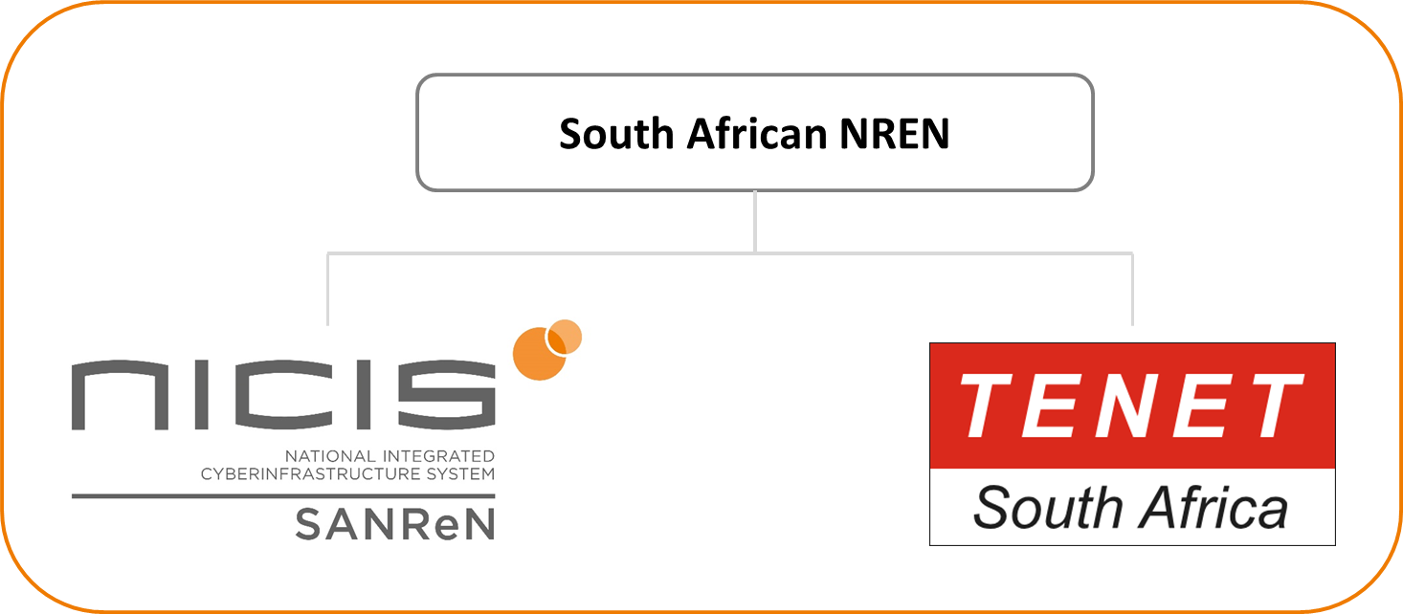

The South African NREN
Structure
  Roles and responsibilities of the de facto South African
  NREN are distributed between SANReN and TENET
Functions
  SANReN
    Builds the Network (network reach and capacity)
    Develops Advanced Services
  TENET
    Operates the SANReN Network under terms of collaboration agreement with CSIR
    Build onto the network
    Host Services
    Represents South African NREN at UbuntuNet Alliance (founding member) – Regional REN for South East Africa
    SABEN – entity for the connection of TVET colleges
TENET, https://www.tenet.ac.za/ | SANReN, https://www.sanren.ac.za/ | https://saben.ac.za/
Notes:
Together SANReN and TENET function as the South African NREN, with the roles and responsibilities of the NREN distributed between them

Slide 4
SANReN Connect POC - What is it?
A new VPN-based solution designed to provide students with zero-cost internet access, with data costs covered by SANReN.
Test user base: South African universities, TENET and SANReN employees

Slide 5


























South African Universities

Slide 6
Requirements
Must be registered with SAFIRE – South African Academic Identity Federation
i.e. Universities manage their own usernames, passwords and authentications
Must have a Telkom SIM card
For the POC: Network provider selected through RFQ to provide data through Reversed billing service for 12 months
Must have the latest OpenVPN client

Slide 7
Why?
GAP in existing internet solutions for education:
Wired SANReN network
eduroam
Network providers offerings
Buying personal data
Students may currently be disadvantaged by a lack of internet access when off campus.
The successful implementation of SANReN Connect will enhance the network's footprint, support education at no cost to the user – currently funded by SANReN.
Bridges digital divide

Slide 8
Why?
Data costs in South Africa have historically been known to be higher than other parts of the world. (Moyo and Munoriyarwa, 2021)
High poverty rates - In most South African households, the money could always be used elsewhere.
According to the Statista Research Department (2025), the number of smartphone users in South Africa was forecast to continuously increase between 2024 and 2029 by 12 million users (+86.83 percent). After the ninth consecutive increasing year, the smartphone user base is estimated to reach 25.83 million users and therefore a new peak in 2029.

Slide 9
How?
Leveraging smartphone adoption, existing SANReN hardware resources and open-source software
The service reroutes student traffic destined for the internet through zero-rated SANReN Connect IP address/s.
Reversed billing service through South African network provider– IP address per SAFIRE IdP represented by a VPN
Multiple VPN servers for load balancing and redundancy
Extends the reach of the SANReN network, overcoming user mobility limitations of traditional campus-based connectivity solutions
Provides access to the SANReN network for users on their existing devices away from the University network and eduroam hotspots.

Slide 10
How?
SANReN team have developed the core functionality of the SANReN Connect Proof-of-Concept (PoC)
Testing the service with users to evaluate the effectiveness of traffic zero-rating and performance under load

Slide 11
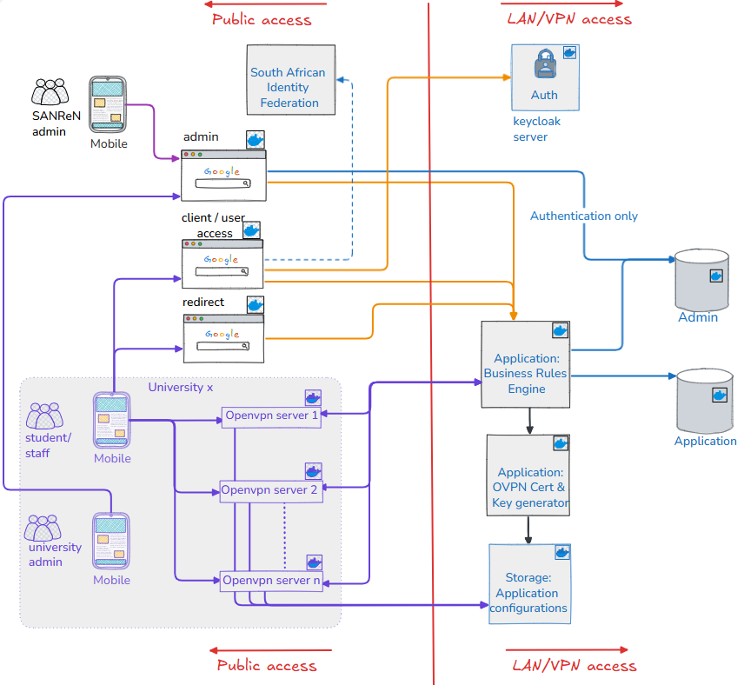
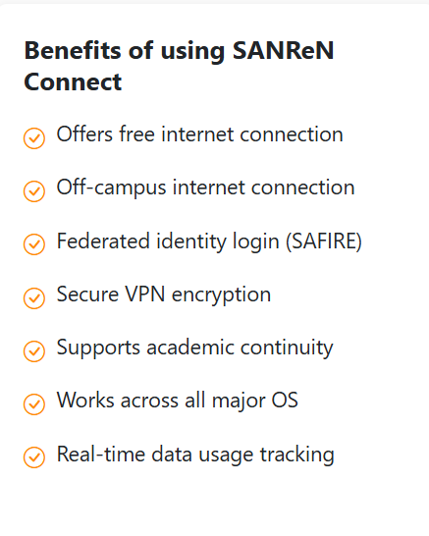
Overview of the service design

Slide 12
Advantages to R&E institutions
Leverages economies-of-scale by purchasing a large quantity of data (at a lower price) that is shared by the national R&E community
SANReN may negotiate on behalf of the community
More flexibility for institutions - no contractual obligations based on the number of students

Slide 13
Functionality for admins
Individual institution control and monitoring:
Able to monitor stats
Activate and suspend students
Manage data limits
Manage login frequency – verification of affiliation
Manage bandwidth limits – premium and standard settings
Able to supplement their allocated free data offering

Slide 14
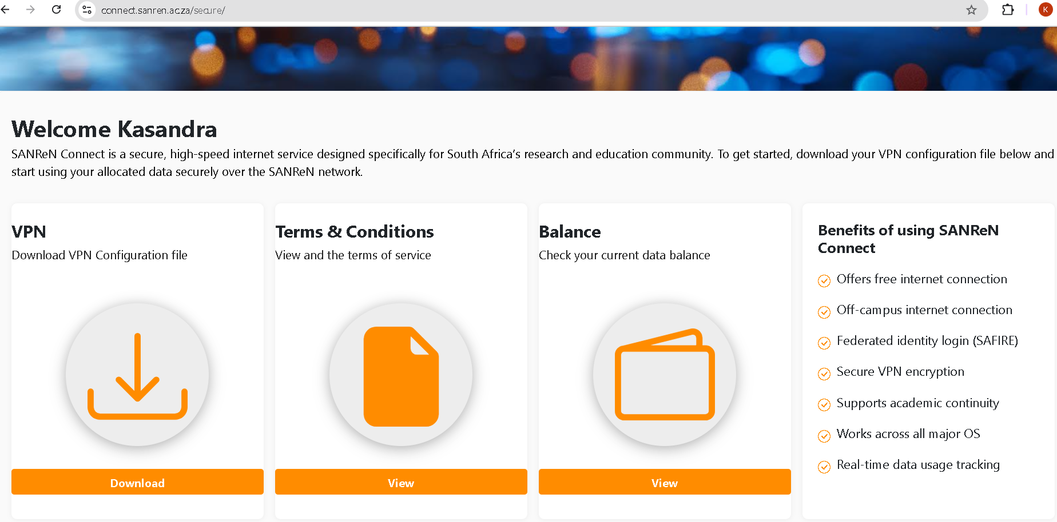
How does a user access the service?

Slide 15

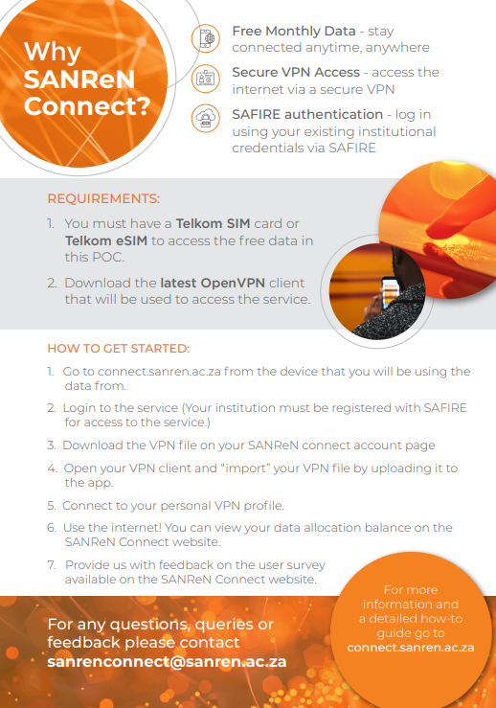
Launch at CHPC conference

Slide 16
Initial observations from the POC
Anticipate that some users will be blocked as their institution is not registered with SAFIRE – trying to address this proactively before the launch at the CHPC conference in December
Some users have difficulty with use of the VPN client: outdated versions, not familiar with downloading and uploading/importing a file.

Slide 17
Next steps?
Interest and ease of use
Usage patterns
Inform decisions on scaling the service
Refine functionality based on practical use
Test the service's performance under load conditions
Assess its ability to provide zero-rated traffic and seamless connectivity for students, regardless of their location.
To validate the feasibility of the solution – better costs, more network providers

Slide 18
Thank You!
Questions?
kasandra@sanren.ac.za
https://www.sanren.ac.za/

Slide 19
References
Statista Research Department (2025) South Africa: mobile internet users 2020‑2029. 3 June. Available at: https://www.statista.com/statistics/558867/number-of-mobile-internet-user-in-south-africa/ (Accessed: 3 October 2025).
Moyo, Dumisani & Munoriyarwa, Allen. (2021). 'Data must fall': mobile data pricing, regulatory paralysis and citizen action in South Africa 'Data must fall': mobile data pricing, regulatory paralysis and citizen action in South Africa. Information Communication and Society. 24. 10.1080/1369118X.2020.1864003.

