Slide 1



Slide 2
Flexibility in DFN service delivery
SIG-MSP | 23.10.2025
Jakob Tendel

Slide 3
Outline
Introducing DFN
DFN Service portfolio
Overview of business units and partnerships
Channels for service development and brokerage

Slide 6
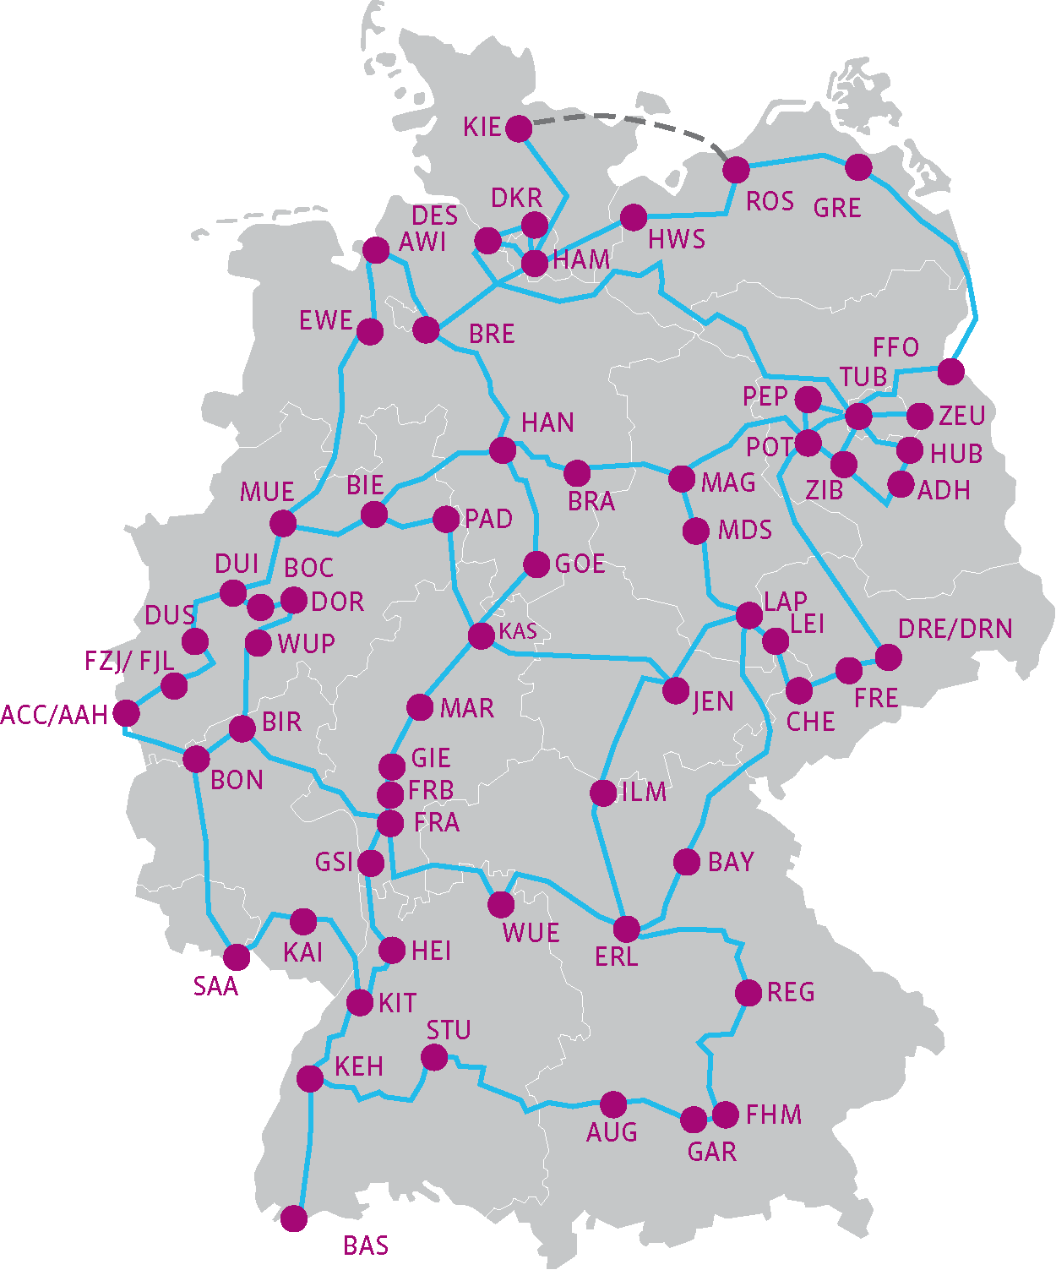
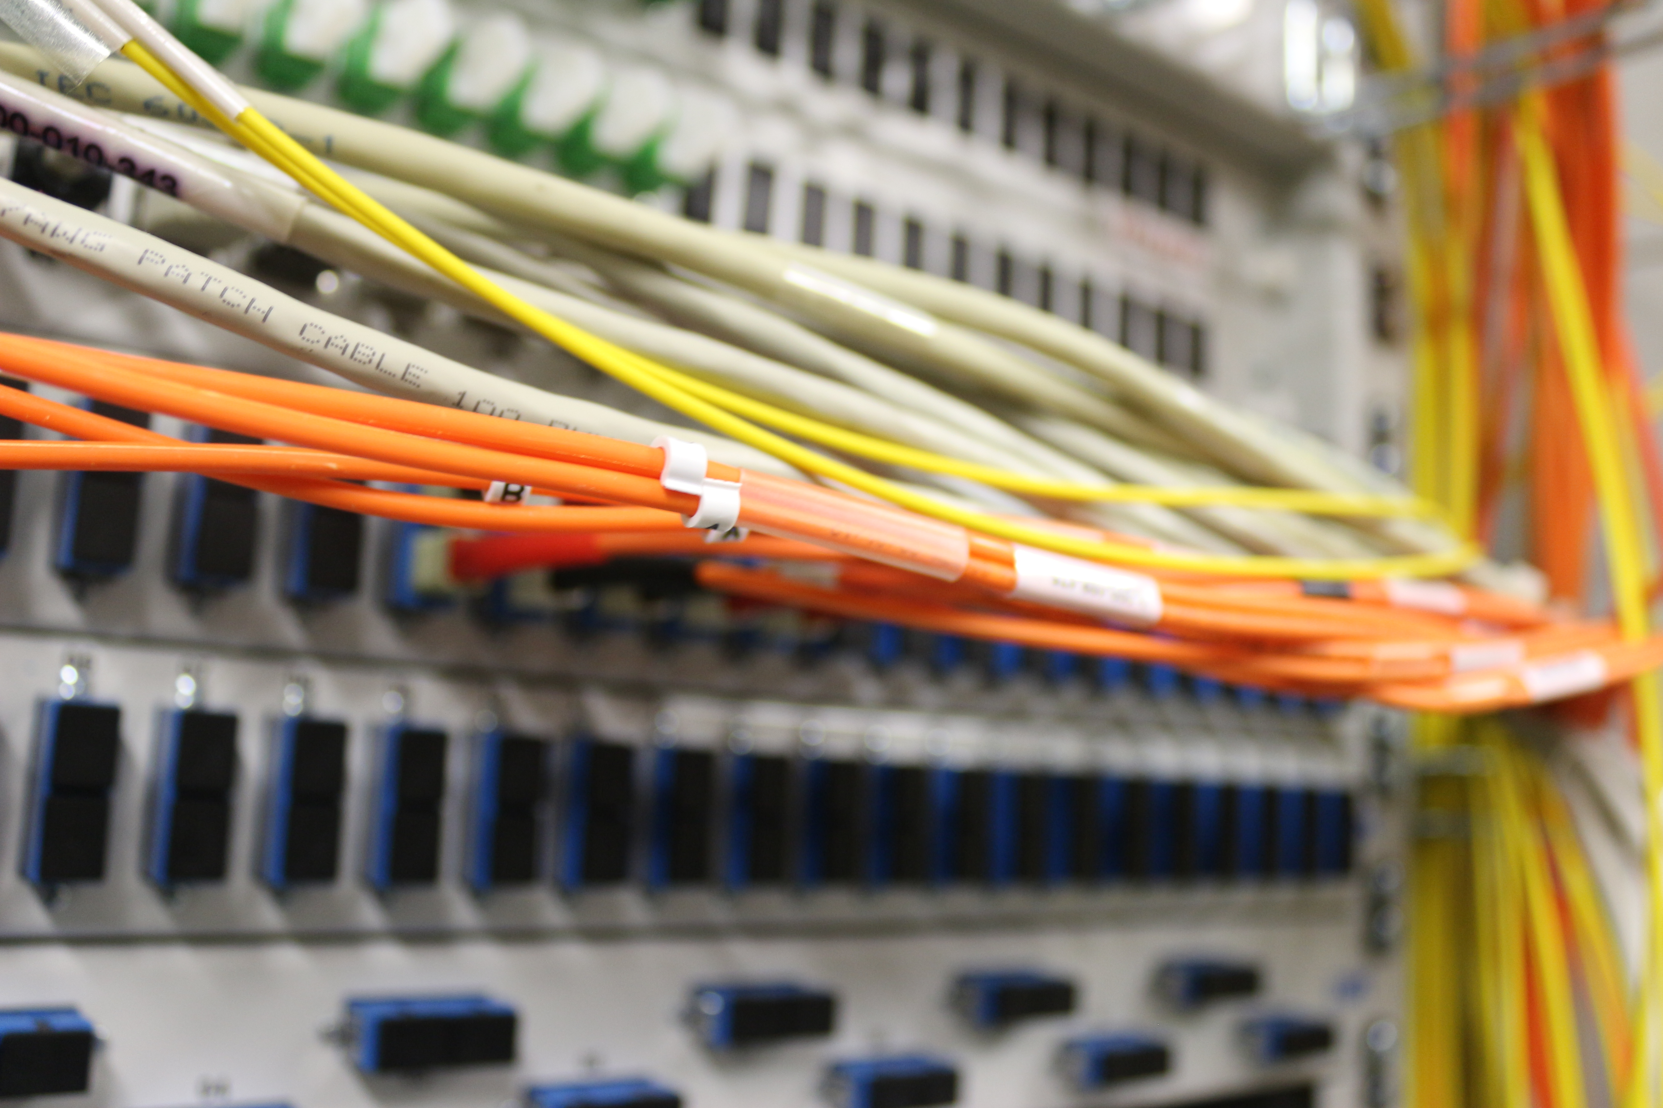
DFN core network

Slide 7
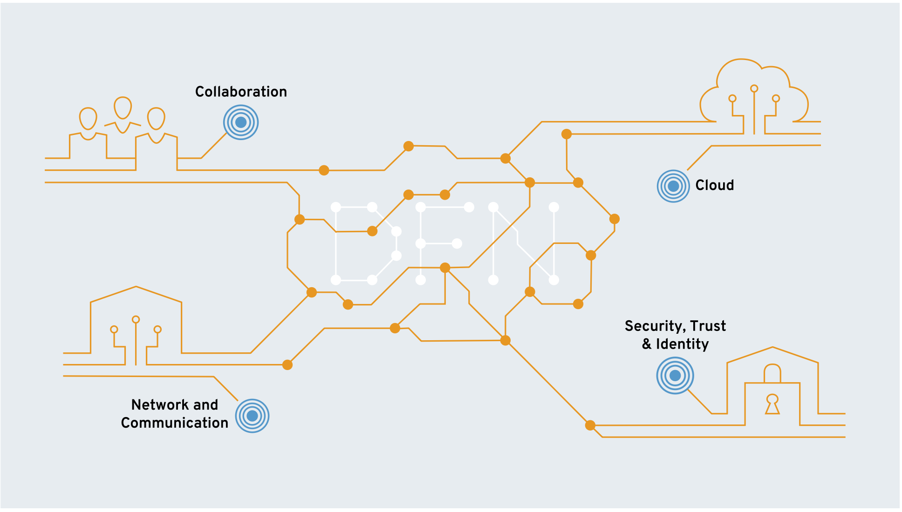
DFN service portfolio
Videoconference
Phone services
DFN-Terminplaner
Federated Community Cloud
Commercial contracts
- OCRE -
DFN-Internet
Domains
VPN
DFN-Security
MailSupport
Eduroam
PKI
AAI

Slide 8

Business units and partnerships
DFN-Verein
Federated Community Cloud
Member institutions
as providers
as customers
External procured cloud services
Other partnerships e.g.
Subcontractors
Legal research
Technical research
Various stakeholder communities
DFN-CERT GmbH
DFN-PKI
Security consulting
Software dev

Slide 9
DFN-Service provision activities
In-house development
  With variable off-the-shelf or sub-contractor content
  Wholly-owned limited company (DFN-CERT) with specific capabilities
Direct public procurements
Community service delivery framework
  Services developed and delivered from and to community institutions
  DFN provides legal and transactional framework
Partnering in collective public procurements

Slide 10
Summary
DFN-Verein is a non-profit membership institution
Service development leverages in-house core competencies
for unique and specific service offerings
Broadening the service portfolio by external procurements and partnerships

Slide 11
Any questions?
Kontakt
  Jakob Tendel
    E-Mail: tendel@dfn.de
    Telefon: 0049 30 884299-348
    Fax: 0049 30 884299-370
    Anschrift:
    DFN-Verein, Geschäftsstelle
    Alexanderplatz 1
    10178 Berlin

