Slide 1


GCC Meeting
Copenhagen, October 1 and 2, 2025
Public

Slide 2
Agenda 1 October
Time | What
12:00 – 13:00 | Lunch and introductions
13:00 – 15:00 | Rethinking the structure of the GÉANT Community Programme
15:00 – 15:15 | Break
15:15 – 15:45 | Update SIG activities
15:45 – 16:00 | Mid year online GCP check-in call
16:00 – 16:15 | Break
16:15 – 17:15 | GPPC question about engagement in run-up to new GN project
17:15 – 17:30 | Update on GÉANT Strategy
19:00~21:00 | Dinner

Slide 3

Rethinking GCP structure and proces

Slide 4
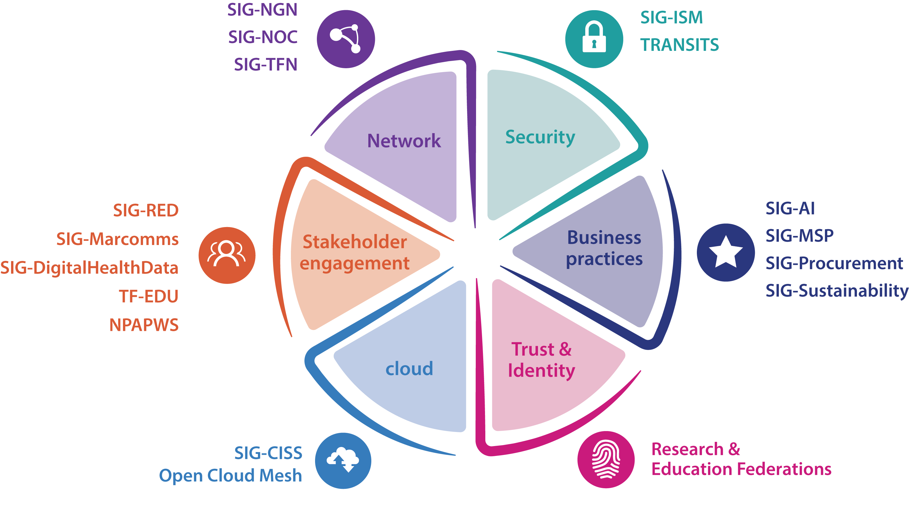
SIG-Quantum
SIG-CNaaS

Slide 5
Challenges with the current GCP structure and processes
We've been adding SIGs at a very rapid rate the last year
So much so, that we're coming to the end of the budget
For smaller NRENs it is becoming more and more stressful to keep up with community events as they will get spread too thin
The newer SIGs are sometimes struggling to get off the ground and require a lot of assistance from Dawn (Procurement and Sustainability)
At the same time, there are still groups within NRENs that do not have a community, that might still want it (legal, public relations etc.)
Do we all agree that these are challenges we face?

Slide 6
Principles
We want the existing community to stay active: any change should be either neutral or benefit the groups that are already active
We want to encourage people to collaborate, exchange and meet up: any change should not quell enthusiasm for inter-NREN collaboration
We want to make sure that people who have not been active in the community before can find a place and feel at home: any change should not lead to a barrier to entry for anyone in our community
We want all SIGs and other activities in the GCP be well facilitated by GÉANT (which in this case includes people funded through the project as well): any change should not overextend GÉANTs resources. More resources can be asked for, but will not materialise right away (if at all)
Do we agree that these are the principles we want to adhere to?

Slide 7
Current process (1)
A GÉANT SIG can be initiated by any member of the GÉANT community based on the following conditions and steps:
  at least 3 NRENs or other organisations support the creation of the SIG and are willing to actively participate;
  an initial Steering Committee (SC) of 3-5 individuals nominated by the supporting organisations is established by simple agreement of the requesting NRENs or other organisations;
  the SC informs GÉANT about the creation of the SIG by submitting the detailed Charter document;
  if GÉANT agrees, the new SIG has been created.

Slide 8
Current proces (2)
A SIG has no pre-defined mandate or expiration date, but its support, subject to yearly monitoring by GÉANT, can be terminated if one of the following situations occurs:
  the SC has fewer than 3 members for a 3-month period;
  the SC collectively requests the termination of the SIG;
  any of the SIG participants, subject to detailed investigation by GÉANT, explicitly requeststhe termination of the SIG;
  GÉANT decides to terminate the SIG.

Slide 9

Proposed solutions: adding to the lifecycle of SIGs

Slide 10
Changes to starting a SIG (1)
Proposed change:
  Each new possible SIG will have a trial period where they mentored by an already existing SIG.
  This way, they can start out having half day meetings attached to the already existing SIG's meeting (like for instance having SIG-Procurement have a half-day meeting attached to a SIG-MSP meeting) and the steering committee of the existing SIG can give tips and pointers.
Way of working:
  There will be a max of two aspiring SIG that can be attached to an existing SIG, to keep meetings manageable.
  The GCC can help aspiring SIGs to find a mentor SIG by giving options and laying connections.
  After that, the aspiring SIG will have to make the decision what fits and get the ball rolling on a first joint meeting

Slide 11
Changes to starting a SIG (2)
What would this solve:
  This would help with the burden on the SIG coordinator
  This would help the new SIG to find their feet before having to do it all by themselves and getting more traction throughout the year
  We will have a longer time to see which initiatives really thrive before saying yes or no to a full new SIG
What is needed to instate this:
  Agree as the GCC that this is a good solution
  Check with the existing SIGs if they support this idea and if they have time to mentor possible new SIGs
  Add it to the GCP process

Slide 12
Changes to engagement from the GCC with each SIG (1)
Proposed change:
  Each GCC member will be the linking pin for 2 or 3 SIGs.
  This means that we will each check in with the steering committee of those SIGs and (where possible) attend one of those SIGs meetings in person each year.
  This way, we will have a good overview of how each SIG is doing and if there are any that need extra help, or might be better suited to phase out of being a SIG.
Way of wokring:
  At each GCC meeting we'll have a quick check in with our contact SIGs beforehand to see if there's any red flags, or any cool things to report.
  At the yearly GCP workshop we'll have an hour check in for the SIGS with their GCC representative.

Slide 13
Changes to engagement from the GCC with each SIG (2)
What would this solve:
  This would enable us to spot possible overlaps and problems
  It would make the route between the SIGs and the GCC as short as possible, which would make it easier for SIGs to flag problems themselves
What is needed to instate this:
  Agree as the GCC that this is a good solution
  Check if we have time for the extra work and travel this entails
  Make a first division of SIGs that we will be linking pins for
  Introduce this new concept to the existing SIGs

Slide 14
Changes to engagement from the GCC with each SIG (3)
What is needed from each GCC member if we instate this:
  Attend one meeting of an extra SIG (as most of us is already attached to at least one SIG), if possible in person
  Have a call with the steering committee once before a GCC meeting
  Check in with the SIG when needed in between
  Budget can be used for travel from Dawn to an extent
  Dawn will continue to coordinate on overlap in discussion topics
This would amount to a week of work per GCC member, per year approx

Slide 15
Changes phasing out a SIG, option 1
Instate an expiration date for all SIGs of three years (the ISOC model). After those three years, each SIG needs to resubmit to remain a SIG.
Way of working: Needs to be thought out in detail.
What would this solve: It would be a way to make sure that each SIG still wants to exist and make it more logical to phase out SIGs after a certain time.

Slide 16
Changes phasing out a SIG, option 2
Instate a kind of self-assessment to do each year/every two years for each SIG to do to check if they still want to be a SIG.
Way of working: This would be very light-weight to check if the SIG has met the goals they have set themselves, like having at least one meeting that year.
What would this solve: It would be a way to make sure that each SIG still wants to exist.
Which option, if any, do we choose?

Slide 17
Brainstorm solutions for broader questions

Slide 18
Offering more forms of community than a SIG
There are already a few ways that people can collaborate between NRENs without having to start a SIG:
  hold an infoshare around a certain topic
  apply for a project within an incubator in the project to work on something together
  apply for an innovation programme grand to work on something together
Outside of this, we can add more options to start collaborating, without it being a SIG right-away:
  Be a working group of an existing SIG: this is well suited for topics that have urgency and are interesting to many NRENs, but might not need to be a long-term collaboration (like GDPR, NIS2, Time and Frequency maybe).
  Yearly/bi-annual events/workshops around a specific theme like CLAW, NPAPW, Security Days, TIIME unconference. Well suited for topics that interest a broad range of people within NRENs and our larger community and/or benefits from interdisciplinary exchange.

Slide 19
Help smaller NRENs in finding their way in the SIG landscape
Working with GÉANT partner relations to make sure smaller NRENs know what SIGs are in existence to figure out which would be of value for them
Make sure all SIG meetings are hybrid, so people can join remotely and for only one or a few agenda items

Slide 20

Break

Slide 21
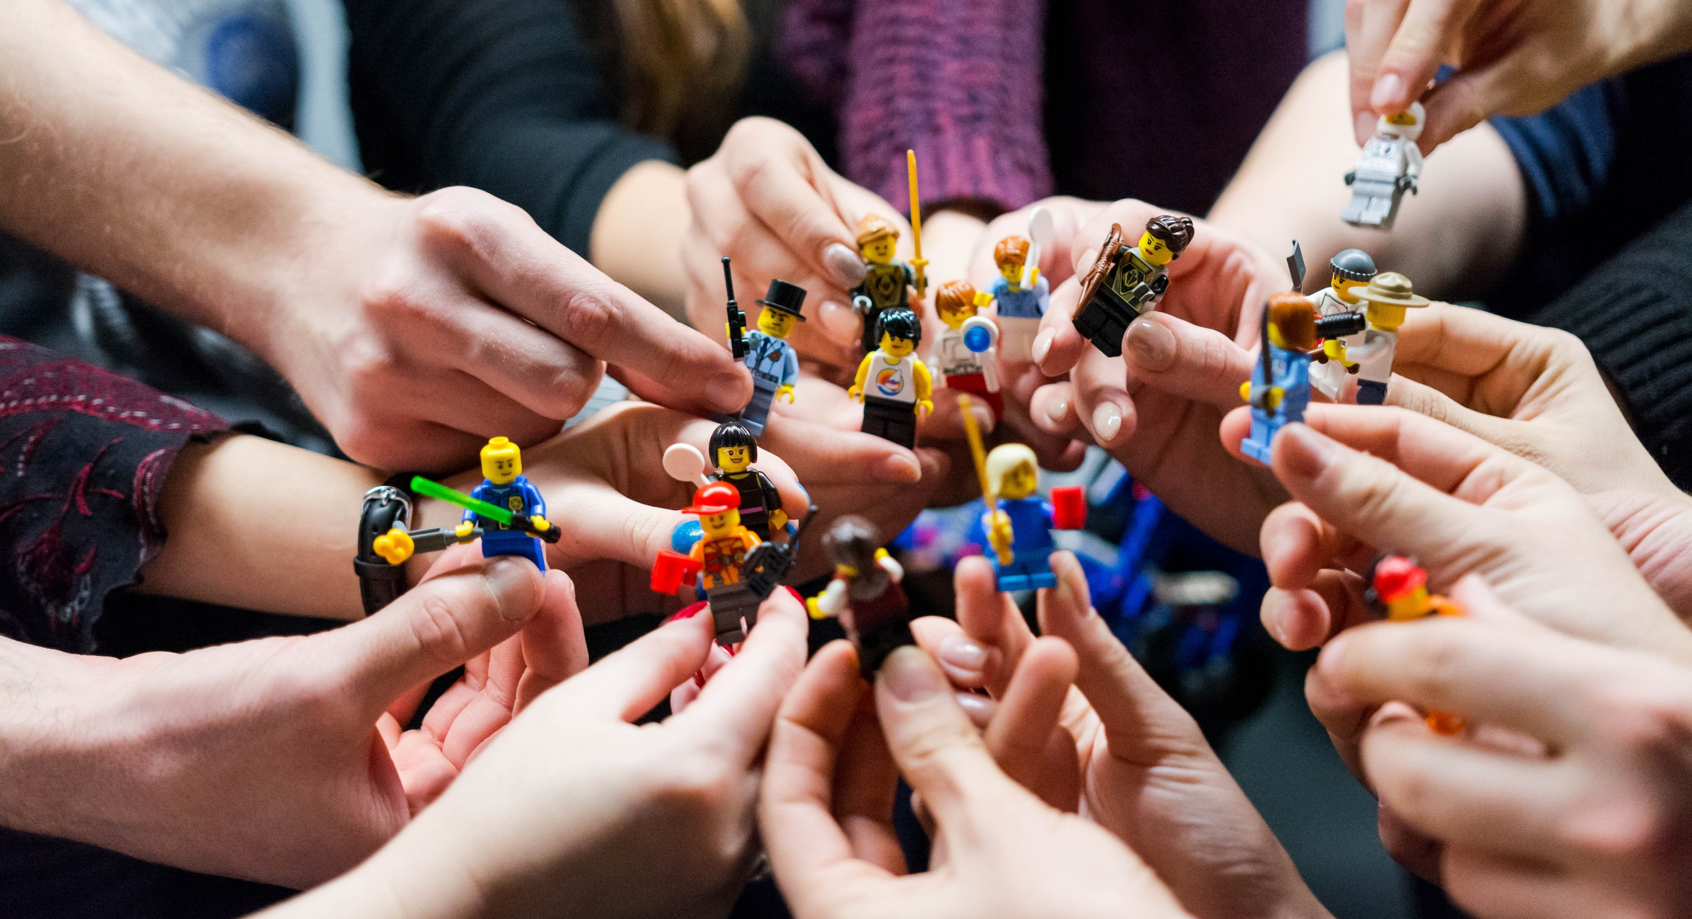
Update on SIG activities
Notes:
Examples: CLAW, services that we copy from each other (ROESTI), SIG-NOC discussions on exit American cloud. Our community

Slide 22
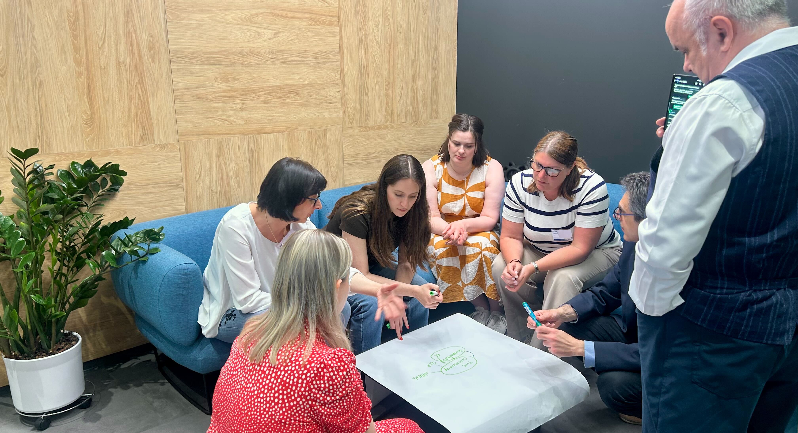
Online GCP check-in

Slide 23
Break

Slide 24

How the GCC and Community Programme can help the GPPC

Slide 25
Current conundrum (1)
In previous GN5-x preparation, the recruitment phase for NREN participation has been near the end of the proposal preparation when the proposal is in its near final draft.
Whilst this may make logistical sense, in terms of having clarity of the type of effort needed and workload on WPLs, NRENs who are not already heavily involved in activities, struggle to respond to the call.

Slide 26
Current conundrum (2)
In the GN5-3 timeline, the GPPC is proposing a longer recruitment phase (dates provisional), however, whilst this may be necessary to improve engagement it is not sufficient; other issues include:
  lack of understanding from NRENs (and their staff) about the needs of the project, or opportunities offered by the project, outside of project areas (if any) the NREN is currently active in;
  a natural tendency for WPLs to chose people they already know have the required expertise and can deliver, which makes it difficult for newcomers to participate.

Slide 27
What the GPPC would like to achieve
A longer process of engagement between the project and NRENs, so that NRENs and prospective participants have a greater understanding of the project activities before the recruitment process begins, and that current WPLs and participants have a better idea of the talent available.
This is indicated in the timeline as “Community (Recruitment) Engagement” – however dates are provisional, and perhaps this is an activity which should continue outside of GNx-y preparation timelines, and perhaps be an explicit part of GNx-y projects and proposals moving forward.

Slide 28
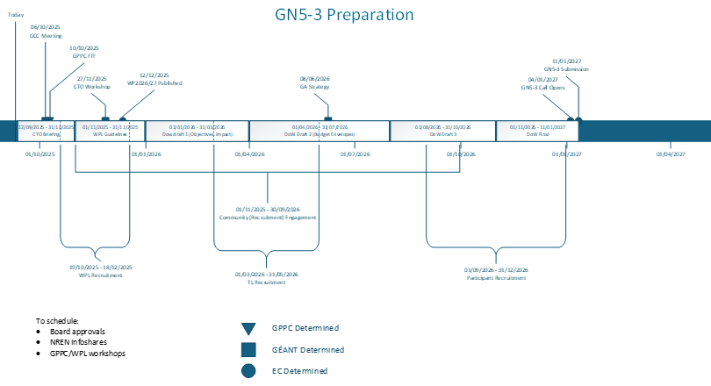

Slide 29
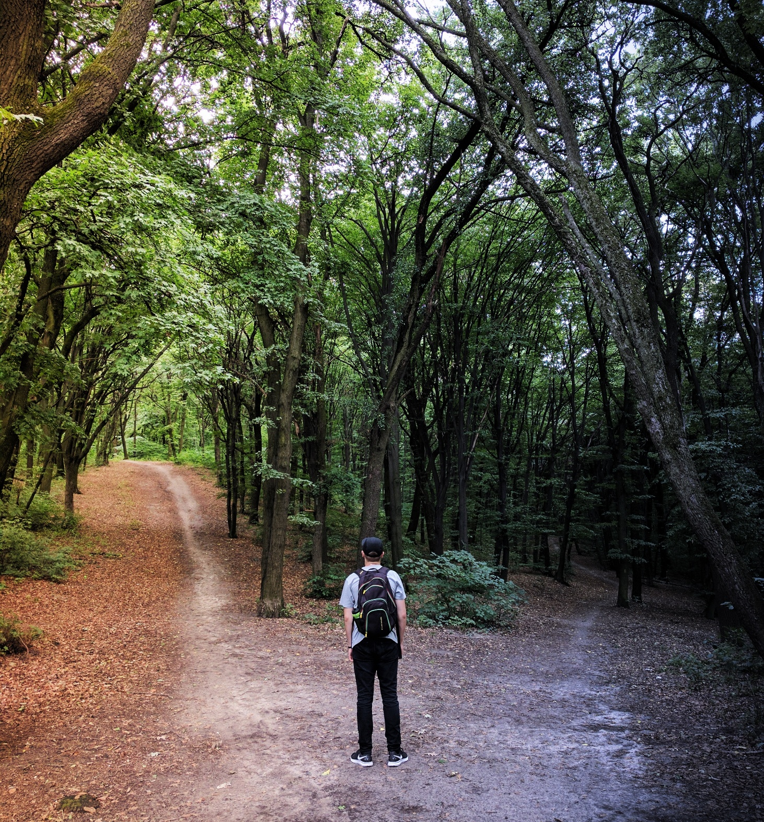
Question to the GCC
Whether we could help
  define,
  shape
  and run
such a “Community (Recruitment) Engagement”, or alternative suggestions to address these issues.
Option to look at brainstorm results from GPPC

Slide 30

Update GÉANT Strategy

Slide 31
Agenda 2 October
Time | What
09:00 – 09:30 | Arrival, coffee, chit chat
09:30 – 10:30 | Discussion on related activities and communities
10:30 – 11:00 | Communications plan
11:00 – 11:30 | Innovation Programme 2026
11:30 – 12:00 | Break
12:00 – 12:45 | TNC related fun stuff brainstorm
12:45 – 13:00 | Humanitarian program group update
13:00 – 13:30 | Wrap up and plan next meeting
13:30 – 14:00 | Lunch and goodbyes

Slide 32

Related activities and communities

Slide 33

Communications plan

Slide 34

Innovation programme 2026

Slide 35
Break

Slide 36

TNC related fun stuff brainstorm
Notes:
Community award and community hub

Slide 37

Humanitarian program group update

Slide 38

Wrap up and plan next meeting

Slide 39

Thank You
Any questions?
www.geant.org

