Slide 1


SIG-Quantum online meeting - 1 December 2025
Welcome and Introduction
Domenico Vicinanza
Géant Senior Research Engagement Manager
First SIG-Quantum Meeting
Online, 01 Dec 2025

Slide 2


Slide 3
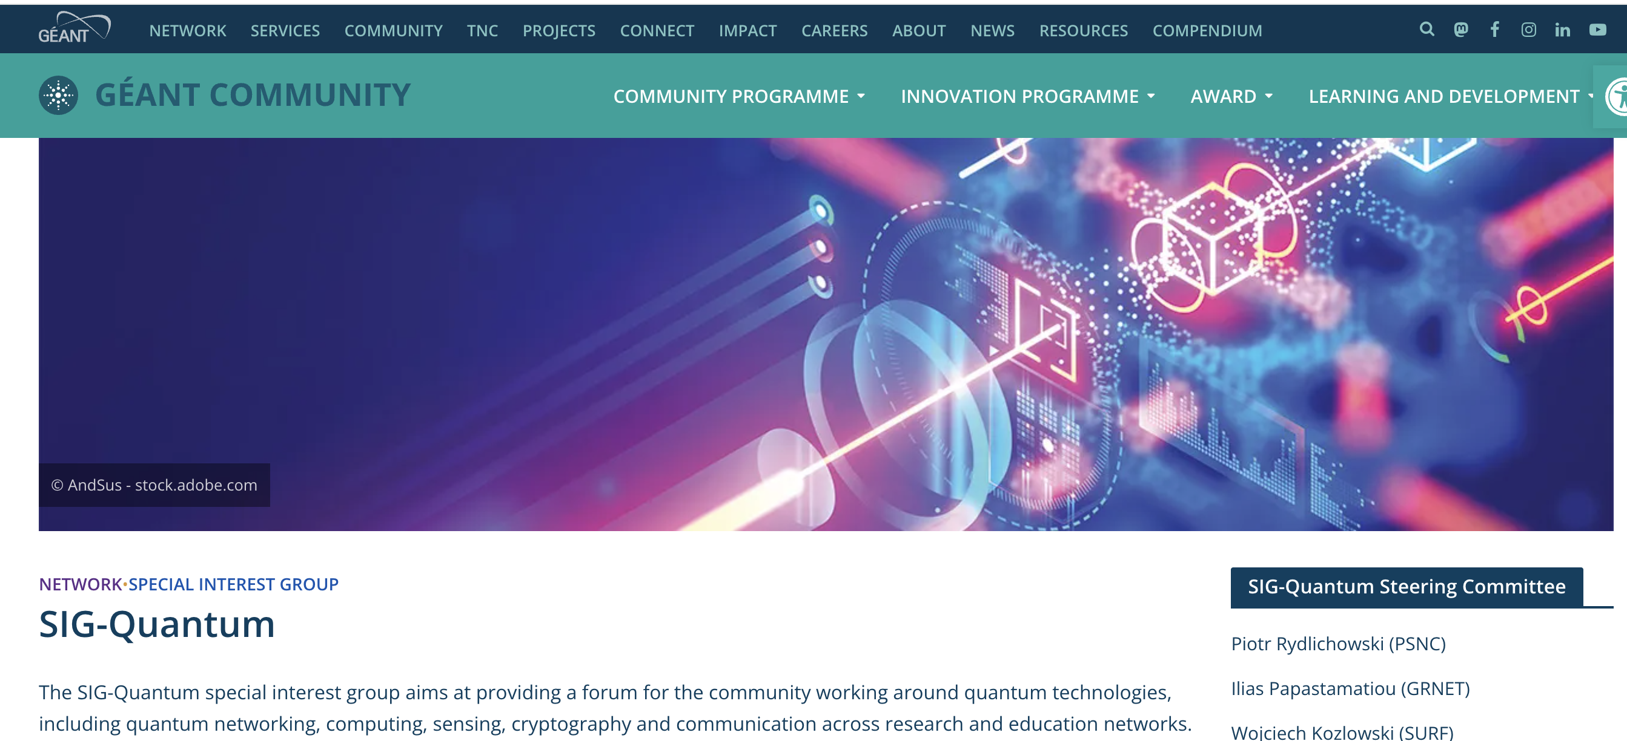
https://community.geant.org/sig-quantum/

Slide 4
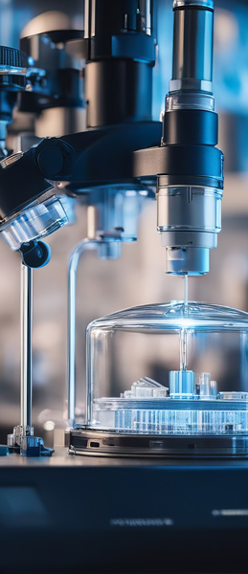
Introducing SIG-Quantum
What: Open forum for the diverse community engaged in quantum technologies, across Research and Education Networks (RENs).
A hub for the exchange of:
  Experiences
  Ideas
  Knowledge on the
    Development
    Deployment
    Testing
    Standardisation of quantum solutions.
Notes:
SIG-Quantum was launched in June 2025 at TNC25 in Brighton, as a collaborative forum to advance quantum technologies and shape the future of Research and Education Networks.

Slide 5
In scope
Focus Areas:
  Quantum networking
  Quantum computing
  Quantum sensing
  Cryptography and communication across Research and Education Networks (RENs).
Aiming at grouping:
  National Research and Education Networks (NRENs)
  Research institutes (worldwide)
  Vendors and commercial partners
  Members of the community with an interested in quantum technologies

Slide 6
Role of SIG-Quantum
Act as a hub for exchanging ideas, experiences, and knowledge.
Facilitate development, deployment, testing, and standardisation of quantum solutions.
Collaborate on designing a coherent quantum strategy for GÉANT.
Liaise with similar initiatives in GÉANT sister networks worldwide.
Lead evaluation and testing of quantum technologies in R&E networks.
Exchange, Facilitate, Collaborate, Liaise and Lead

Slide 7
Current Steering Committee - Coordination
NRENs:
  PSNC (Piotr Rydlichowski)
  GRNET (Ilias Papastamatiou)
  SURF (Wojciech Kozlowski)
International:
  ESNET (Inder Monga, QUANT-NET Lab https://quantnet.lbl.gov/)
Research:
  CERN Quantum Technology Initiative (Michele Grossi)
Coordination: Dom Vicinanza and Nadelina Sandu (GÉANT)

Slide 8
SIG-Quantum online meeting - 1 December 2025
Our first meeting! Aims:
Overview of current initiatives in quantum communication and networking
In addition:
  Create space for participants to share their interests and ideas.
  Set the foundation for future discussions and collaborations within the group.
  Start a discussion around use cases, opportunities for collaboration, next steps.

Slide 9
Agenda
15:00 - 15:10 | Welcome and Introduction - Domenico Vicinanza (GÉANT)
15:10 - 15:30 | Update from WP6T1 - Susanne Naegele-Jackson (RRZE)
15:30 - 15:45 | Quantum Computing for High Energy Physics: CERN perspective - Michele Grossi (CERN)
15:45 - 16:05 | Quantum Communications in Europe: EuroQCI Deployment and the HellasQCI Paradigm - Ilias Papastamatiou (GRNET)
16:05 - 16:20 | Coffee break
16:20 - 16:35 | From Hardware Pulses to Entangled Links: A Two-Level Control Design for Quantum Networking - Inder Monga (ESnet)
16:35 - 16:50 | Quantum Computing and Quantum Sensing - Piotr Rydlichowski (PCSS)
16:50 - 17:10 | Roundtable discussions
17:10 - 17:20 | Closing, meeting evaluation & feedback collection

Slide 10
Roundtable discussion
Two questions for everyone (on Menti):
  What are the most promising use cases for quantum technologies in the research and education network context?
  What should be the primary focus areas for SIG-Quantum in its first year, and how do we ensure alignment with GÉANT’s broader mission?
We’ll have
  5 min to reflect and provide an answer
  10 min discussion
  5 min wrap-up
Notes:
Even if today’s meeting was mostly aiming at sharing what’s happening in our community and setting a common ground for future discussion, we found it useful introducing an element of discussion, something to set the basis for our next meetings and help steering the SIG in the right direction.

Slide 11
Additional questions (please provide an answer in the next 7 days)
Where do you see the strongest opportunities for collaboration between national initiatives (like HellasQCI), global projects (like QUANT-NET)?
Based on today’s talks, which technical challenges (i.e. scalability, or integration with classical networks) should SIG-Quantum prioritise?
What concrete deliverables or milestones should we set for the next 6–12 months to build momentum and demonstrate value to the wider community?

Slide 12

Additional info or do you have a colleague who wants to join?
For more information about SIG-Quantum and how to get involved, visit: https://wiki.geant.org/display/SIGQ/SIG-Quantum+Homepage
Join SIG-Quantum

Slide 13

Thank You!
Let’s stay in touch!
dom.vicinanza@geant.org
www.geant.org

