Slide 1


17th Special Interest Group
on Cloud Interoperable Software Stacks (SIG-CISS)
An introspective discussion on the SIG-CISS itself
Mark van de Sanden
Senior Manager (Data & Research) – GÈANT
March 16, 2026 - Oslo
Public (PUB)
GN5-¹2
Confidential

Slide 2
Agenda
14:00 - 15:45 Session 1
Introduction (& history)
Setting the scene
Round the table discussion:
  What are you working upon today ?
  What so you think it’s relevant for the SIG ?
  What do you think the SIG should help coordinate ?
Coffee break
16:15 - 18:00 Session 2
What are interesting topics?
Where are these topics discussed?
And what could be the role of the SIG-CISS?

Slide 3
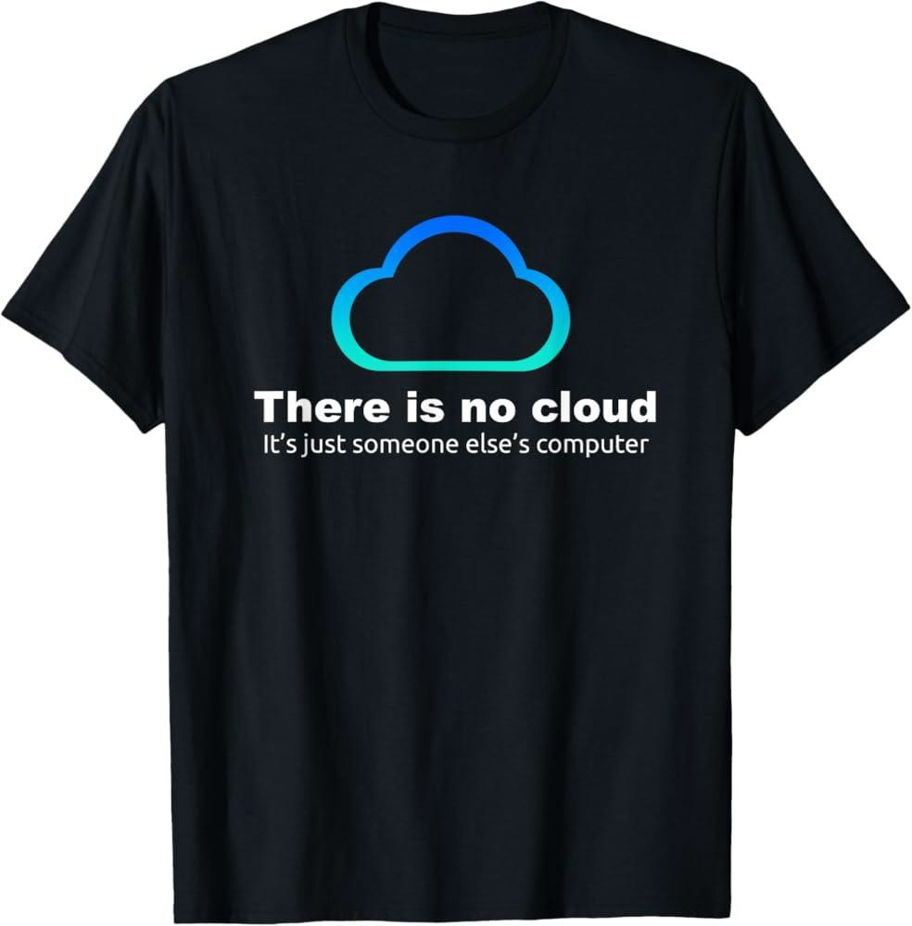
Welcome Everybody
to SIG-CISS #17 !
GN5-2
Workshop jointly organised by GÉANT and the University of Oslo
What should be the focus of the SIG-CISS
and what should be the activities?
an introspective discussion
Confidential
2

Slide 4
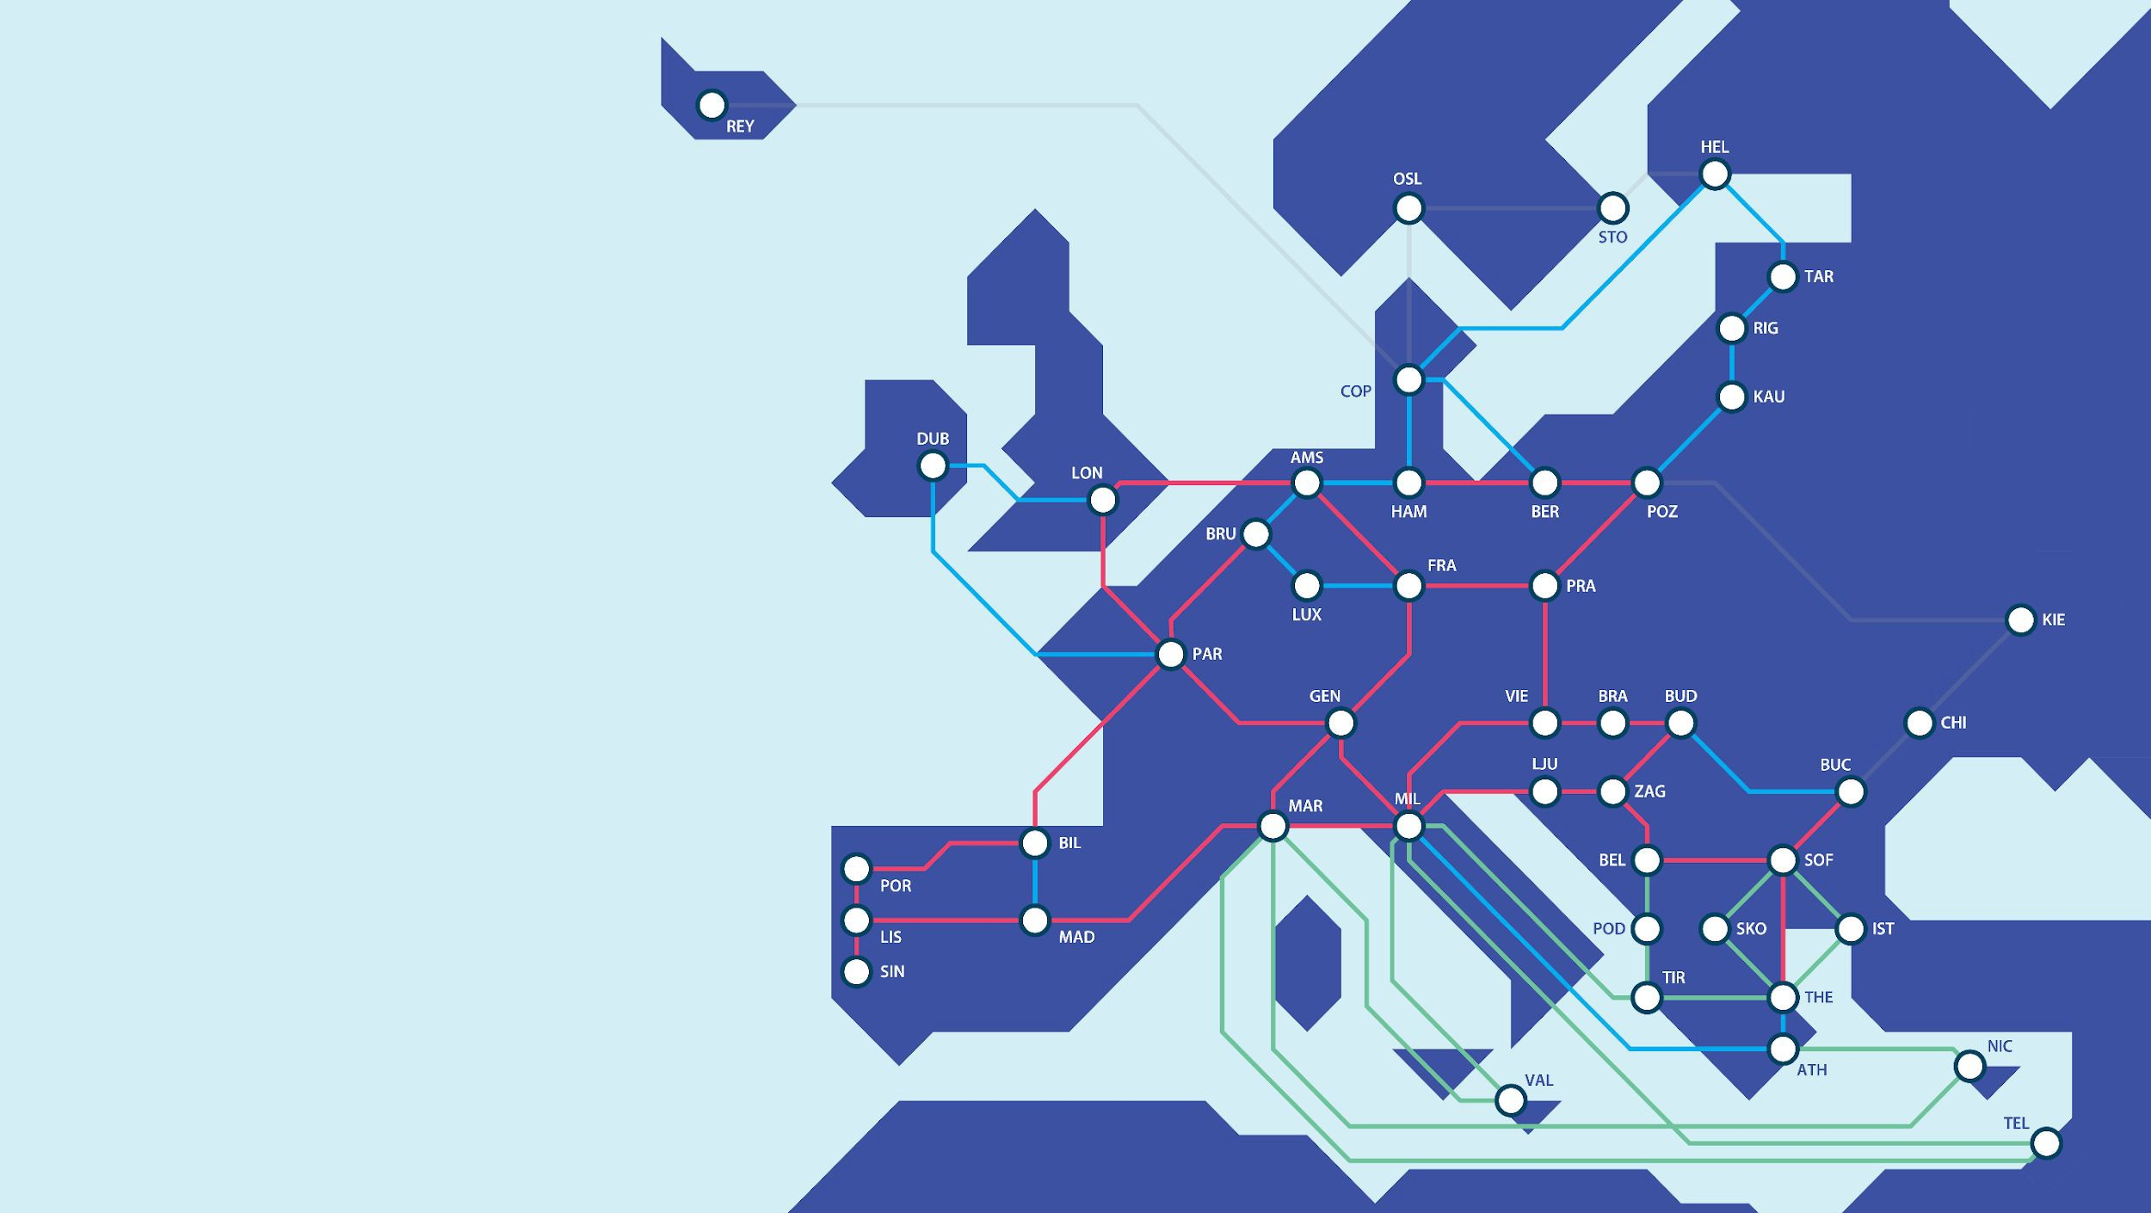
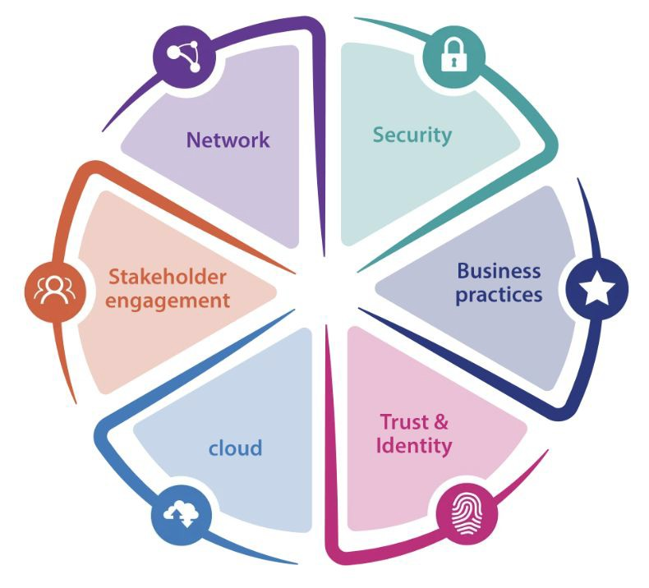
GÉANT Vision
3 |
GN5-2
To collaborate to deliver the infrastructures and services that enable the R&E community to excel.
GÉANT Community Programme:
https://community.geant.org
Confidential

Slide 5
What have we been focusing on at the last SIG events
7 |
GN5-2
SIG-CISS | Topic | Location | When
#16 | Storage Federations, Data and Global Data Infrastructures | Bologna | December 2025
#15 | How do NRENs implement Infrastructure-as-Code | Munich | March 2025
#14 | Handling/managing sensitive data through the Cloud, building Trusted Research Environments and Secure Processing Environments | Rennes | June 2024
#13 | Liaising with other GN5-2 WPs and tasks about plans / strategy / goals Updates from CS3 community | Geneva | March 2024
#12 | OpenStack deployment, management, monitoring, accounting - to provide Computing and Storage services | Zurich | November 2023
#11 | Joint workshop with GÉANT Cloud Frameworks | Tirana | June 2023
#10 | Focused on cloud technologies | Barcelona | March 2023
Confidential

Slide 6
SESSION 1
14:00 - 15:45 Session 1
Introduction (& history)
Setting the scene
Round the table discussion:
  What are you working upon today ?
  What so you think it’s relevant for the SIG ?
  What do you think the SIG should help coordinate ?

Slide 7
SESSION 2
16:15 - 18:00 Session 2
What are interesting topics?
Where are these topics discussed?
And what could be the role of the SIG-CISS?

Slide 8
The WORLD is changing
GN5-2
Confidential

Slide 9
European Data Strategy
The WORLD is changing
Can be summarised to:
Increase the availability and reuse of data across the EU;
Establish trustworthy governance rules for access to and sharing of data;
Support innovation, including AI, through access to high-quality data and digital infrastructure; and
Strengthen the EU’s competitiveness and strategic autonomy in the data economy
Main legislative and policy instruments
Data Act = access to and use of data
Data Governance Act = trust and governance for sharing
FFD Regulation = free movement of non-personal data
Open Data / High-Value Datasets = re-use of public-sector information

Slide 10
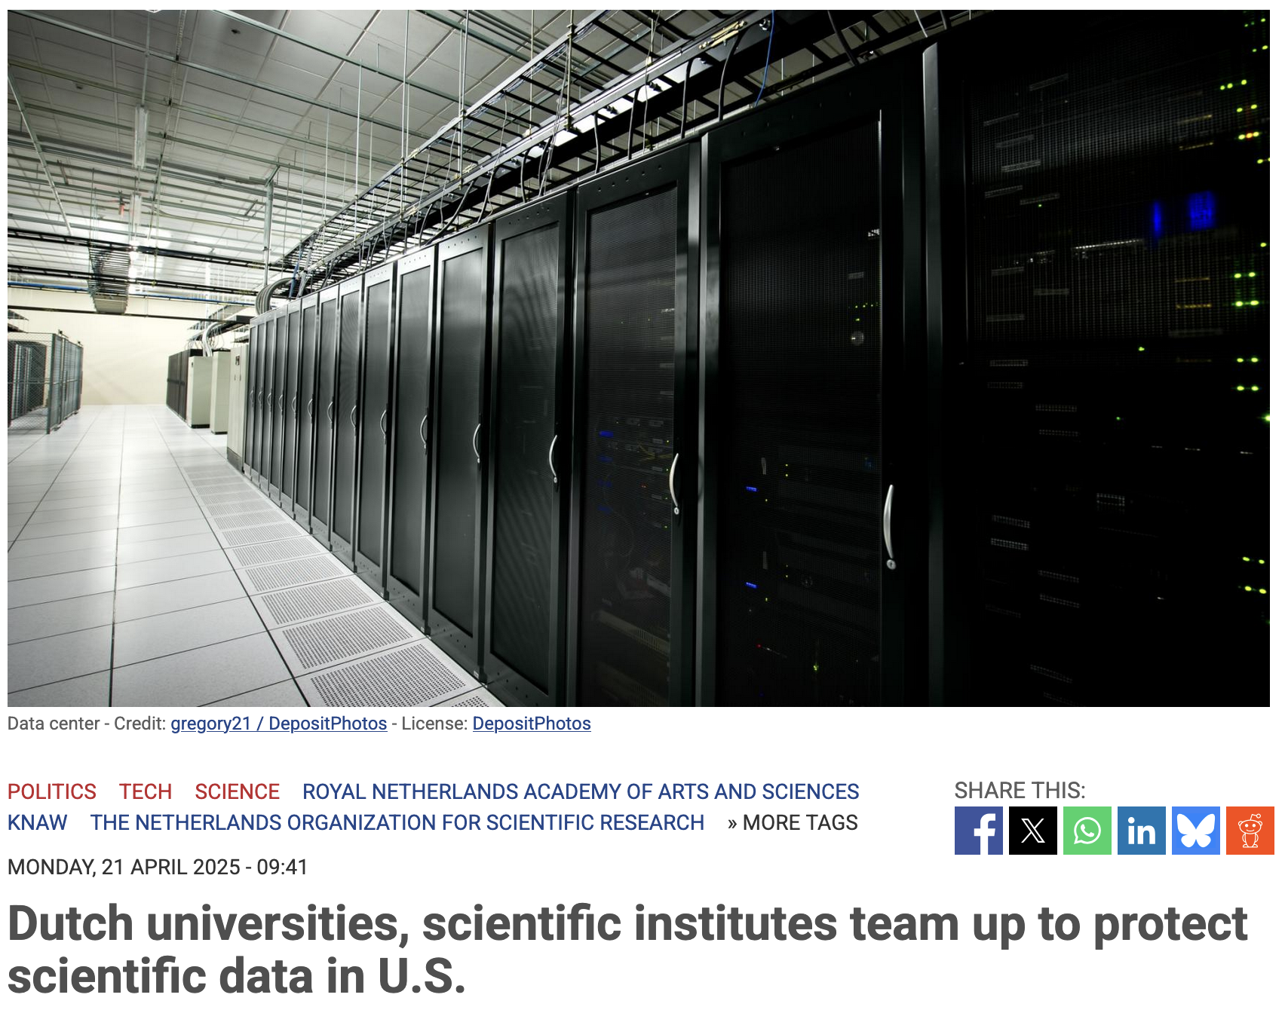
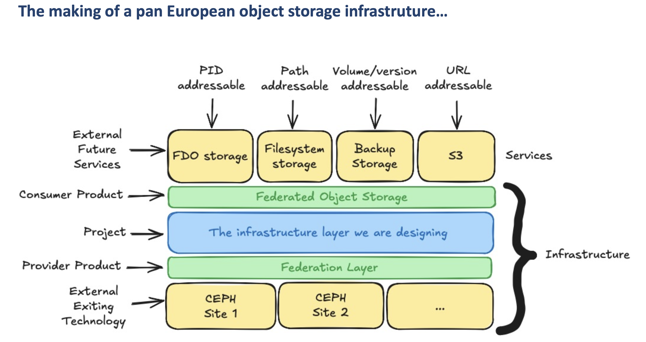
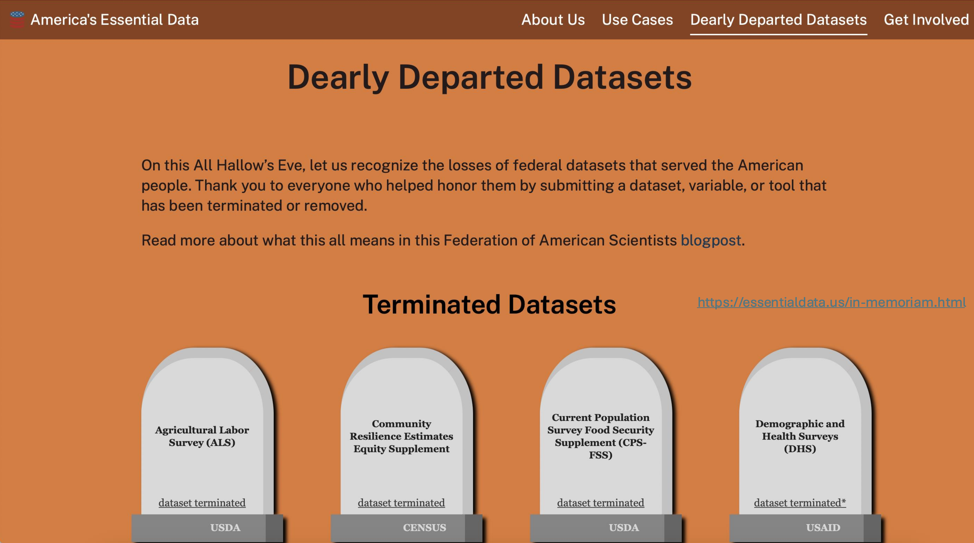
Sovereign European data layer
The WORLD is changing
Due to changing geopolitics, there is much emphasis on European sovereignty
Status in the US is dramatic, datasets are terminated, tools are discontinued, experts are laid off
European initiatives to rescue research data to ensure continued access
Aim is to provide sovereign research data repositories better and cheaper low-level storage by leveraging pan-European economies of scale
Leverage the capabilities and strengths of NRENs
Develop a scalable object storage layer
  GN5-2 T4.3 Pan-European Sovereign Research Data Object-Storage
  GN5-2 Incubator projects: SAGE, Pan ES3
Enterprise File Sync & Share Federation
  EOSC Federation build-up group on EFSS
  EOSC4ALL proposal
Source: EOSC Symposium 2025, keynote Shelly Stall (Vice President AGU)

Slide 11
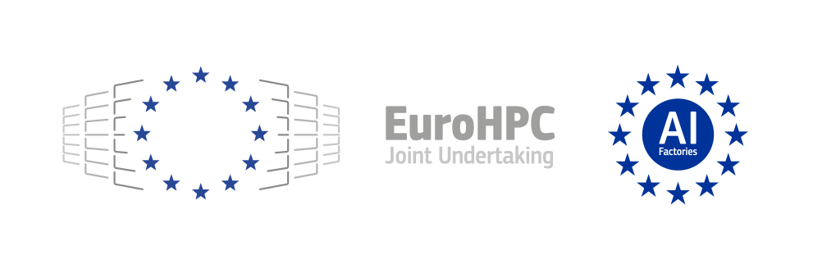





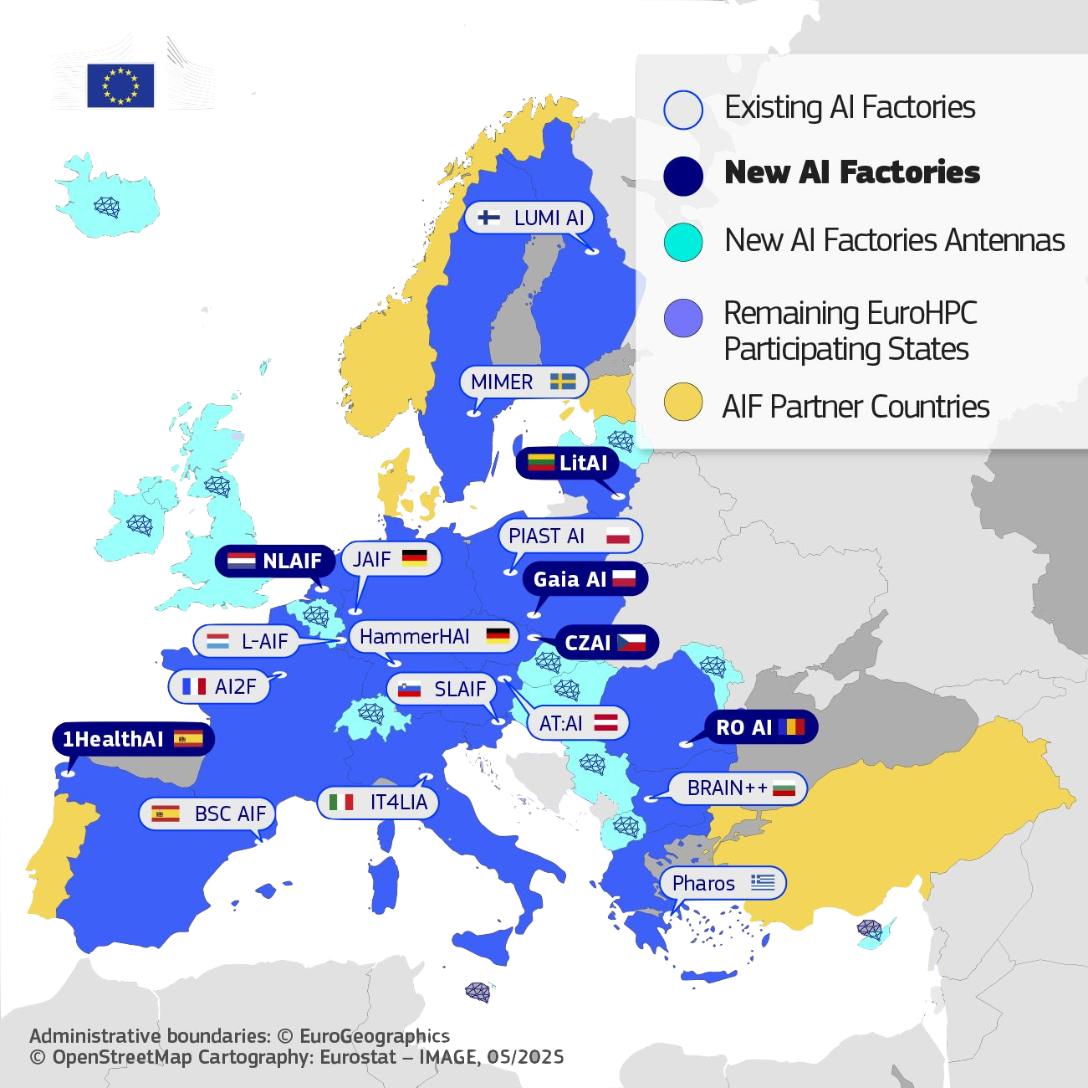




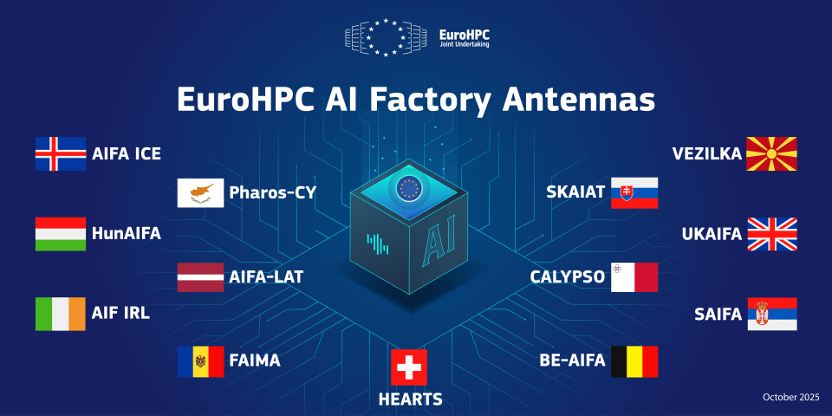


Why data movement is important
The WORLD is changing
European level
Move
Data
Move data from National Nodes cross-border to facilities offered by other Nodes
Move
Data
Scale up from national to EU level
Move
Data
National level
Snellius
Move data from institutional
Repositories to national facilities for processing
Move
Data
Scale up from institutional to national facilities
Move
Data
Institutional level

Slide 12
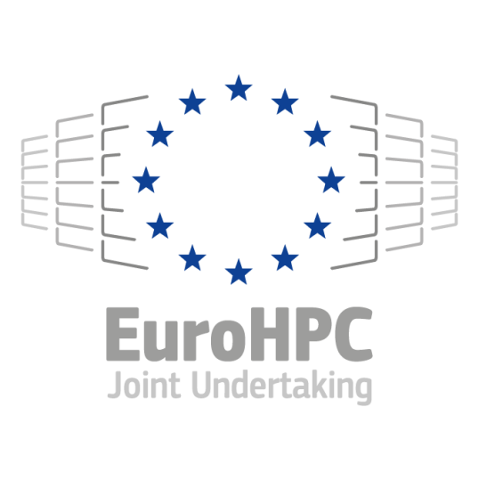
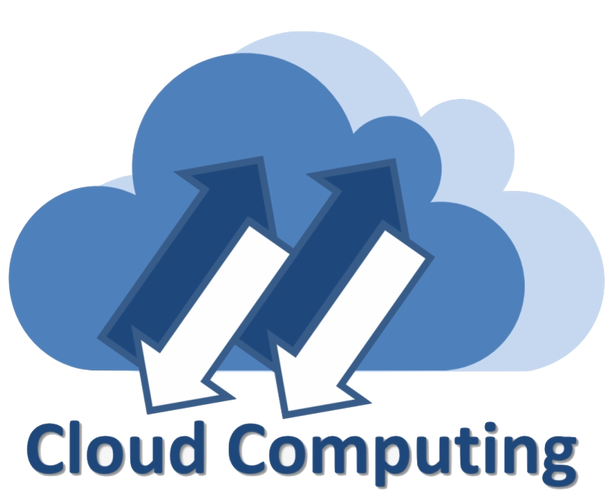

How to build the European data layer
European Sovereignty
What are NRENs doing?
Where can GEANT contribute?
How can we leverage collaborations with other e-infrastructures?
Scientific workflows
Data movement/orchestration workflows
EFSS
Site 1
EFSS
Site 2
EFSS
Site …
FDO
S3
Back
up
Archive
MSCR
TSs
KGs
PIDs
OCM
Data
Source 1
Data
Source 2
Data
Source …
Federated object storage layer
CEPH
Site 1
CEPH
Site 1
CEPH
Site 3
CEPH
Site 4
CEPH
Site 5
CEPH
Site …
MSCR = Metadata Schema and Cross-walk Registry
TSs = Terminology Service
KGs = Knowledge Graph
PIDs = DOI, Handle, ORCID, …

Slide 13
CURRENT SITUATION
FRAGMENTATION
  Multiple things are being addressed in multiple places and contexts/projects
LACK OF COORDINATION
  projects are being implemented with a limited temporal scope and focus; role of EOSC nodes not fully clear in the context of building a sovereign, pan-EU infrastructure for research/EOSC
SUSTAINABILITY
  how to build a system that can sustain itself on the long term ?
ROLE OF NRENS
  Are NRENs really joining forces and coordinating actions in this respect ?

Slide 14
The original charter (2018), ToR and goals for the SIG-CISS 1/2
GN5-2
Gathering and exchanging experiences, ideas and knowledge on the development, deployment, testing and standardisation of cloud infrastructure software stacks, platforms and workflows
To share deployment and operations best practices about all the pillars of the cloud infrastructure
Be the primary community forum in the confluence of computing, storage and networking
Leverage the existing focus groups including CS3 (CERN) on sync&share and storage and OSO (SWITCH) on Infrastructure-as-a-service and OpenStack Operations
To improve awareness of software and hardware solutions available on the market and infrastructures, platforms and services provided by NRENs in the area of (federated) cloud computing, IaaS, PaaS, SaaS, data storage, management, automation and big data, and act as a launch pad for joint procurements and/or brokering thereof as appropriate and necessary
To help identify current and future requirements and workflows of the scientific/academic community related to computing, storage, data management infrastructure, platforms, services and applications as well as preparing NRENs to address these needs
Confidential

Slide 15
The original charter (2018), ToR and goals for the SIG-CISS 2/2
GN5-2
Disseminate about local developments and specific technical solutions and feedback them upstream to the main branch of open-source projects
Leverage the critical mass of the Research and Education community to steer and lobby/provide useful feedback to all key stakeholders around us:
  Large open-source Cloud IT projects and platforms
  European Commission and the EU regulations impacting on the providers and consumers of Cloud services in the Academia
  Large public cloud providers
Support and adopt interoperable solutions based on community adopted standards, enabling to scale up and integrate multi-domain resources
To provide an interface among operators and owners of the cloud computing and storage infrastructure (IT experts) and the actual users i.e. individuals, academic institutions, communities and collaborations (domain experts), that enables mutual understanding of needs and capabilities as well as challenges and opportunities
  To define, stabilise and promulgate mutually agreed upon APIs as exported by NREN cloud stacks, preferably global recognised APIs that cloud users can rely on to build their use case upon, and be guaranteed that their use case will in fact work, and be as portable as possible among NRENs
Confidential

Slide 16
QUESTIONS
What are interesting topics?
Where are these topics discussed?
And what should be the role of the SIG-CISS?

Slide 17

sig-ciss@lists.geant.org
Thank You
www.geant.org
10
Confidential

