Slide 1

FOSTER & OpenAIRE training and learning resources on Open Science and Research Data Management
Iryna Kuchma, EIFL
EaPConnect's OpenAIRE Training| Kyiv | June 5th, 2019

Slide 2










Open Science courses to re-use
What is Open Science? | Best Practice in Open Research | Open Access Publishing | Open Peer Review | Sharing Preprints
Data Protection & Ethics | Open Source Software & Workflows | Managing & Sharing Research Data | Open Science & Innovation | Open Licensing
https://www.fosteropenscience.eu/toolkit

Slide 3


Open Science courses
Answering burning questions of researchers
Where relevant, discipline specific examples (CRG, GESIS, DARIAH-EU)
Interactive content (gamification, quizzes)
Reviewed by community
https://www.fosteropenscience.eu/toolkit

Slide 4
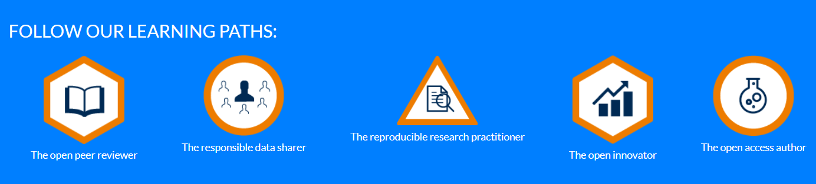
Badges
5 learning paths
Effort 2-4 hours
Complete a set of courses & get a badge
https://www.fosteropenscience.eu/learning-paths

Slide 5











Learning paths
The Reproducible Research Practitioner
The Open
Peer Reviewer
The Open
Access Author
https://www.fosteropenscience.eu/learning-paths

Slide 6
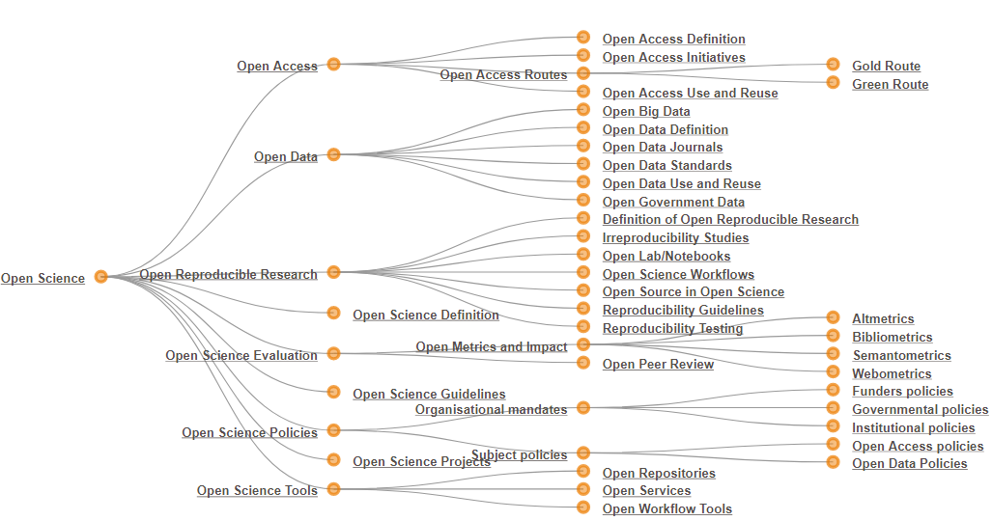
Materials to re-use
Paper available at http://oro.open.ac.uk/44719/. Image available at http://oro.open.ac.uk/47806/

Slide 7
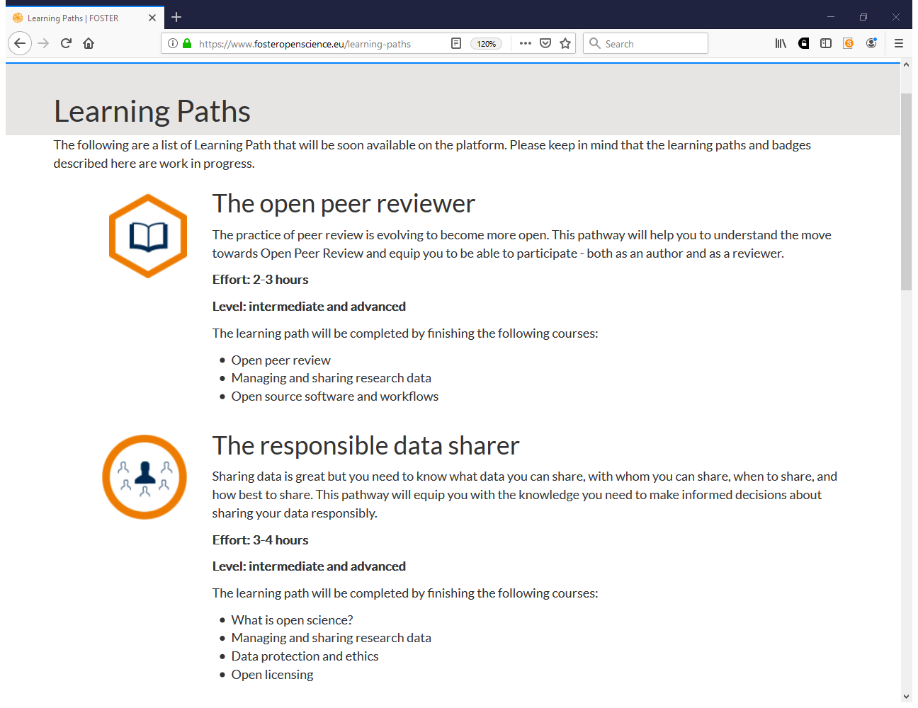

Slide 8
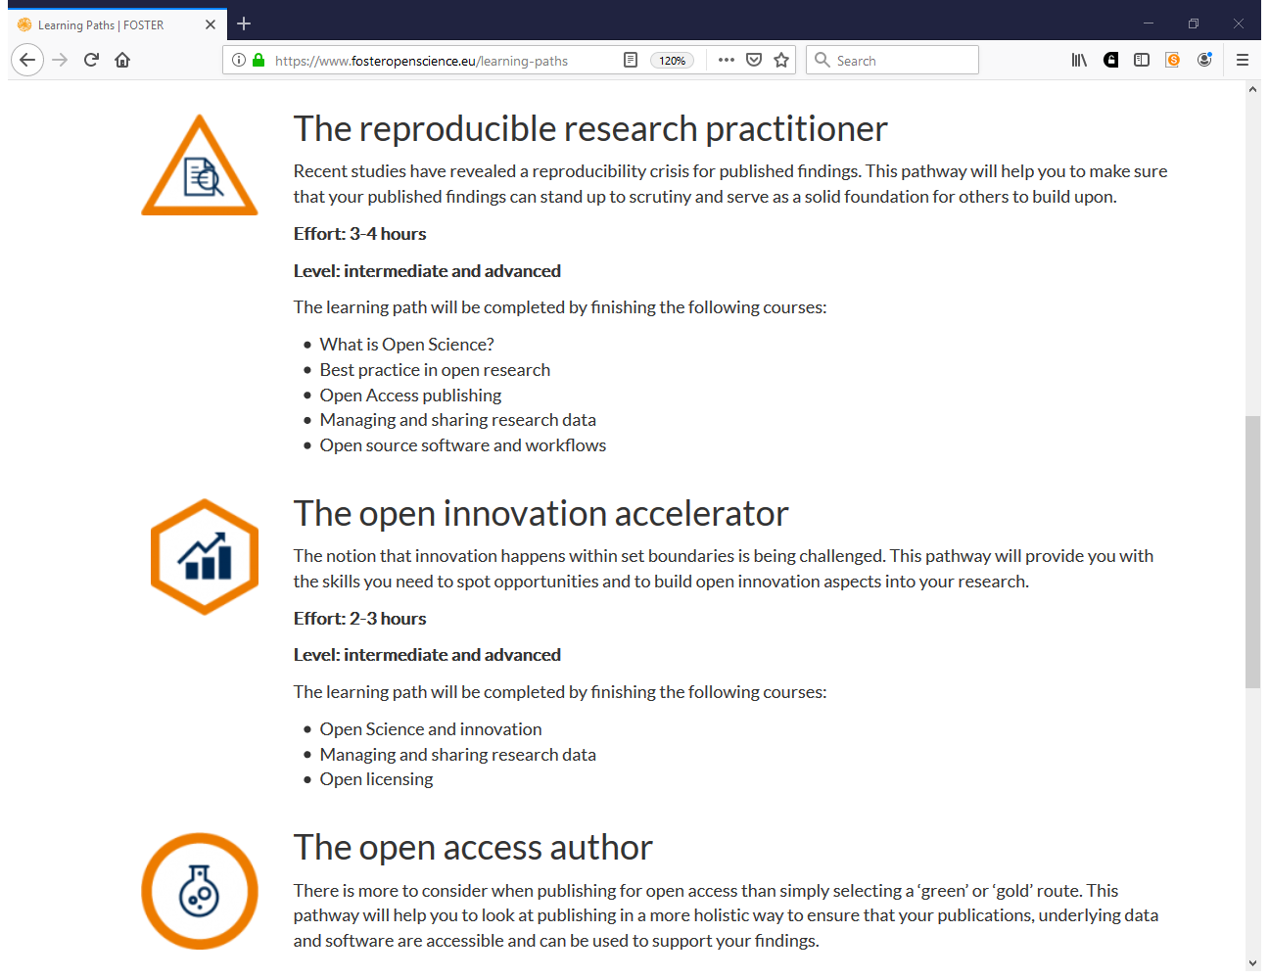

Slide 9
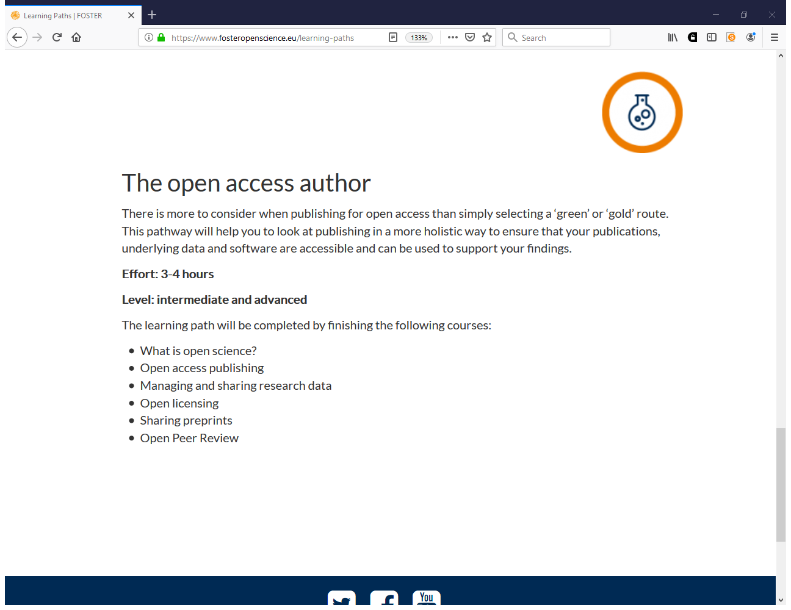

Slide 10





Open Science Training Handbook
Open Science Basics
Open Science Policies
Open Access to Published Research Results
Open Concepts & Principles
Open Licensing & File Formats
Open Research Data & Materials
Open Peer Review, Metrics & Evaluation
Reproducible Research & Data Analysis
Open Research Software & Open Source
Open Education Resources
book.fosteropenscience.eu
Notes:
Collaborative Platforms
Citizen Science
Open Advocacy

Slide 11

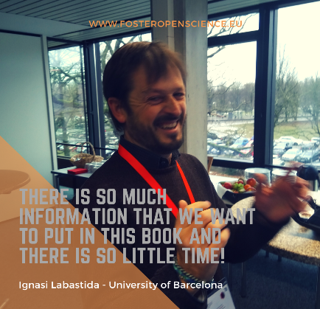



Open Science Training Handbook
What is it?
Further resources
Why is it important?
Questions, obstacles, & common misconceptions
Learning objectives to achieve
Key components: Knowledge & skills
book.fosteropenscience.eu

Slide 12

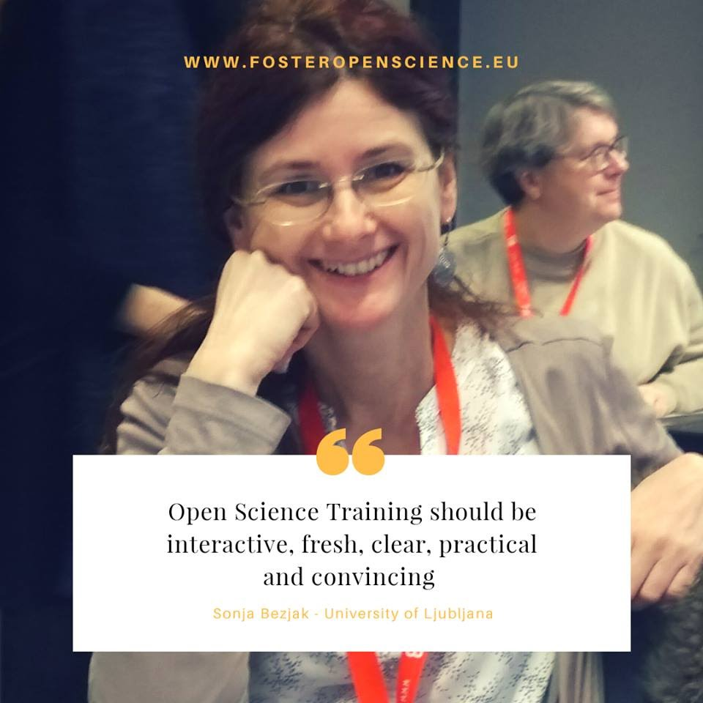
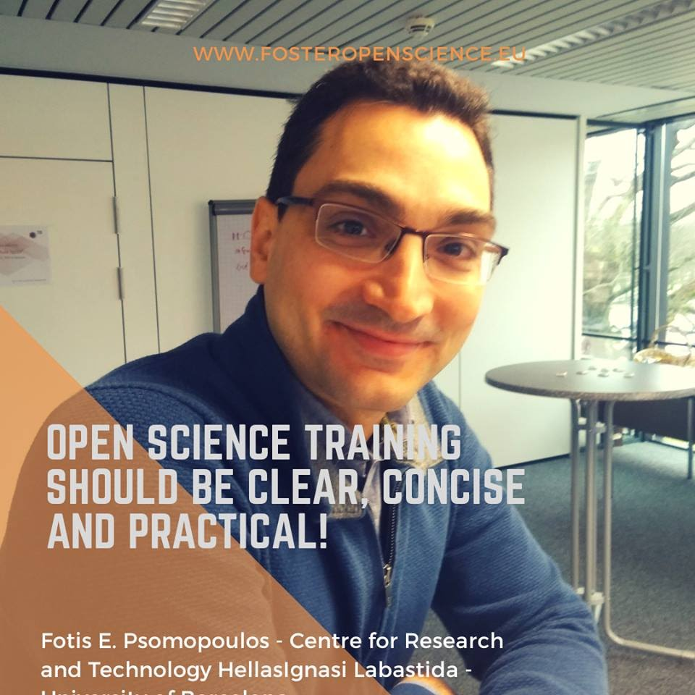
Organisational Aspects
On Learning and Training
How to
Prepare your workshop
  Theoretical learning strategies
  Different audiences
  Strategies to develop motivation
Execute your workshop
  How to design a course
  How to choose content
  How to start training
& reflect on your workshop
  Aspects to evaluate
  Venue
  Timing & budget
  Equipment & media
  Marketing & advertising strategy
  Registration
  Evaluation
  → Check list
Notes:
Methods & organisational aspects

Slide 13

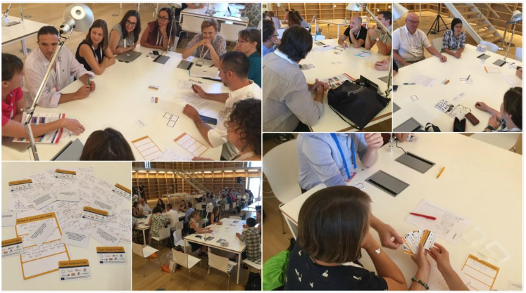
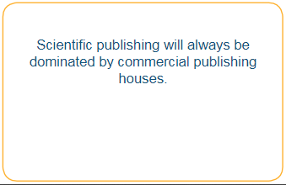
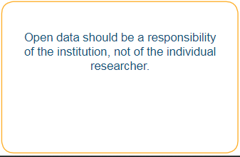
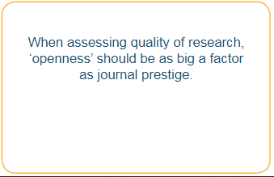
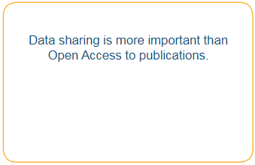
Example training outlines
24 exercises:
  Format, time needed, topic, learning objectives, description, materials needed, level of prior knowledge, how to adapt
Open Science Café
  Enable low-threshold discussion and dialogue between different stakeholders
CC BY Martine Oudenhoven
www.fosteropenscience.eu/content/organise-your-own-open-science-cafe

Slide 14
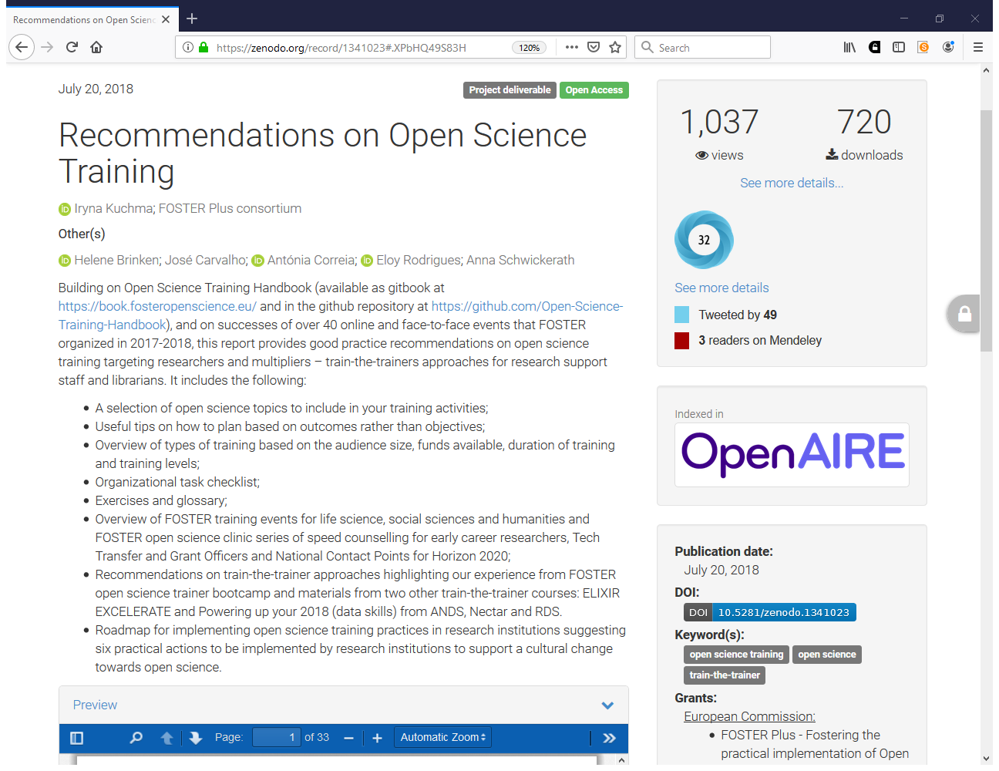
https://zenodo.org/record/1341023#.XPbHQ49S83H

Slide 15
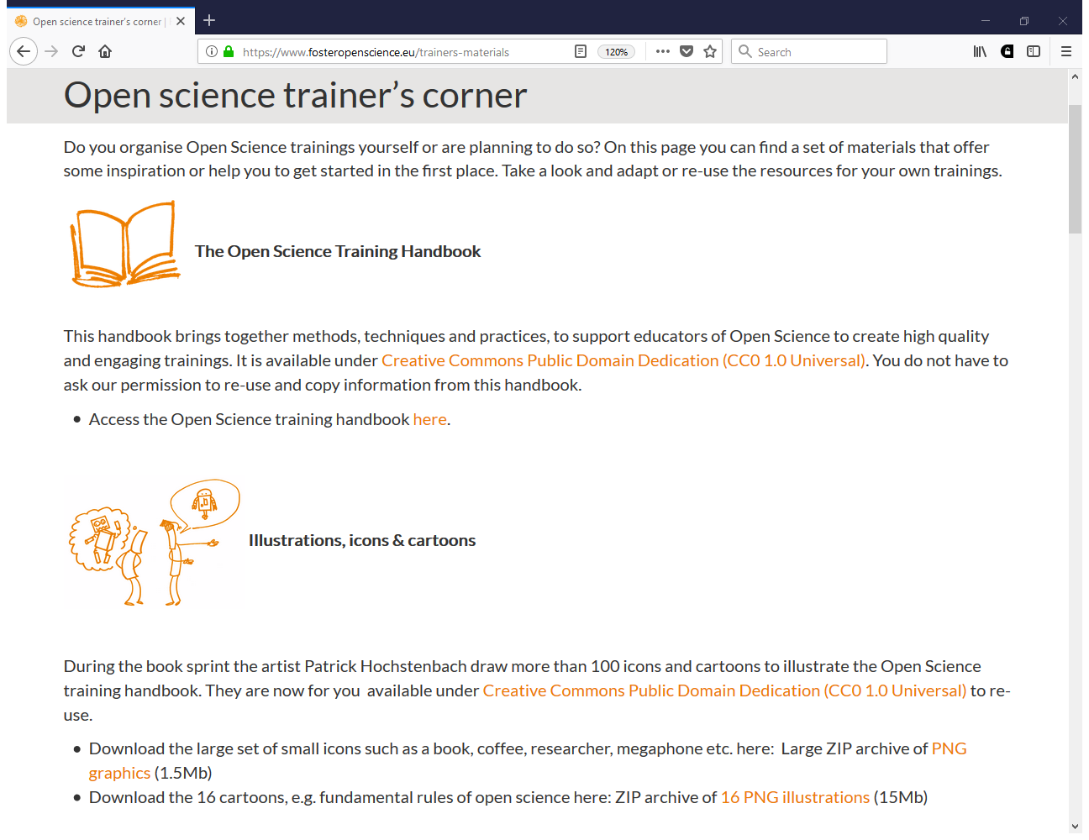
https://www.fosteropenscience.eu/trainers-materials

Slide 16
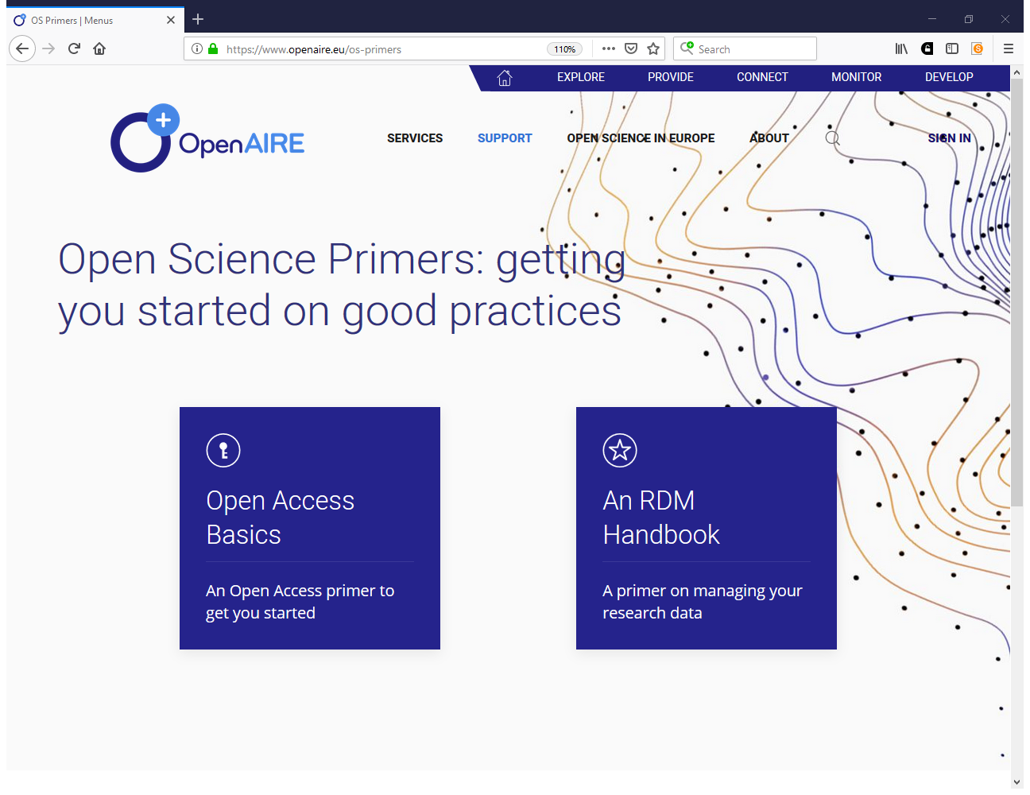
https://www.openaire.eu/os-primers

Slide 17
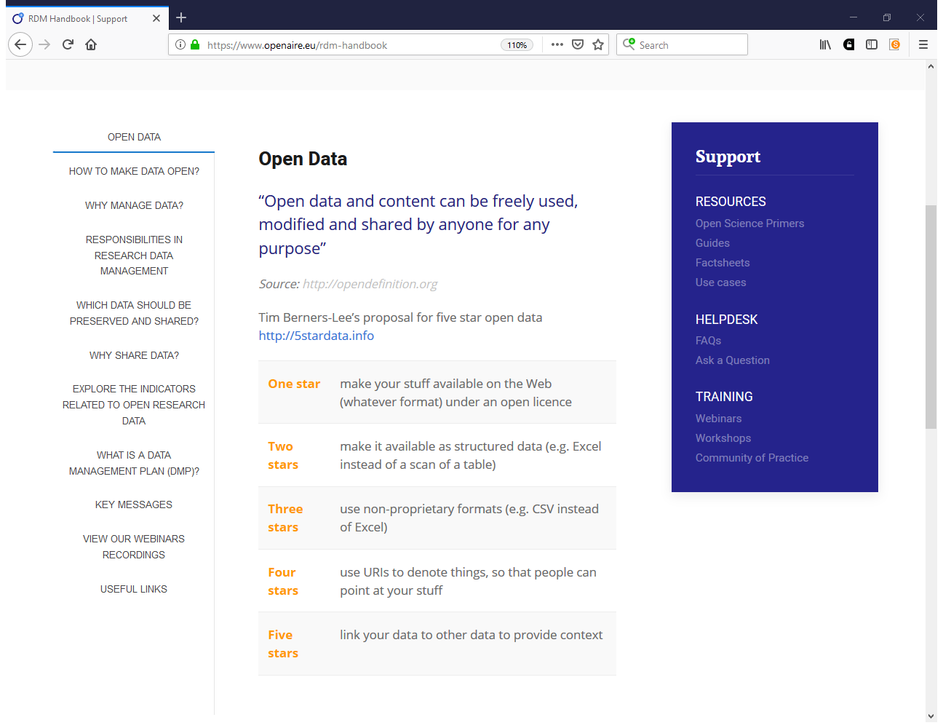
https://www.openaire.eu/rdm-handbook

Slide 18
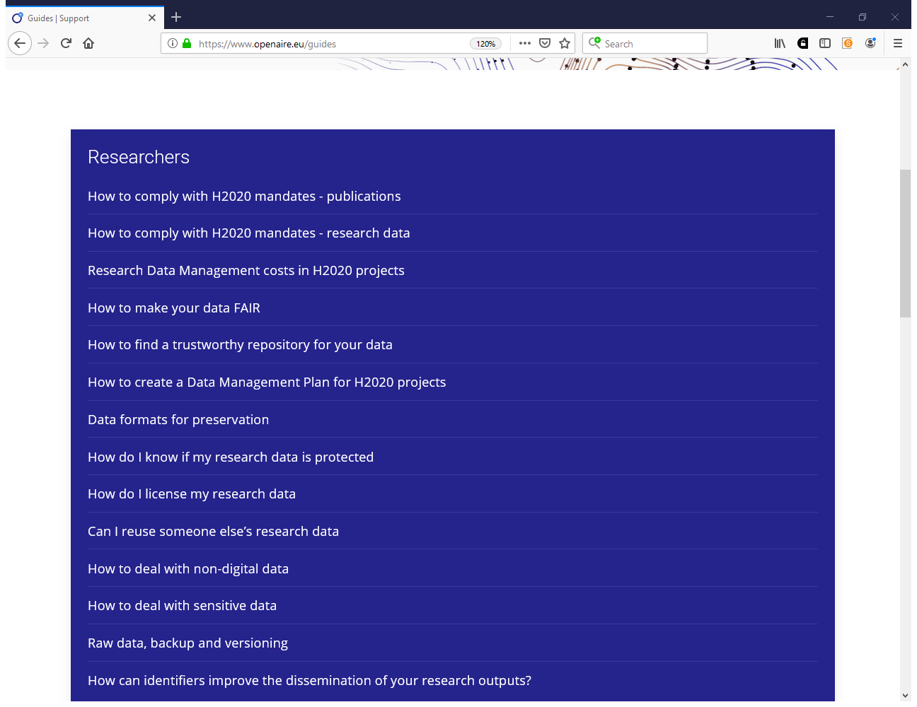
https://www.openaire.eu/guides

Slide 19
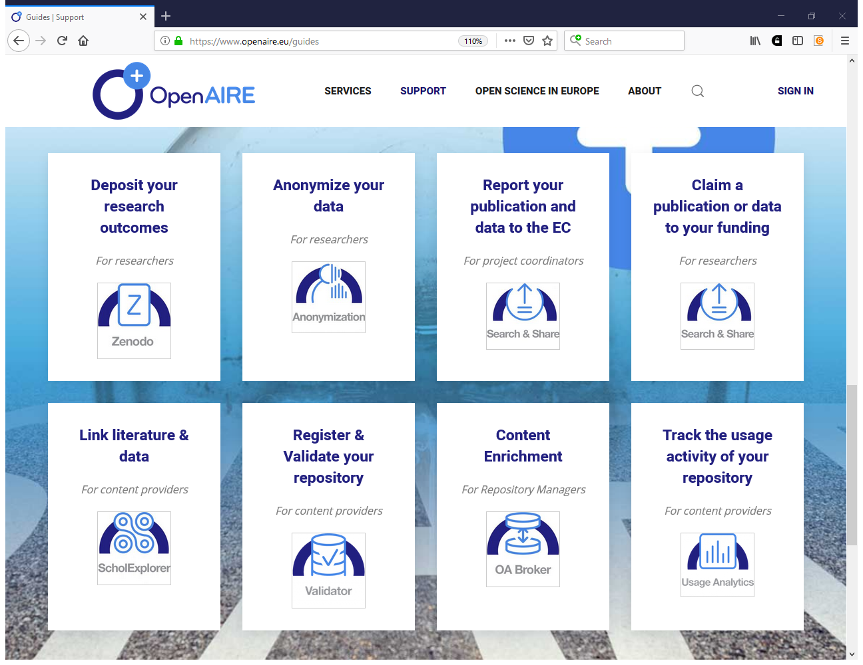

Slide 20
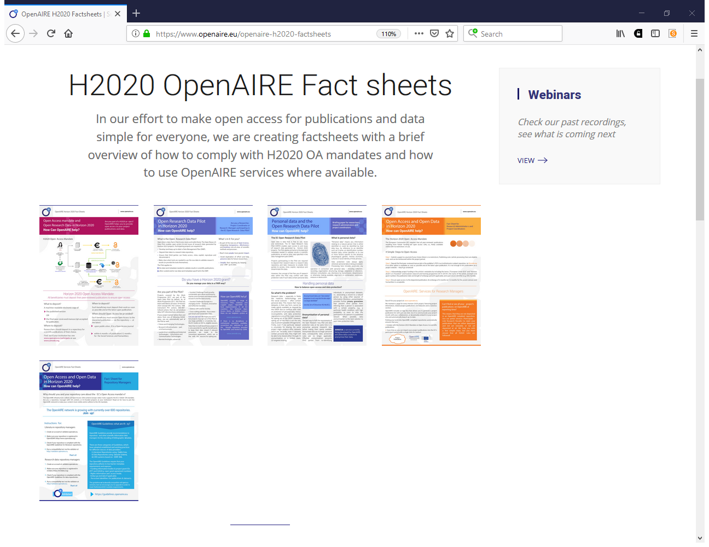
https://www.openaire.eu/openaire-h2020-factsheets

Slide 21
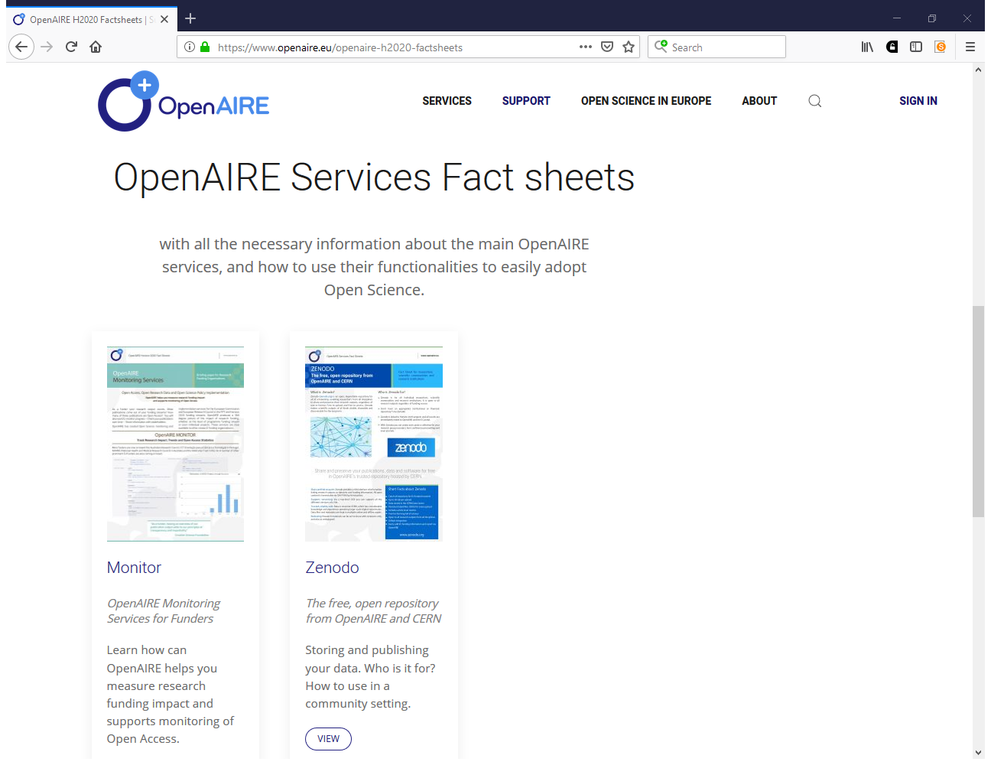

Slide 22
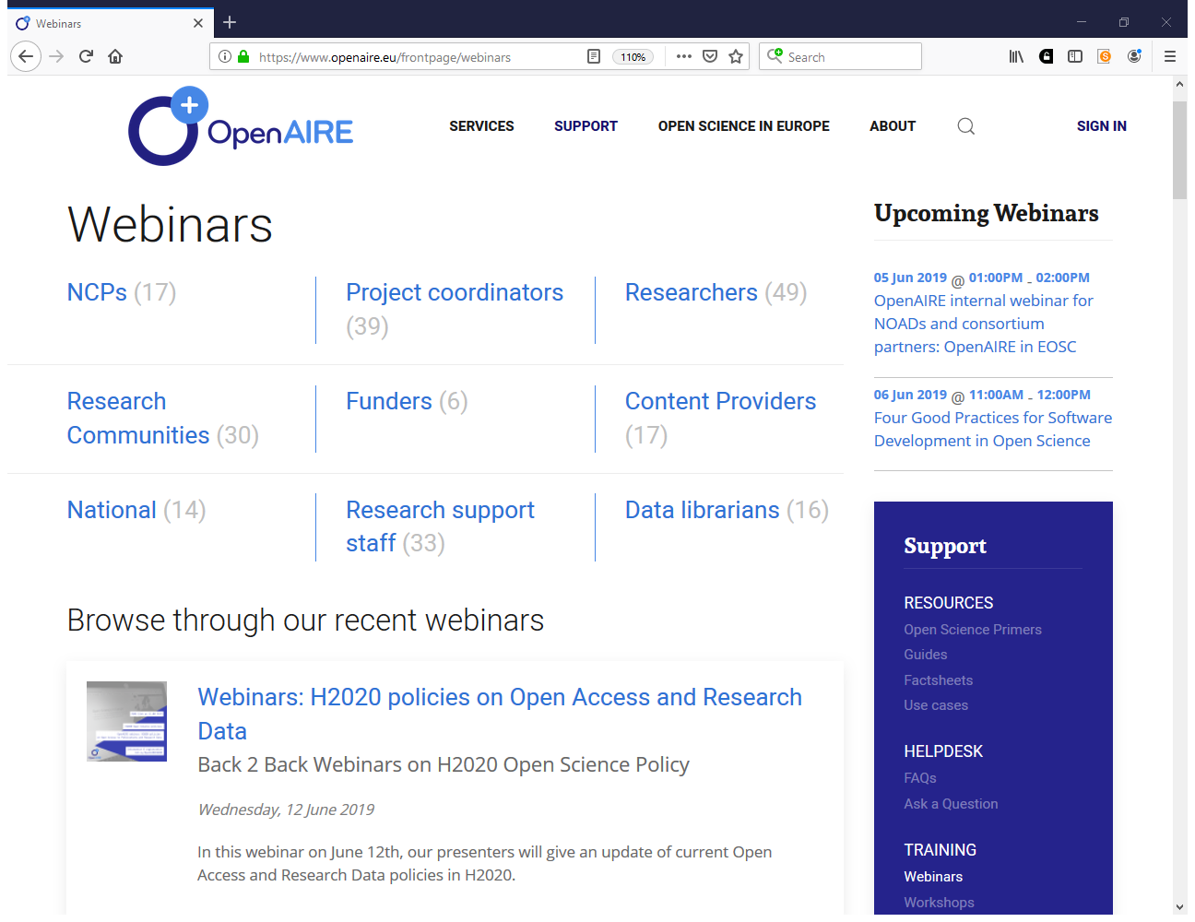
https://www.openaire.eu/frontpage/webinars

Slide 23
Iryna Kuchma
iryna.kuchma@eifl.net

