Slide 1



OpenAIRE Monitor
The OpenAIRE Research Graph and Monitoring Dashboards
Paolo Manghi
Institute of Information Science and Technologies - CNR
Iryna Kuchma
EIFL
Notes:
Paolo Manghi is the technical director of OpenAIRE

Slide 2
Monitoring Tools

Slide 3


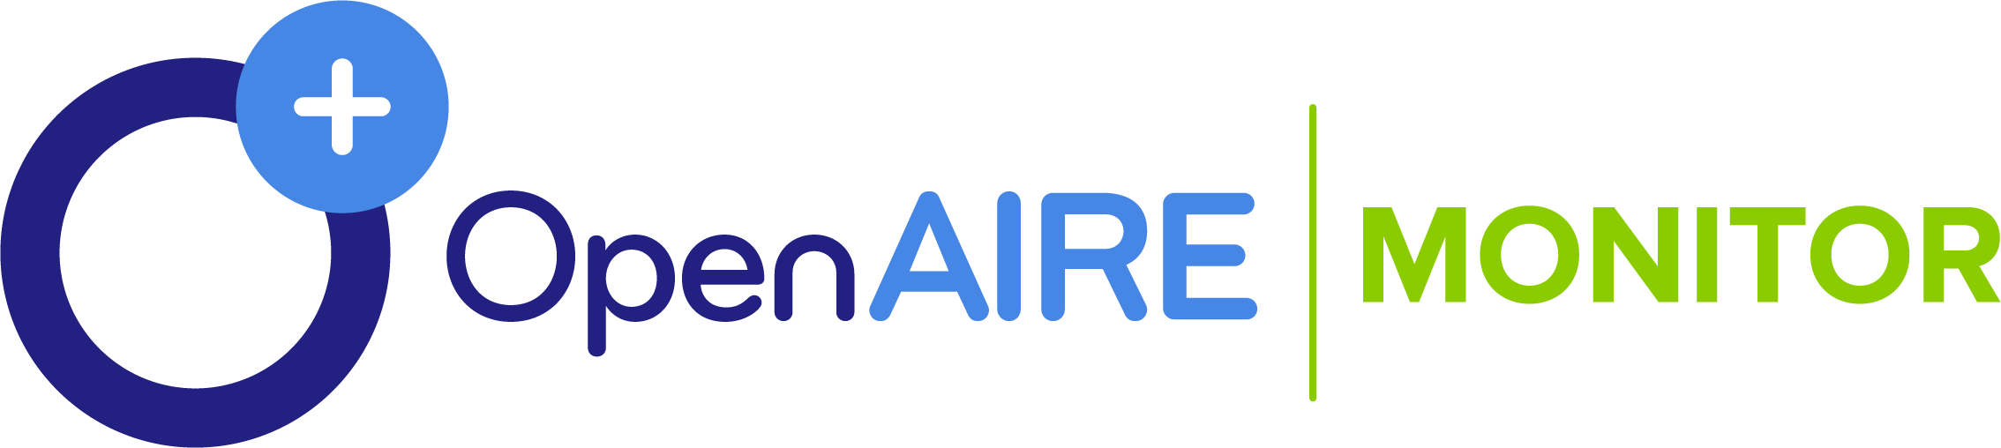



OpenAIRE Open Science Monitoring
Research impact
Research admins
Funders
Open Access/Science trends
Research Organization
Research communities

Slide 4
Funder Dashboard
(Project dashboard)

Slide 5
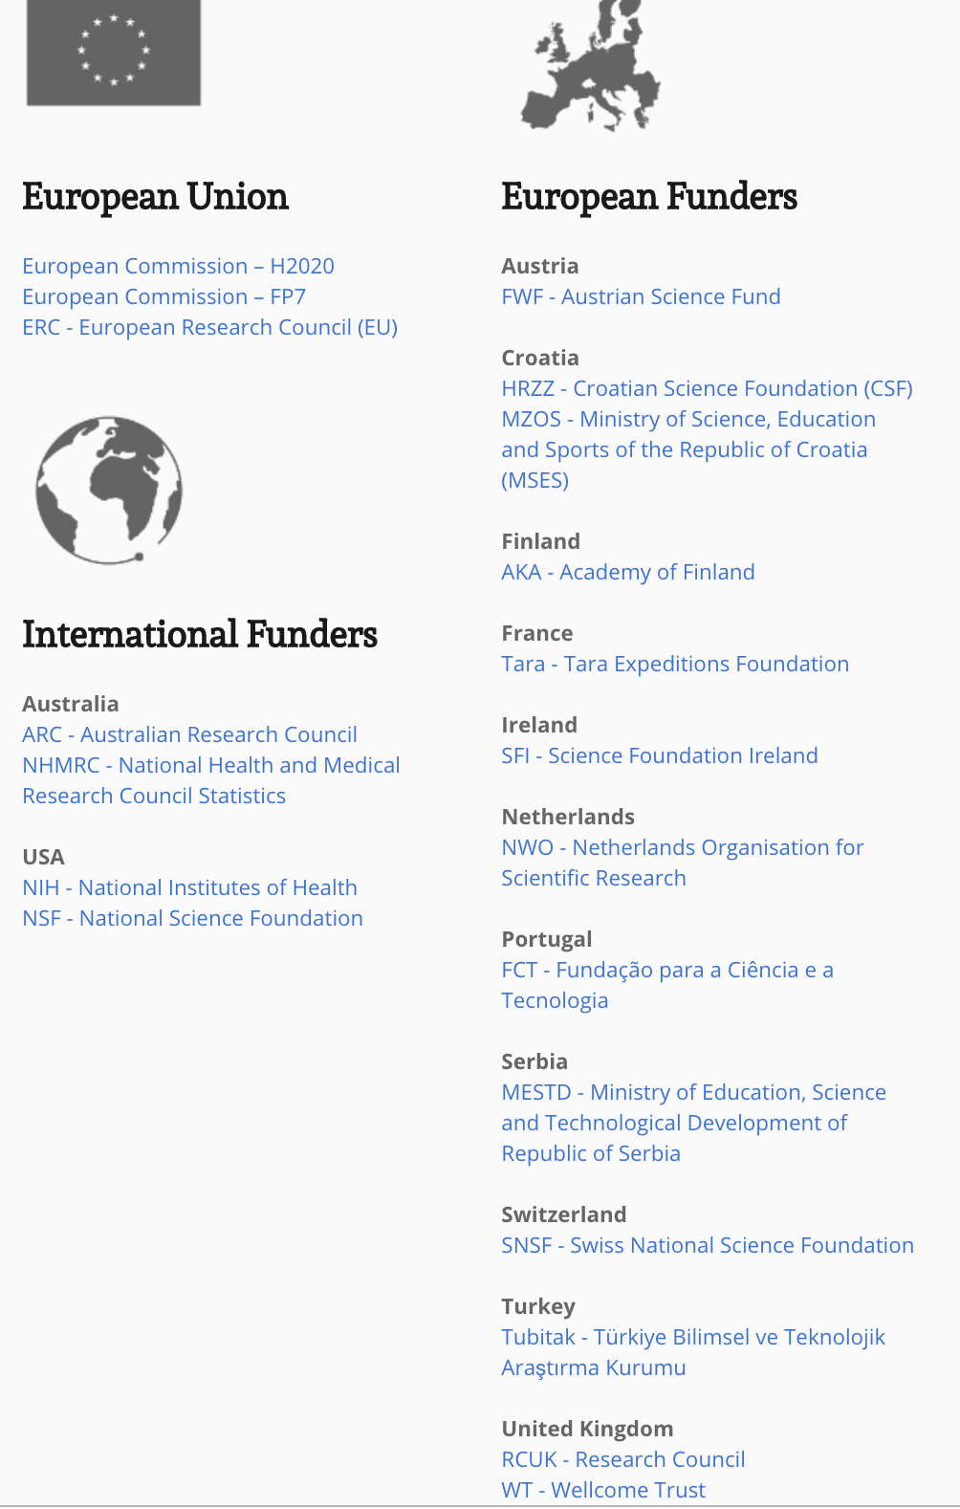
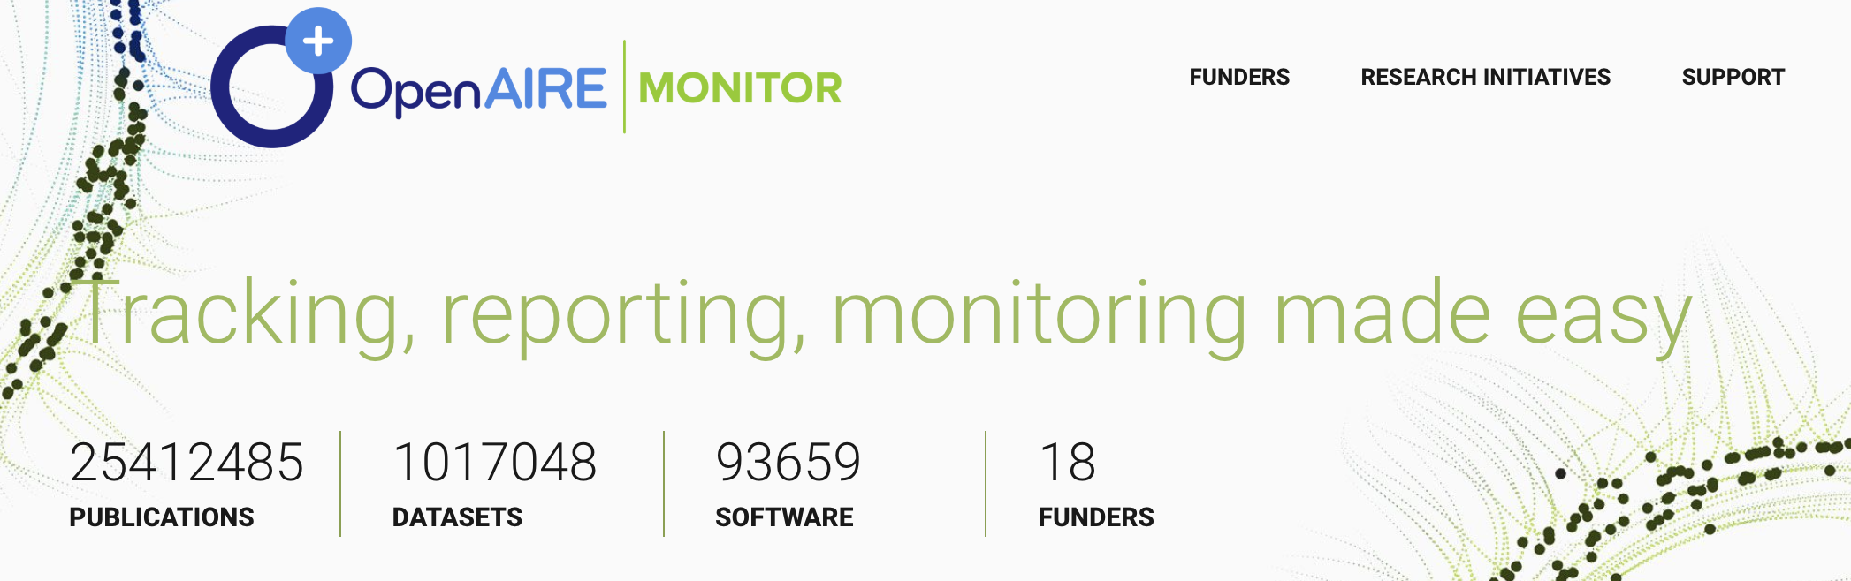

Slide 6
Aims
Funding
Impact
Open Access/Science
Impact
Publications, research data, software published thanks to grants awarded by the funder
Monitoring of Open Science impact: data/software FAIRness, reproducibility trends

Slide 7
Added value functionalities
Funders
  Trends in research fields: new (multidisciplinary) disciplines
Institutions
  OA/OS behavior, ability to attract cross-funder grants
Projects
  Success, interconnections, possible liaisons

Slide 8
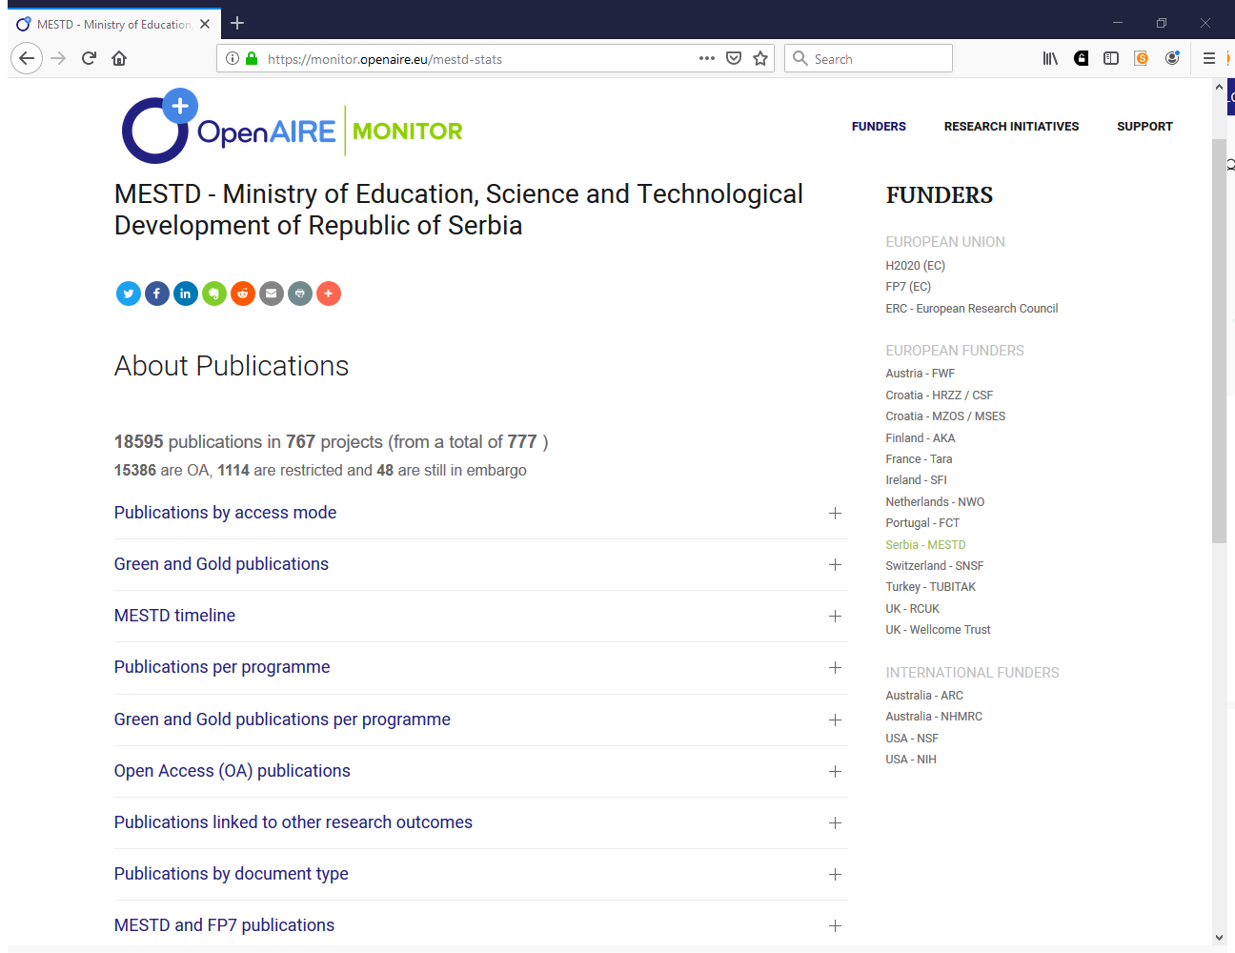

Slide 9
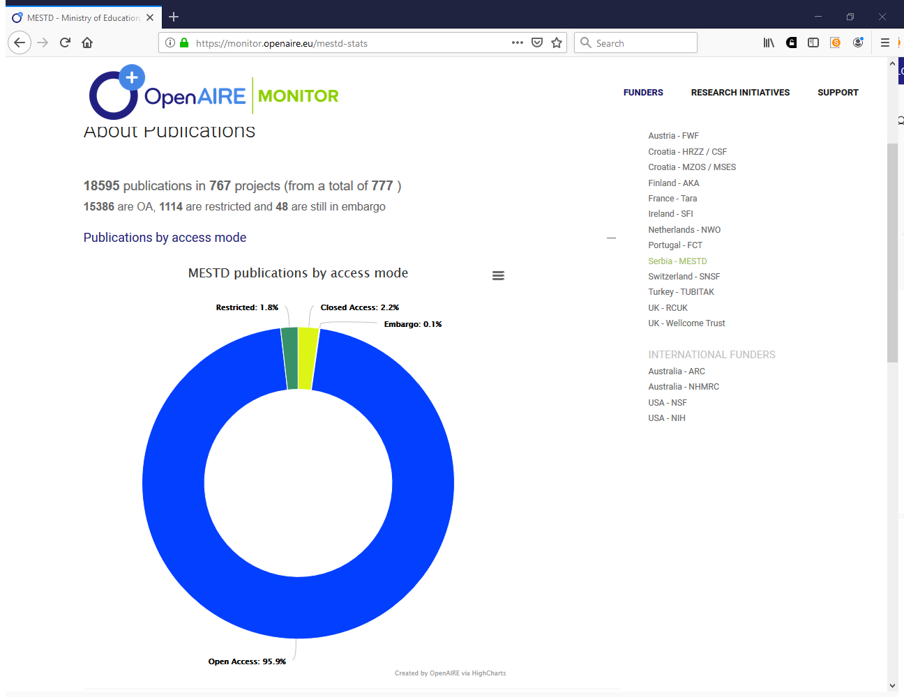

Slide 10
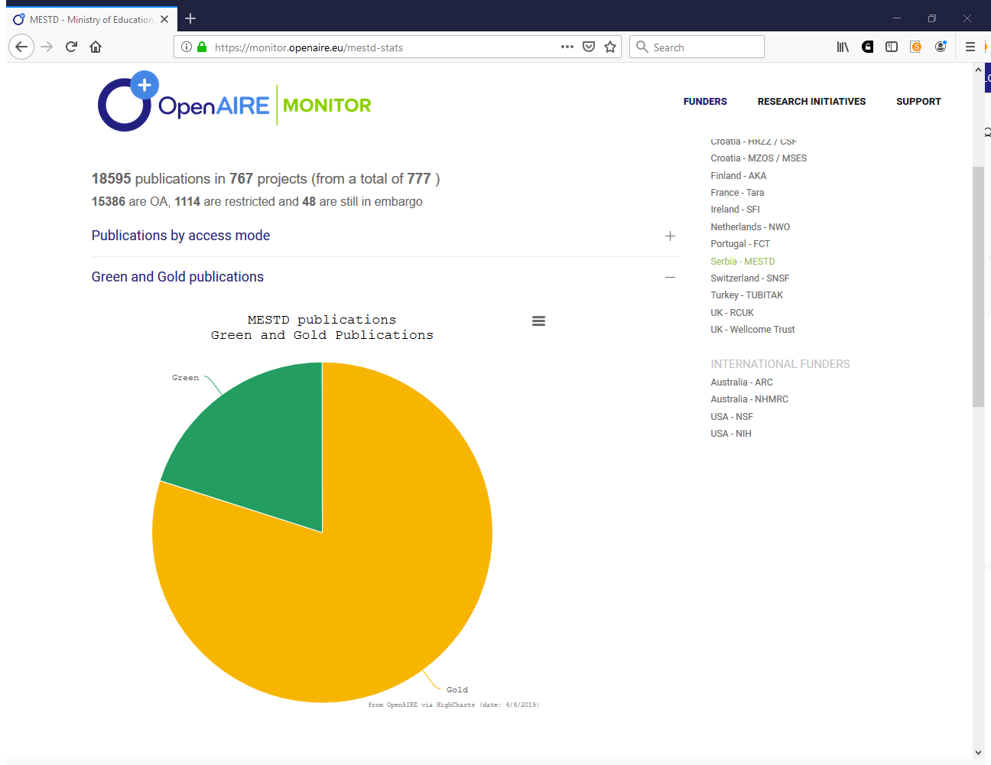

Slide 11
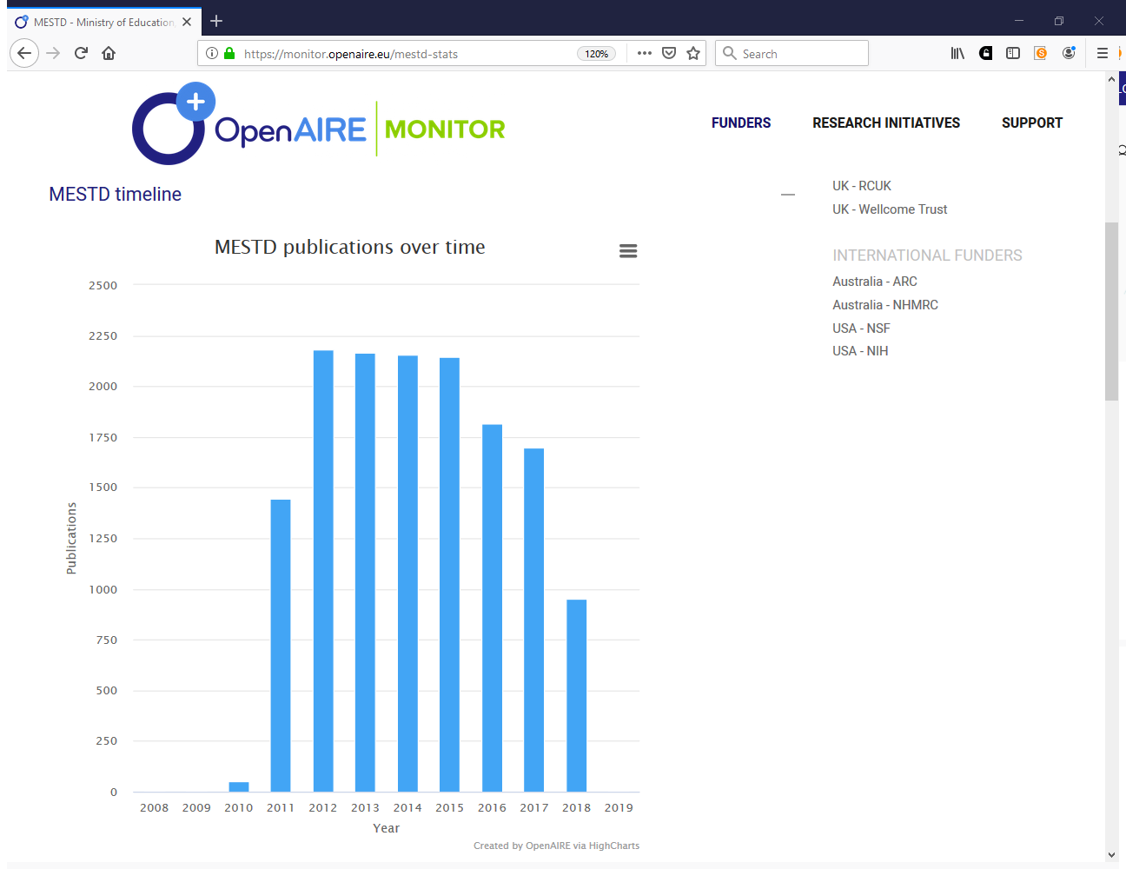

Slide 12
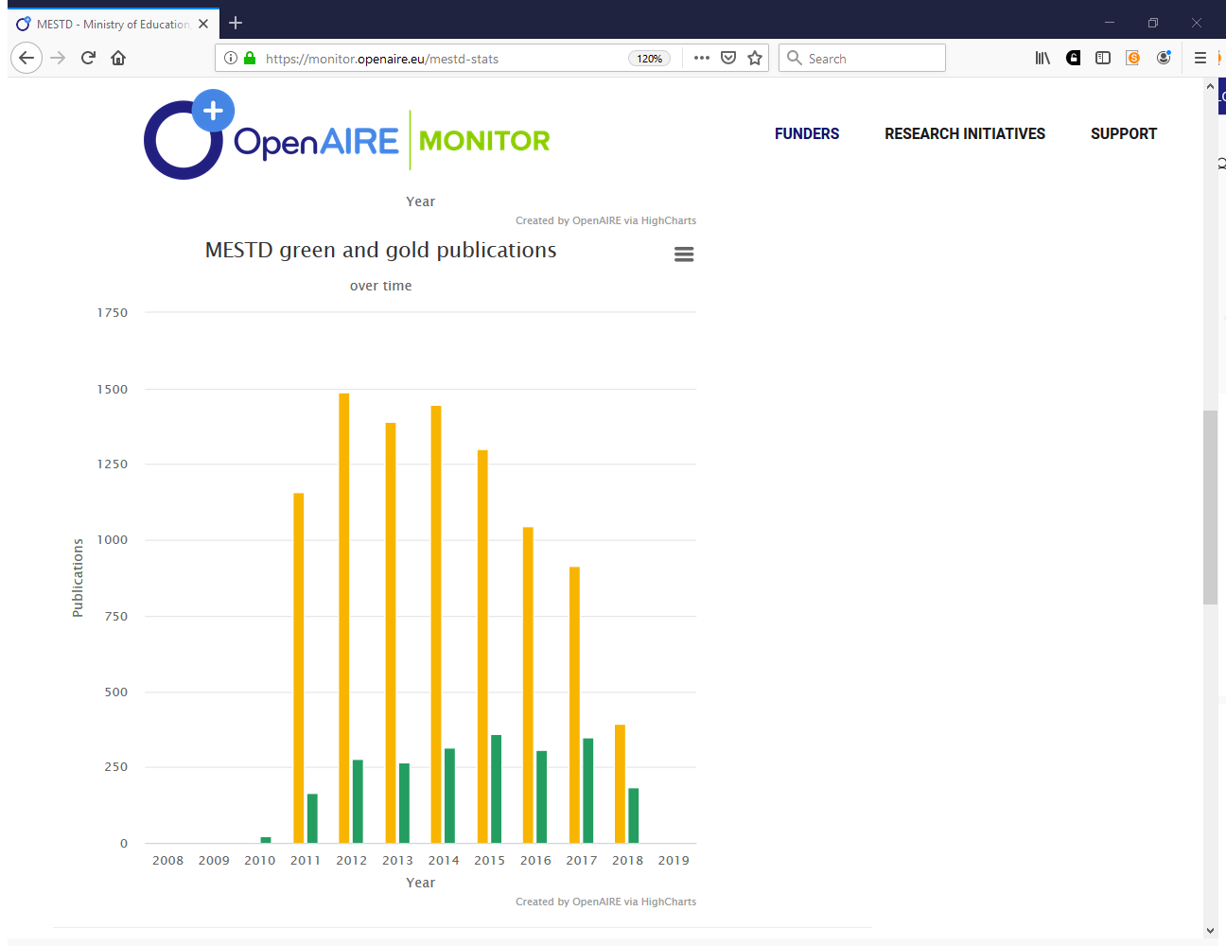

Slide 13
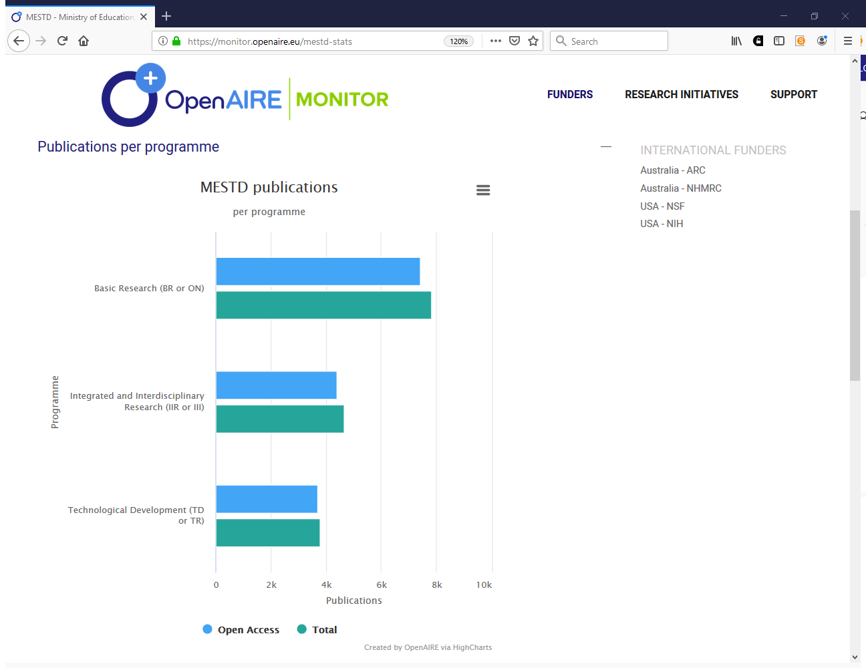

Slide 14
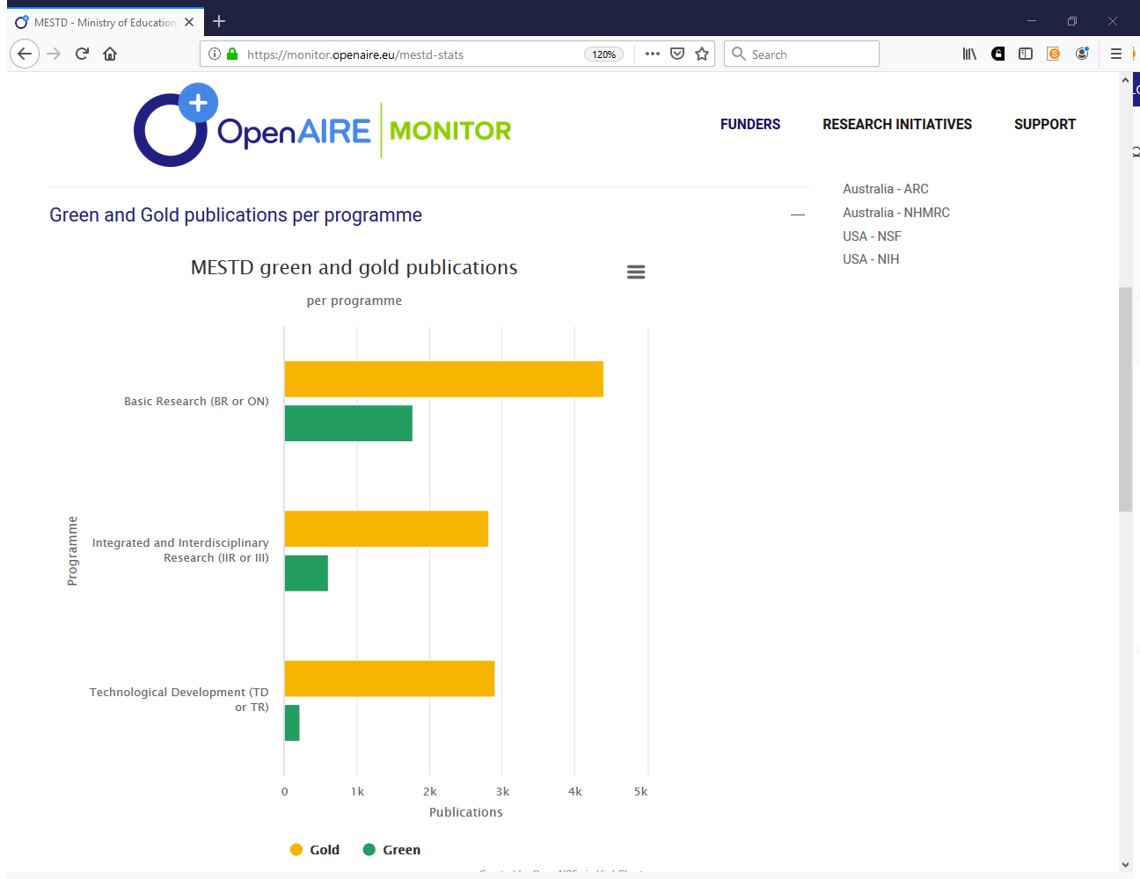

Slide 15
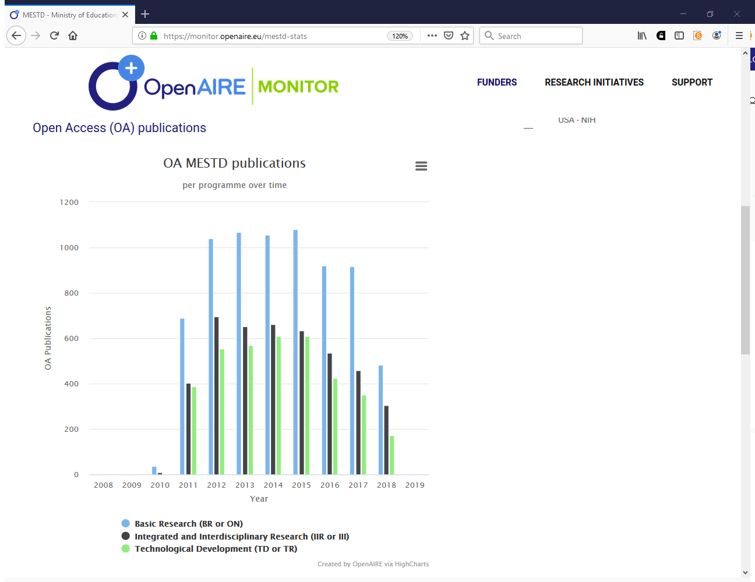

Slide 16
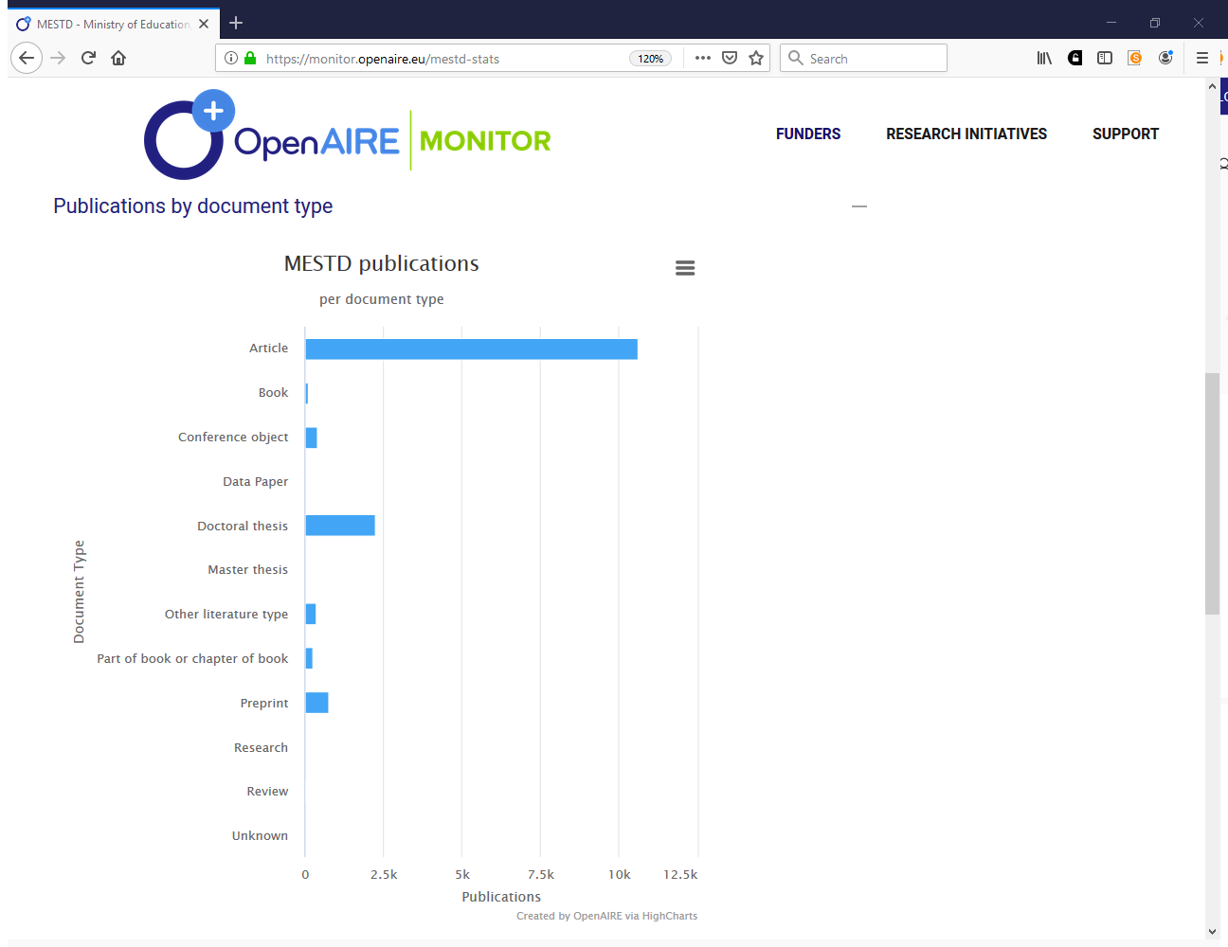

Slide 17
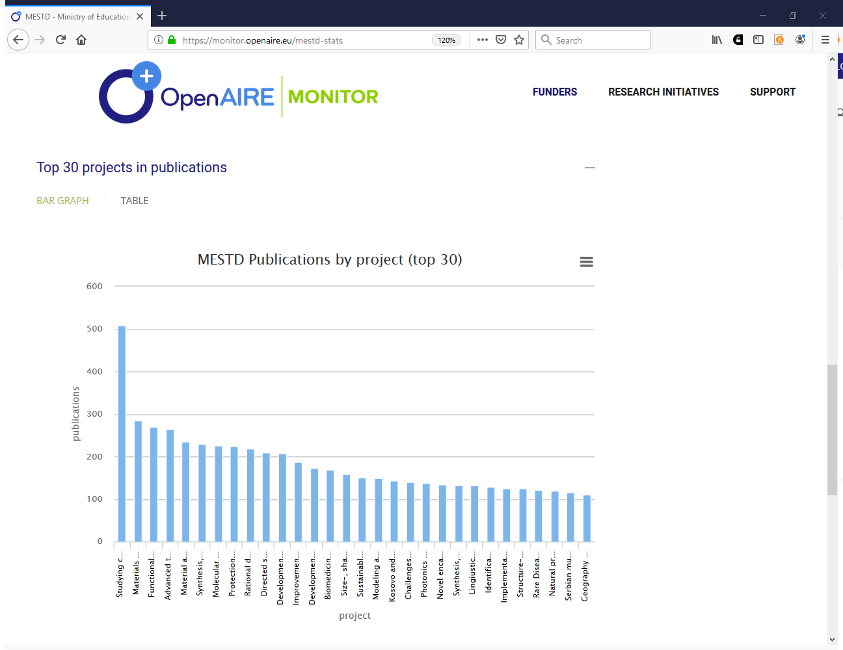

Slide 18
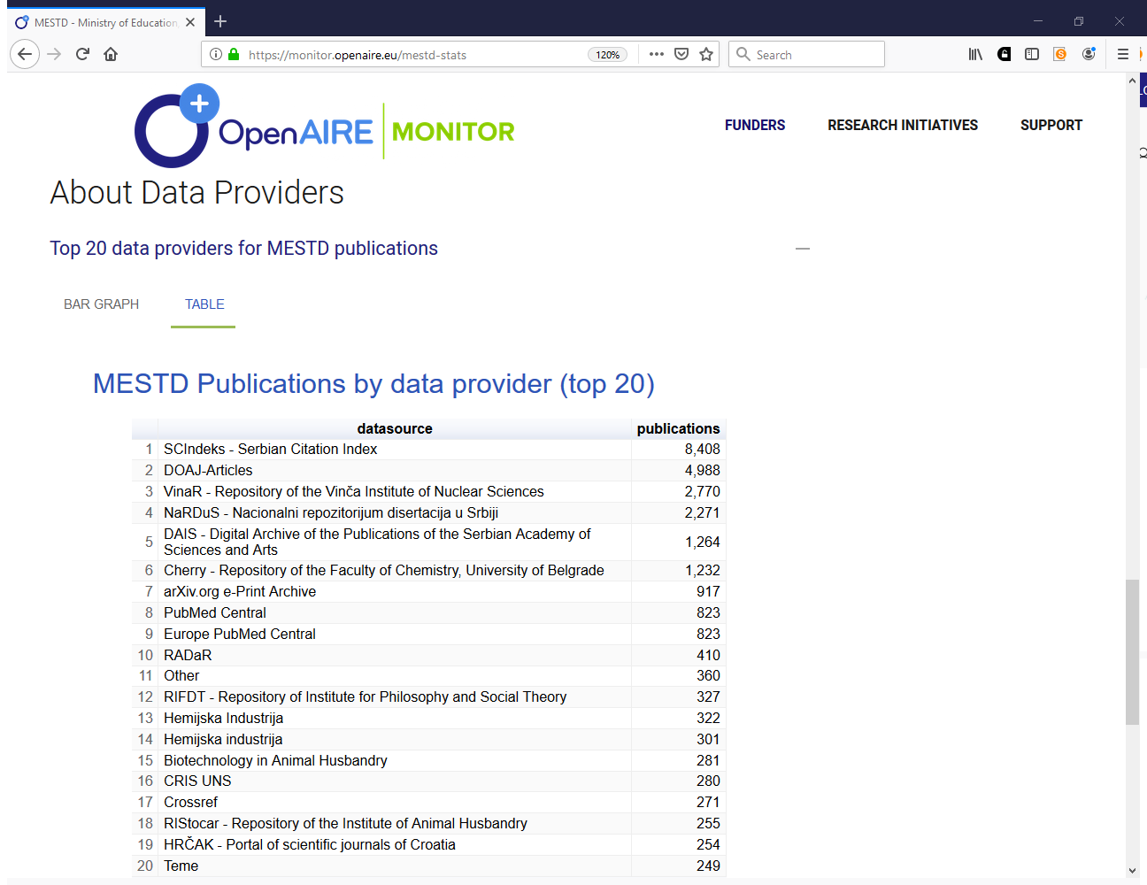

Slide 19
Institutional Dashboard
(under development)

Slide 20
Aims
Research
Impact
Service capacity impact
Funding
impact
Ability of researchers affiliated with the institution to produce innovative and quality scientific products
Ability of services maintained and operated by the institution to support researchers at producing or storing scientific products
Ability of institution to reach funding from different funders and disciplines

Slide 21
Added value functionalities
Funders
  Self-checking compliance to funder mandates
  Recent and past EC and other funders’ activities (representing various funding levels)
  Checking compliance to funder mandates
Institutions
  Collaboration network (by institution) via projects and products
Projects
  Compare project portfolio against that of other similar institutions (anonymized)

Slide 22
WHAT COMES NEXT

Slide 23
To exploit at best the OpenAIRE Research Graph, the dashboard will include sections for:
  Research Initiatives (done)
  Funders (done)
  Projects (under development)
  Institutions (under development)
Dashboards for different stakeholders will be obtained as "views" over the OpenAIRE Reserch Graph via novel statistic tools

Slide 24
Iryna Kuchma
iryna.kuchma@eifl.net

