Slide 1
OpenAIRE APIs
http://develop.openaire.eu

Slide 2
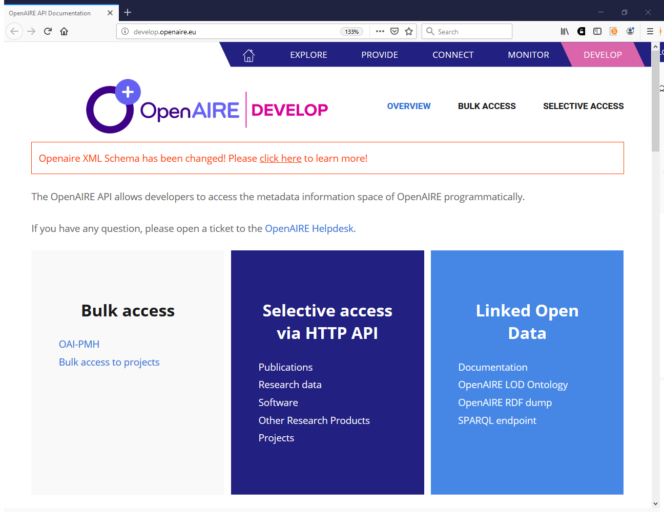

Slide 3
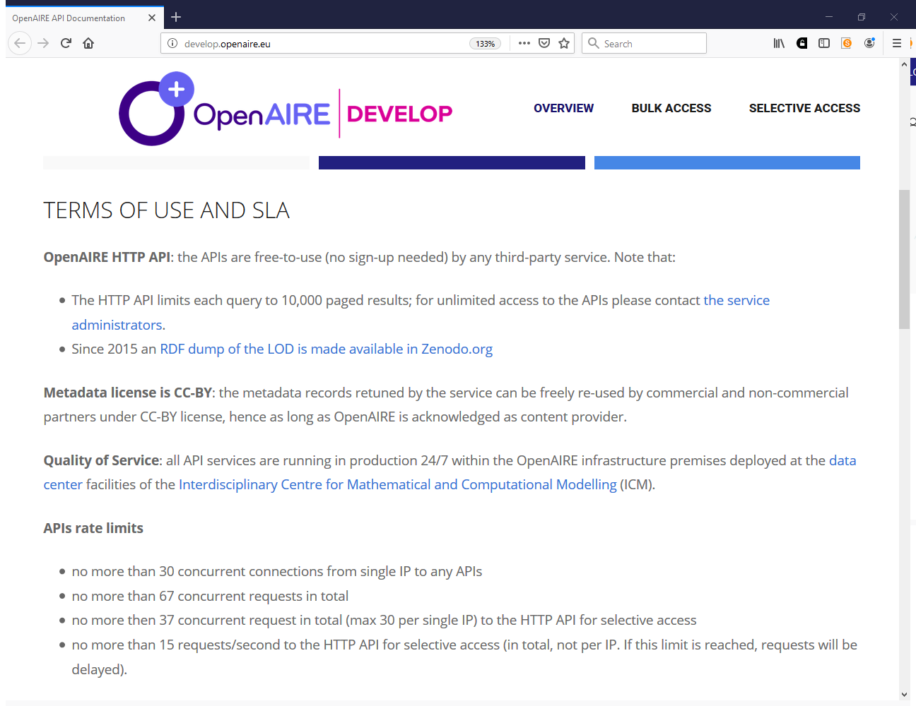

Slide 4
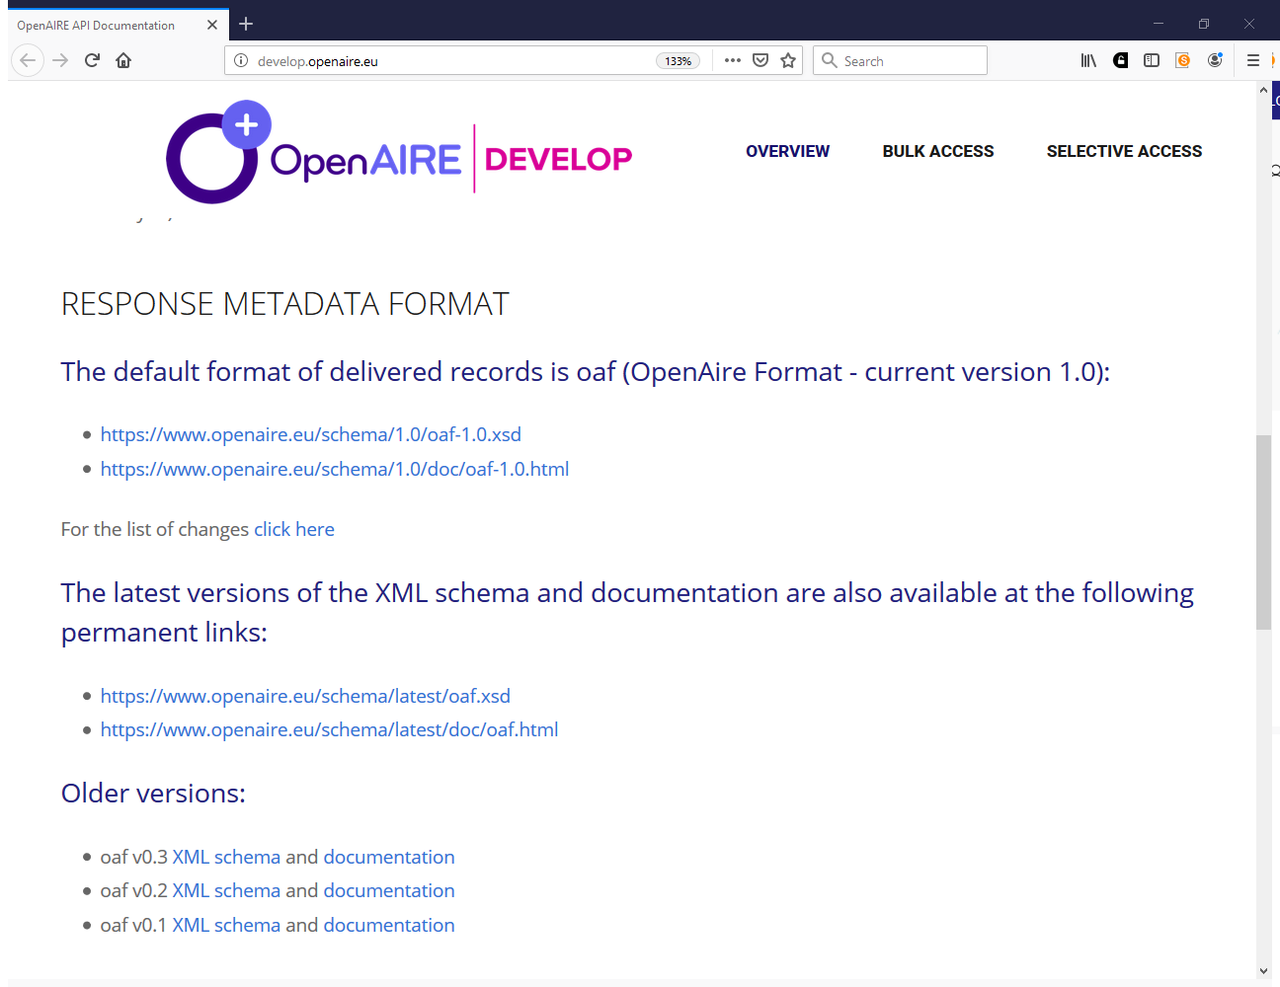

Slide 5
WHAT COMES NEXT

Slide 6





In-sync access to information space to third-party services
  Weekly data bulk in Zenodo
  ResourceSync exports
Data exchange strategies and interoperability with similar initiatives

Slide 7
Iryna Kuchma
iryna.kuchma@eifl.net

