Slide 1

A Decade of NREN Co-Creation and Learning with Cloud Frameworks
Maria Ristkok (EENet of HTM)
Eva Nestorovska (PCSS)
SIG-MSP Meeting
3 March 2026
Lisbon, Portugal
Notes:
Introduction + Open Cloud for Research and Education explanation

Slide 2
Evolution of Collective Procurements
2016 FW
Experimentation
2020 FW
Coordination
2024 FW
Co-creation

Slide 3
GÉANT Cloud Frameworks – it’s been quite a journey!
2015 | 2016 | 2017 | 2018 | 2019 | 2020 | 2021 | 2022 | 2023 | 2024 | 2025 | 2026 | 2027 | 2028 | 2029 | 2030
Prep & Tender
2016 IaaS
2016 IaaS Framework
Prep & Tender
2020 OCRE / IaaS+
2020 OCRE / IaaS+ Framework
Prep & Tender
OCRE 2024
OCRE 2024 Framework
OCRE Project
GN4-1
GN4-2
GN4-3
GN5-1
GN5-2
GN5-3
GN4 FPA
GN5 FPA

Slide 4
Starting Point
Wrong assumptions
Selling Frameworks, not concrete services
Expectations vs reality
10,000 vs 1,000 institutions consuming (10%!)
Focus on contracts
Not enough people for communication & facilitation
Extra work for NRENs
Too much documentation to work through
Slow adoption
It all takes time!
Scarcity of use cases
It was difficult to find them

Slide 5
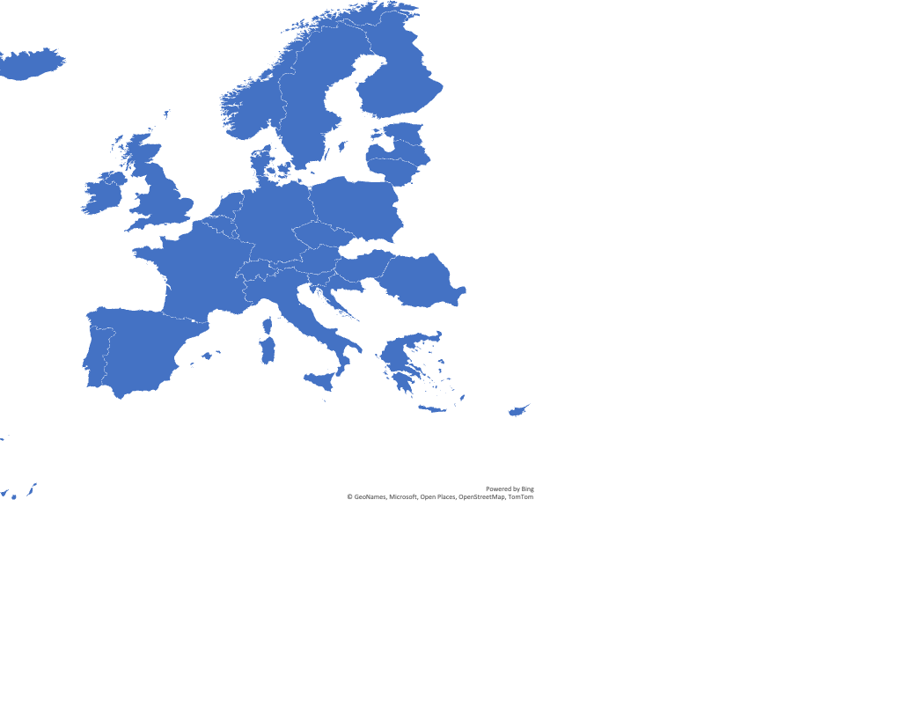
Supporting the Frameworks
  Suppliers
  NRENs
  -> institutions
Increase of Countries

Slide 6
Process of Frameworks
Service Adoption
Communication
  Preparation:
  Publishing the tender
  Evaluation
  Awarding
  Promotion and support to the R&E Community for the OCRE 2024
Planning
Demand aggregation

Slide 7
Parties of the Frameworks
Service providers
NRENs
Institutions
GÉANT organisation
GÉANT Cloud Team
NREN Support
Contract Management
Strategic Vendor Management

Slide 8

Preparation for OCRE 2024
I wonder what the community’s needs are.
National needs and strategy
Onboarding the NRENs (Declaration of participation):
Consumption
Role and the Cost Recovery Fee

Slide 9
Service Adoption
  Cloud Catalogue
Service desk
  Promotion and support to the R&E Community for the OCRE 2024
The Cookbook
  Meetings (suppliers, NRENs)
  Events (Forum, webinars)
  The Gateway (Docs Portal)

Slide 10
Growth of Institutions Consuming the Services
Number
of Institutions
1100 institutions as at Q3 2025

Slide 11
Practical Takeaways
Define the service clearly – don't assume it's business as usual!
Manage expectations of both providers and users
Involve communication specialist early, incl the evaluation process
Communication is key (NRENs -> institutions) – use simple language for a diverse community
Use cases are invaluable – show what worked in practice

Slide 12
Questions?
Thank you!
clouds@geant.org

