Slide 1


SIG-MSP: Atlassian
Nicole Harris
Senior Trust and Security Manager
SIG-MSP, Online
3 March 2026
Public

Slide 2

Atlassian
Australian Company
5.2 billion USD revenue annually
Confluence, Jira, Bitbucket, Trello
Large NREN and university usage
Typical spend between €10K - €50K per annum

Slide 3
Problem?
2020 – announced new licensing and “journey to cloud” restricting on-prem usage: https://www.atlassian.com/blog/announcements/journey-to-cloud
2025 – plan to remove all data center (on prem) licensing by 2029: https://www.atlassian.com/blog/announcements/atlassian-ascend

Slide 4
NREN Offer
Not ”off the shelf” / commodity offer
Service built around commercial offer
On-prem essential
Federated model
Support community
Migration: large amounts of data

Slide 5



(Open Source?) Alternatives?
https://fraud-detector.nl/europese-alternatieven/

Slide 6
Possible Next Steps?
Add Atlassian to the OCRE framework? May solve the problem for people who want to stay with Atlassian with a cloud-based model and have the opportunity to add new requirements for being part of that framework – e.g. federated. Maybe an opportunity to talk about on-prem? Common tender may reduce the costs. Can we get the dialogue going with these providers?
Talk to Atlassian. We need to prepare an overview of how much of the market share we have and reach out to Atlassian for a dialogue. Not just NRENs – organisations. We have some data but this is out of date: https://wiki.geant.org/spaces/msp/pages/179896472/Atlassian .
Talk to alternative providers. Can we work with Xwiki to create a path to address some of the issues we are facing (for example a data migration tool).
Start an initiative within the GN5 project to have a more effective path for supporting European / open source alternatives to the big players.

Slide 7
Bigger Picture
New European Open Digital Ecosystem Strategy: https://ec.europa.eu/info/law/better-regulation/have-your-say/initiatives/16213-European-Open-Digital-Ecosystems_en.
Digital Commons EDIC: https://digital-strategy.ec.europa.eu/en/news/commission-launch-digital-commons-edic-support-sovereign-european-digital-infrastructure-and.
Open Source week: https://opensourceweek.eu/
Open Source Projects “bidding” for procurement?
Understanding of payment models for Open Source
Perceived lack of quality in OSS
Not just Atlassian (e.g. reliance on Microsoft)

Slide 8
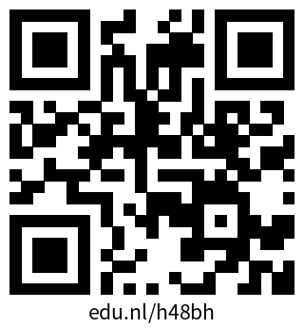
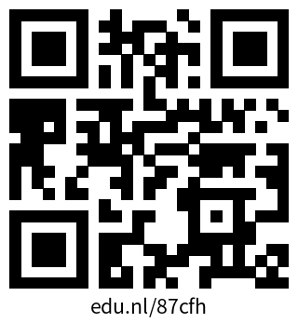
Next Steps?
Poll for next meeting: https://edu.nl/h48bh
Mailing list: https://edu.nl/87cfh

Slide 9
Resources
https://wiki.geant.org/spaces/msp/pages/1231880200/20251028+-+Atlassian+Cloud+Meeting
https://wiki.geant.org/spaces/msp/pages/179896472/Current+Usage+of+Atlassian+Products+in+NRENs ←- please update!

Slide 10
Thank You
Any questions?
www.geant.org

Slide 11
Colour palette
Primary
Secondary
Hex | #004461
Hex | #EE426D
Hex | #F4E200
Hex | #3C51A2
Hex | #0ABBC2
Hex | #1AAA88
Teal is the lead primary colour, its neutrality providing a strong background for accent and secondary colours.
Crimson is the accent primary colour, its brightness providing a strong contrast to the teal and a lead for the secondary colours.
The secondary colours have been selected to complement the primary colours. These secondary colours should be used sparingly and only used in addition to, and where they will not interfere with the primary colours.

Slide 12
Best practice
Please note, this template is for use with GÉANT Association corporate content.
If you are representing project work, ensure you use the correct PROJECT template.
1
2
3
4
Less is more
Clear message
Use photos
Ask for help
Aim for one slide per minute of presentation (maximum!)
Keep your messages concise, try not to overload your slide
Use images to maximise impact
Add notes to request any diagrams, illustrations or photos

Slide 13

Typography
Slide Titles = 28pt Bold
Sentences = 24pt Regular. See Slide 4.
Paragraphs = 18pt Regular (never less). See Slide 2.
Captions = 14pt Regular. See Slide 6.

Slide 14












































Icon set

