Slide 1

.
Pre-Service Examples SURF
Time and Frequency Transfer & Campus Networking
Harold Teunissen et al.
SIG-MSP, 3 March 2026

Slide 2
Strategic Portfolio Management
EXPLORE
HANDOFF
EXPLOIT
TIME
&
ACTIVITIES
AIMED AT DISCOVERING POTENTIAL IMPACT
ACTIVITIES AIMED AT
LAUNCHING AND SCALING
PRODUCTS OR SERVICES
INNOVATION ACTIVITIES
LIFECYCLE MANAGEMENT OF
PRODUCTS AND SERVICES
MEMBER INVOLVEMENT

Slide 3
Lifecycle- & Portfolio Management Process
&
GO-NO GO GATES
BP 0.1
BP 0.5
BP 0.7
BP 1.0
EXIT
Exploration
Proof of concept
Pilot
Service Development
Production
Phase Out
YEARLY EVALUATION
PRE-SERVICE PHASE

Slide 4
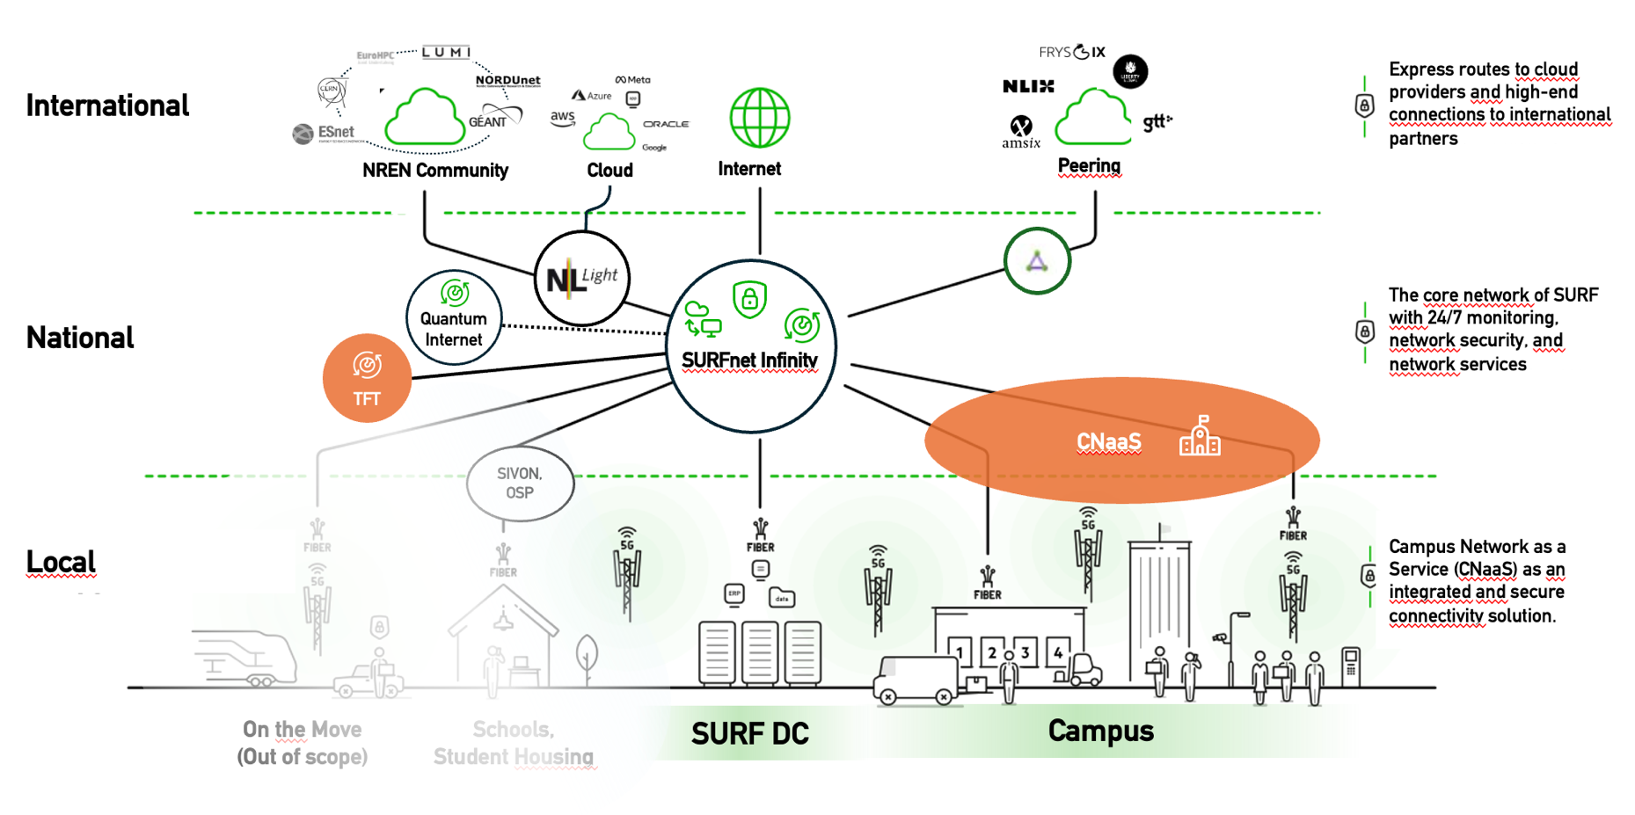
Network Portfolio
PRE-SERVICE
PHASE
PRE-SERVICE
PHASE

Slide 5
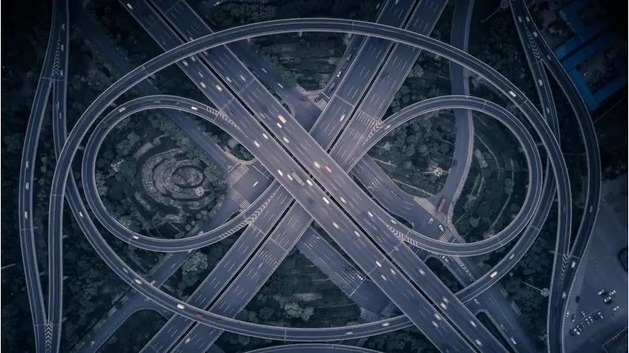

All roads lead to Rome (1/2)
Business
Innovation
# of Users
Commodity
Tailored
Technical Innovation
Weight of requirements and wishes

Slide 6


All roads lead to Rome (2/2)
Business
Innovation
Campus Network as a Service
SURFcumulus
SURFfirewall
Customer Pull
Technology Push
Time Frequency Transfer
IoTroam
Technical Innovation

Slide 7
Pre-Services in Perspective
&
GO-NO GO GATES
BP 0.1
BP 0.5
BP 0.7
BP 1.0
EXIT
Exploration
Proof of concept
Pilot
Service Development
Production
Phase Out
YEARLY EVALUATION
CNAAS
TFT

Slide 8

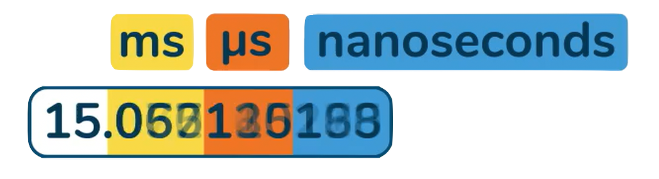

Time Frequency Transfer
TECH

Slide 9


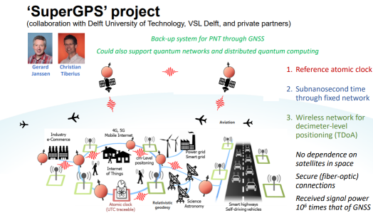
Road to a permanent T&F network
Growth in demand
  Increasing number of timing-critical experiments over time
  Requests coming from different research members and locations
Conclusion
  Need for precise timing is continuous
  This justified building a permanent national T&F backbone
Historical situation
  Built per experiment, on demand
  Required dedicated engineering, routing, and calibration

Slide 10
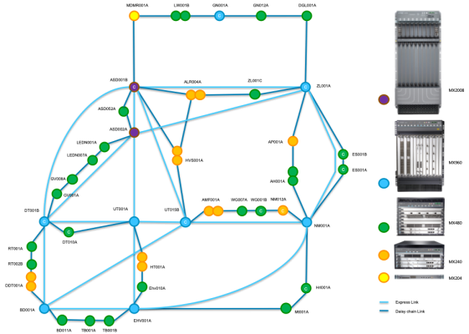
What did we build and how did we get there?
Step 1 – Reuse of existing fiber and optical infrastructure
  Leveraged national R&E fiber and DWDM transport where possible
  Avoided building dedicated fibers for each experiment
Step 2 – Deployment of WR-capable network switches
  Strategic placement at aggregation points and research sites
  Open hardware and firmware
Step 1 – Reuse of existing fiber and optical infrastructure
Step 2 – Deployment of WR-capable network switches

Slide 11
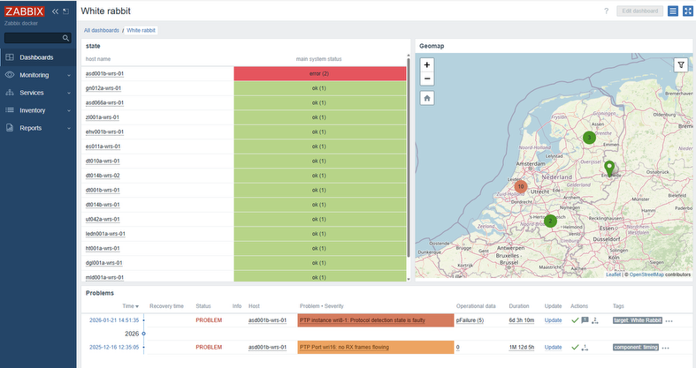
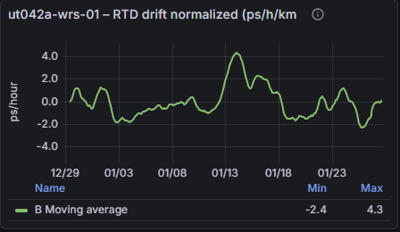
What did we build and how did we get there?
Step 3 – Establishment of calibration methodology
  Procedures for alpha, asymmetry, and Sagnac correction
Step 4 – Integration into operations
  Monitoring of synchronization and link health
Step 3 – Establishment of calibration methodology
Step 4 – Integration into operations

Slide 12
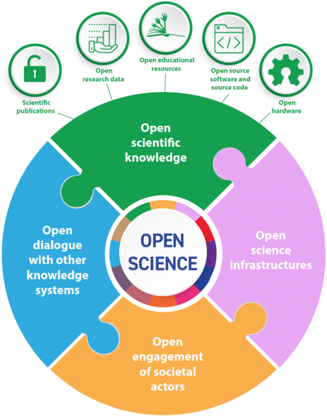
Challenges and key decisions
Technology choices
  Proprietary solutions ↔ open hardware and open firmware
  Risk of vendor lock-in ↔ internal expertise requirements
  Ensuring interoperability across different WR implementations
Support and sustainability
  Limited commercial support for niche timing technology
  Dependence on community knowledge and expert partners
  Need to build in-house operational competence

Slide 13
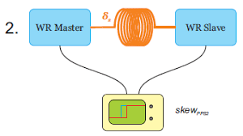
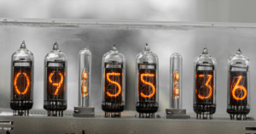
Challenges and key decisions
Calibration complexity
  Accurate delay and asymmetry calibration over routed fiber paths
  Sensitivity to optical path changes
  Need for repeatable, trusted validation procedures
Meeting experiment expectations
  Risk of “it syncs, but is it good enough?”
Integration with SURF network operations
  Maintenance and reconfiguration can affect timing performance
  Requires tight coordination between timing and transport domains

Slide 14




Collaboration as necessity, not luxury
The collaboration was essential
  No single party covers timing, optical transport, and operations
  Many issues only visible at system level
Key partners
  NMI (VSL) NREN (CESNET)
Open community
  We joined the White Rabbit Collaboration
  as a member and participate in the community

Slide 15
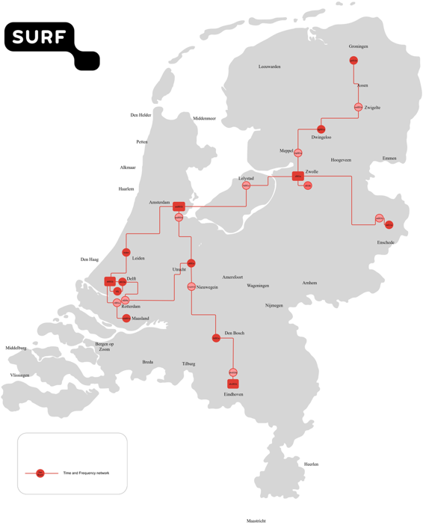
Where are we now, and what are we proud of ?
Stable White Rabbit backbone
  We now operate a stable WR backbone that supports scalable expansion
  New experiments can be connected without rebuilding the network
Built on SURF private network
  Uses SURF’s private fiber and optical transport infrastructure
  Timing services integrated with existing national connectivity
24/7 monitoring and operations
  Continuous monitoring of synchronization status and link behavior
  Faster detection and resolution of timing-related issues
What this enables
  Predictable timing performance for experiments

Slide 16

Partnerships and future outlook for Time & Frequency
Partnerships remain essential
  Continued alignment needed between NRENs, NMIs, vendors, and research users
Evolving requirements
  New experiments push for higher accuracy and longer distances
  Increasing interest from quantum communication and sensing projects
Future direction
  Expansion to more sites and cross-border interconnection
  Preparation for optical frequency transfer alongside time distribution

Slide 17
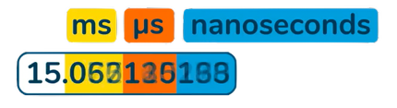
When Push becomes Pull
Business
Innovation
Customer Pull
Technology Push
PTP
Time Frequency Transfer
Technical Innovation

Slide 18

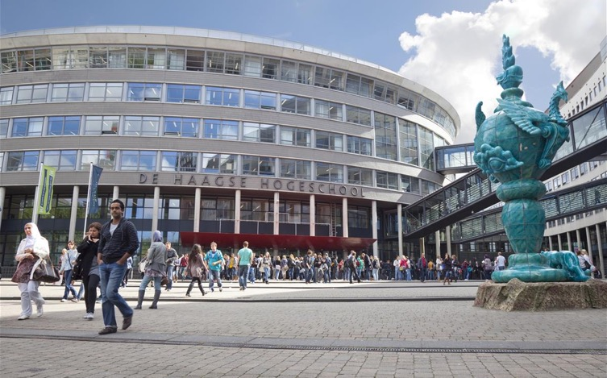
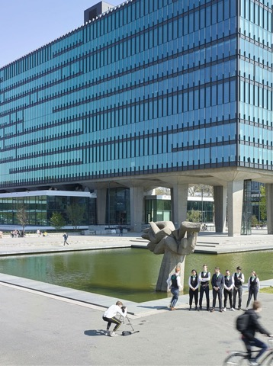
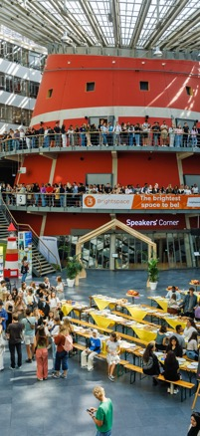
Campus Network as a Service
Campus Networjki
CUSTOMER
?

Slide 19
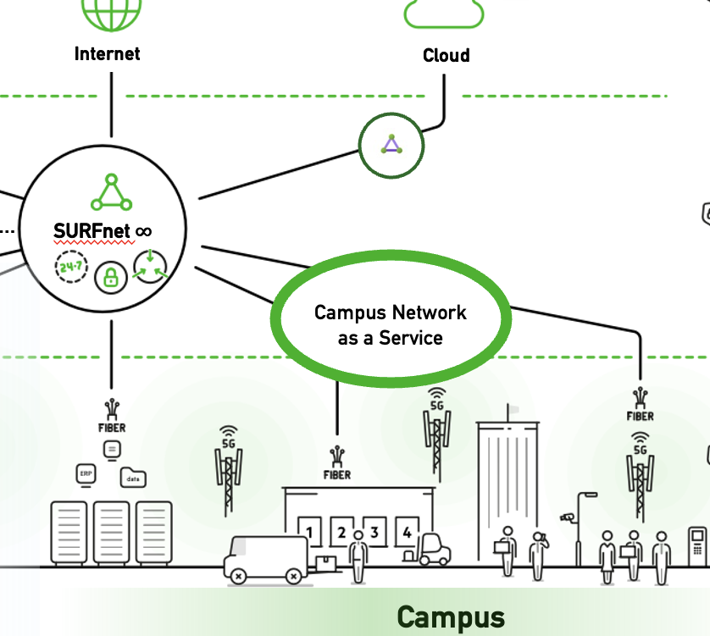
Campus Network as a Service — “Servicer Shaslick”
CNaaS integrates and combines existing campus network services and those currently in development
Each service currently has its own proposition and is delivered or procured separately within SURF
Therefore procurement, organizational structure, architecture, product management, and engineering are all part of the program with a layered structure

Slide 20
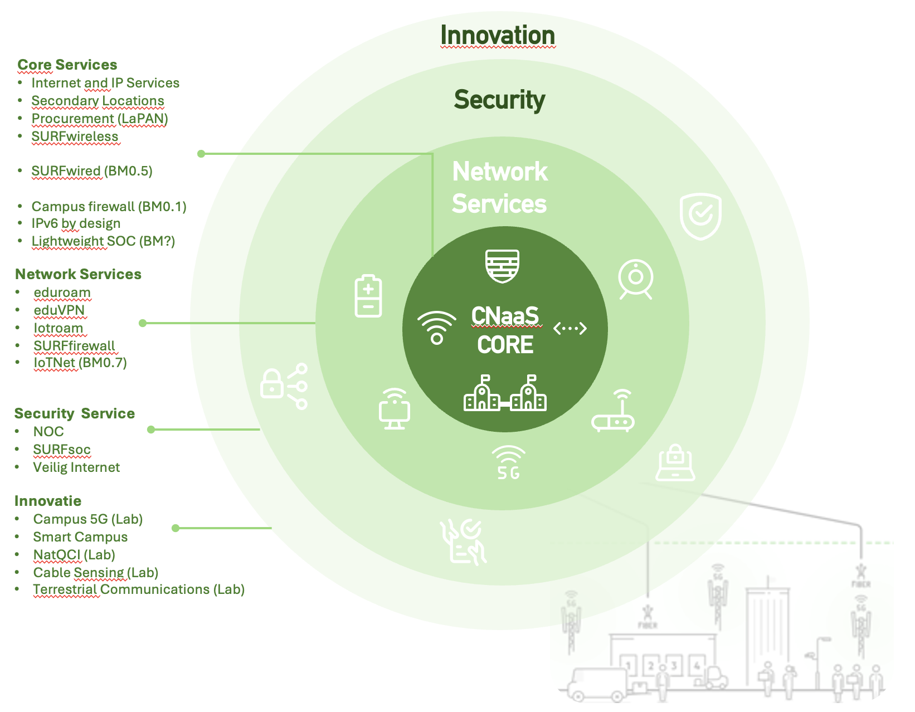










CNaaS Portfolio
SURFwired Pilots
Preparation Phase
Waiting Room

Slide 21
SURFwired Pilot Goals from LCPM
BP 0.1
BP 0.5
BP 0.7
BP 1.0
EXIT
Exploration
Proof of concept
Pilot
Service Development
Production
Phase Out
In 2024, the Portfolioboard gave a GO on BM0.5 to start the SURFwired pilot phase and answer the following questions:
What is the impact on the SURF organization (and its operations partner(s)) of taking on the management of a number of diverse institutions? What resources does it require, is it scalable, and what does it mean for the network team?
Are we actually able to set up the processes properly so that we can provide services from procurement through to operations in a way that both the institutions and we are satisfied with?
Can we handle brownfield situations, where the institution’s own network is still partly operational, and migrate to SURFwired in the short term?
Can an institution procure parts of SURFwired (for example a do-it-yourself variant where only procurement and hardware support are handled via SURF)?
Does SURF, with SURFwired, действительно offer a better solution, meaning added value, than what the market can provide with Network as a Service offerings?
Is the business model valid, and does the designed model actually work in practice?

Slide 22
SURFwired pilot build up
Initial setup → Van Hall Larenstein University of Applied Sciences
2 locations, simple setup, low level of expertise
First validate the network architecture and project organization
Medium-size setup → The Hague University of Applied Sciences
5 locations, complex setup, high level of expertise
More complex network architecture and first scale-up
Large-size setup and partial brownfield → Rijn IJssel
26 locations, complex setup, medium level of expertise
Standardization, further scale-up
Parallel setup → Vista College
Low level of expertise
Standard architecture and parallel rollout to enable scaling

Slide 23




Overlapping Pilot Roll Out
BM0.5
BM0.7
PORTFOLIO PROCESS
GO
GO/ NO GO
Scope
Onboarding
PoC
Migration
Pilot Fase
Pilot Results
START HVHL
Scope
Onboarding
PoC
Migration
Pilot Fase
START HHS
Scope
Onboarding
PoC
Migration
START RIJNIJSSEL

Slide 24




Results so far...
Scope
Onboarding
PoC
Migration
Interpretation of the word pilot and partnership
Institution → Excellent timing! SURF is going to take over our network because the equipment is end-of-service, and besides that let’s reassign the networking staff and achieve cost savings
  We wanted it so badly, but we forgot to mention these decisions…
SURF → Great! we can work together with the institution and start experimenting with our design
  We wanted it so badly, that we adapted to the customer too much, that the design no longer made sense and we forgot to put operations and support in place...

Slide 25

Back on Track
BM0.5
BM0.7
PRE-SERVICE PHASE
BM1.0
GO
Business Development — Market Scan / Service Proposition / Tariff
GO/ NO GO
Product Management
GO/NO GO
Proof of Concept
Pilot Results
Scope
Onboarding
Test Run
Migration
Pilot Fase
START
PILOT-
AGREEMENT
GO/NO GO
GO/NO GO
GO/NO GO
Design & Procurement
GO/NO GO
Setup Operations
GO/NO GO
Development CNaaS Management Platform

Slide 26
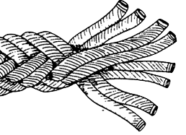
Weaving the rope…
Documentation
Design
Program Management
Business Development
Service
Platform Dev.
Service Mgmt.
Operations
Support

Slide 27
Lessons Learned
What does a ”Pilot” mean when you are replacing the network heart of an institution?
  To big to fail!
What are the risks and critical success factors?
  And since it is still a pilot, a final decision has not been made the LCPM
What are the roles of the institution, SURF, etc?
Promises versus written agreements?
What are the maturity levels?
How to deal with delay... Since the next institution in line has made the same decisions... “Why is this taking so long, we should have migrated 2 months ago! And where is the firewall?” 🤯😡
BP 0.1
BP 0.5
BP 0.7
BP 1.0
EXIT
Exploration
Proof of concept
Pilot
Service Development
Production
Phase Out

Slide 28
Cost of development
€ 119k
BP 0.1
€ 38k
BP 0.5
€ 100k
BP 0.7
€ 100k
BP 1.0
€ 60k
EXIT
Exploration
Proof of concept
Pilot
Service Development
Production
Phase Out
Time Frequency Transfer
€ 357k
€20k
BP 0.1
€250k
BP 0.5
€3,5M
BP 0.7
?
BP 1.0
EXIT
Exploration
Proof of concept
Pilot
Service Development
Production
Phase Out
SURFwired
€3.8 M
PRE-SERVICE PHASE

Slide 29


