Slide 1
Governing user needs
… the before and after
Ariela Herček, ARNES
SIG-MSP Spring Meeting
3 March 2026

Slide 2
THE BEFORE...
UX Design and User Research

Slide 3
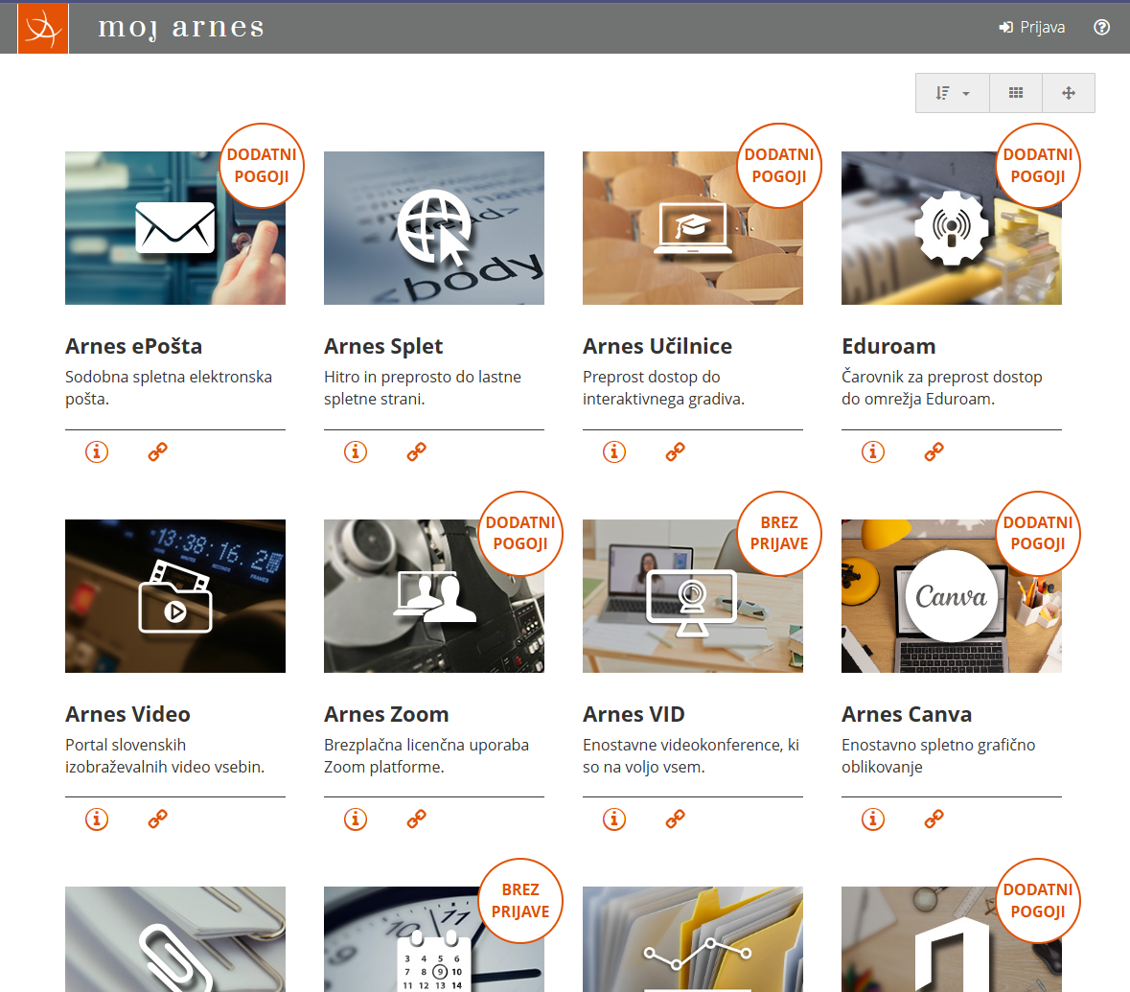
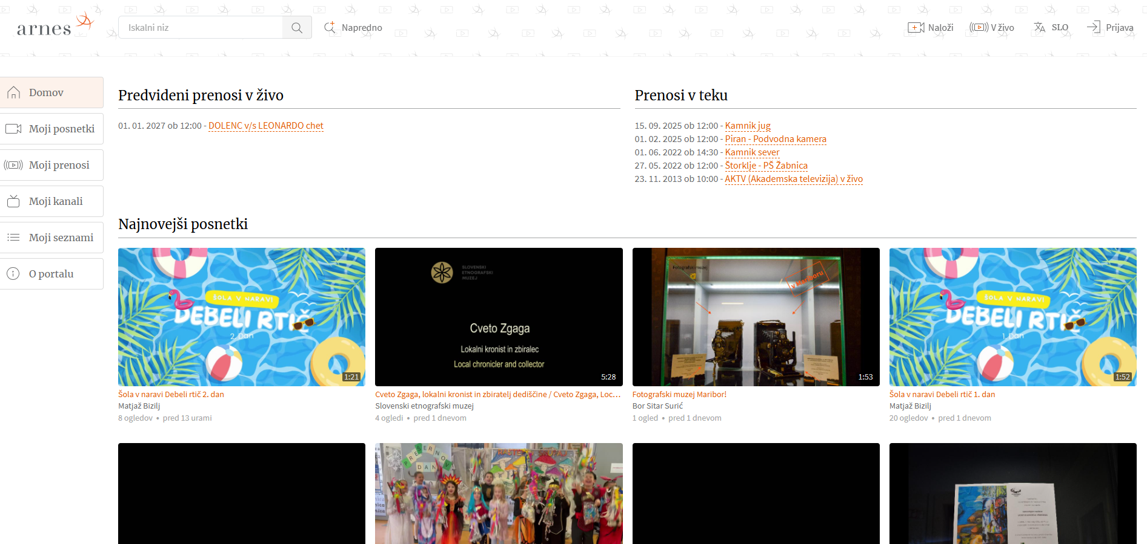
UX? What‘s that?

Slide 4
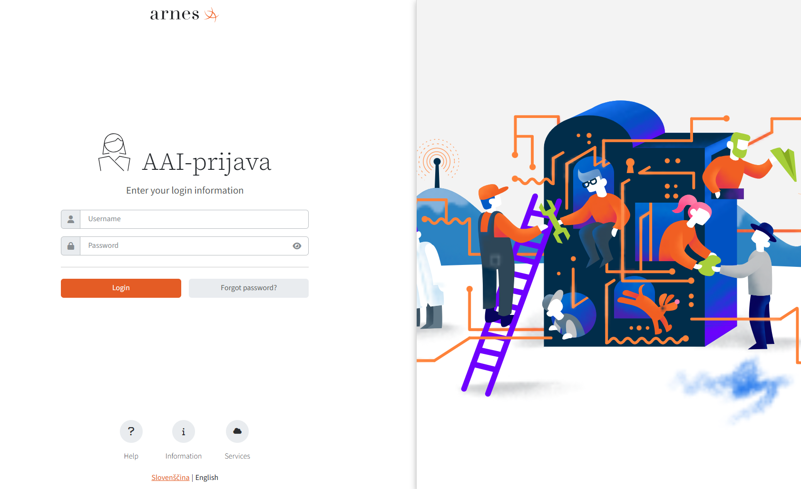
UX? What‘s that?

Slide 5
UX Design collaboration with
UC Berkeley
Sarah Algashgari, Amber Jiang,
Evelyn Wong, Yixin Xiong

Slide 6



Arnes Mapa / Arnes Folder
  open-source, cloud-based collaboration platform built on NextCloud
Identify key usability challenges and opportunities for workflow improvements.
Capture the experience of current users (primary school faculty) and prospective student users.
Provide strategic UX recommendations that ensure the platform is scalable, user-friendly, and aligned with academic needs.

Slide 7
Arnes Mapa / Arnes Folder
Research Methods
01
02
03
  User Survey
  User Interviews
  Usability Testing
  Evaluate general attitudes of current users and learn basic motivations
  Understanding how institutions evaluate what platforms to adopt
Identifying usability barriers and evaluate learnability
  Why?
  Why?
  Why?
  Gather data at scale
  Discover avenues for further research
Understand experience of current users
Gain insight on university’s tech strategies
Examine specific tasks in a workflow
Evaluate learnability
Notes:
Currently in beta testing mode and we expect to roll it out gradually to the community by autumn.

Slide 8
THE IN-BETWEEN...
User Research – Before and After

Slide 9
e-Infrastructures for Researchers
  questionnaire, led by an expert body of the Slovenian Open Science Community, which is led by ARNES
Data Repositories
Collocation
Cloud, Storage, and Data Backup
HPC
User Support

Slide 10
e-Infrastructures for Researchers
  questionnaire, led by an expert body of the Slovenian Open Science Community, which is led by ARNES
Data Repositories
Collocation
Cloud, Storage, and Data Backup
HPC
User Support

Slide 11
e-Infrastructures for Researchers
  questionnaire, coordinated by an expert body of the Slovenian Open Science Community, which is led by ARNES
  What are your current needs?
  What solutions have you already implemented?
  What solutions would you like to use?
  Estimate how your needs will change in the next 3-5 years.

Slide 12
THE AFTER...
User Feedback

Slide 13
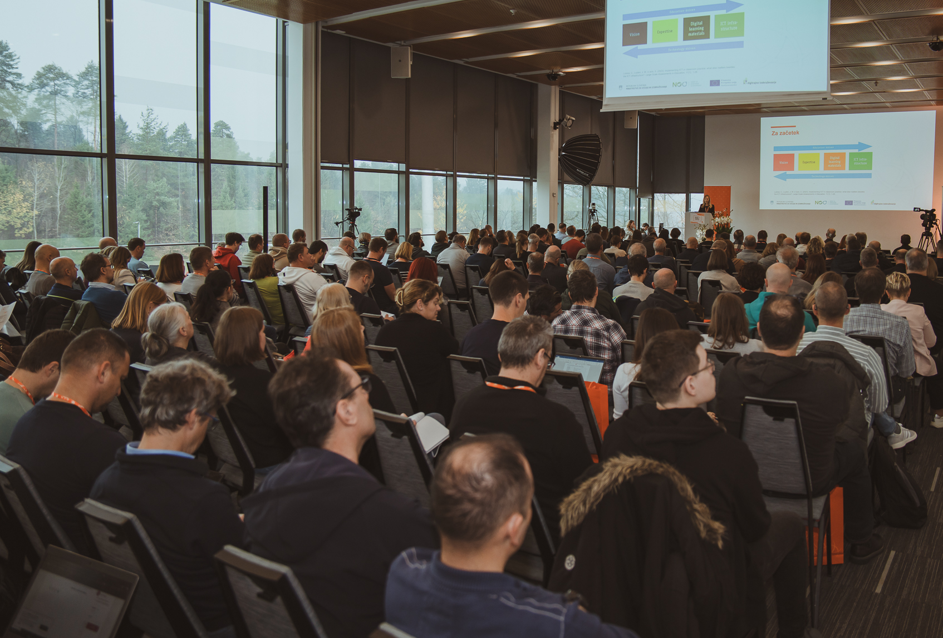
User Feedback for existing services
  Surveys and interviews show the general rating and primary
  advantages of NREN services
Free to use
Ease of use
No ads
GDPR compliance
Support in Slovenian
Security
Notes:
Arnes uses surveys and interviews with representatives of interest groups or partners to gauge the response to its activities, and uses the feedback to plan improvements and further development of its activities. Arnes has most systematically assessed user satisfaction at the annual Knowledge Network conference.Surveys have shown that the vast majority of users are satisfied with Arnes' services. 78% rated them as excellent, 20% rated them as very good, and they also want their further development and implementation of access with an AAI account for external services.91% of respondents believe that the main advantage of Arnes' services is that they are free to use, 84% highlighted the security of the services, and 66% mentioned their ease of use. Among other advantages, a similar percentage of respondents highlighted the absence of advertisements, support in the Slovenian language, and the fact that the services comply with Slovenian legislation on personal data protection.

Slide 14




Business Reviews with Strategic Partners and Users
Jožef Stefan Institute
National Education Institute Slovenia
Faculty of Computer and Information Science, UL
Computer History Museum of Slovenia
  annual reviews serve as an overview and can help gather future needs of strategic users
  project reviews during the project runtime and partner relations after project end
EU AI Factories
EuroCC
Digital Citizenship
SAFE
Notes:
The Jožef Stefan Institute is the leading Slovenian scientific research institute, covering a broad spectrum of basic and applied research.
National Education Institute Slovenia is the main national research, development and consultancy institution in the field of pre-school, primary and general secondary education.

Slide 15

Questions, thoughts and comments are welcome.
Ariela Herček
Communication and Collaboration with Strategic Partners
ariela.hercek@arnes.si

