Slide 1

WELCOME
SIG-MSP spring meeting 2026
📍 Lisbon, March 3-4, 2026
March 2025

Slide 2

Who we are
FCCN, the digital services of the Foundation for Science and Technology (FCT), aims to contribute to the development of Science, Technology and Knowledge in Portugal.
It provides a set of shared digital services that aim to support the development of education and science in Portugal, contributing to the excellence of national teaching and research.

Slide 3
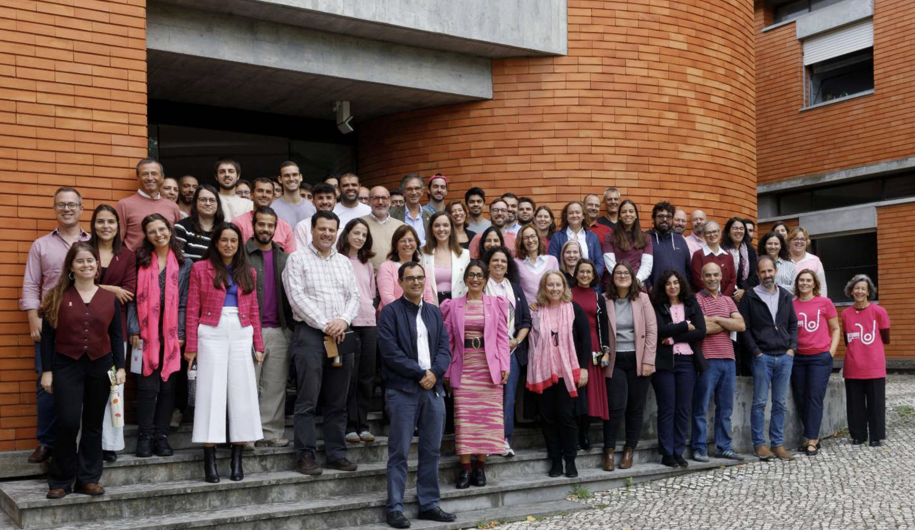

Our Team
117
65%
people
Men
100%
41,03
87%
Contratos Individuais Trabalho
Average age (years)
59%
Higher Education
TIC area

Slide 4

Communities Served
SESP
Portuguese Higher Education System
+600 000
RAE
Extended Network
of Education
Students, teachers, researchers and staff
Public administration
SNCT
Sistema Nacional de Ciência e Tecnologia
MATCH
Ministry of Education, Science and Innovation
+90
Entities linked to RCTS (Science, Technology and Society Network)

Slide 5


Slide 6
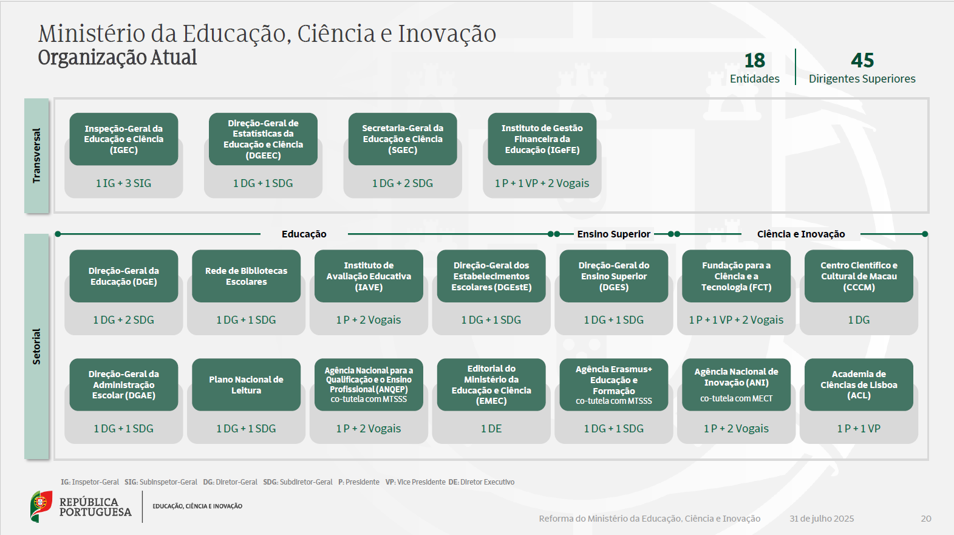

Slide 7
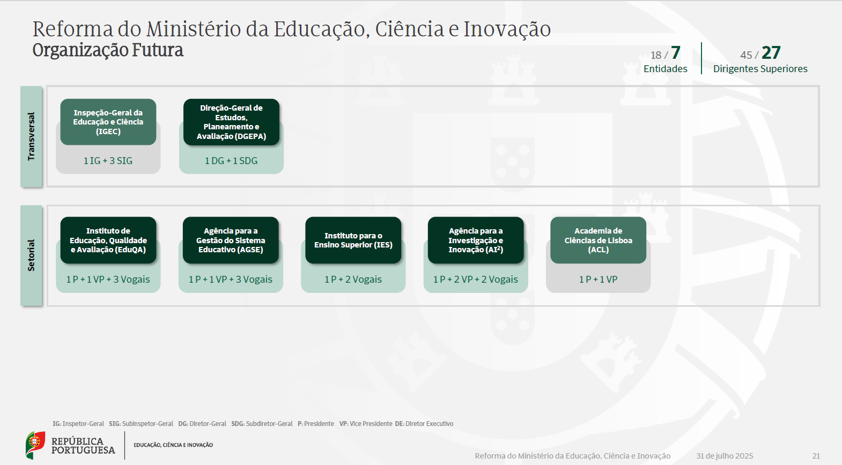

Slide 8



A new paradigm in 2026
2026 is a year of change, following the reform of the Ministry of Education, Science
and Innovation, which announced the dissolution and fusion of some entities.
The FCCN's activity is essential in two critical areas:
1
Process of integrating the Foudation of Science and Technology into the new agency AI² - Agency for Research and Innovation.
Creation of ‘FCCN, Digital Services for Education’ at the AGSE - Agency for the Management of the Education System.
2

Slide 9
Our portfolio today
Pillars of action
Connectivity
Security
Knowledge
Computation
Collaboration
Innovation

Slide 10
Connectivity

Slide 11
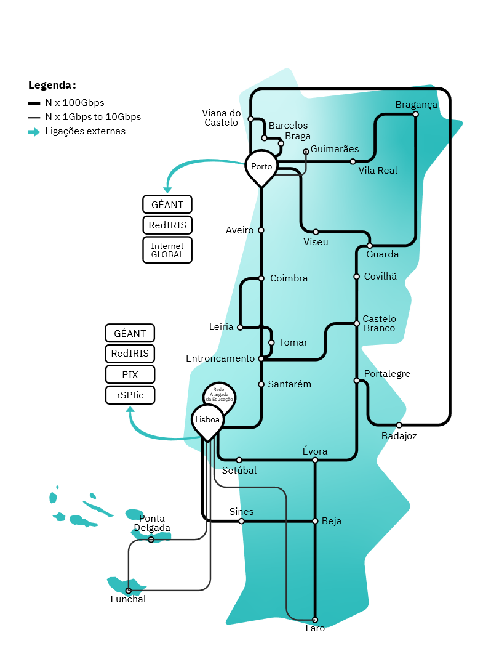
RCTS
Fiber Optic Pairs
2,484 km
Fiber Optic Cable
1,000 km
Points of Presence
105
Installed Capacity
6.5 Tbps
IP Transit Suppliers
2 in 2 locations
Peerings at IXPs
+ 55
Network Operations Centre (NOC)
24x7
Notes:
Investment alignment between RCTS and the GEANT Network.105 points of presence
IP Transit Providers => 2 locations and 2 IP Transit Providers
It guarantees services to all public higher education entities, state laboratories, associated laboratories and most research units; Various topologies of entities detailed in the law of science

Slide 12






Connectivity

Slide 13
Computation

Slide 14



Computation

Slide 15
Collaboration

Slide 16




Collaboration

Slide 17
Knowledge

Slide 18










Knowledge

Slide 19
Security

Slide 20





Security

Slide 21
Innovation

Slide 22




Other co-financed projects
Running
Science Desk
2 M€
CNCA (National Center for Advanced Computing)
21,7 M€
PTQCI
NCC-EN
VESSEL
2,6 M€
SPONSORED
8.6 M €
Safer Internet
SUBMERSE
Execution period
Q4/2023 to Q1/2026

Slide 23
Other activities
Internet Governance Office
ICANN
Internet Governance Forum
HLIG
Other
Representations
GEANT (AG)
EOSC (Board e SB)
Euro HPC
Ripe
CTIC
CNCA
.PT

Slide 24
New Projects and Services

Slide 25
Science4AI
&
AI4Science
Infrastructure
People
Computing Infrastructure
Accelerators of the 21st Century
PhDs and PhD candidates
Academics and Non-Academics
New policy for promoting
research careers at FCT
(PhDs, postdocs and chairs)
Communication network
The backbone of science in Portugal: Nx100Mbps for all universities, research centres, schools, etc.
Challenge: Islands!
Research Data
Infrastructure
& data curation

Slide 26

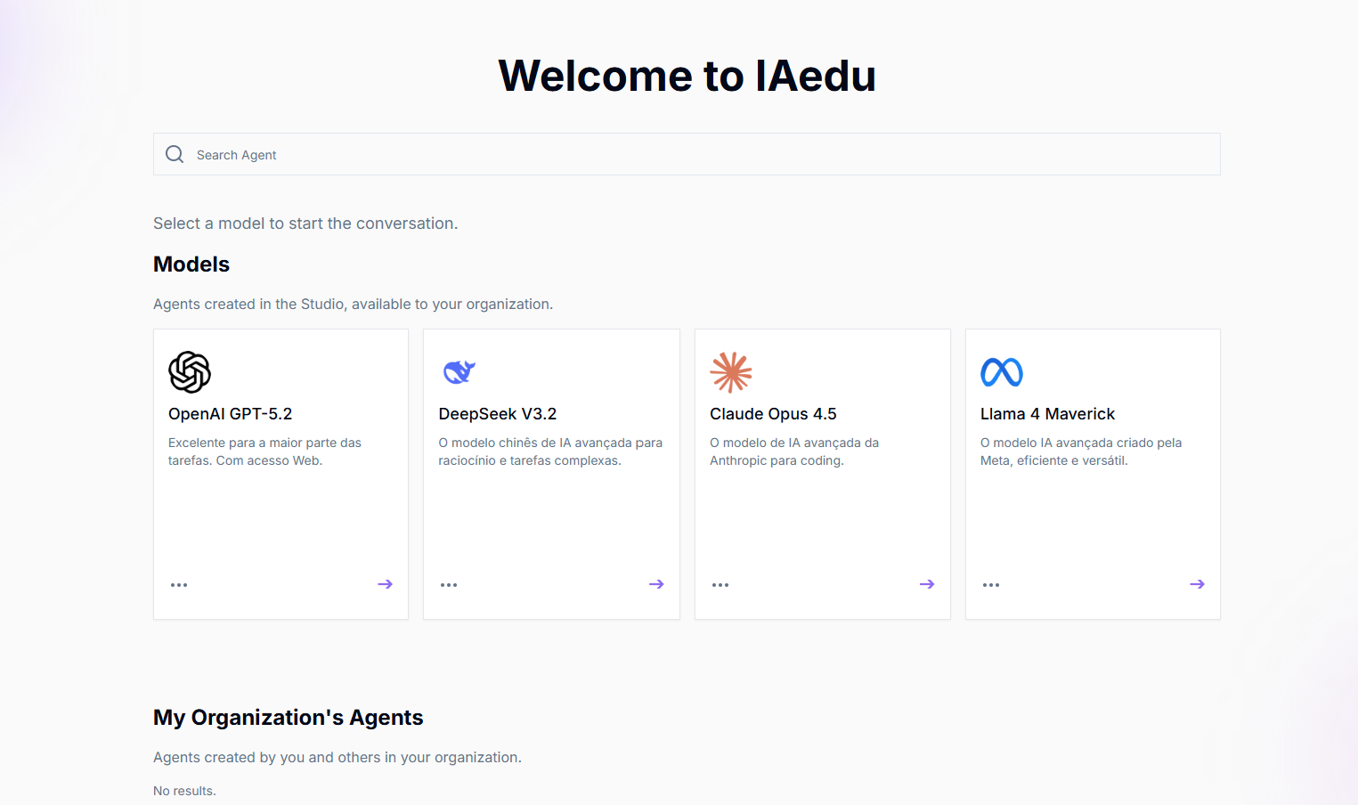
https://iaedu.pt
The digital service developed by FCCN aims to democratise access to Artificial Intelligence in Portugal in Higher Education and the Research community.
Benefits for students, teachers and researchers
Multiple Artificial Intelligence (AI) models in a unique portal;
Single and federated authentication;
3. Platform tailored to the needs of institutions.

Slide 27
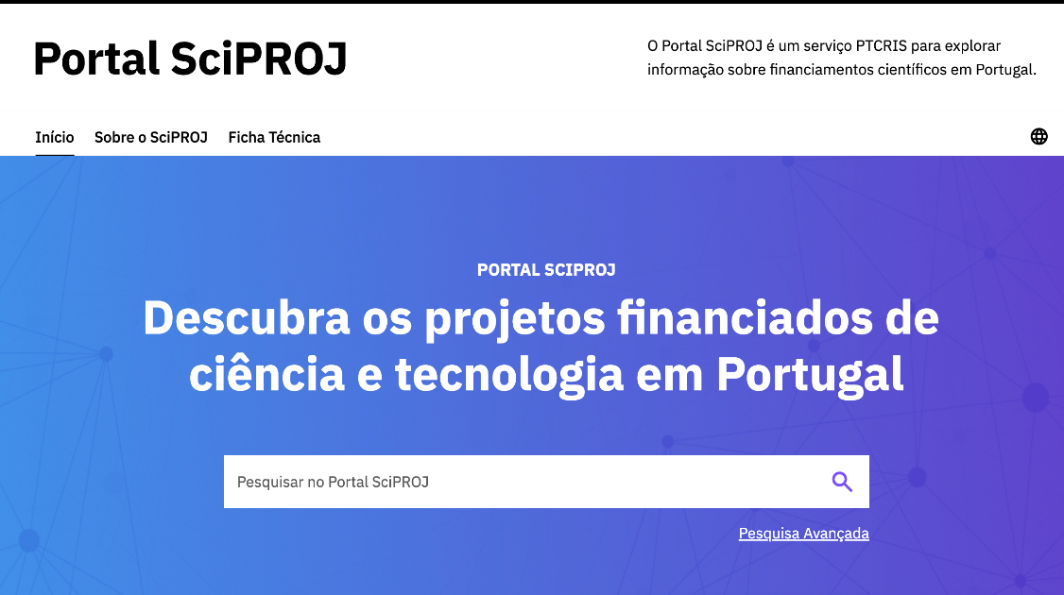
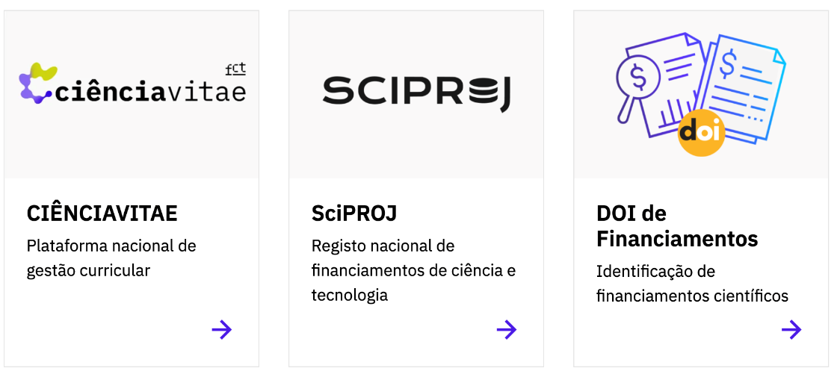
Science Data
SciPROJ
New portal that brings together detailed information on national and international funding that supports science and technology activities in Portugal.

Slide 28

Advanced Computing
Integrated management of new resources
1
Holding Advanced Computing Project Calls and promoting access routes;
2
  Funding for I&D projects in the field of advanced computing (with automatic allocation of computing time);
3
Acquisition of national computing resources (Deucalion and MareNostrum 5);
4
Creation of the Centro Nacional de Computação Avançada (CNCA)​.

Slide 29
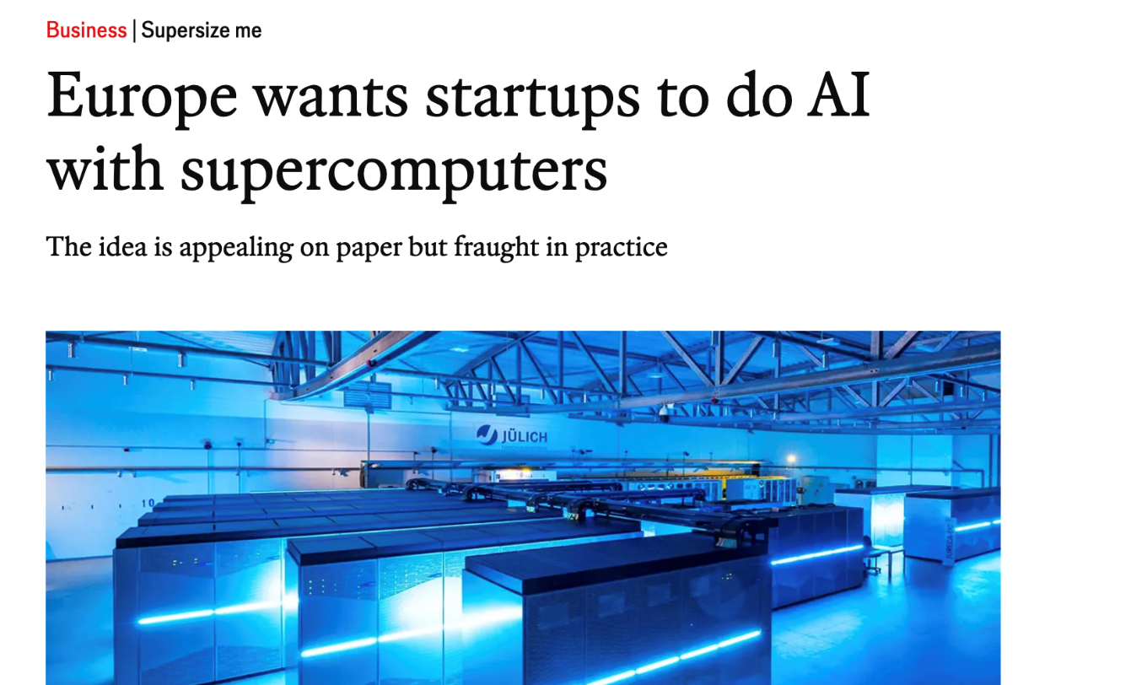
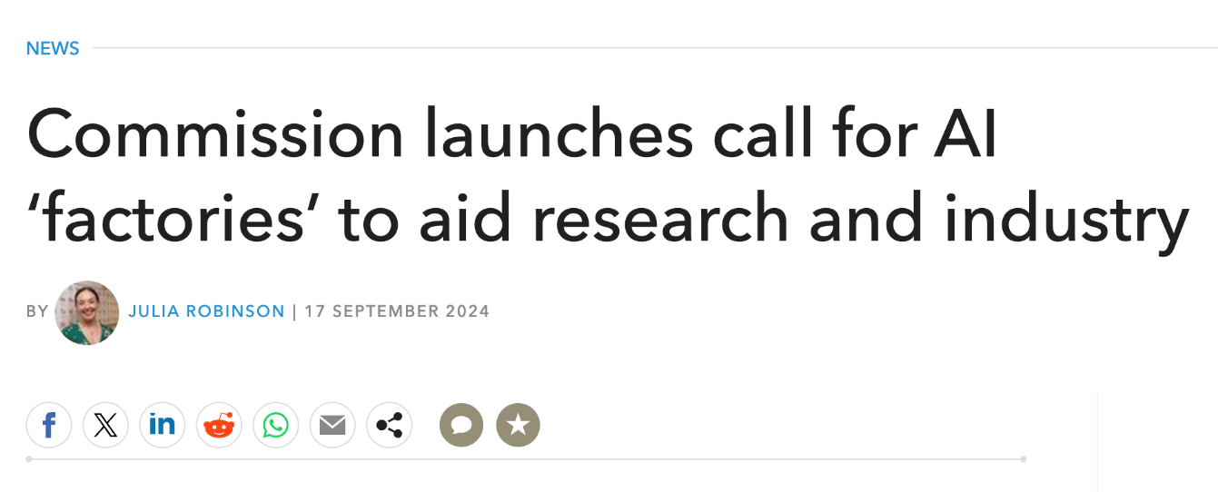
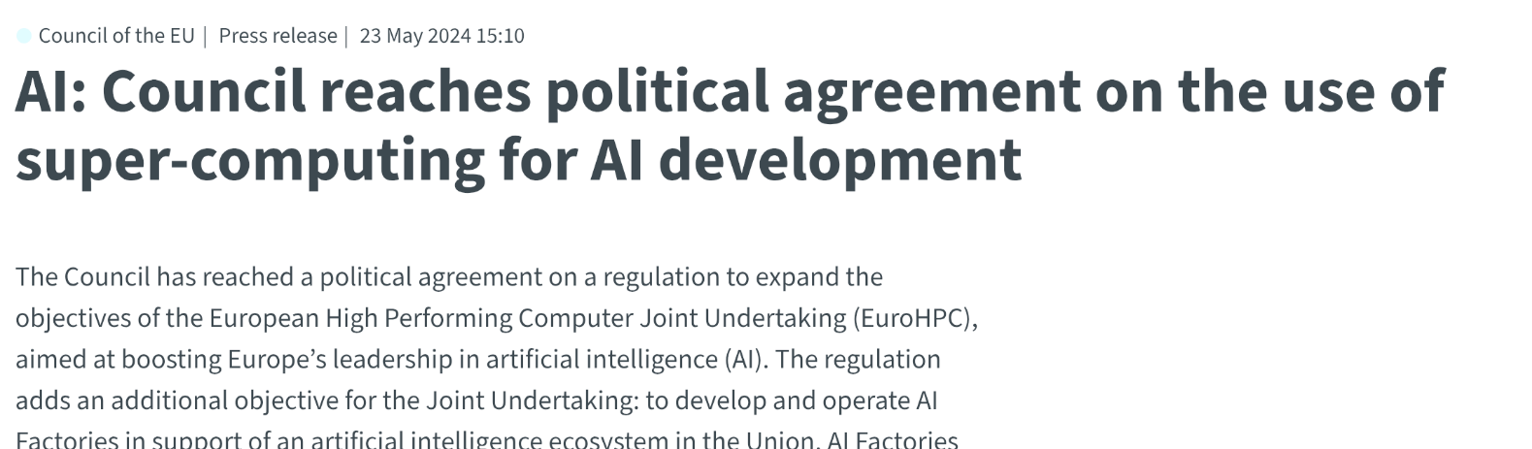
AI FACTORIES

Slide 30
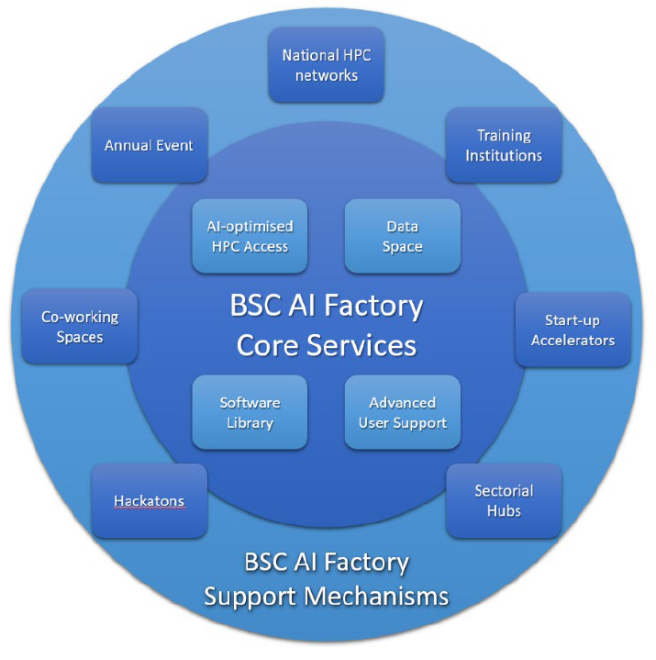

AI FACTORIES
Portuguese participation in the BSC AI Factory
Machine attached to MareNostrum5;
Joint initiative between Spain, Portugal, Turkey, and Romania;
New machine (~€128 million) exclusively dedicated to AI for the business and innovation sector;
Support services within the country.
Core Services
Support Services

Slide 31

New target audience
InovIA
Vouchers for innovation;
Start-ups and small and medium-sized enterprises (response within 5 days);
Another step towards democratising access to supercomputing and artificial intelligence.

Slide 32
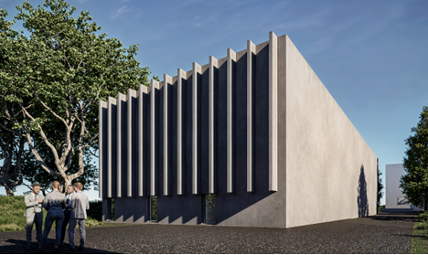
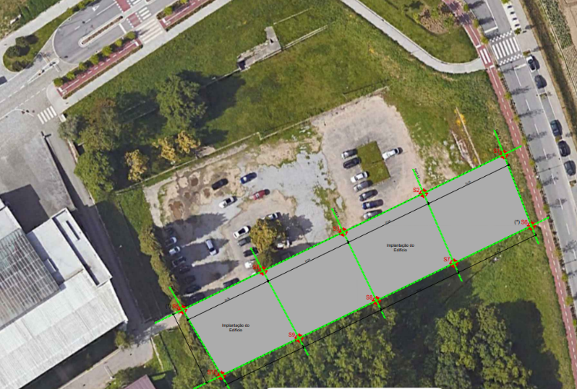
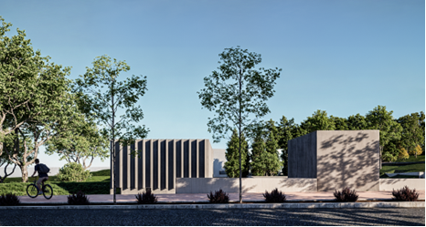
New datacentre for Science and Innovation
New datacenter (2025-26)
Guimarães (next to the existing FCT infrastructure);
Redundancy and data policy.

Slide 33

Thank you.
For complete information on all services, fccn.pt

