Slide 1
SWOT Analysis - SIG-NOC
Strengths
- First SIG to be created
- Active and strong knowledge-sharing community
- Diverse and technical expertise, with operational focus
- It facilitates cross-NOC collaboration
- Practical outputs (Tools Survey)
- Coffee-breaks are much more than coffee!
- Some very loyal attendees (NRENs and end organisations)
Weaknesses
- Dependence on voluntary contributions
- Lack of strategic view - Mostly operational
- External visibility
- Repeating ourselves with time
- Trips and expenses are self-paid
- Some NRENs never joining list or meetings
Opportunities
- AI
- Always evolving Networks, there are always topics to discuss
- Cross-collaboration with other SIGs and groups (SIG-NGN, SIG-AI, Security Days, STF…)
- Some threats can be turned into opportunities for SIG-NOC to find solutions (talent shortage, end organisations, other communities…)
Threats
- Net Operations aren’t as fancy as trend topics (e.g. AI)
- Always evolving networks - Risk of being outdated
- Talent shortage in Network operations
- Ability to reach organisations connected to NRENs
- Several parallel communities (NOG Groups, RIPE Meetings, Infoshares…)

Slide 2
SWOT Analysis – SIG-NGN
Strengths
- Strong & diverse Expertise in NRENs
- History; The oldest SIG
- Core business of NRENs
- Strong technology foundation
- Reach beyond European NRENs
- Bridge industry with R&E networks
- Full picture of Internet evolution
Weaknesses
- The usual suspects
- The oldest SIG
- Many classic topics less relevant now
- Tendency to focus on operational issues
- Where is innovation coming from?
Opportunities
- Many members of the SIG list
- Strong turnout at meetings
- Strong technology foundation
- Catalog of technology topics / opportunities
- Re-engage with IETF
- Focus on innovation and what comes next
- Networks are truly powerful now
Threats
- Lack of time
- NRENs have changed: leaders --> followers
- For some, networking is a solved problem
- New SIG’s offspring from SIG-NGN
- Topics can be very specialised
- Industry focuses on Datacentre/LAN networking

Slide 3


GÉANT SIG-TFN
SWOT Analysis
Domenico Vicinanza
Géant Senior Research Engagement Manager
Introduction GEANT SIG-Quantum
WP6 Meeting

Slide 4
Mission and Focus
The SIG-TFN brings together expertise on time and frequency distribution across NRENs
Focusing on development, deployment, testing, standardisation and interoperability of time/frequency (T&F) solutions and the evolution of a Core-Time & Frequency Network (C-TFN).
It provides a forum, defines operational objectives, data plans, repositories and technical specs, and advises GÉANT bodies.

Slide 5
SWOT Analysis – SIG-TFN
Strengths
- Strong metrology and networking expert base with working groups and committees.
- Active coordination of pilot deployments (e.g., cross-border T&F links).
- Structured approach to sustainability and technical specification for C-TFN.
Weaknesses
- Very specialised domain: may have limited visibility within broader community.
- High infrastructural and coordination costs for pan-European roll-out.
- Requires alignment across NMIs, NRENs and funding agencies.
Opportunities
- Growing demand for high-precision T&F services (e.g., synchronization, scientific use).
- Potential integration with European infrastructure and research programmes.
- Rising strategic interest in timing sovereignty and metrology competence.
Threats
- Funding uncertainties for long-term sustainability and operational costs.
- Interoperability challenges across diverse national networks.
- Competition or overlap with commercial timing solutions and industry efforts.

Slide 6
Trends and Opportunities
Key Trends
Deployment of pan-European backbone for time/frequency distribution.
Precision timing becoming critical for science and network applications.
Increasing dialogue with commercial telecoms on timing requirements.
Collaboration Opportunities
Joint activities with SIG-Quantum on physical layer infrastructure needs shared by quantum and T&F services (e.g., fibre and synchronisation technologies.)
Work with SIG-NGN & SIG-NOC to align core network operations with precision timing and future-ready network architectures.

Slide 7

Thank You!
Let’s stay in touch!
dom.vicinanza@geant.org
www.geant.org

Slide 8
GÉANT SIG-Quantum
SWOT Analysis
Domenico Vicinanza
Géant Senior Research Engagement Manager
Introduction GEANT SIG-Quantum
WP6 Meeting

Slide 9
Mission and Focus
SIG-Quantum provides a forum for the community working around quantum technologies (networking, computing, sensing, cryptography, communication) across research and education networks.
It facilitates exchange of experience, ideas and knowledge on development, deployment, testing, standardisation and contributes to a coherent strategy across GÉANT.
Advisory role to GPPC and project coordination.

Slide 10
SWOT Analysis – SIG-Quantum
Strengths
- Community of experts across quantum networking, sensing, cryptography
- Clear focus on knowledge exchange, evaluation and testing to inform strategy.
Weaknesses
- Early-stage ecosystem with rapidly evolving technology risks.
- Limited deployment experience across NRENs compared to traditional network tech.
- Dependence on standards which are still emerging.
Opportunities
- Evolution of European and global quantum infrastructure initiatives (e.g., QCI )
- Collaboration with industry and research projects for practical pilots.
- Growing interest in quantum technology and communications among NRENs
Threats
- Fragmented national strategies could slow interoperable deployment.
- Fast-changing technology: risk of standards or approaches becoming obsolete.
- Funding is fragmented

Slide 11
Trends and Opportunities
Key Trends
Movement toward national and pan-European quantum networking and testbeds.
Convergence of quantum and traditional networking for hybrid applications.
Collaboration Opportunities
Work with SIG-TFN on physical layer and timing requirements that support quantum communications.
Partner with SIG-NGN & SIG-NOC for integration of quantum technologies in next-gen infrastructure.

Slide 12
Thank You!
Let’s stay in touch!
dom.vicinanza@geant.org
www.geant.org

Slide 13
SWOT Analysis – SIG-MSP
Strengths
- Committed steering committee
- Strong in person attendance
- Attendees contribute during the meeting
- The group picks up topics other groups don’t i.e. it’s one of the only groups to focus on non-technical aspects + Strategy
Weaknesses
- A fairly ‘hands off’ steering committee leads to significant work by co-ordinators (although this has been the case for many years and not necessarily a weakness!)
- Extended Service portfolio of NRENs means that topics can be very disparate as NRENs move to ‘full stack’.
Opportunities
- Bringing ‘new blood’ into MSP attendees
- Joint meetings – potentially 1 x per year with other SIG for cross fertilization of ideas and raising awareness of MSP and bringing new participants to meetings
Threats
- Community in general more used to online meetings…taking time out for in person meetings only when it is ‘necessary’ rather than ‘nice to have’
- MSP are difficult to follow in an ‘all day’ format.
- Many register online but don’t attend, due to full day nature of meetings (more intelligence should be gathered to assess why)

Slide 14
SWOT Analysis – SIG-RED
Strengths
- Relevant: Research is NREN primary mission
- Research always evolving, new topics to engage with are always emerging
- Visit to research institutes – unique and valuable – keeps us grounded real research
- Range of people with different backgrounds on the SIG-RED steering committee
Weaknesses
- Broad subject area - can be difficult to focus
- Not all NRENs have Research Engagement function, so can be difficult to engage with target audiences
-Travel budget: Attending institute visits can be difficult
Opportunities
- Opportunities with other SIGs on topics of common interest.
- New research interests - new opportunities Non- European NRENs are always interested in this topic, so engaging with them is essential
-Wide range of researchers to engage with:
Cross cutting topics/tools
Focus on specific research areas
Threats
-Difficulties in keep track of research need in:
  New areas of research
  New techniques in different science areas
- Overlap with other SIGs

Slide 15
SWOT Analysis – SIG-CISS
Strengths
Existing “asset ownership” mentality
Pan-european reach without competition
Ethics and trust are part of our brand
Community of do-ers, focus on technical topics (build vs buy)
Knowledge sharing
Weaknesses
Small track record, missing tangible outputs
Tendency to get stuck in PoC mode
No long-term vision
Harder to coordinate between unalike actors
Opportunities
The “sovereignty” drive needs an executive arm
EC is looking for sustainable cloud actors
Broaden collaboration with other initiatives, for example CS3
Threats
Many platforms at which same topics are discussed
Initiatives outside of GEANT take over leadership
Procurement-only approach obsoletes CISS

Slide 16
SWOT
For SIG-ISM
Annette Aylward, Michel Gerdes
SIG-ISM coordinator and chair
GCP Workshop, Utrecht, NL
24+25 March 2026
Confidential

Slide 17
Strengths
Solid support from a small number of NRENs and organisations
Relevance: high quality of topics
Weaknesses
Only a small group of NRENs participating
Little action or cooperation outside of meetings or workshops. No resources to create things -> task moved to Security Work Package of GN project
Opportunities
Diversity: There is not one way to do it right
Threats
Security Specialists are usually very busy
Security is often treated as an “add-on”
Security is sometimes hard to understand for non-professionals
Participants are aware what to share
How much can we share (trust)? Not all participants are willing or allowed to share internal confidentialor negative information
Information Security can be linked to everything NRENs daily do
Security specialists in smaller NRENs usually have other hats (e.g. operating the network in a one-man show)
Information Security is relevant for everything NRENs do
Recap and communications after meetings has been slow
GÉANT staff overlap in participants
Security Days conference has similar topics
Willingness from participants to host the workshop
Engaging new formats worked well
Advertising events and funding coverage from other WP works well
Resilience is becoming more important for organisations
Notes:
You see, we have a risk oriented approach:
Focus on weaknesses and threats ;-)
Workshops are in-person only
Small groups possible only
Larger workshops at conferences

Slide 18
Thank You
Any questions?
www.geant.org

Slide 19
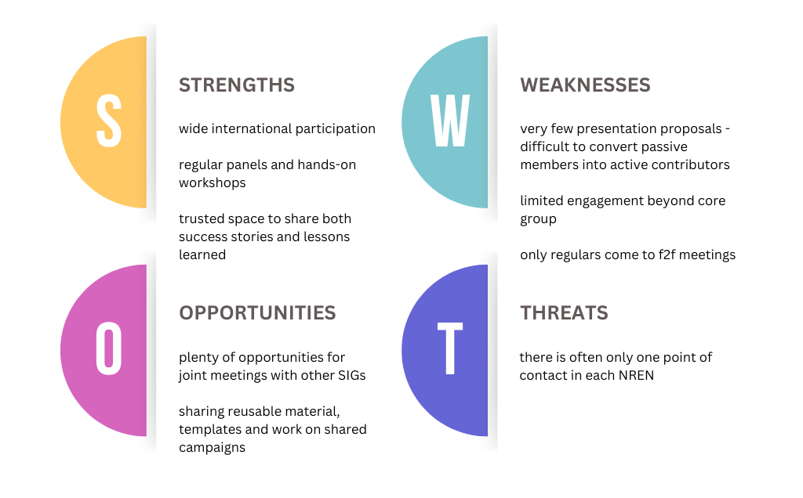
SWOT Analysis – SIG-Marcomms
Opportunities
The “sovereignty” drive needs an executive arm
EC is looking for sustainable cloud actors
Broaden collaboration with other initiatives, for example CS3
Threats
Many platforms at which same topics are discussed
Initiatives outside of GEANT take over leadership
Procurement-only approach obsoletes CISS

Slide 20
SIG-Procurement SWOT
Strengths Expertise within the community and the steering committee that enables discussions and different insights. Trust in each other's expertise and ways of thinking. | Weaknesses The community might be big, but the amount of procurement experts within is limited. The participating specialists are not that diverse (mainly western and northern Europe) Not much awareness within the NREN’s of the impact that public procurement has on the day-to-day activities
Opportunities Multitude of topics that are relevant in the field. Very dynamic field which ensures that past topics stay relevant Common goals which could (hopefully) lead to collaboration and new framework agreements to be used by the NREN’S | Threats Not everyone in the community is as aligned which influences the procurement divisions greatly. Leads to less collaboration. National differences lead to difficulty finding common ground/practices/topics.

Slide 21
SIG Sustainability SWOT Analysis
Strengths
- Good sustainability knowledge in the group
- Collaboration
- Our organisations are at a different level of sustainability and we each work on different topics
Weaknesses
- Still a small group
- Need to put out more comms
Opportunities
- Increasing awareness around impact of networks
- Changes in reporting requirements
- Procurement opportunities
Threats
- Adoption of energy-intensive technologies
- Sustainability taking the back seat right now

Slide 22
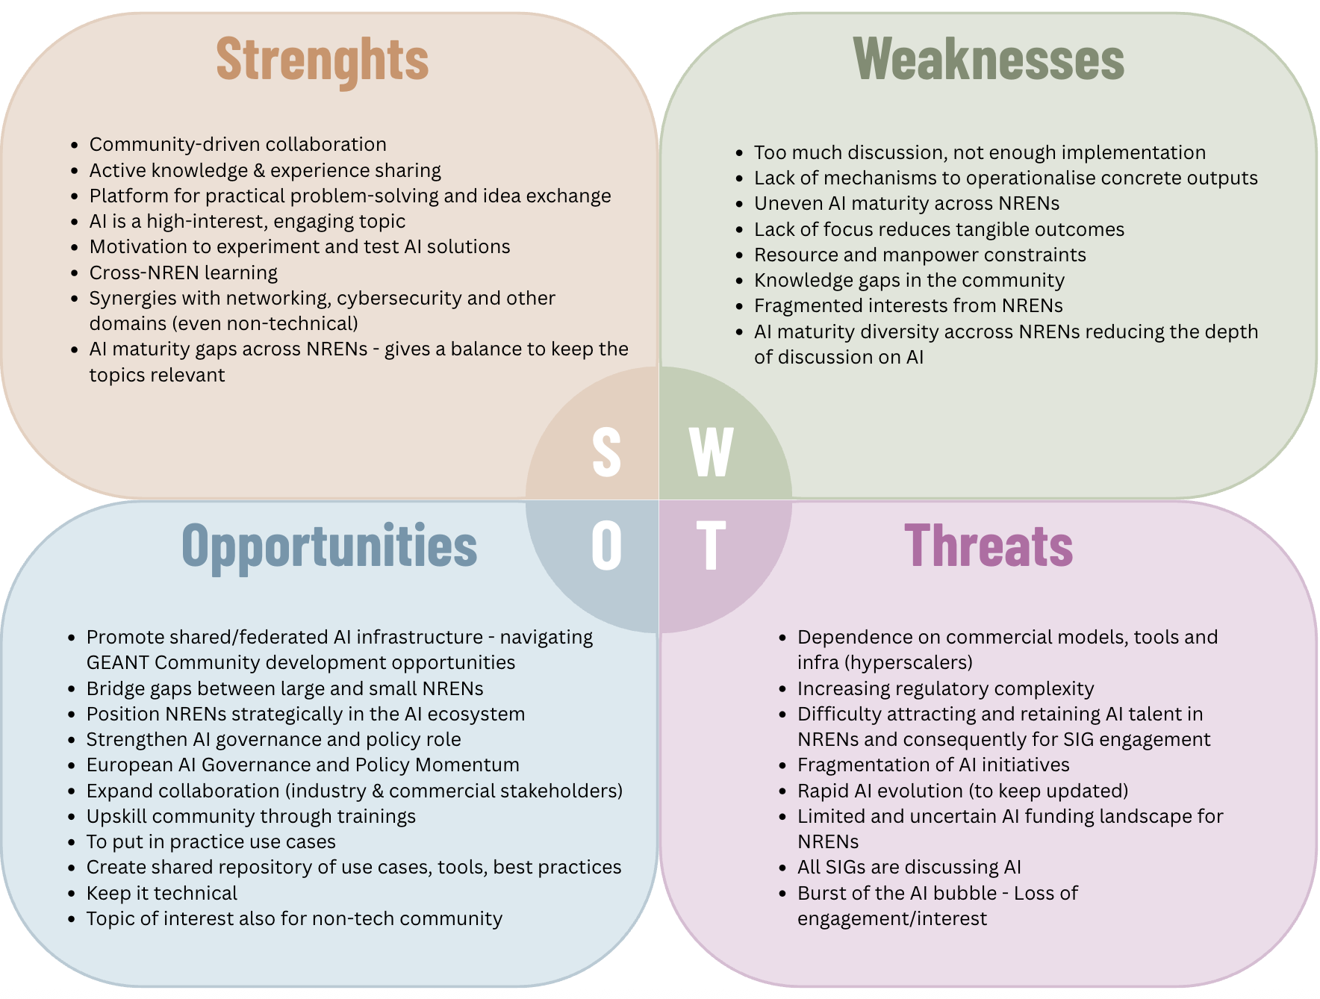
SIG-AI SWOT Analysis
Sustained engagement though experience sharing
remaining practical and technical to be relevant.
Map opportunities for tangible outcomes
Show the path toward concrete and collaborative projects
(use cases, pilots, and reusable outputs).
Fragmentation is the main structural risk
Coordination is critical (topics, maturity, diversity)
AI Federated Services is the strategic opportunity
Can position NRENs strongly in the AI ecosystem.

Slide 23
SWOT Analysis – SIG PA
Strengths
Clear strategic positioning
High political relevance
Forward-looking focus area
European-level alignment
Community expertise
Weaknesses
Voluntary engagement
Newly formed SIG
Sensitivity of some PA topics
Resource constraints
Diverse NRENs expectations
Opportunities
Strengthen strategic awareness
Expand best practice sharing
Grow the network
Early warning for NREN on funding risks
Driving creation of dedicated PA teams in NRENs
Threats
Rapid policy changes
Regulatory complexity and fragmentation
Varied engagement levels
Long-term engagement

Slide 24
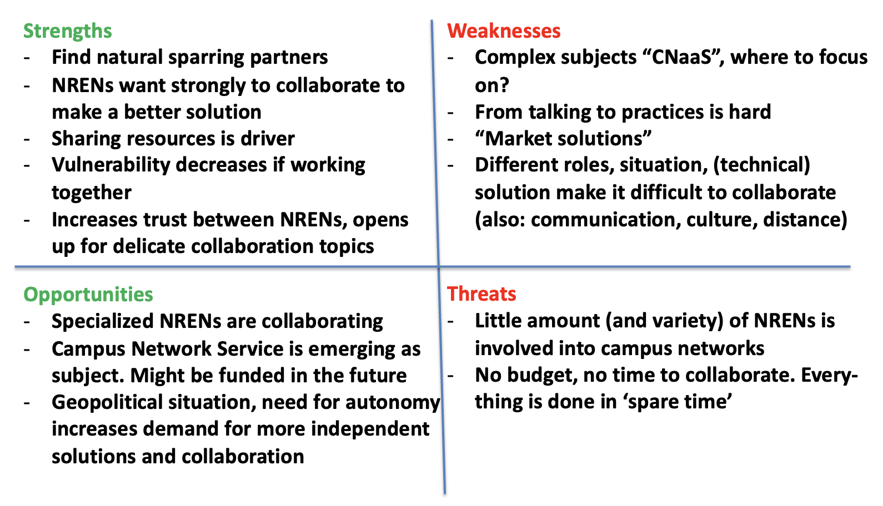
SWOT Analysis – SIG-CNaaS

Slide 25
TF-EDU SWOT Analysis
Strengths
Large geographic coverage
Open sharing of strategies and best practices
Open, inclusive participation model
Broad stakeholder representation
Neutral, trusted position
Strong backing from GÉANT
Access to real implementation experience
Weaknesses
Limited bottom-up community input
Topics often driven by steering committee
Uneven stakeholder engagement
Limited visibility outside NREN ecosystem
Resource constraints
Broad scope can dilute focus
Lack of continuity in participation
Opportunities
Growing need for digitalization in education
Positioning NRENs as independent knowledge leaders
Influence on global and EU policy frameworks
Expansion beyond Europe
Leaders in standards & interoperability
Access to EU / global funding programs
Stronger academia-industry collaboration
Growth of lifelong learning ecosystems
Threats
- Declining community engagement
- Competition from commercial edtech providers
- Fragmentation across similar initiatives
Regulatory and policy differences across countries
Dependence on key individuals
Rapid tech changes (e.g. AI)
Perceived lack of tangible outputs
Funding uncertainty)
Notes:
Limited input

Slide 26
CLAW/ PAW SWOT
GCP Workshop
Zoë Fischer
WP8T2 Sub-task lead Crisis Management
Project Manager (Security) – GÉANT
Utrecht
24-25.05.2026
Public

Slide 27
Strengths
Structured, comprehensive crisis-management training
Hands-on crisis exercise
Strong community engagement
Reuseable materials and skills (PAW)
Weaknesses
Resource-intensive to organise
Resource intensive to to reuse (CLAW)
High level of expectation (every year needs to be better)
    Mostly benefits individuals, doesn’t test internal processes
S
W
O
T
Threats
Rising expectations vs. limited budgets
Changes in Group -> skills gap
Maintaining high‑quality/ realistic scenarios becomes harder
Opportunities
Growing need for crisis preparedness
Integration with other community initiatives (e.g. Security Bootcamp, TALON)

Slide 28
Thank You
Any questions?
www.geant.org

