Slide 1


GCP Workshop March 2026
Public

Slide 2
Agenda Tuesday March 24
Time | What
13:00 – 13:15 | Welcome – who is in the room?
13:15 – 14:45 | SIG and Activities Updates
14:45 – 15:15 | GCC Updates
15:15 – 15:30 | Coffee Break
15:30 – 16:30 | Thematic Area Meet Up
16:30 – 17:00 | Report Back
17:00 – 17:30 | Wrap up
18:30 – 21:00 | Dinner at The Streetfood Club

Slide 3
SIG updates
Public

Slide 4
SWOT Analysis: Strengths, Weaknesses, Opportunities, Threats
1. SIG-NOC | 9. SIG-Marcomms
2. SIG-NGN | 10. SIG-Procurement
3. SIG-TFN | 11. SIG-Sustainability
4. SIG-Quantum | 12. SIG-AI
5. SIG-MSP | 13. SIG-PA
6. SIG-RED | 14. SIG-CNaaS
7. SIG-CISS | 15. TF-EDU
8. SIG-ISM | 16. CLAW/PAW
Trends and opportunities - where can you work with each other?

Slide 5
GCC Updates
Public

Slide 6
Who is your liaison?
SIG-ISM: Charlie
SIG-AI: Dawn & Ivana
SIG-MSP: Michel & Dawn
SIG-Procurement: Michel & Ariela
SIG-Sustainability: Charlie & Ariela
REFEDS: Erik
SIG-CISS: Michel
SIG-RED: Ariela & Ivana
SIG-Marcomms: Ariela & Charlie
TF-EDU: Erik & Dawn
NPAPWS: Maria Isabel & Ariela
SIG-CNaaS: Erik & Michel
SIG-Quantum: Ivana & Maria Isabel
SIG-TFN: Ivana & Maria Isabel
SIG-NOC: Maria Isabel & Ivana
SIG-NGN: Maria Isabel & Ivana
SIG-DigitalHealthData: Erik & Dawn
SIG-Policy: Dawn & Michel

Slide 7

Community Award

Slide 8

Timeline
Nominations open since January
Deadline April 17
Selection criteria open for everyone to consult
Selection by GCC + Chair GÉANT Board and GÉANT CEO in May

Slide 9
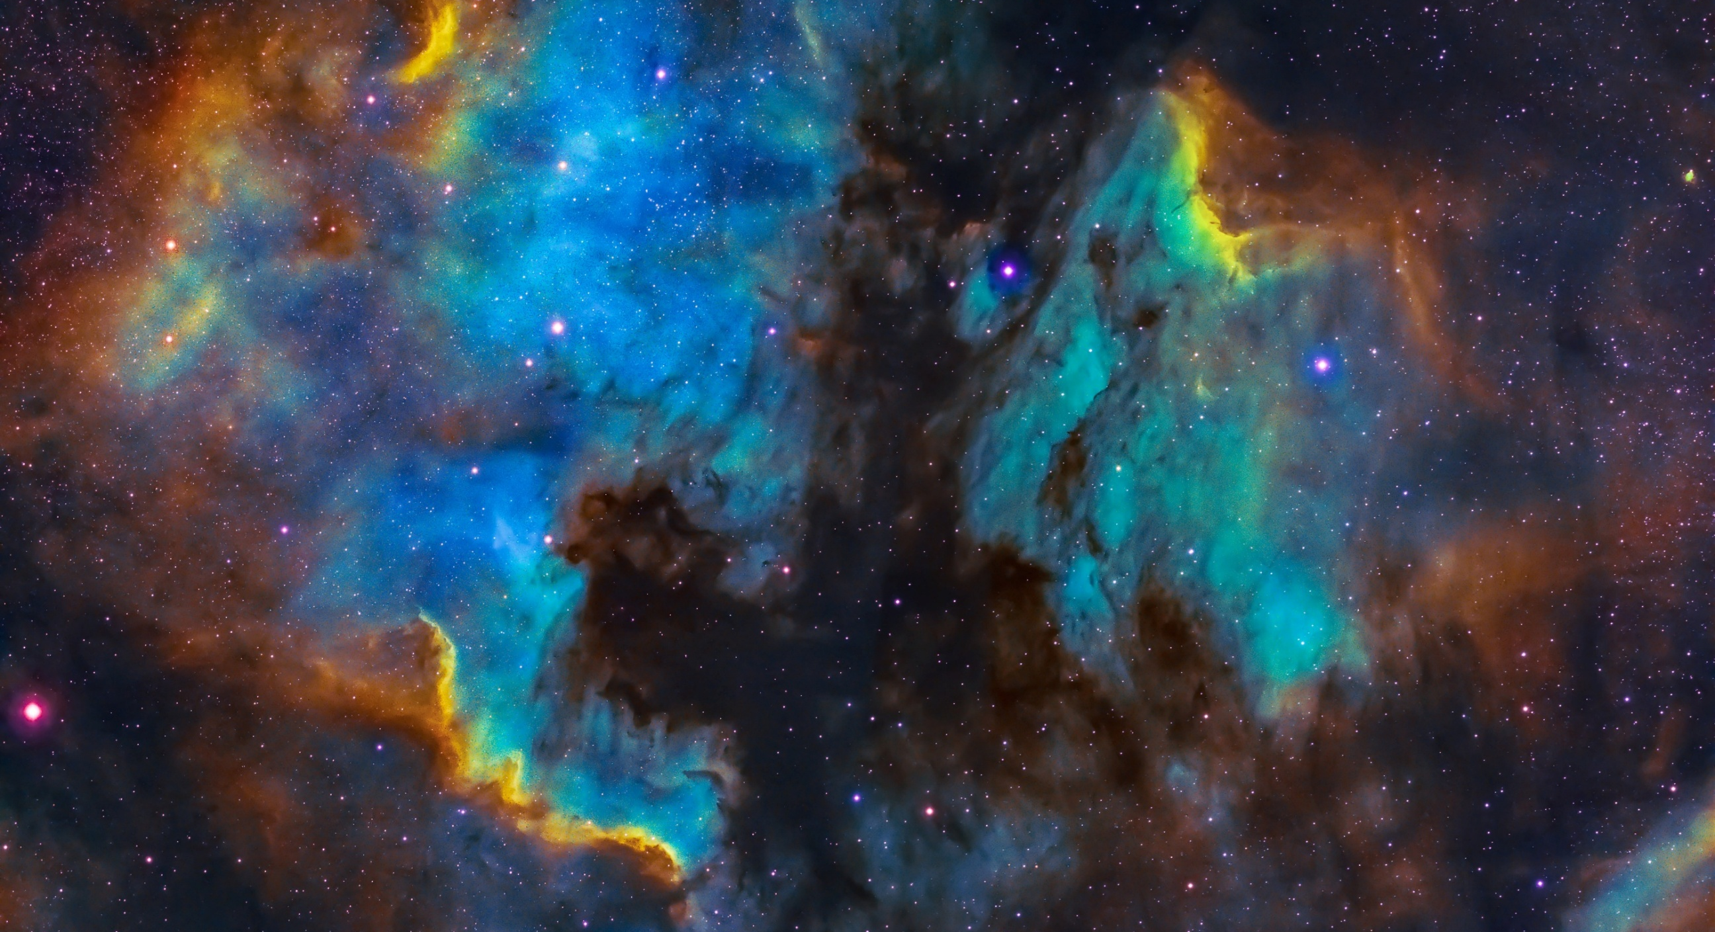
Humanitarian Support Group

Slide 10
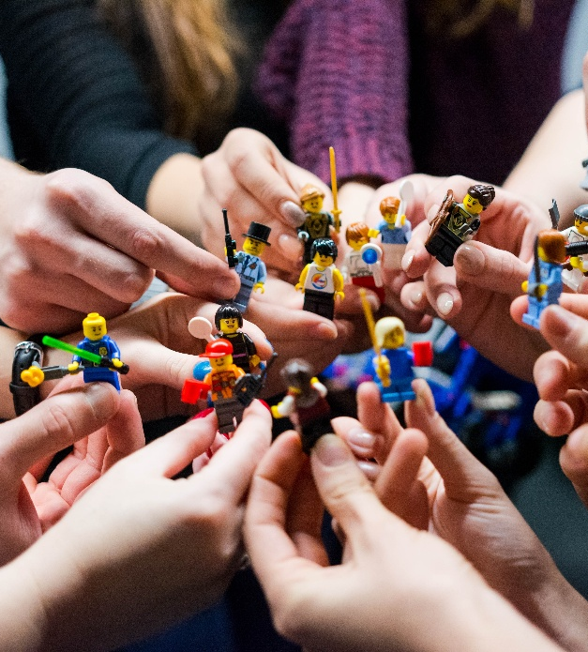
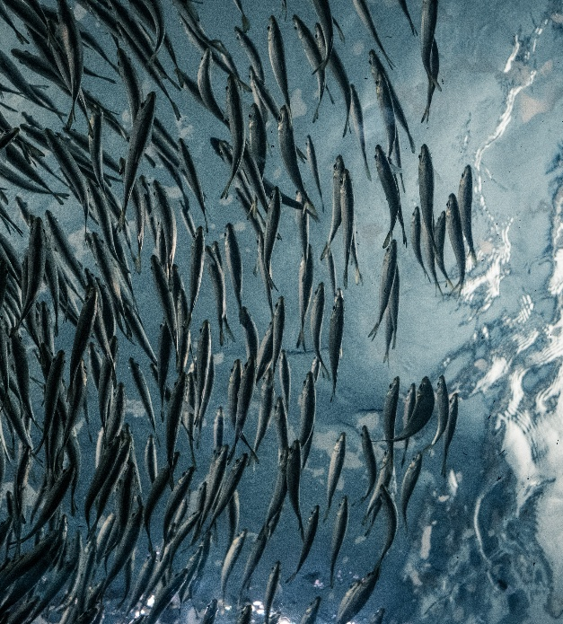
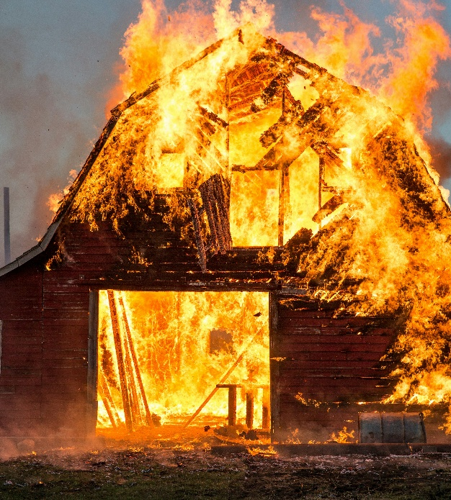
Focus
Now: Supporting URAN
Medium term: distributing lessons learned from URAN to community
Long term: linking pin between any European NREN and community during calamity
Notes:
Initiative from URAN, pitch last TNC, started December 2025

Slide 11




First initiatives
‘I support URAN’ campaign during TNC
URAN online day + webinars to learn from URAN
End of year initiatives: prepping for winter
Basics in place for long term support of any European NREN

Slide 12
Current members
Charlie Van Genuchten Chair
Tetiana Preobrazhenska URAN
Irina Matthews GÉANT
Anna Desaunois GÉANT
Rosanna Norman GÉANT
Raimundas Tuminauskas PCSS
John Dyer/ Erik Huizer Vietsch Foundation
Michel Wets SURF
Brian Nisbet Asiera
Olga Popcova RENAM

Slide 13
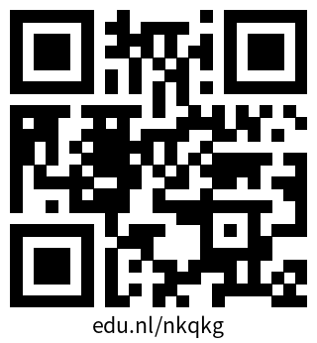
More information
Humanitarian Support Group Wiki

Slide 14
GÉANT Innovation Programme (GIP)
GCP Workshop
24-25.03.2026
Utrecht, Netherlands
Piotr Pawałowski (PCSS) <astagor@man.poznan.pl>

Slide 15
GIP in a nutshell
Community-driven R&D: Empowers GÉANT’s network of NRENs, universities and research institutes to explore and validate novel ideas with minimal administrative overhead.
Proof-of-concept support: Offers targeted backing, both financial and advisory, to turn early-stage concepts into working prototypes.
Innovation to impact: Seeks proposals that promise clear scientific, societal or economic benefits, with a strong eye on creating reusable services.
Integration into the community: Grantees present at the TNC conference to connect results back into the wider network.

Slide 16

GIP and GN Project Incubators
GIP | GN Project Incubators
NRENs and affiliates | GN Project partners
Financial support | PMs
Broader or changing scope | Specific thematic area
Solutions proven in GIP can be extended by an Incubator
Incubator PoCs needing funding for non-project partner can apply to GIP

Slide 17
GIP 2026 - Overview
Budget: €300K
Maximum budget per project: €50K
Thematic scope defined together with GN5-2 Incubator Leads, SIG Leads
Mandatory project presentation at TNC 26 at the Community Hub
Involve Incubator Leads in Expert Review

Slide 18
GIP 2026 - Timeline
Jan - Jun – Implementation
June – TNC presentation
31 Jul – Final report deadline
Aug - Sept – Evaluation of the results
30 Sept – Project closure, invoice due
Sept - Dec – Presentations WP/SIG meetings

Slide 19
Innovation Programme Trends to Date
Total number of proposals per year | 2026 | 2025 | 2024 | 2023 | 2022 | 2021
Submitted | 27 | 1 | 66 | 36 | 42 | 26
Approved | 6 | 1 | 6 | 10 | 10 | 10

Slide 20
GIP 2026 in numbers
 | Submitted | Approved
Proposals | 27 | 6
Area | Submitted | Approved
AI | 11 | 3
Network | 6 | 0
Security | 2 | 1
Above the Net | 2 | 0
T&I | 1 | 0
Multimedia | 1 | 1
Software | 1 | 1
other | 4 | 1
Country | Submitted | Approved
Belgium | 4 | 1
United Kingdom | 4 | 1
Serbia | 3 | 0
Moldova, Republic of | 2 | 0
Portugal | 2 | 0
Italy | 2 | 0
Poland | 2 | 1
Denmark | 1 | 0
Romania | 1 | 0
Ireland | 1 | 1
Spain | 1 | 1
Netherlands | 1 | 0
Austria | 1 | 1
Norway | 1 | 0
Finland | 1 | 0
Gender | Submitted | Approved
F | 4 | 1
M | 23 | 5
Other | 0 | 0

Slide 21
GIP 2026 awarded projects
Project title | Institution | Country | Gender | Area
LARA - LAtent Representation for Adaptative tasks | i2CAT | Spain | M | AI
G.O.READY Feasibility Study for a GÉANT Open Source Program Office (OSPO) | Open Ireland Network | Ireland | M | Software
FeduMEET - Delivering eduMEET as a Services using federated NREN infrastructures | PCSS | Poland | F | Multimedia
PHISHNET - An Open (X)AI-Driven Platform for Real-Time Detection of Phishing and Algorithmically Generated Domains | AIT | Austria | M | AI
EXPATS- Explainable Autofill for Trustworthy Surveys | PXL University of Applied Sciences and Arts | Belgium | M | AI
CHAMELEON-REN | Open University | UK | M | Security

Slide 22
GÉANT Innovation Programme (GIP)
Thank you very much!
Piotr Pawałowski (PCSS) <astagor@man.poznan.pl>

Slide 23
Thematic area meet-up
Public

Slide 24
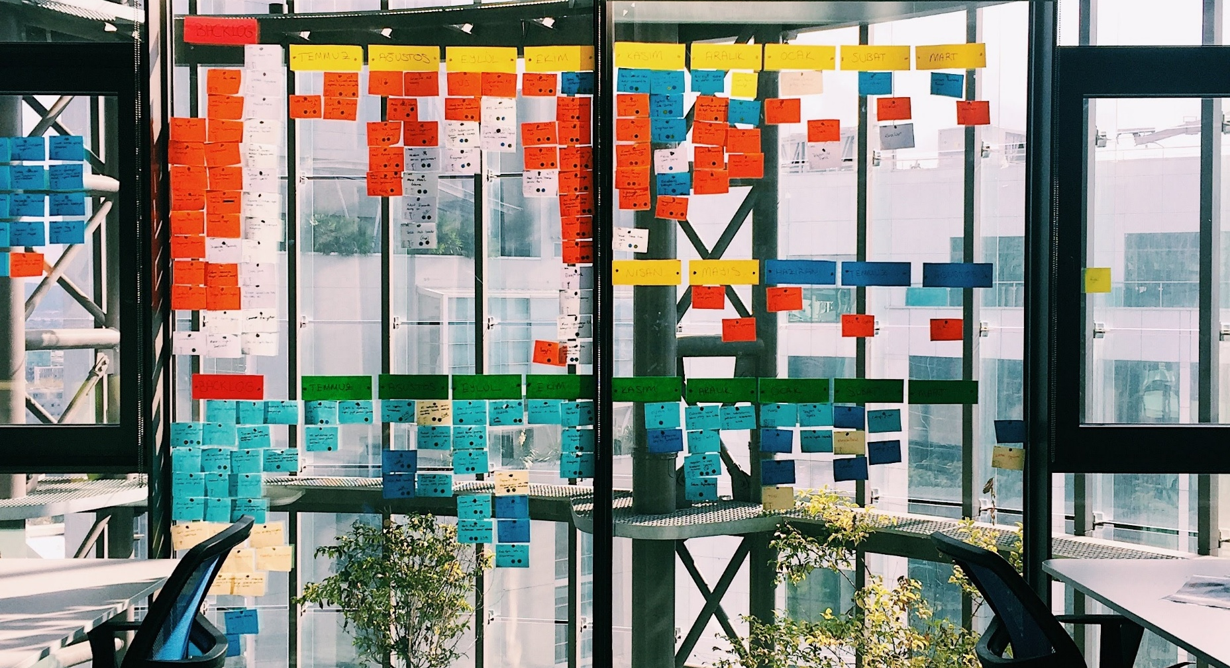
Wrap up Day 1 – Actions?

Slide 25
See you tonight!
18:30 – Informal group dinner at The Streetfood Club
Public

