Slide 1


GCP Workshop March 2026
Public

Slide 2
Agenda Wednesday March 25
Time | What
09:30 – 10:30 | Speed dating session
10:30 – 11:00 | Events update
11:00 – 11:15 | Coffee Break
11:15 – 12:30 | GCC Liaison Meetup
12:30 – 12:45 | Closing and Evaluation
12:45 – 13:30 | Lunch and Goodbye

Slide 3
Speed dating: getting to know everyone
Public

Slide 4
Starting questions
What’s the most popular topic in your SIG right now?
What would you change about your SIG meetings?
What’s one of the biggest strengths of your SIG?
If you could have a joint meeting with one SIG, who would you have it with and why?
Tell a cool memory from a SIG meeting you attended!
What is your pie chart piece? Do you like it / think you fit into it? Why yes/no?
What are some of your SIGs weaknesses?
Which area do you think we should collaborate more in?

Slide 5
SIG/TF events support – new request-based model & strategic master calendar
Nadelina Sandu
GCP Workshop - Utrecht
25 March 2026

Slide 6
What’s happening and why
Current challenges:
Need for more professional, consistent and high-quality event planning across SIGs/TFs and GÉANT events in general
Uneven levels of event management across SIGs/TFs - while some SIGs/TFs manage event organisation independently, others may benefit from additional support in this area
→ We are introducing a request-based model for events support for SIG/TF meetings.
Objectives:
1. Ensure that SIGs/TFs who require additional help with event planning and delivery have access to the right level of support – moving towards coordinators being field experts first and foremost.
2. Support the community in a flexible way - offer SIGs/TFs the opportunity to request event support based on their specific needs.
3. Improve overall event quality - help ensure that all SIG/TF meetings are well-organised, consistent, and professionally delivered, regardless of internal skill sets.

Slide 7
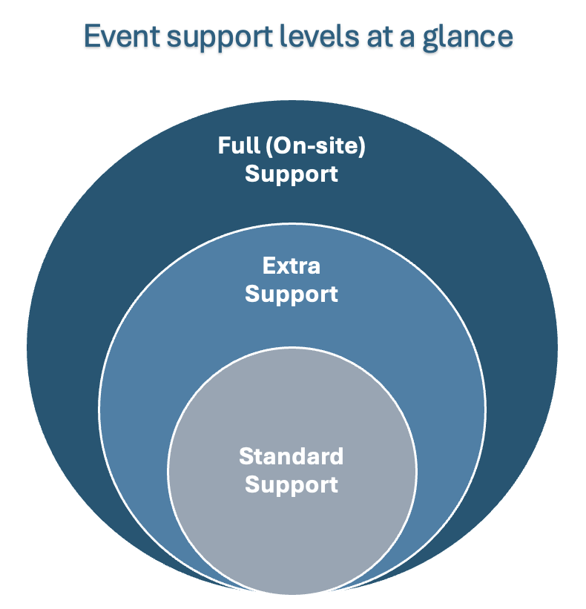
Introduction of an event support request form
Request form with defined event support levels:
Standard Support (default)
Event setup & registration
Extra Support
Includes standard + additional coordination
Full (On-site) Support
Includes extra + on-site (for more complex events)

Slide 8
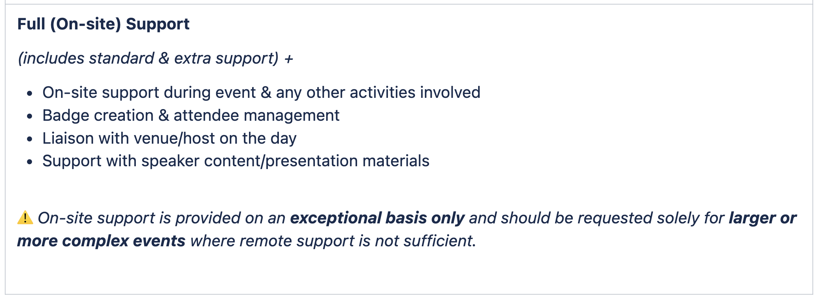
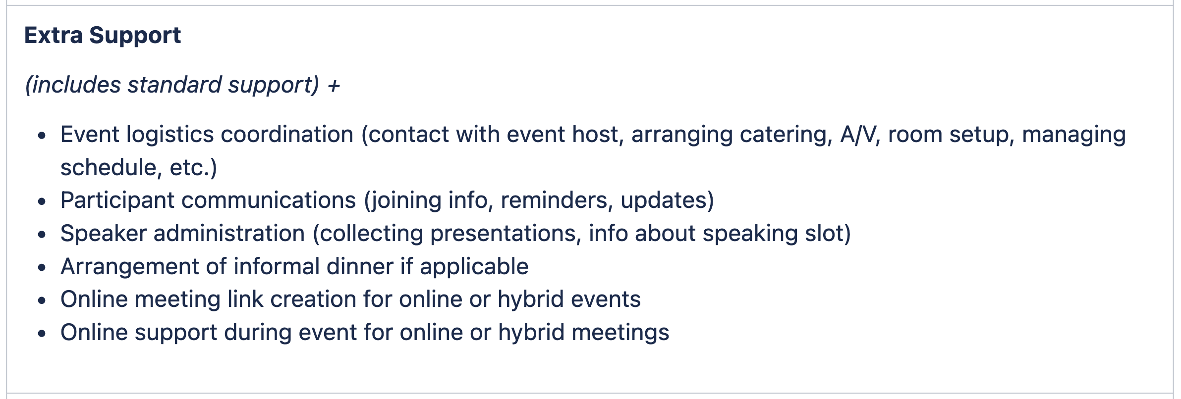
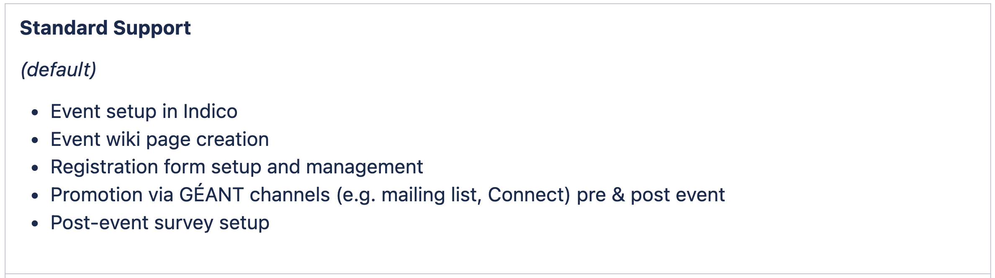
Event support levels

Slide 9
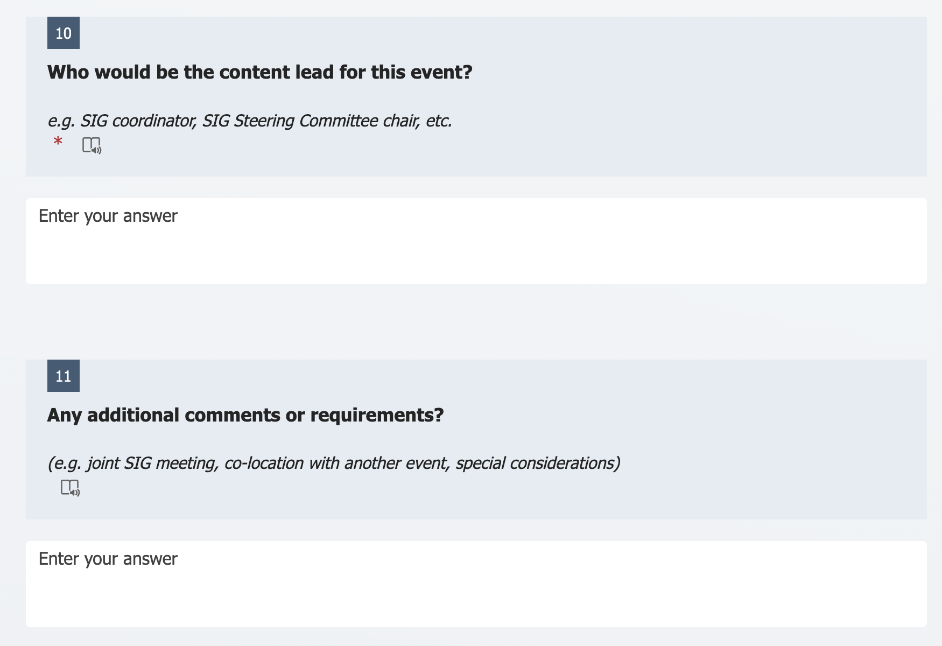
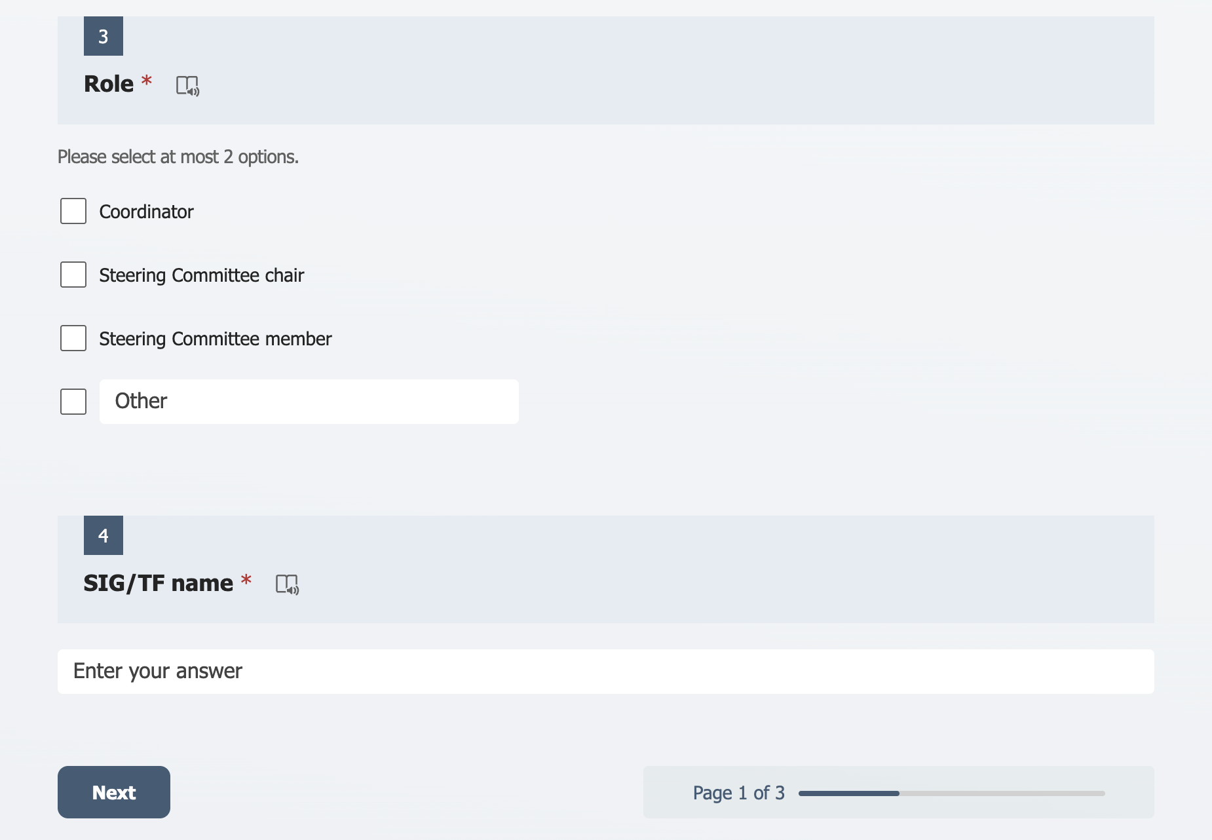
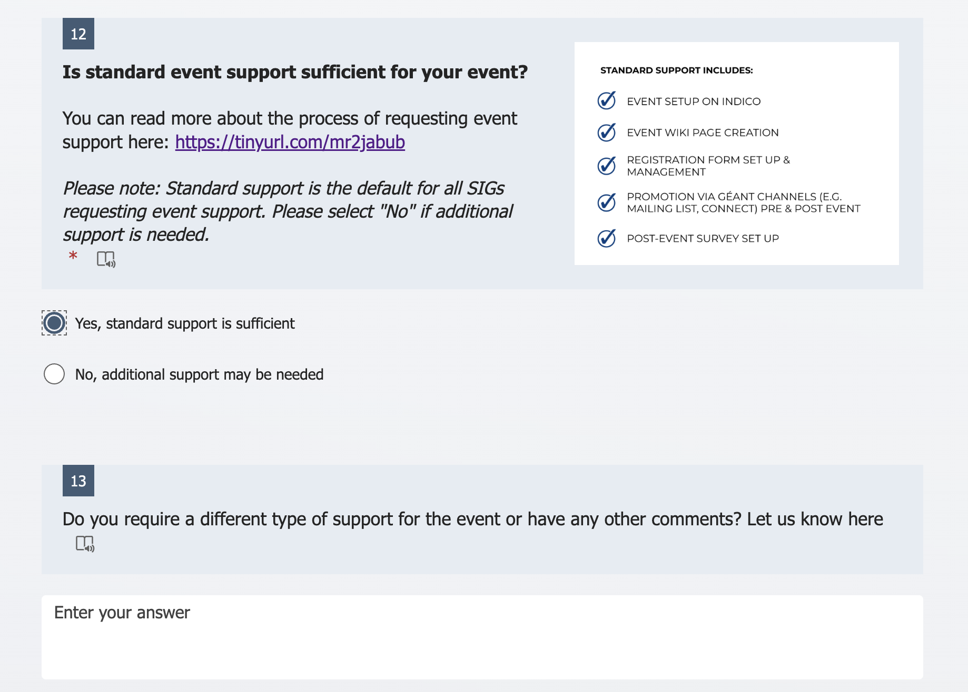
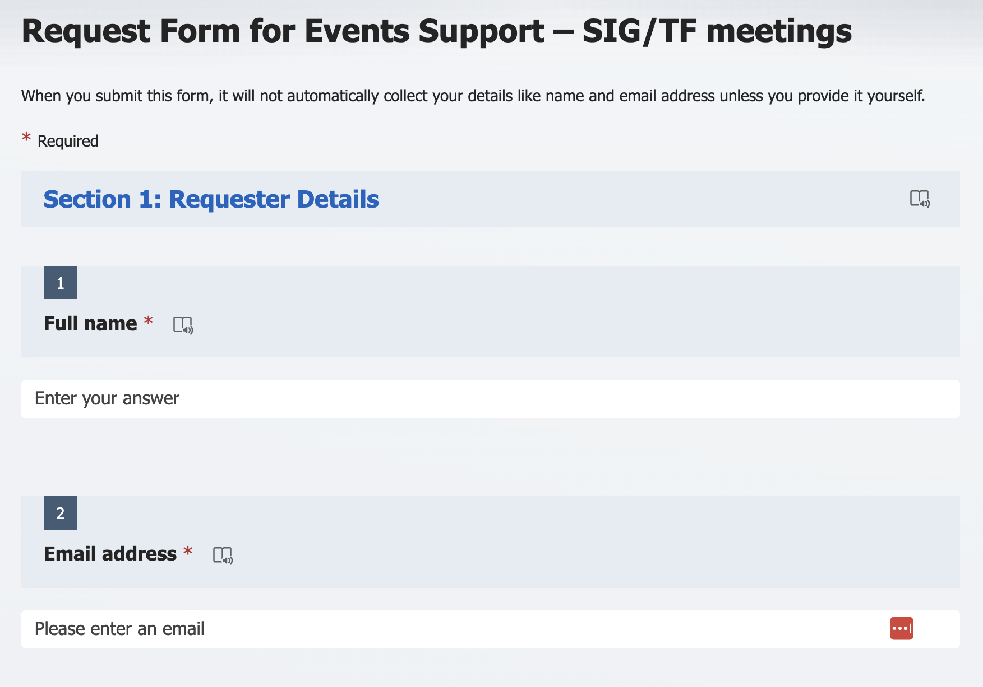
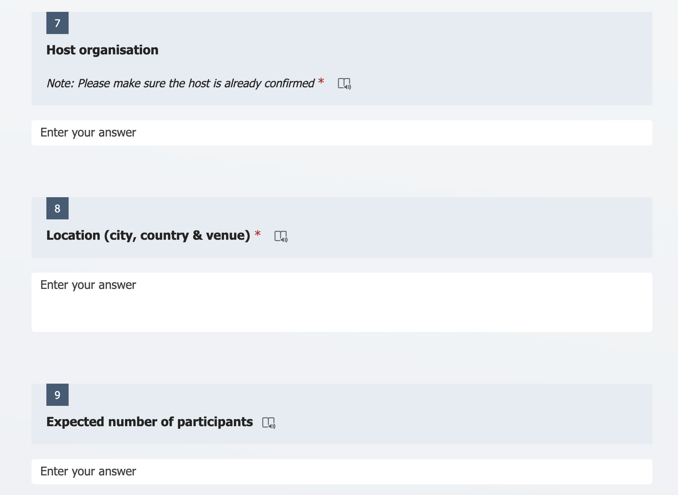
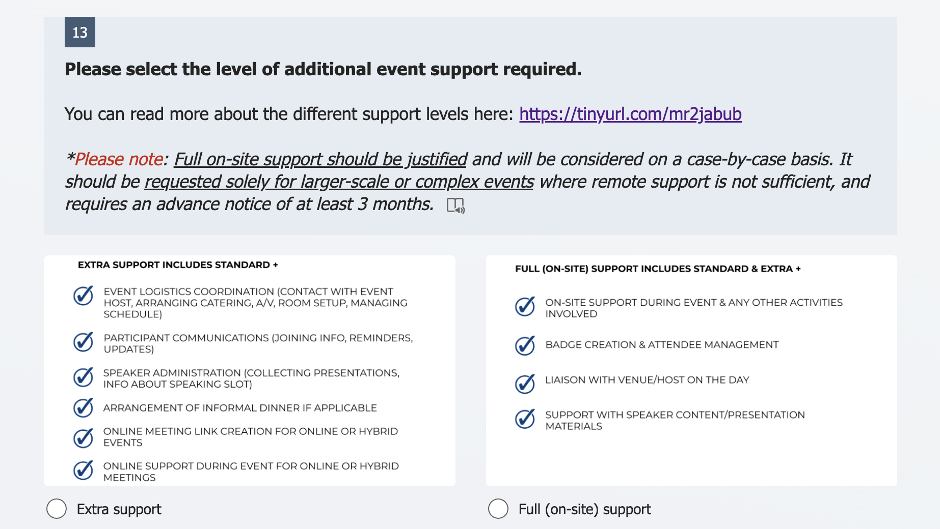
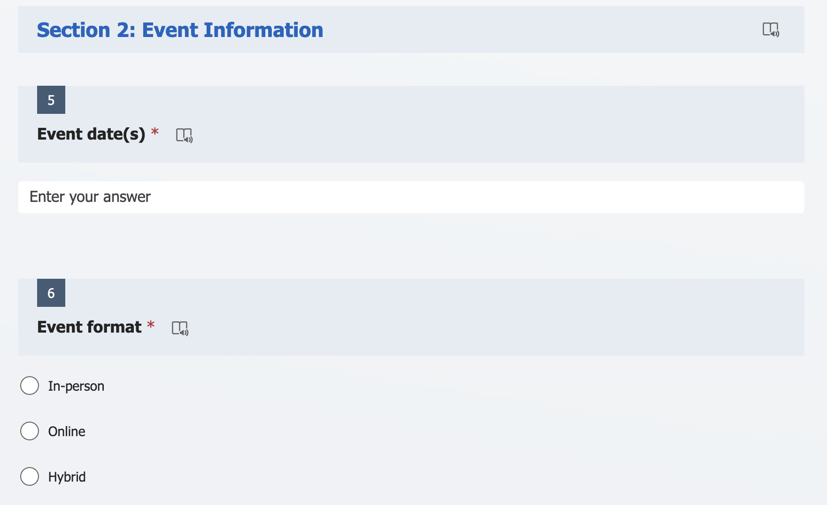
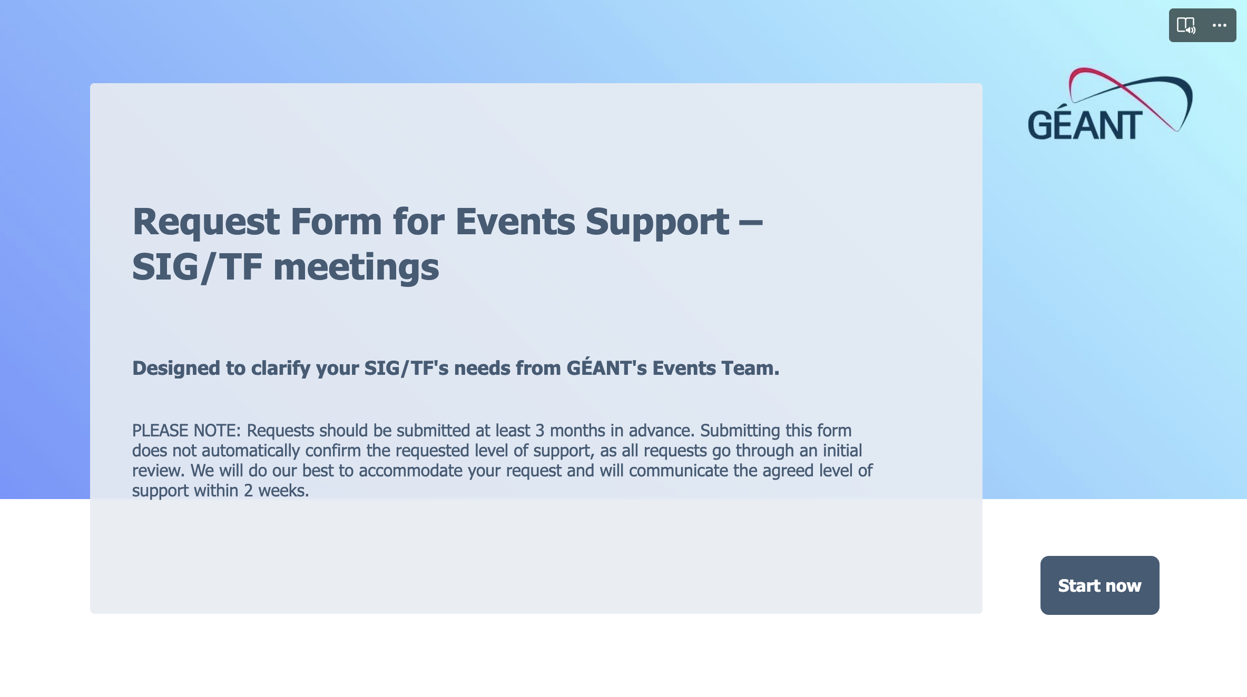
Request form demo

Slide 10
Process overview
You can submit an event support request once the following are confirmed:
Event date(s)
Location
Hosting organisation
Requests can be submitted by SIG Coordinators or Steering Committee members.
⚠️ Requests should be submitted at least 3 months in advance. The earlier, the better.
Submitting does not automatically confirm the requested level of support, as all requests go through an initial review to see if the necessary level of support based on event’s needs is selected.
You will receive confirmation of the agreed level of support within two weeks of submitting your request.

Slide 11
Process overview
Requests are reviewed by the Community Programme & Events Team. What is considered:
Your desired level of support
The size, type and complexity of your event
Experience of your SIG/TF coordinator
Level of involvement of SIG/TF Steering Committee
Maturity level of your SIG/TF
Current Events Team capacity
Possible Outcomes
1. Approved as requested
2. Approved with adjusted support level
3. Referred back for clarification

Slide 12
Key principles to keep in mind
The aim is to support the community as much as possible and provide the desired level of support to everyone who requests it (as long as requests are reasonable and there is enough capacity/resources)
HOWEVER, please take a moment to assess what level of support your event truly requires before submitting a request.
Standard or extra support is sufficient for most SIG meetings. Full on-site support only when there is clear added complexity or need.
If you are unsure, we recommend requesting just ’Standard Support’ and adding additional details in the form - we will advise if a different level is more appropriate.
Standard support shall be default for all SIGs who submit a request.
Nadelina to be the default event support provider.

Slide 13

Pilot phase – we’re trying this out together
This is a trial approach
We will review end of 2026 and adjust based on feedback
Your input is important!
*All this information will be shared with you afterwards.

Slide 14

SIG/TF meetings strategic master calendar
SIG/TF meetings could be planned more strategically in terms of date, location and attendee management.
Need of an overarching overview of SIG/TF events to make better informed decisions and plans + increase visibility across all SIG/TF activities.
→ Introducing a master calendar for SIG/TF meetings

Slide 15
SIG/TF meetings strategic master calendar
We urge you to plan, find hosts and confirm dates for your meetings as much in advance as possible.
Request to submit (at least) tentative details of your meetings ahead of time to aid in yearly planning and strategic scheduling:
For the rest of 2026 – by 15 May (next half-year as a start)
For 2027 – by 15 December (full year from this moment on)
We might make suggestions for improvements when it comes to dates or locations, in cases such as:
e.g. we see SIG meetings with similar attendees happening in the same city at different times - opportunity for co-location
e.g. we see majority of SIG meetings are set to happen in the same weeks or on same dates – need for adjustment

Slide 16
Thank You
Any questions?

Slide 17



TNC26 Community Hub update
GCC meeting recap
Call to action: promote the Community Hub within your networks!
Open mic during TNC Opening reception

Slide 18
TNC26 Community Hub – Proposals Submitted per Organisation
2025 2026
Organisation/NREN
CESNET
CSUC
DFN x4
e-Science Data Factory / SURF
GÉANT x14
Huawei
Institute for Informatics (Armenia)
Internet2
Jisc
Peking University
RNP
SUNET x2
SURF
The Vietsch Foundation
AIT Austrian Institute of Technology
CSC x 3
CSUC
DFN x6
EGI Foundation
GÉANT x13
Jisc
National Technical University of Athens
Nokia
PCSS x2
Research And Education Network Uganda
RIPE NCC
RNP
SUNET
SURF x2
Switch
Tampere University

Slide 19
And now… Group photo!

Slide 20

GCP meeting, 24-25 March 2026, Utrecht, Netherlands
<Click to edit label> Public (PU) / Project Participants Sensitive (SEN)

Slide 21
Agenda
Objectives
Speed dating Groups

Slide 22
GCC meet SIGs - Objectives
Share and discuss
Success stories and pain points
Becoming Better, Stronger, Smarter…
Objectives for SIGs
Ask for help
Hear from others
Objectives for GCC
Understand challenges and opportunities SIGs are facing
How better to support the SIG
Commonalities and gaps

Slide 23
How: 3 Sessions, 5 Groups + Wrap-up
Session 1.
30 minutes
Group 1: NOC, NGN, TFN, AI
GCC: Maria Isabel, Ivana
Group 2: CISS, TF-EDU, CNaaS
GCC: Michel, Dawn
Group 3: ISM, MARCOMS, Sustainability, REFEDS
GCC: Ariela, Charlie
Session 2.
30 minutes
Group 4: RED, Quantum
GCC: Maria Isabel, Ariela, Ivana
Group 5: PA-Policy, MSP, Procurement
GCC: Michel, Dawn
1
2
Session 4.
15 minutes
Summary and conclusions from all Groups
3

Slide 24
Thank You
Any questions?

