Slide 1
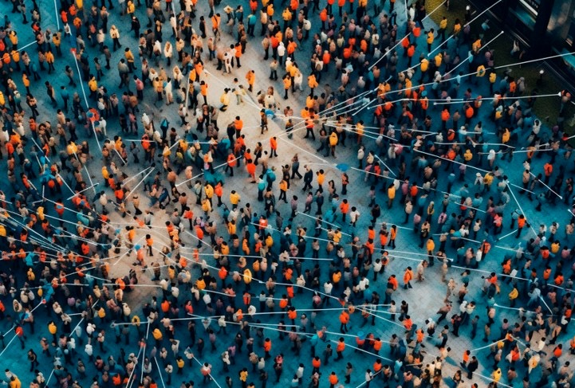


The SURF and Quanza
Tooling Landscape

Slide 2
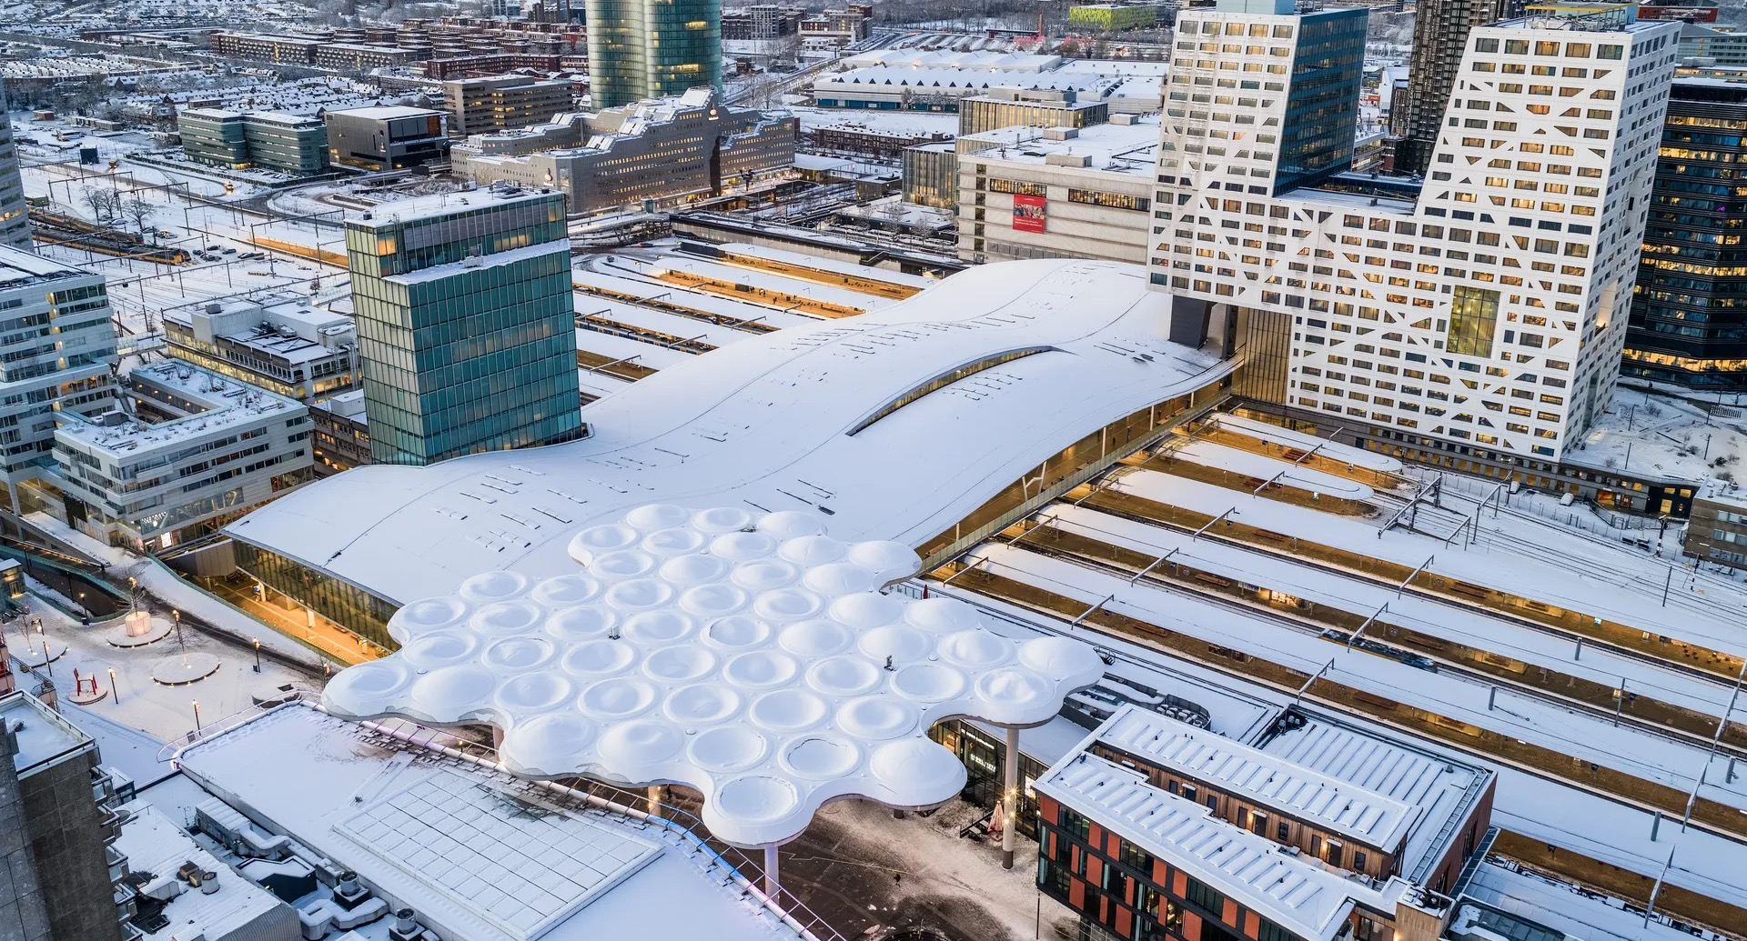
Agenda
01
02
03
A little context
The SURF tooling landscape
The Quanza tooling landscape

Slide 3
Chapter green
01 A little context

Slide 4
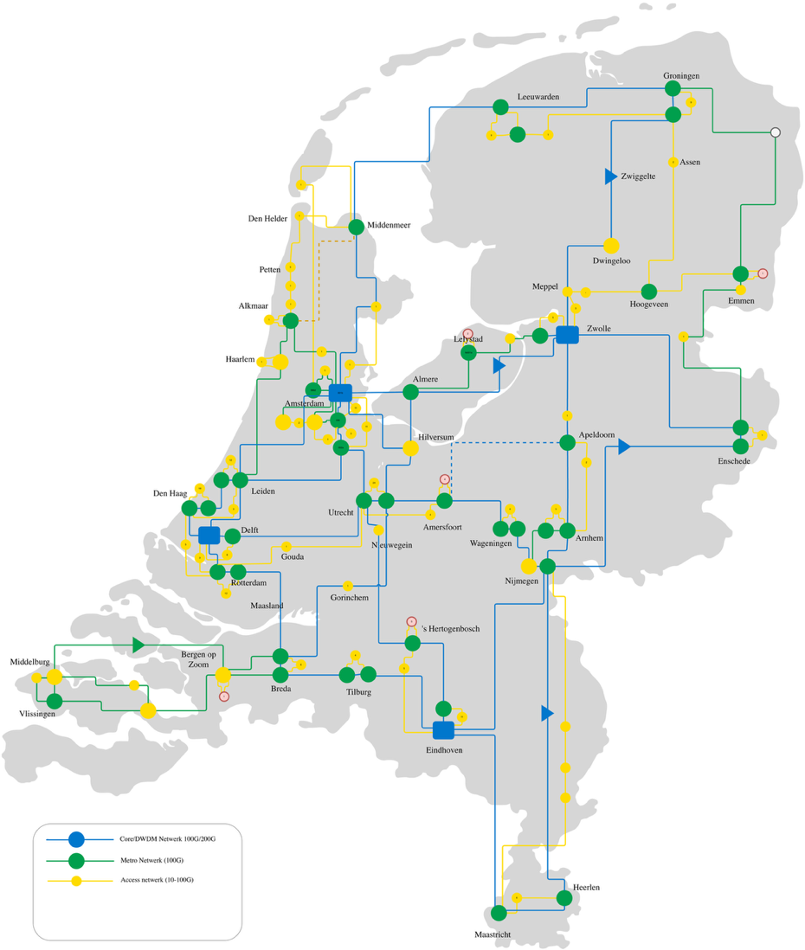
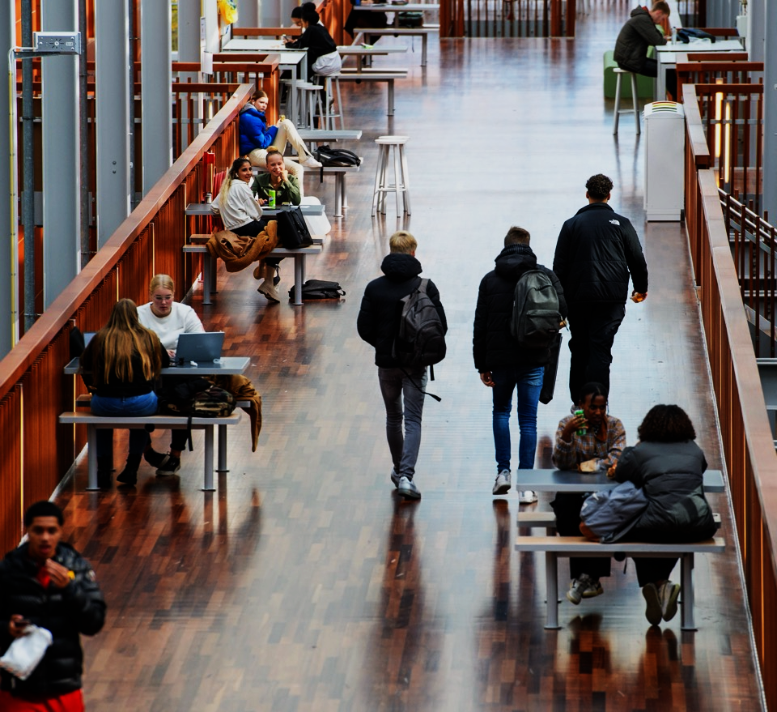
Network
Campus

Slide 5



Network Services
Campus Services
IP
SURFfirewall
EVPN / LxVPN
Netherlight
SURFwired
DWDM
SURFwireless
TFT
Quanza
Quanza
Quanza
Team Expert Networking (TEN)
Network Operations
Network Development
Campus Development

Slide 6


Questions

