Slide 1
Sustainable Working practices in Asiera
Andy Byrne - SIG Sustainability
April 2026

Slide 2
The Sustainability Challenge for NRENs
What we have learned
What we are doing
Where we need help
What NRENs can do today

Slide 3
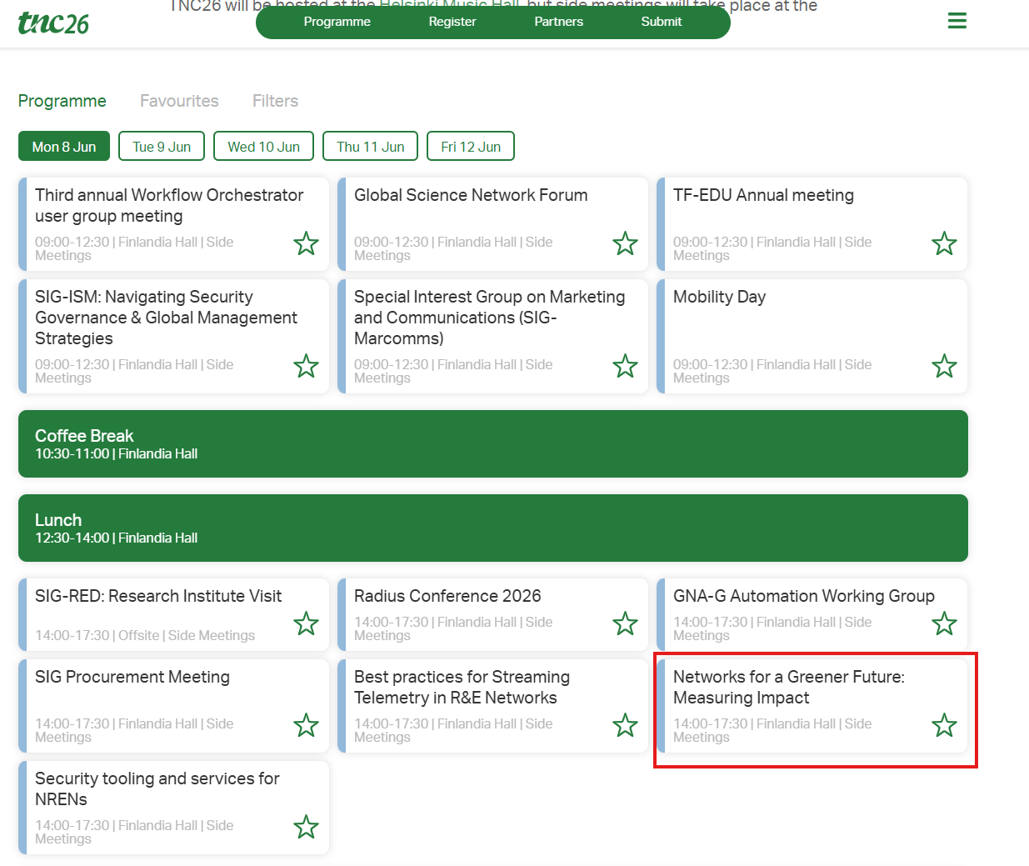
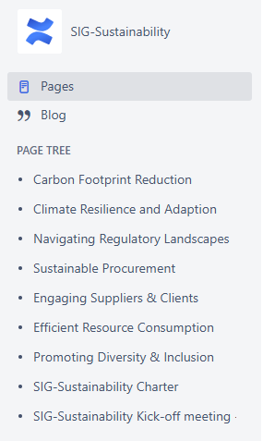

Slide 4
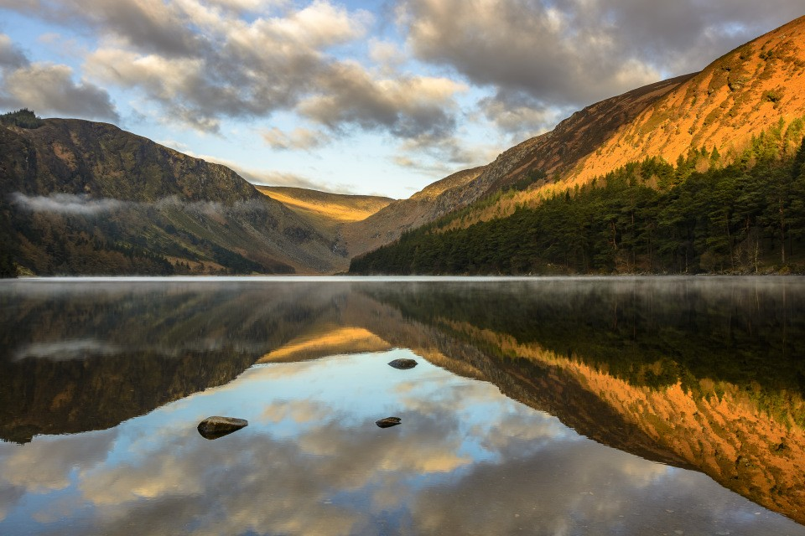
Photo : Robert Hackett – Asiera
Glendalough, County Wicklow, Ireland
Today 22% of Irelands Electricity supply is consumed by Data Centres
Why this matters
NREN’s have a role to play
Cost, regulation, carbon targets, reputation
Energy Efficiency – do the same, by using less

Slide 5
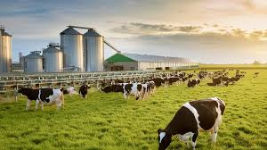

Aseira’s Co2 Emissions – Scope 1&2
Average Irish dairy farm produces approximately 606 tonnes of CO₂ equivalent annually.
673 Tonnes
96% Grid Electricity

Slide 6

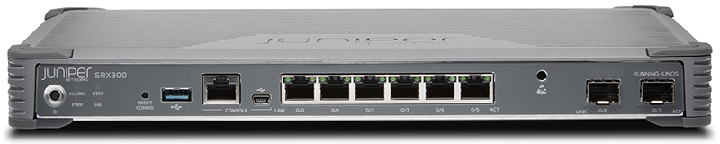

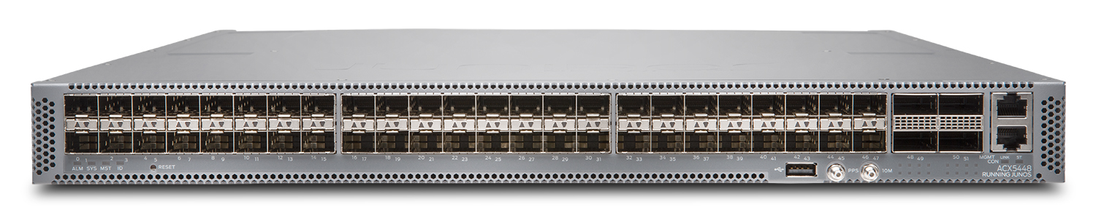
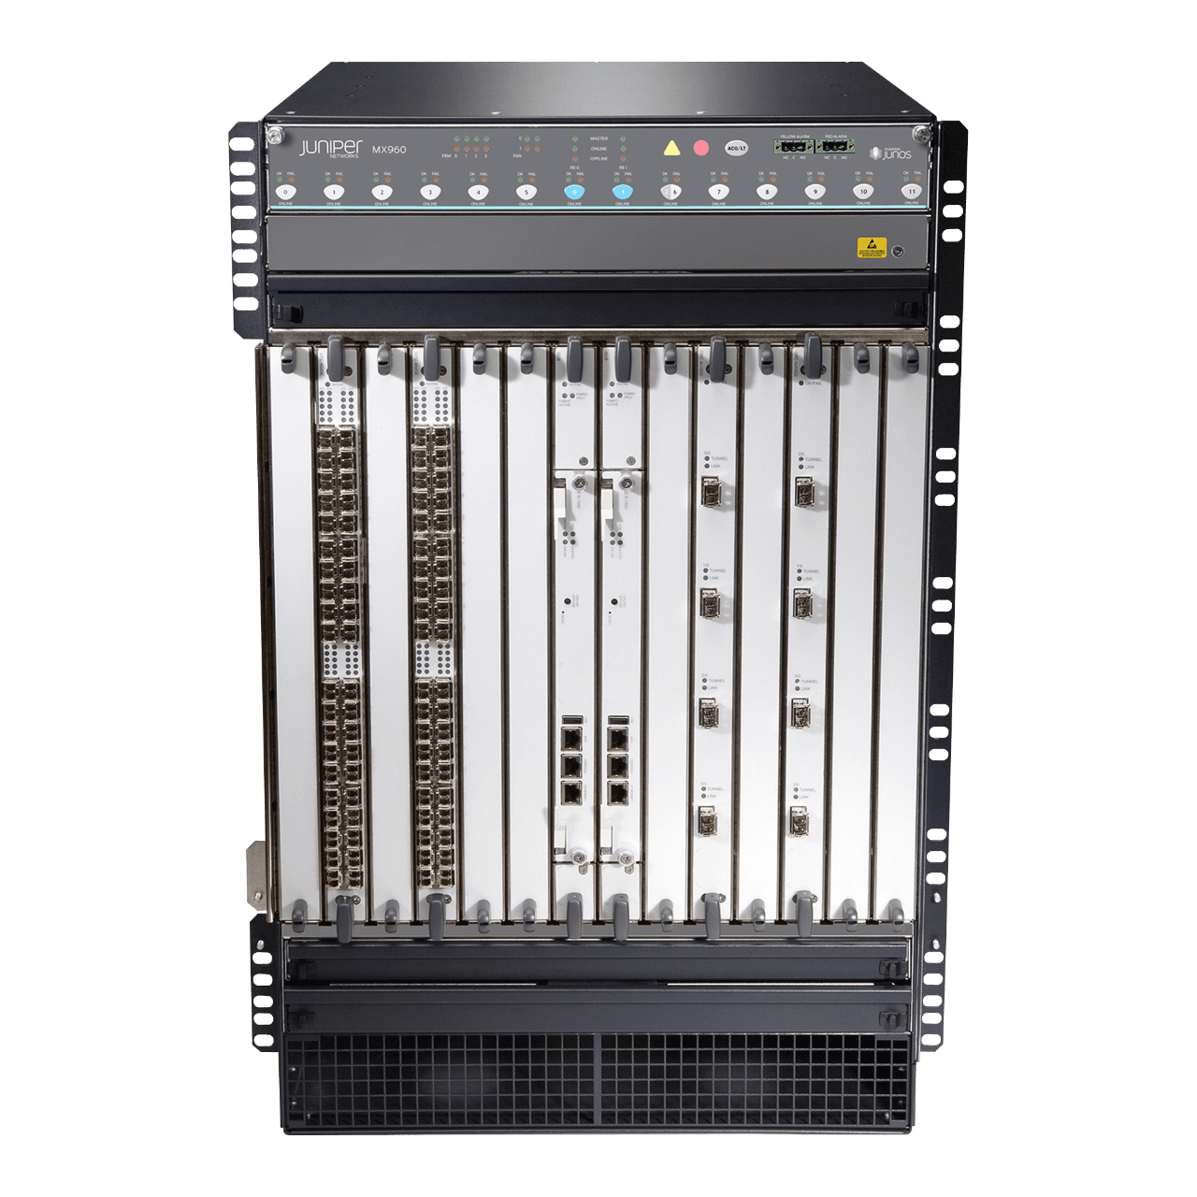
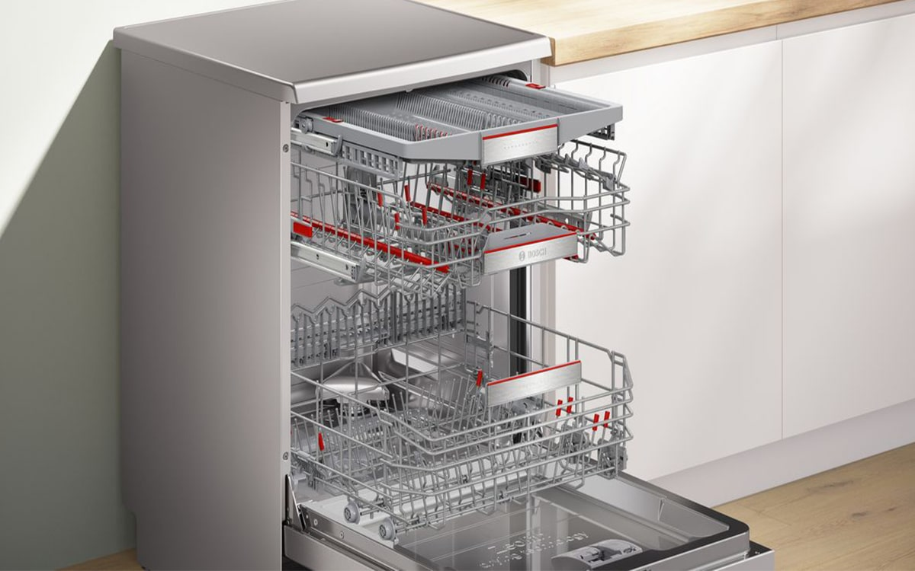
Household devices V’s Asiera Devices
12 Hours a Day ?
25 Watts 3,000 Devices !
60 Watts
1. Power
Power : watt (w)
1,000 watts
= 1 kilowatt (kW)
2. Energy
Energy = Power x Time
Energy is measured in hourly = kWh
6 Hours a Day ?
300 Watts 20 Devices
180 Watts
24 Hours a Day, 365 Days a Year !
1500 Watts
2,700 Watts 4 Devices
2 Hours a Day ?

Slide 7

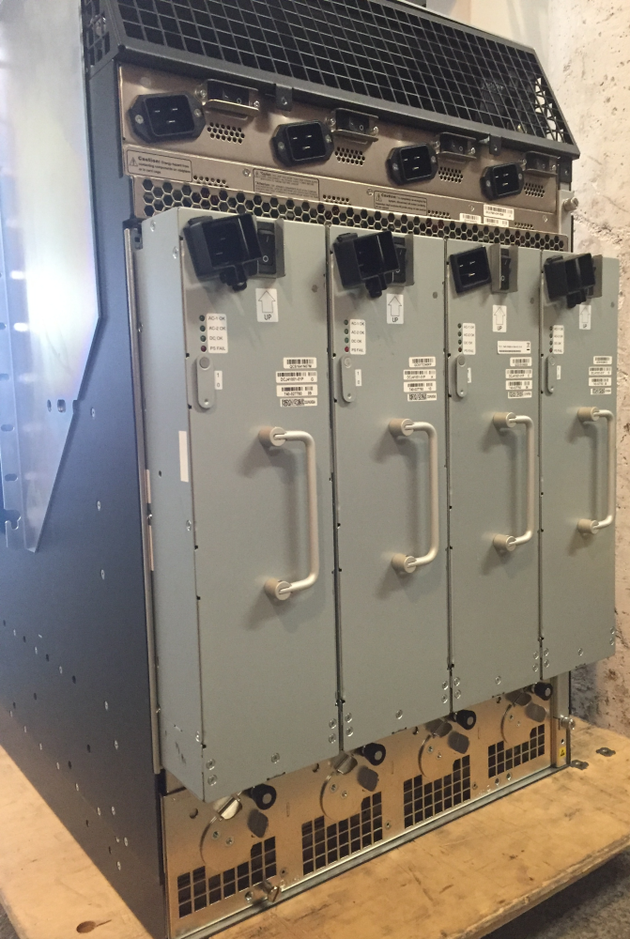
Core Routers
Single Juniper MX960 ~ 2,700 Watts
~24,000 KwHr a year
2.2 petrol powered passenger vehicles driven for one year
1.3 homes energy use for one year
https://www.epa.gov/energy/greenhouse-gas-equivalencies-calculator#results

Slide 8

Electricity Strategy
Renewable Utility Provider
Use more efficient equipment
Have a target
Design Choices
  Retire, Consolidate, Virtualise, Move to Cloud
  Mean ambient temperature
  PUE Data Centers
……what else ?

Slide 9
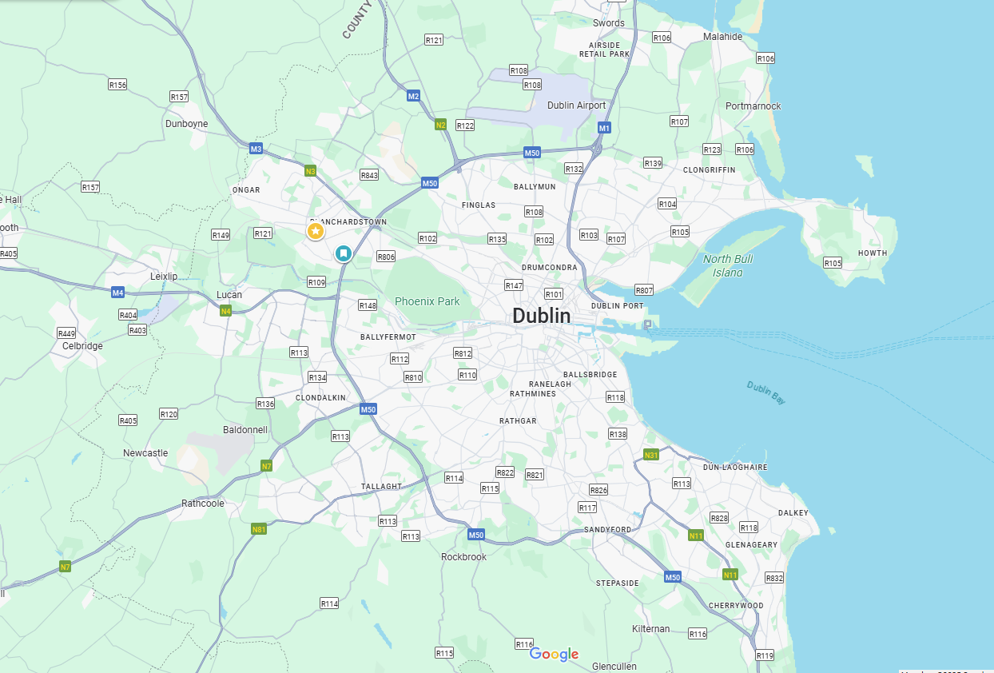
HEAnet Data Centre Review
Blanchardstown
58 Racks
$$$
Parkwest
34 Racks
$$
Citywest
18 Racks
$$

Slide 10
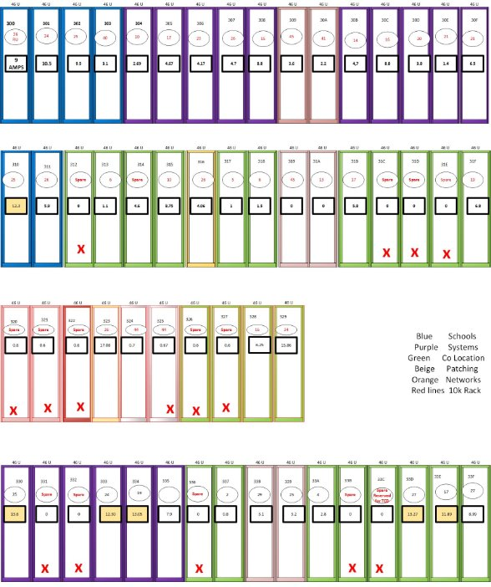
Blanchardstown
Data Centre
X empty Rack
Least used % for space and power​
Activities scaled down
  Moodle, Hosting, Multimedia, Storage
Most expensive rental ​
Least client circuit connections​
Dedicated Room
~ €2.5M Rental Savings over 5 years

Slide 11
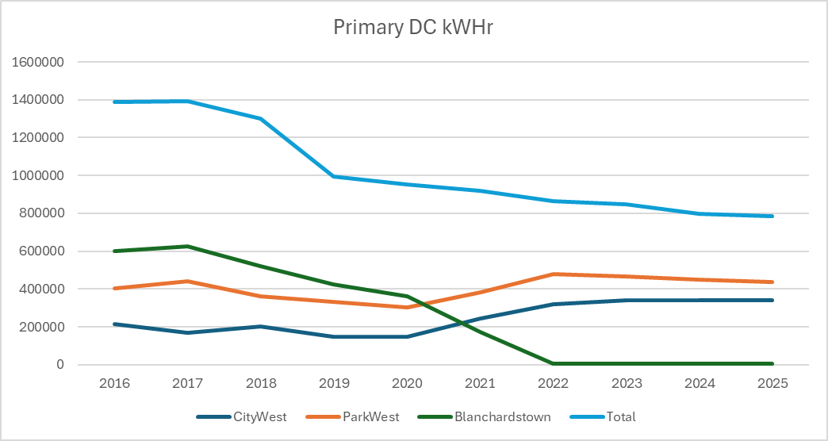
673 Tonnes CO2

Slide 12

Data Centre Consolidation Results
45 % Reduction of Electricity in Data Centres
Cost Savings (Per Year) ~€165,000
Co2 Emissions Savings (Per Year) ~170 Tonnes
26 Million cups of Tea !

Slide 13
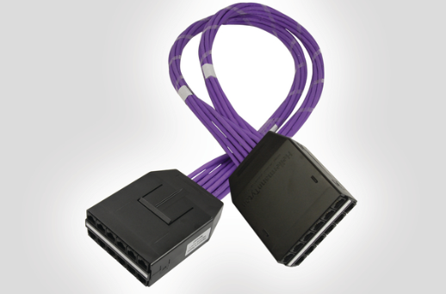
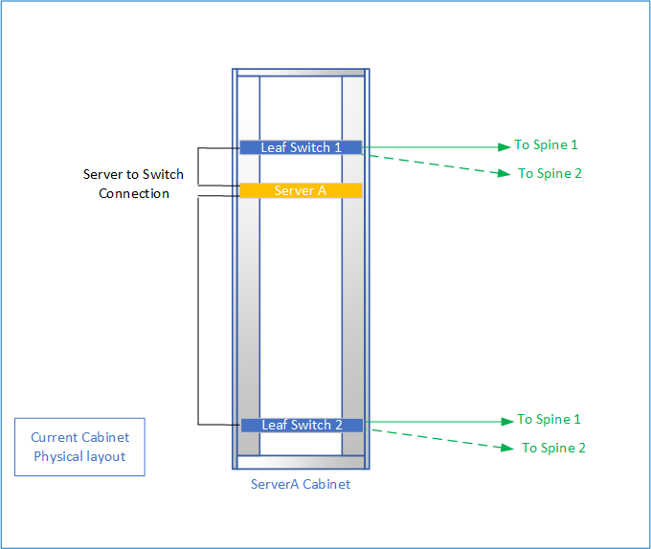
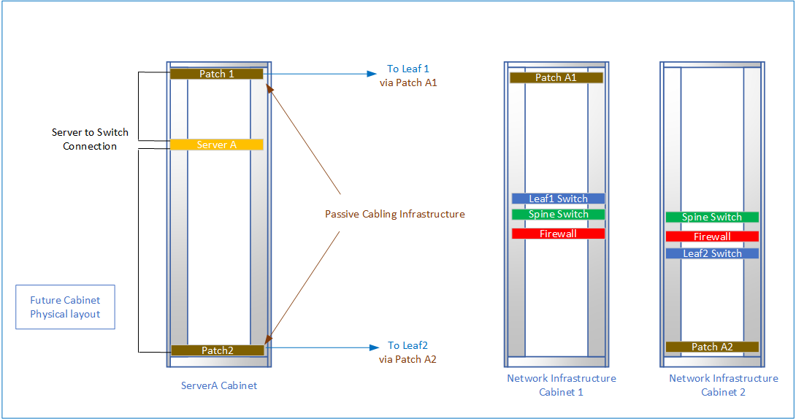
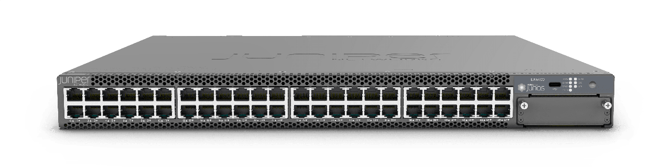
Consolidation in Data Centre
30 % Switch Utilisation
95 % Switch Utilisation
Co2 Emissions Savings (5Yr) : ~19 Tonnes
Equivalent of :
4 Homes Electricity for 1 year

Slide 14
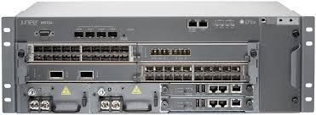



Network Upgrade Programme
OLD KIT
New KIT
47 x ACX7024X
97 Watts
39 x MX104
450 Watts
29 Million cups of Tea !
20 x ACX5448
303 Watts
27 x ACX5048
354 Watts
Co2 Emissions Savings (5Yr) : ~157 Tonnes
Equivalent of :
31 Homes Electricity for 1 year

Slide 15

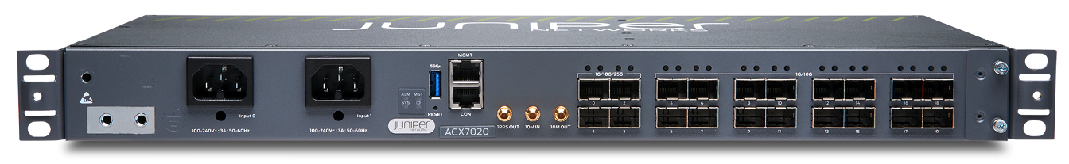
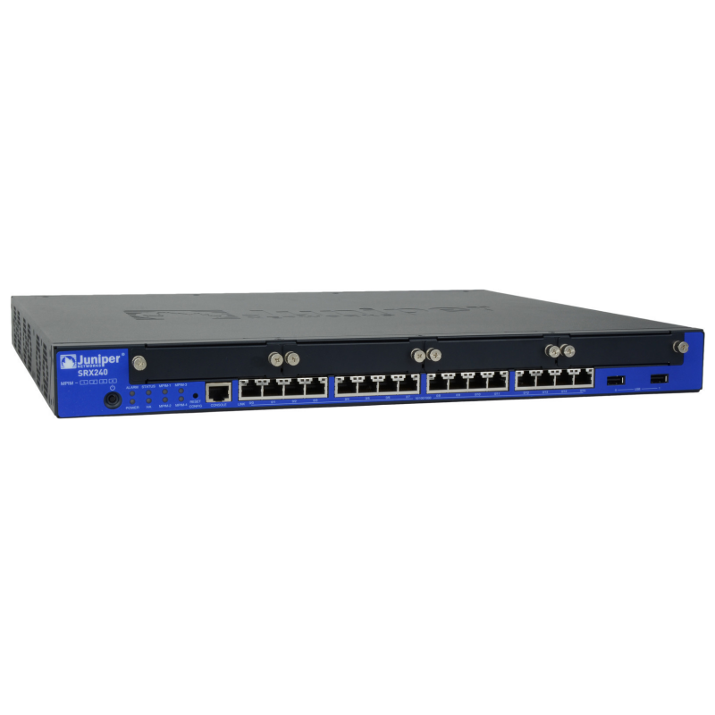
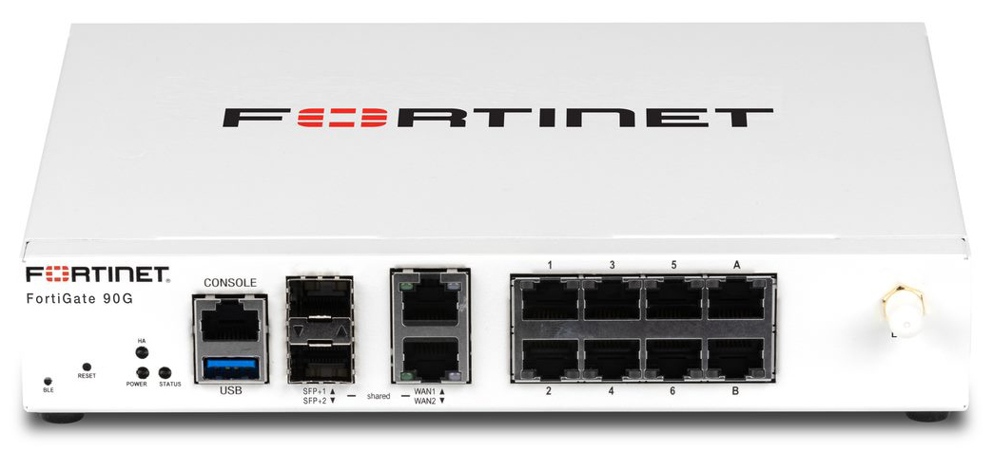
CPE Projects
OLD KIT
New KIT
192 x ACX2200
60G Throughput
60 Watts
192 x ACX7020 Device
100G Throughput
65 Watts
800 x SRX240
600Mb Throughput
150 Watts
800 x XXX Device
28 Gb Throughput
20 Watts
Electricity Savings (5 Years) : ~4.5M KWHr
Cost Savings (5 Years) : ~€1.1M
Co2 Emissions Savings (5Yr) : ~1,181 Tonnes
182 Million cups of Tea !

Slide 16
Sample Project – Network Migration
 | Total KwHr
Migrate in 2 years | 301,453
Migrate in 1 year | 236,599
Migrate in 6 Months | 204,172
Old Network Consumed 64k KWHr a year
New Network Consumes 35k KWHr a year

Slide 17







eWaste & Waste
Option A:
Option B:
Option C:
Client Auction
Income Guaranteed
Shared Revenue
Incurs a Costs

Slide 18
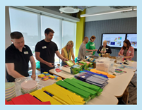
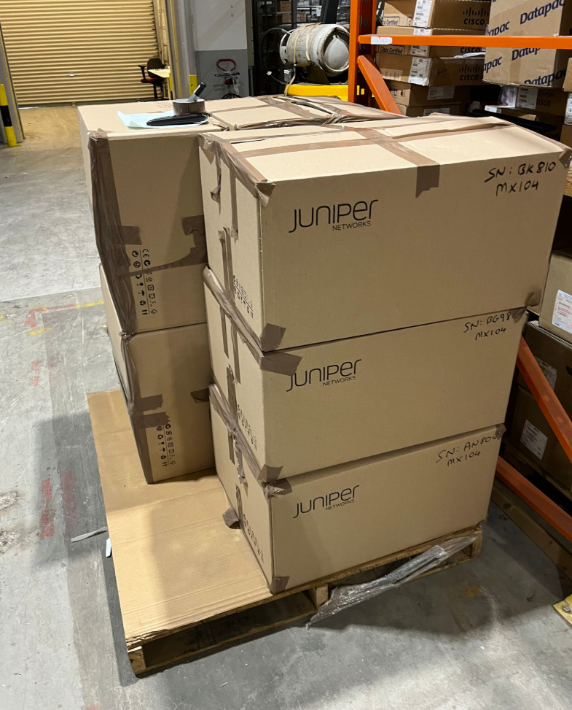

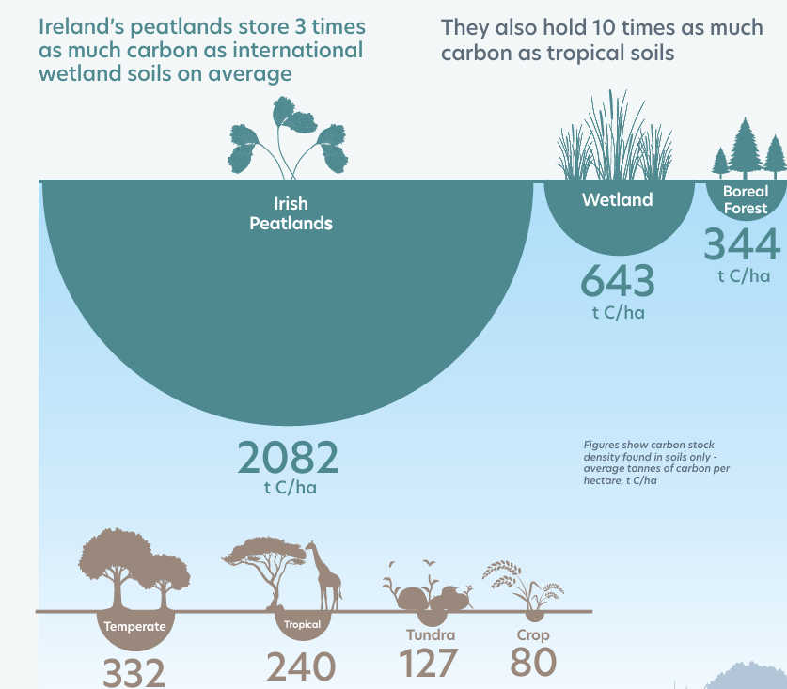
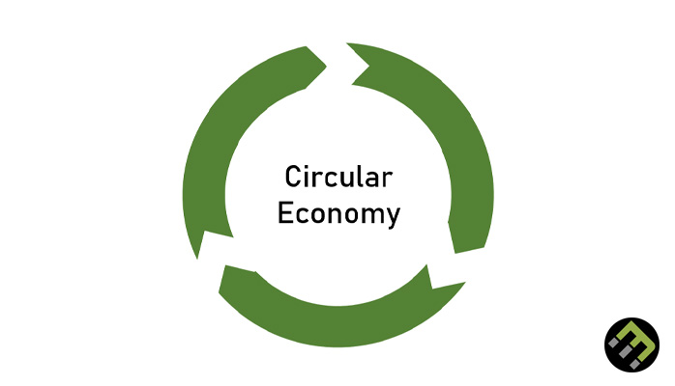



Sustainability Fund
STEM Education-Focused Employee Volunteering
Organised by Volunteer Ireland

Slide 19
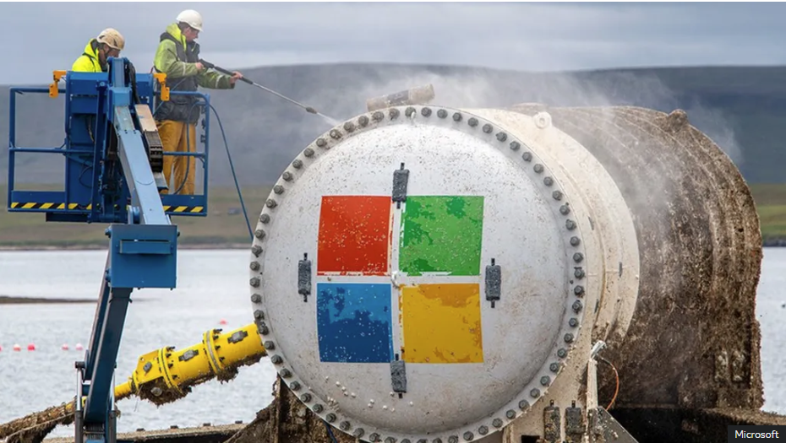
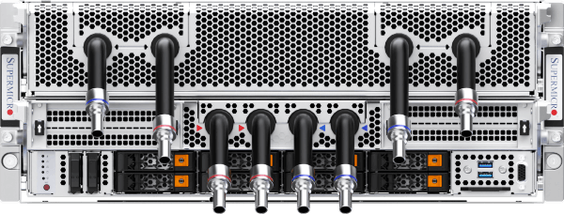
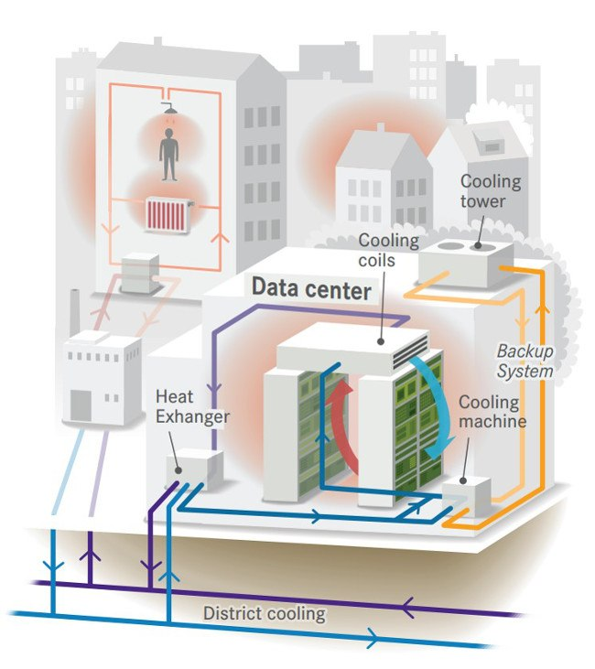
Energy Efficiency in Networks

Slide 20
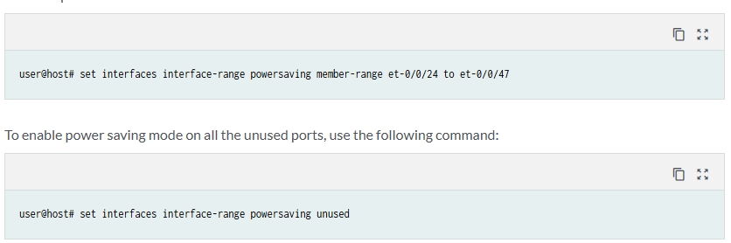
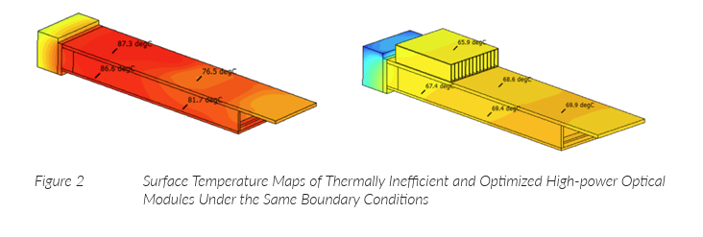
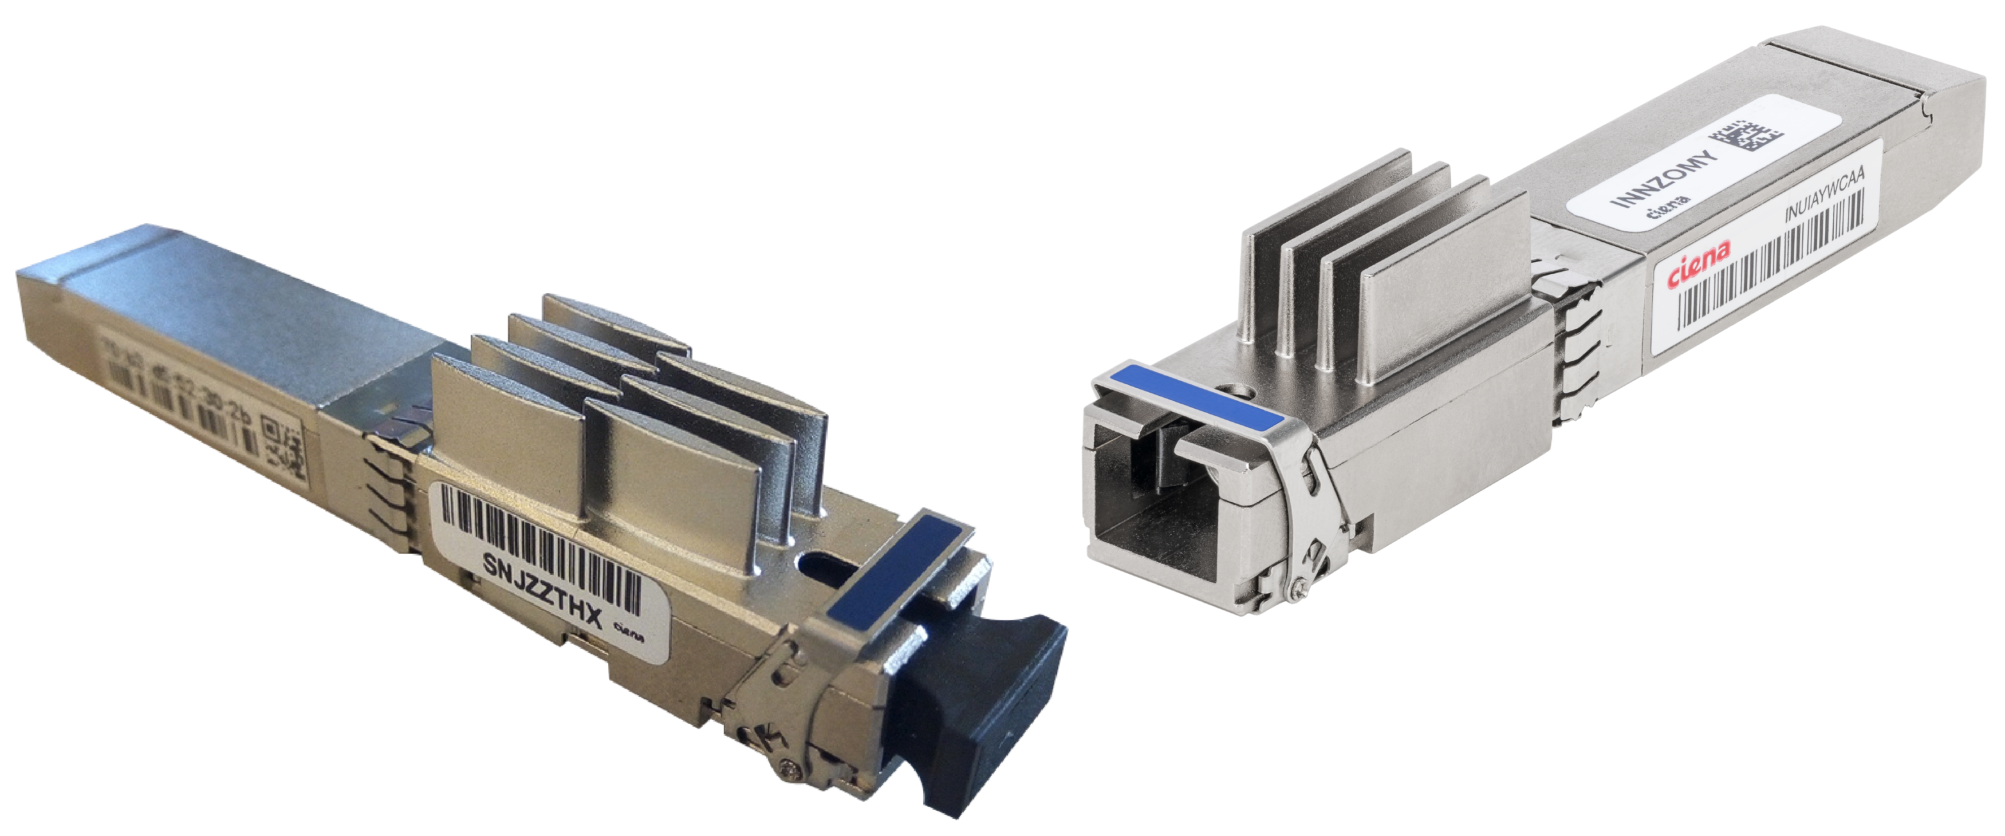
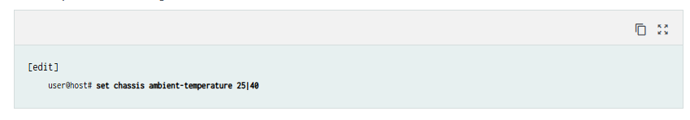
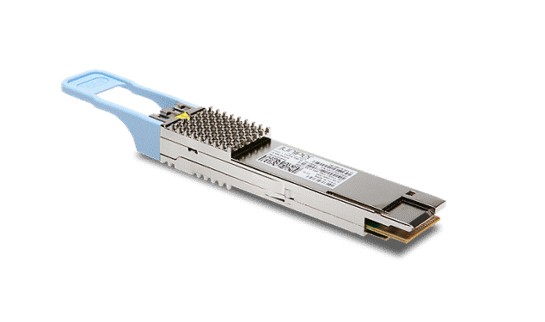
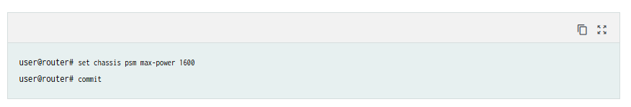
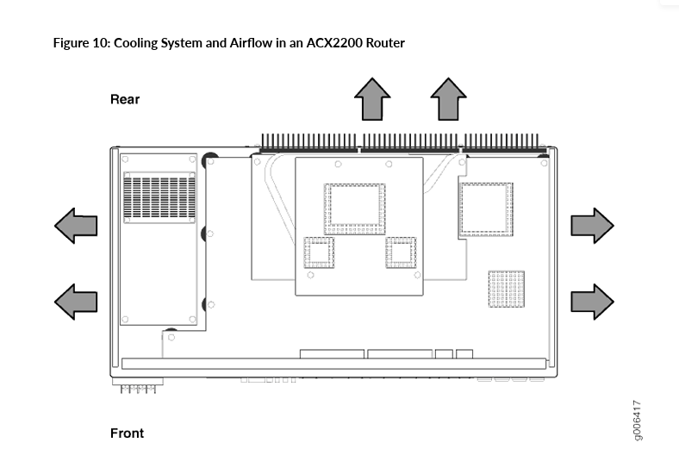
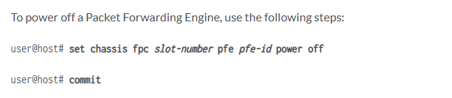
www.juniper.net/content/dam/www/assets/sustainability/us/en/day-one-green-optimized-thermal-design.pdf

Slide 21
In Conclusion
We need your help
Incorporate Sustainability into your working practices
  Design
  Procurement
  Measure & Report
Share ideas
Share Successes
Collaboration is key
sig-sustainability@lists.geant.org

