Slide 1
OSS stack Quanza
VERSIE 1.00
08-04-2026

Slide 2
Maarten Kerkvliet
Manager network engineering at Quanza
Have been working for over 12 years at Quanza
Working togheter with SURF for the past 10 years

Slide 3
Quanza's challange
OSS
Serve multiple customers with different infrastructures
Deal with different level of skills of operators and engineers
Delivery of consistent quality

Slide 4
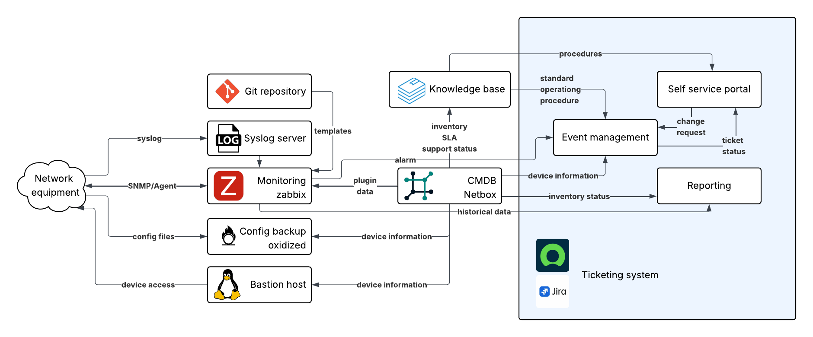
Architecture
OSS

Slide 5
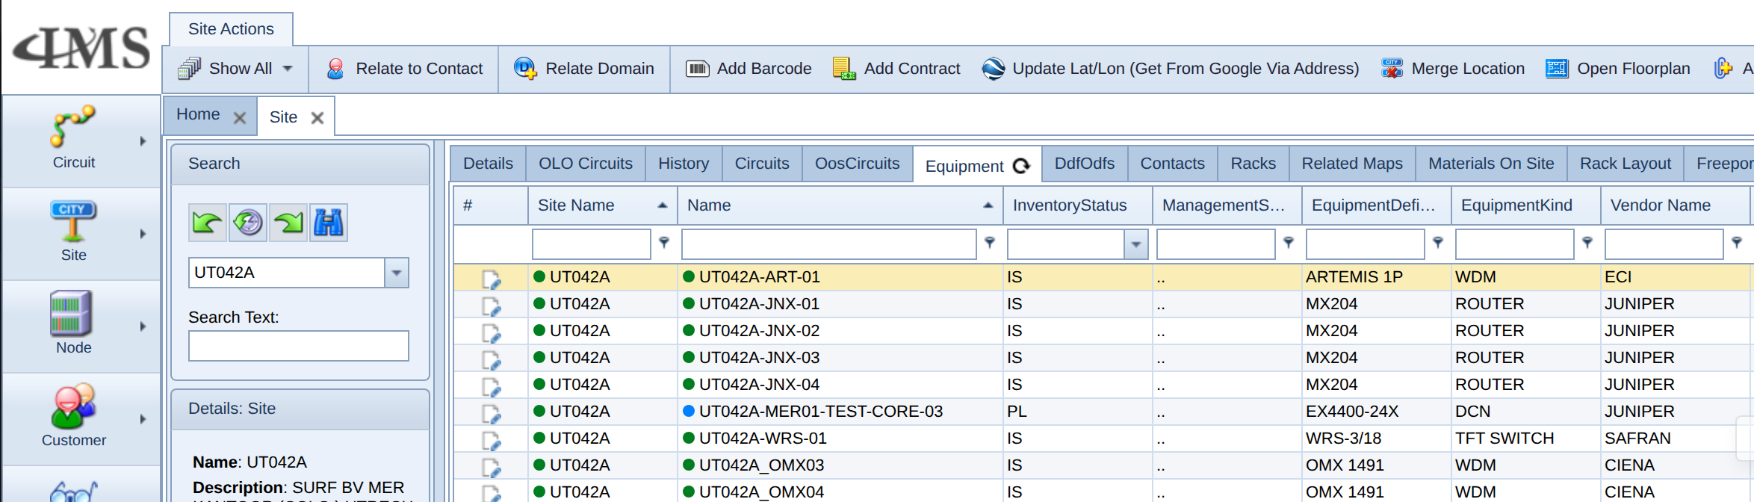

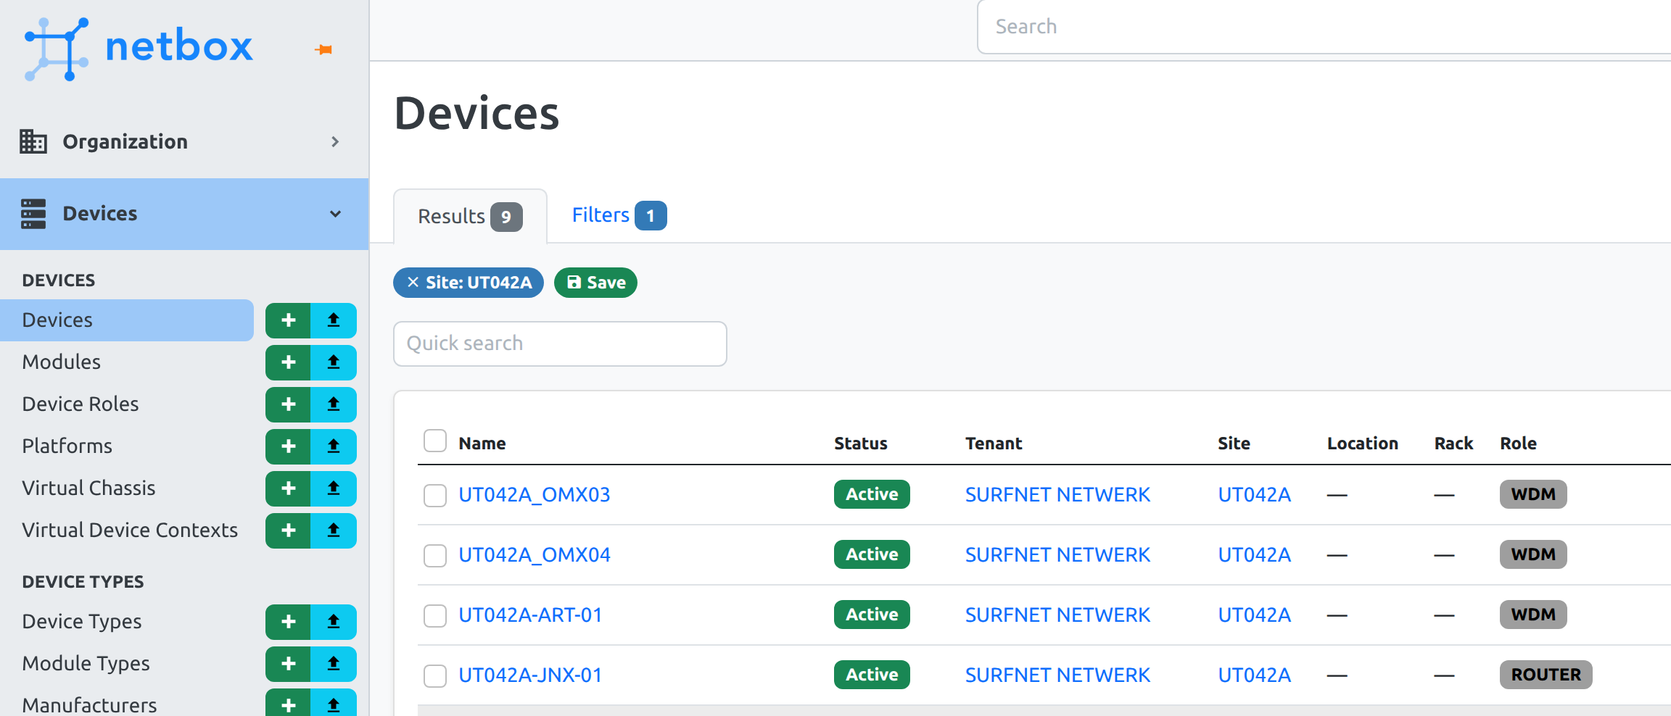
Single source of truth
OSS
SURF is using IMS (VC4) as CMDB/single source of truth
The OSS stack uses netbox as single source of truth

Slide 6
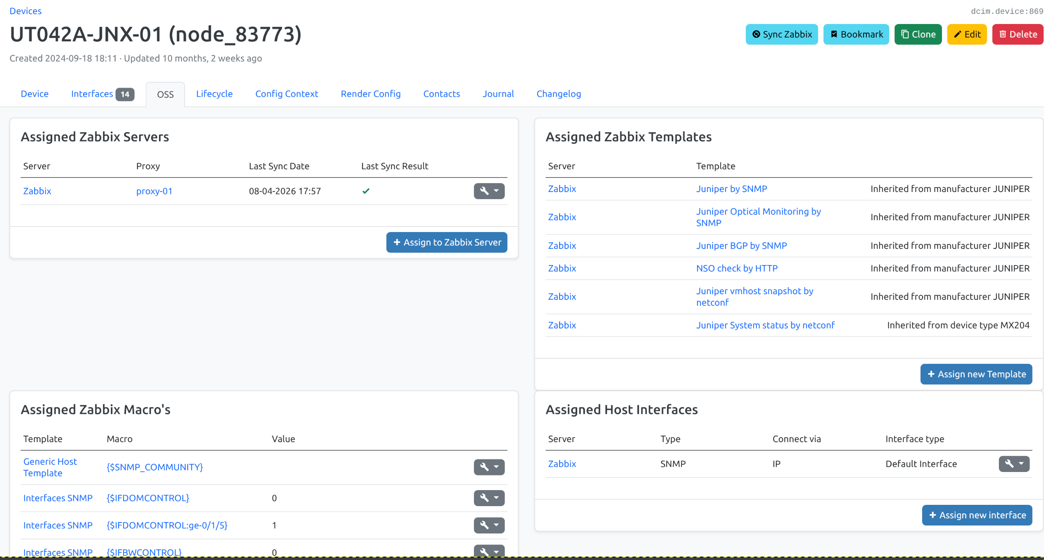
Zabbix plugin
OSS
Connectivity information
Template selection
Trigger manipulation via macro's
Multi level macro configuration
  Per vendor
  Per device type
  Per OS
  Per host

Slide 7
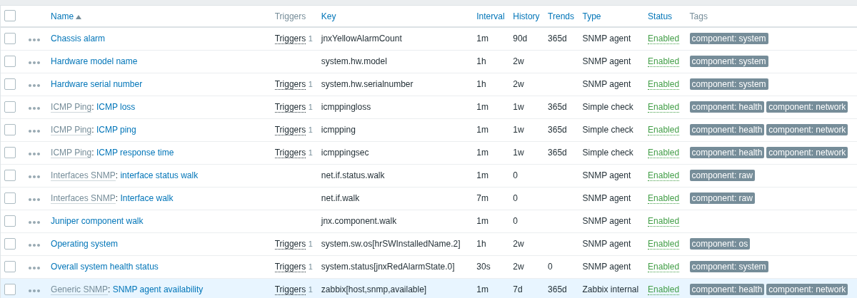
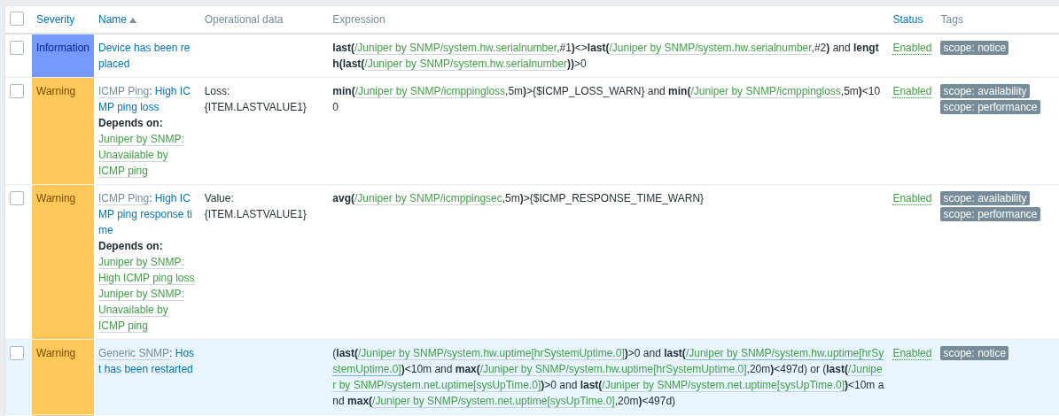
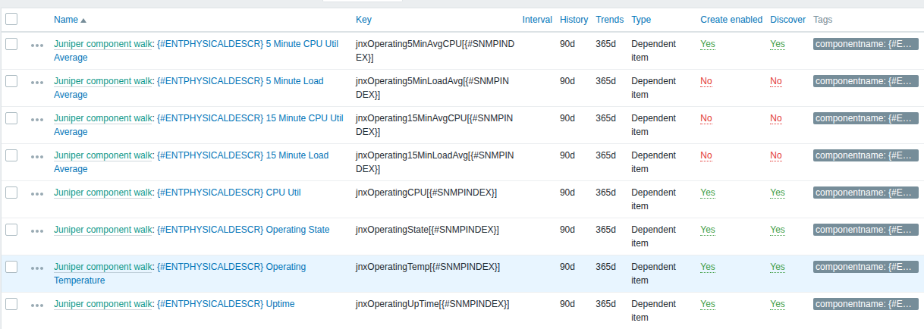
Zabbix templates
OSS

Slide 8
Roadmap
OSS
Event correlation by implementing a message broker
Planned work scheduling based on calculated impact
Discovery and reconciliation
Use of AI to provide suggestions based on knowledge base articles

