Slide 1
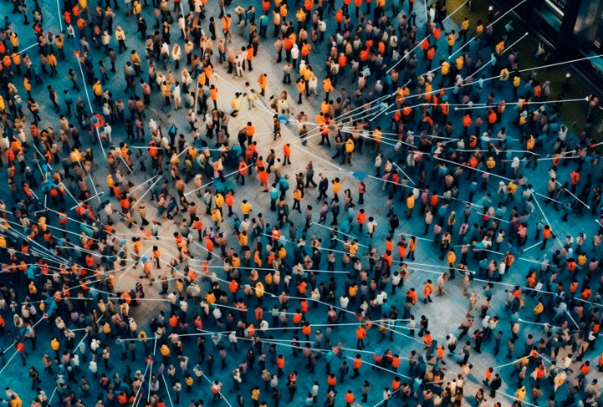
AI Agent in the Workflow Orchestrator
Peter Boers – peter.boers@surf.nl

Slide 2

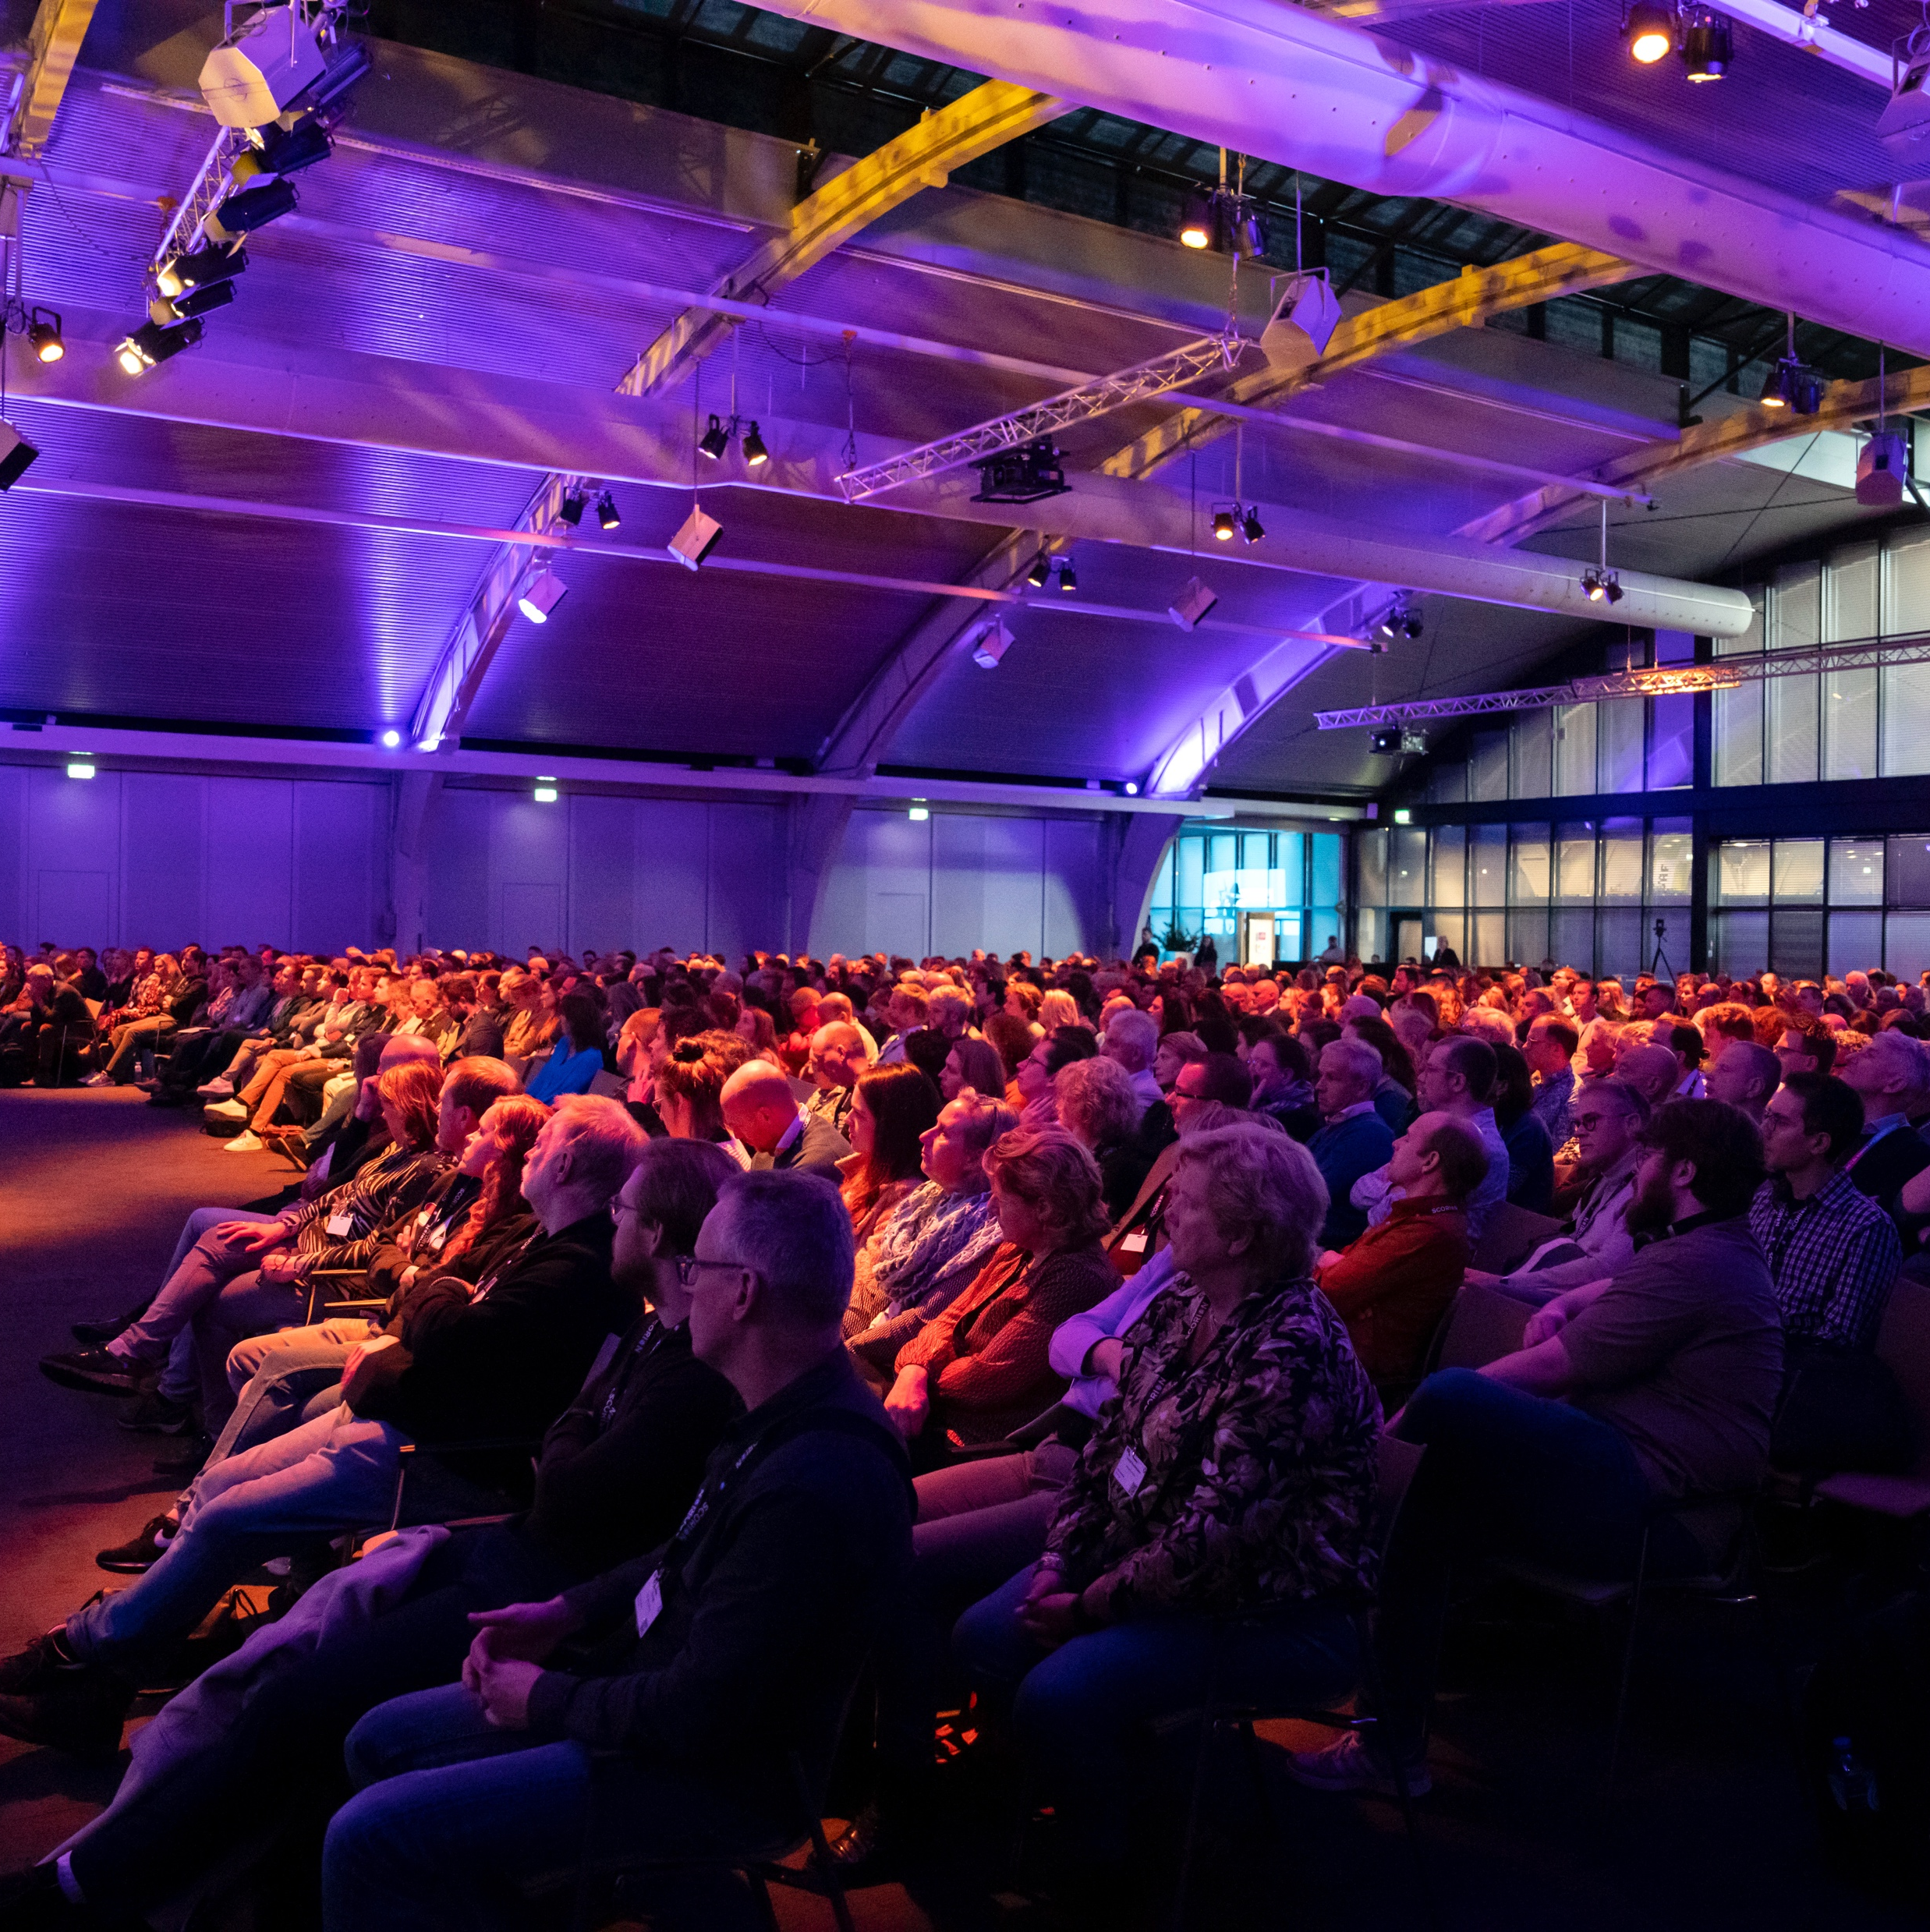
> whoami
Peter Boers
37 years old
10th year at SURF
Background in Software and Network (SNE @ UvA)
Started as a Trainee...
…. moved on as Technical Product Manager A&O
Tech lead of the Workflow Orchestrator Programme

Slide 3
> cat ~/.zsh_history
Programming languages: Python, React, Angular
Databases: Postgres, Mongo, MySQL, Redis
Streaming: Kafka, Risingwave
Platform: Kubernetes, ArgoCD, GitlabCI, Github
Opensource: Workflow Orchestrator Programme
Current focus: Influx, PyTorch, Snellius + ML, AI Agents

Slide 4

Automation -> Orchestration -> Intelligent Networks
Since 2018, SURF has been automating the network.
Fully automated delivery of services with the arrival of SURFnet8
Results:
+/- 30 thousand automated changes
> 14 million automated tasks
5554 active services (from BGP to Interfaces)
15k/month downloads on PyPi for orchestrator-core
Self-Service in the Network Dashboard
Open source Software developed by SURF in use by 12 to 13 other coporations

Slide 5
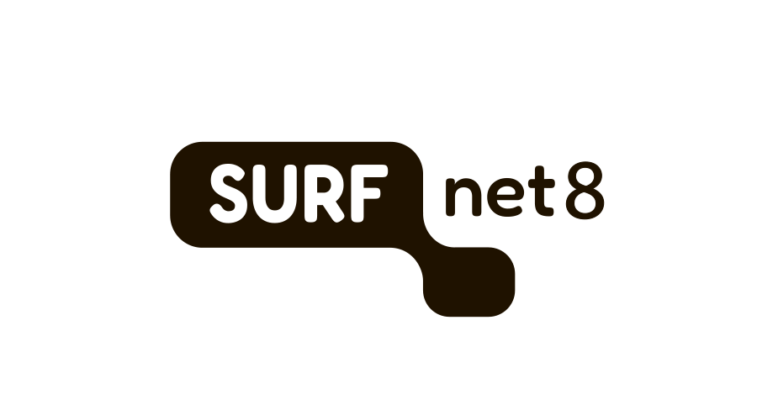
SURFnet8 -> SURFnet∞

Slide 6
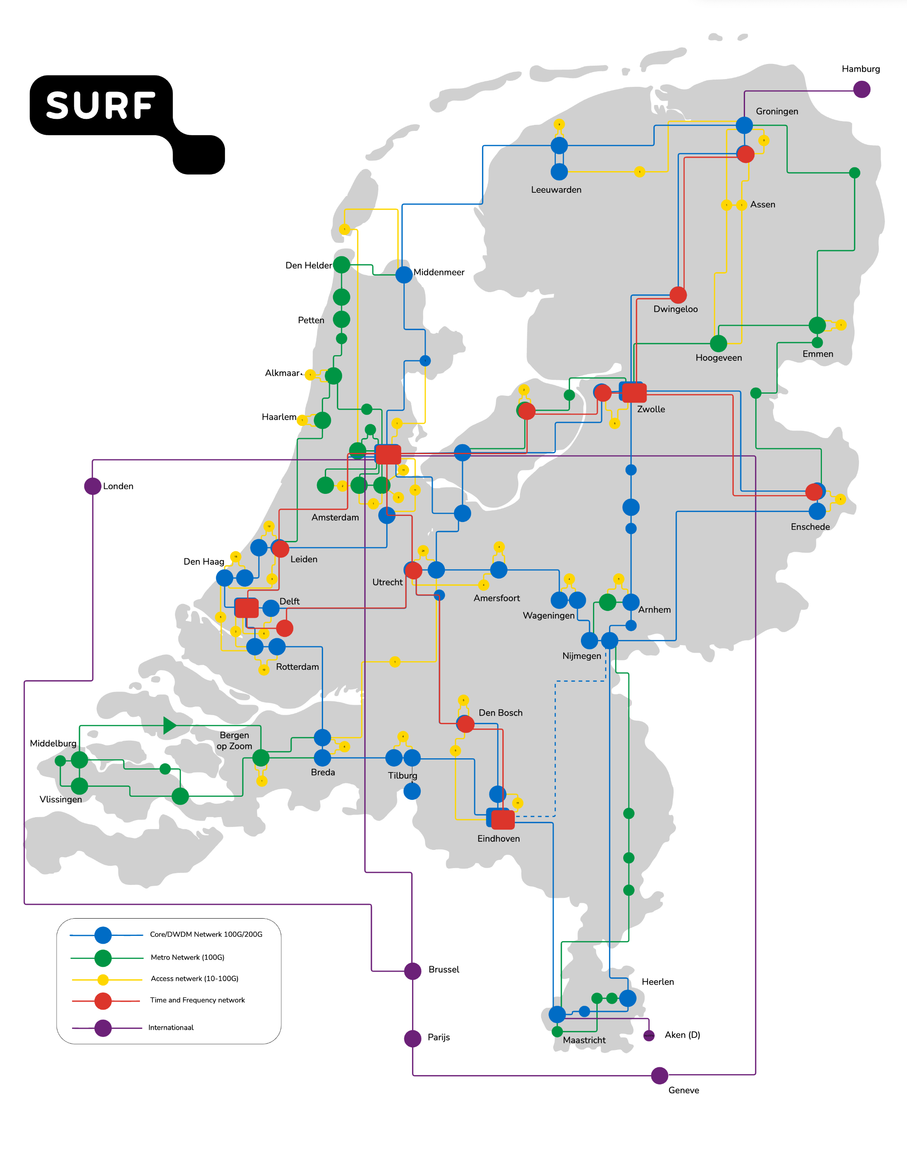
SURFnet8 -> SURFnet∞
Opportunity to revitalize the network and the software that controls it
From the tender(s) it is possible to get a Multi Vendor/Multi-OS architecture
Diversity and complexity are increasing
  Campus network offering
  TFT
Higher level of integration is required.
Developments follow in rapid succession and the tools we use must grow with them

Slide 7

Our ambition is to have an Intelligent Network capable of correctly assessing incidents and fixing them in real-time by using AI-Ops

Slide 8
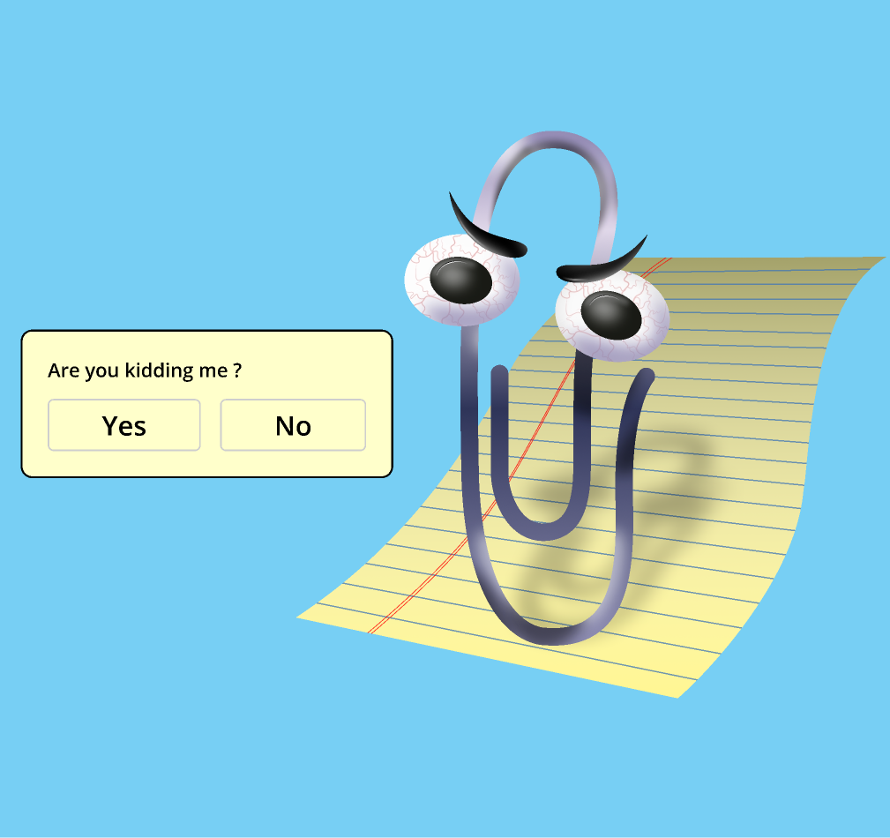

Network evolution, not revolution
With the continued development of SURFnet8, there is an opportunity to work with new(er) technologies
Two strategies are emerging for AIOps
  Machine Learning
  LLM integration

Slide 11

What does clippy have to do with AIOp’s and WFO?
Arguably one of the first well known assistants with “intelligence”
A very naïve example of what would become the inspiration for an AI Agent in the Workflow Orchestrator.
An interface to ask questions about the application you are working in designed to help with day-to-day tasks.
Why was clippy so bad?
  Intrusive, hard to disable and irrelevant tips
Goal was to build an understanding of how generative AI can be used in a relatively simple way: chatting to the orchestrator.

Slide 12

Sidenote: Who remembers November 30th 2022?
Perhaps just as significant: Who remembers June 11 2020???
  Release of the first OpenAI api spec
Since 2022 the technology and architecture for creating a search backend has fundamentally changed.
All about Retrieval Augementation Generation Agents (RAG agent)
RAG stands for the process of how an LLM searches a database, augments the data from external/internal sources and then generates an answer
Key part of the Retrieval process is having a correctly indexed database of documents.
The RAG architecture was the first iteration of an AI agent in WFO

Slide 13
What is an AI Agent?
“An AI agent is a system where an LLM drives a loop — perceiving inputs, deciding on actions, calling tools, and observing results — until a goal is reached.” – Claude Code (2026)
The loop mentioned above is usually the ReAct (Reasoning + Acting) loop.
  The LLM first reasons about the prompt
  Then Acts upon it by calling tools and/or generating a result.
The goal the agent tries to achieve is the System Prompt combined with the User Prompt
  System Prompt: You are a useful AI agent and an expert in search the orchestrator, these are your tools….
  User Prompt: Look up subscription xxx
LLM’s are stateless/have no database, they have a bounded memory they can consume during each call/session, their context window

Slide 14
What is an AI agent?

Slide 15
Context window

Slide 16

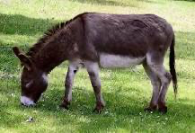
How does a RAG agent work?
LLM based retrieval needs a vector database to enable semantic retrieval
A vector is an object that has both a magnitude and direction, in contrast to a scalar which only contains a magnitude.
  v = [1223444, -122344222, 53259, -12234875, …]
A vector database maps v to a database entity or document
Why is this useful; consider the following scenario
  An image of a horse generates: v = [1,2,3,4,5,6]
  An image of a donkey generates: v = [1,2,3,7,9]
When querying the database for a ”four legged animal”
  Search v = [ 2,3,4,5,6,7]
Both objects will return with a metric describe how close they match to the document determining the rank

Slide 17
RAG pipeline

Slide 18
RAG use cases
Primary usecase: Retrieval of documents
Secondary usecases implemented through tool calling:
  Aggregation
  Counting
  Exporting
  …
By exposing tools to the AI Agent you can make it more intelligent and reliable in the way it returns results.

Slide 19
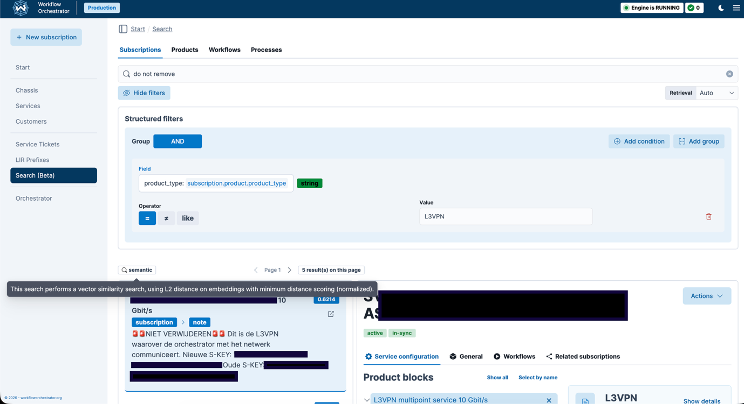
Results:

Slide 20
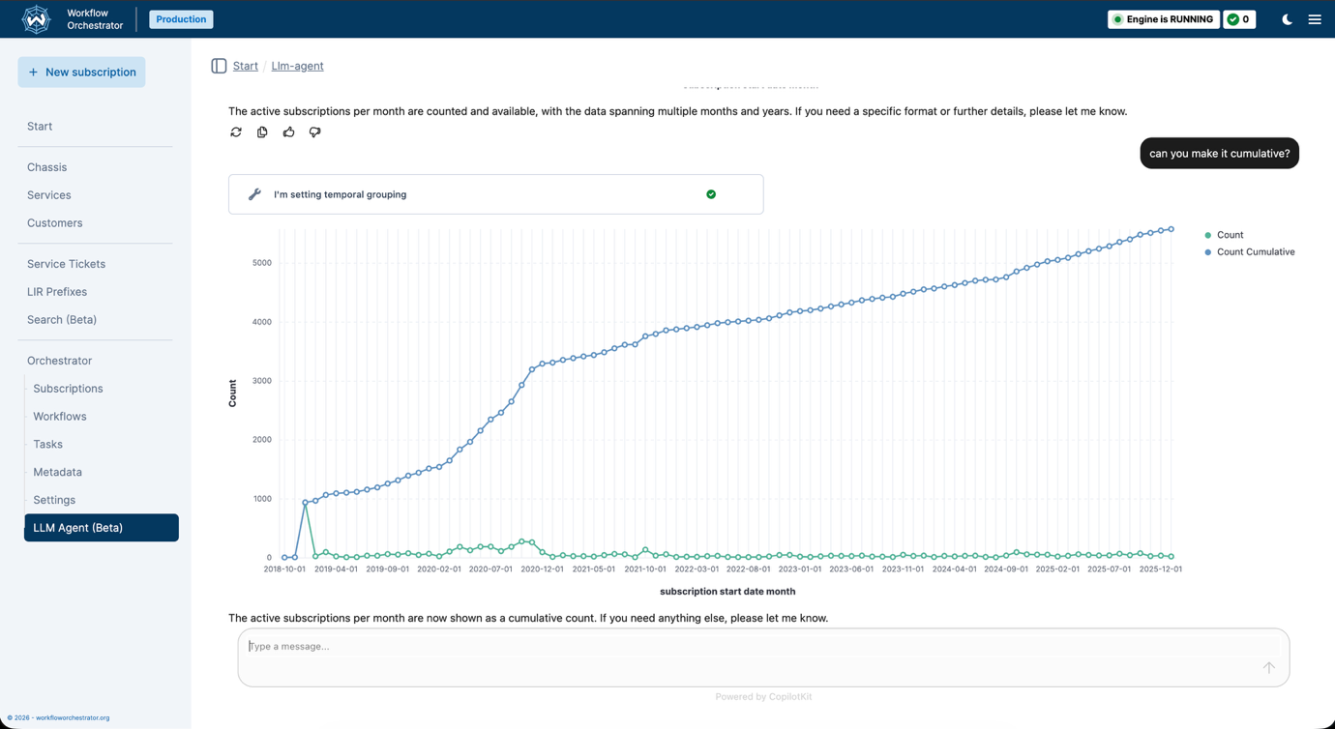
Results:

Slide 21
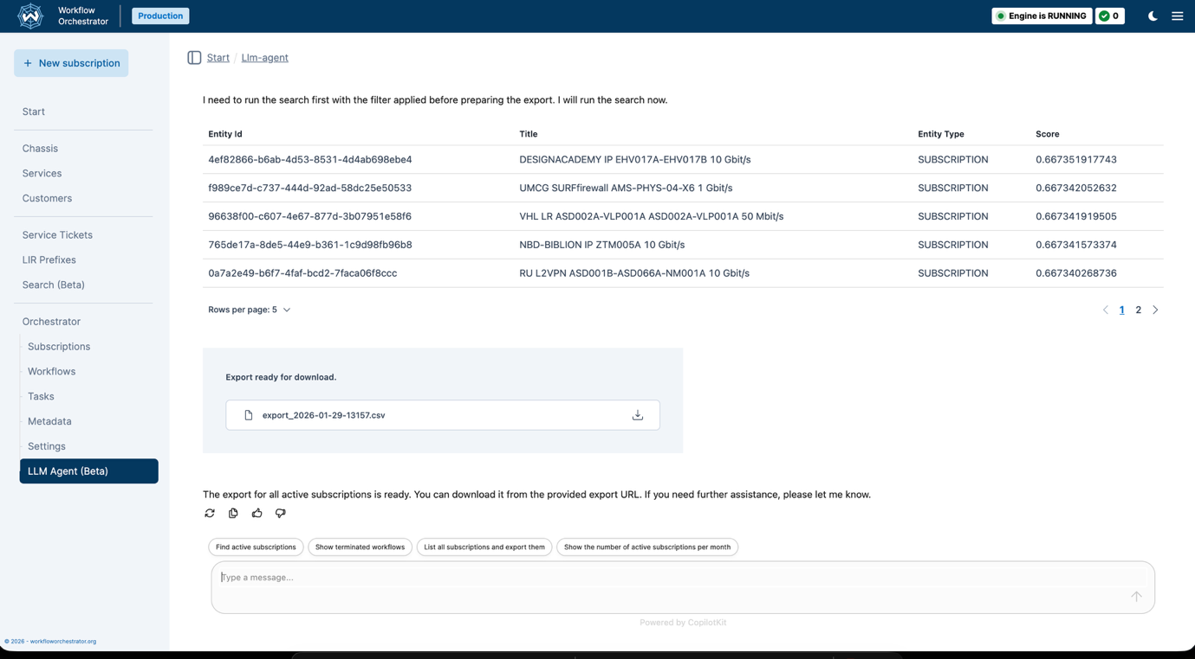
Results:

Slide 22
What did we learn?
When creating an AI agent, managing the context of your conversation is key.
  First iterations had poor performance as the workflow described in the System prompt was too complex
Not all LLM’s are suitable for Agentic architectures
  Older opensource models are not trained to drive the ReAct loop.
Delegate deterministic tasks to stateless tool calling as much as possible
Libraries and standards are moving targets
  Difficult to judge whether you have made the ”right” choice
We want more!

Slide 23
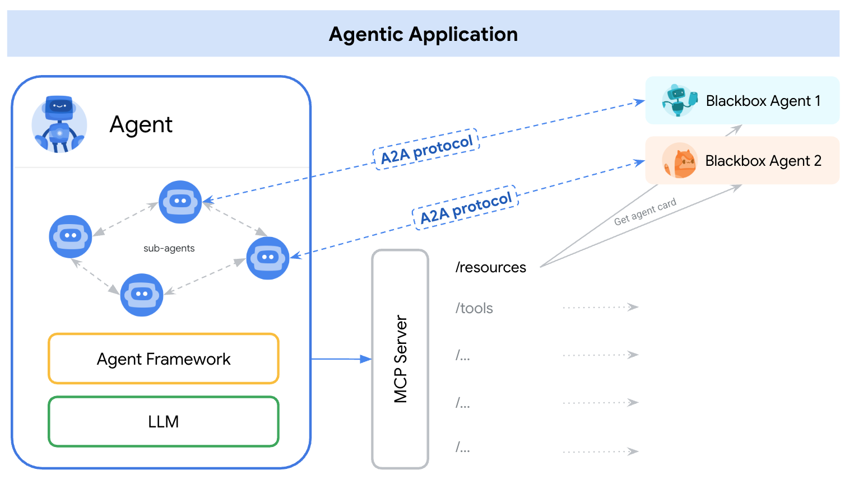
A solution to the context problem? A2A
Agent2Agent (A2A) protocol is designed by Google to build and design an Agentic Application
Each Agent within the constellation of Agents can communicate its capabilities in a standardised way through a service discovery mechanism
Sessions, artefacts, memory and context are formalised constructs that may be shared between agents.
Together the Agents work in a large ReAct loop to solve a certain task. However the context that each agents uses remains small
Microservice architecture for agents
a2aprotocol.ai

Slide 24
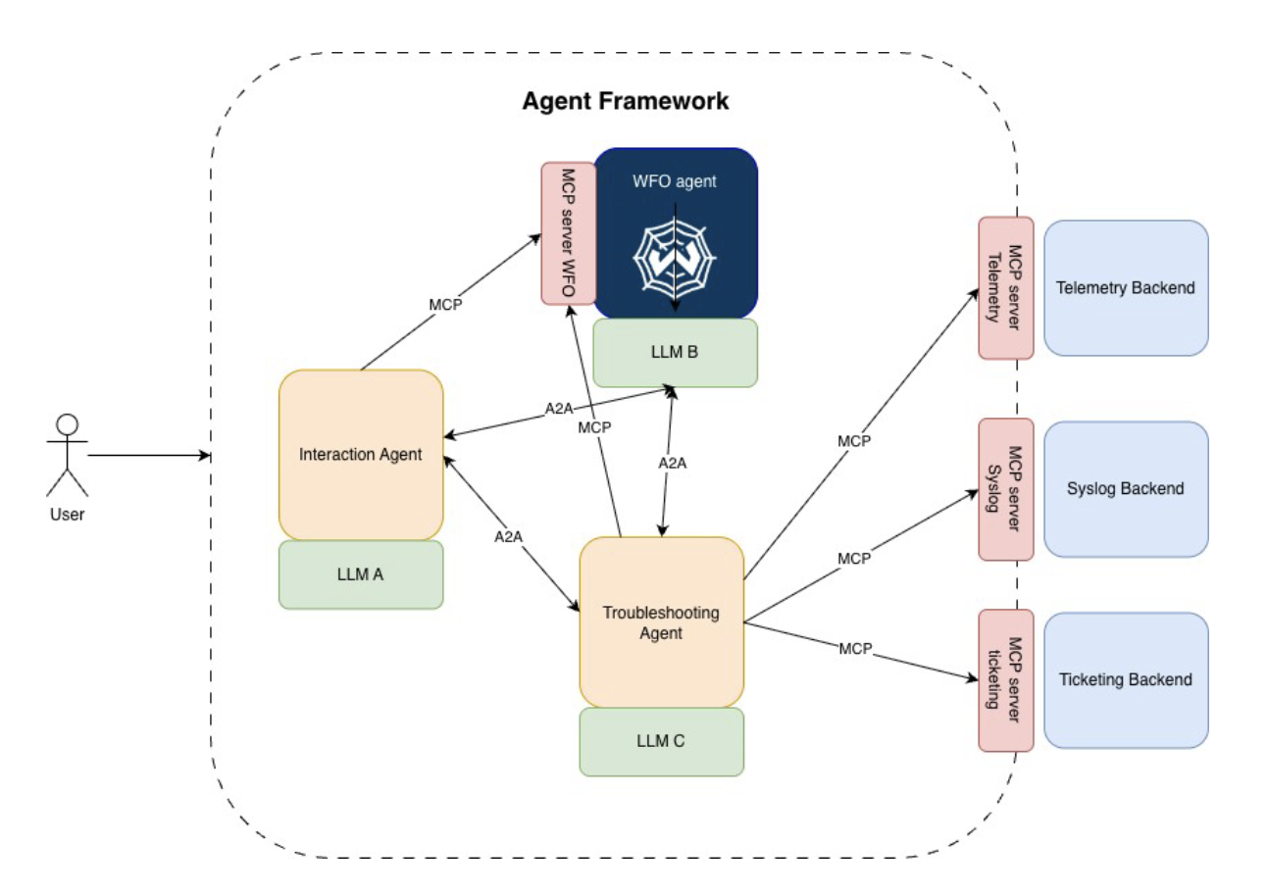
GN-52 is sponsoring SURF to build an A2A extention to the Workflow Orchestrator
Goal: Enable high quality consistent reasoning, across multiple agents by leveraging, Agent delegation, tool use and MCP servers to troubleshoot network incidents.
Interactions with the Agent architecture should be:
  Observable
  Reliable
  Deterministic
  Consistent
  User Friendly
  Time Saver

Slide 25
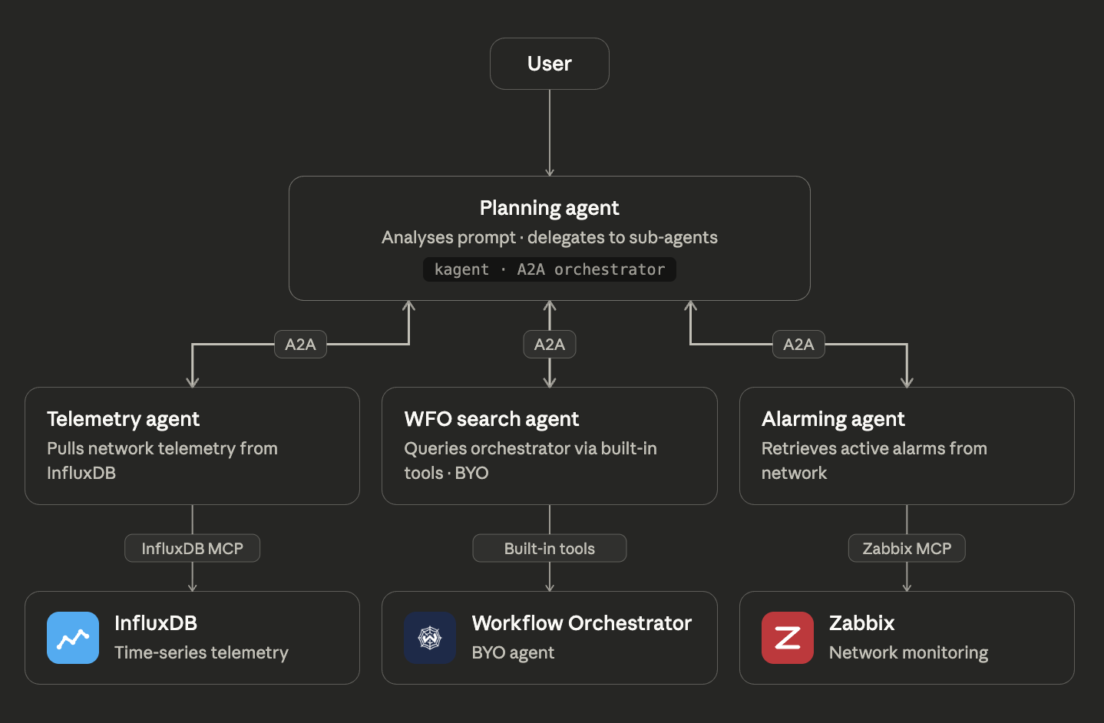
Demo: Current state (1)

Slide 26
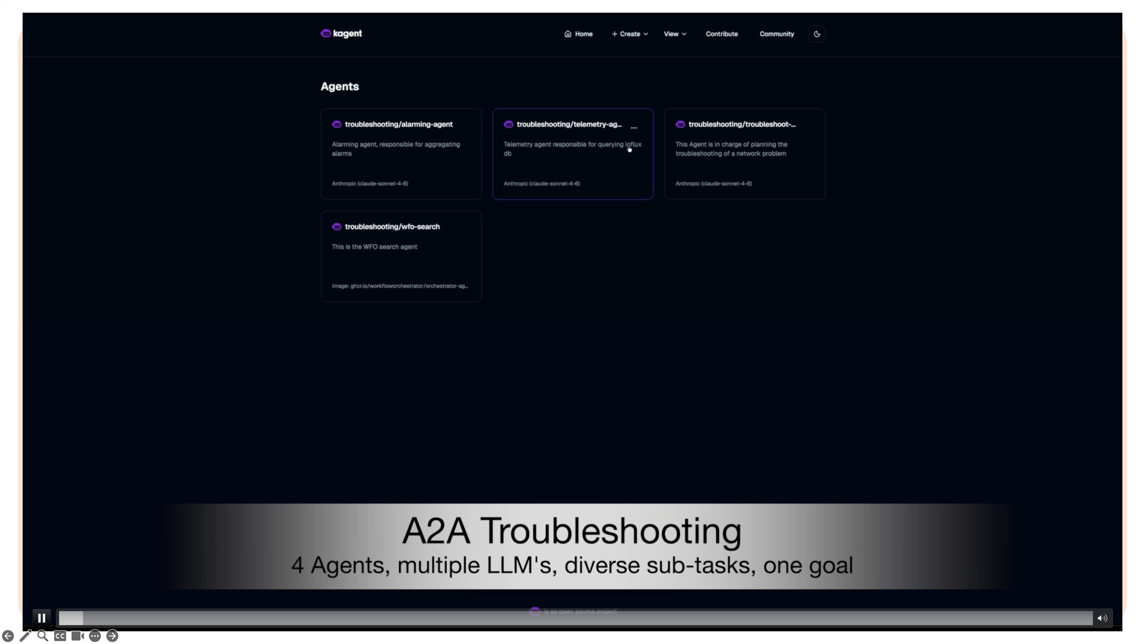

Slide 27
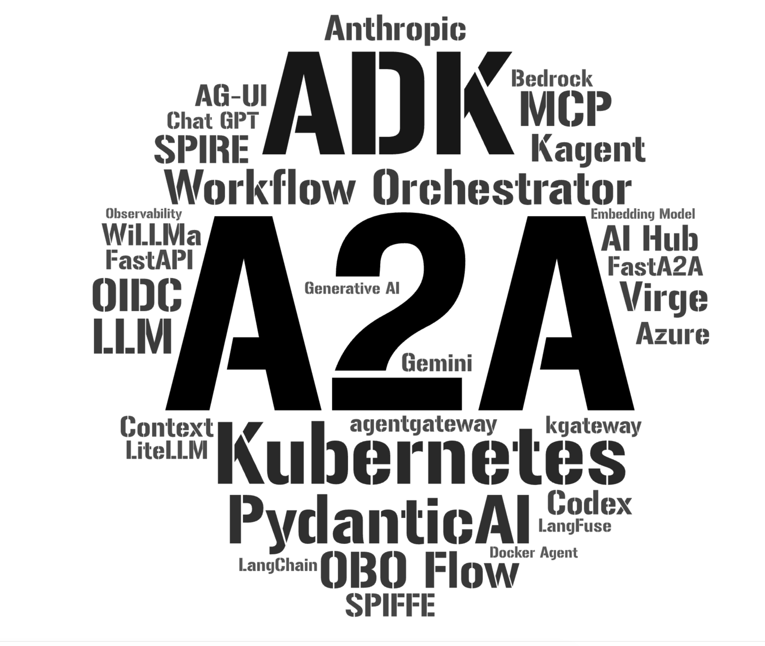
Current state (3)

Slide 28
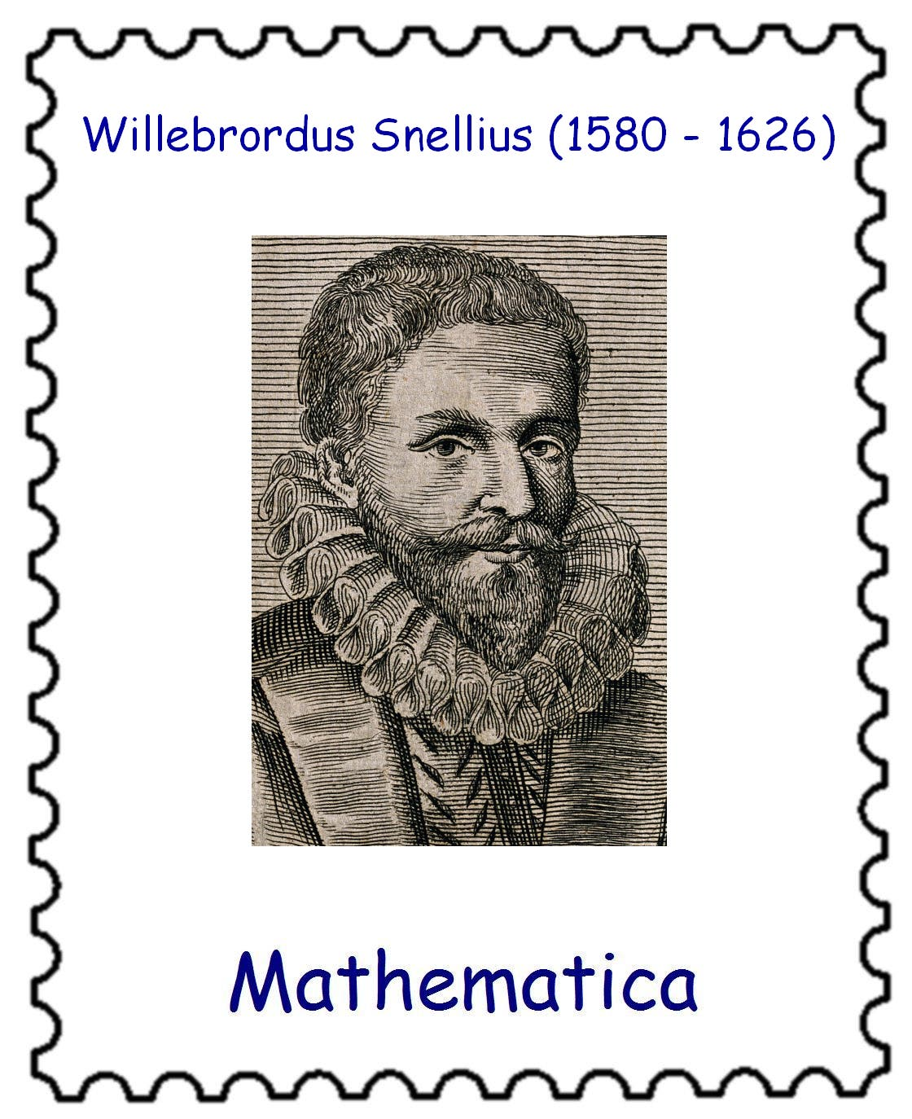
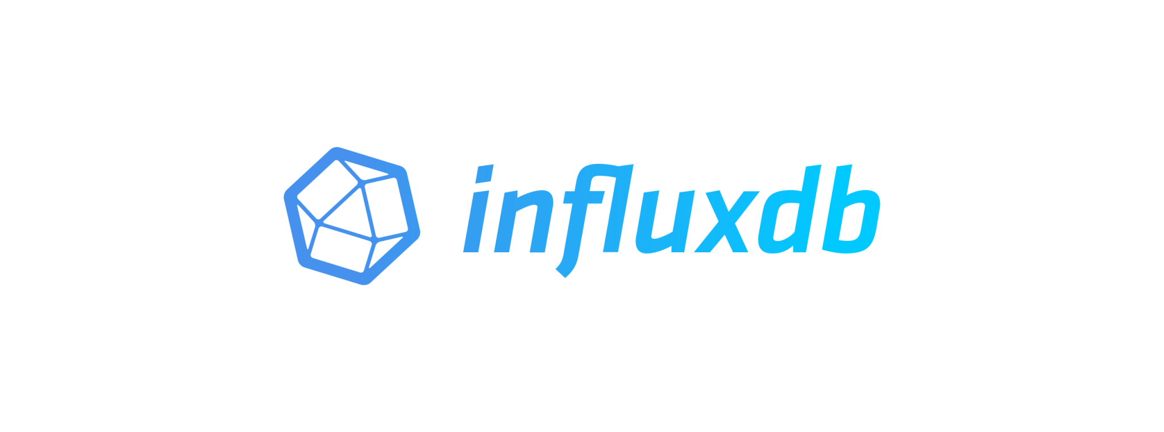
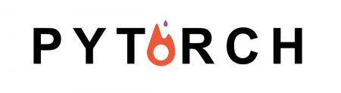

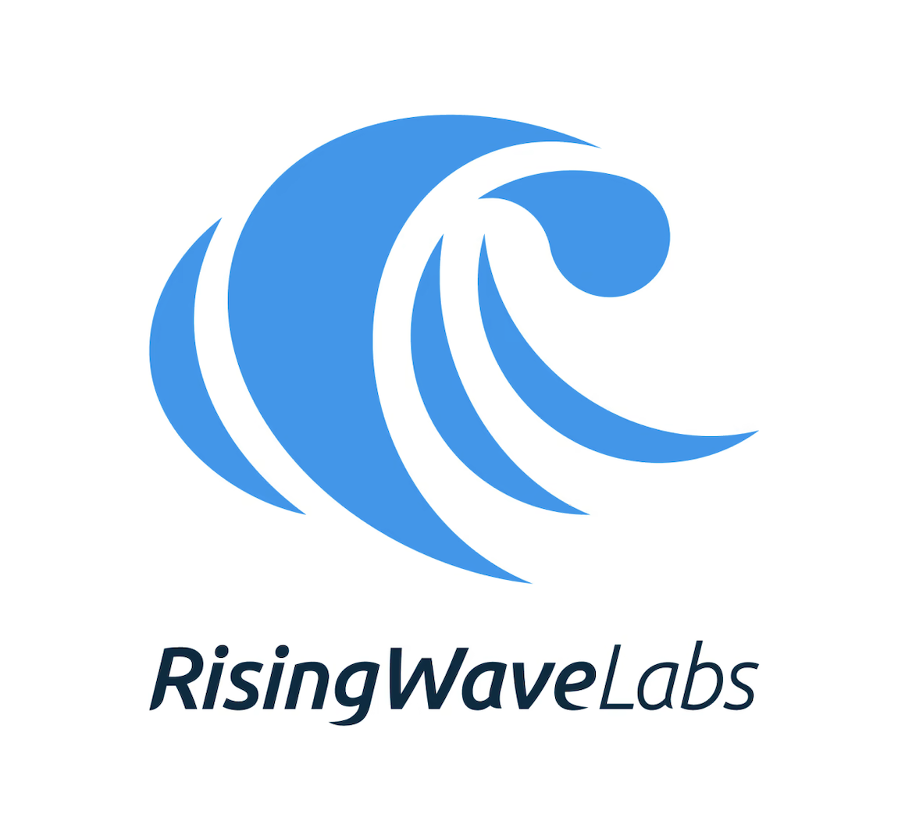


Tying the ML pipelines together with the Agentic Application
Network
+/- 200k e/ps
TSDB
ML Models
gNMI
+/- 5 tot 10k e/ps
gNMIc
Sanitization
BGP Correlator
Other Correlator
Other Correlator
Other Correlator
+/- 10 e/s
events
Proposers
Alerters

Slide 29
2026: 1st iteration of an Intelligent network
First goal is to develop a Human-In-The-Loop troubleshooting and remediation tool
ML models paired with an AI Agent to AI Agent architecture enables (semi) autonomous remediation of incidents
Each AI agent will use specific fine tuned LLM’s to enable accurate analisis of the anomaly.
Validation and remediation will flow through the network orchestrator
Network
+/- 200k e/ps
gNMI
gNMIc

Slide 30
Conclusion (so far)
Fast moving landscape
Some issues are still dificult to solve, Auth(n|z)
More experimentations to be done:
  TNC GNA-G automation WG. A2A troubleshooting between NREN’s???
We still need to be able to pivot to different frameworks and technology fast. AI helps with that.

Slide 31
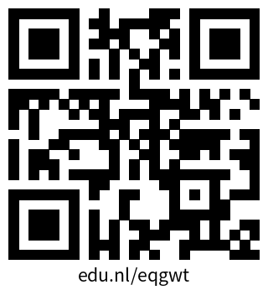
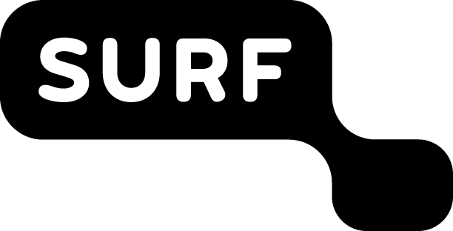
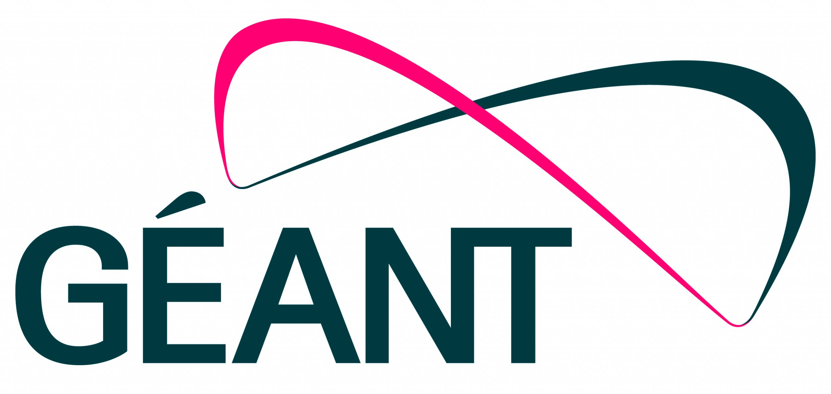

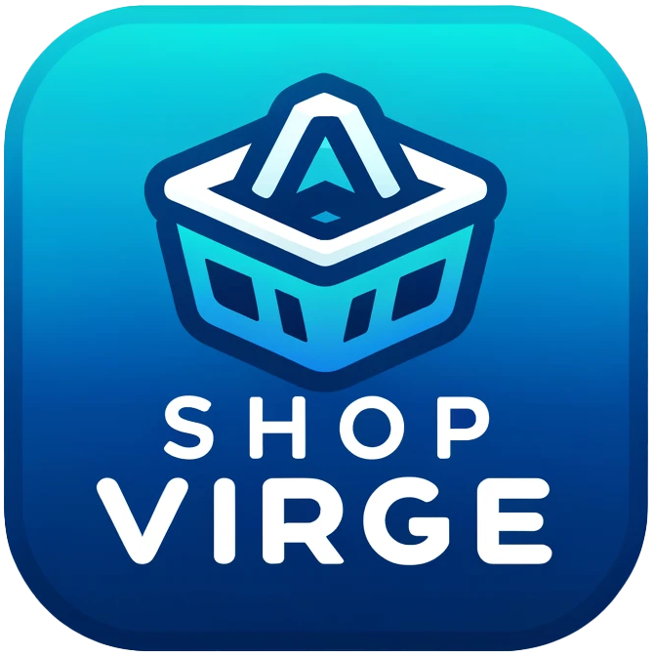



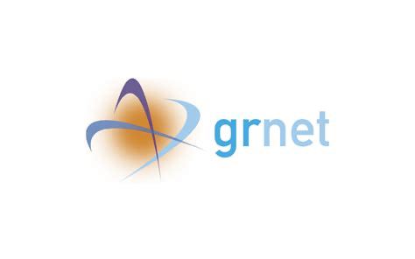


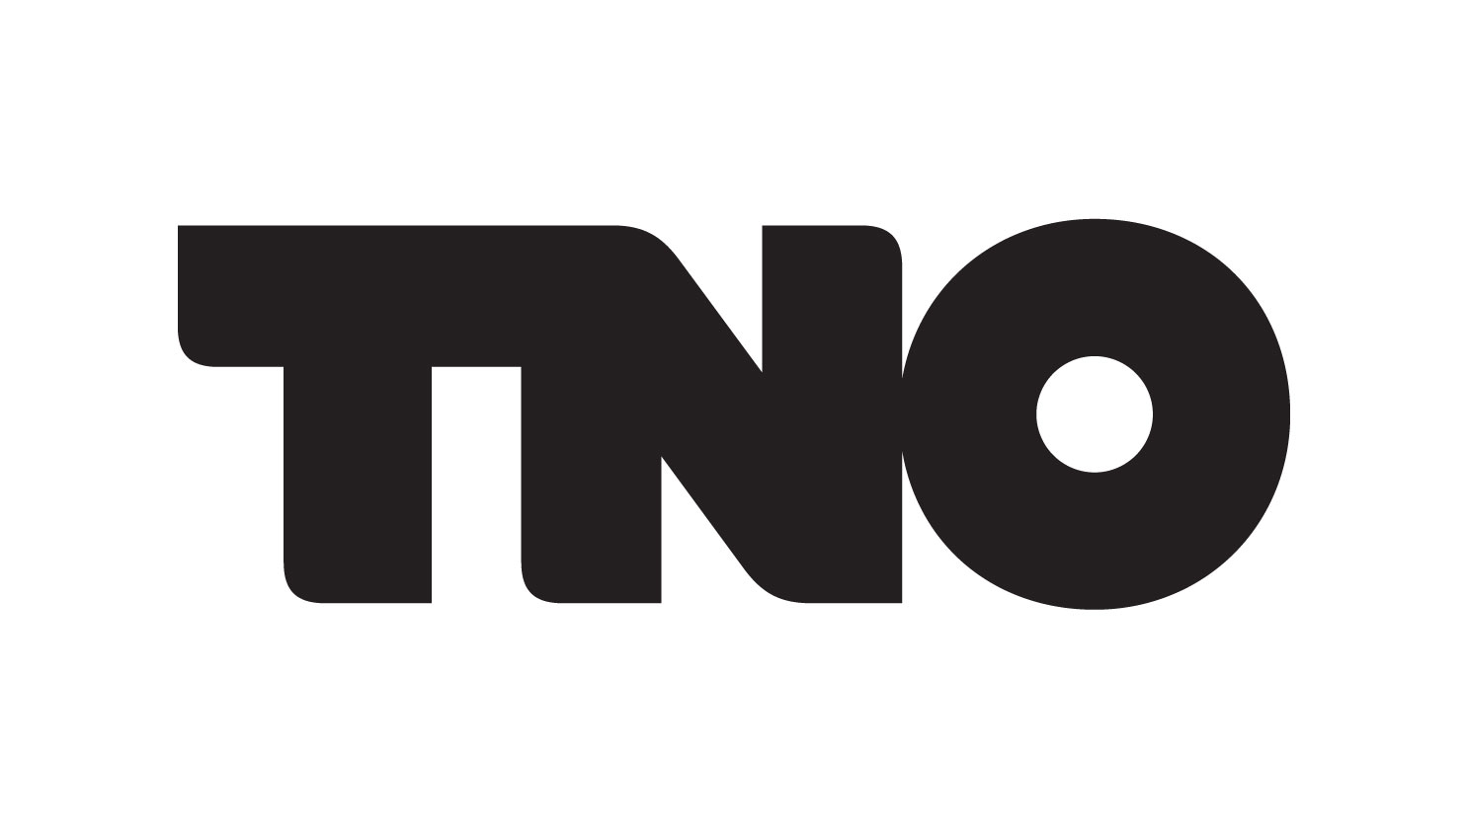


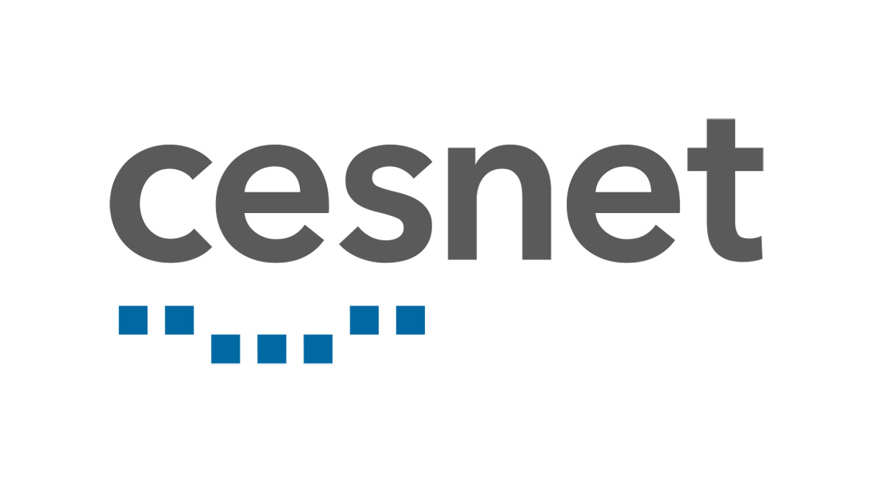
Are there any questions?
Source Code
\
Scan QR code for Workflow Orchestrator resources
Discord
?

