Slide 1


GEANT Updates
Utrecht, Netherlands
Temoor Khan
Head of GEANT OC
Notes:
There is also a registration sheet which I’ll send round, and again please just enter your name and organization.
Colea

Slide 2
Staff Update
Tony Barber retiring end of April
Temoor Khan taking on the role

Slide 3

IP/MPLS Refresh project
Complete! *
Full Lessons Learned to follow …
* Additional routers e.g. Stockholm outside of project

Slide 4
IP/MPLS Refresh Project - Overview
Invitation To Tender (replace MX960/480) – 9 Jun ‘22
Contract awarded (Nomios/Nokia) – 15 May ‘23
First router in lab – 26 Oct ‘23
First router deployed in network – 6 Mar ‘24
First backbone traffic – 25 Jun ‘24
First user service migrated – 29 Jan ‘25
Last user service migrated – 22 Jan ‘26
Notes:
The whole project, from launching the “invitation to tender” to migrating the last user service, took 3 and a half years, but it’s important to bear in mind that we committed to introducing automation and the two projects were rolled out in parallel and co-dependently. Had we not done so, likely we would have started the deployments and migrations a few months earlier, *but* we would probably be one to 2 years behind where we are now with our automation.

Slide 5
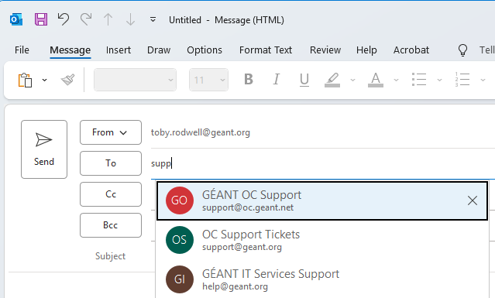
New Ticket System – Gotcha
Ivanti network services e-mail address - support@geant.org
  Currently, Network Service Orders only
  … all incident and planned work mails still support@oc.geant.net
No reason to send new mail to support@geant.org (just reply)
… but email auto-complete might sabotage
Notes:
The email address Ivanti uses for Network Services is ‘support@geant.org’. Currently this address is only used for new Network Service Orders. All network incidents, problems and planned maintenance are managed in Otobo using the support@oc.geant.net address. There should be no need at the moment for you to send a new mail to support@geant.org, any mail you send about a new service will be a reply to a previous mail of ours, but email autocopmplete might mess you up. There’s a screen clipping of me starting to write ‘support’ in the To field and Outlook is offering me both options.
… if you inadvertently send a mail to the Ivanti-related address rather than the Otobo address then the mail won’t go to our24/7 Service Desk where it will get immediate attention, but it won’t be completely black-holed – a copy of the mail will be put in a mailbox which gets looked at 2 or 3 times a day, but only during the week.

Slide 6
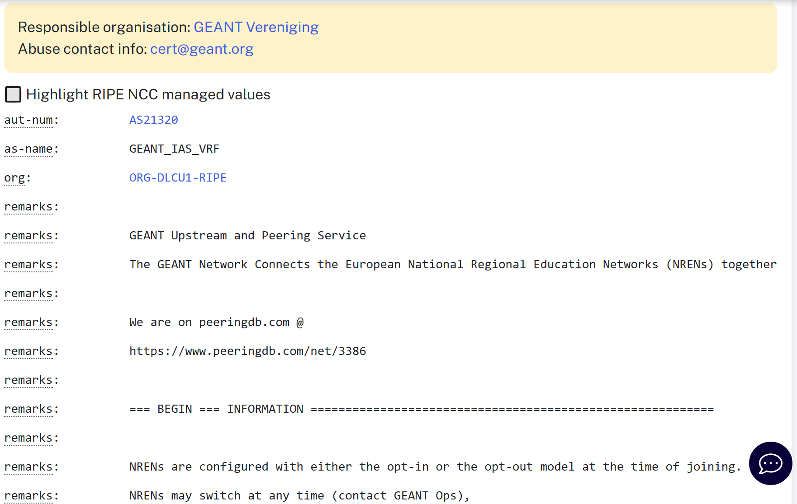
BGP Communities
Used for
  Information
  Traffic Engineering
Fully described in GEANT RIPE autnum objects
– AS20965 & AS21320

Slide 7
BGP Communities – Informational
21320:XXXyy, where XXX denotes our relationship to the BGP speaker
21320:xxxYY, where YY denotes the location at which we learned the route
Relationship :-
21320:645yy Upstream/Tier 1 transit
21320:646yy Public commercial peer via Internet Exchange fabric
21320:647yy Private commercial peer via dedicated interconnect
21320:648yy Research & Education peers (e.g. ASNET)
21320:649yy NREN peers, i.e. GEANT consortium members

Slide 8
BGP Communities – Location Information
21320:xxx13 Amsterdam NL (AMS)
21320:xxx14 Athens GR (ATH/ATH2)
21320:xxx15 Bratislava SK (BRA)
21320:xxx16 Brussels BE (BRU)
…
21320:xxx88 Budapest HU BiX
21320:xxx89 Madrid ES DE-CIX Madrid
21320:xxx90 Marseilles FR DE-CIX Marseilles
21320:xxx91 Prague CZ NIX.CZ

Slide 9
BGP- Traffic Engineering
Block
64512:<ASN> - Don't announce to <ASN>
origin:<ASN>L:64512 - Don't announce to <ASN> (required for 4-byte ASNs)
64599:65532 - Don't announce to peers at AMS-IX (Amsterdam)
64598:65532 - Don't announce to peers at DE-CIX (Frankfurt)
…
64512:65532 - Don't announce to any public peers
64512:65533 - Don't announce to any private peers
64512:65534 - Don't announce to any upstreams

Slide 10
BGP- Traffic Engineering
Prepend to ASN
Two communities at a minimum …
One to specify who to prepend to, and how many times:
6480X:<ASN> - Where X can be 1, 2, 3 or 6 times prepending
… and one to specify at which location to prepend:
648XX:<ASN> - Where XX is the IX or POP code (as per Informational communities)

Slide 11
BGP- Traffic Engineering
Prepend globally
6480X:65532 - Prepend X times toward all public peers
6480X:65533 - Prepend X times toward all private peers
6480X:65534 - Prepend X times toward all upstreams
Notes:
For global prepending then one of these communities is sufficient.

Slide 12
BGP- Traffic Engineering
Announce
For opt-in users
64700:<ASN> - Announce toward <ASN> everywhere
64700:65532 - Announce toward all public peers
64700:65533 - Announce toward all private peers
64700:65534 - Announce toward all upstreams
Notes:
A small number of NRENs are opt-in users, meaning that by default GEANT will not advertise *any* of their prefixes in AS21320, the Internet Access L3VPN. Instead those NRENs must specifically tag an prefixes they want tog et advertised, using the communities shown here.

Slide 13
Practical example of Traffic Engineering
High latency reaching a network in Marseille
Traffic “tromboning” from Marseille to Frankfurt (DE-CIX)
  No direct connection in Marseille …
  … best path via Frankfurt peer
Checking feasibility of new peering …
.. but TE community could be used to stop advertisement of NREN’s prefixes
Notes:
Here is a real-life example of how Traffic Engieering could help you.
An NREN reported very high latency reaching the Akamai data centre in Marseille
The GEANT OC investigated and found that the NREN’s traffic was “tromboning” from Marseille to Frankfurt (DE-CIX) – as we have no peering with Akamai in Marseille the best GEANT path was via DE-CIX in Frankfurt. We’re trying to peer with Akamai in Marseille, but in the meantime any NREN advserely affected by this routing could use a TE community to block that path and use a more direct path from an alternate upstream provider, albeit that would likely come at a cost.

Slide 14
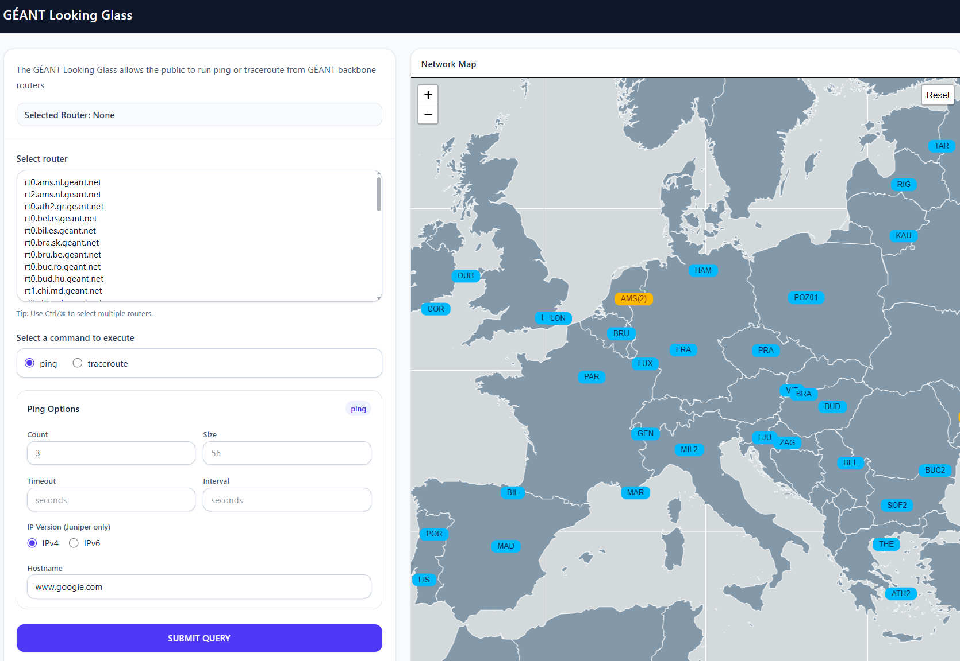
Notes:
But very soon that will be replaced by this new, Nokia compatible Looking Glass. As with the current LG you can click on the map icons to select a router, or choose from the list …

Slide 15
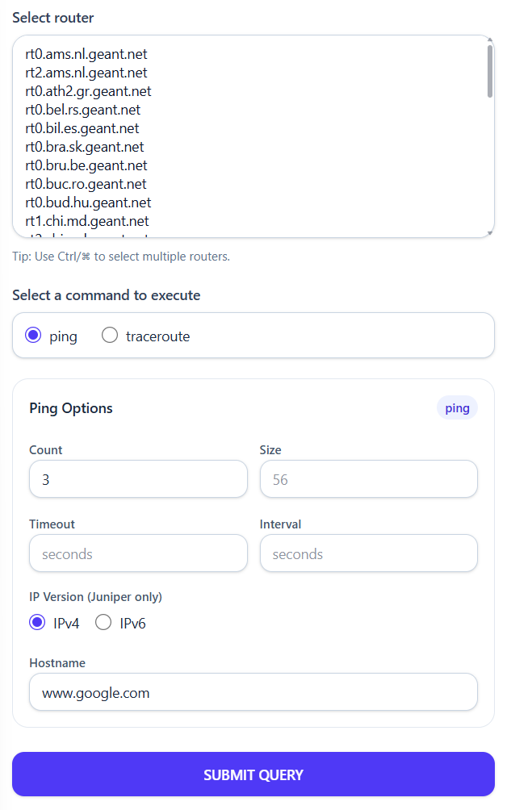
Simultaneous tests allowed
  But number limited to protect routers
  “HTTP 503”
Ping and traceroute only
Notes:
… and zooming in on the form you can see more clearly the options. Not apparent from this image, but I can tell you that it is possible to select a small number of routers to run tests concurrently, though the number of tests is controlled to prevent overloading the router management planes, and if you *were* to try to run concurrent tests on all the routers you would see a response of 503 for most of them, as the LG server throttles the requests it gets. As mentioned on several previous occasions, this new LG is just for pings and traceroutes, if APMs and NREN NOCs want greater insights then they need to use the jumpbox that gives command line access to the routers, including now Nokia.

Slide 16
Jumpbox – Getting access (reminder)
APM sends email to support@oc.geant.net:
The subnet prefixes (IPv4 and/or IPv6) from which NREN will access jumpbox
The SSH public key(s) to be used to log in to the device
$ssh nren@nren-jump-box.geant.org

Slide 17
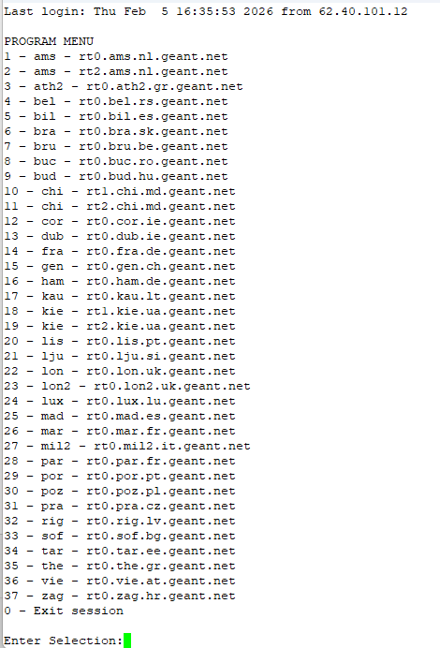

Slide 18
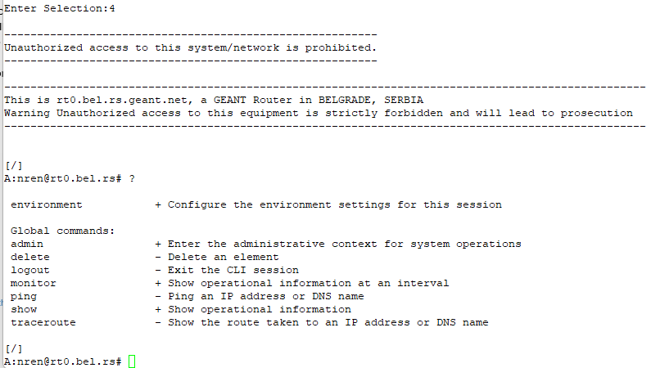
Notes:
Once in, you can type question mark to see all the possible commands you run , or I should say the start of the command because if for example you wanted to see what show commands you can run you’d type ‘show’ and then question mark again.
… don’t be alarmed by the ‘delete’ option there, if you follow it you’ll see all you can delete are your session environment settings. Likewise for admin, if you select that … [click]

Slide 19
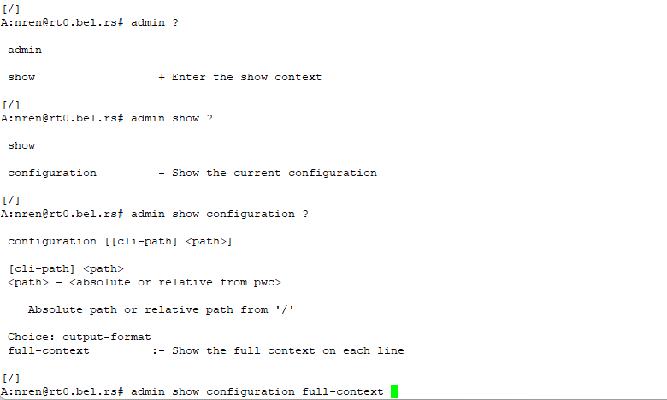

Slide 20
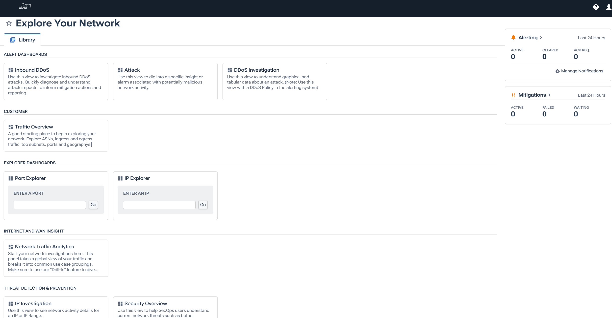
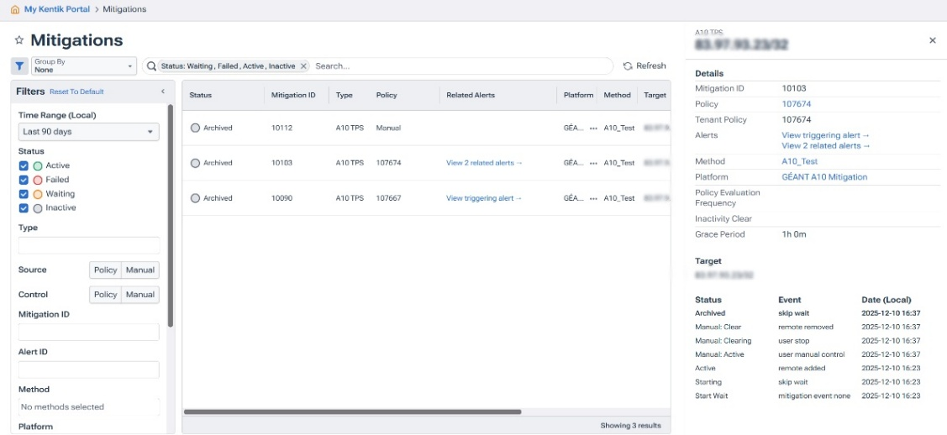
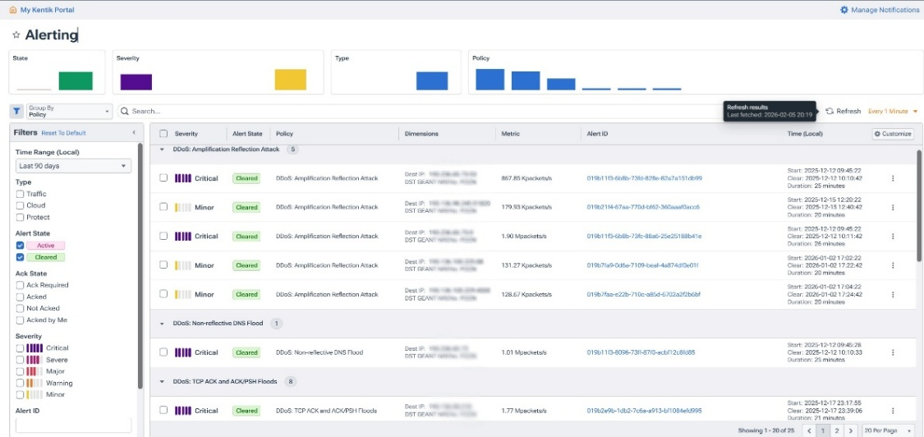
GÉANT Tenant Portal – Kentik
Explore Your Network
Dashboards and saved views
Alerting page
Attack details and history
Advanced DDoS search
NREN-defined Notification channels
Mitigation page
Mitigation details and history
Advanced search
User Management
2FA
SSO

Slide 21
Suggestion – One Page for Tools from all NOC’s
Looking Glass
JumpBox
Network Map
Ongoing Incidents
Traffic Graphs

Slide 22
Nokia Migration – Operational Feedback
ST resulting in high management CPU
BGP Convergence issue
For Discussion or sharing information on Nokia Platform – join the distribution list (nokia-users@lists.geant.org)

Slide 23

Thank You
Any questions?
www.geant.org
© GÉANT Association
As part of the GÉANT 2020 Framework Partnership Agreement (FPA), the project receives funding from the European Union's Horizon 2020 research and innovation programme under Grant Agreement No. 856726 (GN4-3).

