Slide 1
RPKI ASPA:
The Next Frontier in Securing BGP
Simon Leinen <simon.leinen@switch.ch>
Version 01, 4 April 2026

Slide 2
BGP (Routing) Security Issues
Threat: Attacker announces your routes from elsewhere and attracts traffic for your address space.
Possible impact:
  Loss of connectivity
  Traffic capture (can be mitigated by encryption, e.g. TLS)
  Impersonation (can be mitigated by authentication, e.g. X.509 certificates in TLS)
  Traditional countermeasures:
  Route filtering (only viable near edges)
  Detection via route collectors (e.g. RIPE RIS, BGPalerter…)
  Radical countermeasure:
  Replace BGP with something designed with security, e.g. SCION

Slide 3
RPKI (Resource Public Key Infrastructure)
PKI to publish signed assertions about resources (IPv4/IPv6 prefixes, AS numbers)
Follows allocation hierarchy of these resources (RIRs/LIRs)
These assertions can be authenticated and used for validation of (BGP) routes.

Slide 4
RPKI Publication Process: Delegated

Slide 5
RPKI Publication Process: Hosted
We use this

Slide 6
RPKI Publication Process: Hosted
We use this

Slide 7
RPKI Relying Party and Validation by Routers

Slide 8
Route Origin Authorization (ROA)/Validation (ROV)
ROAs have the form “ASx is authorized to announce prefix y/n [and more-specifics up to /m]”
When someone else (unauthorized) announced your prefix (or a more-specific), those announcements will be rejected by ASes performing Route Origin Validation (ROV).
Switch has been publishing ROAs for all announced prefixes for a few years (authorizing AS559 as origin)
Many ISPs, in particular most large ones, perform ROV and will reject simple “hijacks” of those prefixes.
But: Attackers could still announce prefixes with authorized origin!
More commonly, other networks may “leak” your routes to unexpected places…

Slide 9
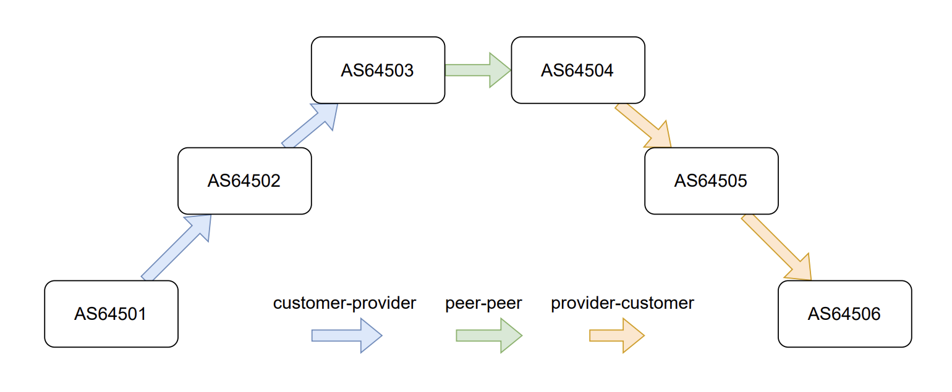
AS Provider Authorization (ASPA) and AS Path Validation
An ASPA has the form “The providers of ASx are (only) ASa,b,c”.
AS Path Validation checks whether the AS_PATH attribute of an incoming route is “valley-free”.
Source: Cloudflare

Slide 10
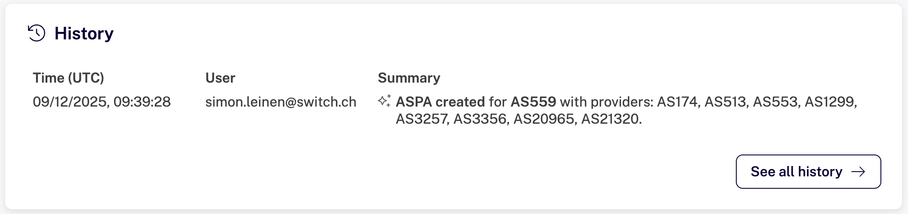
AS559 ASPA

Slide 11
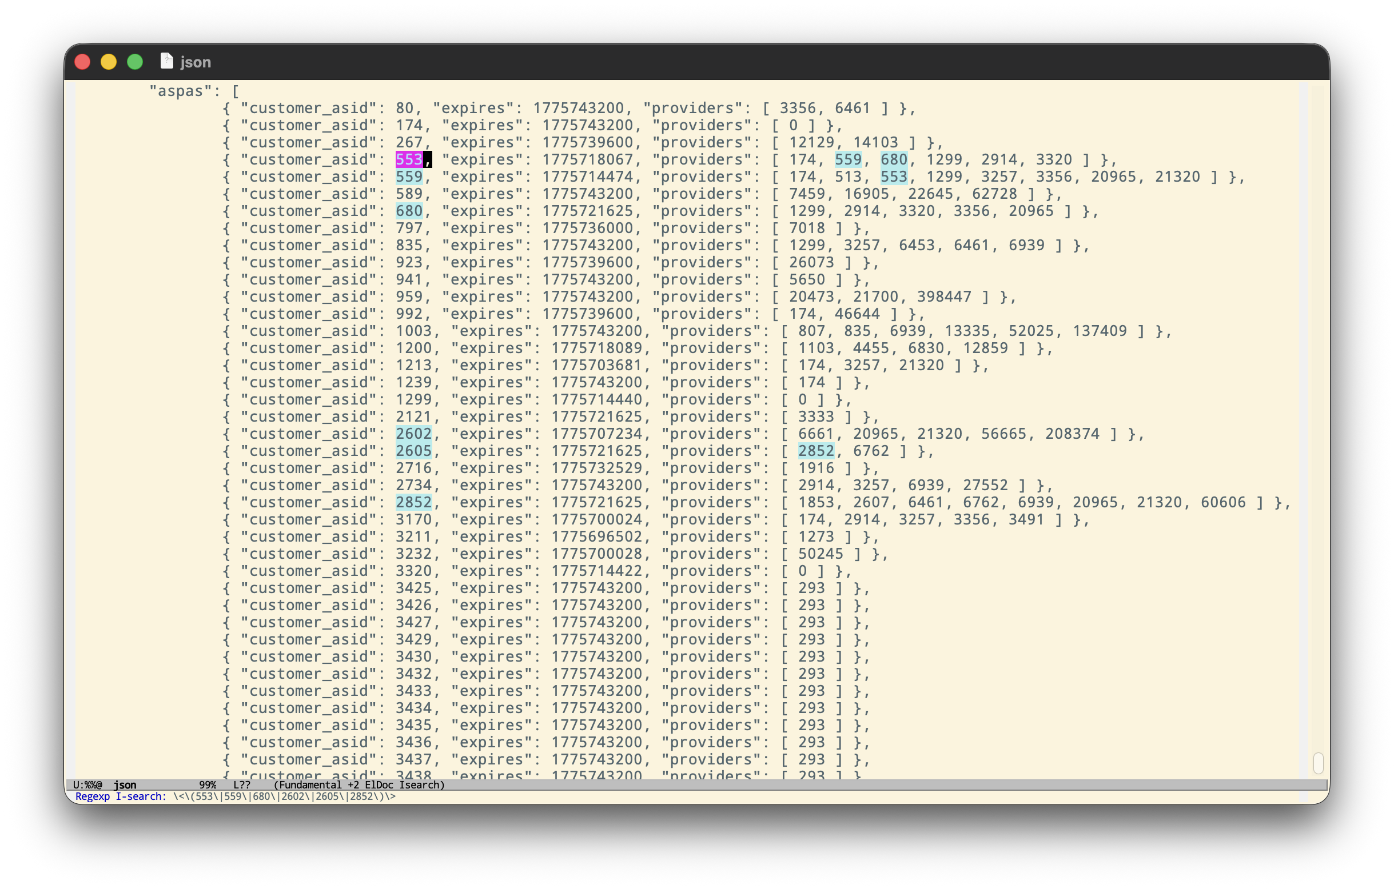
Other ASPAs found in the wild

Slide 12
AS_PATH Validation
Nobody does it ☺ — not yet available in “mainstream” router software.
Cisco has an IOS-XR version with ASPA support in EFT (Early Field Trial)
We have this running on a test router in the lab—looks quite usable already!
Requires new version of RRP (RPKI-to-Router Protocol)
Supported in Routinator “out of the box” (and Fort as well, I think)
Requires patch for StayRTR (which we use with rpki-client)

Slide 13
Next Steps
Provide Feedback about ASPA in Cisco’s IOS-XR
Encourage others to publish ASPAs—anyone here has their own AS? Talk to me ☺
Track and investigate AS_PATH validation failures (https://github.com/sleinen/aspa-invalid-analysis, WIP)
Contribute to safe adoption of the mechanism across the Internet

Slide 14
Further Reading
ASPA: making Internet routing more secure, Cloudflare blog, February 2026
ASPA in the RPKI Dashboard: A New Layer of Routing Security, RIPE Labs, December 2025
@newaspa@bgp.tools Mastodon Account (posts whenever an AS posts its first ASPA)
https://rootbeer.internet2.edu/ BGP Analysis tools of the ROOTBEER project

Slide 15

Your contacts
Simon Leinen
Network Engineer
P +41 44 268 1536
simon.leinen@switch.ch

