Slide 1
Network Automation Forum (NAF)
Simon Leinen <simon.leinen@switch.ch>
Version 00, 9 April 2026

Slide 2
What is NAF?
https://networkautomation.forum/
A forum for the “community of practice” around network automation

Slide 3
NAF Communication Channels
NAF Slack (auto-onboard via Web site)
  Wide range of discussions (general, topic-specific BOFs, AutoCon…)
  ~4500 members, quite a few active, mostly from US and Europe
AutoCon Conference (~twice yearly, even numbers in US, odd in Europe)
  See below
Regional “office hours”
  Every first Thursday of the month at 1400 UTC on Jitsi
  Just show up and discuss. Informal, moderators usually prepare conversation starters

Slide 4
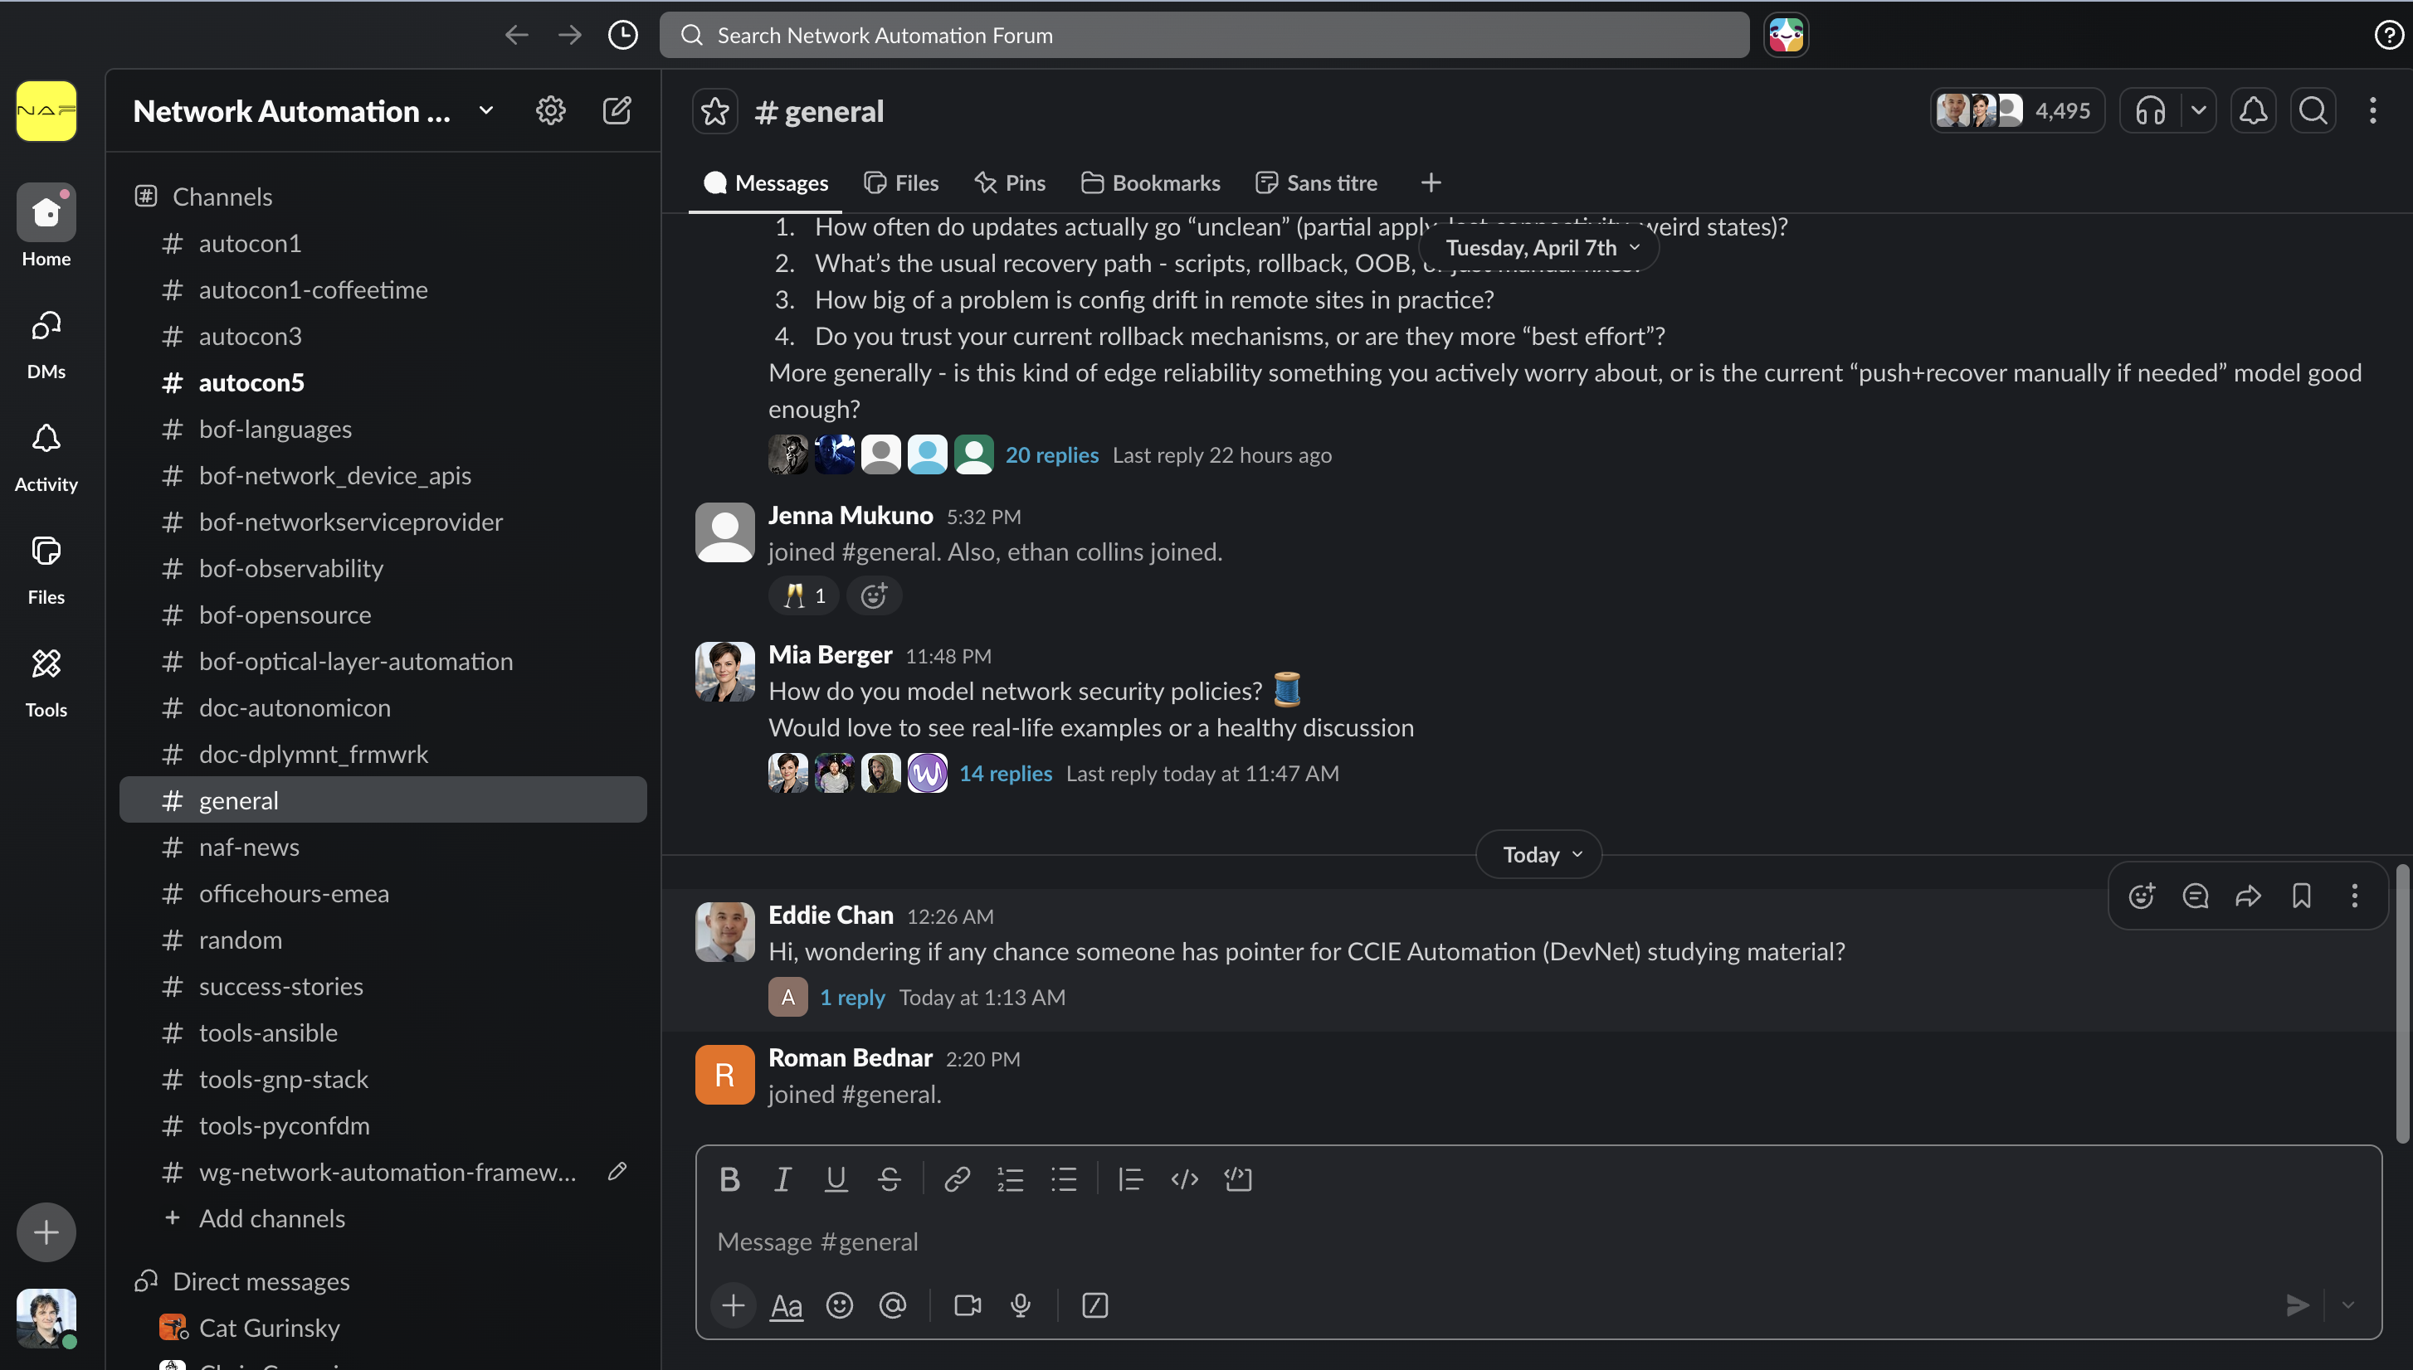
NAF Slack

Slide 5
NAF Topics
Automation “philosophy”, business cases etc.
Network Source of Truth (NetBox, Nautobot, Infrahub…)
Orchestration (Workflow Orchestrator, Temporal, Itential…)
Observability (e.g. gnp-stack)
Use of ”AI”
…

Slide 6
NAF Impact
”Safe space” for network automation “believers”
  Ongoing (mostly) productive conversation
Visibility
Ability to spawn projects (e.g. the NAF Framework)

Slide 7
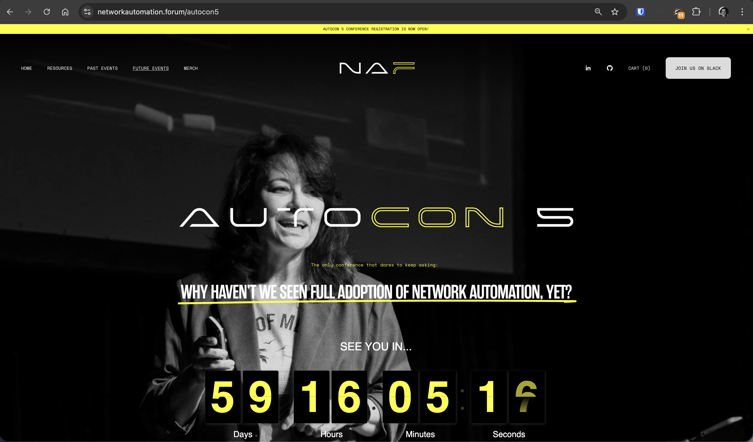
AutoCon (5 in Munich, 8–12 June 2026, oops TNC)

