Slide 1
Network and Service Management in a nutshell
From HBONE+ to DJG
Attila Gyürke – KIFÜ Hungarian NREN

Slide 2
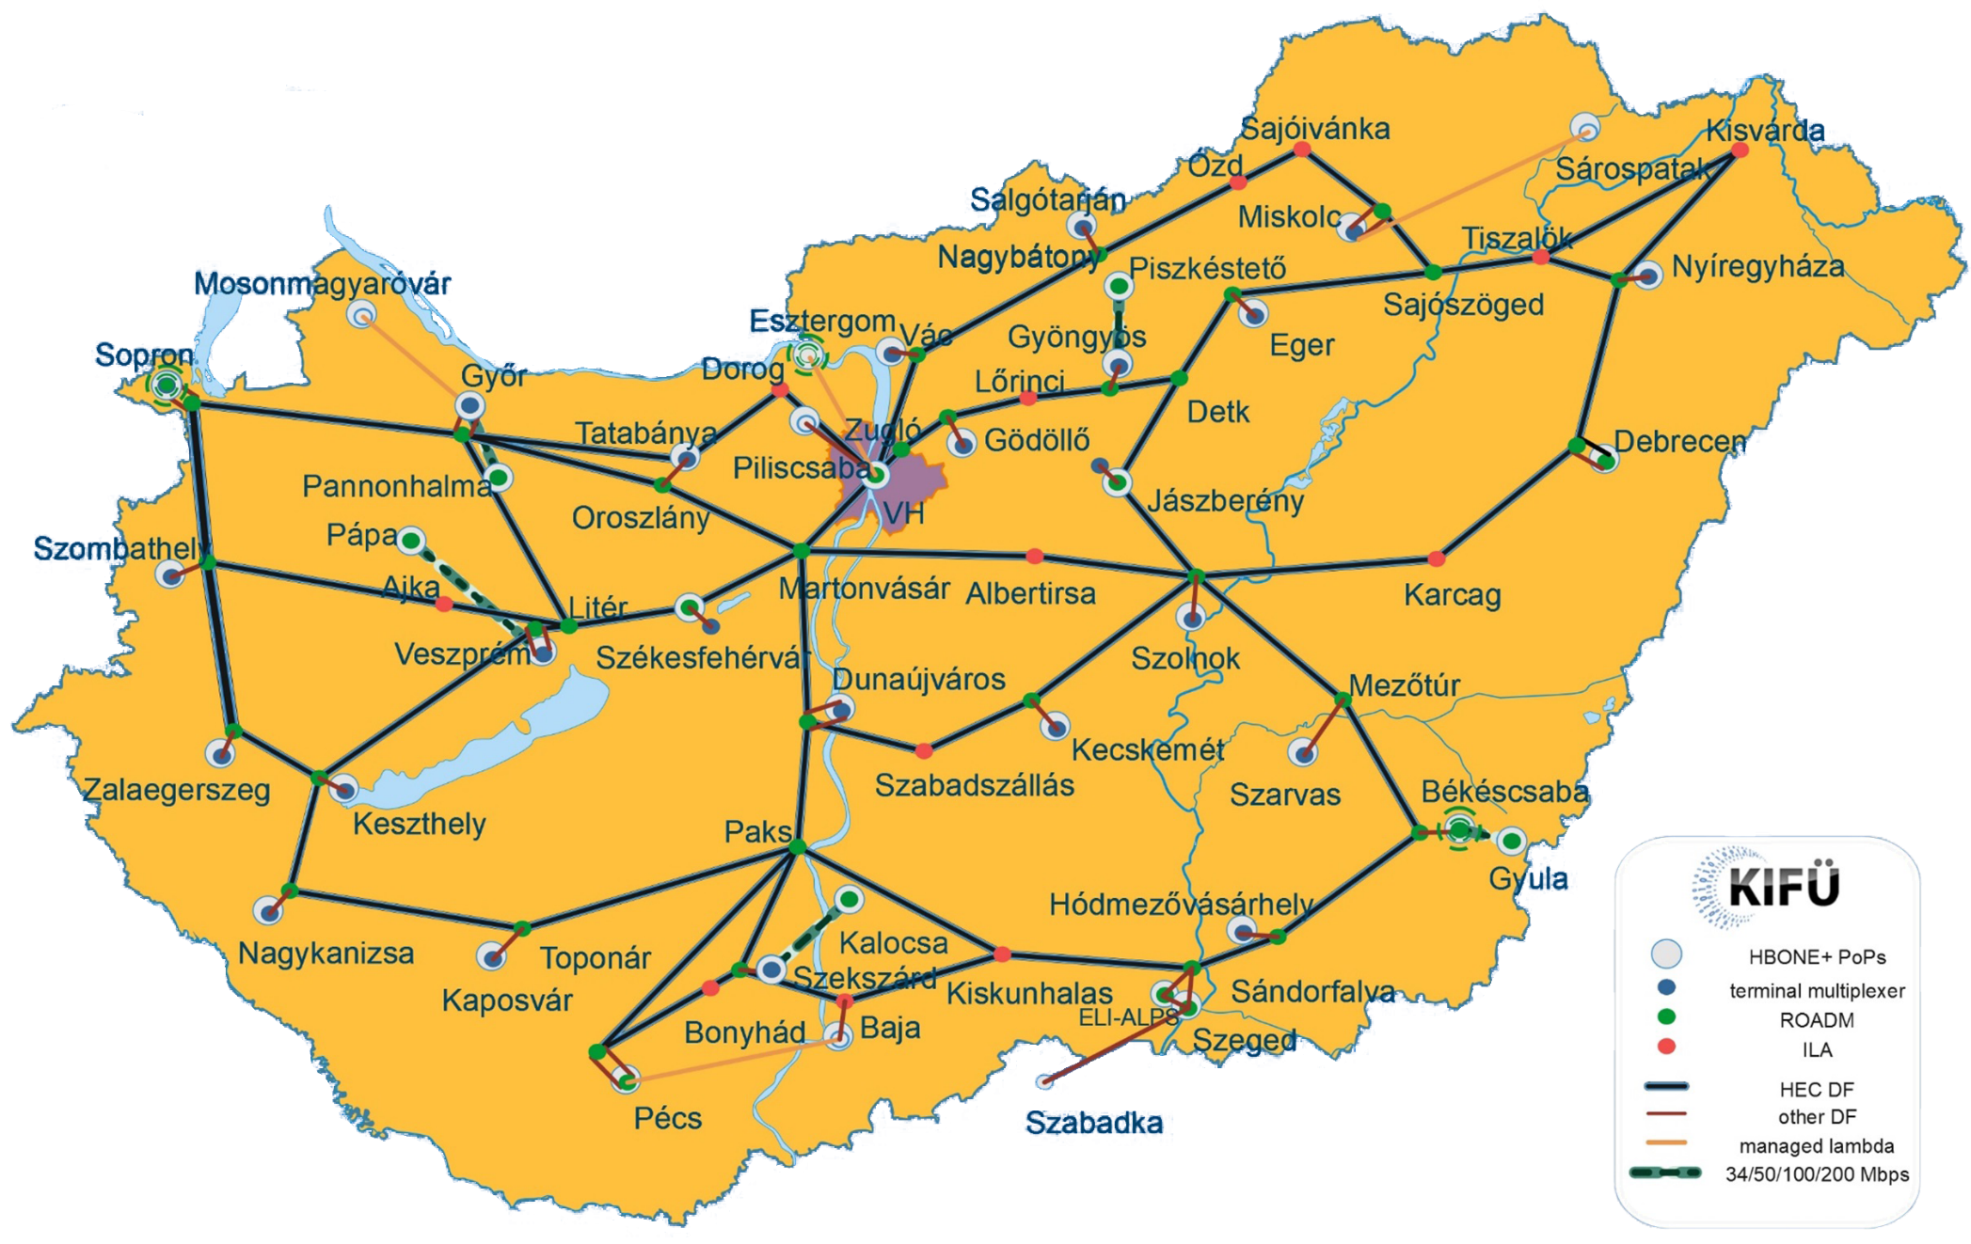
HBONE+ & DJG (Digital Welfare Backbone)
NIIF Program since 1986
Member of NREN community since 1996
NIIFI + KIFU merger 2016
USERS - ACCESS
1.6 Million PERSON
    3000 university, research, public collections and public cultural institutions, hospitals
  6500 educational endpoints, all Primary and secondary schools
  300 Gb/s traffic planned
NETWORK technologies
MPLS (2002), IPv6(2003), Segment routing (2013), 100 Gbps (2012)
Hybrid network
IP/MPLS layer
DWDM layer
  ~ 3200 km
  Shared DWDM management
Access speed up to 100 Gbps
~1000 monitored core devices
~7000 monitored access devices
SERVICES (Network & Application)
Helpdesk; Network - DHCP/firewall configuration; DNS – administration (.hu and .eu - and sulinet.hu ) IP address (IPv4/IPv6); NTP; NIIF CSIRT; Web hosting (PHP); database; Microsoft KMS licenc service; Mail relay, mail service,list service; Multimedia: videoconferencing, videotorium, streaming; Sulinet eduroam/eduID service; Server hosting; Certificate Service; …..???

Slide 3





Service FUTURE:
KIFÜ is NIIF and STUDENTNET Program depositary
Hungarian LAW designation in a nutshell:
KIFÜ the Hungarian NREN is appointed to MANAGE, DEVELOP and OPERATE resources of NIIF and DIÁKHÁLÓ (StudentNet) Program:
Manage networks (DJG + infrastructure+ access+ routing+ MANAGEMENT)
Manage Services and Users
INSOURCING
„NORMAL”
HBONE: Hungarian Backbone Network
DJG: Digitális Jóléti Gerinc = DWC: Digital „Welfare Core”
Rented CAPACITY
(near-bitstream)
DIÁKHÁLÓ
DJG
HBONE+
Access
fibre
Aggregation
fibre
Core
fibre
OUTSOURCING
In „special” cases..
SCHOOL
(education unit)
T-PoP
(Settlements)
J-PoP
(County capitals)
E-PoP
(UNIVERSITIES)
KIFÜ VH
(Country INTERNET X)

Slide 4
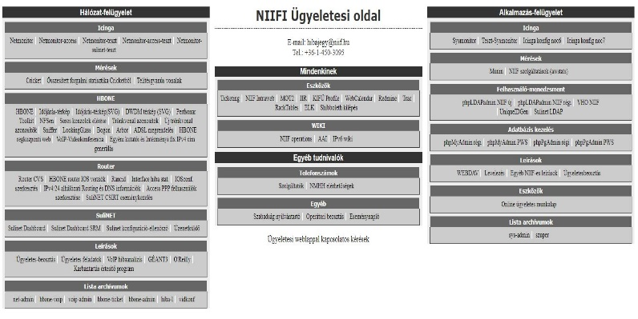
Management Insource ← Outsource
INSOURCE
PLAN
OUTSOURCE
Helpdesk, Support
Level 1 (management)
Level 2
Level 3 (+ providers)
Helpdesk, Support
Level 1 (call centre, partly)
Network & Service management
Core (DJG & Hbone+)
Network and Application services
USERS, EndPoints
Access (Partly)
Development
Security
(Firewall, partly)
SDN for StudentNet
Network & Service management
Access (service/capacity rent from the market)
WiFi AP management (StudentNet, 2017)
Content Filtering (Central Firewall PA, partly, 2017)

Slide 5
Thank You!

