Slide 1


Data plane programmability (P4) and telemetry
Mauro Campanella (GARR), Pavel Benacek (CESNET), Damian Parniewicz (PSNC),
Marco Savi (FBK-GARR)
Performance Management Workshop
Zagreb
4-5 March 2020

Slide 2

Agenda
Why Programming the Data Plane
Use case 1: DDoS Detection using P4
Use case 2: In-Band Network Telemetry
Collecting and visualizing INT telemetry data
Lessons Learned

Slide 3
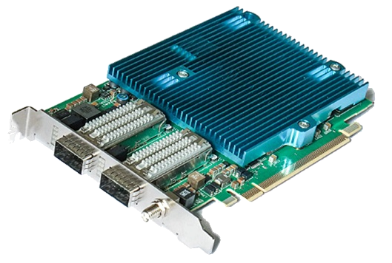
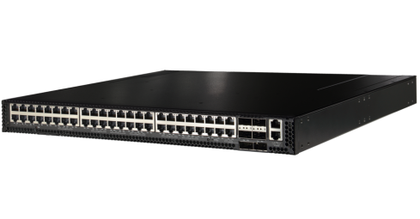
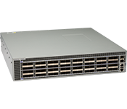
Why Programming the Data Plane
Validate the novel programmability and monitoring concepts implementable directly in the data plane
Usage of P4 language for FPGA and new chips (e.g. Barefoot Tofino) for improved monitoring and network functions
Implement prototypes for two use cases:
  In-band Network Telemetry (INT)
  DDoS Detection and Mitigation
Netcope NFB-100G2
FPGA
  Edgecore Wedge100BF-32X
  Tofino (Barefoot)
  Arista 7170-32c

Slide 4

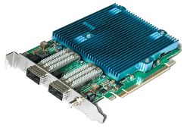

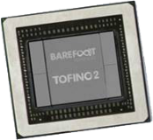
Why Data Plane Programming: (Open) Software deluge
(Open) User SW
Data Plane programming + New Silicon
Fast, local action
In-depth visibility
Faster innovation
Disaggregation
SDN
Legacy networking
SW and HW
…(BIG) DATA
2008
2016
Time

Slide 5
Use Case 1 for Data Plane Programming
Distributed Denial of Service Detection

Slide 6
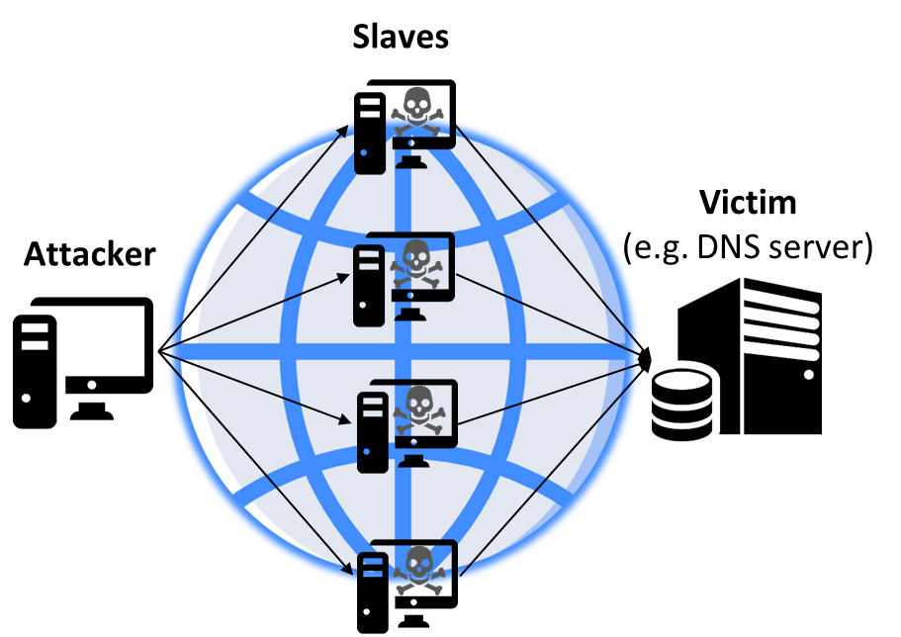
DDoS Detection Use Case
Goals of the DDoS Detection use case
  Very fast detection of DDoS attacks starting on boundaries of NRENs / GÉANT network
  Providing detailed information about the DDoS attack characteristics
  Possibility of almost immediate mitigation of the attack
Based on Big Data streaming algorithms (sketches) implemented in P4
  Memory-effective collection of summarized traffic statistics
Usage of P4-enabled switches
  Started with P4 behavioural model - bvm2 (emulator),
  then implementation in
    Edgecore Wedge100BF-32X
    Arista 7170-32c

Slide 7




In-network DDoS Detection using Programmable Data Planes
DDoS attack!
CP/MP
DDoS attack!
CP/MP
Sampled packet/flow info
Destination under potential attack
Monitoring Collector
From Legacy
to Programmable
Data Planes
Monitoring Collector
CP/MP
CP/MP
DP
DP
PDP
PDP
CONTROL /
MONITORING PLANE
CP/MP
PROGRAMMABLE DATA PLANE
DATA PLANE
DP
PDP
Potential DDoS attack!
Router
Programmable
Switch
Pros
  Well-established protocols and solutions
Cons
  High communication overhead
    Sampling needed
  Low time granularity (typically 5 mins)
Pros
  Low communication overhead
  High time granularity (few seconds at most)
  Packet processing at line rate
Cons
  Hardware limitations

Slide 8


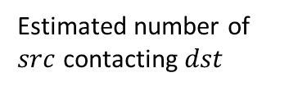
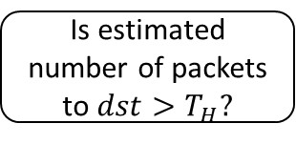




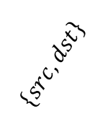
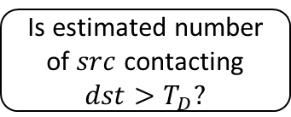
Implementation Evolution for In-network DDoS Detection
12 STAGES OF P4 PIPELINE ONLY & MEMORY LIMITATIONS
$$\left\{dst_{DDoS},V_{DDoS}\right\}$$
$$\left\{dst_{DDoS}\right\}$$
src cardinality
Estimated number of $src$ contacting $dst$
COUNT-MIN SKETCH
HYPER
LOGLOG
Is estimated number of $src$ contacting $dst>T_{D}?$
Yes
Is estimated number of $src$ contacting $dst>T_{D}$
AND
estimated number of packets to $dst>T_{H}?$
BITMAP
$$\left\{src,dst\right\}$$
REPLACED
$$\left\{src,dst\right\}$$
Incoming packet
dst traffic volume
Estimated number of packets to $dst$
$$dst$$
COUNT-MIN SKETCH
Is estimated number of packets to $dst>T_{H}?$
Yes
REMOVED
P4 DATA PLANE PIPELINE
Sketch-based strategy for volumetric DDoS attack detection
Successfully implemented in P4 using the P4 behavioral model [1] in an emulated environment
Porting on carrier-grade P4-programmable switch hardware…
...LOT OF PAINS: TRANSITION FROM EMULATOR TO HW AND FIT IN HW BOUNDARIES
[1] https://github.com/p4lang/behavioral-model

Slide 9



Implemented Strategy and Experimental Setup
src cardinality
Estimated number of $src$ contacting $dst$
$$\left\{dst_{DDoS}\right\}$$
Incoming packet
COUNT-MIN SKETCH
BITMAP
Is estimated number of $src$ contacting $dst>T_{D}?$
Yes
$$\left\{src,dst\right\}$$
P4 DATA PLANE PIPELINE
Detection strategy: estimate what destination IP addresses have been contacted by more than X number of source IP addresses
Experimental validation with a single P4-programmable switch
Digest
Detection strategy in P4
Traffic
Command line interace
Port: 10 Gbps
Ports: 33 x 100 Gbps
Port: 10 Gbps
P4-programmable
switch
Traffic sender
Traffic receiver

Slide 10
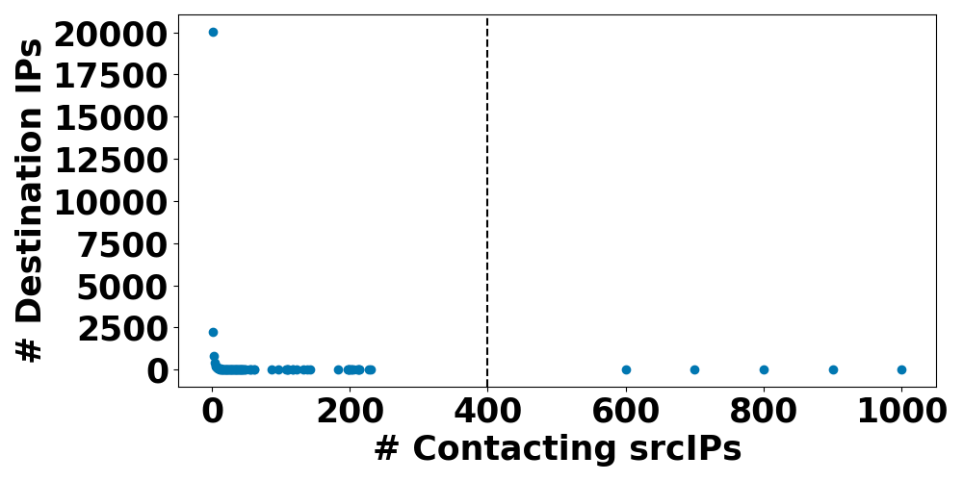
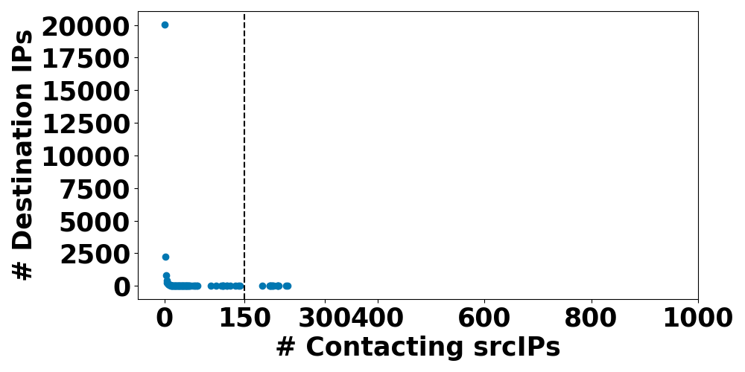
DDoS Detection Performance Evaluation
Real traffic (with simulated DDoS)
Time window: 1s (~ 491K packets ~28K flows [2])
Sketch memory in Tofino | Recall (Detected outliers / Real outliers) | Precision (Detected outliers / Overall detected)
~ 400 KB | 1.0 (5 / 5) | 1.0 (5 / 5)
Threshold = 400
Good results
Real traffic [2] (no DDoS)
Sketch memory in Tofino | Recall (Detected outliers / Real outliers) | Precision (Detected outliers / Overall detected)
~ 400 KB | 1.0 (21 / 21) | 0.32 (21 / 65)
Threshold = 150
False positives due to low threshold and limited sketch memory in the switch
[2] CAIDA UCSD Anonymized Internet Traces Dataset - [passive-2018]

Slide 11
Switch P4 Program Performance Cross-check at 10 Gbps
Traffic generated using iPerf – P4 program for DDoS detection active
iPerf bandwidth: 10 Gbps
L4 Protocol | Datagram/ Segment size | Packet loss | Throughput | Average Packet processing time
UDP | 500 bytes | 0% | 1.03 Gbps | 393 ns
UDP | 1000 bytes | 0% | 1.95 Gbps | 390 ns
UDP | 1470 bytes | 0% | 2.87 Gbps | 389 ns
UDP | 3000 bytes | 0% | 5.45 Gbps | 396 ns
UDP | 6000 bytes | 0% | 9.62 Gbps | 392 ns
UDP | 9000 bytes | 0% | 9.67 Gbps | 392 ns
TCP | 64 Kbytes | - | 9.05 Gbps | 392 ns
TCP | 128 Kbytes | - | 9.41 Gbps | 389 ns
Server load can be reduced enabling computation of IP checksums in the server network interface
Bottleneck: ServerCPU
No loss
In line with typical processing times [3]
Good performance
[3] https://www.nvc.co.jp/pdf/product/arista/7000X_Series_Performance_White_Paper.pdf

Slide 12
Use Case for Data Plane Programming
In-Band Telemetry

Slide 13
Use Case 2: In-Band Telemetry
Goal: Framework for production (and processing) of rich telemetric data with FPGA
  Based on P4 implementation of In-band Network Telemetry specifications
  P4-to-VHDL compiler developed at CESNET
  VHDL code deployed on the FPGA-based SmartNICs
  Tofino chip built for INT
  Heavy processing and visualization outside the data plane
  NOTE:
  In-Band Telemetry ≠ Streaming Telemetry
  Streaming Telemetry is real-time streaming of data in which devices push monitoring information to subscribed listeners, without modification of other traffic
Netcope
NFB-100G2

Slide 14
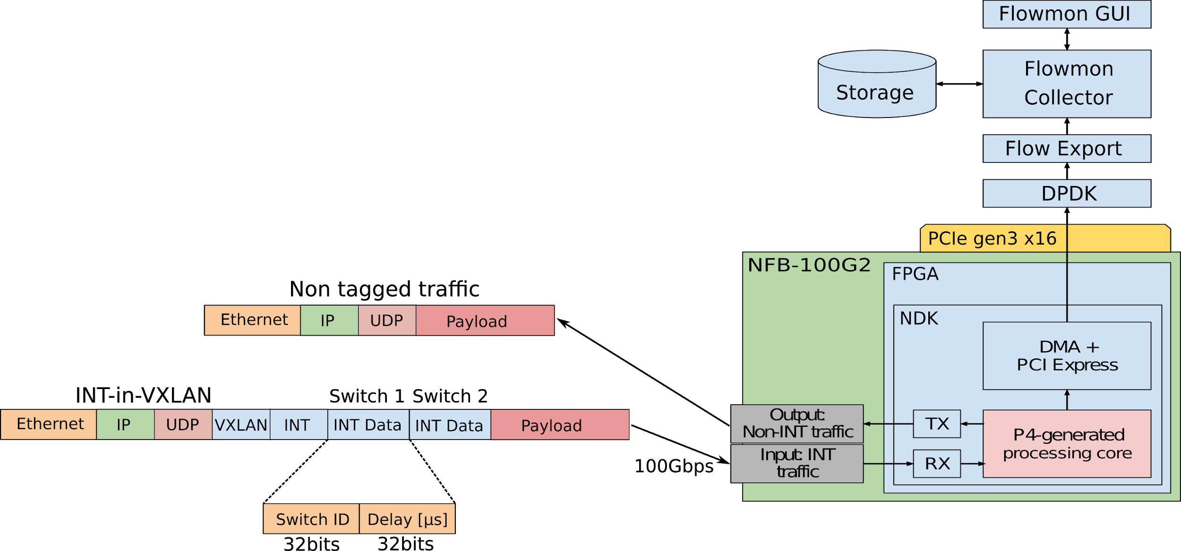
In-Band Telemetry edge values
Live network traffic and switches/routers monitoring at line rate at each (equipped) node (nanosecond precision)
Addition/modification of monitoring information into each traffic frame
  To map the taken path through the network
  Monitor Buffer occupancy in network devices and so on
Push/subscription model versus pull (SNMP-type)
Programs can be ported on different targets (ASIC, FPGA, x86-64, NPU)
Different equipment can interoperate
Standardized by the P4 consortium
  www.p4.org → Specification
  → P4 Data-plane Telemetry

Slide 15
In-Band Telemetry: Results
Experiment goals
  Build framework for In-Band Telemetry with P4, prepare a P4v16 compiler ✓
  Collect key frame data, analyze and visualize on external platform with
  Grafana and InfluxDB with an x86-64 server with FPGA card + Linux ✓
  Scale up to 100 Gb/s - ongoing
  Create a flexible extensibility of collected telemetric data ✓
  Live demonstration of the In-Band Telemetry per frame
  Collected data for each packet on casual delayed, traffic:
    Delay (easy, same sending and receiving host)
    Jitter
    Delay variation
    Reordering
Tabletop Demo at Symposium Ljubljana Feb 2020
Netcope
NFB-100G2

Slide 16
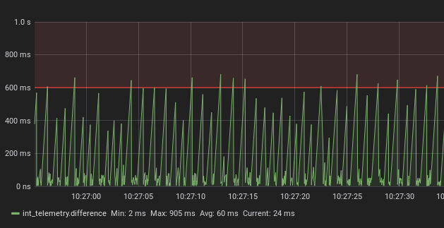
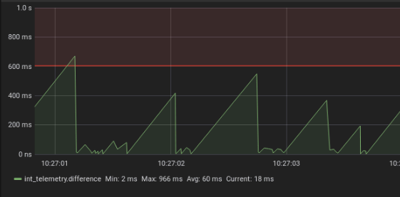
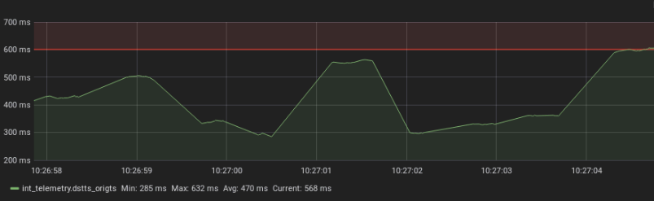
In-band Telemetry – Sample Symposium Graphs
Jitter (5 seconds scale)
Jitter (seconds scale)
Delay (seconds scale)

Slide 17
Use Case for Data Plane Programming
Collecting and visualising INT data
Facing really Big Data

Slide 18
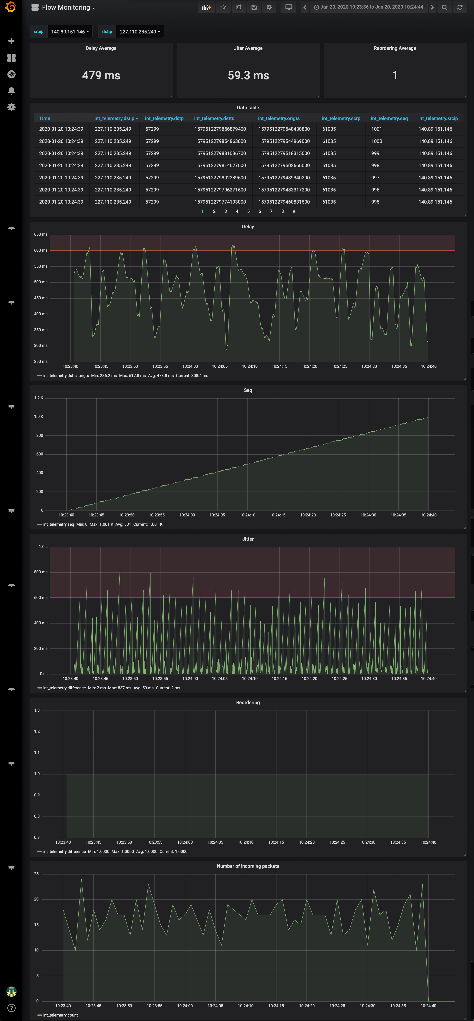
Collecting and visualising INT data
INT data gathered inserted first in the Influx database
Each packet info of the monitored flow is visualised in Grafana
PC
INT reports
InfluxDB
(version 1.7.3)
Grafana
(version 6.0.0)
REST API
Data queries
Fiber
loop
Docker infrastructure
HP ProLiant DL 380 Gen 9
INT report (InfluxDB line protocol)
INT report contains a packet inforamation:
source and destination IP addresses
source and destination ports
source and destination timestamps
IP sequence number
int_telemetry, srcip=10.0.0.1, dstip=10.0.0.2, srcp=1111, dstp=80
origts= 1576569600000000000, dstts=1576569600000001000, seq=625 1576569600000001245

Slide 19
Gathering INT reports
Why did we choose InfluxDB?
  High performance write and query of time data series
  Nanosecond timestamp precision (5ns is the 64-byte packet duration on 100G)
  Very effective time series data compression
  Very rich functionality for time series manipulation:
    Visualisation queries for INT require mathematical operations on two data entries: jitter and packet reordering
    Other databases or processing tools can’t do that (Apache Spark can, but only as batch processing)
Jitter query:
SELECT DIFFERENCE(\"dstts\") FROM int_telemetry.flow_monitoring_policy.int_telemetry WHERE \"srcip\" = '${srcip:query}' AND \"dstip\" = '${dstip:query}' ORDER BY asc

Slide 20
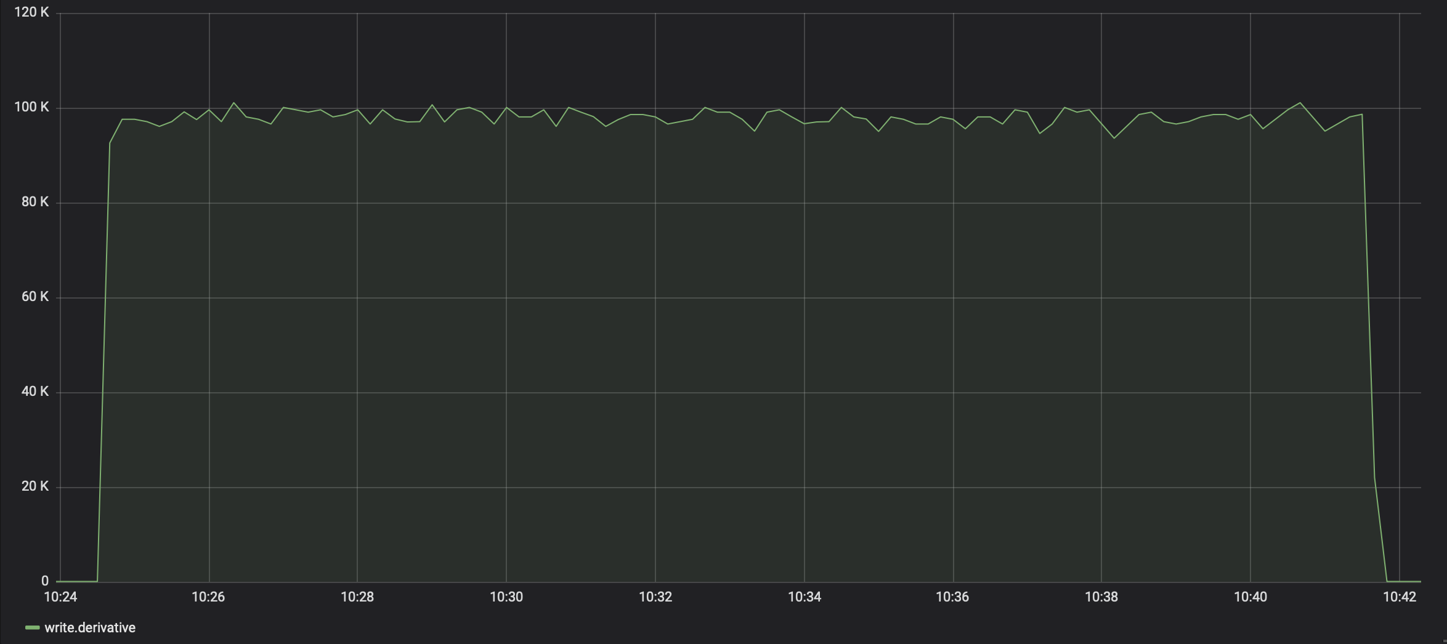
InfluxDB write performance testing (single telemetry source)
Single telemetry node may send 100 milions INT reports to a single instance of InfluxDB:
Measured write performance is 100K reports/s

Slide 21
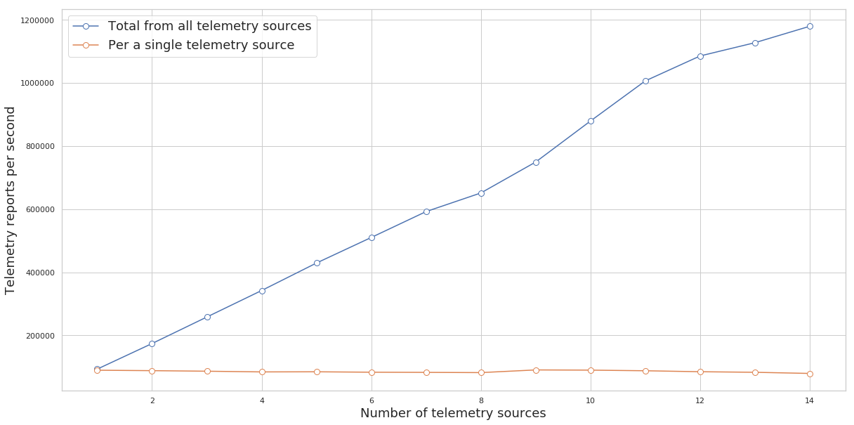
InfluxDB write performance testing (multiple telemetry sources)
Multiple INT sources may send to a single InfluxDB instance up to 1.2M reports/s without losses:
InfluxDB can handle up to 14 telemetry sources each generating 85k reports/s
Telemetry reports losses experienced when more than 14 telemetry sources tested
Telemetry losses

Slide 22
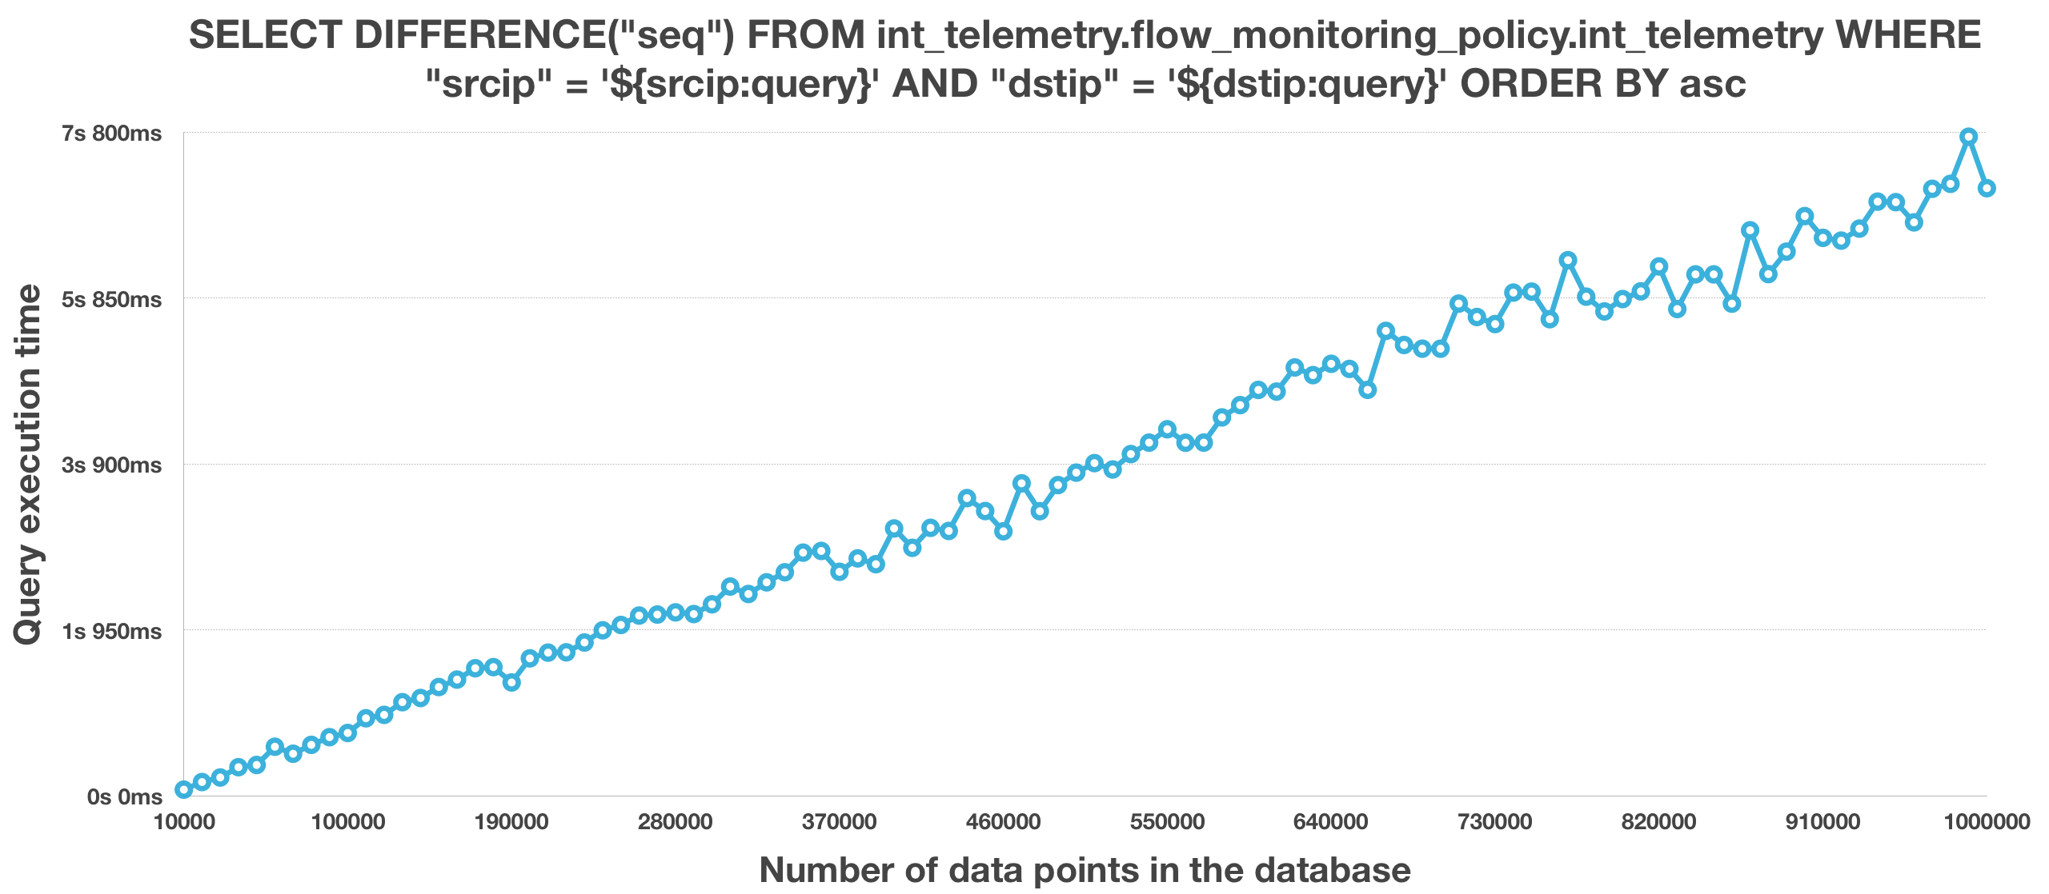
InfluxDB query performance testing
Performance was measured for all used queries by Grafana:
Packet reordering indicator query :
Measured query performance is 100-120K data points/s
Query performance doesn’t change if additional operations (e.g.: `DIFFERENCE` and `ORDER BY`) are applied

Slide 23
Is InfluxDB performance enough?
Theoretical considerations for maximum possible flow per interface speed:
Interface speed | Only 64B packets | Only 1500B packets | Conclusion
1G port | 1.9M packets/s | 83k packets/s | DB horizontal scaling required
10G port | 19.6M packets/s | 830k packets/s | Not trivial for INT
100G port | 196M packets/s | 8.3M packets/s | Beyond our scope. Currently no server can generate a such flow.
Observed flow statistics in PIONIER network (PSNC):
  Most flows are below 10k packets/s
  Few flows up to 25k packets/s
  Exceptionally serving 250k packets/s (3 Gbps of radio astronomy data if send without jumbo frames)
InfluxDB can be scaled when running on server cluster (only with paid licence)

Slide 24
Flow choosing:
Telemetry visualisation
Summary:
Measurments:
Grafana dashboard allows of monitored flow
For the chosen flow, it displays:
  Packet transmission delay
  Packet jitter at destination
  Packet sequence value
  Packet reordering indicator
  Ingestion rate of INT reports (equals packet/s in a monitored flow)
  Min/Avg/Max of above statistics
Delay:
Sequence:
Jitter:
Reordering:
Ingestion rate:

Slide 25
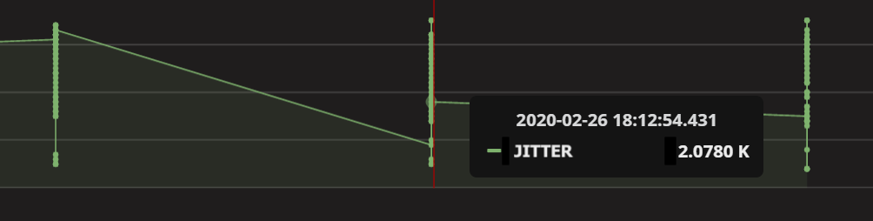
Telemetry visualisation – Challenges
„Zoom-in” problem:
Grafana resolution is up to millisecond:
„zoom-in” to a single packet detail (requires at least micro-second or ns time resolution)
Now time-series points are grouped in a single millisecond bin
Searching for alternatives (Gnuplot, pyplot, …)
„Zoom-out” problem:
Telemetry graph generation problem for long time periods (minutes, hours,)
Too many time series points to be queried (Grafana freezes)
Influx query with both „GROUP BY” time interval and mathematical operations („DIFFERERENCE”) doesn’t work
Influx continous queries with mathematical operations („DIFFERENCE”) also doesn’t work
Searching for another approach (Influx Kapacitor to be checked)

Slide 26
Conclusions

Slide 27
Conclusions
Data plane programming improves flexibility in the implementation of existing and new network services
The P4 emulated environment is only the first step, need program validation in a real testbed (hardware with Tofino chip) a.s.a.p.
Programming the data plane requires a detailed knowledge of the (specific) hardware capabilities and limitations and use of a more careful logic
Substantial improvements in network monitoring understanding is achievable (however total size of monitoring data may skyrocket)
Advanced monitoring has now a wide range of possibilities, requiring in depth analysis and a strategy and choice of the best information to collect
Planning in advance the use of chip memory, i.e. data structures is paramount.
DDoS detection algorithms developed may have a limit on maximum number of flows to follow, which is equivalent to limit the link capacity to 1-10 Gbps. Mitigation does not have issues.

Slide 28

Next steps
Challenge in front of us, due to traffic data and monitoring data deluge.
Approach is to measure, understand, DevOps and measure again at the data plane for
  Choice of algorithms in the data plane (Nework Functions)
  Traffic and network behaviour with higher (extreme) precision (see Esnet efforts in the same direction) using INT
Requirements are already here
  Traffic engineering in "real time"
  Predictive monitoring
  Real time application …
Joining efforts on monitoring is much better

Slide 29
Additional Remarks
Programming the Data Plane in P4

Slide 30
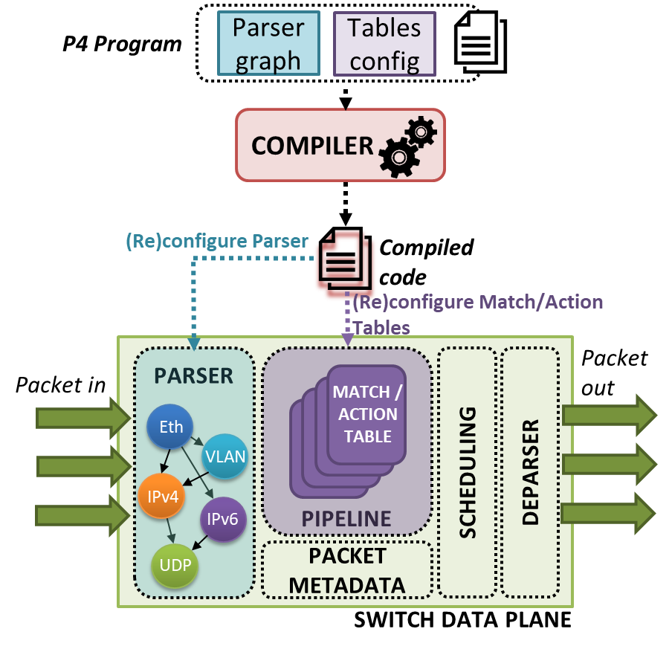
Program the Abstraction of a Network Device
Programmers write P4 code for a set of programmable blocks of the network device
  Blocks are defined by device data plane architecture
Minimum 3 blocks to be programmed:
  Parser
  Flow control (a.k.a pipeline)
  Deparser
Coding processing logic for a single packet
  P4 device is responsible for P4 code parallel
  execution for each incoming packet

Slide 31
P4 Guide for C Language Programmers
P4 is based on C syntax, however:
  Forget about loops, recursive calls
    Packet forwarding must be fast and deterministic at compilation time
  No pointers, malloc, and free
    Implicates no data structures having arbitrary size like linked list, trees, maps, etc.
  No need for floats and strings
    Network devices do not have division ALU
    Operating on binary protocols only
You immediately realize that P4 is not a general-purpose programming language
P4 is a domain-specific language for expressing how packets are processed by a network device

Slide 32
Additional Complexities Planning the Logic Flow of a Program in P4
Methods for overcoming the lack of loop operations:
  Use packet recirculation via pipeline
  Explicit coding of unfolded (unrolled) loops in the P4 program
  Utilization of hash operation providing an index of data in a structure to be manipulated (instead of looping over a structure)
Lack of dynamically resizable structures (e.g. lists, maps):
  Use register (it’s like C array) and indexes generated hash operation
  Move data to control plane where you can use a general-purpose language (e.g.: Python)
There is a problem of storing the state between the P4 program calls for different packets:
  Store state in registers
  Send state to the controller which can put the state to match tables (takes time!)

Slide 33
Additional Complexities Planning the Logic Flow of a Program in P4
Hardware limitation in the amount of flow logic
  Optimize pipelines for specific hardware
  Monitor pipeline packet processing time
Unwanted outcomes, loops or security flaws
  Use built-in debuggers
  Use external tools for testing and monitoring if available (there are not so many tools in the P4 ecosystem yet)

Slide 34
References
Enio Kalji, Almir Maric, Pamela Njemcevic, Mesud Hadzialic, "A Survey on Data Plane Flexibility and Programmability in Software-Defined Networking", IEEE Access, Apr. 2019. https://arxiv.org/pdf/1903.04678.pdf
https://github.com/p4lang/p4-applications/blob/master/docs/INT.pdf
100G In-Band Network Telemetry with P4 and FPGA. In: P4 Workshop, Stanford, CA, USA, 2017.
https://p4.org/events/2017-05-09-p4-workshop/
P. Chaignon, K. Lazri, J. Francois and O. Festor, "Understanding disruptive monitoring capabilities of programmable networks“, IEEE Conference on Network Softwarization (NetSoft), 2017.
DOI: 10.1109/NETSOFT.2017.8004248
D. Ding, M. Savi, G. Antichi, D. Siracusa, "An Incrementally-deployable P4-enabled Architecture for Network-wide Heavy-hitter Detection", to appear in IEEE Transactions on Network and Service Management, 2020. DOI: 10.1109/TNSM.2020.2968979
D. Ding, M. Savi, D. Siracusa, "Estimating Logarithmic and Exponential Functions to Track Network Traffic Entropy in P4", to appear in IEEE/IFIP Network Operations and Management Symposium (NOMS), Apr. 2020. Preprint: link
ESnet6 High Touch Services: Real-Time Precision Telemetry and ML-based TCP Classification – Richard Cziva & Chin Guok, ESnet, 4th SIG-NGN Meeting, Jan 2020, Geneva, Link

