Slide 2
Performance monitoring ten years ago
RIPE TTM (Test Traffic Measurements) project (till 2014)
  PC boxes with GPS antenna
  Delay measurements
  Packet loss rates
  Delay variations (jitter).
  Bandwidth
GN3 perfSONAR (Toolkit v3.2)
  Similar metrics
  Similar footprint
  2-3 weeks training
Vendors – proprietary protocols Cisco IP SLA, Juniper RPM
What if I want to make vendor agnostic solution to monitor my network (link by link)? What is the cost of that solution?

Slide 3
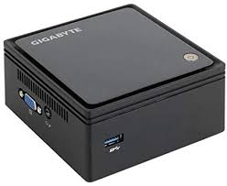
During the last 10 years
SLA monitoring: delay, jitter, loss (throughput is not that important)
Initiatives to decrease the footprint (smallnodes - PMP, RIPE Atlas) – raspberry Pis, small computers
  But is it convenient to maintain such a device in a remote rack?
Virtualization – can we do it on a virtual machine?
  But can we expect to have servers in all PoPs/racks?
Service multiplexing (namespaces, etc.)
Can we go to an even smaller footprint? (zero footprint monitoring – no VMs, no small devices)?

Slide 4
Some things have changed in meantime
TWAMP implementation on Juniper devices
Virtual services on Cisco - can install Linux on spare CPU cycles and on that Linux e.g. perfSONAR
Is it interoperable with Linux implementation?
Can it be used for detailed network performance monitoring? (end-to-end and per segment)
Also new databases, UIs (influxDB, ELK, Grafana,…) – more about the integration, less software development

Slide 5
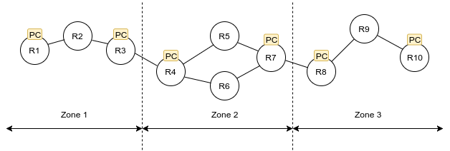
Our previous studies
GN4-2 – NetMon, a system for scalable multiplexed network service monitoring
Per segment multidomain performance verification
VMs in intermediate nodes
Packet capturing to analyze performance
Modified OWAMP packets
Published in: https://doi.org/10.1016/j.comnet.2019.107050

Slide 6
Two-Way Active Measurement Protocol (TWAMP)
Host to Host (twping – perfsonar/owamp)
Host to Router (twping – TWAMP server)
Router to Router (TWAMP server – client)
Host to virtual service on a router (twping - twping)
VS-ubuntu
VMX
CSR1000v
VM
VM
VM
VM
Servers

Slide 7
Network Measurements
Juniper Routers (SNMP)
  Round Trip Time (RTT)
  RTT Jitter
  RTT Inter-arrival Jitter
  Egress Jitter
  Egress Inter-arrival Jitter
  Ingress
  Ingress Jitter
  Ingress Inter-arrival Jitter
Linux Hosts
  Round Trip Time (RTT)
  Send Time
  Reflect Time
  Two Way Jitter
  Send Jitter
  Reflect Jitter
Notes:
roundTripTime -- this is the delay between the the transmission of a probe and the arrival of its response.
rttJitter -- this is the difference between the current round trip time measurement and the previous one.
rttInterarrivalJitter -- An estimate of the statistical variance of a packet's interarrival time. Defined in rfc1889 as: J=J+(|D(i-1,i)|-J)/16 where J is the interarrival jitter and D(i-1, i) is the current round trip jitter measurement.
egress -- this is the delay between the transmission of a probe and its arrival at its destination.
egressJitter -- this is the difference between the cu+rrent egress delay the previous measurement.
egressInterarrivalJitter -- similar to rttInterarrivalJitter, but applied to egress jitter measurements.
ingress -- this is the delay between the transmission of a probe response and its arrival at its destination.
ingressJitter -- this is the difference between the current ingress delay and the previous measurement.
ingressInterarrivalJitter -- similar to rttInterarrivalJitter, but applied to ingress jitter measurements.

Slide 8
Network Measurements
Juniper Routers (SNMP)
  Round Trip Time (RTT)
  RTT Jitter
  RTT Inter-arrival Jitter
  Egress Jitter
  Egress Inter-arrival Jitter
  Ingress
  Ingress Jitter
  Ingress Inter-arrival Jitter
Linux Hosts
  Round Trip Time (RTT)
  Send Time
  Reflect Time
  Two Way Jitter
  Send Jitter
  Reflect Jitter
  Min, Max, Median
  Min, Max, Average, StdDev
Notes:
roundTripTime -- this is the delay between the the transmission of a probe and the arrival of its response.
rttJitter -- this is the difference between the current round trip time measurement and the previous one.
rttInterarrivalJitter -- An estimate of the statistical variance of a packet's interarrival time. Defined in rfc1889 as: J=J+(|D(i-1,i)|-J)/16 where J is the interarrival jitter and D(i-1, i) is the current round trip jitter measurement.
egress -- this is the delay between the transmission of a probe and its arrival at its destination.
egressJitter -- this is the difference between the cu+rrent egress delay the previous measurement.
egressInterarrivalJitter -- similar to rttInterarrivalJitter, but applied to egress jitter measurements.
ingress -- this is the delay between the transmission of a probe response and its arrival at its destination.
ingressJitter -- this is the difference between the current ingress delay and the previous measurement.
ingressInterarrivalJitter -- similar to rttInterarrivalJitter, but applied to ingress jitter measurements.

Slide 9
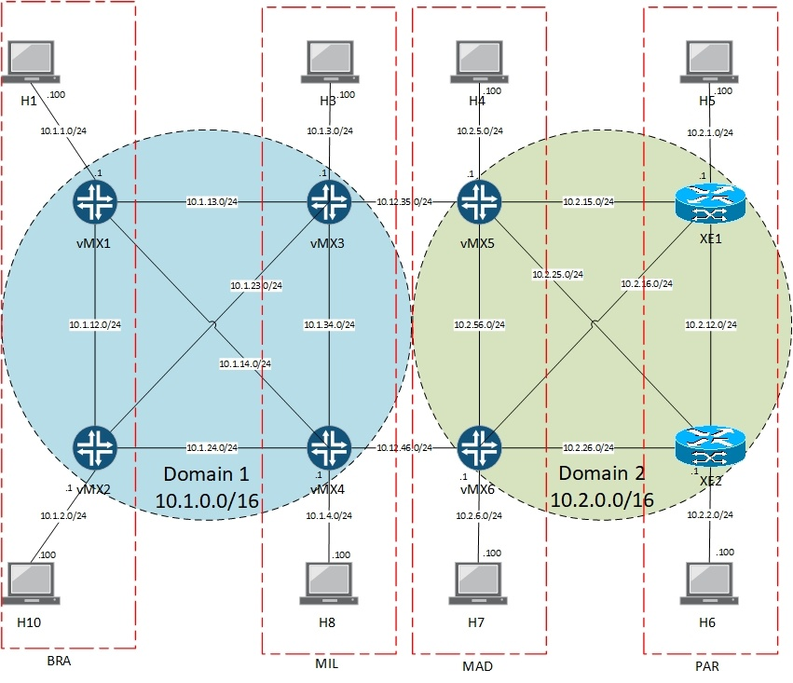
Testbed (1/4)

Slide 10
Testbed (2/4)
JunOS 19.3 - vMX
- Twamp Server
- Twamp Client
Cisco IOS XE – CSR V1000
- Twamp Server

Slide 11

Testbed (3/4)
Host to Host
Reported by Sender
Host to Router
Reported by Sender
Router to Router
SNMP collection & report
Measurements

Slide 12
Testbed (4/4)
Experiments

Slide 13
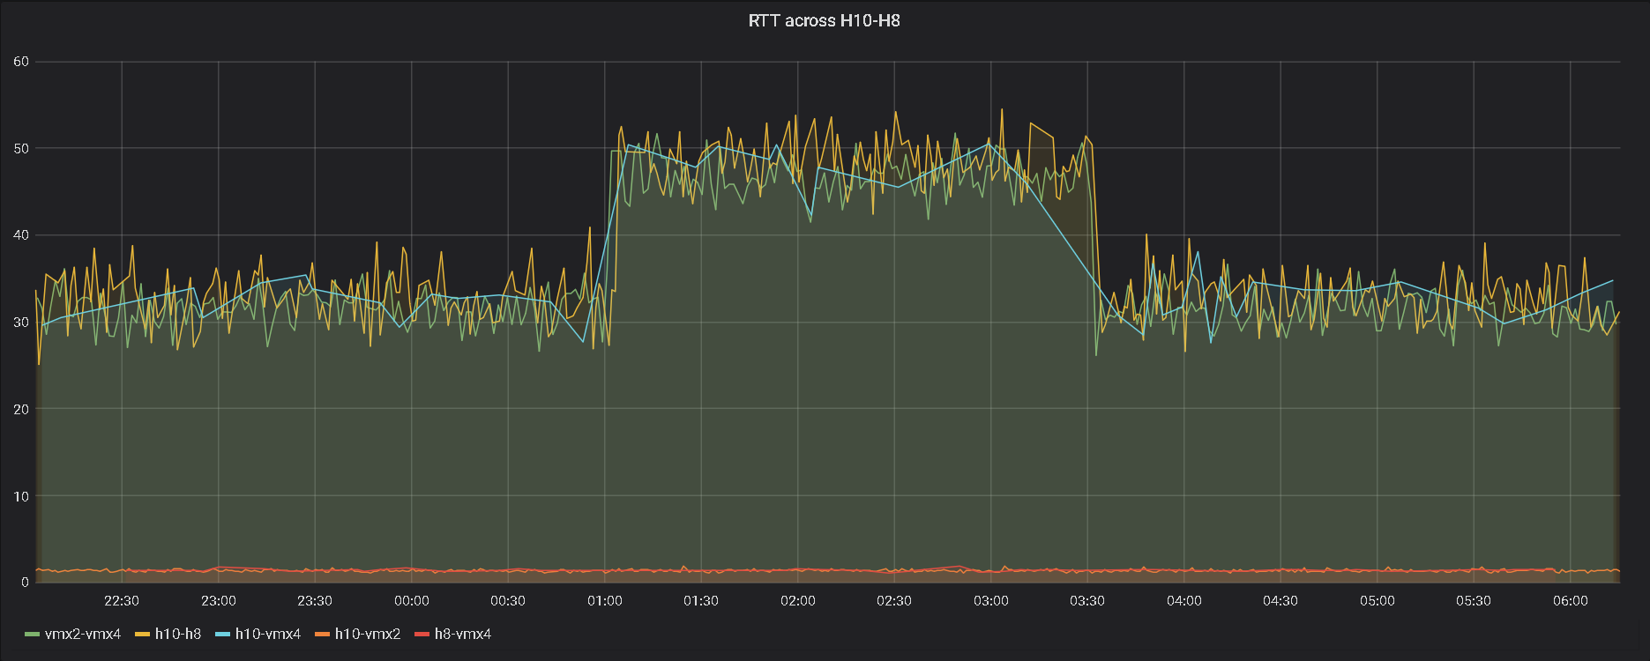
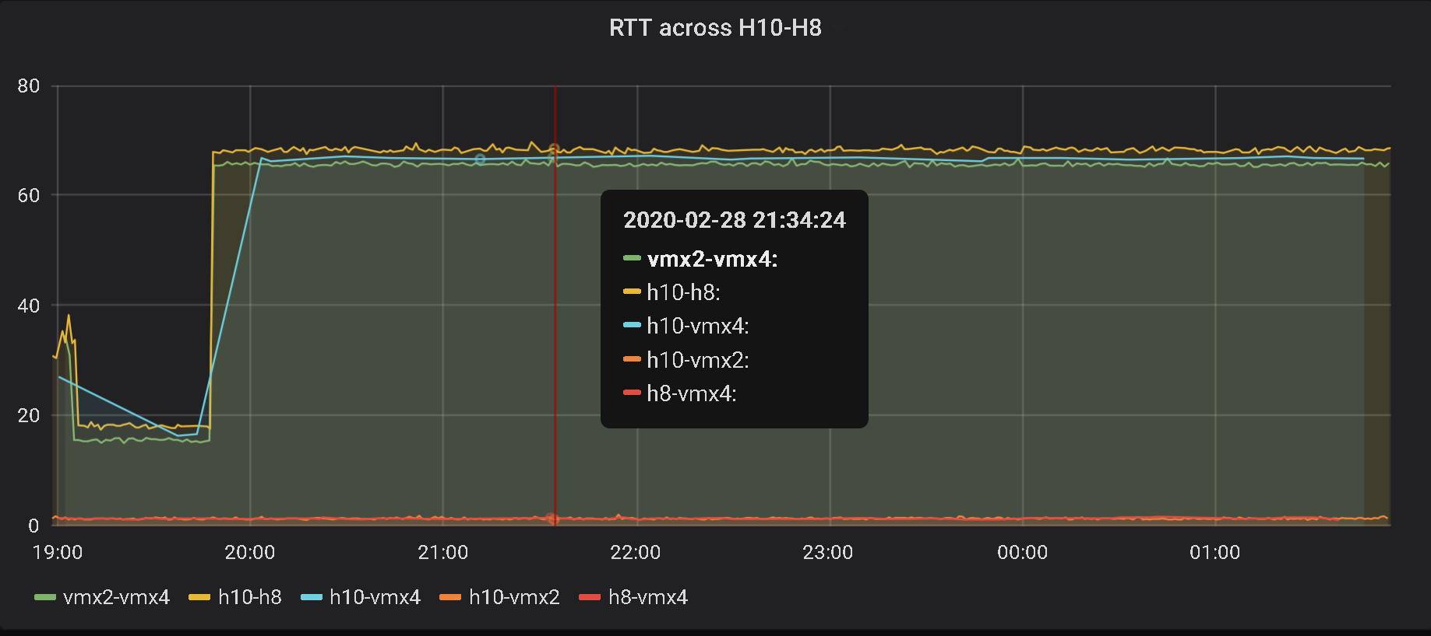
Experiments (RTT)
  TWAMP Sessions
  vmx2-vmx4 (Router to Router)
  h10 – h8 (host to host)
  h10 – vmx4 (host to router)

Slide 14
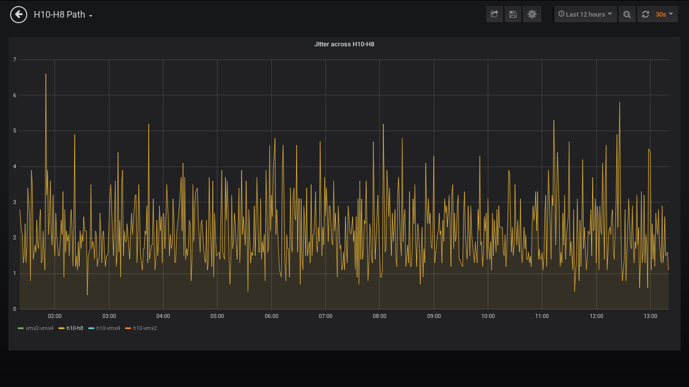
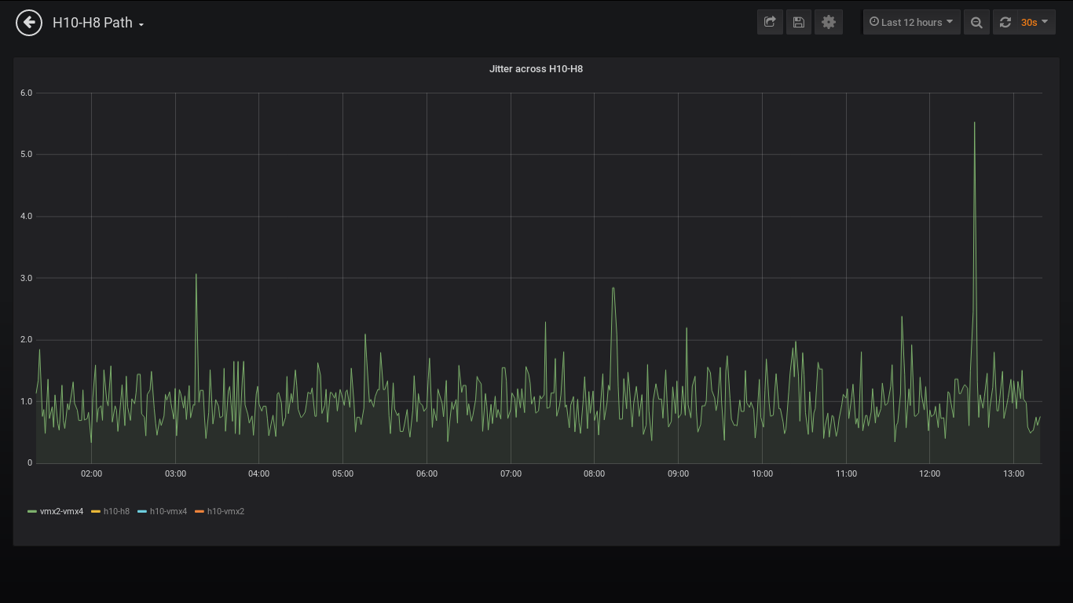
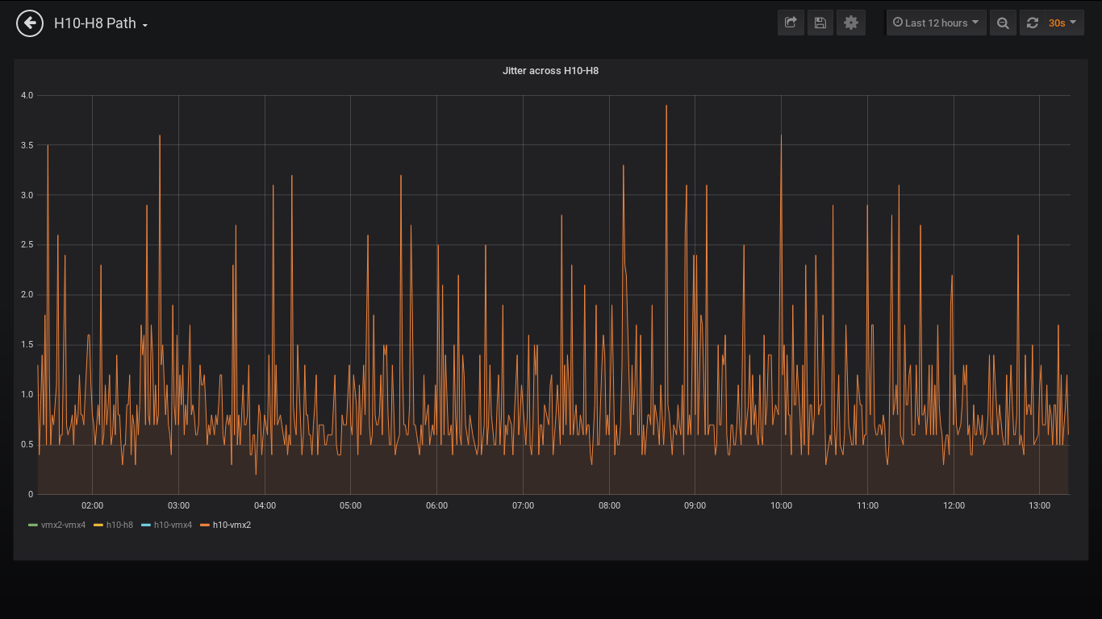
Experiments (Jitter)
  TWAMP Sessions
  vmx2-vmx4 (Router to Router)
  h10 – h8 (host to host)
  h10 – vmx4 (host to router)

Slide 15
Future Plans
Investigate Streaming Telemetry Capabilities
In-Band Network Telemetry (Service Monitoring)

