Slide 2

Network Monitoring
Polling-based Monitoring
Streaming Telemetry
In-Band Network Telemetry (INT)

Slide 3
Network Monitoring
Polling-based Monitoring
Streaming Telemetry
In-Band Network Telemetry (INT)

Slide 4
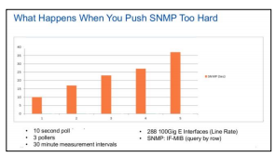
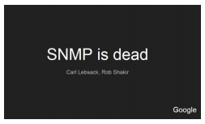
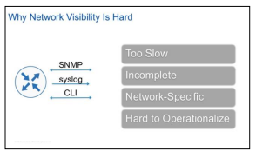
Simple Network Management Protocol
Rate Calculation introduces artifacts
Limited precision (no source timestamp)
Unreliable delivery (SNMP traps)
Scalability Limitations
  Short-Time interval polling

Slide 5
Network Monitoring
Polling-based Monitoring
Streaming Telemetry
In-Band Network Telemetry (INT)

Slide 6
SNMP vs Streaming Telemetry
 | SNMP | Streaming Telemetry
Collection Schema | Polling | Pushing
Transport Layer | UDP | TCP
Application Layer | SNMP | HTTP/gRPC
Data Model | MIB | Vendor-Specific / Neutral
Data Format | SMI / ASN-1 | proto file
Encoding | BER | GPB/JSON
Security | Communities/Keys(v3) | User/Password or TLS certificate

Slide 7
gNMI – gRPC Network Management Interface
Protocol for state management on network elements
RPCs
  Capabilities
  Get
    small sets of data (part of the configuration)
    timestamp for all requested data
  Set
  Subscribe
    ONCE
    STREAM
    POLL

Slide 8
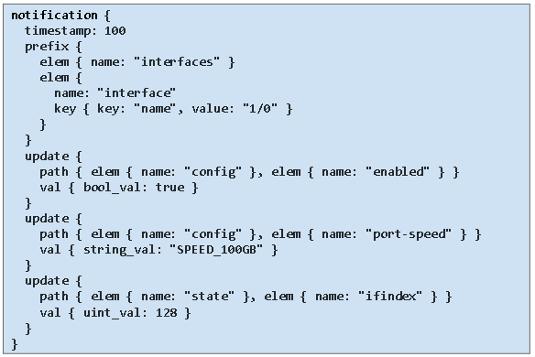
Streaming Telemetry - Example
Get/Subscribe response – gNMI Sensor: /interfaces/interface[1/0]

Slide 9
Vendor support / Open Source Efforts¹
Cisco - OS: IOS XE, XR and Nexus OS; Platform: ASR9K, CRS, NCS 6K
Juniper - OS: Junos OS; Platform: MX, QFX, EX, vMX
Arista – EOS
Nokia - SR OS
Open Source Collectors
Pipeline (backed by Cisco)
OpenNTI (backed by Juniper)
GoArista (backed by Arista)
https://www.kentik.com/blog/how-to-maximize-the-value-of-streaming-telemetry-for-network-monitoring-and/

Slide 10
Network Monitoring
Polling-based Monitoring
Streaming Telemetry
In-Band Network Telemetry (INT)

Slide 11
In-Band Network Telemetry - INT
“In-band Network Telemetry (“INT”) is a framework designed to allow the collection and reporting of network state, by the data plane, without requiring intervention or work by the control plane.”¹
https://p4.org/assets/INT-current-spec.pdf

Slide 12
INT Monitoring Data
Switch ID, Ingress Port ID, Egress Port ID
Link Utilization
Ingress Timestamping
Hop Latency
Queue Occupancy, Congestion Status
Encapsulation¹
1.https://github.com/open-nfpsw/P4-16_INT/tree/master/ioam_p4-16

Slide 13
INT support on Vendors/Devices
Network Devices
  Edgecore Wedge100BF-32X
  Arista 7170
  Cisco Nexus 9000 Series
SmartNICs
  Netronome
Servers eBPF/XDP
Hypervisors – Open vSwitch

Slide 14
INT - Use Cases
Which path did my packet take?
  Path Tracing for ECMP Networks
  Enhanced Load-Balancing Schemes
Service Level Agreement proof: Delay, Loss
Fast Failure Detection and Fault Isolation
  Pinpoint faulty behavior at device level

