Slide 1


GEANT DTN Testing tool Updates
D. Vicinanza and E. Capone
GÉANT Research Engagement and Support Team
STF Zagreb – 5th March 2020
www.geant.org

Slide 2
The problem
Standard data transfer protocols do not make the most of the capacity offered by R&E networks
80+% of network traffic is using TCP
  Traditional TCP’s maximum throughput on standard servers is low compared to the available capacity
  TCP takes substantial time after a packet loss to restore its congestion window size.
Efficient data transfer can highly benefit from using specific protocols and/or methodologies
  i.e.: GridFTP + Science DMZ, other than basic scp, rysnc

Slide 3
How GÉANT DTNs can help
  Speed.net-like tool
  Dedicated hardware for wide-area transfers
    connected @ 10-100Gbps
  Security implementations
    Access control lists + Host-based firewalls (No Firewall!)
  Careful tuning from the Operating System to the Application layer
  Bottleneck-free
  Ability to test the whole stack (storage+software)

Slide 4
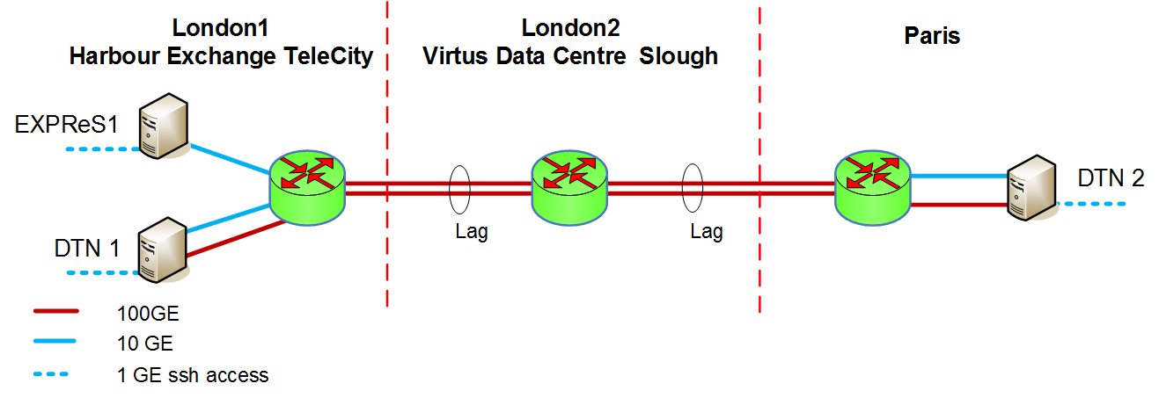
GEANT DTN Network topology
Both 10Gb/s and 100 Gb/s interfaces available

Slide 5
Tools currently available
Fast Data Transfer Service (FDT)
GridFTP
Iperf (v2.0.8) and Iperf3 (v3.1.2)
Udpmon
XRootD/Webdav
RDMA
We are investigating the possibility of hosting other tools like:
mdtmFTP (Fermilab)
MMCFTP
Conteinerised solutions (using singularity)

Slide 6
Other low-level diagnostics
UDP Achievable Throughput and packet loss as a function of the inter-packet gap (udpmon)
Histograms of the inter-packet arrival times for UDP packets sent
Investigation of lost UDP packets (udpmon)
TCP Achievable Throughput and the number of re-transmitted segments as a Function of TCP Buffer Size (iperf3)
TCP Achievable Throughput and the number of re-transmissions as a Function of Time (iperf3, logging information every 10seconds)

Slide 7
Hardware description
CPU: 2 x Intel Xeon E5-2643 v3
M/B: Supermicro X10DRT (Intel C612 chipset)
RAM: 128 GB DDR4 2133MHz ECC
Storage: 6 x Intel DC P3700 400GB NVMe (8xPCI-e)
NICs
  Mellanox ConnectX-4 100GE 16 x PCI-e 3.0
  Mellanox ConnectX-5 100GE 16 x PCI-e 3.0
  Mellanox ConnectX-3 10/40GE 8 x PCI-e 3.0
  Intel X540-AT2 10GE (integrated, for user access)
  1G IPMI (OOB)

Slide 8
Why using a DTN node?
Use cases include:
Achievable network throughput measurement
Network validation
Network troubleshooting

Slide 9
Current use cases
AENEAS project: very long-haul communication between Europe, South Africa and Australia.
WLCG/LHC: test of transfer protocols within LHCONE
BELLE-2: Data transfer to/from Japan
LRZ: test of data transfer capabilities to/from LRZ using GÉANT servers as beacons.
LSST/IN2P3: support to the LSST data distributions
The service is currently being used for in-dept testing of the latest network transfer applications and protocols.

Slide 10
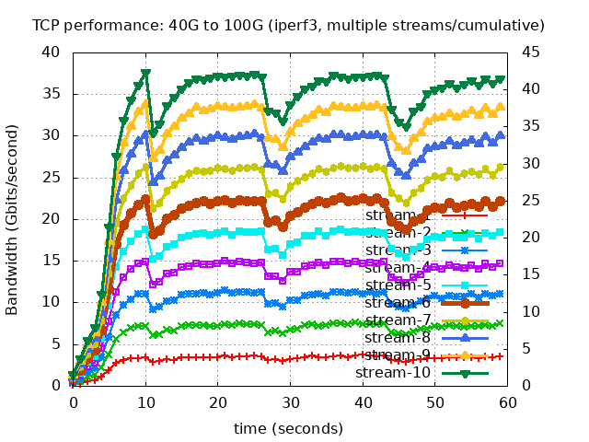
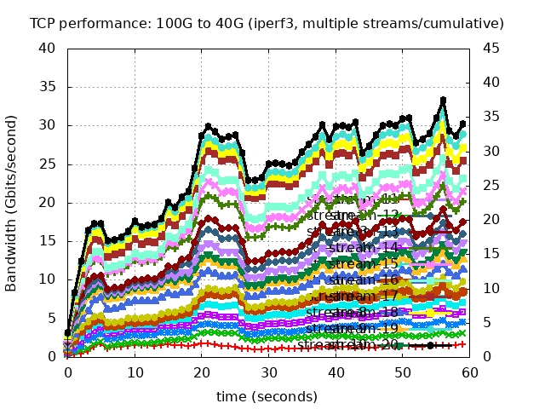
Belle II
Japan (KEK) -> London DTN
Max 37 Gb/s
London DTN → Japan (KEK)
Max 33 Gb/s
Notes:
Belle-II tested data transfer using multiple data flows between KEK in Japan and London DTN.
The max speed was 37Gb/s (JP-Lon) and 33 Gb/s (Lon-JP), with an average available bandwidth of 32 Gb/s in both directions

Slide 11
LRZ
Achievable bandwidth
(iperf and GridFTP)
96 Gb/s LRZ -> Paris
96 Gb/s Paris -> LRZ
80 Gb/s LRZ -> London
50 Gb/s London -> LRZ
Notes:
LRZ tested the characteristics of their DTN in Gärching (DE), using GEANT Paris and London DTNs as beacons.
They used GridFTP (for disk-disk) and iperf (for mem-mem) using both standard and jumbo frames. They were also interested in monitoring the memory usage (top part of the picture) during the data transfer.

Slide 12
AENEAS
Achievable bandwidth
(iperf, FDT, DaviX, XRootD, GridFTP, WebDAV)
Stability of multiple flows
Retransmission and TCP limits
Notes:
AENEAS compared different protocols (iperf, FDT, DaviX, XRootD, GridFTP, WebDAV) for long-haul big data transfers. In addition to measuring bandwidth/data moving performance, the project investigated stability of multiple flows, retransmission and TPC limits.
Picture captions, clockwise from top:
- An example of using FDT (Fast Data Transfer, a java-based free tool developed at CERN), between Lon-Par, 10Gb/s interface
An example of TCP achievable bandwidth, plotted for different buffer sizes (up to 1023MB). The TCP window (buffer) size may be increased by using the Window Scale Factor which is negotiated at the SYN exchange, but the maximum value is 1024 MBytes as per RFC 7323. We then demonstrated we reached the limit of TCP on this link, limiting the bandwidth to slightly less than 30 Gb/s. A possible implication/recommendation is that for higher speed on a very long fat link a different protocol (based on UDP, for example) should be used.
An example of testing the the stability of TCP throughput using multiple flows. Data were recorded every 10s for two 4 minutes between London and Canberra. The second flow was started 30s after the first flow as indicated by the red circles followed by the blue squares. Each flow was stable at 28.3 Gbit/s giving a total transfer rate of 56.6 Gbit/s shown by the green triangles. In total 1.55 TBytes data was sent in 4.5mins. No TCP segments were re-transmitted during these tests. This performance clearly demonstrates the long-term stability of the academic path and its suitability for moving SKA data.

Slide 13
How to access GÉANT DTN
The service is currently managed by the Research Engagement team
Request for access should be sent by email to researchengagement@geant.org
The team will analyse the request and, if approved, provide access to the service

Slide 14
GÉANT Research Engagement team responsibilities
Provide ssh access to the DTN server
Amend the local firewall trusted zone to allow all traffic between inter-DTN facing network
Set/manage any needed static routes
Co-ordinate ACLs management for accessing the DTN

Slide 15
DTN Support
Support is currently on a best effort basis: Monday-Friday, 9AM to 5PM BST (UTC+01:00)
researchengagement@geant.org

