Slide 1


GN4-3 Performance Workshop
Frédéric LOUI, GÉANT
RARE telemetry requirement
Network Technology Evolution
Router for Academia Research and Education (aka RARE)
Zagreb, Croatia
3-4 March 2020

Slide 2

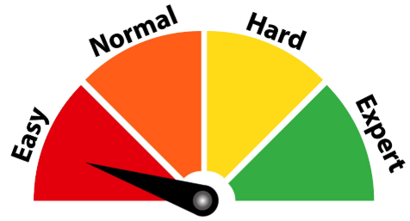
Agenda
RARE project
  Group focus
  Partner
P4 in a in a nutshell
  An open programming language: P4
  P4 packet forwarding
RARE current status
  RARE features
  P4 testbed status
RARE network management
  SNMP vs Streaming telemetry
  RARE streaming telemetry: Overall design
  Packet Postcard Telemetry reports
  Technical approach
Key take away
Looking ahead

Slide 3
RARE project : Group focus
WP6-T1 sub-task: RARE
  Control plane software
  P4 data plane compliant hardware
  Interface them and the result is …
Fully functional router
  running at hardware line rate
  DIY “hackable/extensible” router
  Control plane independence

Slide 4







RARE project : Partner
Ivana GOLUB /Activity Leader
Tim CHOWN /Activity Leader
Xavier JEANNIN /Task Leader
Frederic LOUI /Technical coordinator
Maxime WISSLE /White Box SME
Janos MOHACSI /White Box SME
Csaba MATE /FreeRouter lead developer
Jordi ORTIZ /ONOS SME
Alexander GALL
Simon LEINEN

Slide 5
RARE current status (M15)
RARE network core features
  Routing: ISIS, OSPF
  Label based forwarding: IS-IS-SR, OSPF-SR
  SRv6
  Network service signalling: BGP
RARE network service edge features
  L3VPN
  P2P L2VPN
  P2MP L2VPN (VPLS, EVPN)

Slide 6
RARE current status (M15)
RARE network security features
  Control Plane Policy
RARE network management features
  TACACS/RADIUS
  SSH/NTP/DHCP/DNS
  Accounting ⬅ On-going Telemetry work

Slide 7
RARE validation design: P4 european testbed design
SLOUGH
RARE P4 switch
AMSTERDAM
10GE link
POZNAN
FRANKFURT
BUDAPEST
PARIS
GENEVA
MADRID
GENEVA
LYON
MURCIA

Slide 8
RARE validation design: P4 Testbed network management via NMaaS !
P4 Testbed OOBM
VPLS or EVPN
Internet
…
NMaaS micro-services
Bastion
European Testbed

Slide 9
RARE Network Management goal
  Expose Interface Counter/Statistics

Slide 10
SNMP vs Streaming telemetry
SNMP stack
  SNMP suite implementation is a tremendous tasks
    ➔MIB implementation
    Counter/Stats implemention
  No specific existing SNMP library
  ➔Rewrite of SNMP stack is needed
  ➔Use of an existing SNMP stack is needed
Telemetry stack ⬅ RARE choice
  2 flavors: INT and Packet Postcard report
  Leverage GRPC for control plane trigger
  Built in BAREFOOT WEDGE-BF100-32X

Slide 11
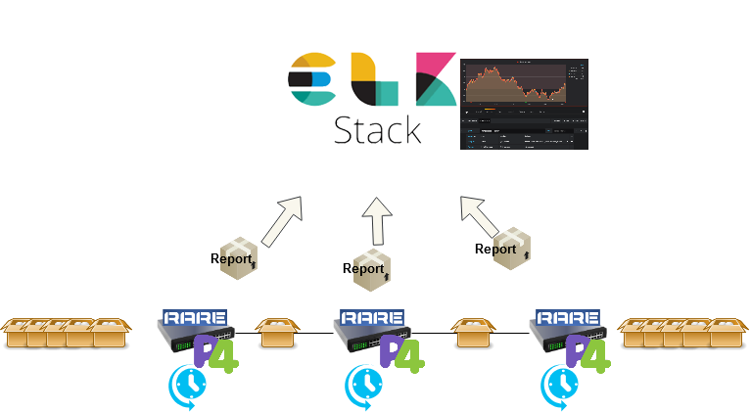
RARE streaming telemetry: Overall design
Consumer
Producer
Packet Postcard
Telemetry reports

Slide 12
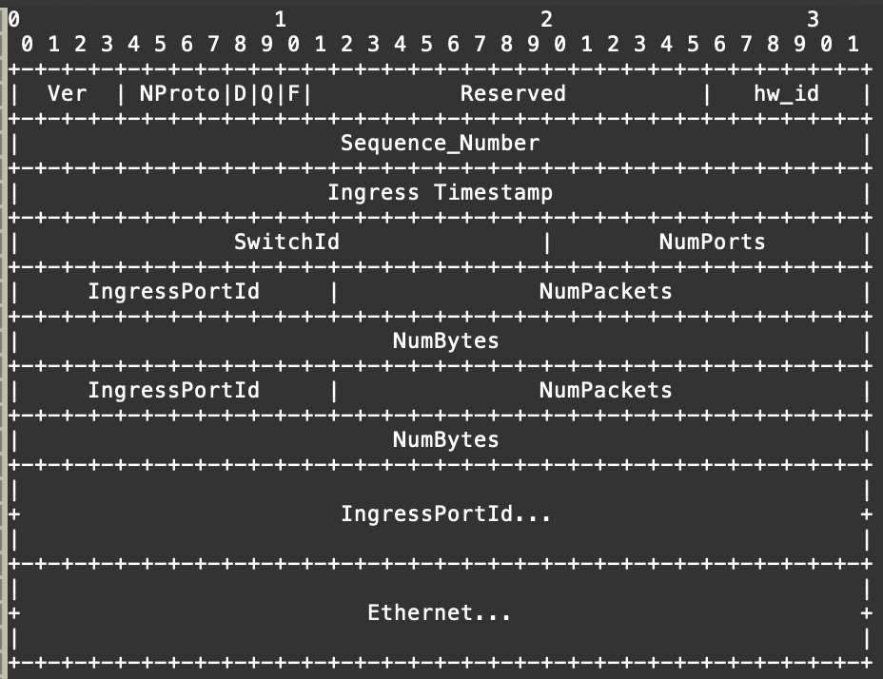
Packet Postcard Telemetry reports: p4 Telemetry Report Format 0.5 ¹
^{1.} https://github.com/p4lang/p4-applications/blob/master/docs/telemetry_report_v0_5.pdf

Slide 13
Packet Postcard Telemetry reports: p4 switch as producer
Generate periodic telemetry reports
  Each Network Element generates directly from the Data Plane statistical reports
  Initial approach report in/out packet number and bytes per port.
  The reports are generated periodically
    ➔for every port without control plane interaction.
    Control plane defines a timer in order to trigger event.
  Use packet cloning to “generate” the reports.
  ➔Trim payload and rewrite headers

Slide 14
Packet Postcard Telemetry reports: ELK as consumer
Elastic Search and Kibana processing
  Each report is directed to a Consumer defined endpoint
  ➔which analyses the information from every Network Element.
  Endpoint implemented in ELK stack

Slide 15

Technical approach: storage
Metadata information (packet/byte count) updated between packets.
Counters vs Registers
Counters only accessible from control plane → Use Registers
CONTROL PLANE
Registers
Counters
payload
stats
ELK
clone
payload
Routing

Slide 16
Technical approach: Time control using whatchlist and timer
Nothing available like a timer to be triggered automatically.
Trigger from Control Plane vs Trigger from Data Plane
Use ingress packet timestamping to calculate time elapsed.
Interval configured from Control Plane
If no packet arrives to the Router, no way to generate reports!

Slide 17
Key take away 1/3
RARE project objective is to assess the possibility:
To couple a control plane to a P4 data plane
Qualify the missing (if any) components in order to have a complete Network OS
Apply RARE outcomes to R&E use case defined by other GN4-3 subtasks

Slide 18
Key take away 2/3
RARE network accounting is the last component to be implemented :
Export ports/interfaces counter
SNMP was considered and is still considered …
RARE started to consider streaming telemetry as it is built in p4 hardware

Slide 19
Key take away 3/3
RARE network accounting is the last feature to be implemented :
Use of ~ Telemetry Specification Report 0.5
Producer / Consumer problem
  P4 nodes as report Producers
  ELK as report Consumers
Technical implementation
  Use of p4 Register stateful object
  Watchlist with a Timer
  Telemetry in the p4 hardware dataplane
  Control Plane is involved only to configure specific report generation period
We don’t forget SNMP
  But we are looking at simple ways to feed existing SNMP based NMS
  Considering the manpower with decided to go for Telemetry
  But does it make senses ? (Your opinion is valuable)

Slide 20
Useful links
RARE-FreeRTR documentation web site
  https://rare-freertr.mp.ls/
Ubuntu P4Lang repository at Launchpad
  https://launchpad.net/~frederic-loui
Debian stable P4Lang repository at Open Build System
  https://build.opensuse.org/project/subprojects/home:frederic-loui:p4lang
RARE public github repository
  https://github.com/frederic-loui/RARE
RARE private Bitbucket git (GN4-3 Community access only)
  TOFINO code subject to NDA.
FreeRTR web site
  http://freerouter.nop.hu/

Slide 21
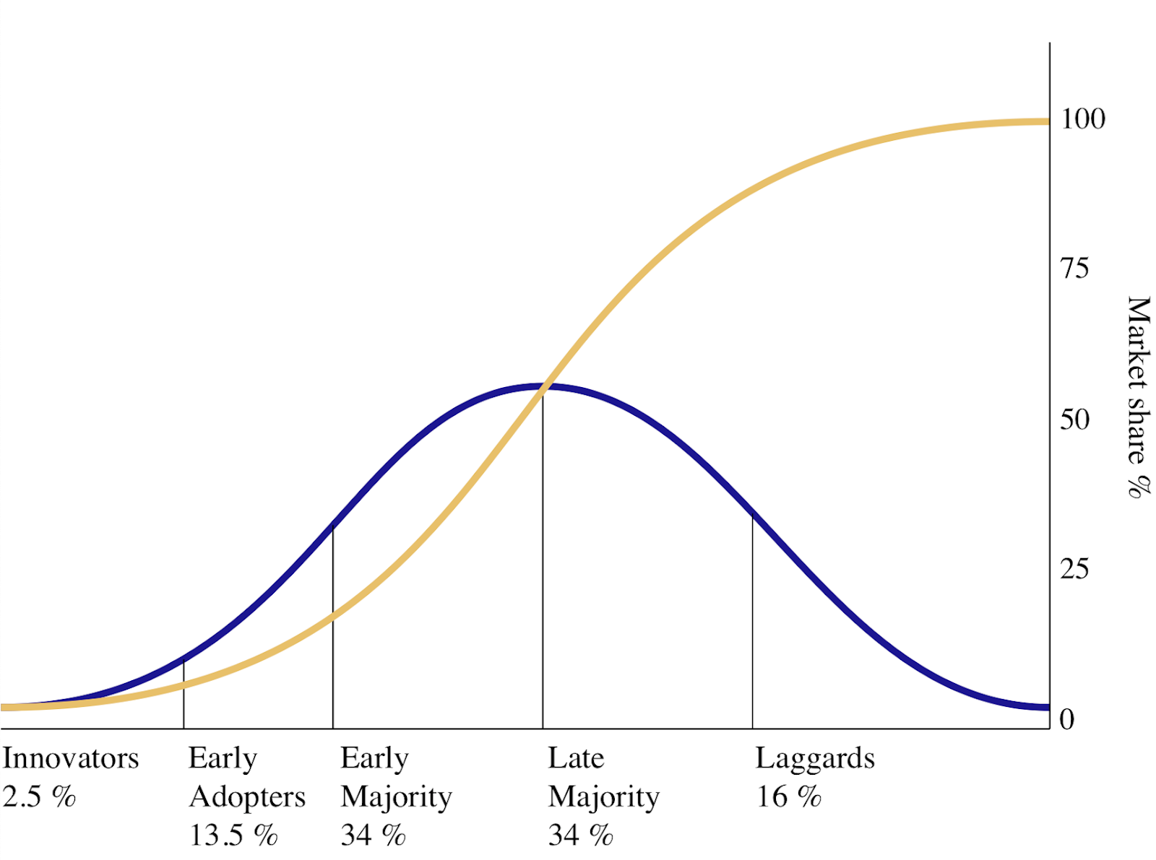
Let’s create a P4 NREN community
Share RARE P4 testbed
Elaborate your use case
Workshop/Training ?
We are here
Diffusion of Innovation: https://en.wikipedia.org/wiki/Diffusion_of_innovations

Slide 22
Looking ahead … Let’s build a RARE NREN community

Slide 23

Thank you
Any questions?
frederic.loui@renater.fr
As part of the GÉANT 2020 Framework Partnership Agreement (FPA), the project receives funding from the European Union's Horizon 2020 research and innovation programme under Grant Agreement No. 856726 (GN4-3).​​​

Slide 24
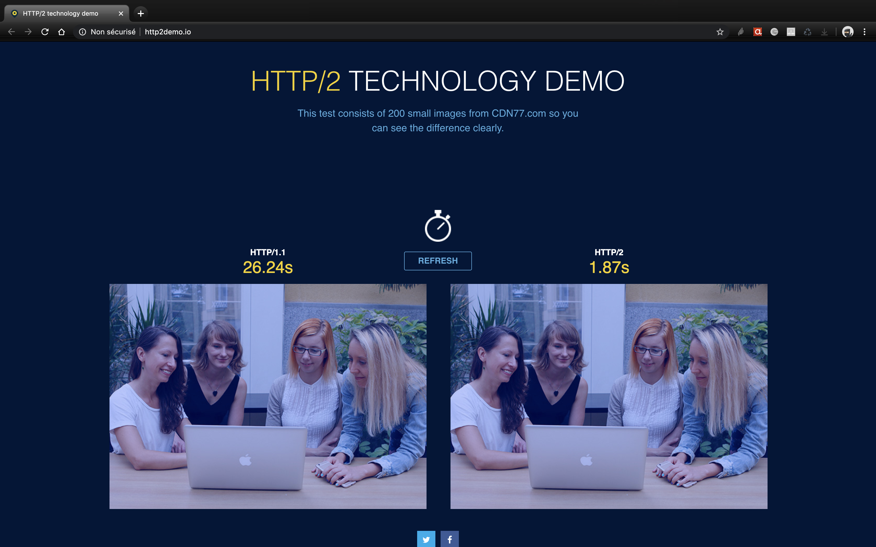
GRPC HTTP2.2 speed

