Slide 1


Performance Management Workshop
Szymon Trocha, Antoine Delavux, Poznań Supercomputing and Networking Center (WP6 Task3)
Strengthening international R&D communities with perfSONAR monitoring
Zagreb, Croatia
4-5 March 2020

Slide 2
#3S rule
How
perfSONAR
services
can help you strengthen
your international community?
The 3S’s

Slide 3
An architecture, software and service
perfSONAR Software development and user support within the international collaboration with ESnet, Internet2, Indiana University and University of Michigan
The 3S’s
Supporting the GÉANT community to deploy perfSONAR in their environment as a part of perfSONAR’s consultancy and expertise service, providing advice, training and Support for designing and deploying a perfSONAR-based measurement architecture
  Providing Performance Measurement Platform
  aka
  Small nodes

Slide 4
Softare development
The presentation you have just seen was part of it
(New and innovative ways to use perfSONAR by A. Delvaux)
www.perfsonar.net

Slide 5
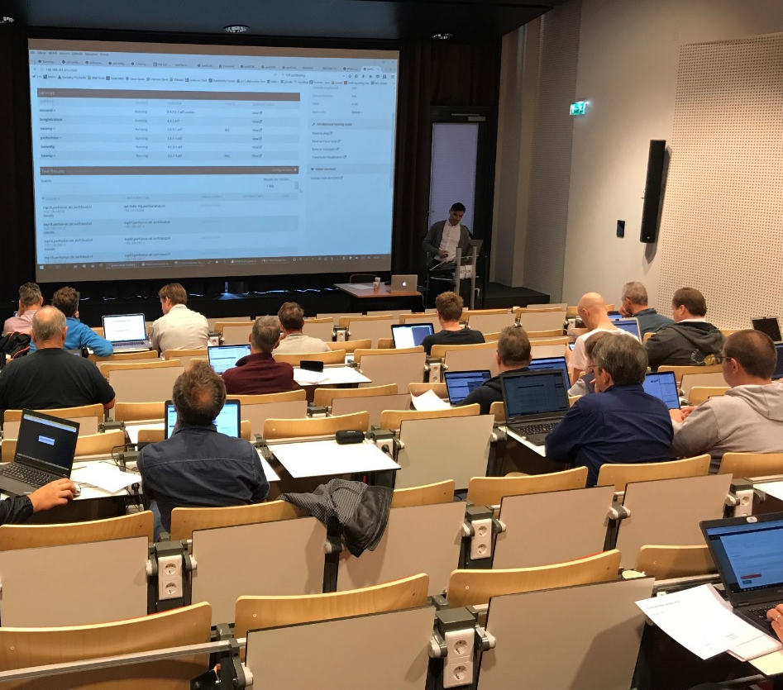
perfSONAR’s consultancy and expertise
Helps to ensure that design measurement architectures and infrastructures based on perfSONAR fit the performance monitoring and measurement needs of the requesting party
Specific training on perfSONAR deployment, usage and best practices
Extra support to deploy and operate perfSONAR provided by GÉANT and NRENs, as requested

Slide 6
Performance Measurement Platform (PMP project)
Consists of set of low-cost hardware nodes with preinstalled perfSONAR software
Natural evolution of successful Small Nodes project (2016)
The central components that manage the platform elements, gather, store and represent the performance data
  Operated and maintained by the GÉANT project
Coupled with GÉANT MPs to create a partial mesh for NRENs
Small nodes users can shape the predefined setup and configure additional measurements to their needs and get more familiar with the platform
  Can become example measurement experimentation and training platform
  Can provide an easy way to setup a new perfSONAR small nodes on new small devices (not tied to the hardware)
Operations team WP6 Task3
Central infrastructure
Automation
Monitoring
Processes and documentation

Slide 7
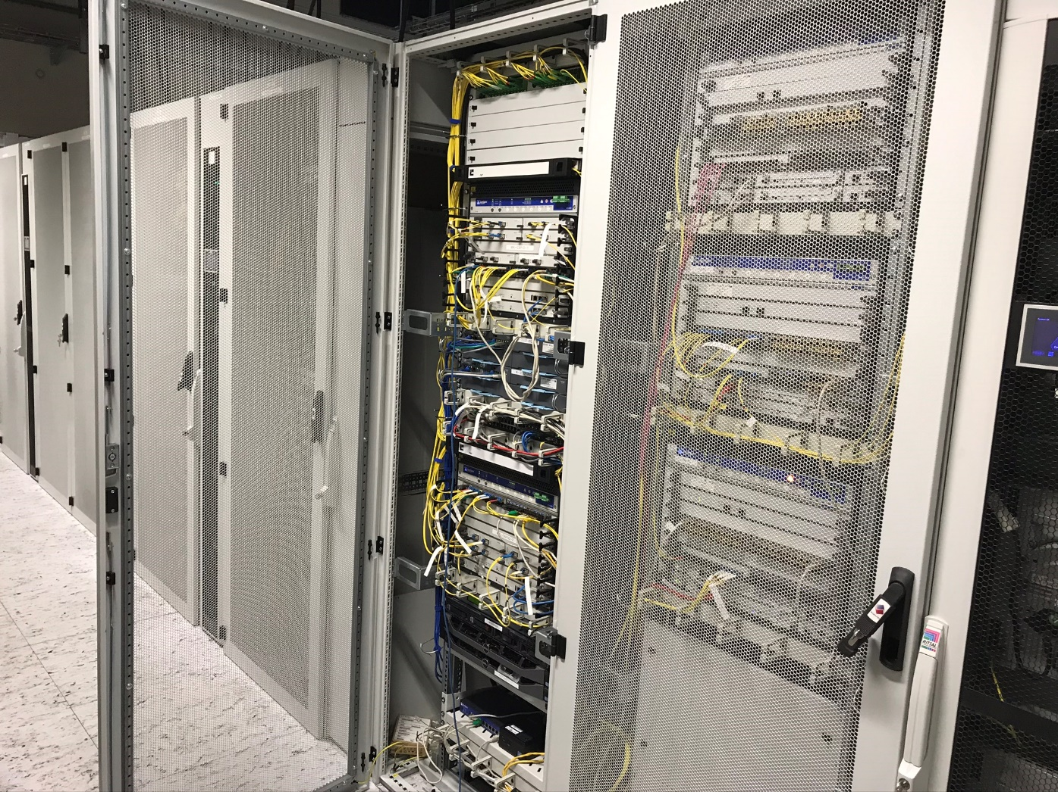
Can you spot it?
It’s small!
56 x 107 x 114 mm
Notes:
Here is a short on click animation of the arrow

Slide 8
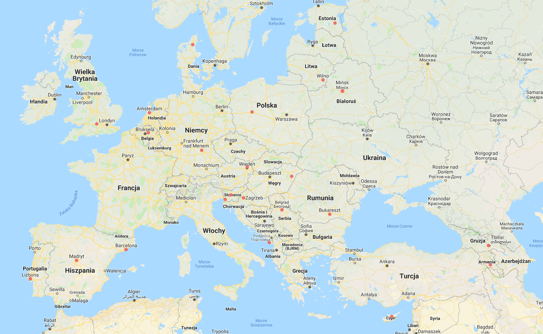
Pan-european community of trust
+3 in African NRENs
Some contries have >1
EE
DK
LV
LT
IE
NL
BY
UK
DE
PL
UA
BE
CZ
FR
LU
AT
HU
MD
HR
SI
RS
RO
IT
GE
ES
ME
MK
AL
AM
PT
GR
CY

Slide 9
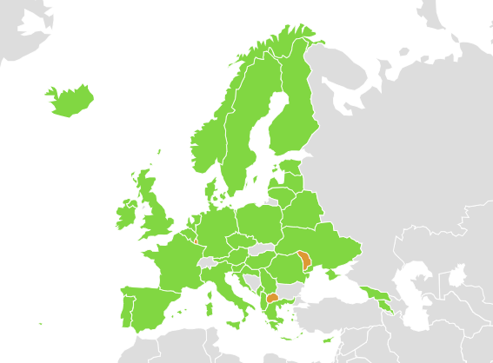
PMP Coverage Map
https://www.geant.org/Services/Connectivity_and_network/Pages/perfSONAR.aspx

Slide 10
International community
The global Research & Education networks enable international, national and local-scale research communities work together
PMP has 80%+ coverage of GN4-3 partners
2000+ other worldwide locations to test with and growing
Researchers can make sure they get similar level of performance
Useful for custom and experimental deployments
WP6T3 and international team keeps close loop with potential users to understand their needs

Slide 11
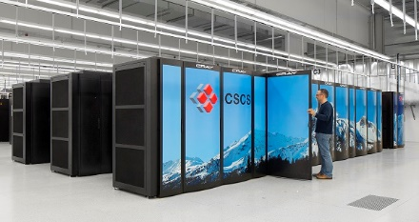
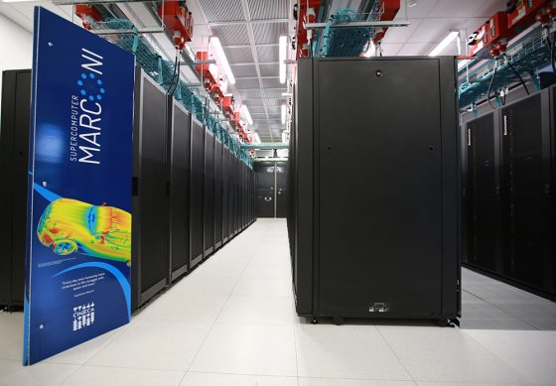
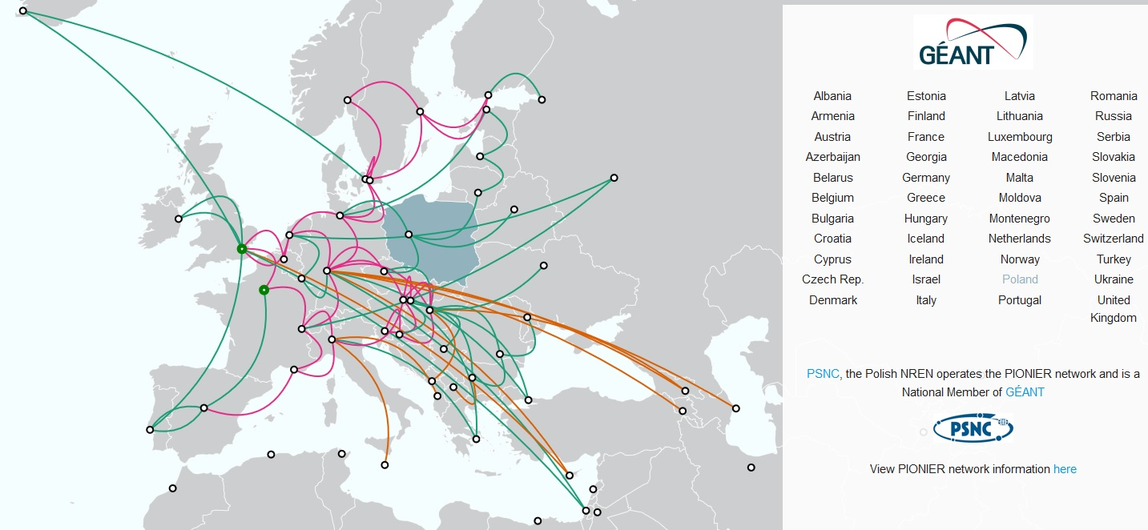
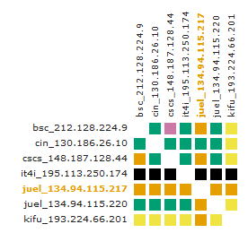

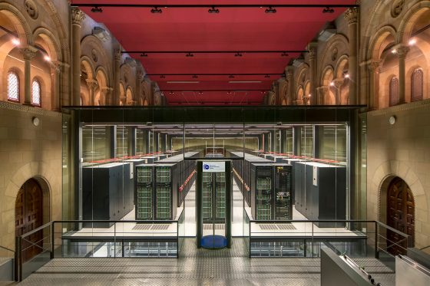
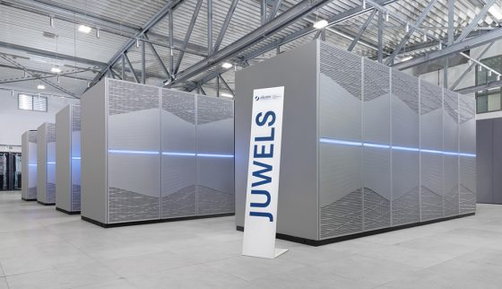
PRACE
Pictures from http://www.prace-ri.eu/, http://prace.it4i.cz/

Slide 12
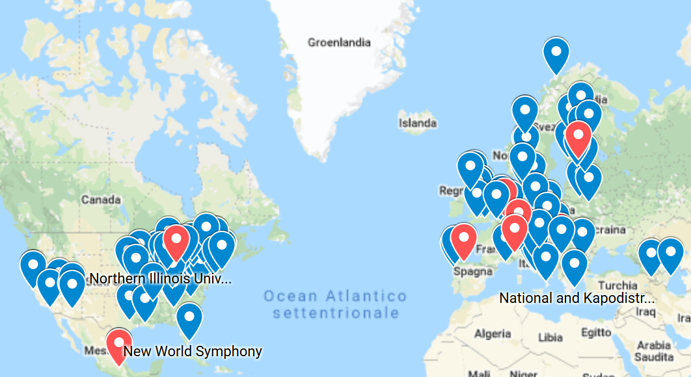

LoLa
Real time
Physically in remote sites
Connected by advanced network services
Needs a way to perform latency and jitter measurements

Slide 13
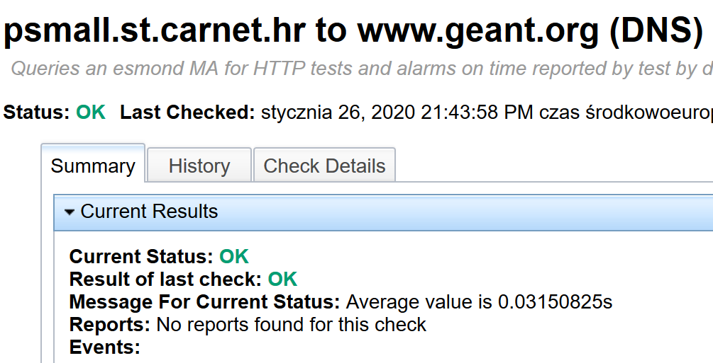
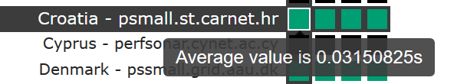
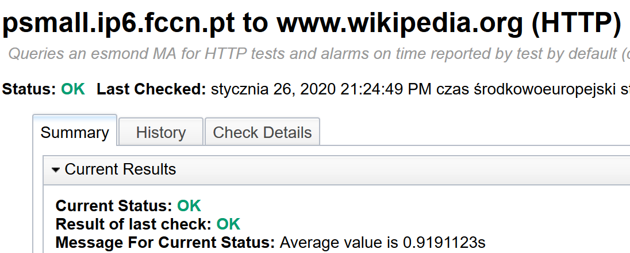
A place for experimentation and demonstration
DNS, HTTP tests
Can check the status of your Internet services
IPv6 reachability and coverage

Slide 14
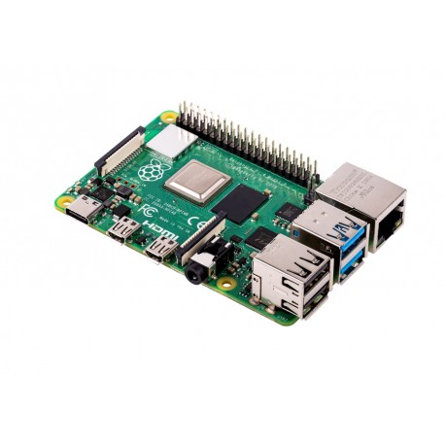
PMP goes smaller
Raspberry Pi4
Even quicker way of ad-hoc measurements
WP6T3 will test new platform
  HTTP
  DNS
  Latency
  WiFimon integration
  …
Intended for
  quick setup
  simple tests
  small communities,
  ad-hoc networks

Slide 15

pShooter service extension
A prototype program designed to automate the repetitive process of running tests to troubleshoot a network path
It automates part of the process of troubleshooting network problems between two points by running pScheduler tests to as many perfSONAR nodes as can be found along the path between them
Uses DNS as a locator service for nearby perfSONAR nodes
Runs a test to each point along the path where perfSONAR was found
Collects and presents results
Stay tuned!
https://youtu.be/2HUY6b5T9DM

Slide 16
Current ongoing perfSONAR work in GN4-3
CNaaS performance monitoring dashboard
  Trying to measure end user experience
  Through DNS and HTTP response time measurements
  Comparing performance across different VLANs, as in a campus network
Find best way to measure jitter for real time application (with LoLa project)
perfSONAR deployment automation, with Ansible
NMaaS offering: perfSONAR central archive and dashboard
MaDDash test now! feature…

Slide 17

perfSONAR Roadmap 2020 (global perspective)
4.2.3 — Published 27th February 2020
  Bug corrections and security fixes
  Update ASAP if you’re not rolling auto-updates
4.3 — Q2 2020
  Python 3 port
  Minor enhancements and further bug corrections
4.4 — Q4 2020
  Improvements for better support of 3rd party dashboards (Grafana, Kibana, …)
  Esmond re-haul to remove the dependency to Cassandra

Slide 18

perfSONAR European Users workshop
May 5-6-7 2020
Paris, RENATER office
Half day demo/training
2 days workshop, exchanges between users and developers
We welcome your presentations:
  How do you use perfSONAR?
  What new features are you craving for?
  What are the issues bugging you?
If you’re interested, get in touch with us through perfsonar@lists.geant.org

Slide 19
perfSONAR side meeting at TNC20
Friday 12th of June, morning
Presentation and discussion between users and developers
Follow-up on User Workshop
Roadmap update
We welcome your presentations too! If you’re interested, get in touch with us through perfsonar@lists.geant.org

Slide 20
Get involved!
Want to participate?
  If you are an NREN or institution connected to an NREN
  If you belong to the R & E community
    Being part of a networking team, service or research group
www.geant.org/Services/Connectivity_and_network/Pages/perfSONAR.aspx
pmp-central.geant.org/maddash-webui/
www.perfsonar.net

Slide 21

Thank you
Any questions?
szymon.trocha@psnc.pl
As part of the GÉANT 2020 Framework Partnership Agreement (FPA), the project receives funding from the European Union's Horizon 2020 research and innovation programme under Grant Agreement No. 856726 (GN4-3).​​​

Slide 22

Performance Management Workshop
Szymon Trocha, Antoine Delavux, Poznań Supercomputing and Networking Center (WP6 Task3)
Strengthening international R&D communities with perfSONAR monitoring
Zagreb, Croatia
4-5 March 2020
The scientific work is published for the realization of the international project co-financed by Polish Ministry of Science and Higher Education in the years 2019 - 2022 from financial resources of the programme entitled "PMW"; Agreement No. 5023/H2020/2019/2

