Slide 1


Latency & Jitter monitoring: how to get data and use them to improve service for Low Latency Applications
Claudio Allocchio, GARR
Fabio Farina GARR, Victor Olifer Jisc, Vytenis Gadliauskas LMTA (LITNET)
Zagreb, Croatia
4-5 March2020

Slide 2
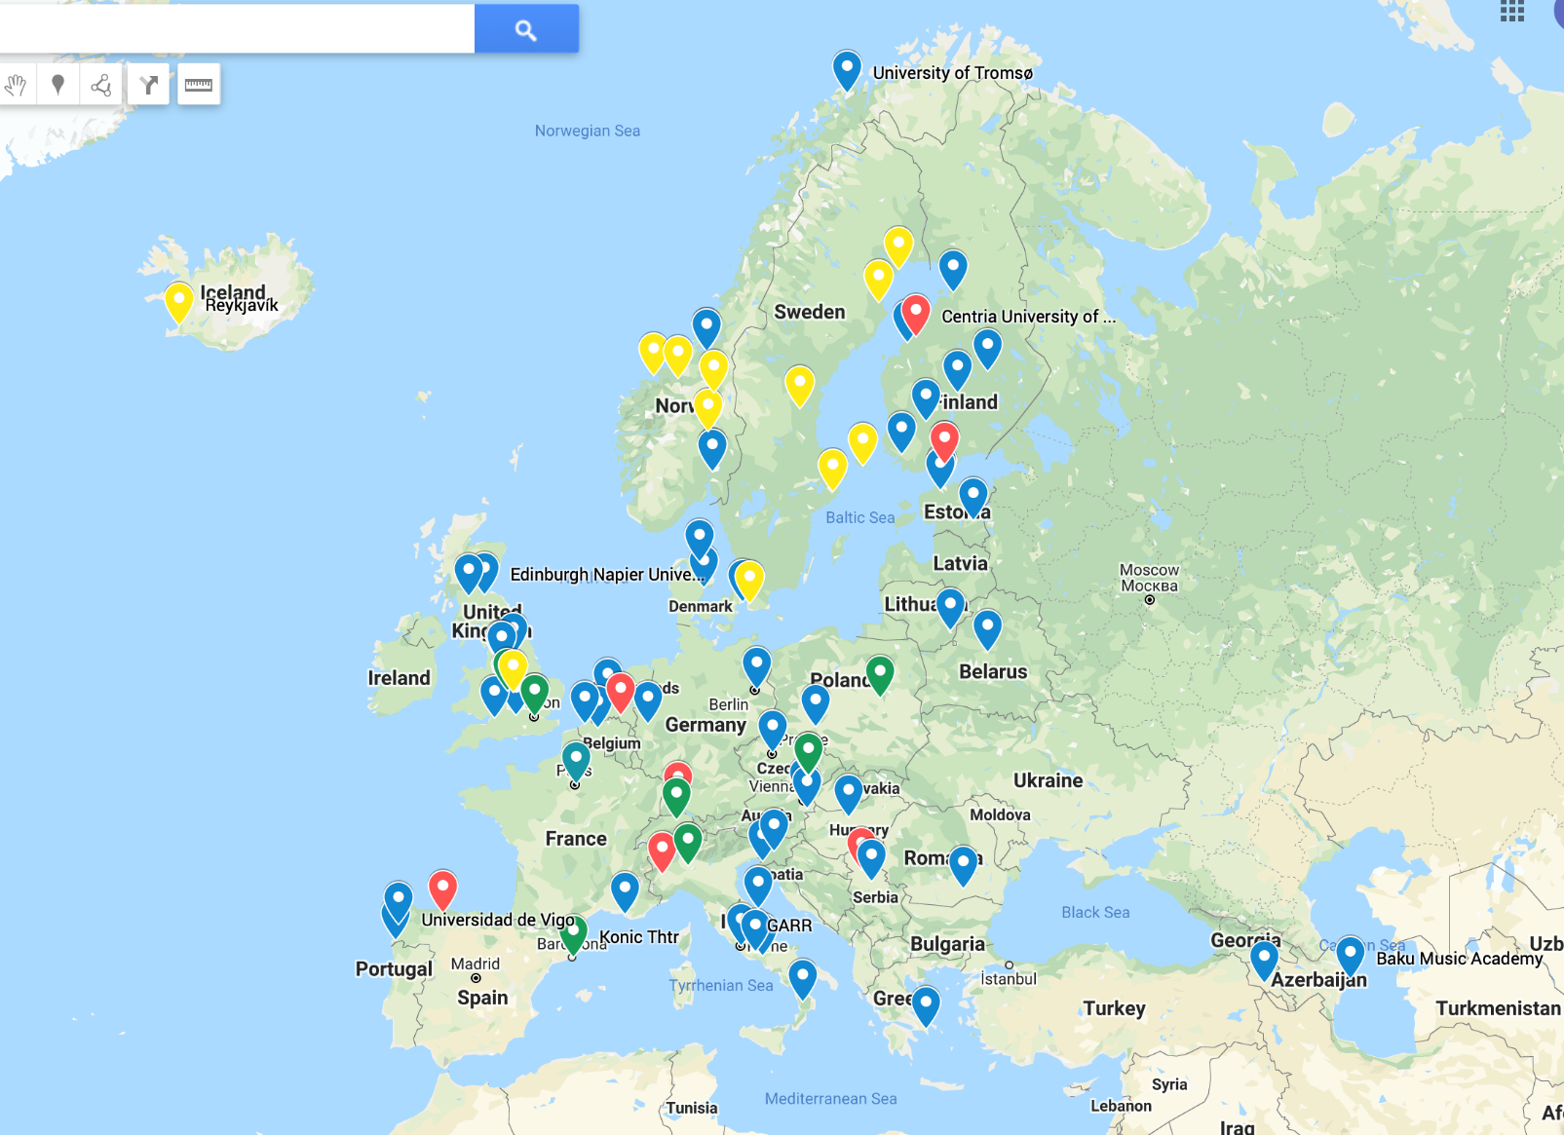
A map (incomplete) of Institutions using Low Latency Applications
LoLa
Ultragrid
MVTP
Nimbra

Slide 3
Involved NRENs: do they all know about this?
Rhnet*
Jisc
RedIris
RENATER
BELnet
SURFnet
GARR
SWITCH
DFN
Uninett*
Sunet*
DeIC*
ACOnet
CESnet
PSNC
ARNES
AMRES
NIIF
RoEduNet
GRNET
Litnet
EEnet
FUNET*
BASNET
ASNET-AM
AZscienceNet
RENAM
* Nordunet

Slide 4
What these applications need?
Bandwidth (multi Gigabit)
Low Latency ( possibly < 25ms RTT end to end )
Low Jitter ( < 1.5ms )

Slide 5
The issues and → our goals
Paths are optimized for Bandwidth, not for Latency or Jitter
There is no Latency and Jitter monitoring service
There is no historic tracking for Latency and Jitter
→ Collect Latency and Jitter data on the backbone
→ Create easy to read weather maps / graphs

Slide 6
Our activities
Study and test various possible monitoring solutions
  PMP nodes infrastructure?
  Other “small nodes” probes?
  PerfSONAR installations in GÈANT PoPs?
  Telemetry solutions inside routers and switches?
Propose a monitoring architecture and discuss it with GÈANT Operations to create a service
Support the creation of the initial monitoring service
Propose further activities

Slide 7
Early stage tests Milan Laboratory to find if LoLa traffic affects results
Chassis – Fujitsu Primergy CX400 S2
Servers – 4x CX250-series
  Xeon(R) CPU E5-2640 v2 @ 2.00GHz
  2x 16 cores, 128 GB RAM
  Storage 2x4 TB HDD
  Intel I350 NIC 4 x 1Gbps
ToR switches
  CISCO 3750-X
  Netgear gs108tv2
Logical connectivity schema
PS1 ----+ +---- PS2
| |
H1--------------H2
| |
LT1 ----+ +---- LT2
Nodes 1, 2 - Windows 10 with LoLa full install + Wireshark + LatencyMon
Nodes 3, 4 - PerfSonar CentOS Linux 7 installation with PerfSonar version 4.1.6-1.el7

Slide 8
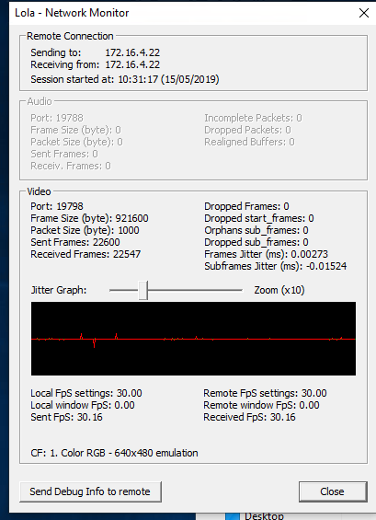
Good results for less demanding test cases
P1-MIL-test1-owping.txt | P1-MIL-test1-twping.txt | P2-MIL-test1-owping.txt | P2-MIL-test1-twping.txt
One-way Latency Statistics -------------------------- Delay Median ......... -0.09 ms Delay Minimum ........ -0.20 ms Delay Maximum ........ Not Reported Delay Mean ........... -0.10 ms Delay Mode ........... -0.09 ms Delay 25th Percentile ... -0.11 ms Delay 75th Percentile ... -0.08 ms Delay 95th Percentile ... -0.05 ms Max Clock Error ...... 0.76 ms Common Jitter Measurements: P95 - P50 ........ 0.04 ms P75 - P25 ........ 0.03 ms Variance ......... 0.00 ms Std Deviation .... 0.03 ms | One-way Latency Statistics -------------------------- Delay Median ......... -0.21 ms Delay Minimum ........ -0.33 ms Delay Maximum ........ -0.06 ms Delay Mean ........... -0.22 ms Delay Mode ........... -0.26 ms Delay 25th Percentile ... -0.25 ms Delay 75th Percentile ... -0.19 ms Delay 95th Percentile ... -0.17 ms Max Clock Error ...... 0.76 ms Common Jitter Measurements: P95 - P50 ........ 0.04 ms P75 - P25 ........ 0.06 ms Variance ......... 0.00 ms Std Deviation .... 0.04 ms | One-way Latency Statistics -------------------------- Delay Median ......... 0.05 ms Delay Minimum ........ -0.10 ms Delay Maximum ........ 0.16 ms Delay Mean ........... 0.05 ms Delay Mode ........... 0.05 ms Delay 25th Percentile ... 0.03 ms Delay 75th Percentile ... 0.06 ms Delay 95th Percentile ... 0.09 ms Max Clock Error ...... 0.71 ms Common Jitter Measurements: P95 - P50 ........ 0.04 ms P75 - P25 ........ 0.03 ms Variance ......... 0.00 ms Std Deviation .... 0.03 ms | One-way Latency Statistics -------------------------- Delay Median ......... 0.05 ms Delay Minimum ........ -0.05 ms Delay Maximum ........ 0.21 ms Delay Mean ........... 0.04 ms Delay Mode ........... 0.06 ms 0.05 ms Delay 25th Percentile ... 0.01 ms Delay 75th Percentile ... 0.07 ms Delay 95th Percentile ... 0.10 ms Max Clock Error ...... 0.71 ms Common Jitter Measurements: P95 - P50 ........ 0.05 ms P75 - P25 ........ 0.06 ms Variance ......... 0.00 ms Std Deviation .... 0.04 ms

Slide 9
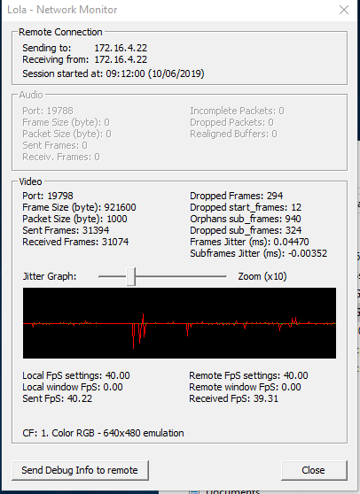
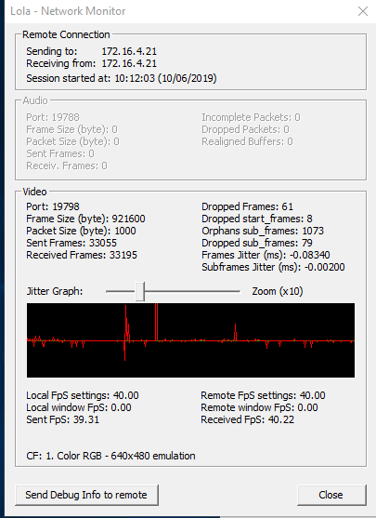
Unsatisfying / unclear results for more demanding test cases
P1-MIL-newsetup-test2.txt | P2-MIL-newsetup-test2.txt
One-way Latency Statistics -------------------------- Delay Median ......... -1.11 ms Delay Minimum ........ -1.18 ms Delay Maximum ........ -1.00 ms Delay Mean ........... -1.11 ms Delay Mode ........... -1.11 ms Delay 25th Percentile ... -1.12 ms Delay 75th Percentile ... -1.09 ms Delay 95th Percentile ... -1.06 ms Max Clock Error ...... 2.41 ms Common Jitter Measurements: P95 - P50 ........ 0.05 ms P75 - P25 ........ 0.03 ms Variance ......... 0.00 ms Std Deviation .... 0.03 ms | One-way Latency Statistics -------------------------- Delay Median ......... 2.16 ms Delay Minimum ........ 0.94 ms Delay Maximum ........ 4.06 ms Delay Mean ........... 2.34 ms Delay Mode ........... 1.00 ms Delay 25th Percentile ... 1.03 ms Delay 75th Percentile ... 3.45 ms Delay 95th Percentile ... 4.01 ms Max Clock Error ...... 1.02 ms Common Jitter Measurements: P95 - P50 ........ 1.85 ms P75 - P25 ........ 2.42 ms Variance ......... 1.35 ms Std Deviation .... 1.16 ms
Tests without LoLa traffic seem to give
too optimistic results; this proves we
need traffic to have realistic results.
☹

Slide 10
Tests WAN Vilnius-Trieste involving LoLa, PerfSONAR and PMP nodes
Long-distance end-to-end tests between pS and LoLa hosts (mostly between Vilnius-Trieste sites)
iperf/pScheduler tool can generate up to 800-900 Mbps traffic with LoLa UDP packets on a 1G host interface without disruption of other pS tests
Latency and jitter measurements (during periods of LoLa traffic generation) should better be done with twping/owping tool under a purpose built scheduler or powstream (implementing the same OWAMP/TWAMP protocol for regular background tests) under pScheduler control.
Twping/owping/powstream tools provide diverse statistics for latency: median, max, min, mean delays, STD and percentiles for jitter and the delay histogram.
precision strongly depends NTP sync of the hosts. There is good precision with stable latency values in 27 +/- 2-3 ms between Vilnius and Trieste and jitter in the region of 1-2 ms

Slide 11
Tests WAN Vilnius-Trieste involving LoLa, PerfSONAR and PMP nodes
Also twping/owping can generate LoLa-like traffic. This makes possible to use of the same tool for traffic generation and latency measurements.
However:
  pScheduler struggles to find a gap in its schedule for a twping/owping test with high throughput (> 400 Mbps, the higher rate the less a test period allowed by pScheduler)
  A host with low power processor and consumer-based network interface (like PMP hosts) struggles to generate a high rate of traffic; no more than 200-250 Mbps with owping/twping.
  having better hardware could help pS machines to generate at least 500 Mbps or even higher traffic using owping/twping (tests with different hardware in Vilnius)
  Generating traffic with Iperf takes less processor power, and even a small PMP node managed to generate about 400 Mbps traffic with Iperf.
the option with one tool for generation and measuring seems to be perspective only if there would be better hardware for PMP nodes
  A typical LoLa-like traffic, video fullHD 60fps, 10 audio ch = 490Mbps, 60 kPPS

Slide 12
TWAMP tests involving PerfSONAR and Juniper Telemetry
per-segment host-to-router and router-to-router tests (the GEANT MX960 router in Poznan and the Janet MX80 routers in the lab have been used)
Juniper TWAMP is RFC 5357 compliant and interoperates with pS twamp client. Successfully tested between Janet ps-slough-1g.ja.net host and mx1.poz.pl MX960, 17.4R2-S6 router.
Juniper TWAMP client works against Juniper TWAMP server. Tested between MX80 routers in the Janet lab and the GEANT MX204/MX480, Junos 17.4R2-S6 routers.
TWAMP servers being activated on the routers along some path can be used for fault detection and localization by tw-pinging from some end host (no need for TWAMP clients on Juniper routers)
TWAMP sessions between Juniper TWAMP clients and servers can be used for per-segment fault detection and localization or per-segment weather maps without using end hosts.
☺

Slide 13





Proposed technical design for the weather map tool implementation
High level architecture design proposal
Micro-service architecture
based on Docker containers
Juniper
RPM/TWAMP
Measurements
Input events
data normalization and filtering
Time series
Data Base
Weather map
graphical visualization tool

Slide 14
Proposed technical design for the weather map tool implementation
Have access to the RPM probes running on Juniper routers.
get the results from RPM/TWAMP measurements as SNMP packets
poll the network devices a central Virtual Machine (either in GEANT Operations or in one NREN)
Use RPM/TWAMP to collect Maximum round-trip time, Average round-trip time, StdDev round-trip time, Jitter, and Loss percentage for UDP ping probes.
Increase measurement frequencies: 10 packets every 600sec (sampling rate comparable to MRTG would be optimal)
A jitter greater than 1.5ms impacts the LoLa users: rise a trap when this constraint is violated. (when deeper inside knowledge on the data will be achieved, additional requests for thresholds and traps will be forwarded to Operations for setup on the routers)
JTI streaming telemetry is currently under investigation: stay open to the integration also for this data source
provide scheduled or on demand traffic generators so that measurements also display this situation. The frequency and synchronization needs to be tuned when we see first result

Slide 15
Requests to the GEANT Operations
Today
  Access to the scripts providing topology and ISIS topology
  Access to RPM probes on Juniper routers. RPM/TWAMP measurements as SNMP packets. Logstash Docker container as polling agent
  Virtual Machine on the GÉANT Infrastructure, where Docker containers run
  Current configuration of RPM/TWAMP changes
    Add Max round-trip time, Avg RTT, StdDev RTT, Jitter, and Loss percentage measurements for UDP ping probes
    Measurement frequencies for tests with 10 packets every 600 seconds
    GN4-3 WP6 T1 knows that jitter >1.5ms impacts the LoLa users, rise traps
Tomorrow
  Juniper JTI streaming telemetry sending gRPC events to the telemetry
  Evaluate pS+TWAMP integration as additional data source
  Open discussion on the Portal integration

Slide 16
Proposed workflow 1/2
What is the workflow to use the service?
  End-users will appeal to NREN NOC in case of problems or if they need help to seek optimal performance. Users must specify if this is a permanent request or just a request for a limited period of time.
  NREN NOC will use latency/jitter weather Map (WM)
  NREN NOC will analyze and identify the best path
  NREN NOC will contact GÈANT Operations to ask for implementation of better path (in case limiting the service to specific endpoints using the sensitive application service)
  GÈANT Operations confirms NREN NOC analysis, and implements better path request.

Slide 17
Proposed workflow 1/2
Who will use it the WM?
  NREN NOC and end-users will appeal to NREN NOC
Who will watch the WM?
  NREN NOC and users
if there is a solution available to steer a low latency or lower jitter path, who will initiate the path?
  NREN NOC will make the request to GÈANT Operations

Slide 18
Where we go after this?
Explore possible extension of the monitoring service INSIDE the NRENs, in case using also new generation “small probe nodes”
Collaborate to design new “small probe nodes” and test them
Tune the alarms threasholds, and study possible semi-automated actions to react
Brainstorm and propose viable semi-automation of activities (for GEANT backbone and inside NRENs) to optimize or provide better paths for Low Latency applications, when the default path is non optimal
Further explore available and future telemetry data to improve the monitoring service

Slide 19

Thank you
Any questions?
Claudio.Allocchio@garr.it
As part of the GÉANT 2020 Framework Partnership Agreement (FPA), the project receives funding from the European Union's Horizon 2020 research and innovation programme under Grant Agreement No. 856726 (GN4-3).​​​

Slide 20
Milan Lab Connectivity
LAN @MIL
VPN GW
NOTES:
Addresses on VLAN 194 from 172.16.4.0/24
Port mirror reflects the whole VLAN 194
Back2back direct connections use 192.168.10.0/24
22
Cisco 3750-X
22
4
13
15
5
[194]
Netgear gs108tv2
[194]
2
3
4
[194]
Fuji-1 (Win10)
Fuji-2 (Win10)
.21
em3
em3
.22
Fuji-3 (Centos)
Fuji-4 (Centos)
em1
.23
.24
em1

Slide 21
Vilnius Lab Connectivity
NOTES:
Cisco uses access mode on ports 5-8, no other equipment is connected to the device.
Mikrotik bridged connections use main CPU for traffic transferring (HW offload disabled), creating higher jitter as bandwidth increases.
perfSONAR1 and perfSONAR2 machines uses identical hardware and operating system.
LOLA Workstation 1 and LOLA Workstation 2 uses the the same model network interface and operating system.
WAN @LITNET
Cisco Catalyst C3560CX-12PD
1 (16), SFP+ 10 GbE
5, 1 GbE
6, 1 GbE
7, 1 GbE
8, 1 GbE
LAN @LMTA
Mikrotik RB951G-2HnD (jitter generator)
1, 1 GbE
2, 1 GbE
3, 1 GbE
4, 1 GbE
5, 1 GbE, Management
Bridged
LOLA Workstation 1 (Win10)
LOLA Workstation 2 (Win10)
Intel I219-V, 1 GbE
Intel I219-V, 1 GbE
CESNET Gigabit Packet Reflector
perfSONAR1 (CentOS)
1 GbE
perfSONAR2 (CentOS)
Realtek PCI-E NIC, 1 GbE
Realtek PCI-E NIC, 1 GbE

Slide 22
Original Test plan @ Milan Lab
Test 1: Measure between P1 and P2 while L1 and L2 are inactive
Test 2: Measure between P1 and P2 while L1 and L2 send traffic at 30fps, 1 Color RGB 640 x 480
Test 3: as before with traffic at 60fps, 1 Color RGB 640 x 480
Test 4: as before with traffic at 30fps, 7 bayer encoded 1280 x 720
Test 5: traffic at 60fps, 7 bayer encoded 1280 x 720
Test 6: traffic at 30fps, 8 bayer encoded 1920 x 1080
Test 7: traffic at 60fps, 8 bayer encoded 1920 x 1080

