Slide 1
Accessibility and procurement
Working together to empower all learners, create a fairer world and meet global regulations
Kellie Mote
Programme lead (accessibility)

Slide 2


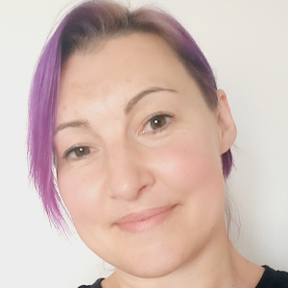

The Jisc accessibility team
Kellie Mote
Programme lead
John Kelly
Regulation and compliance specialist
Laura Hutton
Accessibility specialist
Helen Nicholson-Benn
Assistive technology and AI specialist

Slide 3
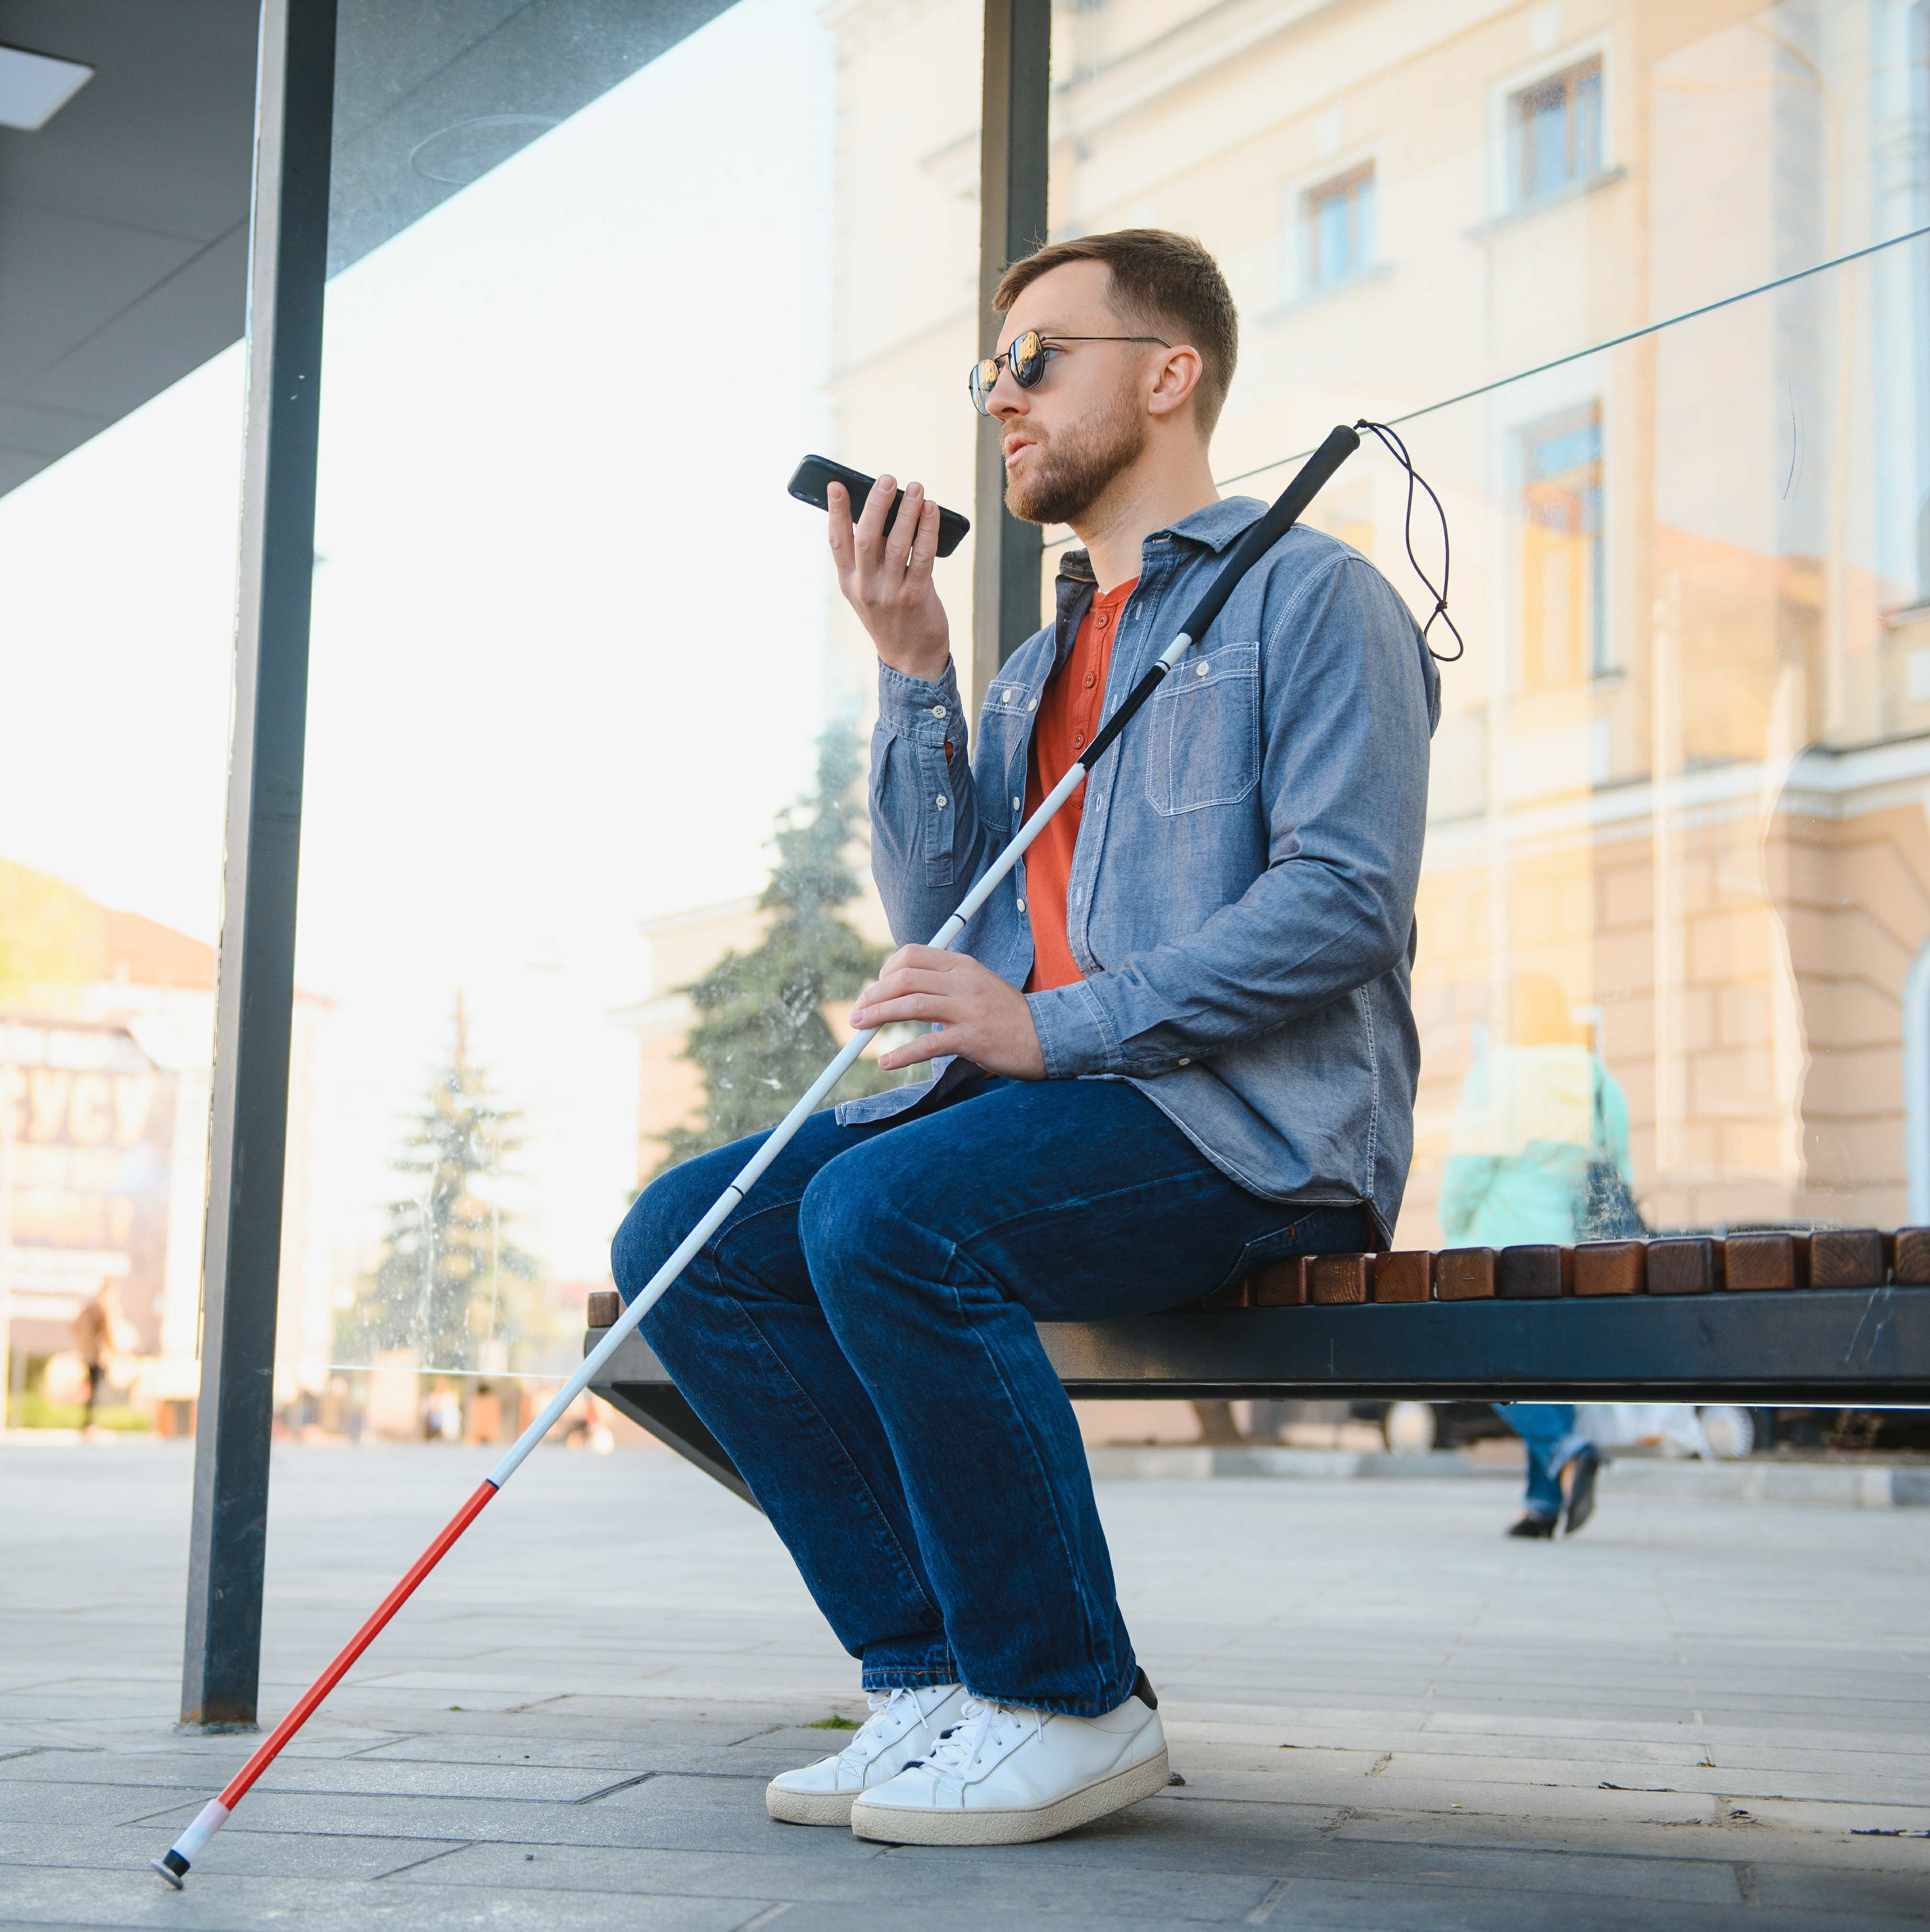
What do we mean by accessible?
Digital content and products that everyone can use, including all disabled people
Internationally recognised standards such as WCAG* provide guidance on how to achieve this
*Web Content Accessibility Guidelines
Notes:
What we mean by accessibility in this context?
Some definitions help and some don’t.
Definition of disability:
“ a physical or mental impairment that has a ‘substantial’ and ‘long-term’ negative effect on the ability to do normal daily activities.”
Disability is a protected characteristic under the Equality Act 2010. Therefore it is UNLAWFUL for an education provider to discriminate directly or indirectly against someone on the basis of their disability.
Websites, e books and journals, booking systems, library catalogs, mobile apps, videos, podcasts.
… impairment … that effects … normal daily activities.
Legislation has helped
Disability is a legally “protected characteristic” … discrimination
Reasonable adjustments

Slide 4

Regulations
UK: Equality Act 2010 and the Public Sector Bodies (Web Content and Mobile Applications) No.2 Accessibility Act 2018
USA: Title II of the Americans with Disabilities Act (ADA) 2024
EU: European Accessibility Act 2019 and 2025

Slide 5
Our recent project Accessible Digital Futures discovered that procurement is important in helping to ensure we have accessible products

Slide 6
Some recommendations from the project
Higher education sector buying power should be used to positively influence the tech industry to develop accessible tools and provide accurate information about accessibility.
HE providers, procurement consortia, industry experts and sector bodies should agree and adopt sector-wide accessibility standards for digital tools, including AI.
UK universities should grasp the opportunities provided by the recent European Accessibility Act (EAA) and work with partners in the EU to learn and ensure a consistent approach.

Slide 7
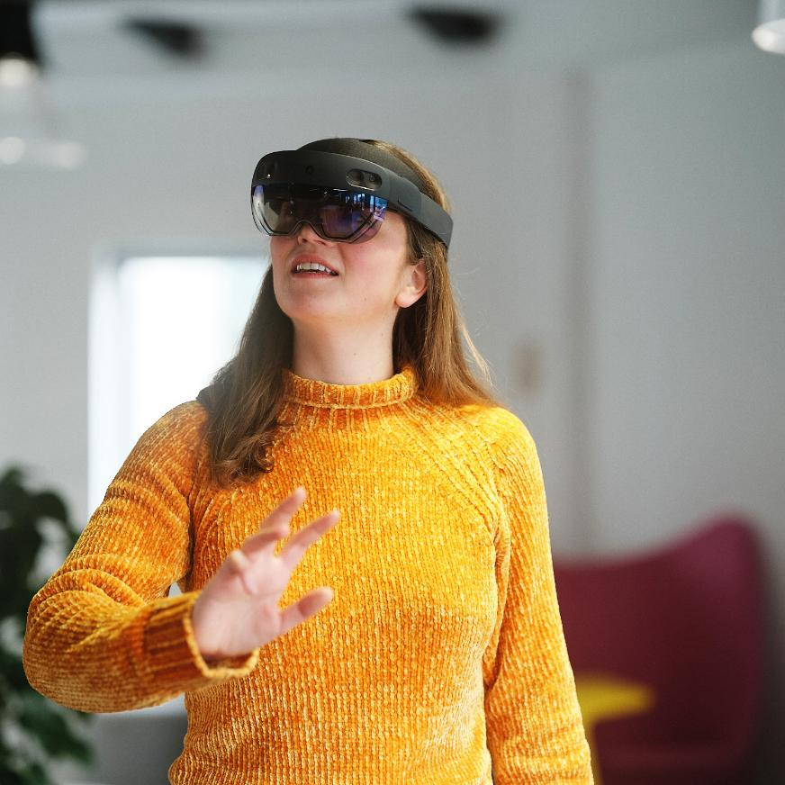
You’re all invited
Join Jisc’s accessibility and assistive technology communities.
Have a look at our Accessible Digital Futures report (launching 30 Jan).
Talk to us to exchange experiences, resources, ideas and to explore practical ways procurement can influence accessibility.

Slide 8
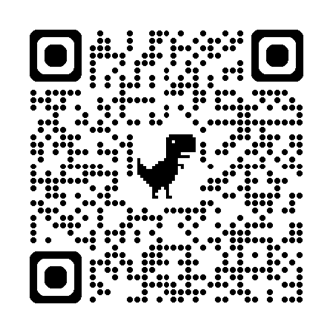
Get involved
Kellie Mote
kellie.mote@jisc.ac.uk

