Slide 1
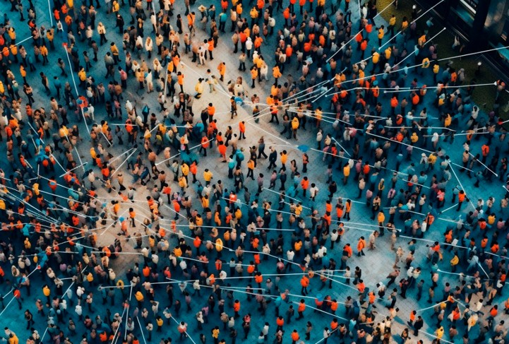
What else can we do with Quantum Networks?
Garazi Muguruza Lasa,
Wojciech Kozlowski
Notes:
QKD: commercial, low adoption
QI: far away

Slide 2


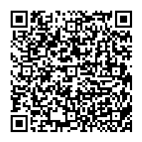
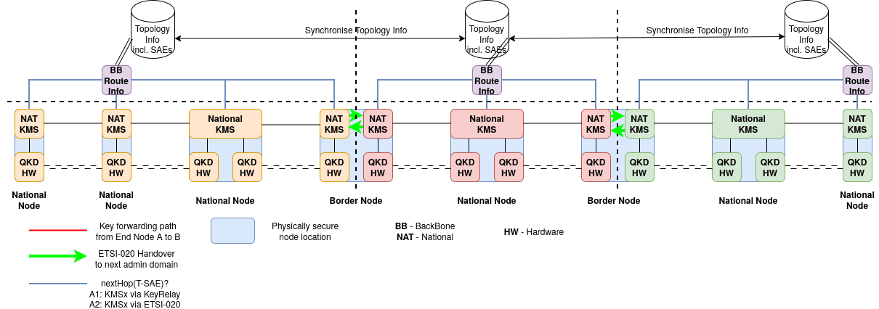


eduQKD
Service A&O
Workflow Orchestrator
Open-source software stack (Apache 2).
Fully integrated with production A&O Workflow Orchestrator.
Stack consists of
  eduQDC: quantum domain controller.
  eduKMS: key management server.
Cross-domain support will be added for Benelux-QCI.
REST API
Domain Control
eduQDC
eduQKD repo
QKM
Vendor #1
QKM
Vendor #2
KMS
eduKMS
eduQKD slack

Slide 3
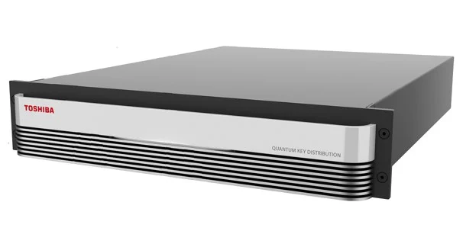
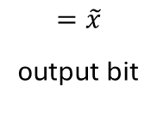
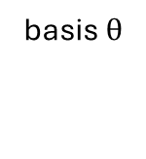
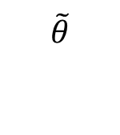
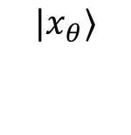
What happens inside QKD boxes?
Goal: either both parties have the same secret bitstring k, or they know that someone was eavesdropping.
basis
input bit x
$$|x_{θ}⟩$$
$$\tilde{θ}$$
$$=\tilde{x}$$
output bit
basis $θ$
Classical post-processing:
share partial information about
input/outputs and bases choices
What other than QKD can we do by changing the post-processing of qubits?

Slide 4
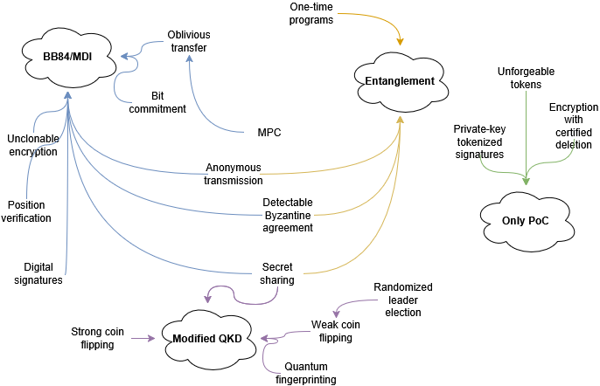


Slide 5
Quantum Multiparty Computing
Combining datasets of distrusting parties.
no party learns any other
parties input
each party distrusts the
other’s implementation
Classically:
PKI → Oblivious Transfer (OT)→ MPC
F( , , , , )
can we replace PKI by quantum communication?

Slide 6
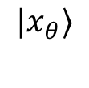
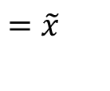
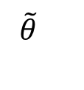
Quantum Multiparty Computing
Assumptions: quantum links between every 2 parties
Steps:
quantum comm between every 2 parties
classical post-processing of OT keys
chose a function to jointly compute
classical post-processing between every 2 parties
$$|x_{θ}⟩$$
$$\tilde{θ}$$
$$=\tilde{x}$$
F( , , , , )
Bonus: if parties have access to quantum computers they can jointly compute quantum operations.

Slide 7
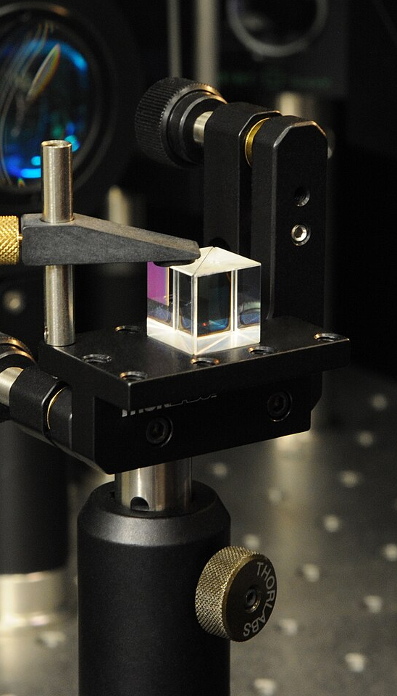
Conclusions
We need more access to the QKD devices: we need to know which qubit – measurement basis – measurement outcome are correlated.
We need more noise and performance analysis of the primitives.
We need to know which trade-offs between security and performance we deem acceptable.
does any of these applications ring a bell?

Slide 8

Closing slide
Thank you for
your attention!
garazi.muguruzalasa@surf.nl

