Slide 1
Hybrid Quantum-Classical computing infrastructure - algorithms and use cases
Piotr Rydlichowski
1st GEANT SIG-QUANTUM workshop - CERN 30th June – 1st July 2026

Slide 2
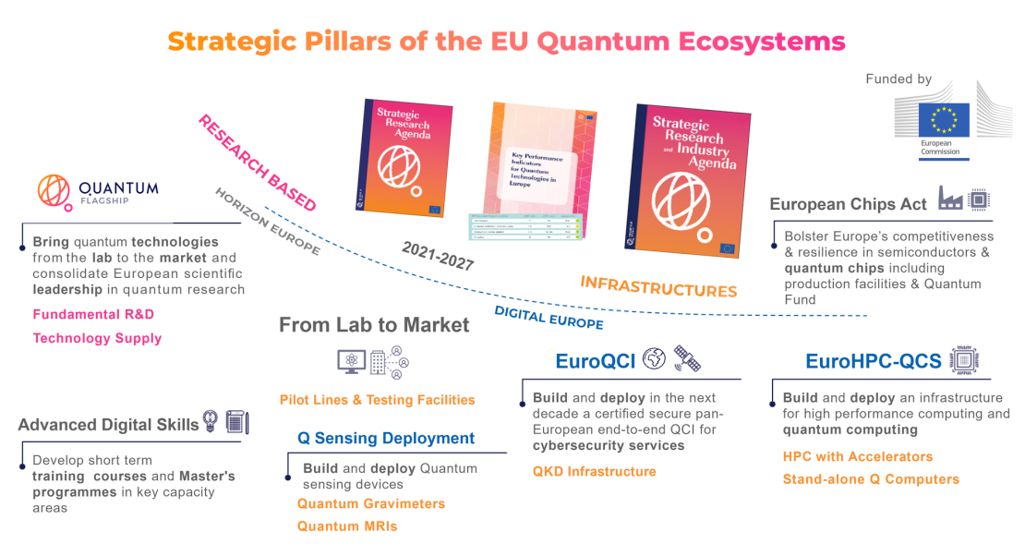
EC European Quantum Technologies Initiatives

Slide 3
Why we need quantum-classical integration ?
The following aspects need to be considered:
Efficient quantum system access, jobs preparation, pre/post processing, results analysis
Quantum-classical algorithms that operate in the loop between quantum and calssical system for specific job
Specific problems are more efficient to be solved on CPU, GPU, TPU and QPU we need a system to connect and access all these resources
Quantum Error-Correction and Error-Mitigation R&D can require signifficant HPC resources
We need quantum systems simulators, these require HPC signifficant HPC resources (Exascale machine can simulate ~ 50 qubits)

Slide 4
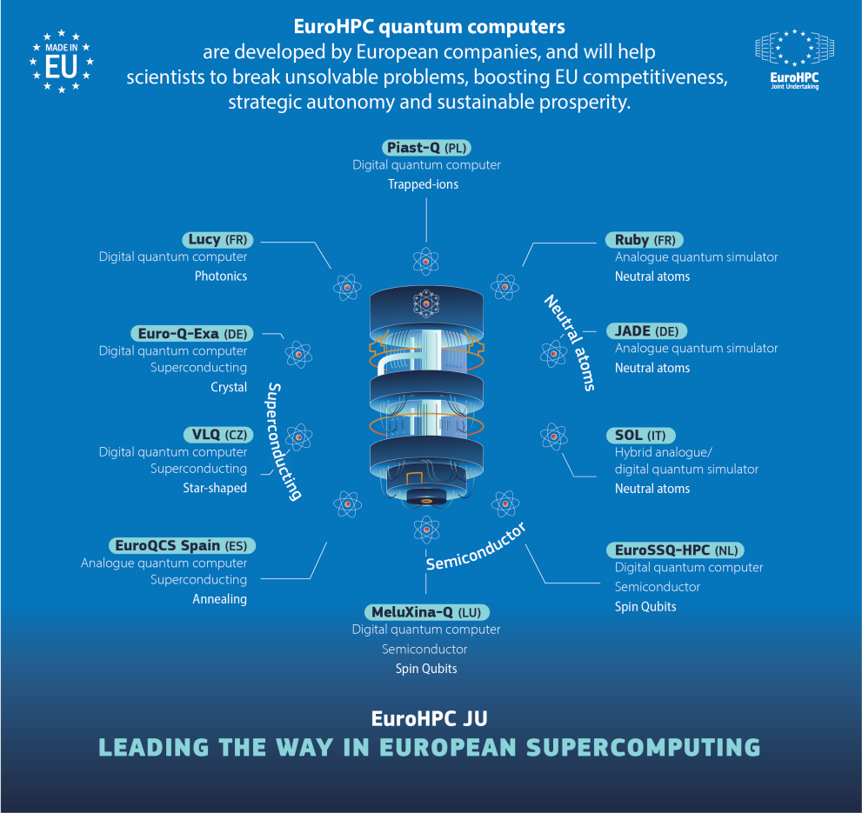
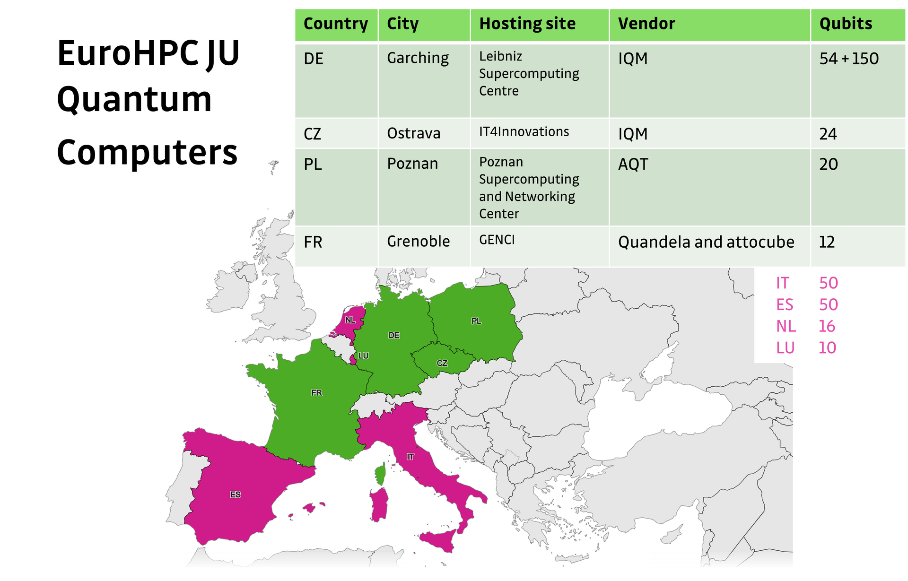
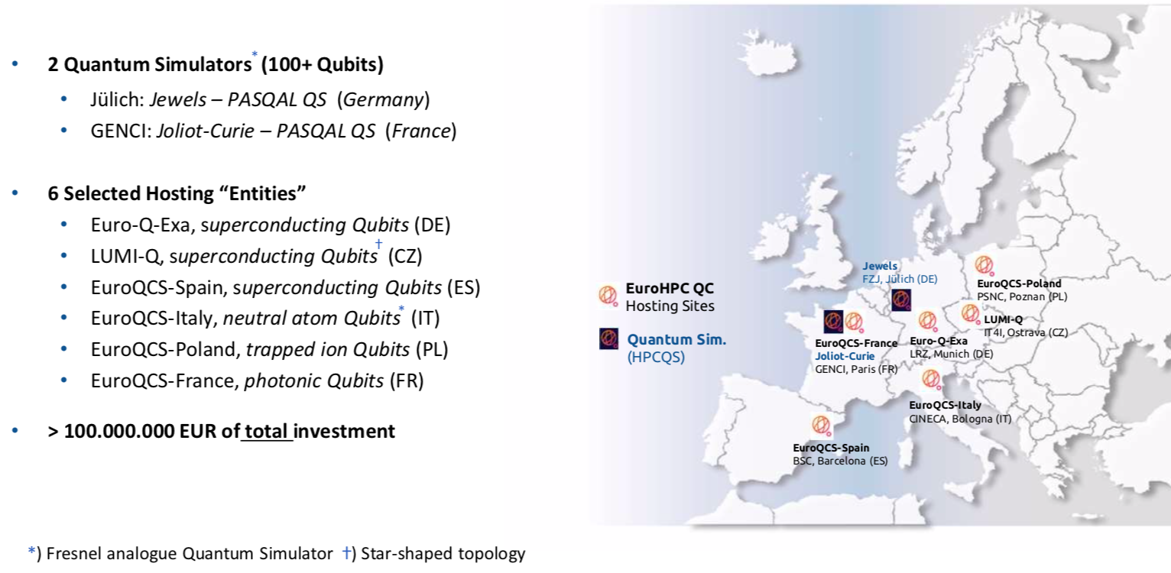
EuroHPC and EuroQCS infrastructures

Slide 5
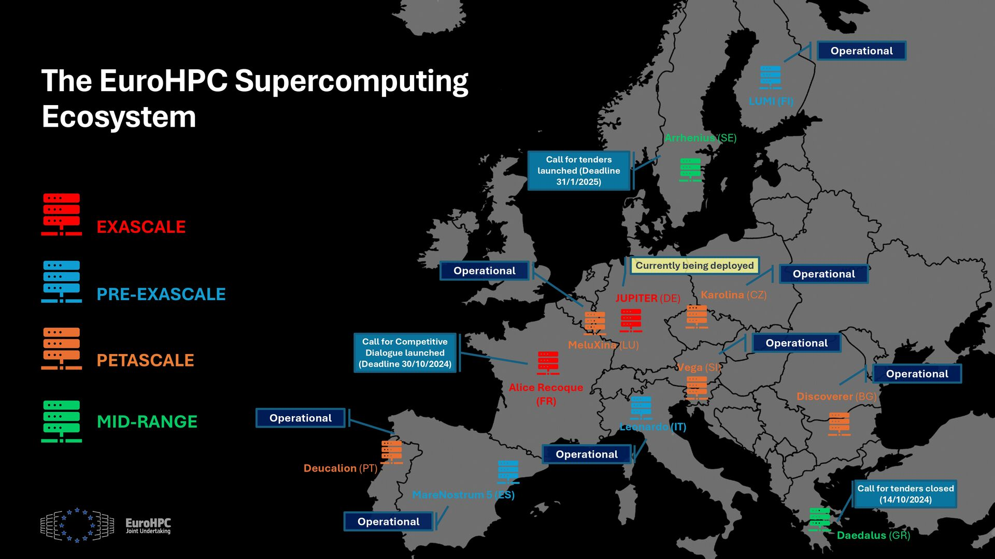
EuroHPC and EuroQCS infrastructures

Slide 6
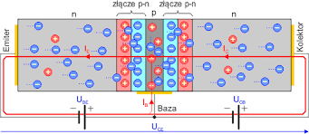
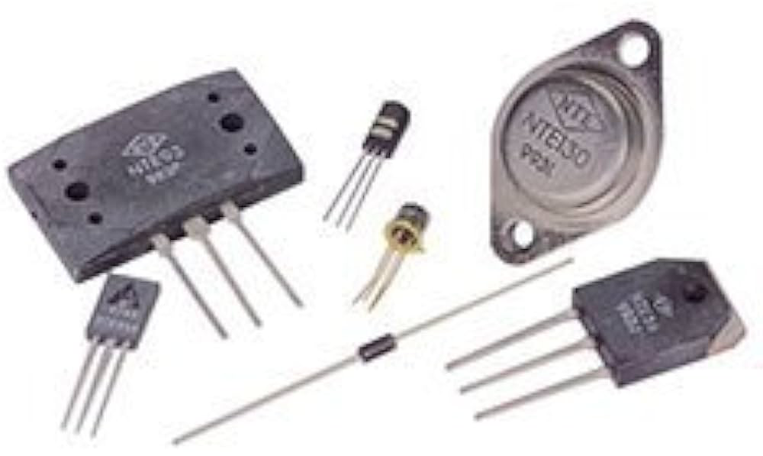
How does a classical computer work?
Classical computers are built from integrated transistors, which work when they have two states:
  0 → no voltage or a low level
  1 → presence of voltage or a high level
As a result:
It is easy to tell whether current is flowing or not
A classical system is resistant to various disturbances (no need to distinguish a million voltage levels — just two states (a classical bit) are enough)!
There is possibility to use Multi-Valued Logic (MVL) gates and systems but practically difficult

Slide 7
How does a classical computer work?
Current = directed flow of electric charge carriers through a conducting body, occurring under the influence of an electric field.
Transistors are miniature switches that can be:
  turned on (1) → conduct current
  or turned off (0) → do not conduct
Many transistors that:
  process data (processor)
  store data (e.g. RAM)

Slide 8
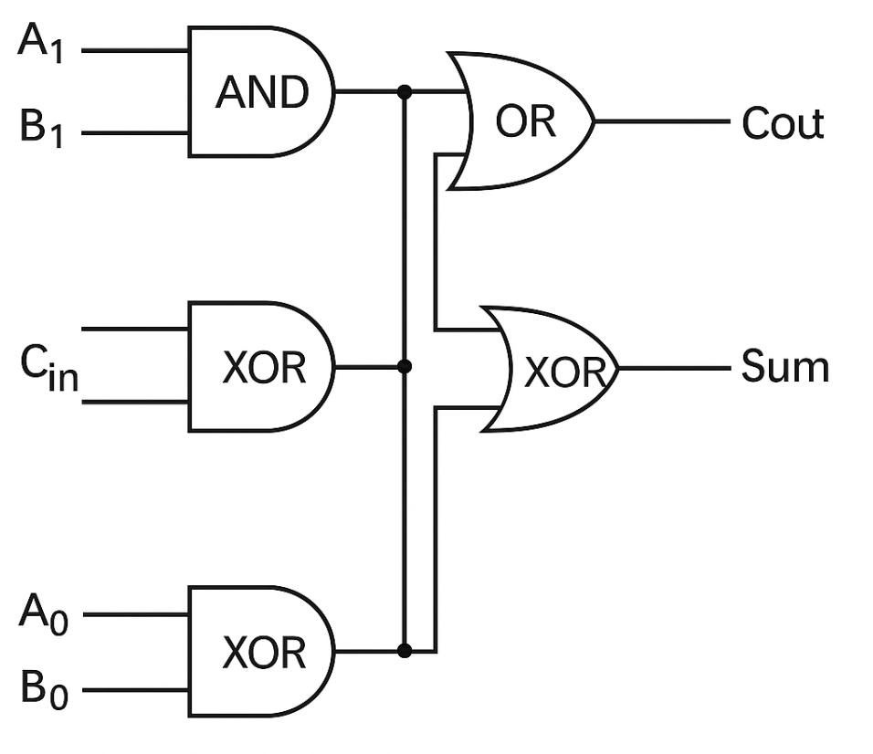
Zeroes and Ones
A binary system based on bits is:
  Simple and efficient to implement in hardware in classical computers
  Ideal for building logic using logic gates (e.g. AND, OR, NOT)
If you want to add two numbers 2+2 :
  The computer converts this into a binary representation and adds 10 + 10 in registers
  Transistors perform the addition bit by bit
  The result is 100 (that is 4) — only zeros and ones!
  MVL system requires complex logic and gates

Slide 9
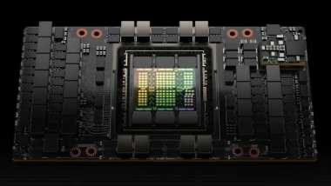
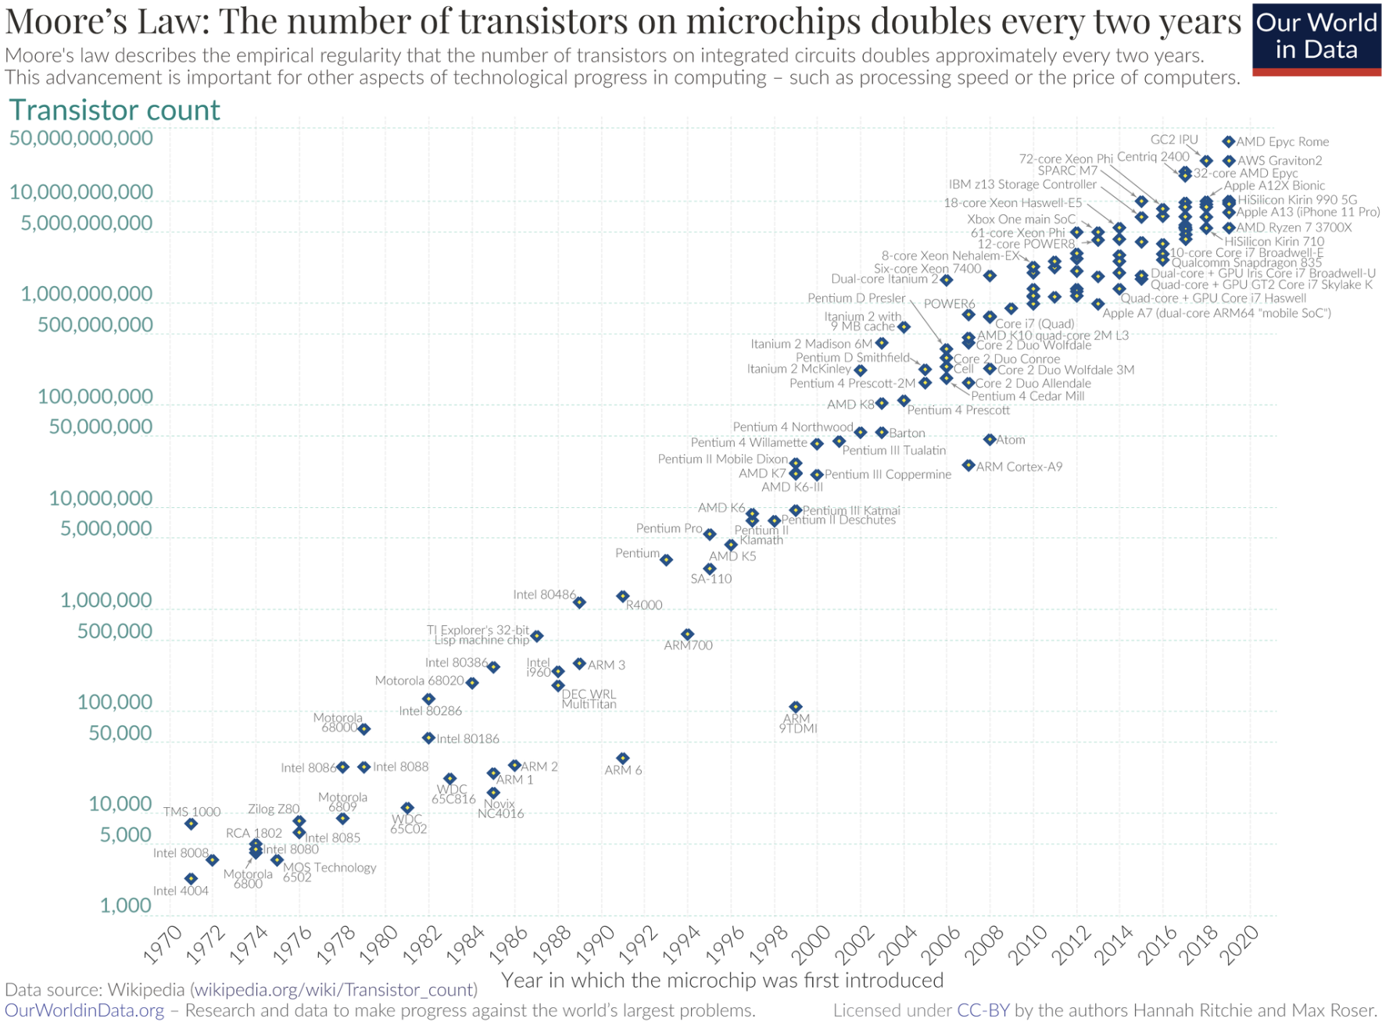
Supercomputing Iron
​NVIDIA B200/B300 GPU graphics card:
  Contains 208+ billion transistors (Rubin 336B)
  Consumes 1000 - 1 200 W!
  AI factories consist of 1500+
of the latest GPUs (e.g. PIAST AI)
  AI gigafactories (100 000+ GPUs)

Slide 10

Complex problems
The computational complexity of an algorithm determines how efficient the algorithm is, how many operations it must perform depending on the amount of data and how much memory it needs.
O(2ⁿ) – "Every possible combination"
Example: opening a safe with a PIN code
You have a safe with a 4-digit PIN; for digits 0–9 → 10⁴ = 10 000 combinations
For a binary code (bit) of 0 or 1 we have 2 possible options
For a code of length n, we have 2ⁿ possibilities to check
For 4 digits: 2⁴ = 16 combinations – checking bit by bit
For 20 digits: 2²⁰ = 1 048 576 combinations

Slide 11
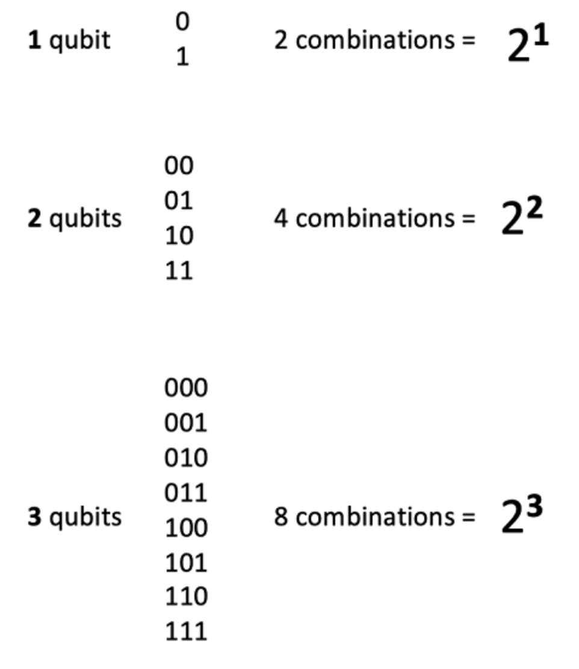
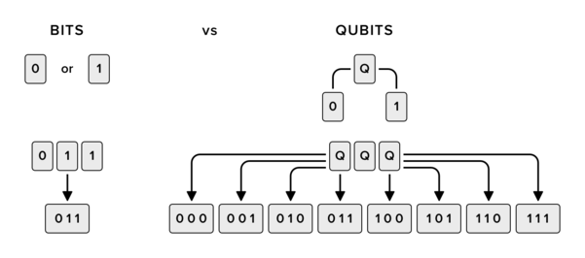
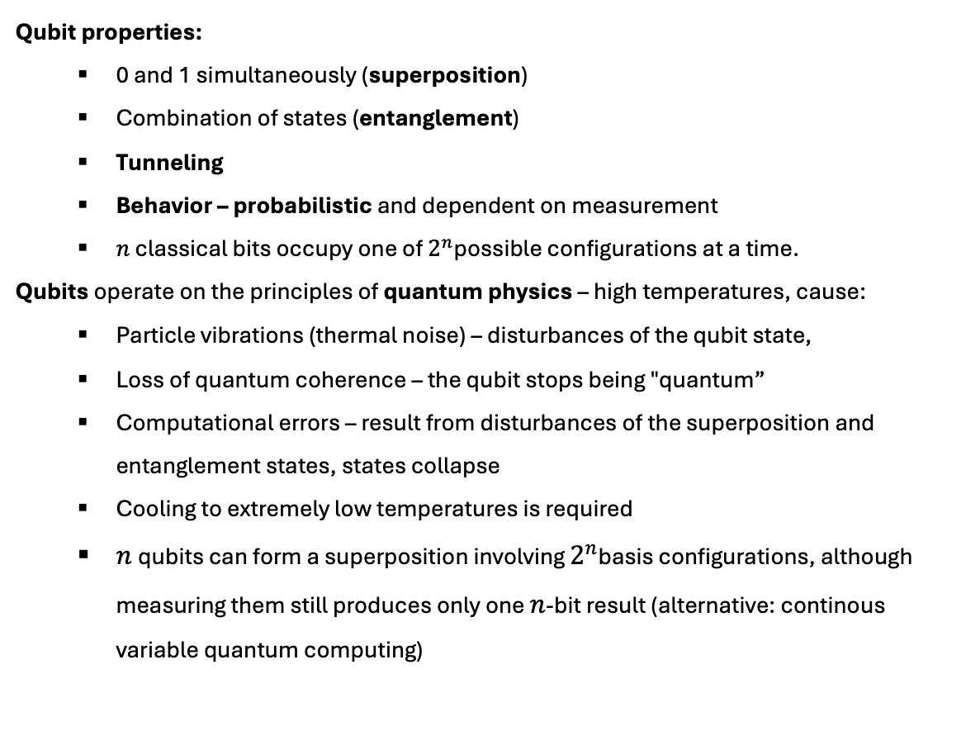
Bit vs Qubit
Qubit properties:
  0 and 1 simultaneously (superposition)
  Combination of states (entanglement)
  Tunneling
  Behavior – probabilistic and dependent on measurement
  $n$ classical bits occupy one of $2^{n}$possible configurations at a time.
Qubits operate on the principles of quantum physics – high temperatures, cause:
  Particle vibrations (thermal noise) – disturbances of the qubit state,
  Loss of quantum coherence – the qubit stops being "quantum”
  Computational errors – result from disturbances of the superposition and entanglement states, states collapse
  Cooling to extremely low temperatures is required
  $n$qubits can form a superposition involving $2^{n}$basis configurations, although measuring them still produces only one $n$-bit result (alternative: continous variable quantum computing)

Slide 12
How does it work ?
In modern transistors (5-7 nm technology), switching a single transistor – a 0 to 1 operation - requires a flow of a few hundred electrons to a few thousand electrons
”Let’s pull out” 20 particles and build a quantum computer
Particles do not behave like tiny elements (as in classical physics) but there is wave-particle duality
20 qubits = 2²⁰ = 1 048 576 combinations
A quantum state can be a superposition of all 1,048,576 outcomes, but one measurement returns a single 20-bit result
-
-
-
-
-
-
-
-
-
-
-
-
-
-
-
-
-
-
-
-

Slide 13
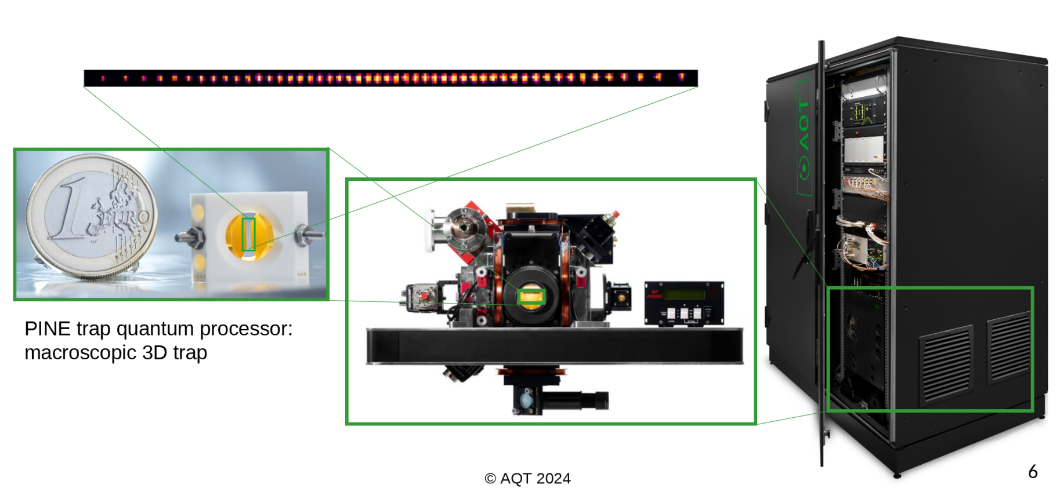

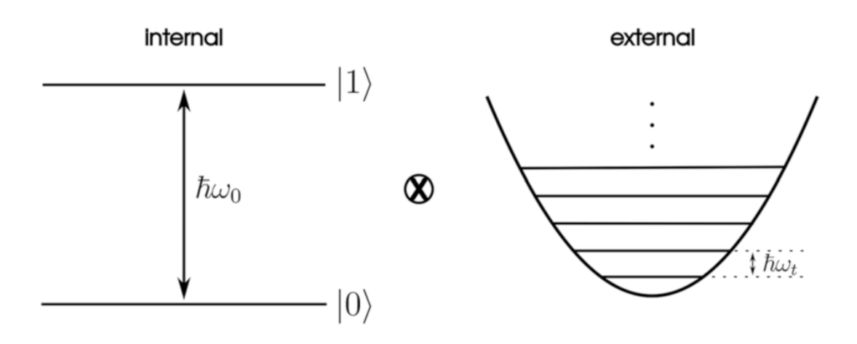
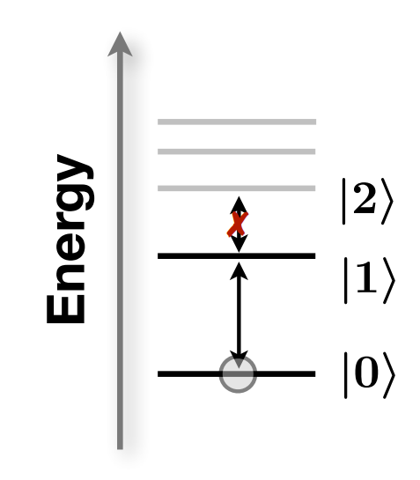
How does it work ?
Ca+

Slide 14
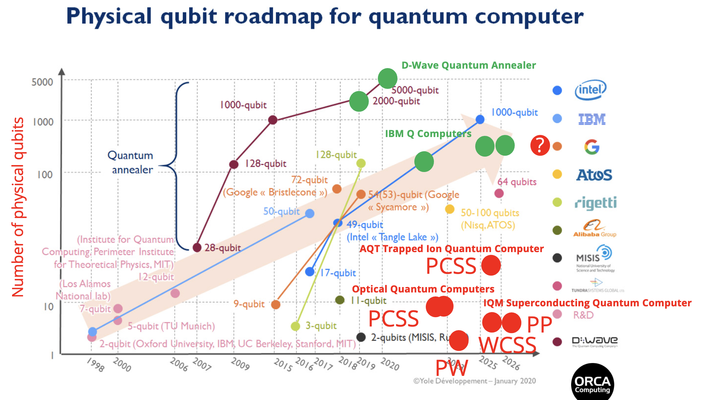
How Many Qubits do we have in Poland ?

Slide 15
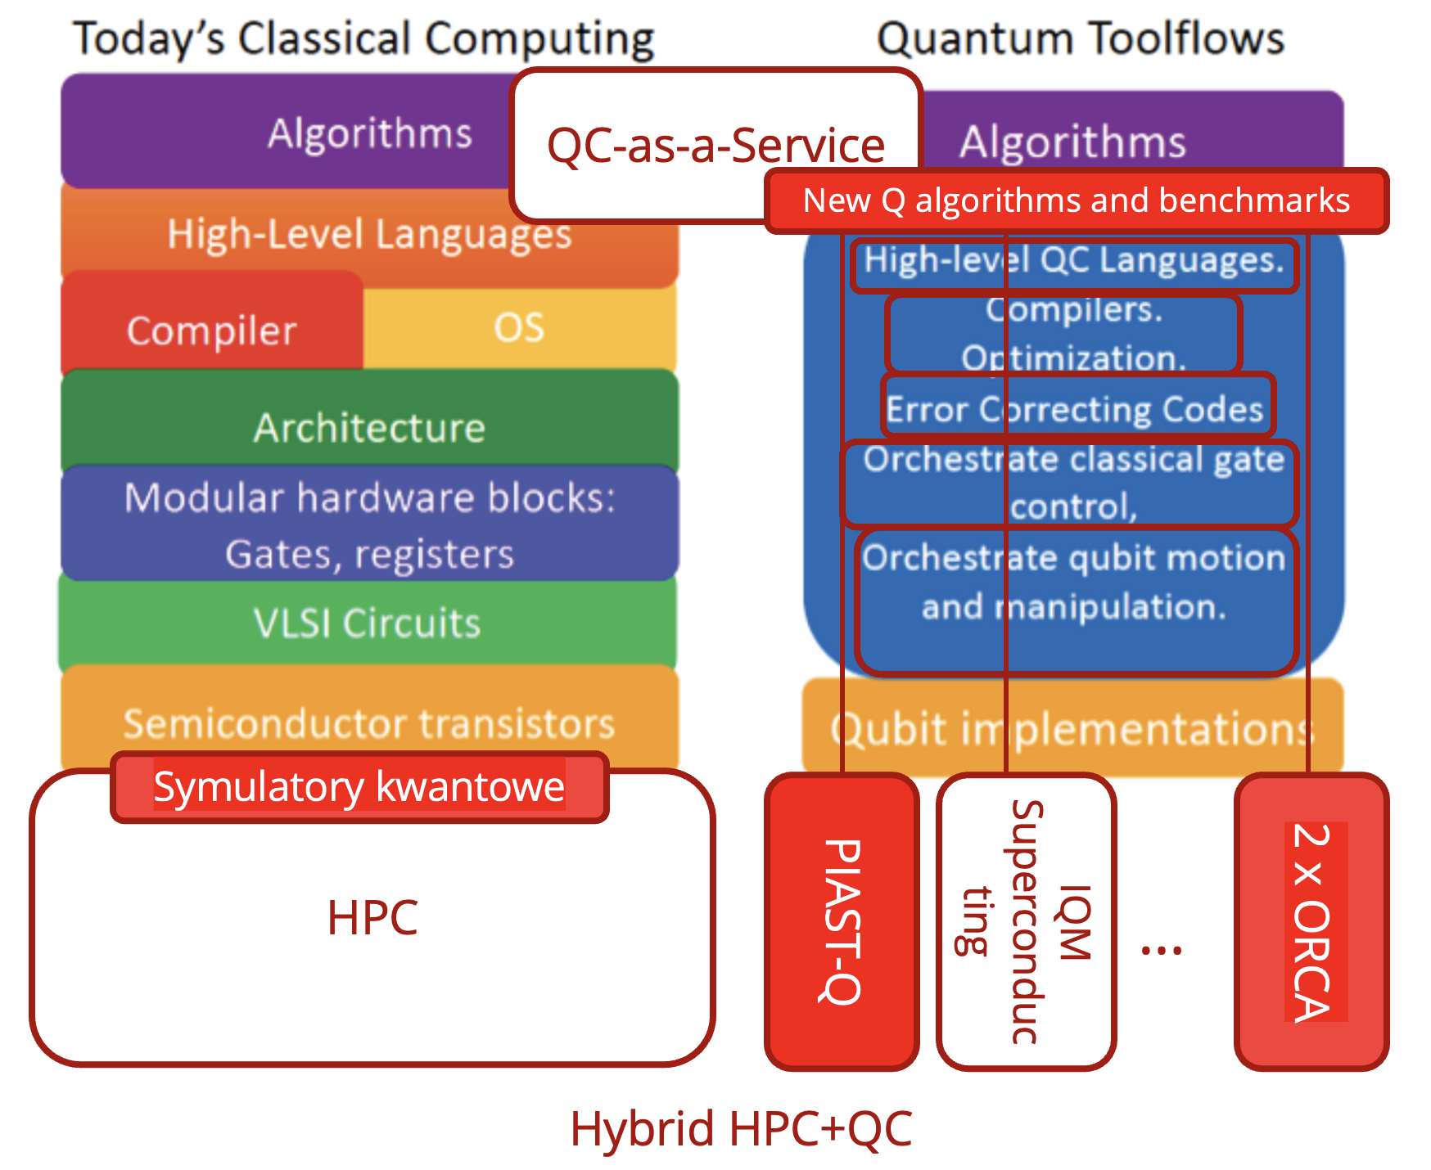
HPC + Quantum Computing ?

Slide 16
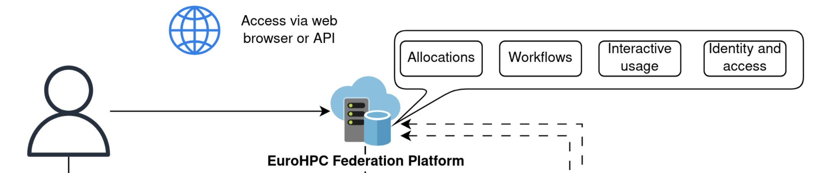
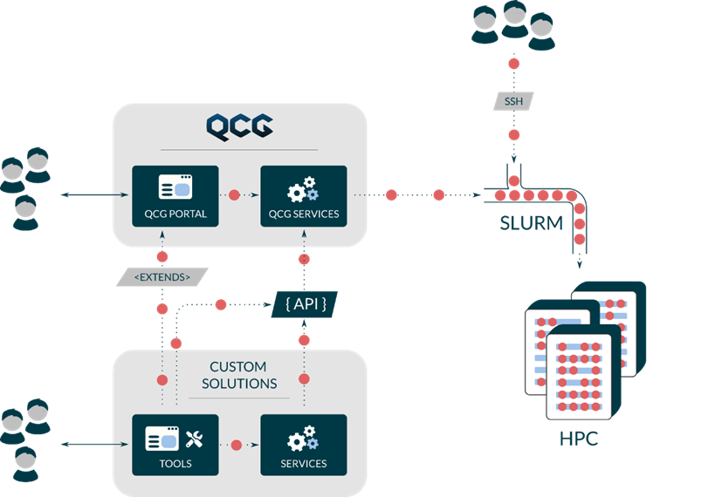
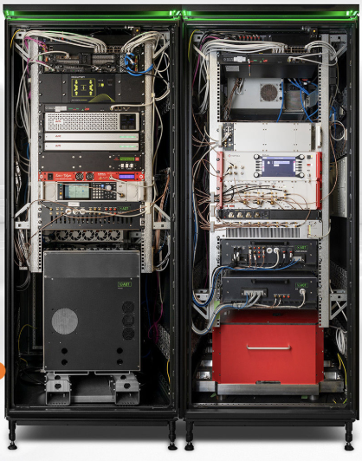
HPC + Quantum Computing ?
PIAST-Q
Quantum computer

Slide 17

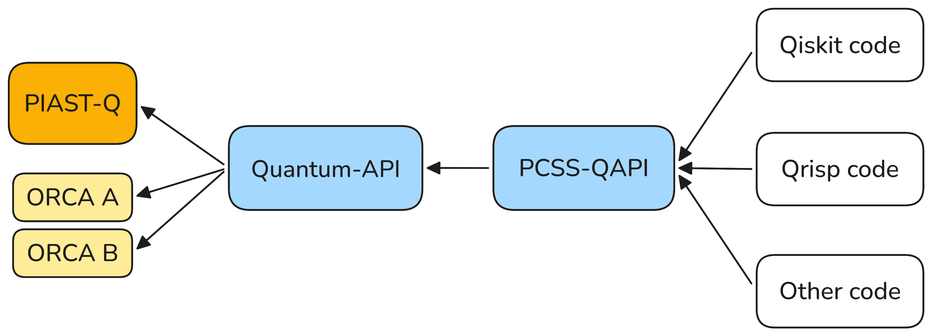
HPC-QC integration
Cloud-based

Slide 18
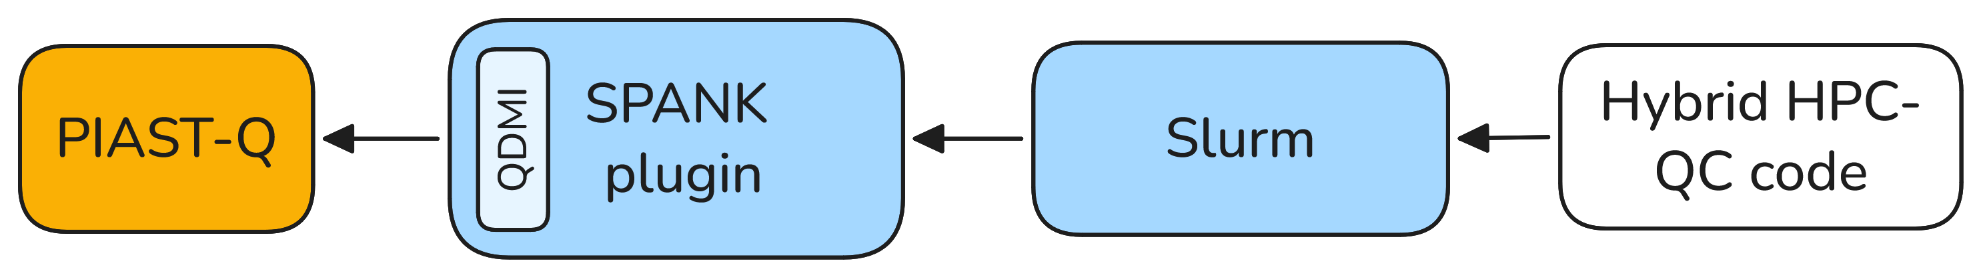
HPC-QC integration
Direct Slurm access

Slide 19
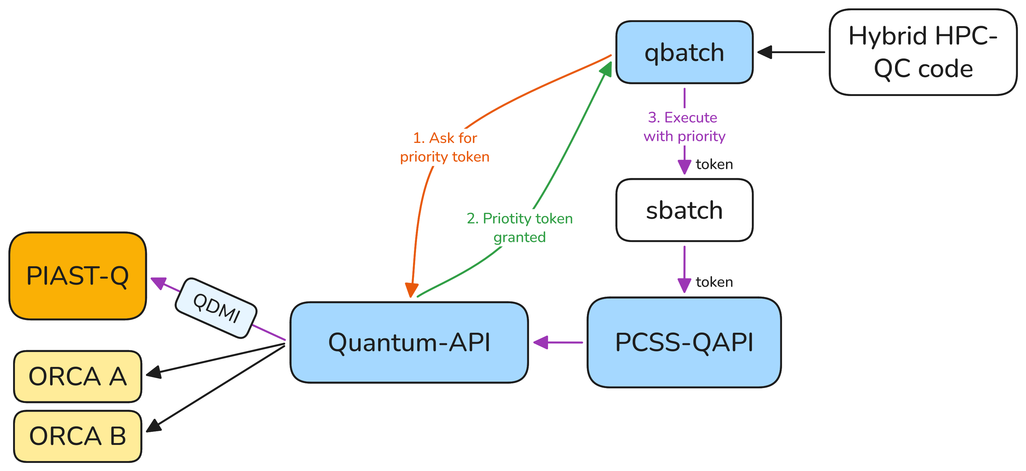
HPC-QC integration
qbatch

Slide 20
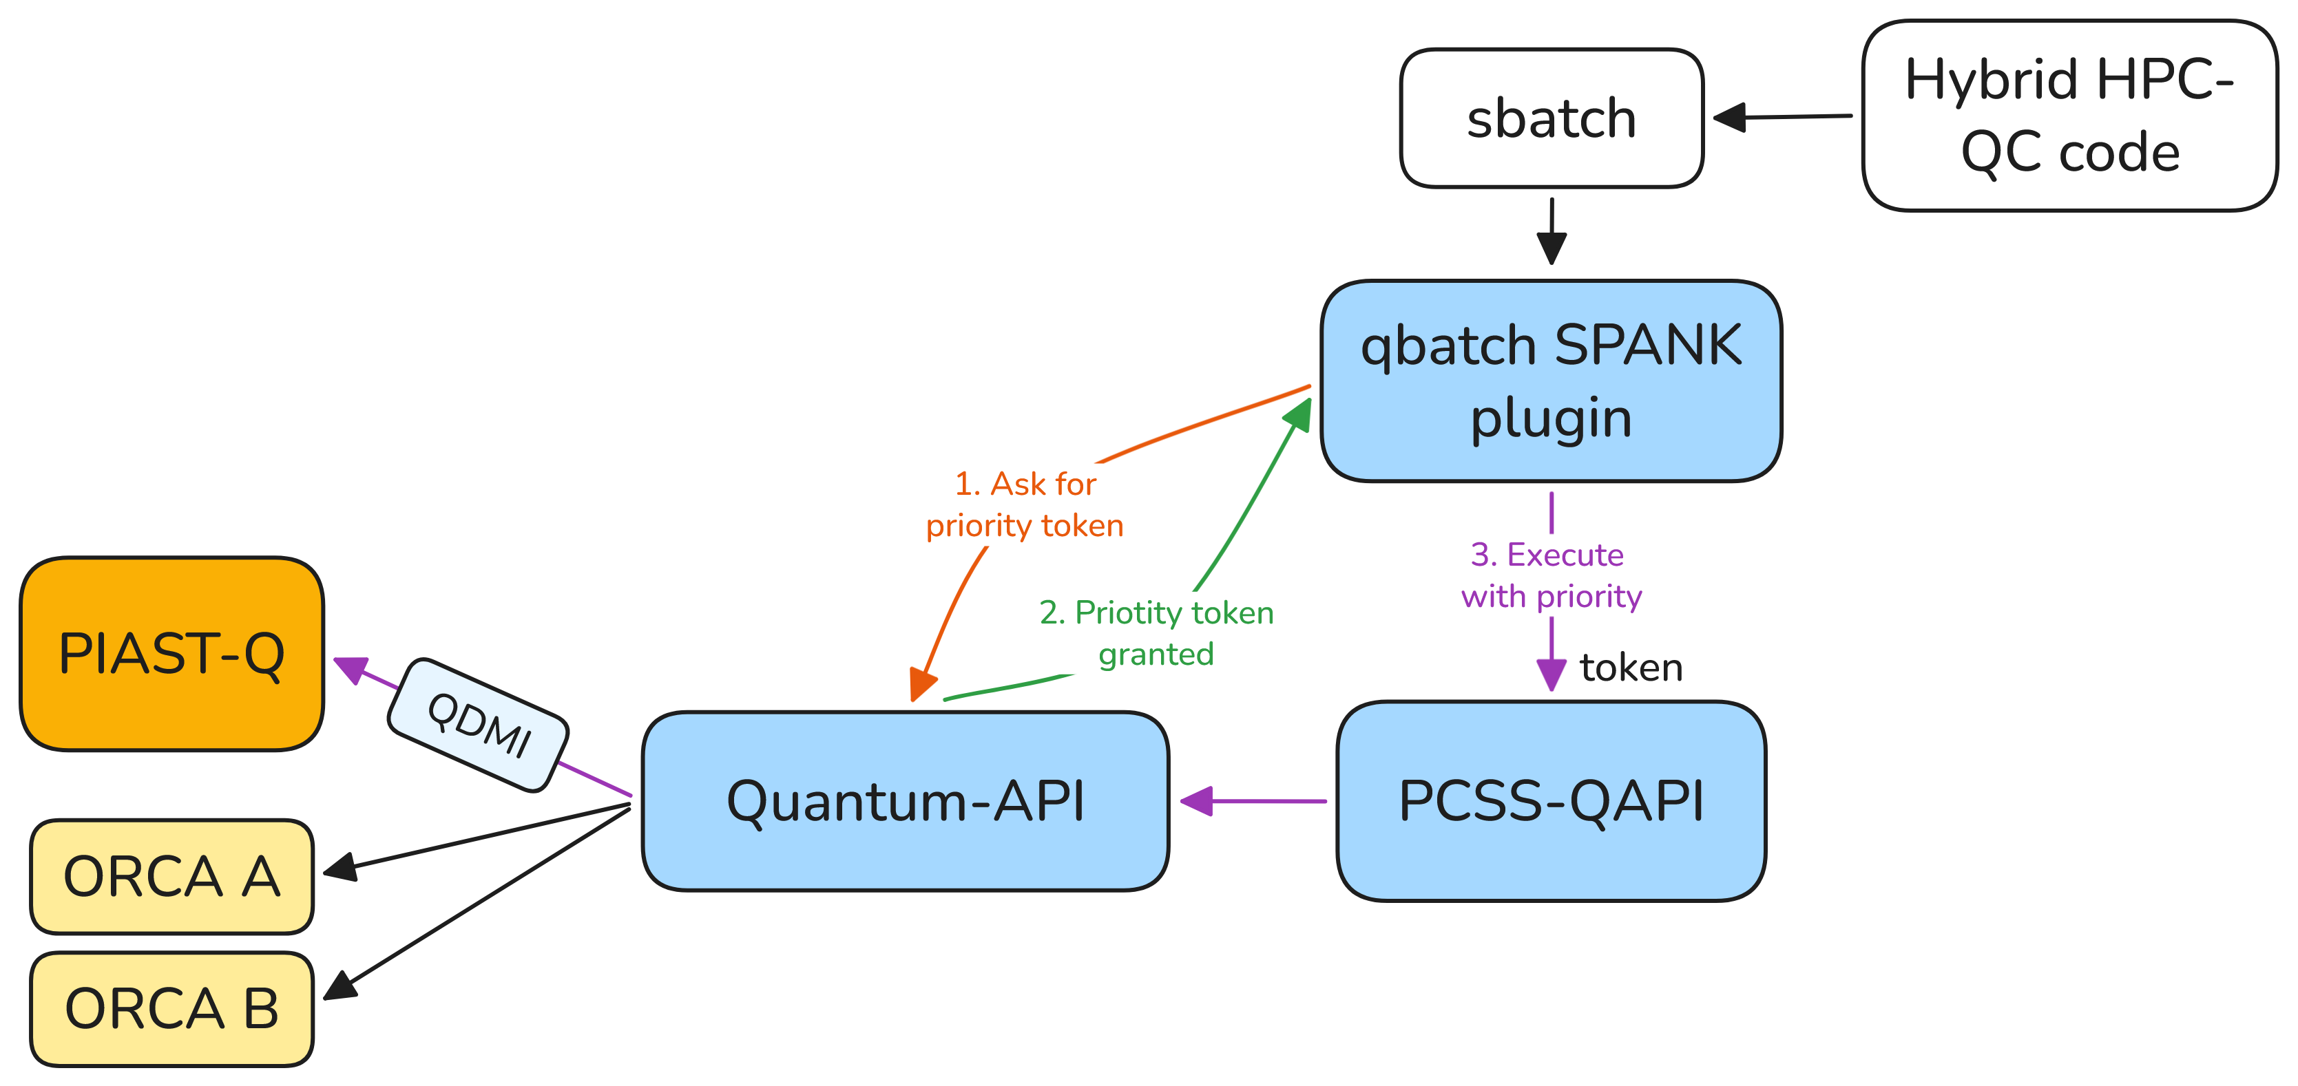
HPC-QC integration
qbatch as a SPANK plugin

Slide 21
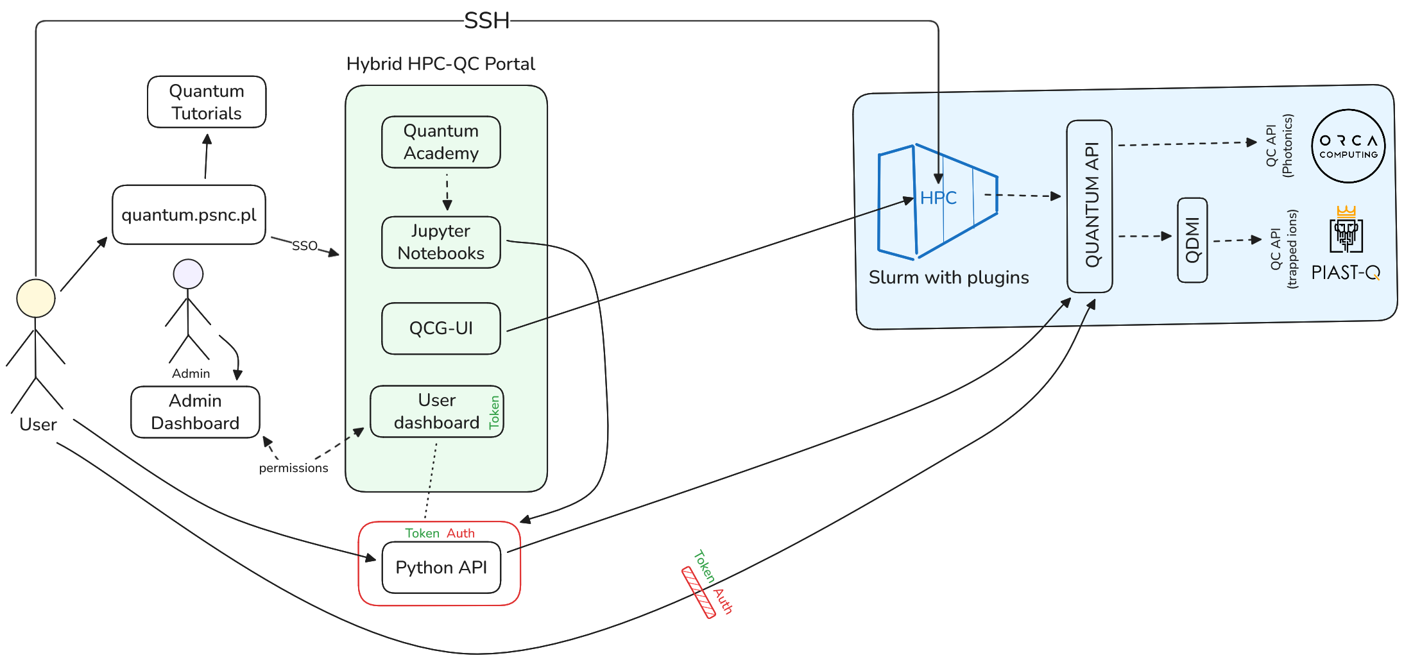
The overall hybrid HPC-QC architecture

Slide 22
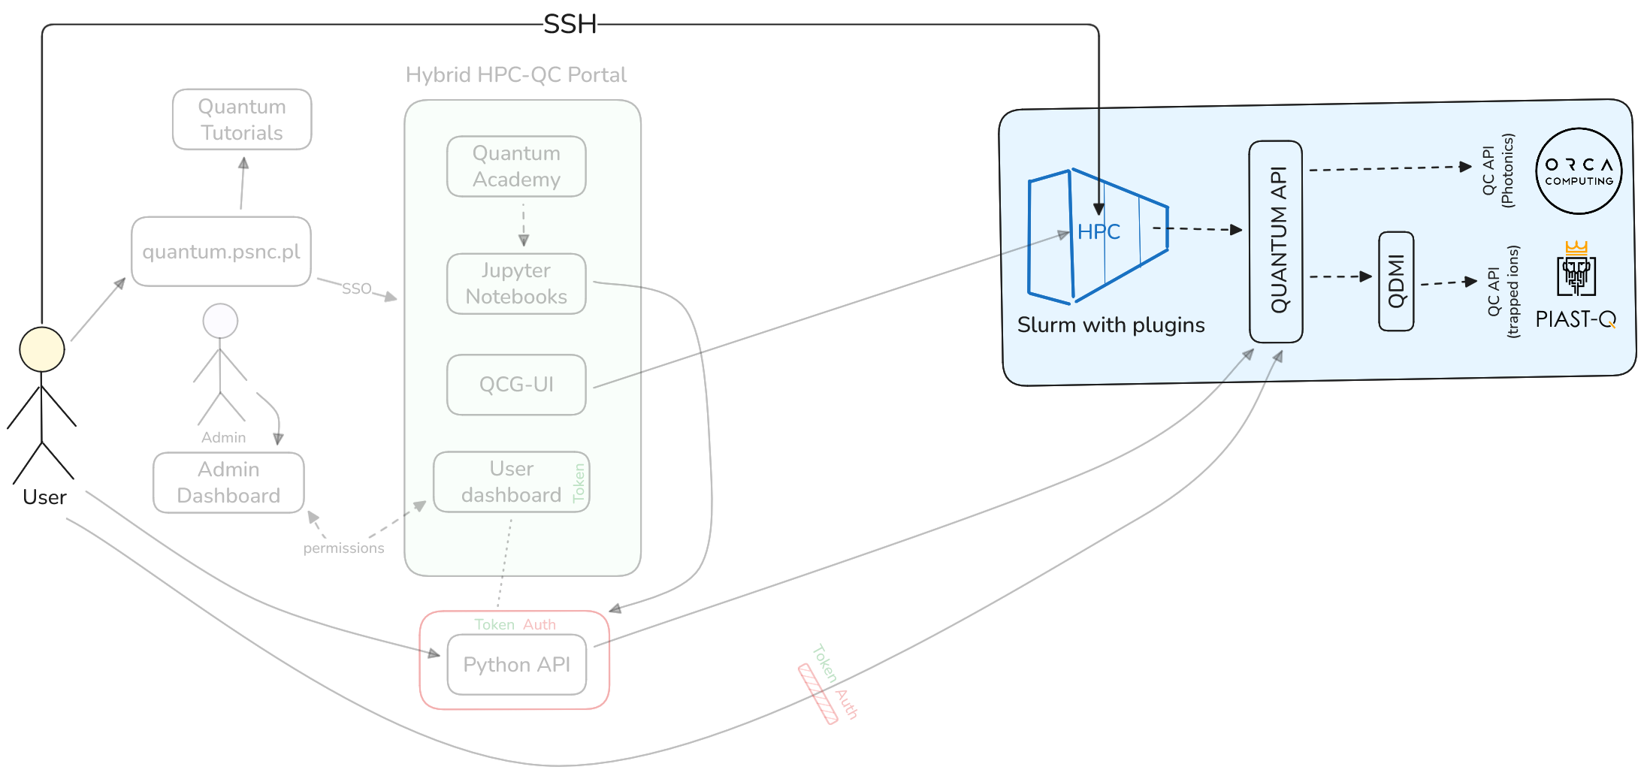
SSH access to HPC-QC resources

Slide 23
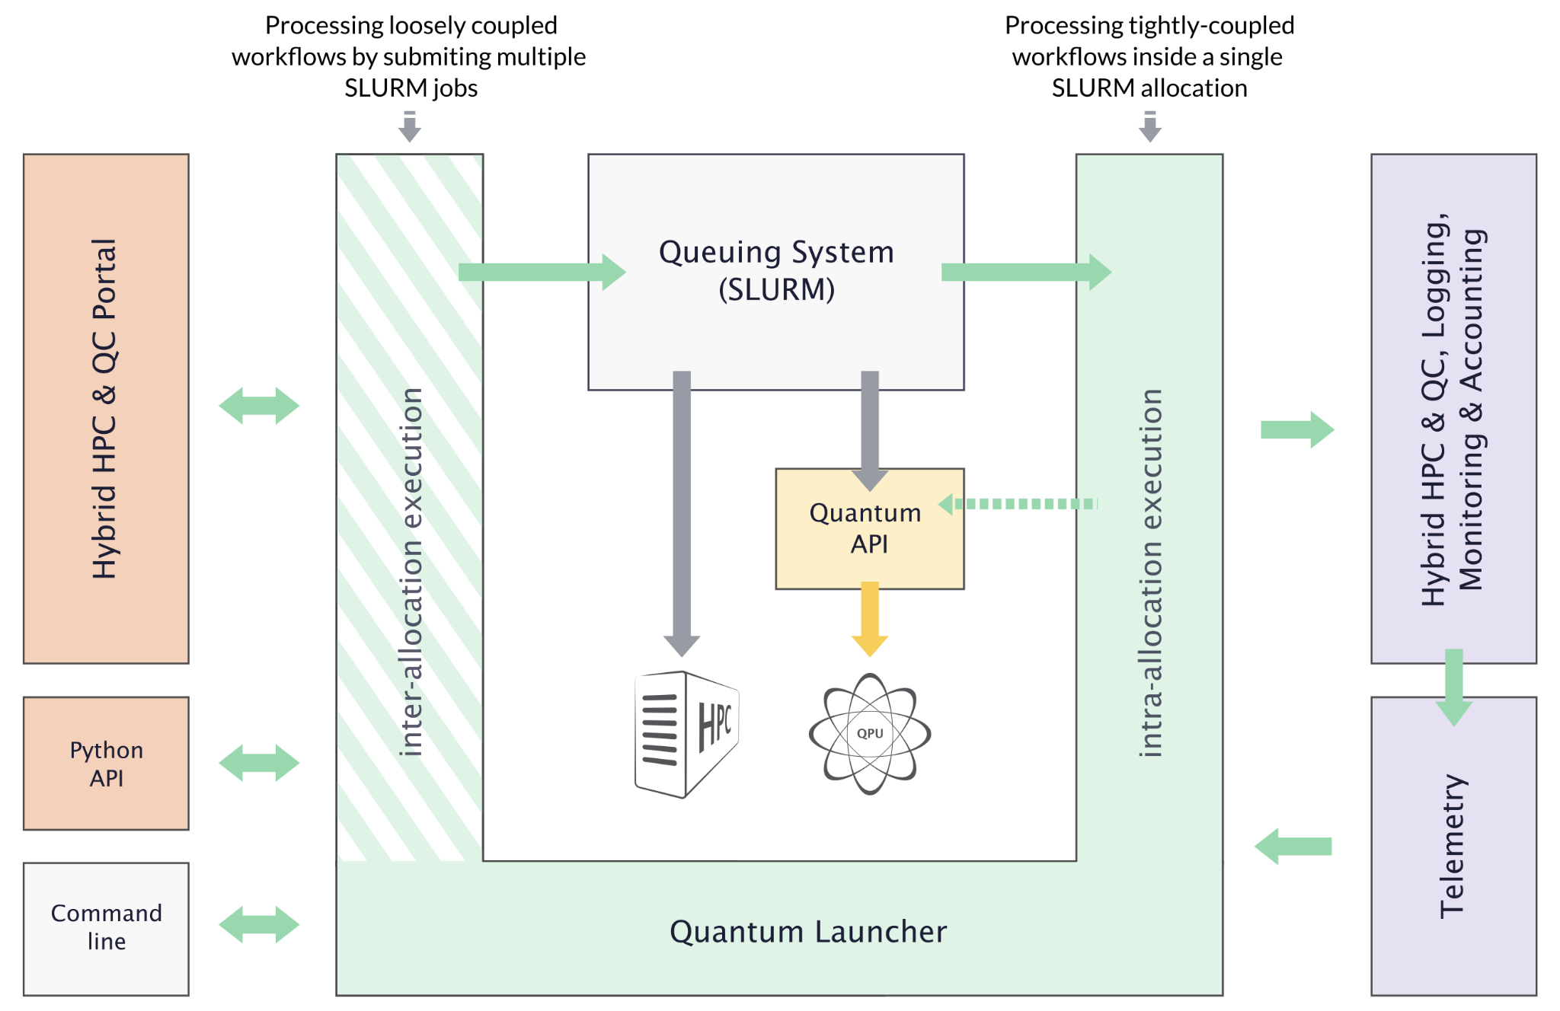
Hybrid workflows
Hybrid workflows with QLauncher:
  inter-allocation (loosely coupled)
  intra-allocation (tightly coupled)
Two levels of scheduling:
  Slurm-based scheduling of hybrid jobs
  Quantum API for scheduling Quantum jobs
Queueing System
(Slurm with plugins)
Quantum API
QDMI

Slide 24
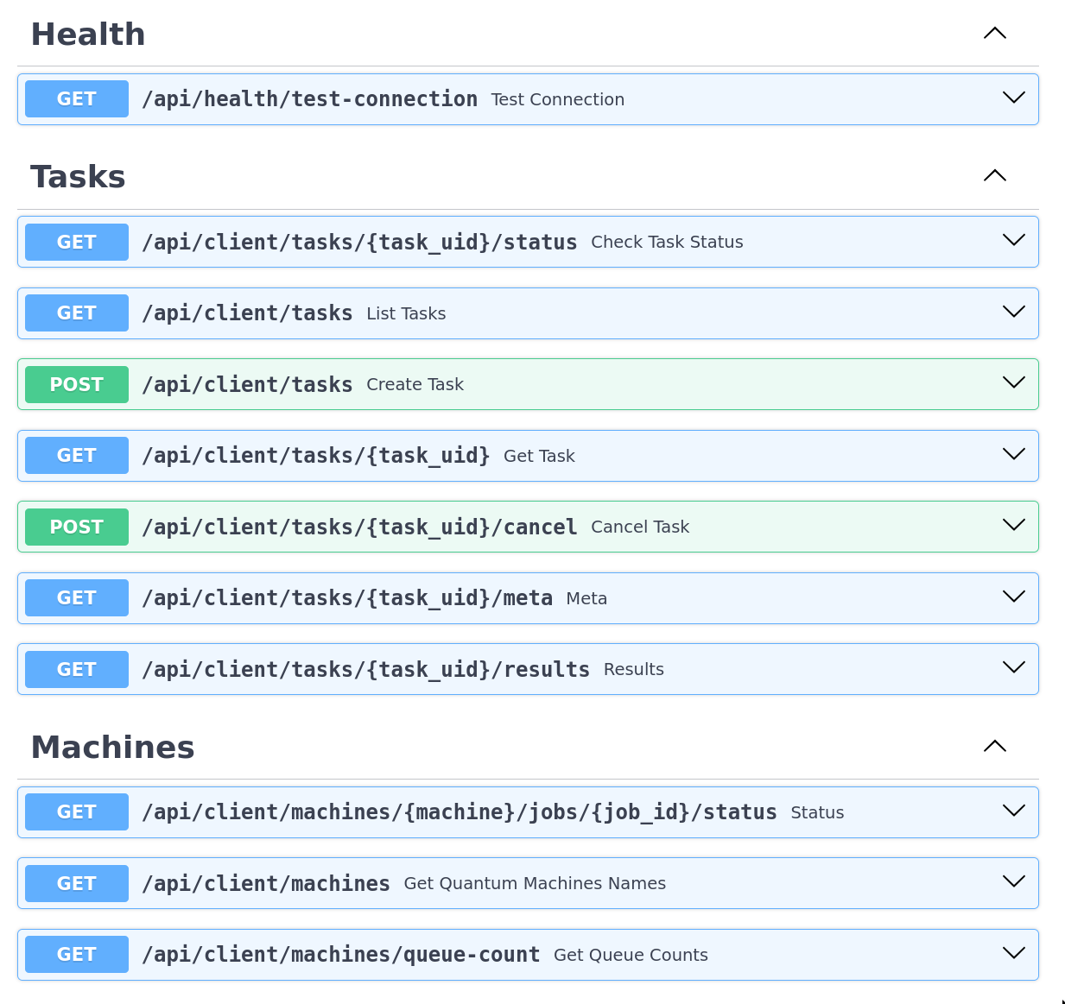
Quantum API
Users can operate the Quantum device through an abstraction layer called Quantum API
User permissions are managed by the administrator using dedicated tools
Quantum API manages access and schedules jobs for the QPUs
QDMI can be integrated as a lower layer that provides an interface for integrating additional backends

Slide 25
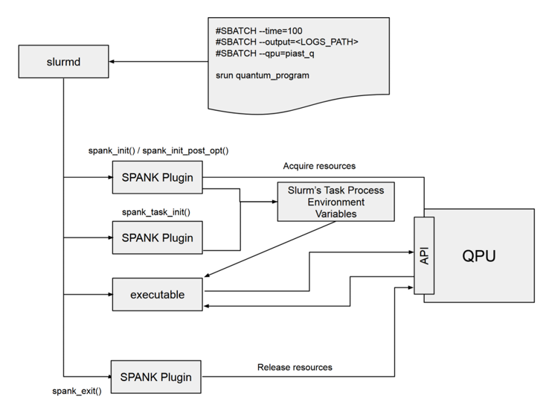
Slurm plugin overview

Slide 26
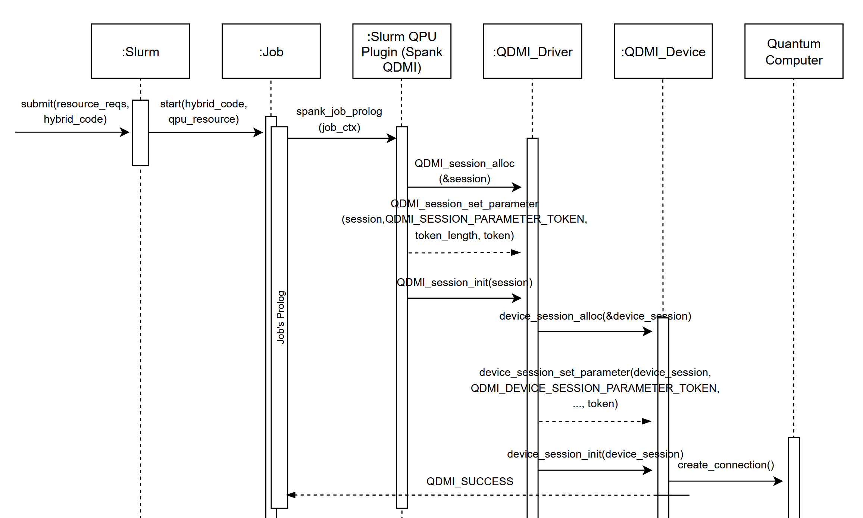

Slide 27
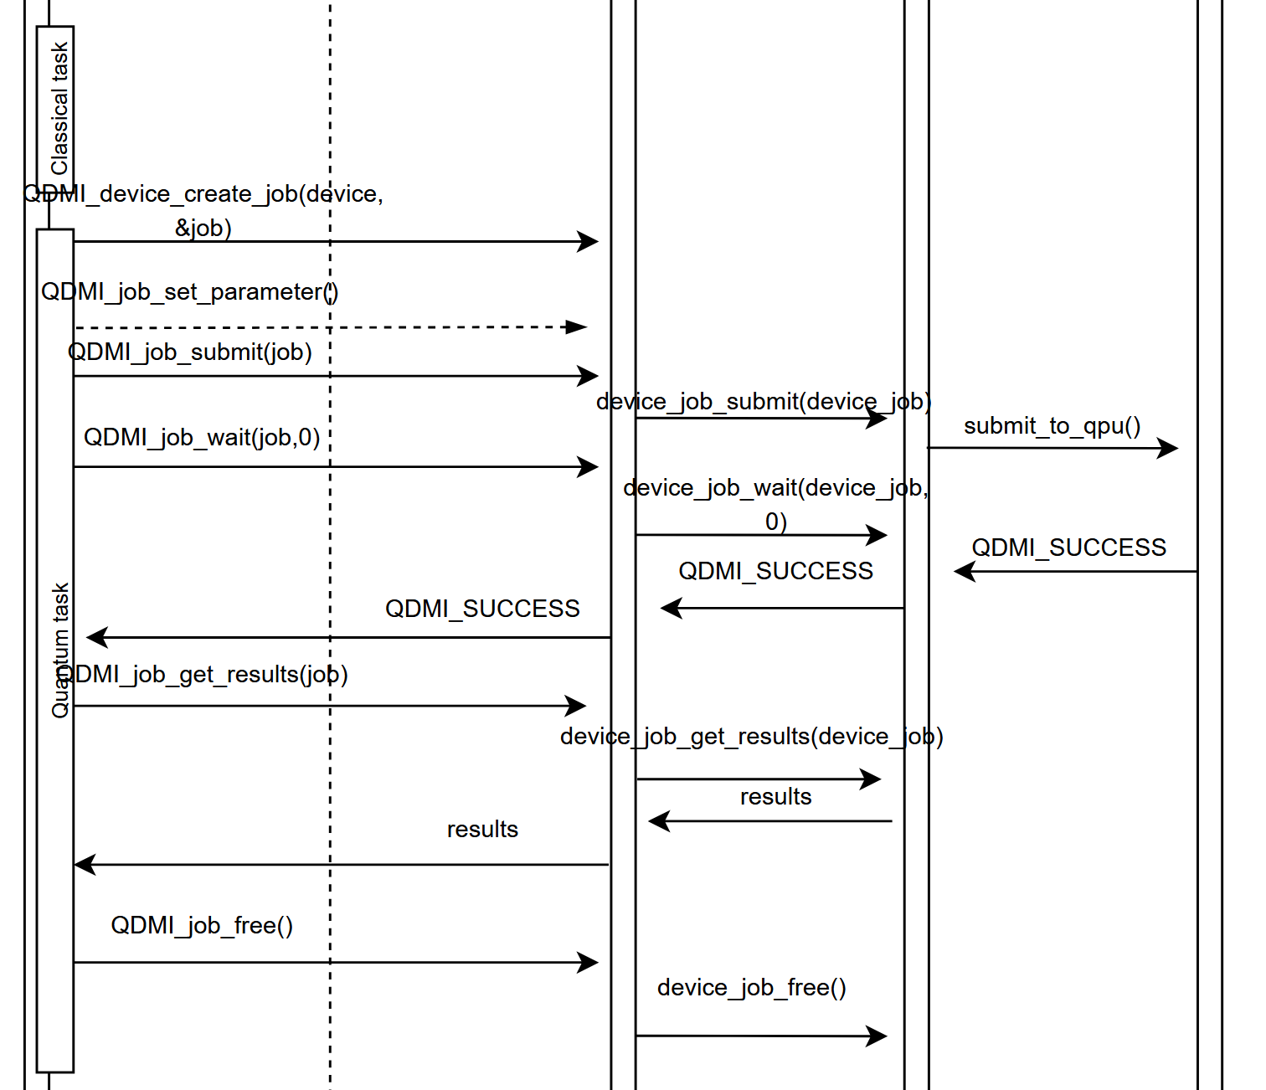

Slide 28
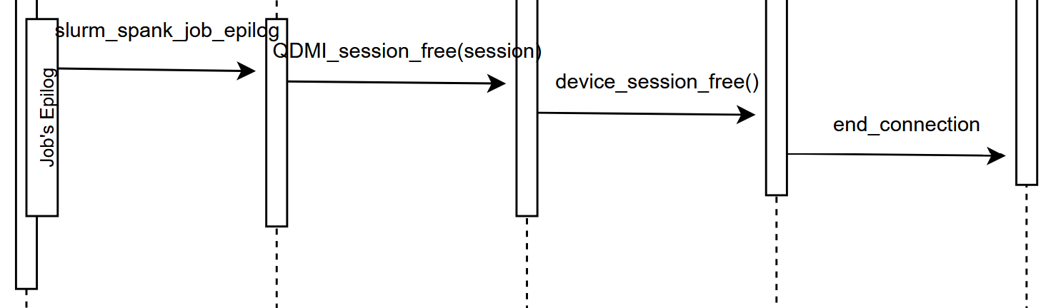

Slide 29
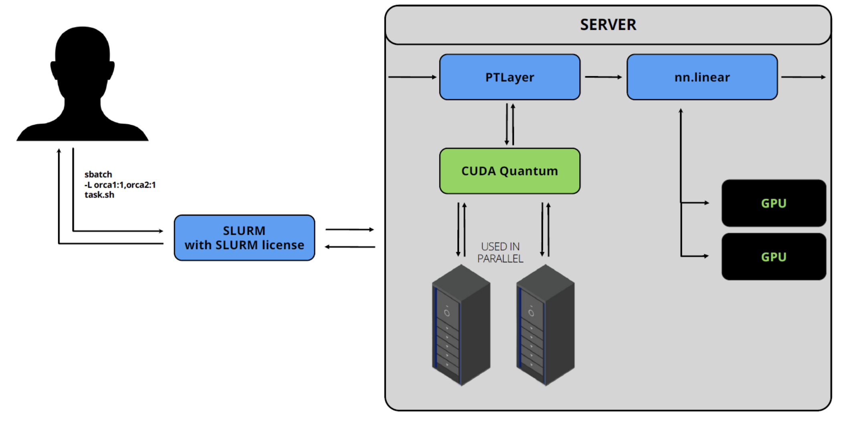
SLURM-based Multi-QPU architecture

Slide 30
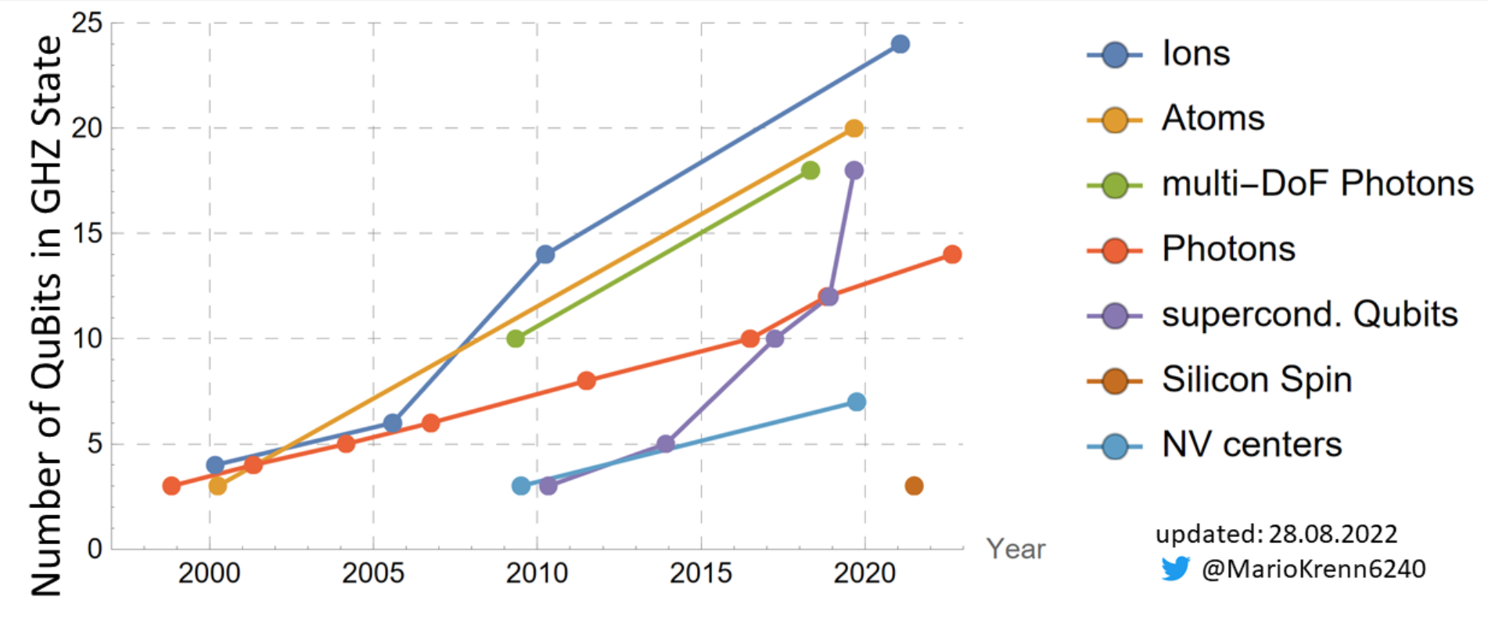
Why Ion Traps and Photonic Quantum systems ?
AQT
ORCA
Record numbers of entangled qubits in a GHZ (Greenberger-Horne-Zeilinger) state on different platforms for the last ca. 20 years. The number of qubits entangled in a GHZ state characterizes the “size” of a computational problem that can be run on a quantum register while exploiting the entanglement between qubits.
Source: https://mariokrenn.wordpress.com/2021/01/29/reference-list-for-records-in-large-entanglement-generation- number-of-qubits-in-ghz-states/

Slide 31
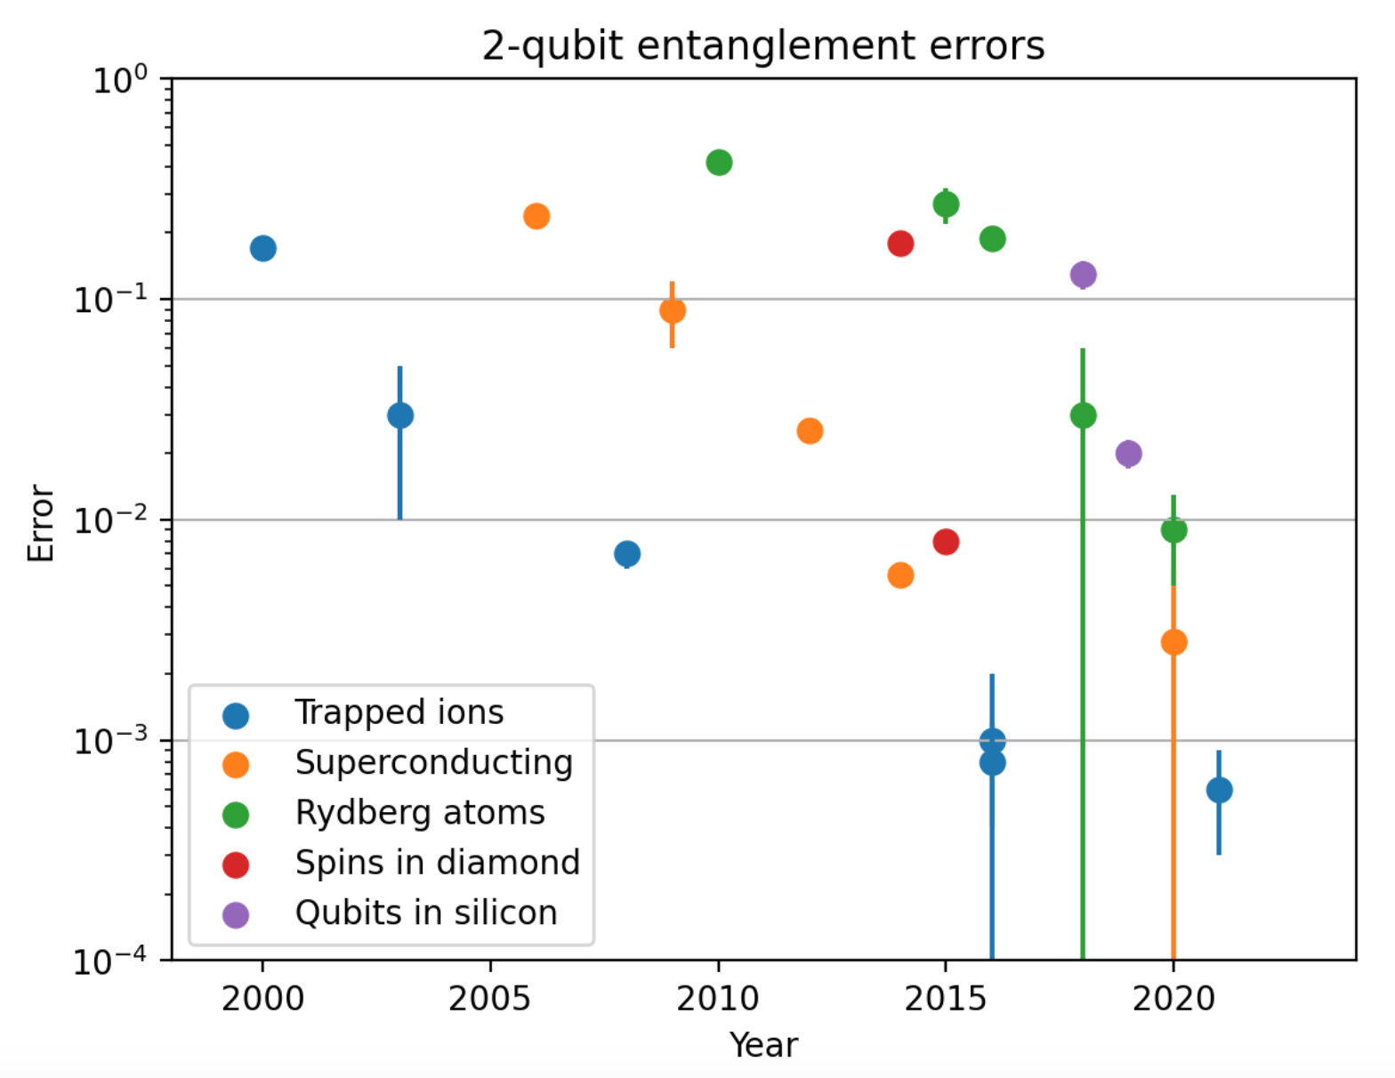

Why Ion Traps ?
A quantum system with more than 20 individually controlled qubits
Entangling (2-qubit) gate fidelity > 99.999% with very stable, high-quality physical qubits.
Full (all-to-all) connectivity for both single- and two-qubit operations on more than 20 qubits.
EuroQCS-Poland
Piast-Q
Record numbers of entangled qubits in a GHZ (Greenberger-Horne-Zeilinger) state on different platforms for the last ca. 20 years. The number of qubits entangled in a GHZ state characterizes the “size” of a computational problem that can be run on a quantum register while exploiting the entanglement between qubits.
Source: https://mariokrenn.wordpress.com/2021/01/29/reference-list-for-records-in-large-entanglement-generation- number-of-qubits-in-ghz-states/

Slide 32
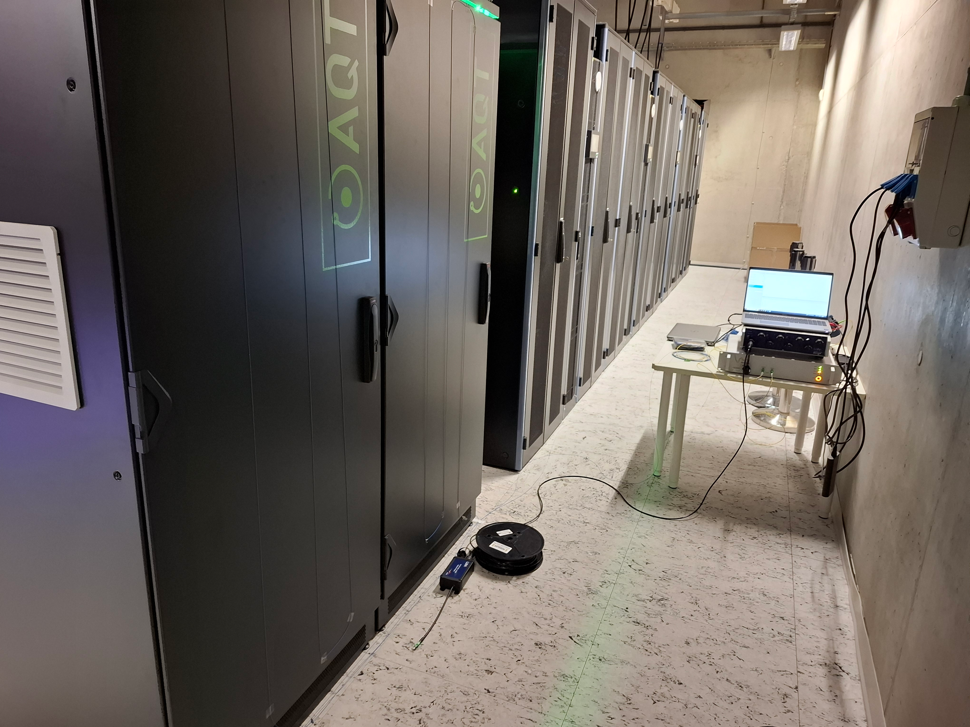
Ion Trap system – fiber sensing
Fiber sensing – temperature
Fiber strain sensing - vibrations

Slide 33
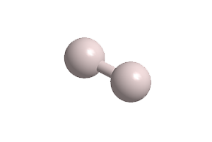
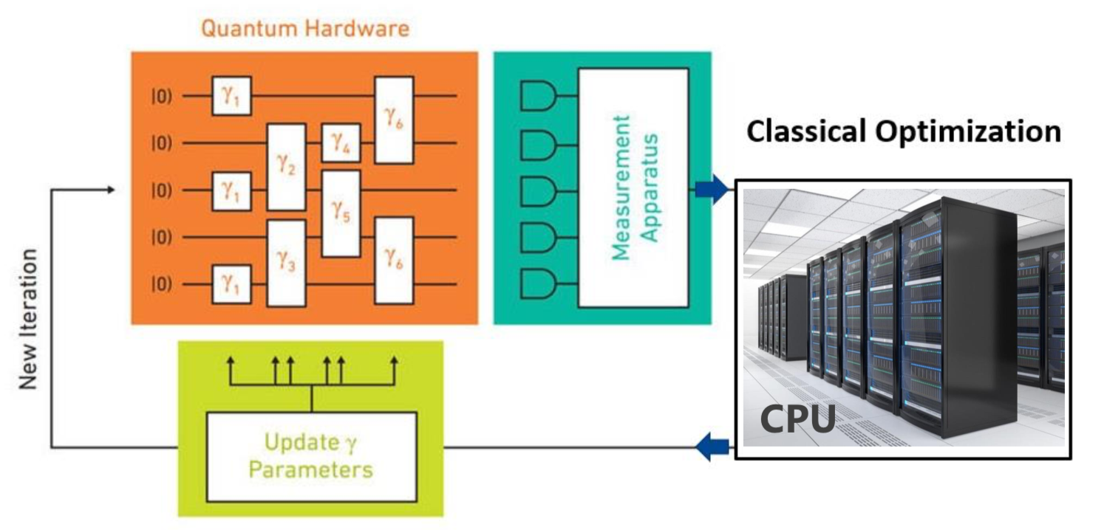
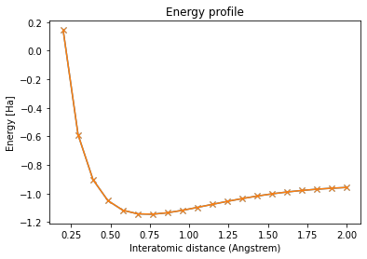
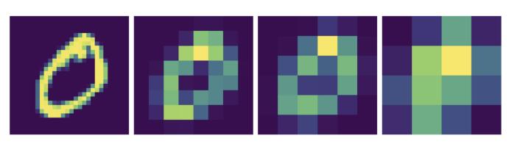
What are the first application benchmarks ?
Entanglement in GHZ state
Toffoli gate
Grover’s Algorithm
Quantum Fourier Transform
VQE for quantum chemistry
QAOA for combinatorial problems optimization
Quantum Support Vector Machine for image classification
Quantum Walk
Source: Kurowski K, et al, Application Performance Benchmarks for Quantum Computers, https://arxiv.org/abs/2310.13637
Benchmarking Code: https://drive.man.poznan.pl/s/J3fSDrZdSabJGpr

Slide 34
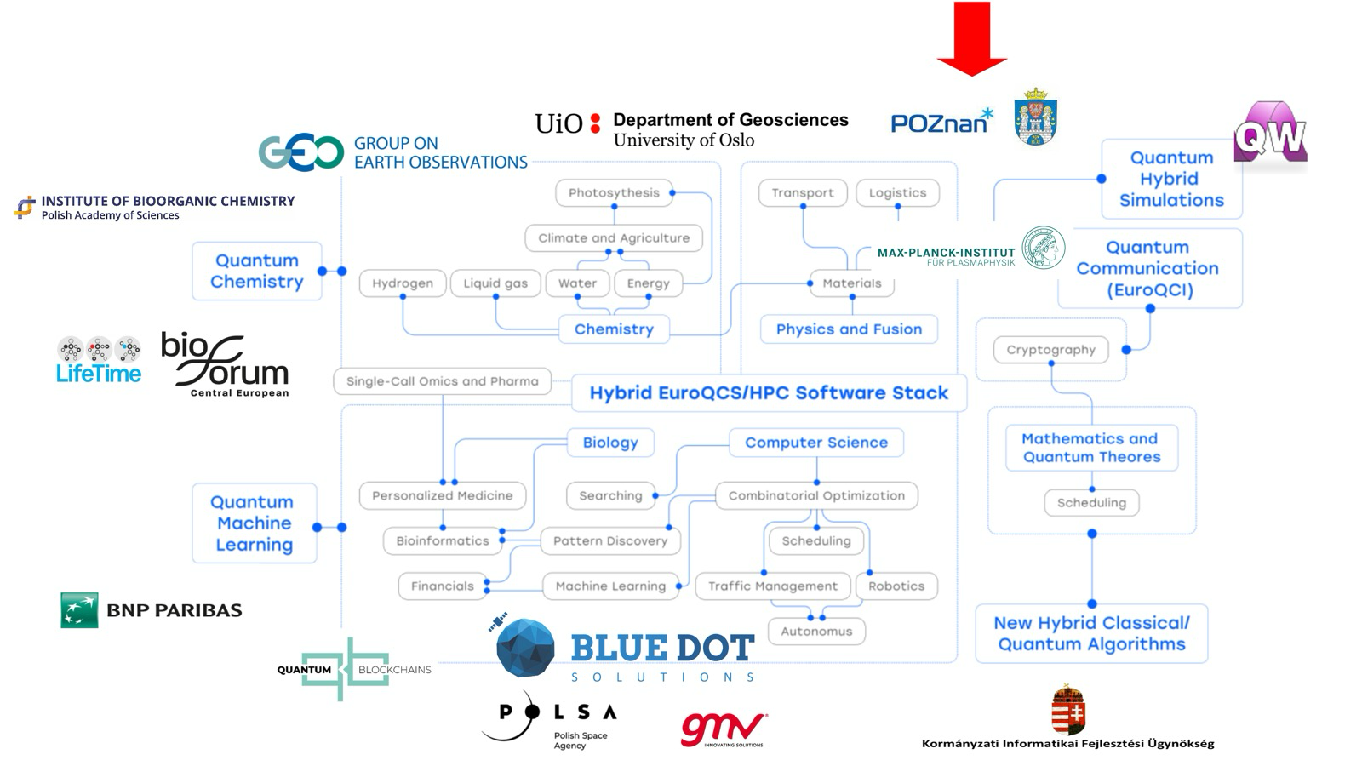
What are the first user applications ?

Slide 35
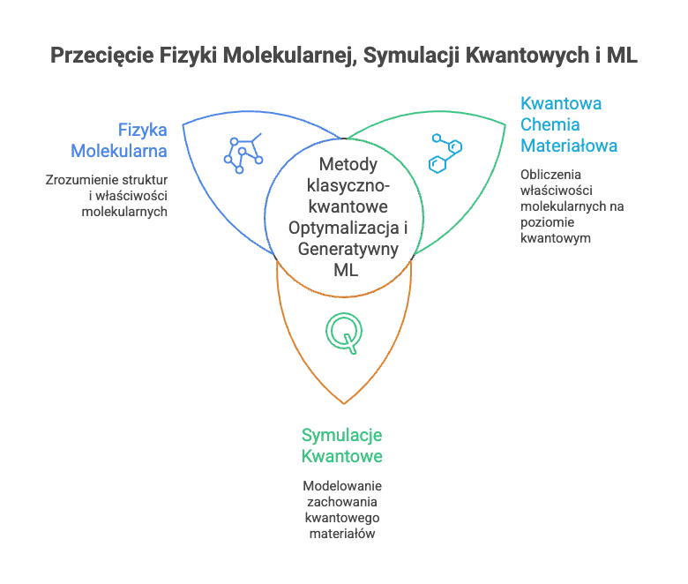
Intersection between Molecular Physics, Quantum Simulations and ML

Slide 36
PCSS prydlich@man.poznan.pl
30.06.2026 – 01.07.2026

