Slide 1
Quantum sensors:
1st GEANT SIG-Quantum meeting
Technologies, networks and interfaces.
Ksawery Mielczarek 30th June 2026

Slide 2
What is a quantum sensor?
Quantum sensor utilizes quantum mechanical phenomena, such as quantum superposition, quantum entanglement, and quantum squeezing, to measure physical quantities. [https://en.wikipedia.org/wiki/Quantum_sensor]
Main platforms:
  clocks,
  magnetometers,
  gravimeters,
  gyroscopes,
  antennas.

Slide 3
01
Technologies

Slide 4
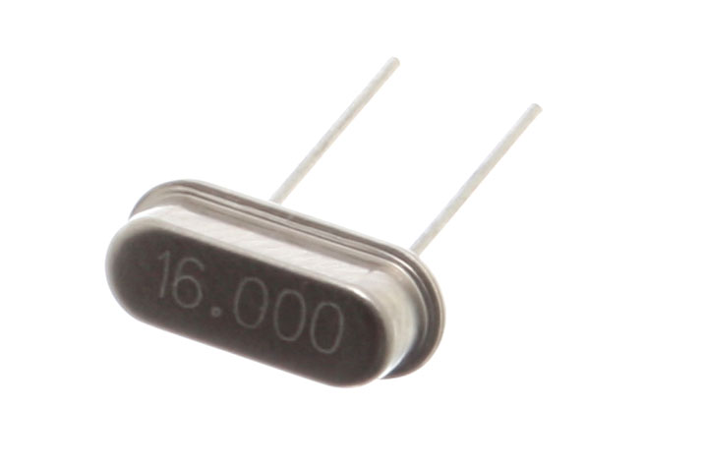
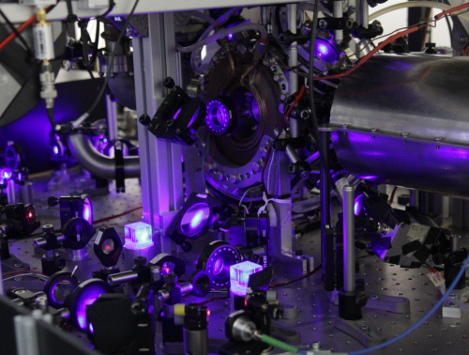
1.1 Atomic clocks
https://en.wikipedia.org/wiki/Crystal_oscillator
https://www.fizyka.umk.pl/
Quartz clocks Atomic clocks

Slide 5
1.1 Atomic clocks
https://en.wikipedia.org/wiki/Crystal_oscillator
https://www.fizyka.umk.pl/
Quartz clocks: ms-s stability over 1 day. Atomic clocks: <1 ps stability over 1 day.
Quantum advantage: 9 orders of magnitude

Slide 6
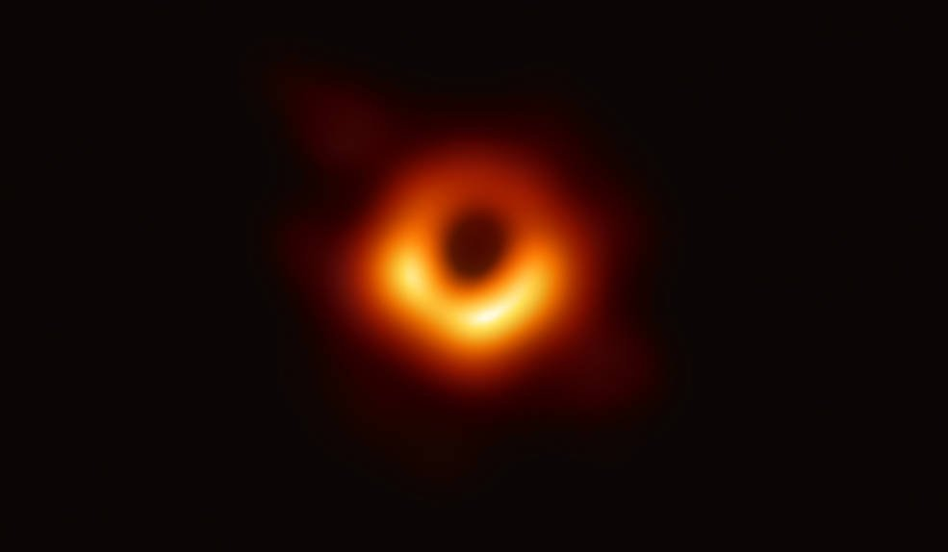
1.1 Atomic clocks
Applications:
fundamental for GNSS (every satellite has atomic clock onboard),
electric power grids control (monitor AC phase),
5G telecom antennas (synchronize stations to avoid interference),
high-frequency trading (avoid microsecond-scale clock drift),
telescope (VLBI) and radar synchronization,
altitude measurement with general relativity.
Black hole shot with EHT. Credits: NASA
[1] https://spie.org/news/atomic-clock-applications
[2] https://www.nist.gov/atomic-clocks

Slide 7

1.1 Atomic clocks
How does it work?
https://commons.wikimedia.org/wiki/File:Caesium_spectrum_visible.png

Slide 8
1.1 Atomic clocks
How does it work?
Infrared

Slide 9
1.1 Atomic clocks
How does it work?
Infrared
Terahertz

Slide 10
1.1 Atomic clocks
How does it work?
Infrared
Terahertz
Microwave

Slide 11
1.1 Atomic clocks
How does it work?
Tuning RF oscillator to an ultra-narrow spectral line.
9 192 621 770 Hz
Infrared
Terahertz
Microwave
Radio

Slide 12
1.2 Magnetometers
Applications:
detection of magnetic objects (e.g. submarines),
no-GNSS navigation,
geophysical surveying and mapping,
magnetic imaging of integrated circuit,
subcellular resolution imaging,
brain acticity monitoring (MEG).
Quantum advantange: sensitivity higher 3-6 orders of magnitude.
[1] https://opg.optica.org/optica/fulltext.cfm?uri=optica-12-12-2008
[2] https://www.nature.com/articles/s42254-023-00558-3
[3] https://www.pnisensor.com/quantum-magnetometry-vs-classical-magnetometry/

Slide 13
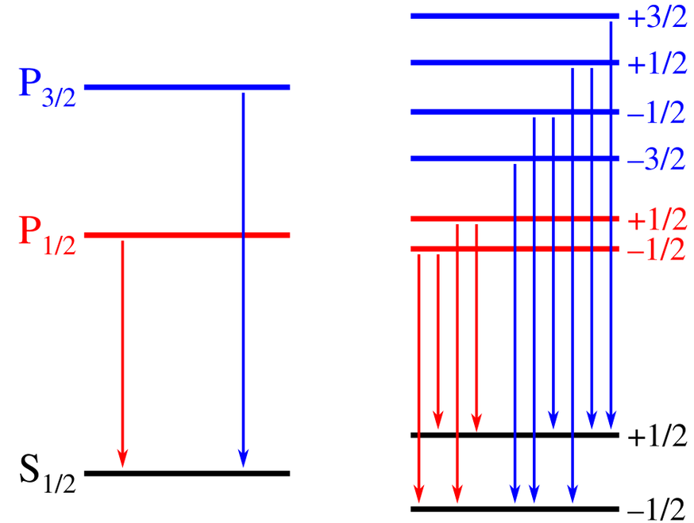
1.2 Magnetometers
Technologies :
atomic vapour magnetometers,
nitrogen-vacancy (NV) center magnetometers,
SQUIDs.
https://en.wikipedia.org/wiki/Zeeman_effect

Slide 14



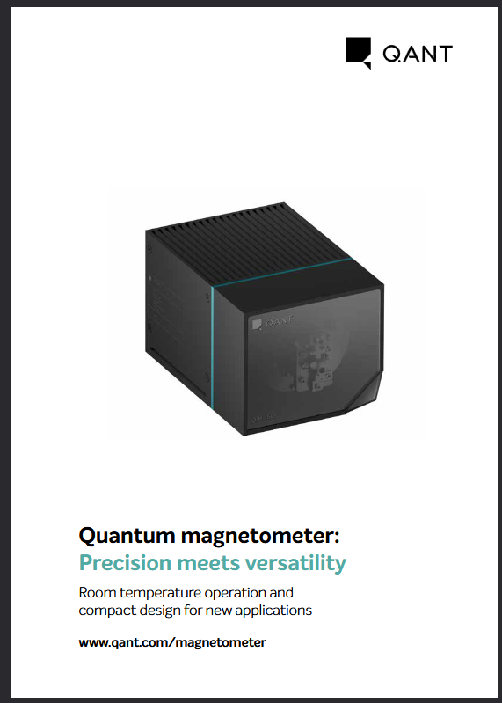
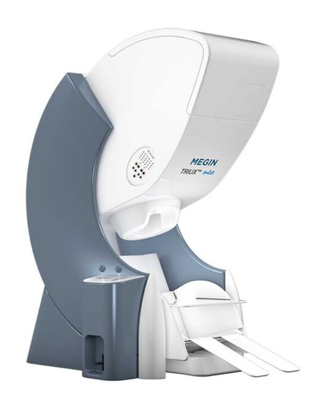
1.2 Magnetometers
Technologies:
atomic vapour magnetometers,
nitrogen-vacancy (NV) center magnetometers,
SQUIDs.
https://en.wikipedia.org/wiki/Zeeman_effect
Buy an NV magnetometer from QANT or a SQUID magnetometer from MEGIN
[1] https://qant.com/wp-content/uploads/2023/11/231114-Magnetometer-Brochure.pdf
[2] https://megin.com/megmaps/

Slide 15
1.3 Atomic gravimeters
Applications:
no-GNSS navigation,
minerals and oil finding,
predicting volcanic eruptions (underground lava monitoring),
agriculture (soil humidity measurement, forest growth),
detecting submarines.
Quantum advantage: 3 orders of magnitude higher sensitivity.
[1] https://www.mdpi.com/2072-4292/16/14/2634
[2] https://www.nist.gov/quantum-information-science/quantum-sensing-explained/turning-atoms-waves-measure-gravity-and

Slide 16
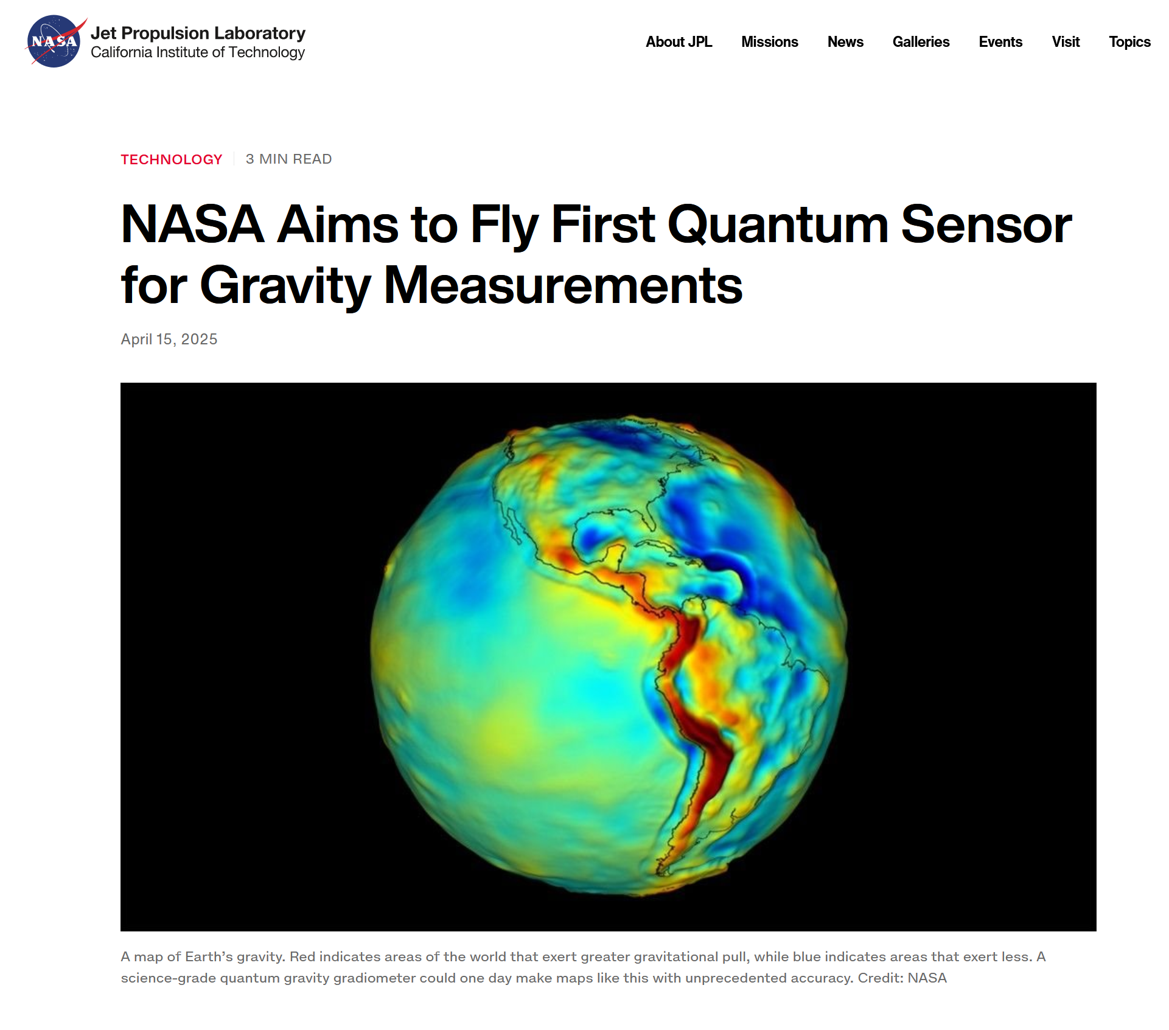
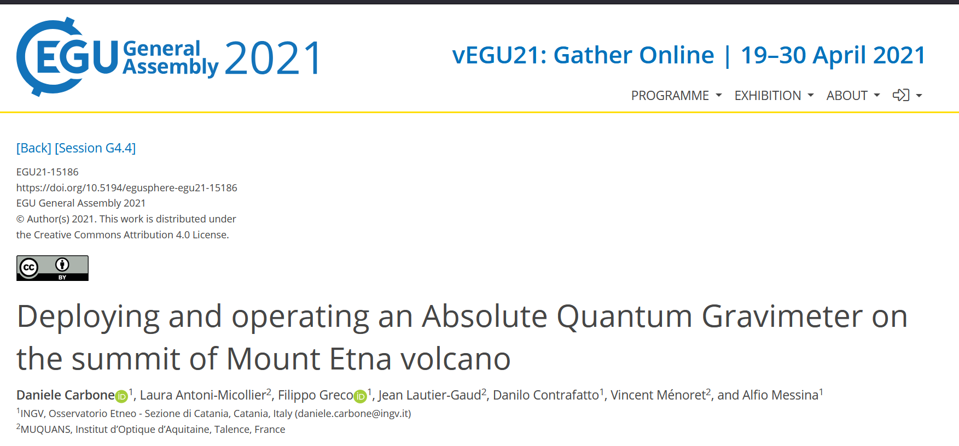

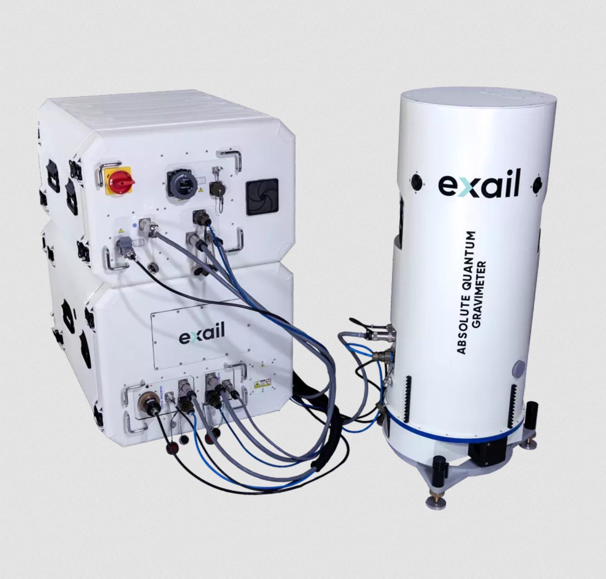
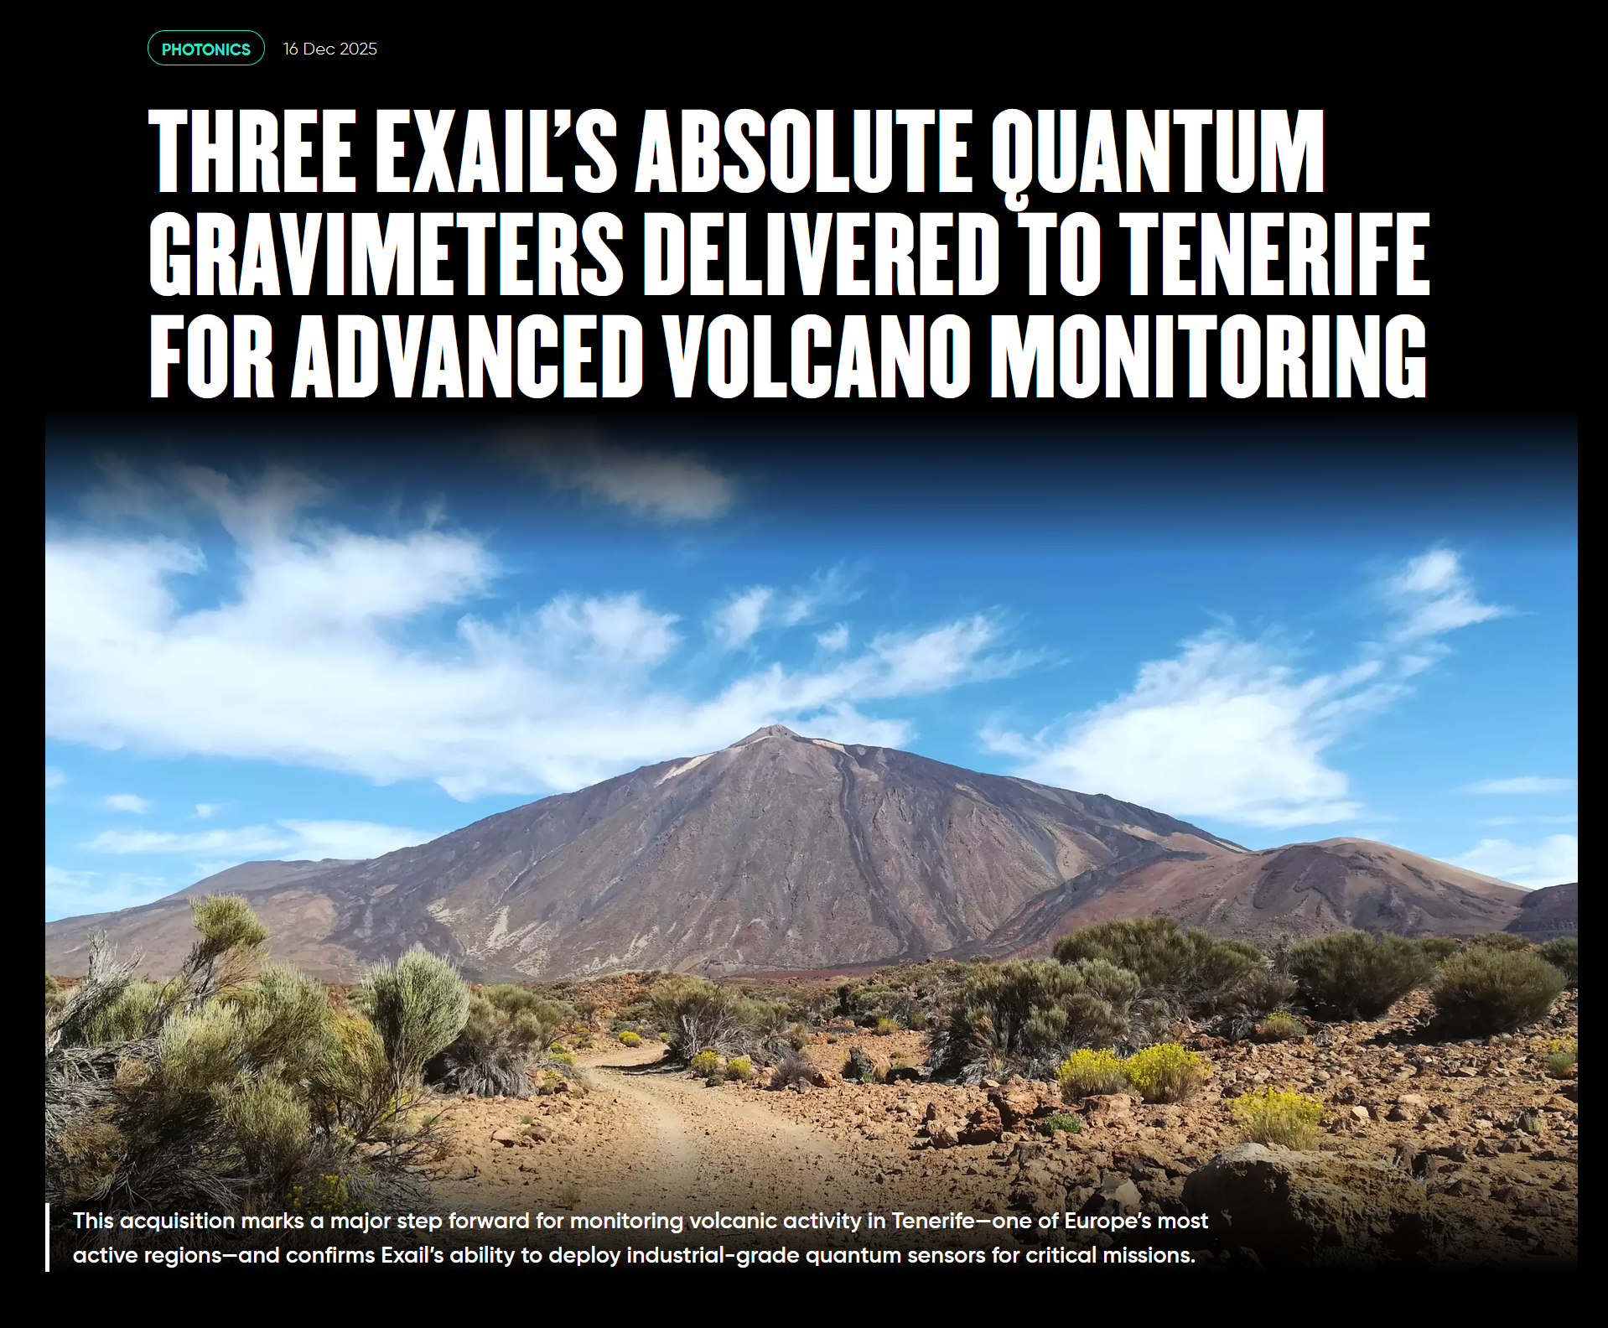
1.3 Atomic gravimeters
Commercial quantum gravimeter
from EXAIL
[1] https://www.exail.com/product/quantum-gravimeters
[2] https://www.jpl.nasa.gov/news/nasa-aims-to-fly-first-quantum-sensor-for-gravity-measurements/
[3] https://www.exail.com/resources/customer-stories/a-year-long-field-campaign-on-mount-etna-to-prove-the-absolute-quantum-gravimeter-value-for-volcanology
[4] https://www.exail.com/news/three-exail-absolute-quantum-gravimeters-delivered-to-tenerife-for-advanced-volcano-monitoring

Slide 17
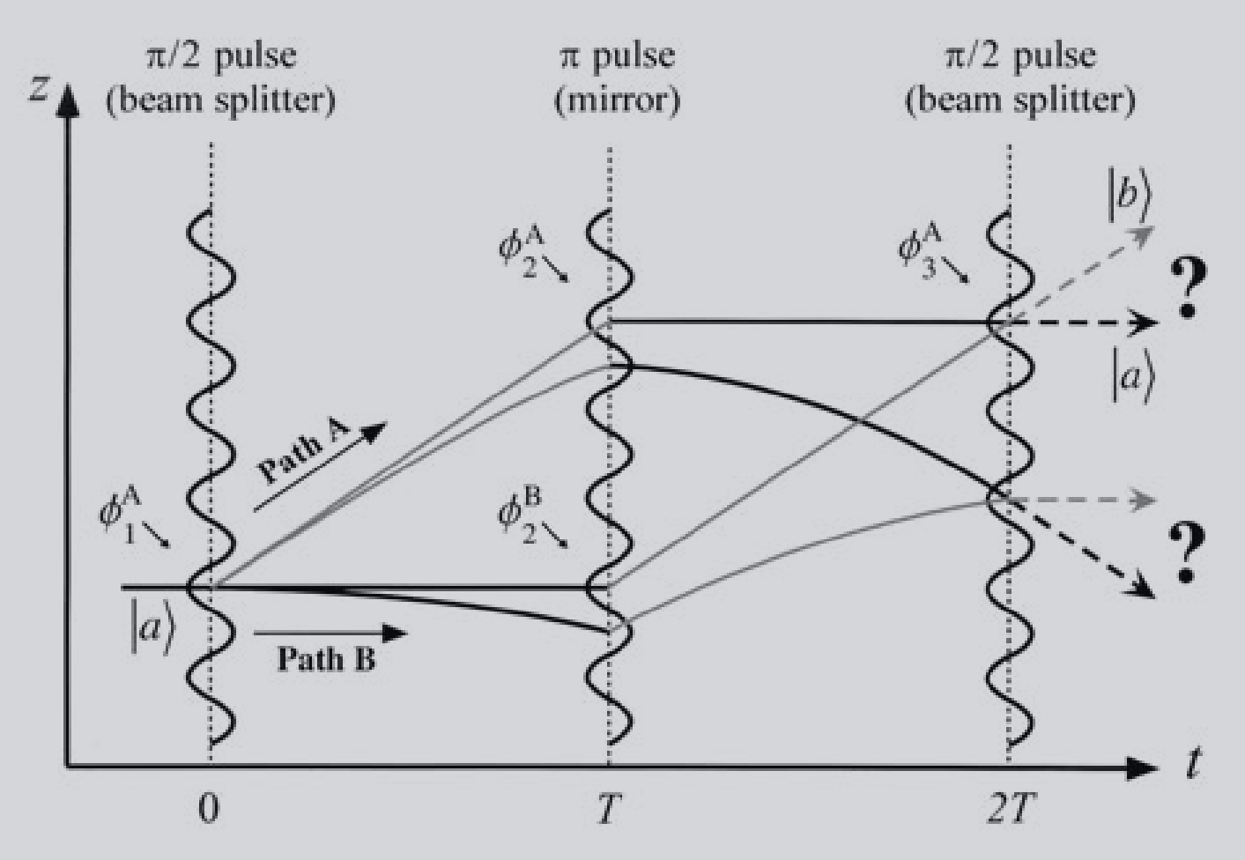
1.3 Atomic gravimeters
How: atomic interferometry, mixing of two laser-controled free-falling atom beams.
A. Peters et al., 2001, Metrologia, 38 25

Slide 18
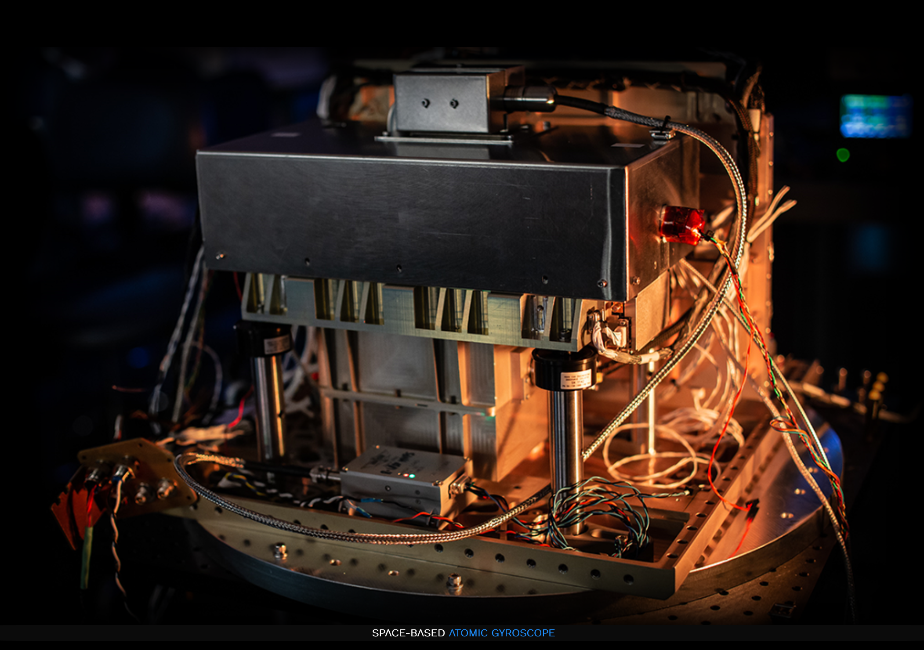
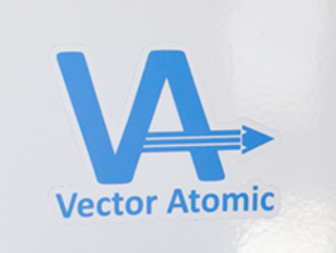
1.4 Atomic gyroscopes
Application: navigation in the areas where no electronic or visible feedback is available (aircrafts, submarines, ships, missilies, drones).
[1] www.nist.gov/noac/technology/time-and-frequency/atomic-gyroscopes
[2] https://payloadspace.com/vector-atomic-deliv
[3] https://www.quantum-australia.com/use-cases/quantum-gyroscopes-for-navigation
[4] https://vectoratomic.com/#inertial_section

Slide 19
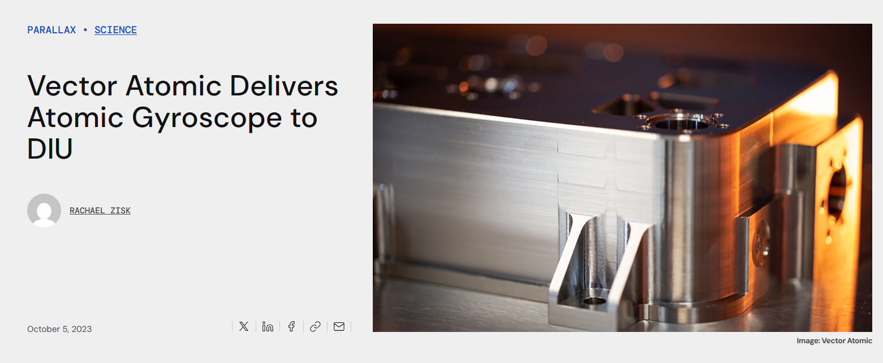
1.4 Atomic gyroscopes
Application: navigation in the areas where no electronic or visible feedback is available (aircrafts, submarines, ships, missilies, drones).
[1] www.nist.gov/noac/technology/time-and-frequency/atomic-gyroscopes
[2] https://payloadspace.com/vector-atomic-deliv
[3] https://www.quantum-australia.com/use-cases/quantum-gyroscopes-for-navigation
[4] https://vectoratomic.com/#inertial_section

Slide 20
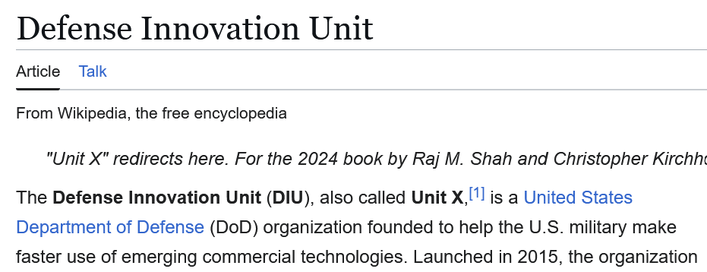
1.4 Atomic gyroscopes
Application: navigation in the areas where no electronic or visible feedback is available (aircrafts, submarines, ships, missilies, drones).
[1] www.nist.gov/noac/technology/time-and-frequency/atomic-gyroscopes
[2] https://payloadspace.com/vector-atomic-deliv
[3] https://www.quantum-australia.com/use-cases/quantum-gyroscopes-for-navigation
[4] https://vectoratomic.com/#inertial_section

Slide 21
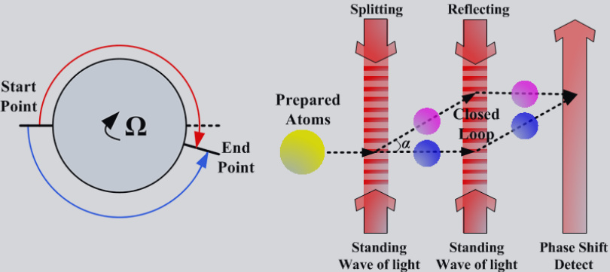
1.4 Atomic gyroscopes
How does it work?
A horizontal atom interferometer in which the atoms are launched with initial velocity.
Fang, J.; Qin, J. Advances in Atomic Gyroscopes: A View from Inertial Navigation Applications. Sensors 2012, 12, 6331-6346.

Slide 22
1.4 Atomic gyroscopes
How does it work?
A horizontal atom interferometer in which the atoms are launched with initial velocity.
Fang, J.; Qin, J. Advances in Atomic Gyroscopes: A View from Inertial Navigation Applications. Sensors 2012, 12, 6331-6346.
Alternative: Atomic spin gyroscope – less sensitive but compact.

Slide 23
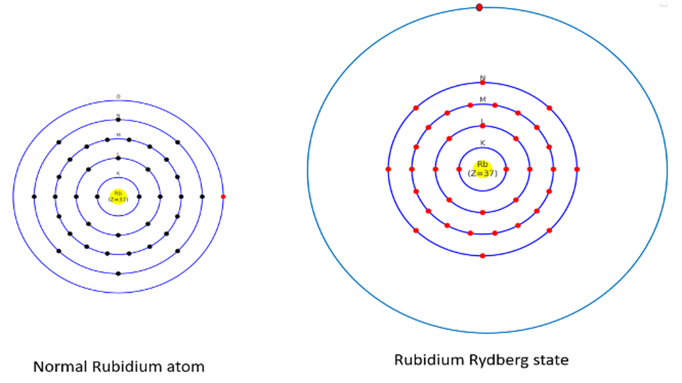



1.5 Rydberg sensors (Quantum antennas)
Applications: very broadband (DC - THZ), compact antennas able to receive very strong and very weak signals.
How it works: Pump laser excites atoms to Rydberg states, which are sensitive to electromagnetic field. Incoming microwaves/RF change the transperency of the atomic vapour to the probing laser, detected by a photodiode
Atom radius
$$r=r_{0}n^{2}$$
$$r_{3}=0.1 nm$$
$$r_{100}=1 μm$$
[1] https://www.nist.gov/quantum-information-science/giant-atoms-measuring-radiation
[2] https://www.rydbergtechnologies.com/products
[3] https://www.forbes.com/sites/moorinsights/2024/02/20/quantum-sensing-unleashed-how-rydberg-sensors-will-disrupt-telecom/

Slide 24
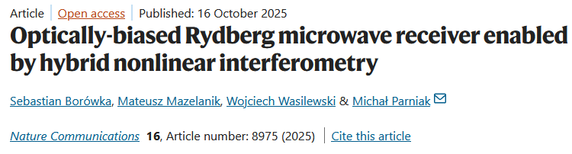
1.5 Rydberg sensors (Quantum antennas)
A quantum antenna with optical detection? Not exactly, typically one uses electronic reference for higher accuracy.
Recent major improvement: a fully-optical Rydberg sensor.
[1] https://www.nist.gov/quantum-information-science/giant-atoms-measuring-radiation
[2] https://www.rydbergtechnologies.com/products
[3] https://www.nature.com/articles/s41467-025-63951-9

Slide 25
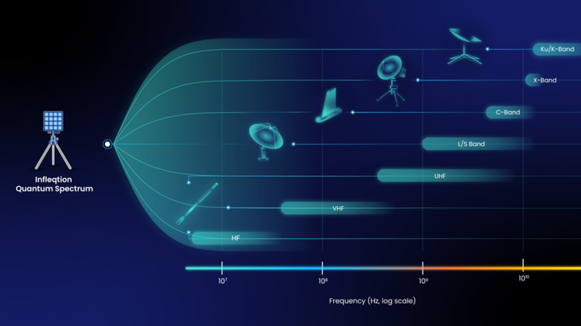
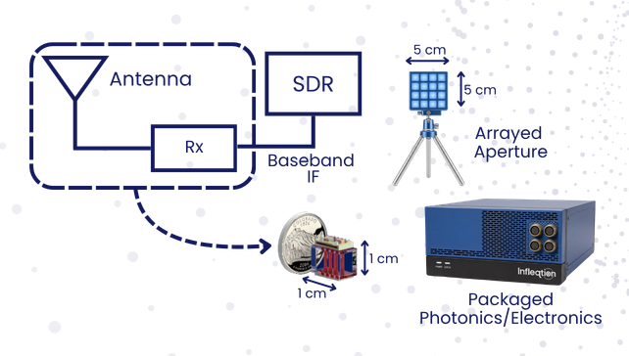
1.5 Rydberg sensors (Quantum antennas)
Buy a 3 MHz – 6 GHz quantum antenna from INFLEQTION.
[1] https://infleqtion.com/quantum-rf-receiver/

Slide 26
02
Networks

Slide 27

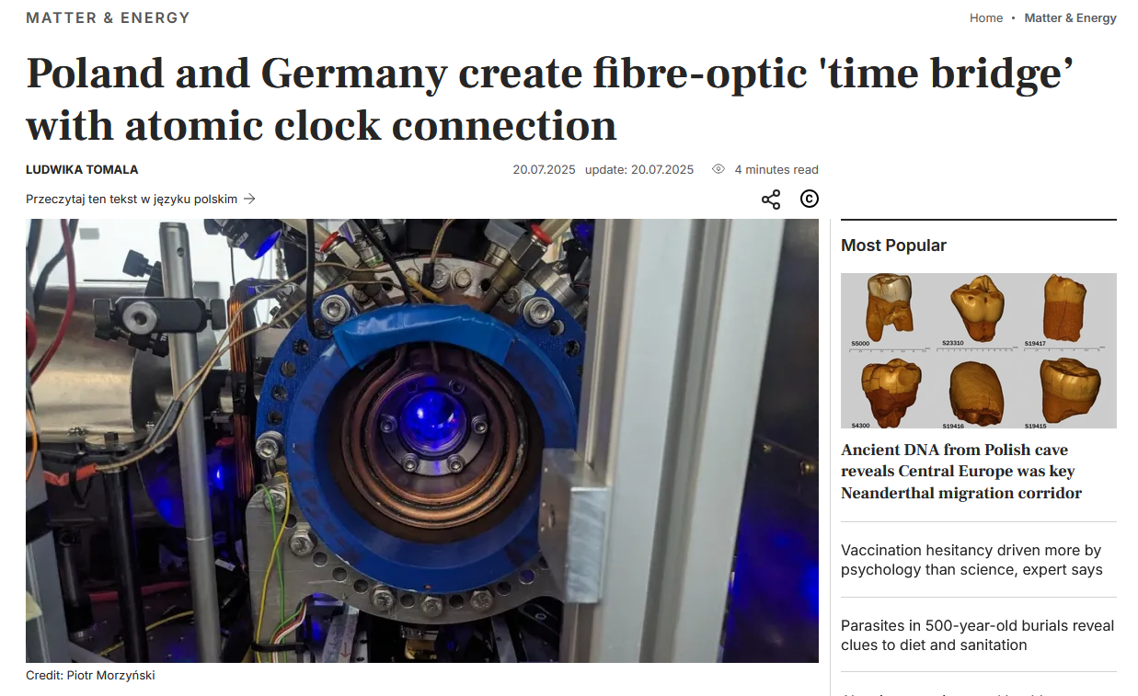
2.1 Optical clocks networks
Can we?
Definetely.
Should we?
Yes, to have common time reference.
Do we?
Sure.

Slide 28
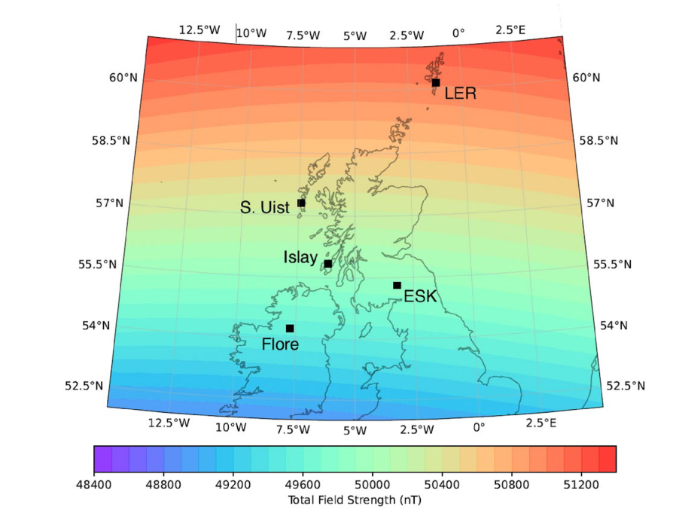
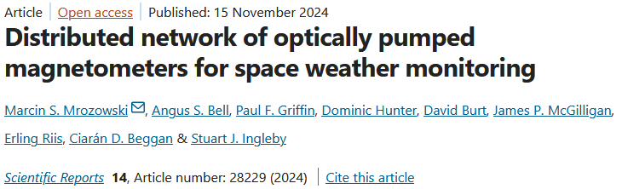
2.2 Magnetometers networks
Can we?
Yes.
Should we?
Yes, to monitor geomagnetic storms and Earth’s core activity.
Do we?
Yes.

Slide 29
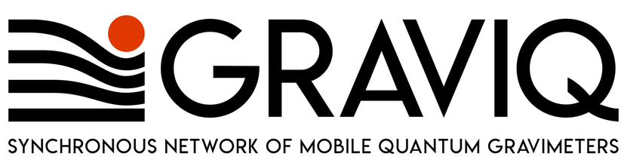
2.3 Gravimeters networks
Can we?
Yes.
Should we?
Yes, to monitor geological activity and underground water resources.
Do we?
Yes.

Slide 30

2.4 Rydberg sensors networks
Can we?
Yes.
Should we?
Possibly, for triangulation of unknown radars, jammers and transmitters.
Do we?
Not yet.

Slide 31
2.5 Gyroscopes networks
Can we?
Yes.
Should we?
No?
Do we?
No.

Slide 32
03
Interfaces

Slide 33
3.0 Different platforms in quantum
NV diamonds
(magnetometers)
SQUIDs
(magnetometers)
Trapped ions
(optical clocks)
Rydberg atomic vapours
(quantum antennas)
Cold neutral atoms
(gravimeters)
Alkali atomic vapours
(atomic clocks)

Slide 34
3.0 Different platforms in quantum
NV diamonds
(magnetometers)
SQUIDs
(magnetometers)
Trapped ions
(optical clocks)
Rydberg atomic vapours
(quantum antennas)
Cold neutral atoms
(gravimeters)
Alkali atomic vapours
(atomic clocks)
Quantum sensors => Quantum memories & qubits

Slide 35
3.0 Different platforms in quantum
NV diamonds
(magnetometers)
SQUIDs
(magnetometers)
Trapped ions
(optical clocks)
Rydberg atomic vapours
(quantum antennas)
Cold neutral atoms
(gravimeters)
Alkali atomic vapours
(atomic clocks)
Approximate optical spectral bandwidth
1 GHz electronic 10 MHz 5 MHz 1 MHz 100 MHz
Approximate pulse duration
0.5 ns electronic 50 ns 100 ns 500 ns 5 ns
Quantum sensors => Quantum memories & qubits

Slide 36
3.1 Spatial analogy
Multi-mode fibres
50 μm
Single-mode fibres
5 μm
Electro-optic modulators
10 μm
Quantum dots
1 μm

Slide 37
3.1 Spatial analogy
Multi-mode fibres
50 μm
Single-mode fibres
5 μm
Electro-optic modulators
10 μm
Quantum dots
1 μm

Slide 38

3.2 Spatial analogy
The plane wave treats space and time symmetrically.
$$\exp{(kx+ft)}$$

Slide 39
3.2 Spatial analogy
The plane wave treats space and time symmetrically.
$$\exp{(kx+ft)}$$
A glass lens stretches (magnifies) light spatially.
A ’’time lens” stretches (magnifies) light temporally*.
*And compresses spectrally – check time-bandwidth product.

Slide 40
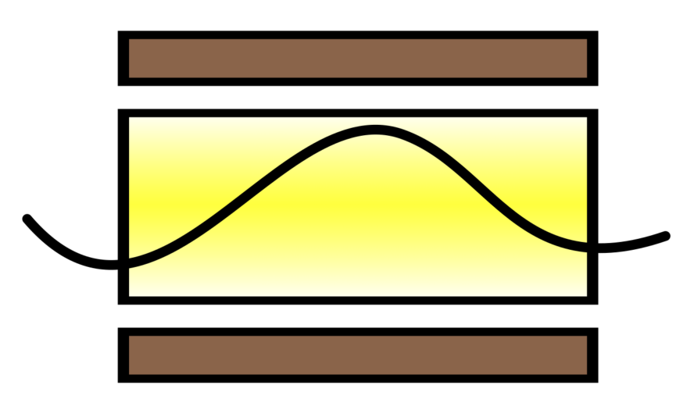

3.3 What is a time lens?
Spatial lens
(piece of glass + focal length)
Time lens
(EOP modulator + dispersion)
+ + + + + + + + + +
Pockels effect
$$n\left(t\right)=n_{0}+n_{1}I\left(t\right)$$
- - - - - - - - - - - - -

Slide 41
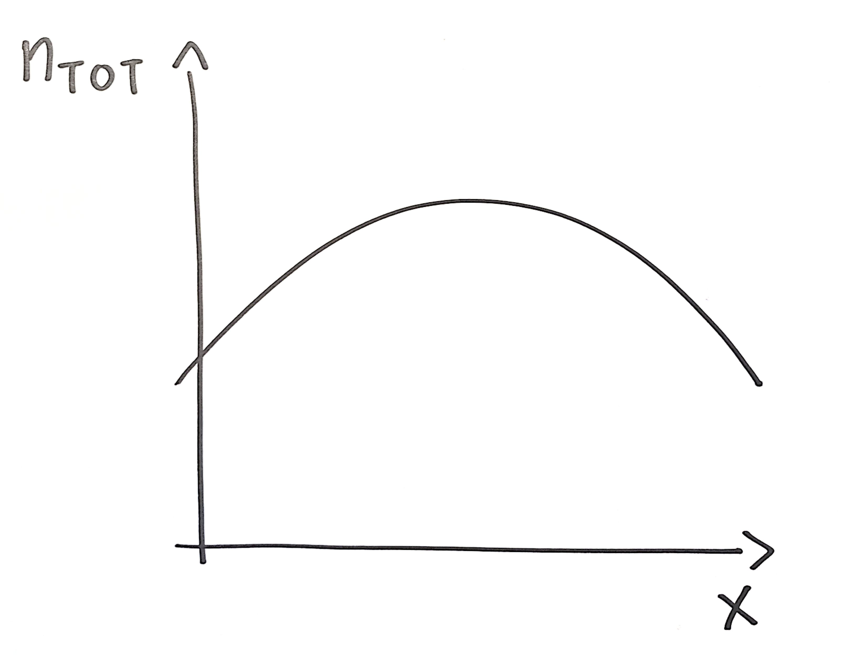
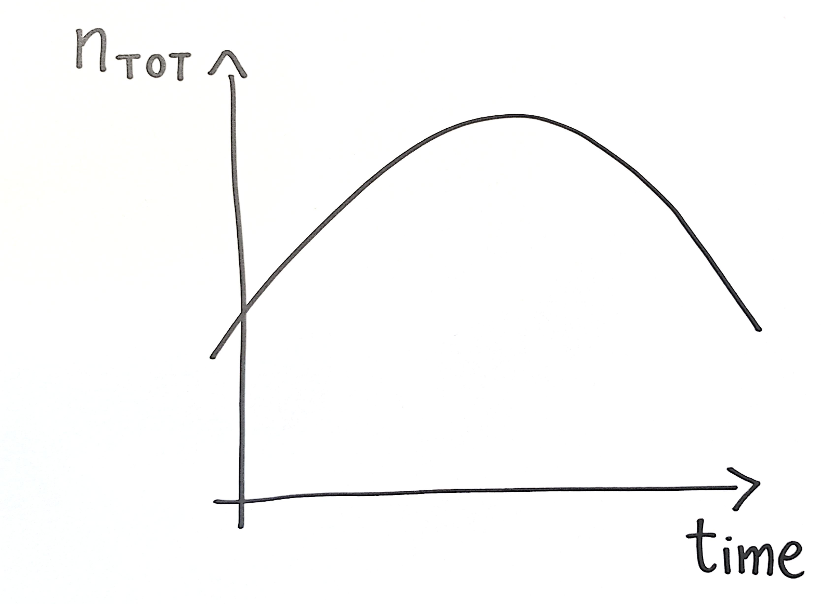
3.3 What is a time lens?
Spatial lens
(piece of glass + focal length)
Time lens
(EOP modulator + dispersion)
+ + + + + + + + + +
Pockels effect
$$n\left(t\right)=n_{0}+n_{1}I\left(t\right)$$
- - - - - - - - - - - - -
Total refractive index (or spatial phase, to be precise) changes parabolically in space.
Total refractive index (or temporal phase, to be precise)
changes parabolically in time.

Slide 42
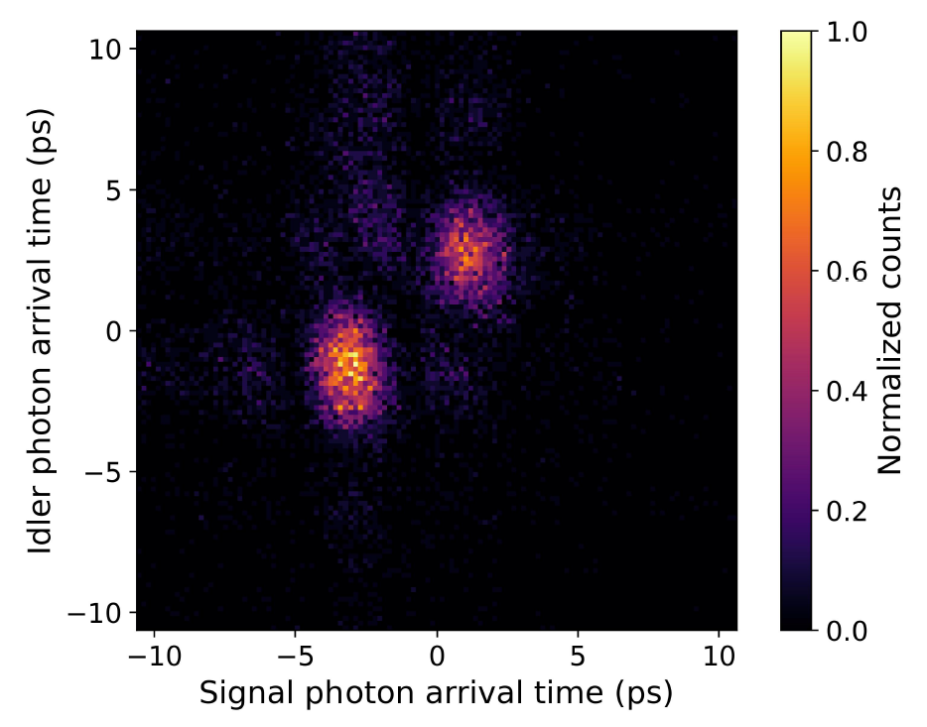
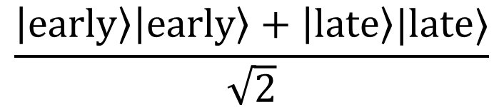
3.4 Time lens – use cases
Time lens application:
Imaging entangled photons below detector resolution.
State of entangled photons:
$$\frac{\left|early\right\rangle \left|early\right\rangle +\left|late\right\rangle |late⟩}{\sqrt{2}}$$
*Time-correlated entangled photons from an SPDC source separated by 6 ps recorded with SNSPD detectors with 50 ps time jitter. Measured at QPL UW.

Slide 43
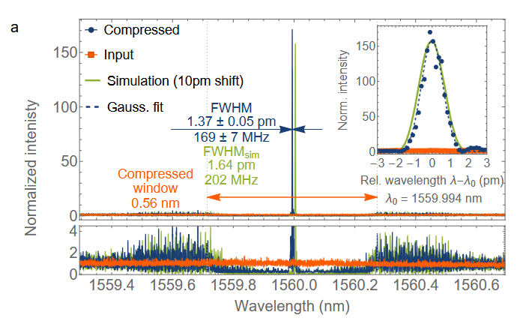
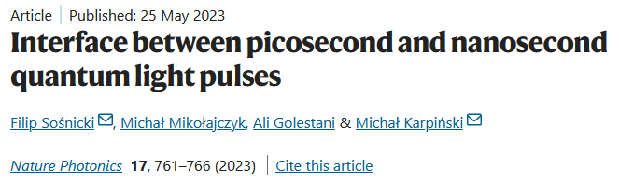
3.4 Time lens – use cases
Time lens application:
Compressing spectral bandwidth of 70 GHz to 170 MHz.

Slide 44
Thank you!
1st GEANT SIG-Quantum meeting
Ksawery Mielczarek 30th June 2026
kmielczarek@man.poznan.pl

