Slide 1
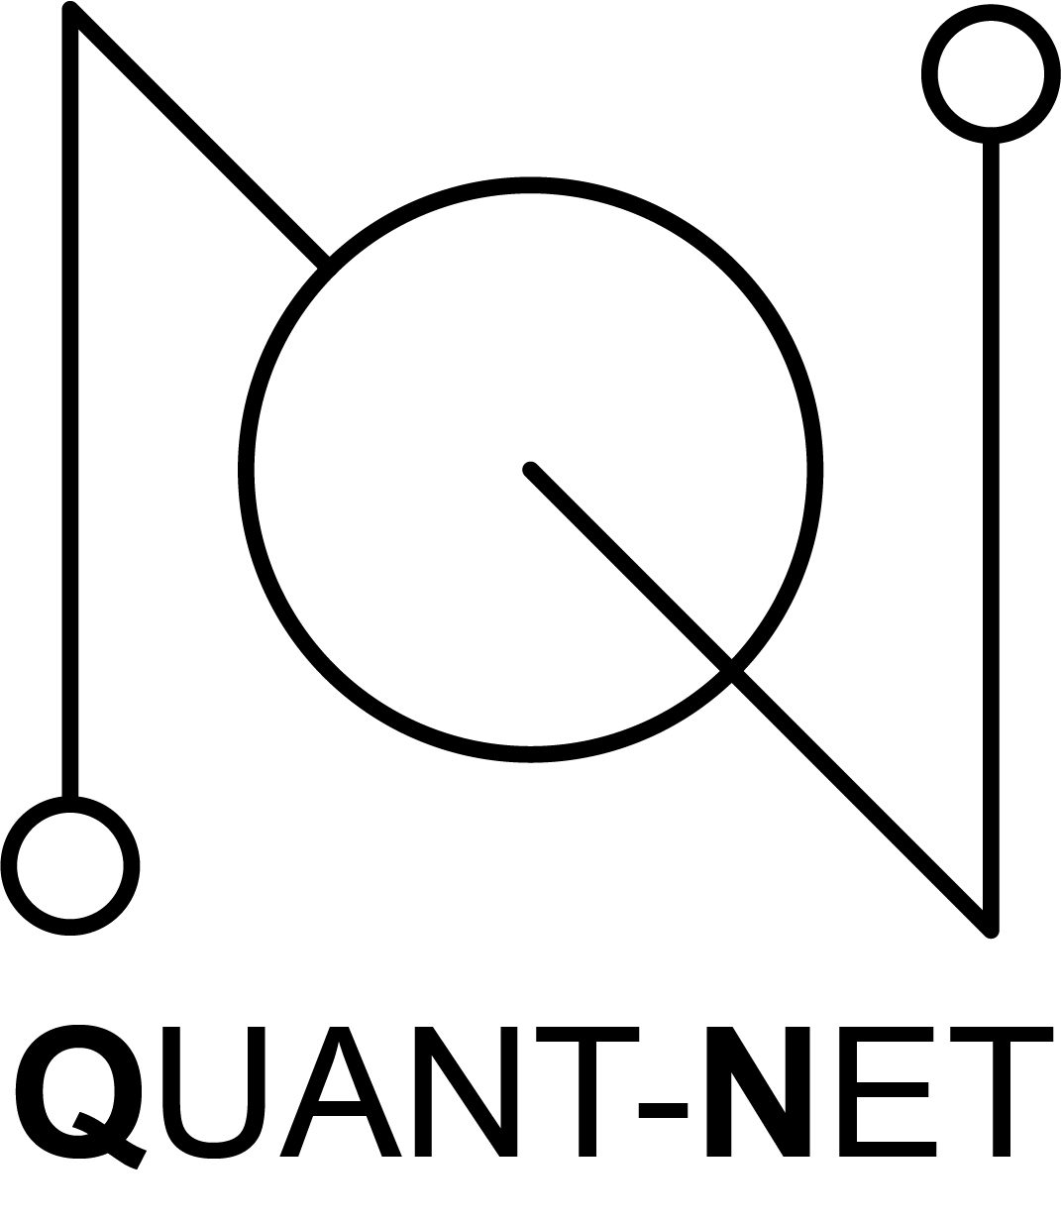

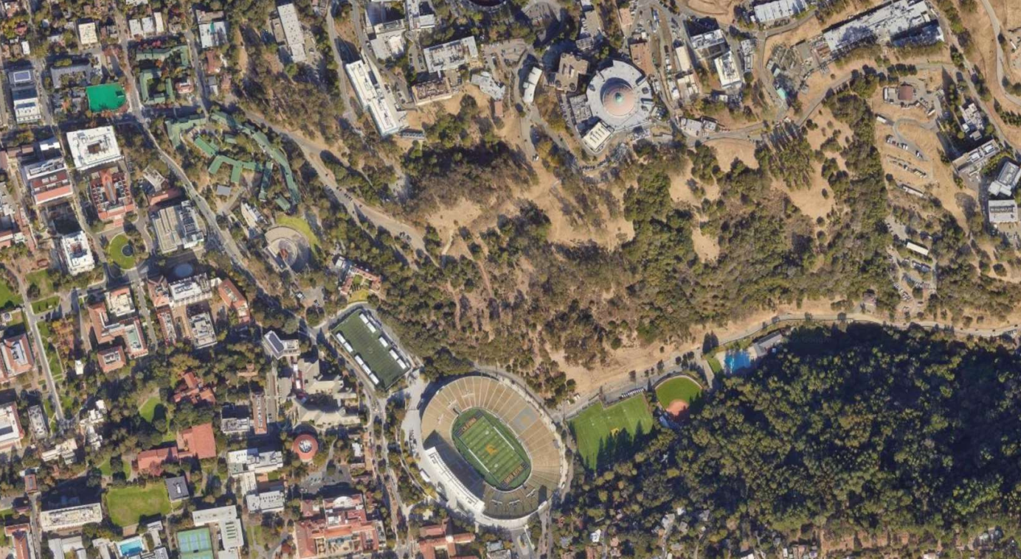
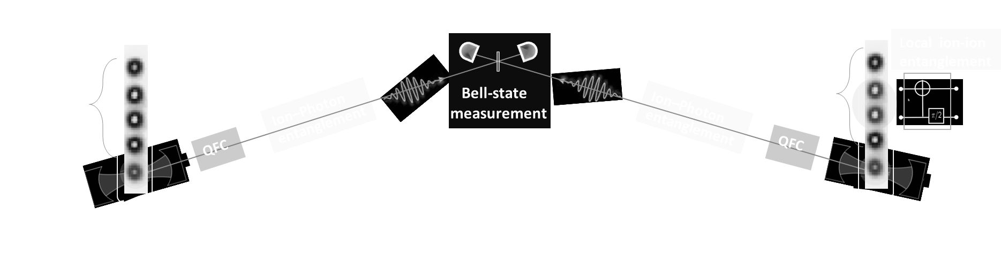
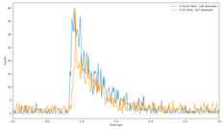
QUANT-NET: A Distributed Quantum Computing Testbed using photon-matter entanglement distribution over fiber-link
Modular, extensible, control framework
A quantum network testbed, not just a physics experiment
High-rate, high-fidelity entanglement generation using ion-traps
Inder Monga,
Executive Director, Esnet
Lead-PI, QUANT-NET

Slide 2
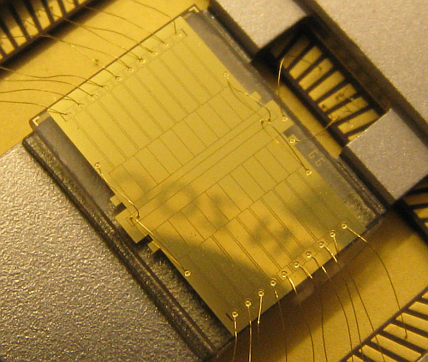
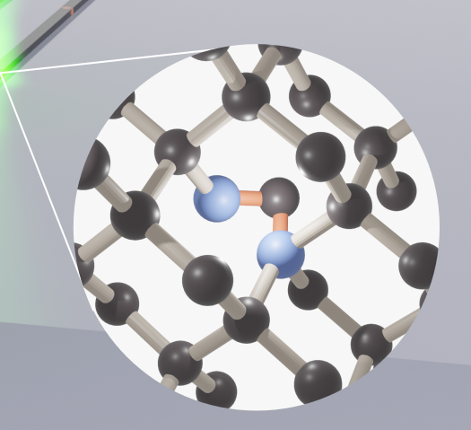
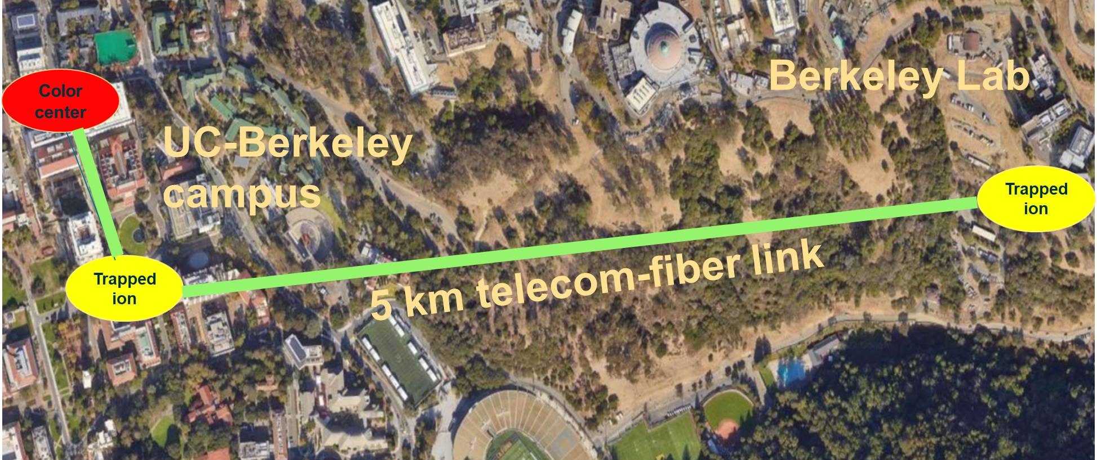
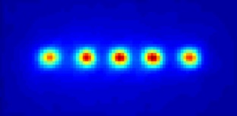
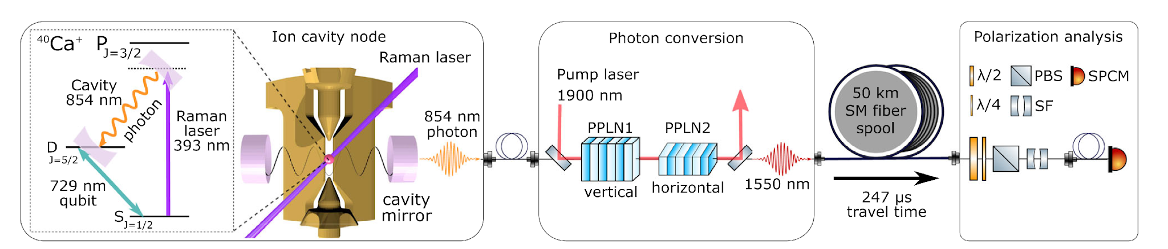
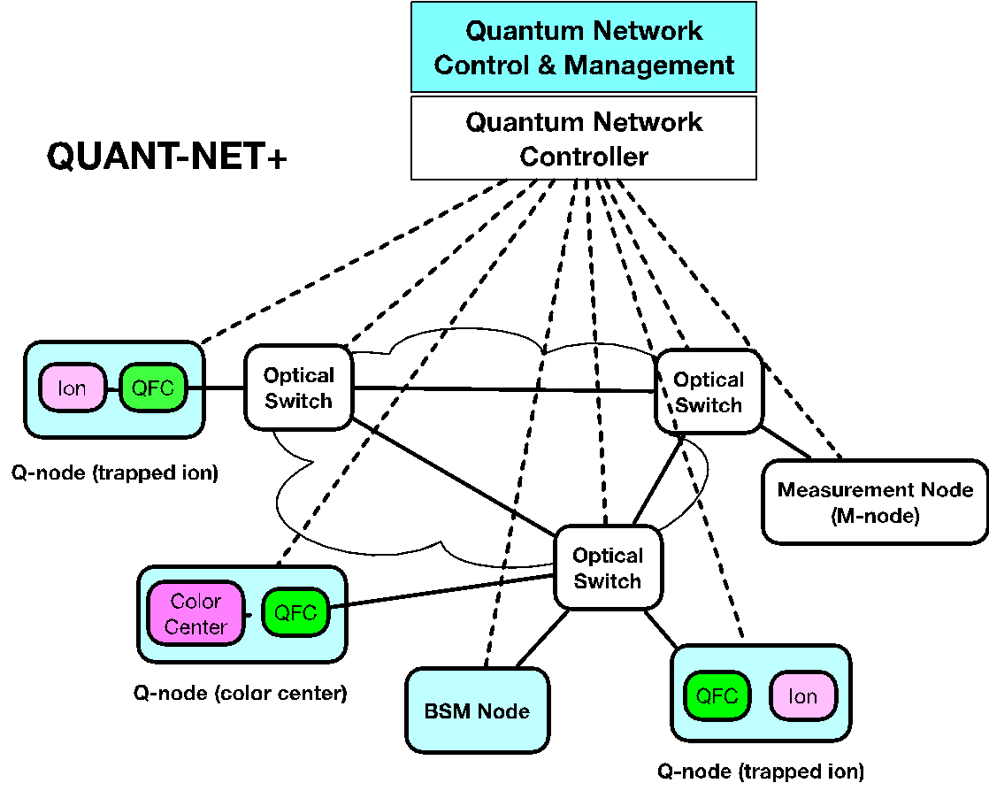

Participants: Berkeley National Lab + 6 principle investigators from 3 universities
QUANT-NET
QUantum Application Network Test-bed for Novel Entanglement-based Techs
1. Quantum-node technologies
Color-centers
Trapped ions
PI : A. Sipahigil
PIs : Haeffner & Northup
2. Quantum frequency conversion
3. Quantum network control
PI: M. Spiropulu
PI: I. Monga

Slide 3
Agenda
This presentation is about experimental progress in Distributed Quantum Computing at Berkeley
I will not touch upon the QFC, solid-state silicon centers or the control plane part of the work that is part of the project.

Slide 4
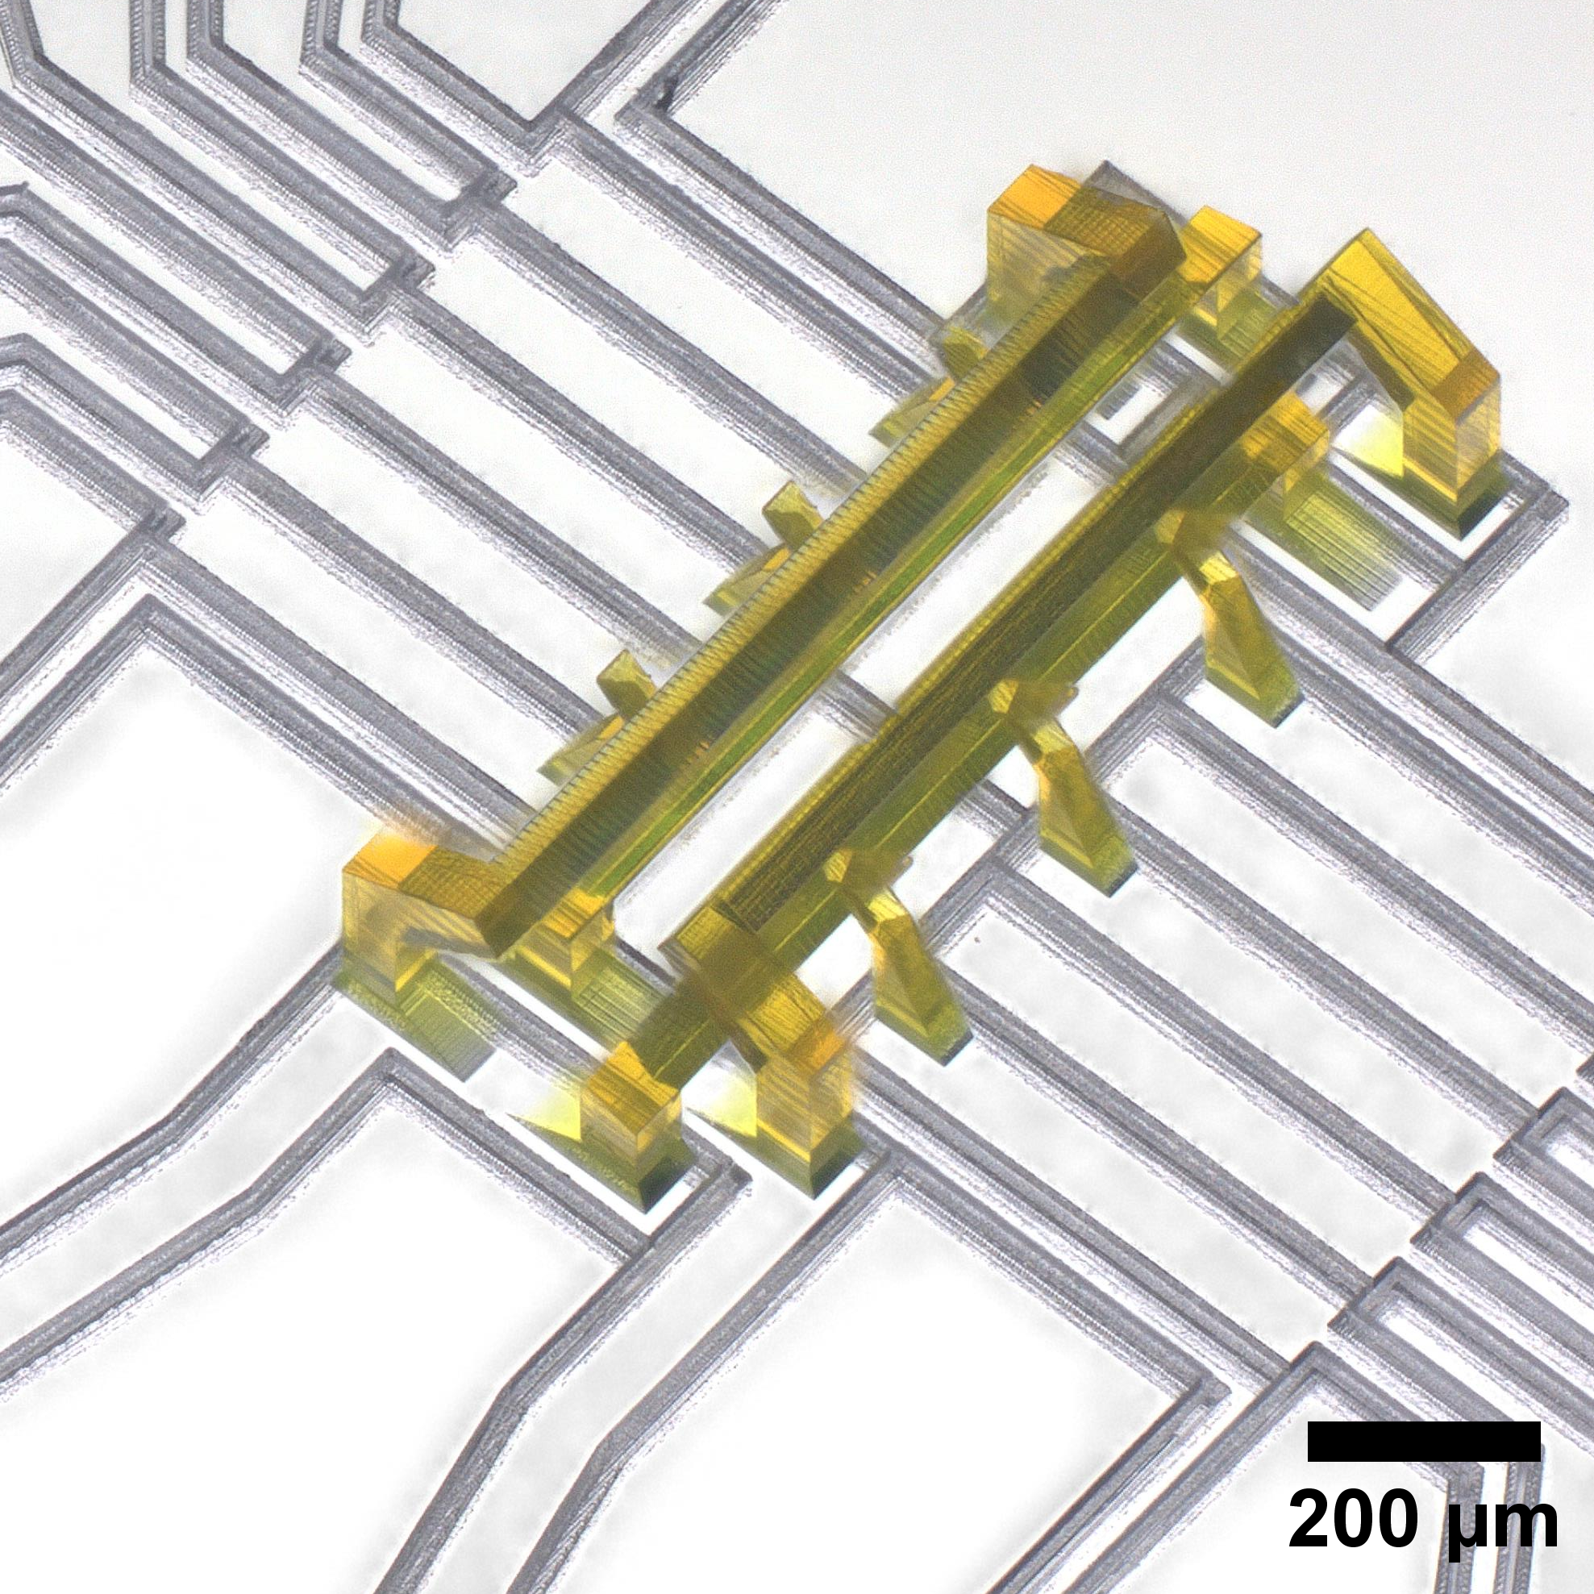
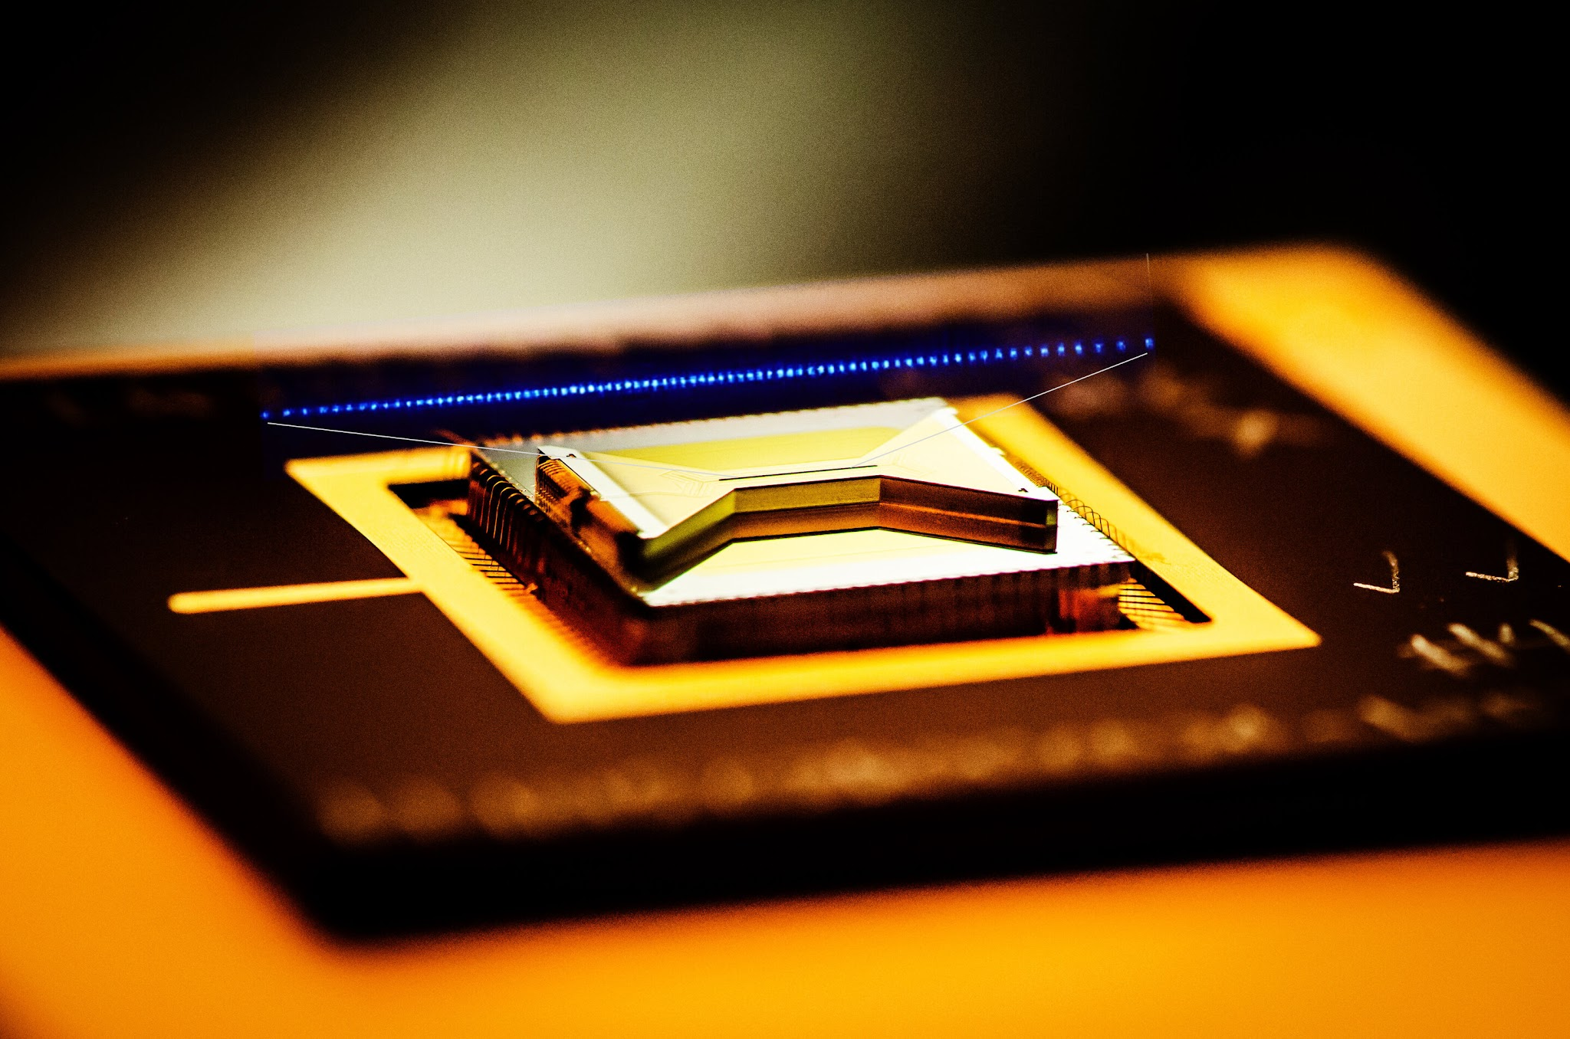
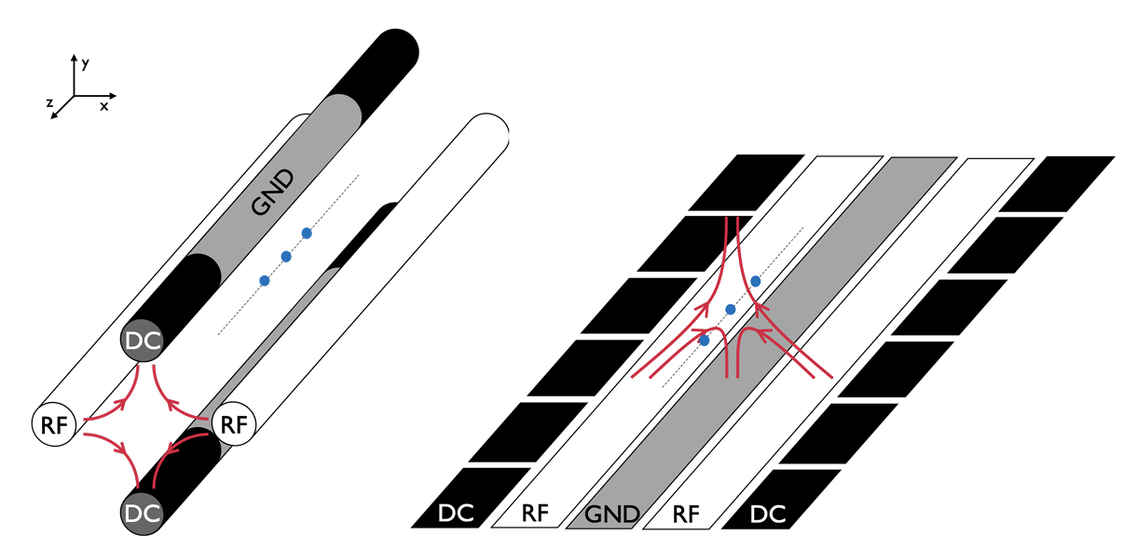
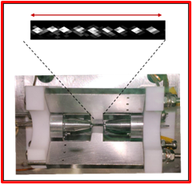
Trapped ions for distributed quantum computing
Photon-wave packet indistinguishability
Bell-state measurement
High- rate & high-fidelity
remote entanglement
Long-lived storage of remote entanglement
Innsbruck, Oxford, Maryland/Duke
Oxford, Tsinghua
Oxford, Maryland/Duke
Quantum teleportation
Non-local quantum gates
Saarland, Maryland
Oxford, Maryland
Distributed quantum
algorithm
Network compatibility
Scalability & Integration
Oxford
Saarland, Innsbruck, Tsinghua
Scalable and networked ion-trap processors at Berkeley
Scalable superior traps
~10-100 μm
… superior trap
~1-10 mm
Scalable…
3D printed micro-trap technology
Surface micro-trap
Near-ideal harmonic trap while being as small as a surface trap
3D macro-trap

Slide 5
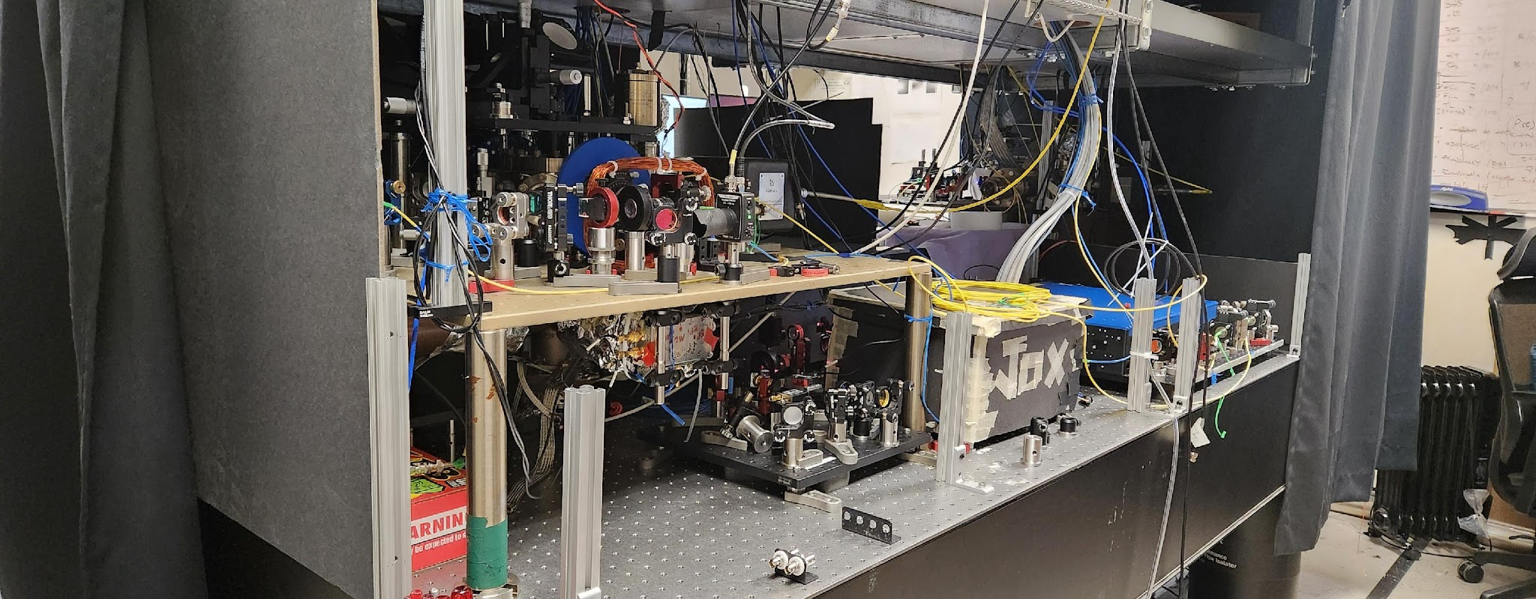
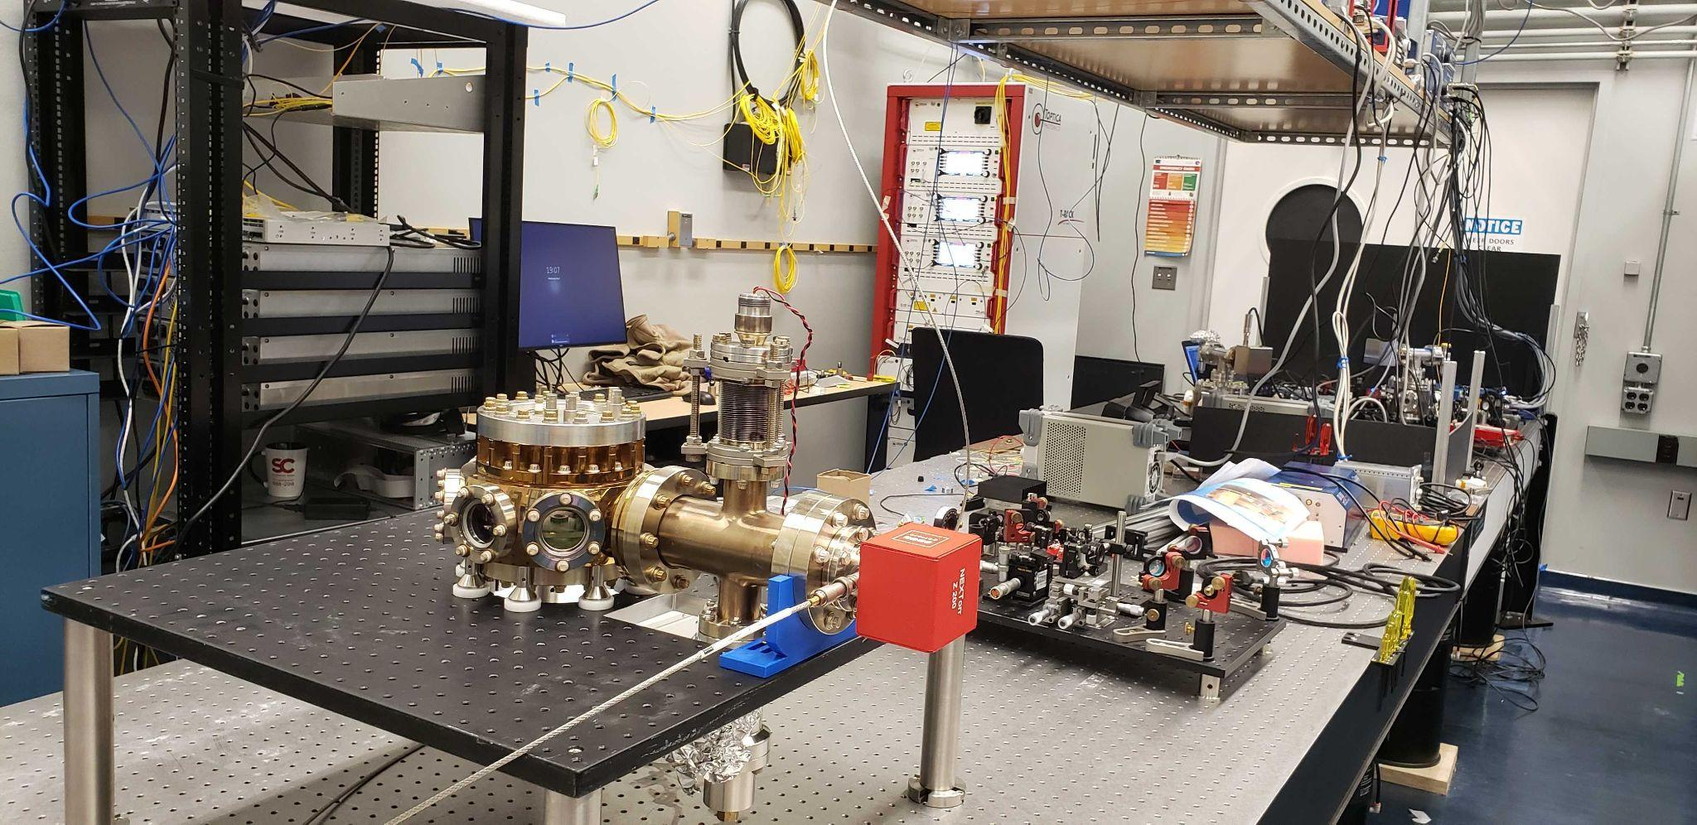
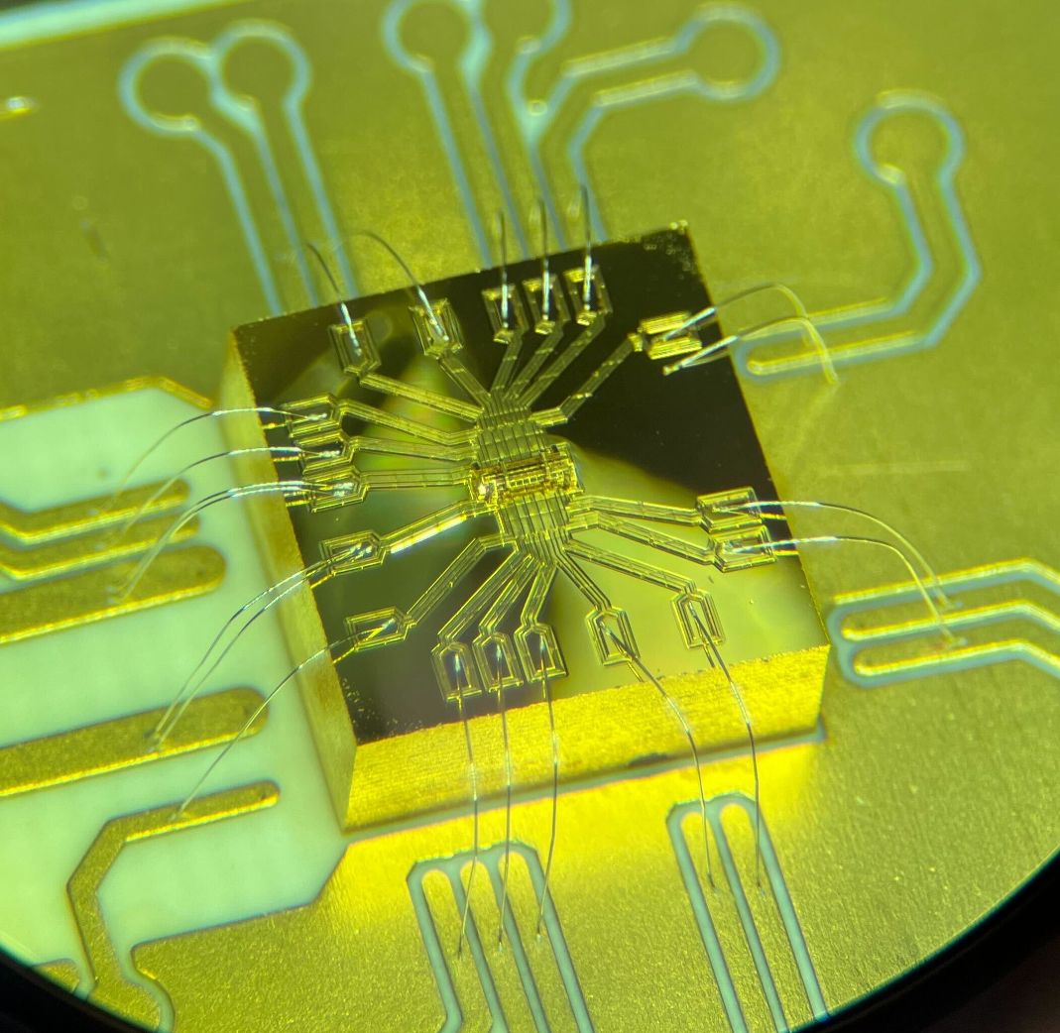
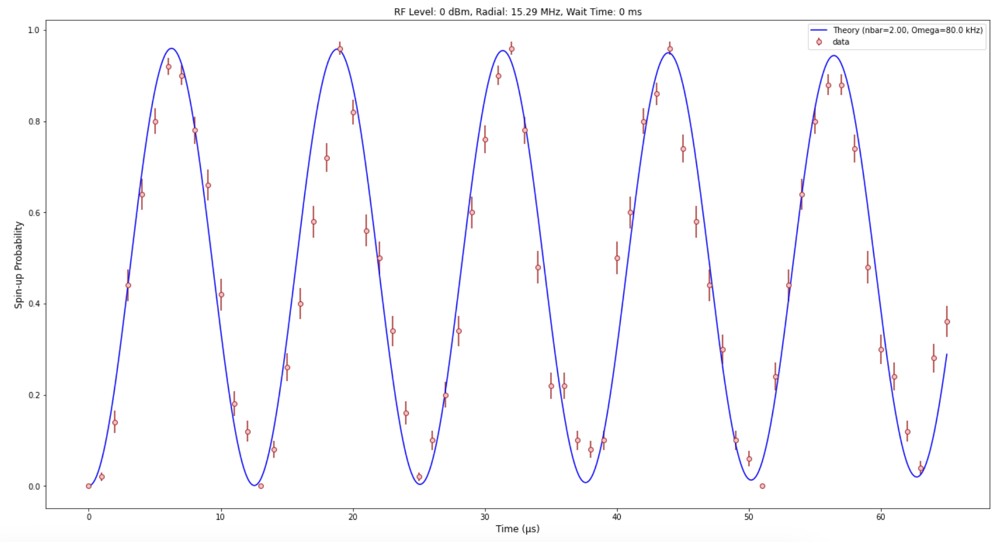
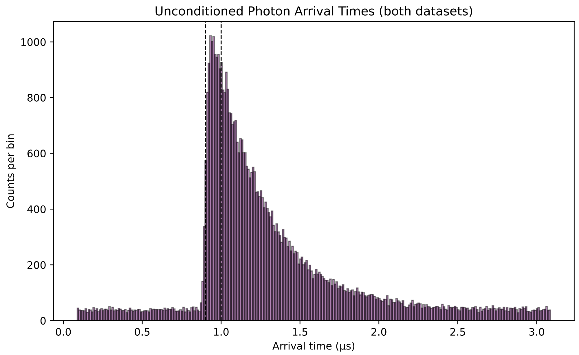
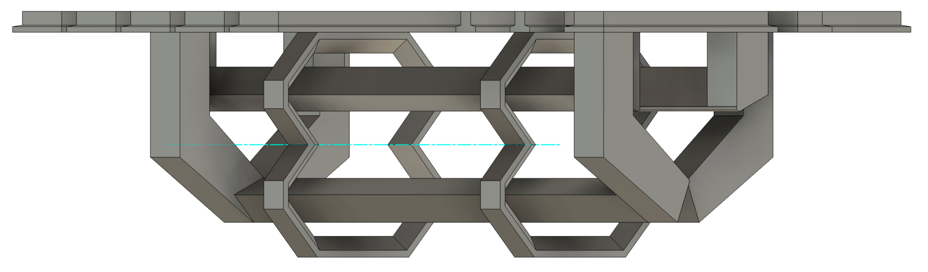
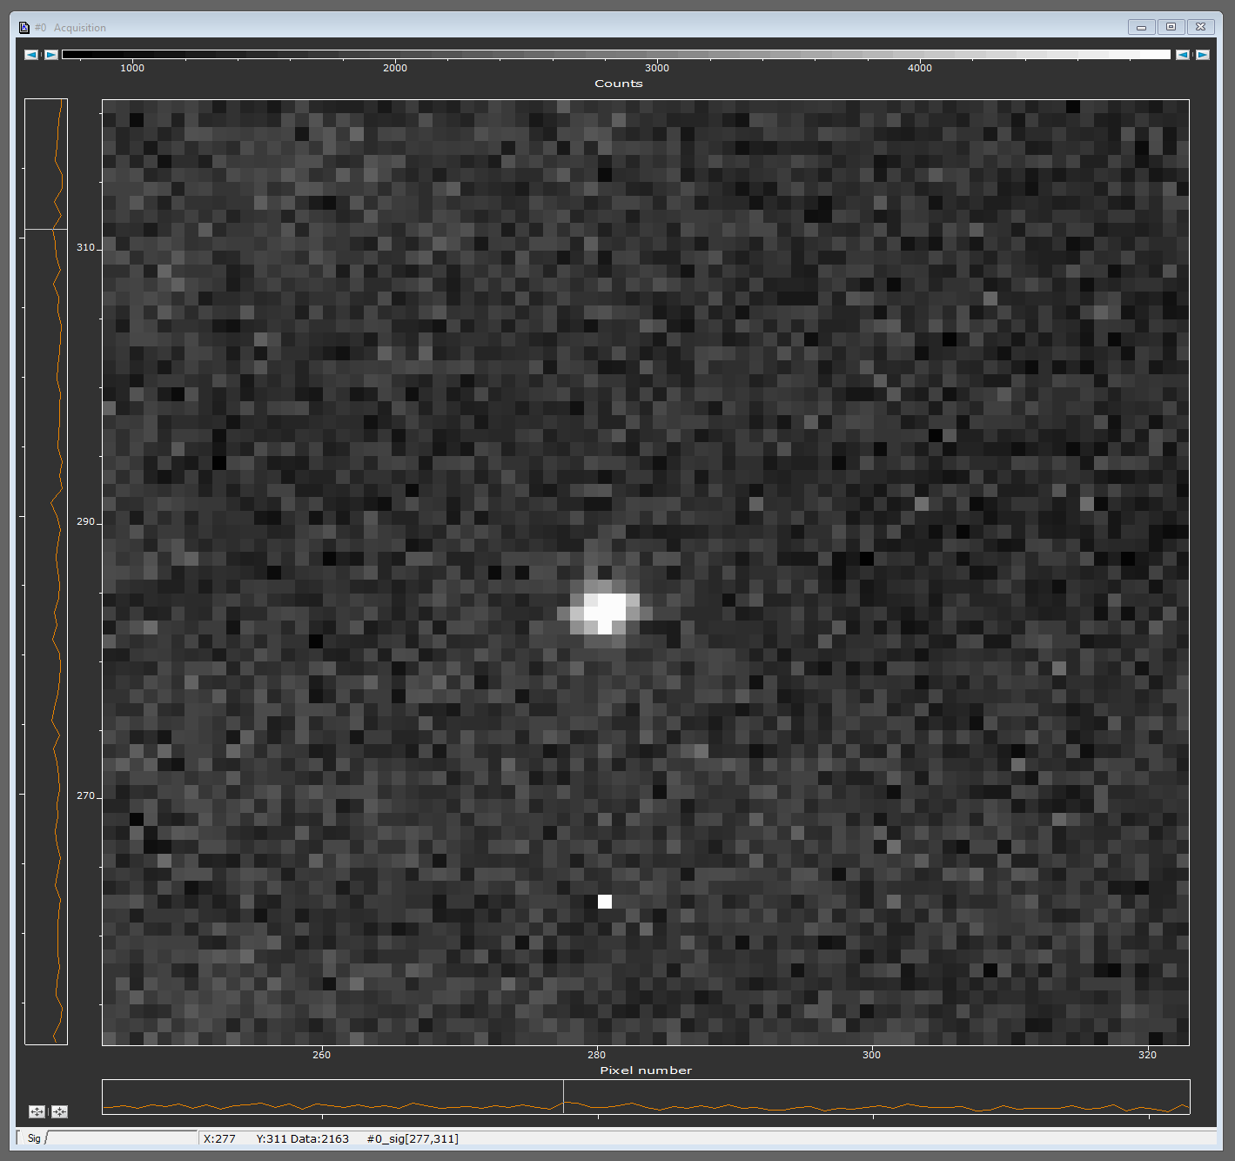
Ion-trap quantum nodes at LBNL and UCB
UCB Lab
New lab at LBNL
3D micro-trap for quantum networking
Single ions in 3D micro-trap
Coherent matter & photonic qubit manipulations
200 μm
Rabi flopping on an ion-qubit
Single photon emitted from an ion
1.0
0.8
0.6
0.4
0.2
0
Excitation probability
Fiber-coupled
854-nm photons
Trapping of Ca ions at large trap frequencies
0 10 20 30 40 50 60
Time (μs)

Slide 6
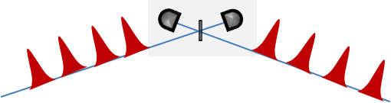

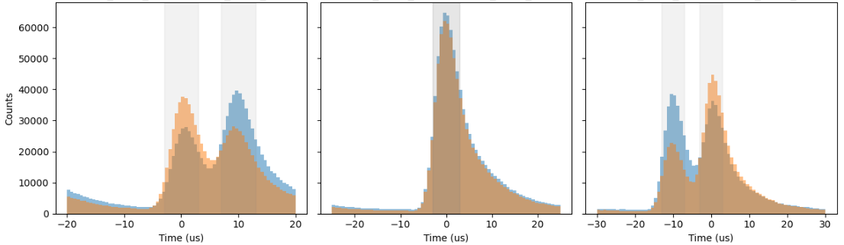
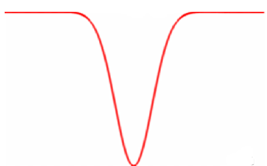
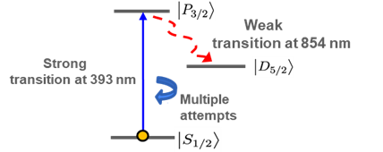
Ion-trap quantum nodes at LBNL and UCB
UCB Lab
New lab at LBNL
Hong-Ou-Mandel interference for quantum teleportation
HOM with delayed single photons
Indistinguishable photons from trapped ions
Distinguishable
Indistinguishable
Distinguishable
Multiple attempts
≈ 70 %
N max
N min
N max
Single Ca⁺ ion
Ca⁺
N max
N max
coincidence
Arrival time difference between single photons extacted from the same ion-trap setup
Experiments between two ion-traps are underway
N min
0
relative time
Notes:
"In quantum teleportation, the sender has to perform a joint measurement on the particle they want to send and half of an entangled pair. In optical systems, we do this using a beam splitter. Hong-Ou-Mandel interference is the quantum rule that says identical photons hitting a beam splitter will usually 'bunch' together. By looking for the rare cases where they don't bunch (one photon exits each side), scientists can successfully confirm the specific quantum measurement required to trigger the teleportation to the receiver."

Slide 7

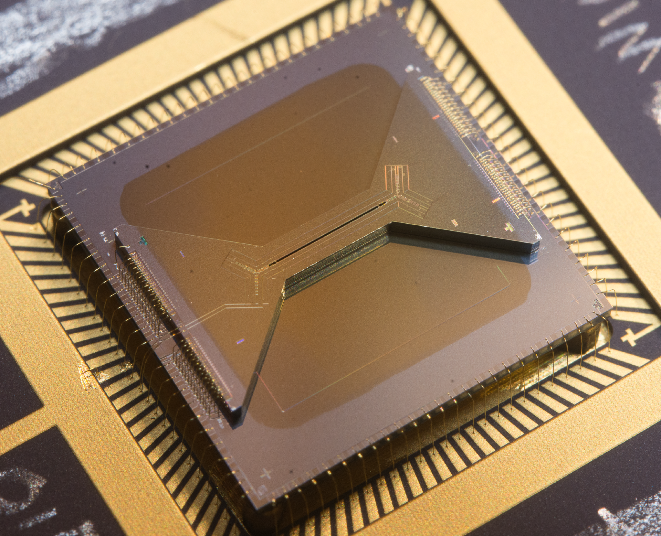
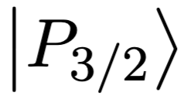
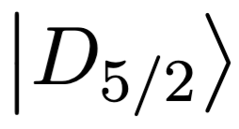

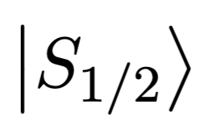
Ion-trap quantum nodes at LBNL and UCB
UCB Lab
New lab at LBNL
10
1
4
Photon-matter entanglement
Entanglement generation
Correlations between spin and polarization
∣Ψ⟩=​(∣↑,V⟩+∣↓,H⟩)
Single Ca⁺ ion
854 nm photon
_{|V>}
_{|H>}
Spin-up
Spin-down
PBS
Entanglement distribution
B -field
∣Ψ⟩=​(∣↑,V⟩+∣↓,H⟩)
Fiber
Simplifed scheme

Slide 8
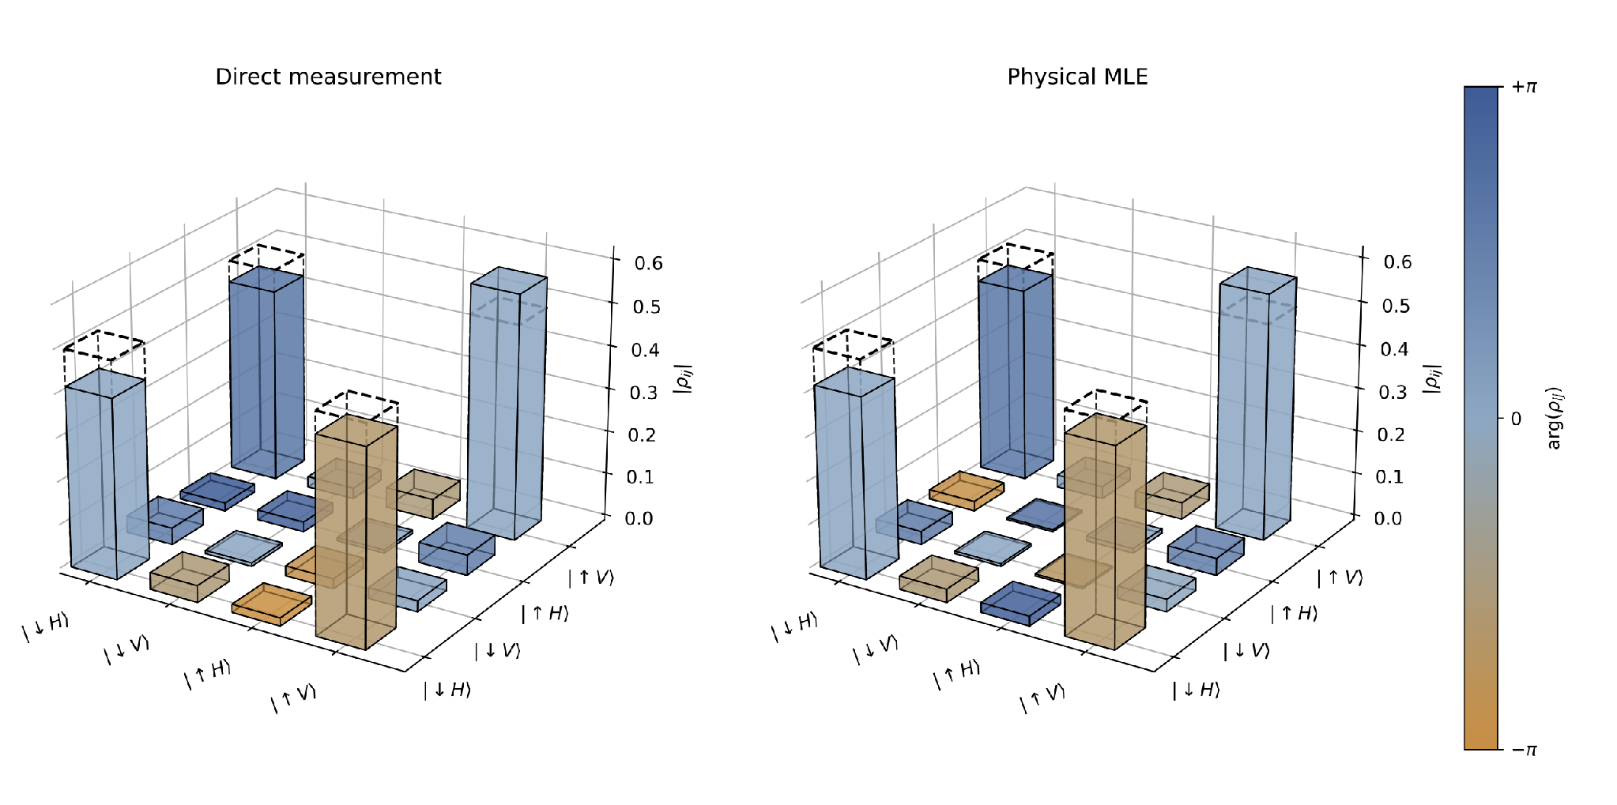
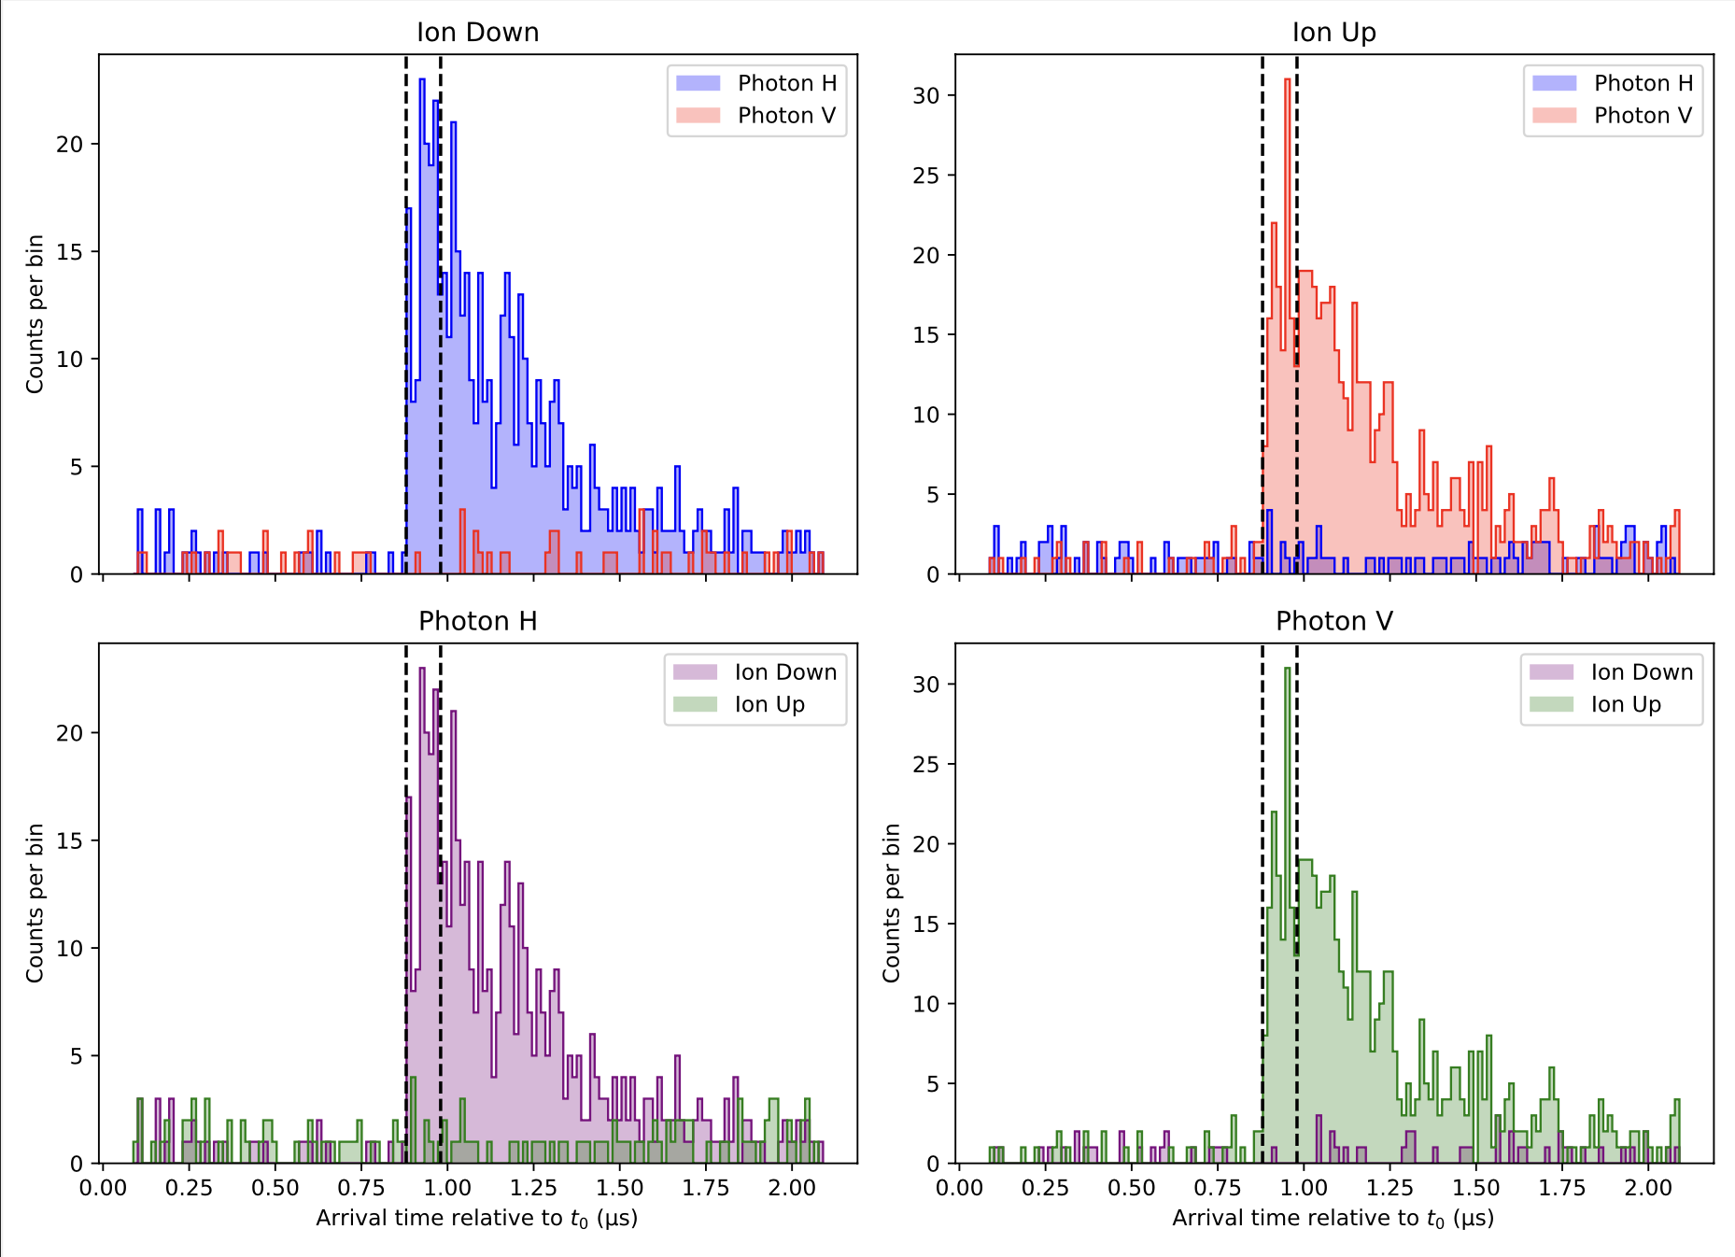
Photon-matter entanglement
Spin-photon correlation measurements
Quantum state tomography
Entanglement fidelity wrt Bell-states
F = 94.1 ± 1.4 %
Entanglement generation
Correlations between spin and polarization
|H>
∣Ψ⟩=​(∣↑,V⟩+∣↓,H⟩)
Single Ca⁺ ion
854 nm photon
_{|V>}
_{|H>}
|V>
Spin-up
Spin-down
PBS
Local entanglement distribution
B -field
Fiber
UC Berkeley node
Simplifed scheme

Slide 9
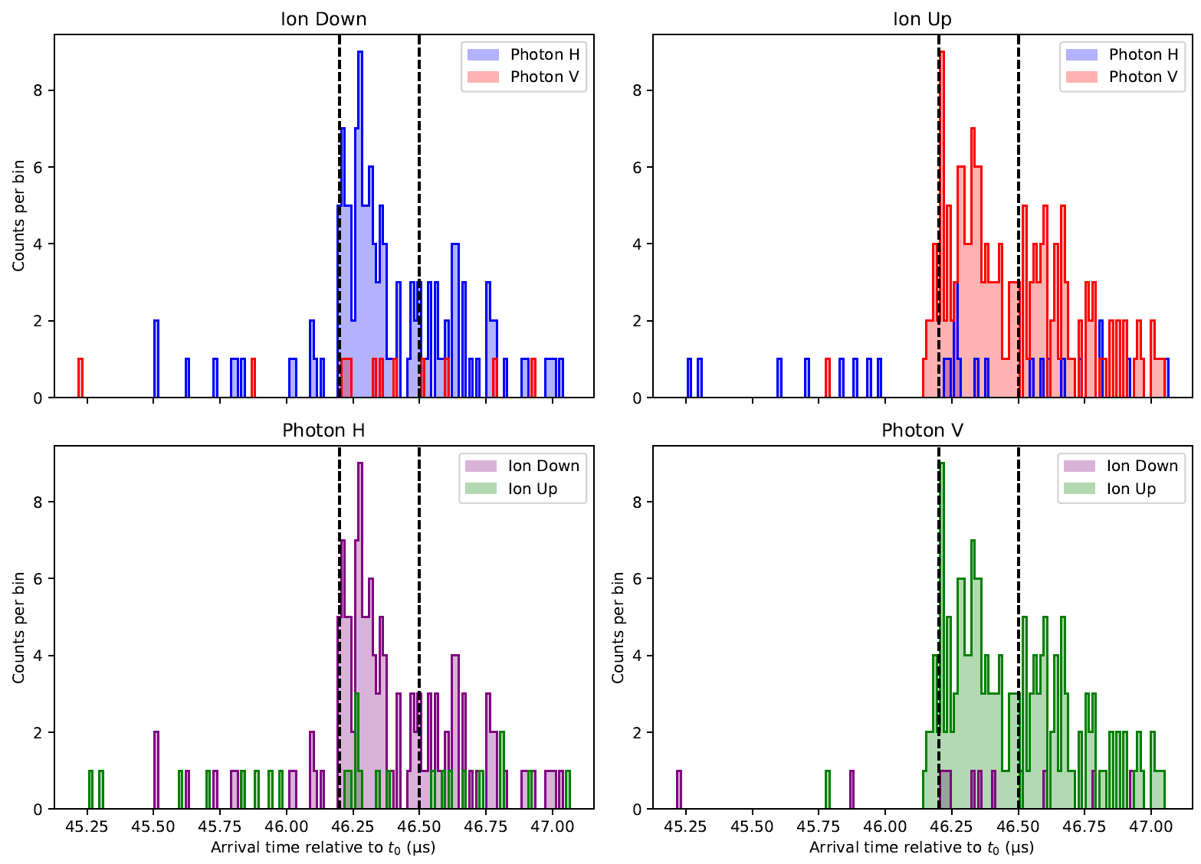
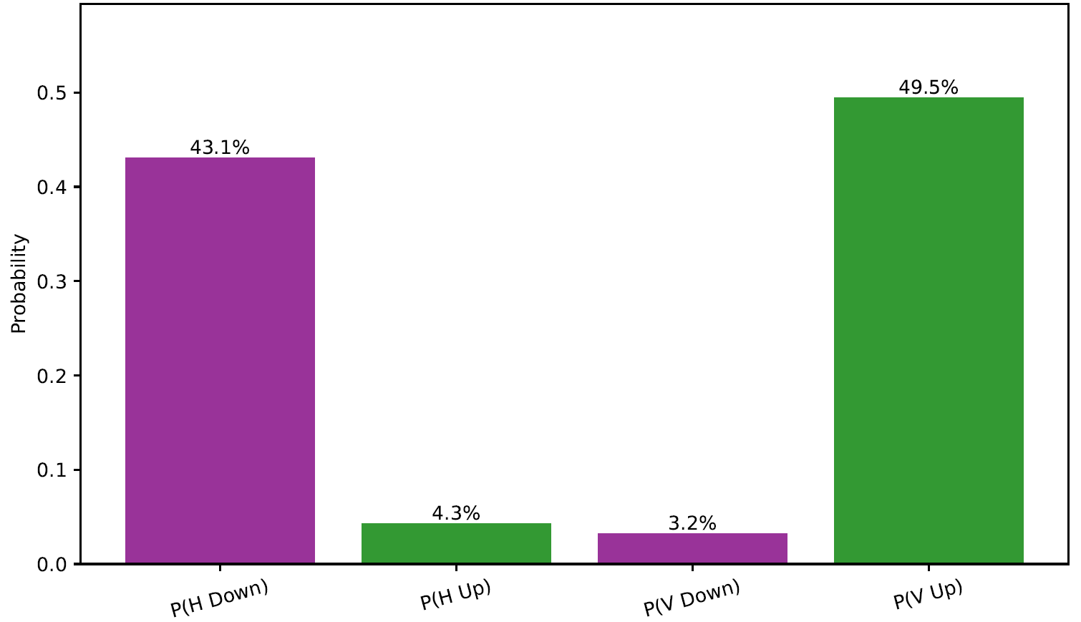
Experiments across 5 km-long deployed fiber
ZZ Joint Probability Distribution
F_{zz}≈ 0.9
Preliminary measurements
Entanglement generation
Correlations between spin and polarization
|H>
∣Ψ⟩=​(∣↑,V⟩+∣↓,H⟩)
Single Ca⁺ ion
854 nm photon
_{|V>}
_{|H>}
|V>
Spin-up
Spin-down
PBS
Entanglement distribution across 5 km fiber-link
B -field
Fiber
UC Berkeley node
Berkeley Lab node
Simplifed scheme
∣Ψ⟩=​(∣↑,V⟩+∣↓,H⟩)

Slide 10
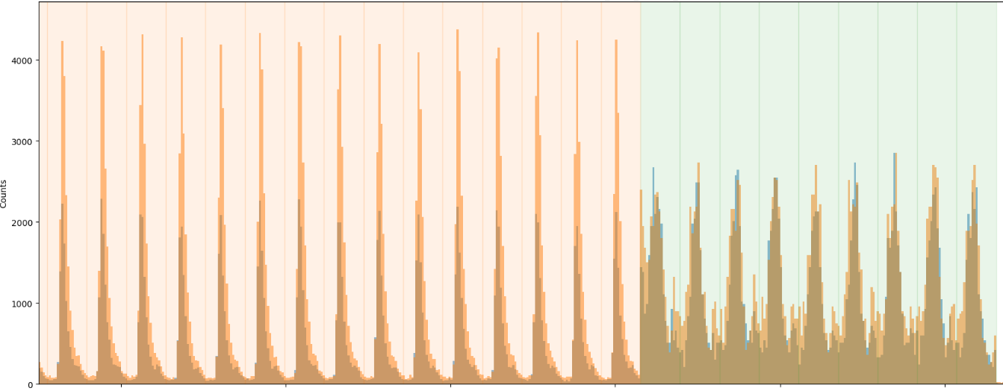
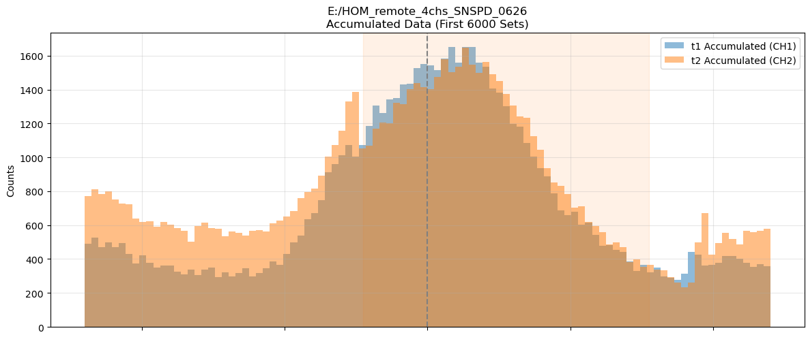
HOM interference between remote ion-trap nodes
LBNL-node UCB-node after 5 km-link
Interferference of photons from independent ion-traps
x20
Preliminary results
Detected single photon trains at LBNL
Initial results : V≈ 0.45, Coinc. Rate ≈ 1 per two hours
Target : V≈ 0.70, Coinc. Rate ≈ 1 per 10 minutes
Single photon generation
HOM interference between distant nodes
854 nm photon
854 nm photon
Single Ca⁺ ion
Single Ca⁺ ion
HOM
Berkeley Lab
5 km fiber-link
UC Berkeley node
Berkeley Lab node

Slide 11
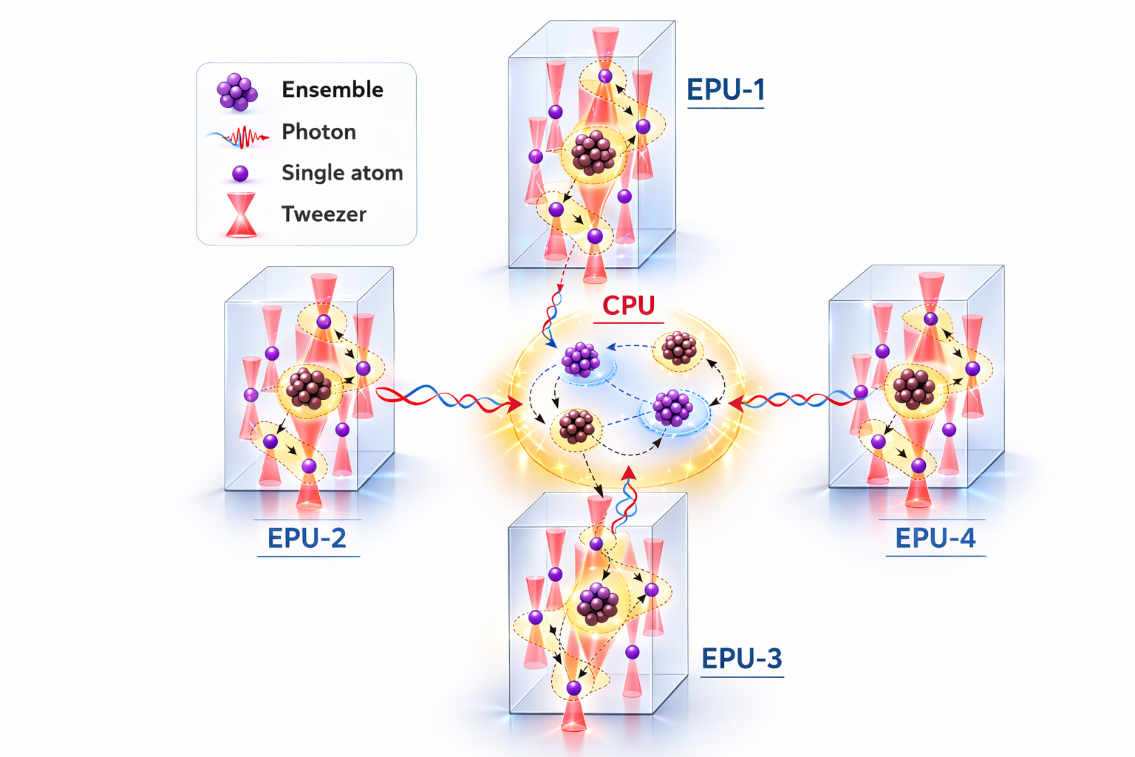



Modular neutral-atom quantum computing enabled by ensemble qubits
Envisioned distributed quantum processing
Motivation
Single atomic qubits are excellent for quantum processing while
ensemble qubits are inherently suitable for quantum communication.
We explore an avenue to combine the complementary features of the single-atomic qubits and ensemble qubits for scalable distributed quantum computing.
Optical interconnect
Processing qubits
Local Rydberg interaction
Advantages
High-rate remote entanglement without the need of optical cavities
High fidelity local entangled operations between single atom and ensemble via native Rydberg gates
Scalable approach & fully compatible with the tweezer based neutral-atom QPUs and their zoned architectures
Central Processing Unit that uses ensemble based quantum memories for photonic quantum processing, deterministic BSM, and routing
EPU: Elementary processing unit CPU : Central processing unit

Slide 12
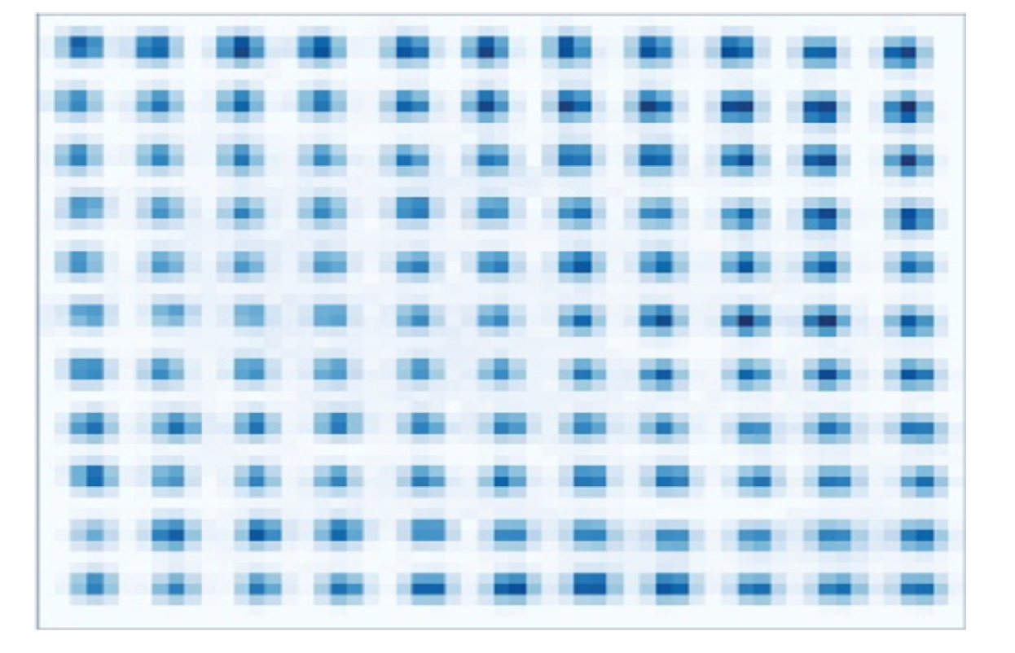

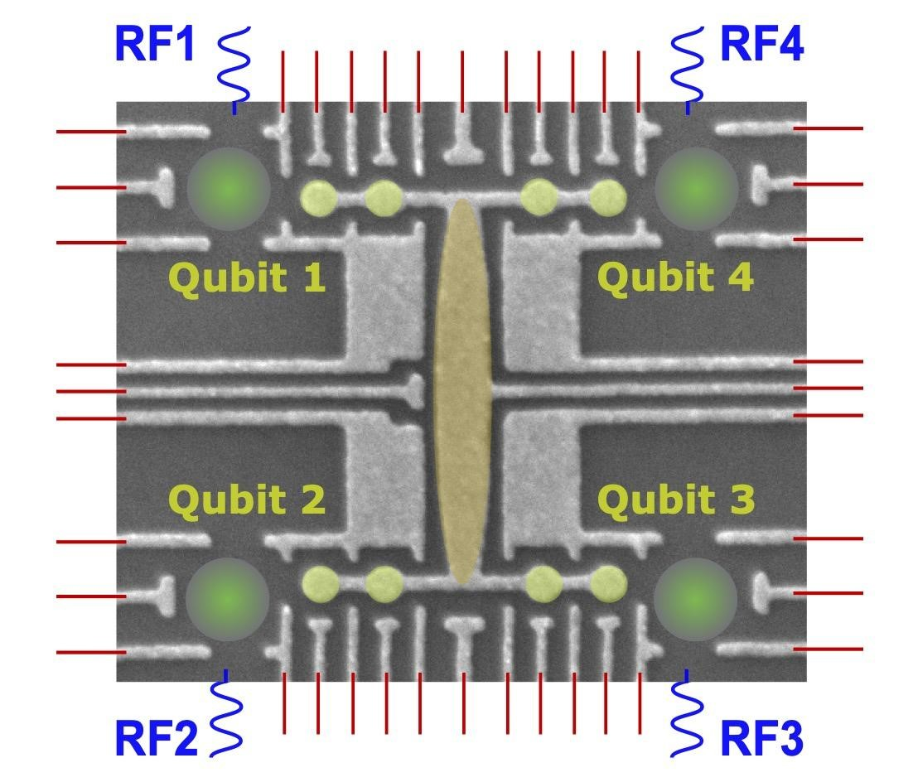


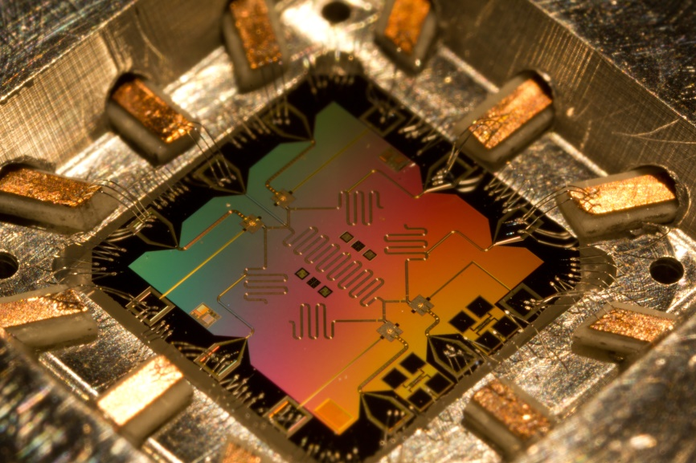
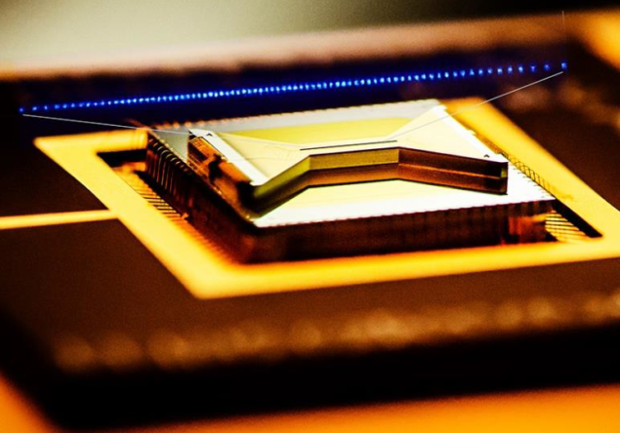
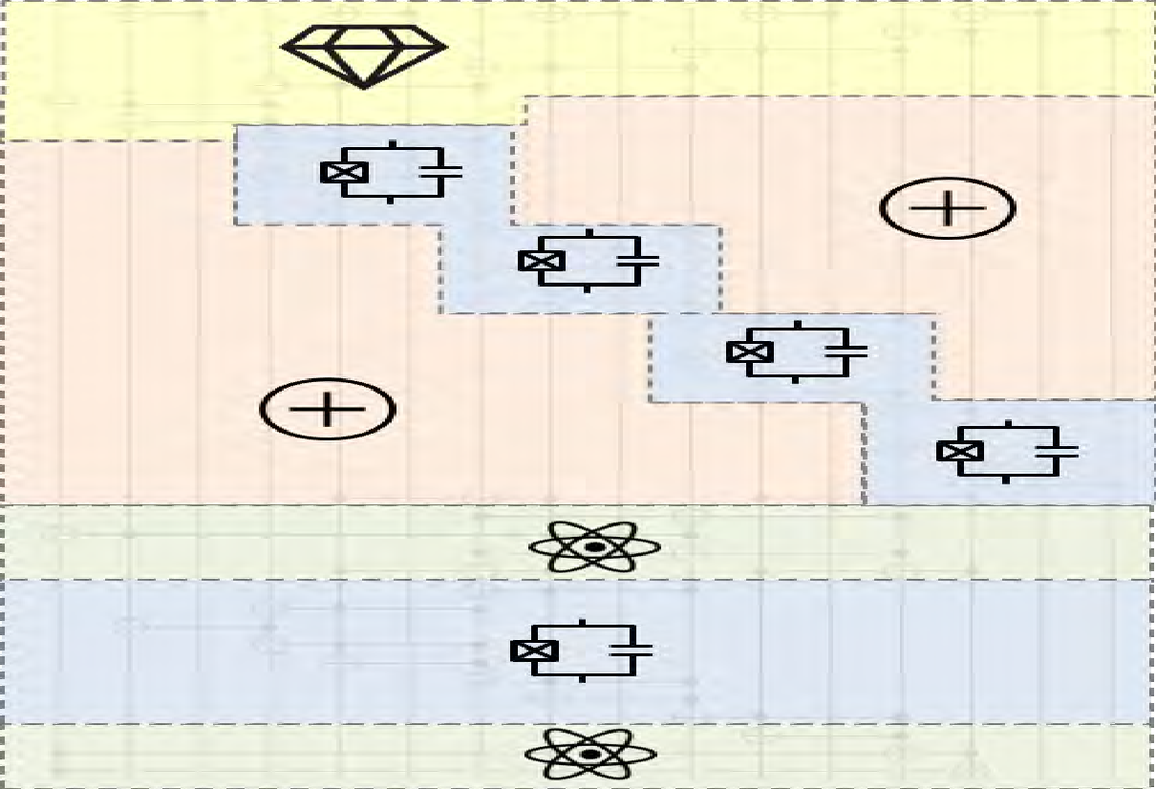
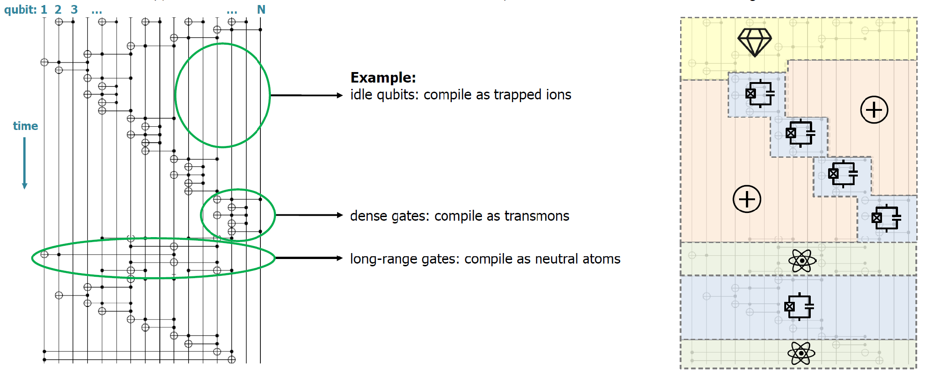
Heterogeneous distributed quantum computing
Superconducting circuits (fast operation)
Trapped ions
(long memory)
Neutral atoms
(parallel processing)
Solid-state qubits
(scalable photonic interface)
Adopted from DARPA’s public distribution
Notes:
Slide 2 – Heterogeneous Distributed Quantum Computing
We are launching a new collaborative effort aimed at interconnecting different qubit modalities to enable heterogeneous distributed quantum computing.
The motivation stems from the fact that no single quantum computing platform currently excels in every metric required for large-scale fault-tolerant quantum computing. Each modality offers unique advantages. For example, superconducting circuits provide extremely fast gate operations, trapped ions offer long coherence times and some of the highest gate fidelities demonstrated to date, neutral atoms excel in parallel processing and reconfigurability, and solid-state platforms are naturally suited for scalable integration with photonic technologies.
A closer look at quantum algorithms, illustrated on the left, suggests that different portions of a computation may benefit from different hardware capabilities. Some qubits may primarily serve as long-lived memory, others may be optimized for dense local gate operations, while still others may be best suited for long-range connectivity. This mirrors the evolution of classical computing architectures, where specialized hardware such as CPUs, GPUs, and memory systems work together to maximize overall performance.
This naturally raises the question: Can we build a heterogeneous quantum computing architecture that leverages the strengths of multiple qubit technologies through photonic interconnects?
Our vision is to develop such an architecture by combining expertise across several quantum platforms with advanced quantum networking and control technologies. Ultimately, we aim to create a framework in which different quantum processors can operate together as a unified computational system, each contributing the capabilities for which it is best suited.

Slide 13
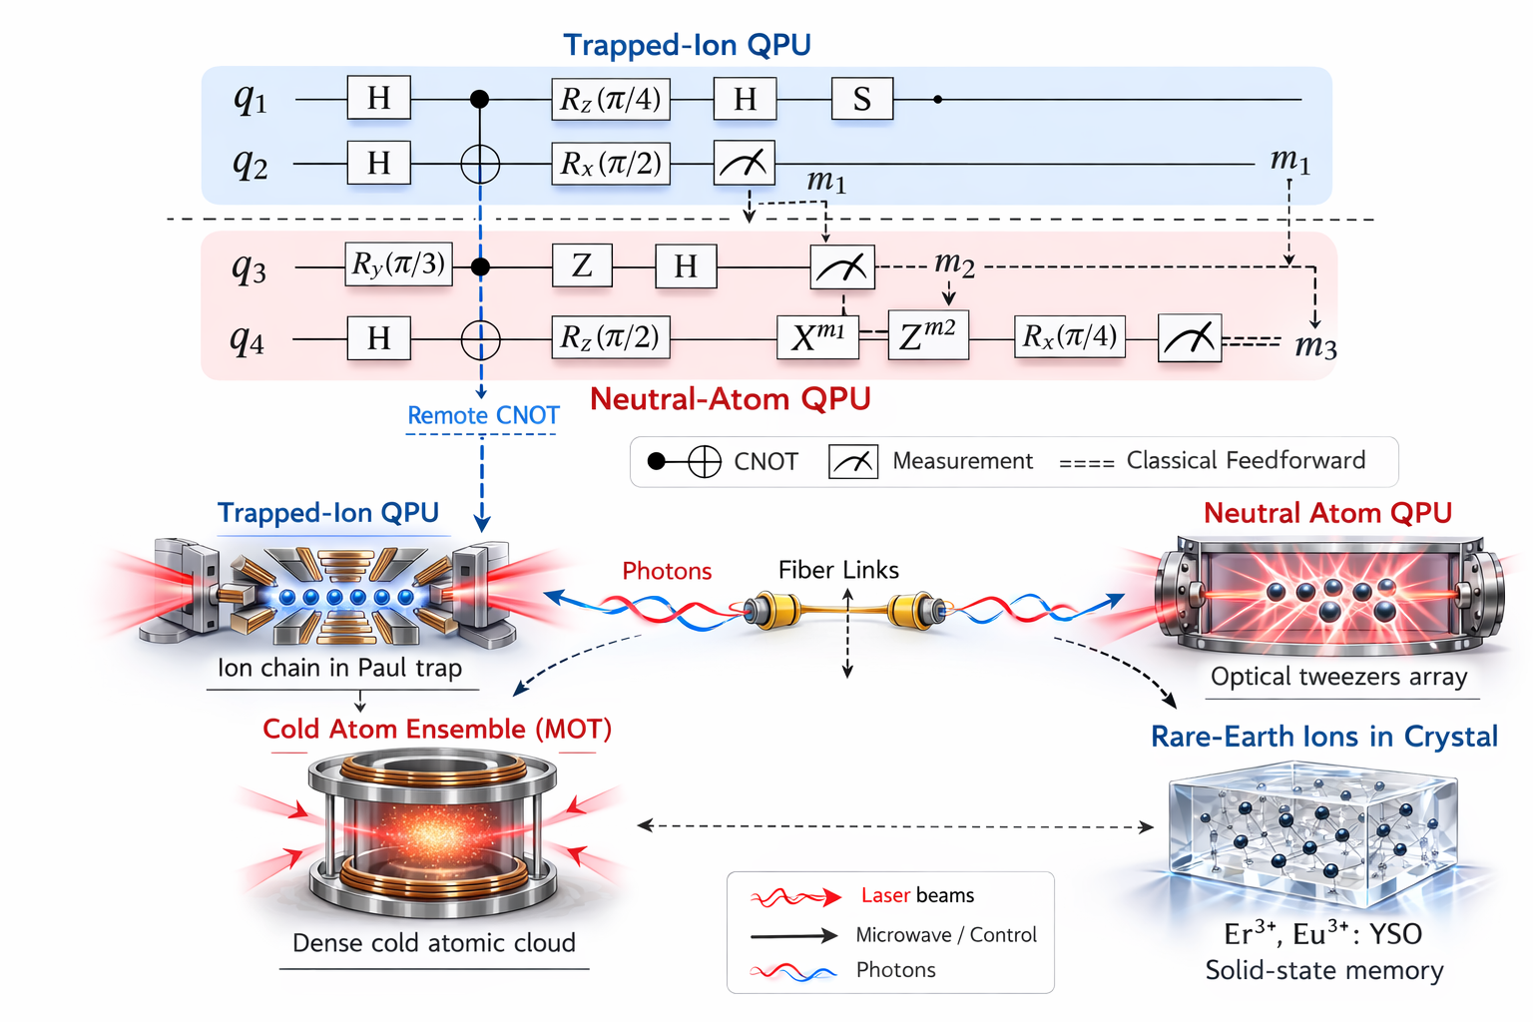


Envisioned heterogeneous architecture
Optical interconnects using
ensemble quantum memories

Slide 14
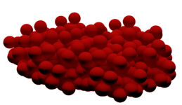

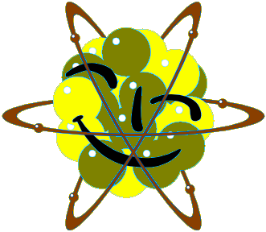

Remote entanglement between different qubit platforms
Heralded entanglement mediated by storage of a single photon
in Tm and Rb ensembles
Heralding
photonic
detection
Storing remote entanglement between matter qubits is in the essence of distributed quantum computing
Entangling two different qubit platform opens the door for heterogeneous quantum computer
Entangled photon pairs
from hot-Rb ensemble
(QUNNECT collaboration)
Beam
splitter
Ongoing efforts
Notes:
Slide 5 – Near-Term Experimental Milestones
Looking ahead, we are targeting two key experimental demonstrations within the coming year that represent important steps toward heterogeneous distributed quantum computing.
The first demonstration focuses on establishing remote entanglement between two fundamentally different ensemble-based quantum platforms: a solid-state quantum memory based on thulium-doped lithium niobate and a laser-cooled rubidium ensemble. As illustrated here, this experiment will leverage Qunnect’s entangled photon-pair source to distribute entanglement between the two systems. Demonstrating entanglement shared and stored across distinct quantum hardware platforms would represent a significant milestone toward heterogeneous quantum networking and the seamless integration of diverse quantum technologies.
In parallel, we will perform remote Hong–Ou–Mandel interference between two trapped-ion nodes connected through our 5-kilometer deployed fiber network linking Berkeley Lab and UC Berkeley. This experiment will validate the indistinguishability of photons generated at geographically separated nodes and provide a critical building block for heralded remote entanglement between trapped-ion qubits.
Together, these efforts will establish both the networking primitives and cross-platform interoperability required for future heterogeneous quantum systems. More broadly, we view these demonstrations as the first steps toward distributed quantum information processing architectures in which different qubit modalities work together through photonic interconnects, each contributing its unique strengths to a larger quantum computing ecosystem

Slide 15
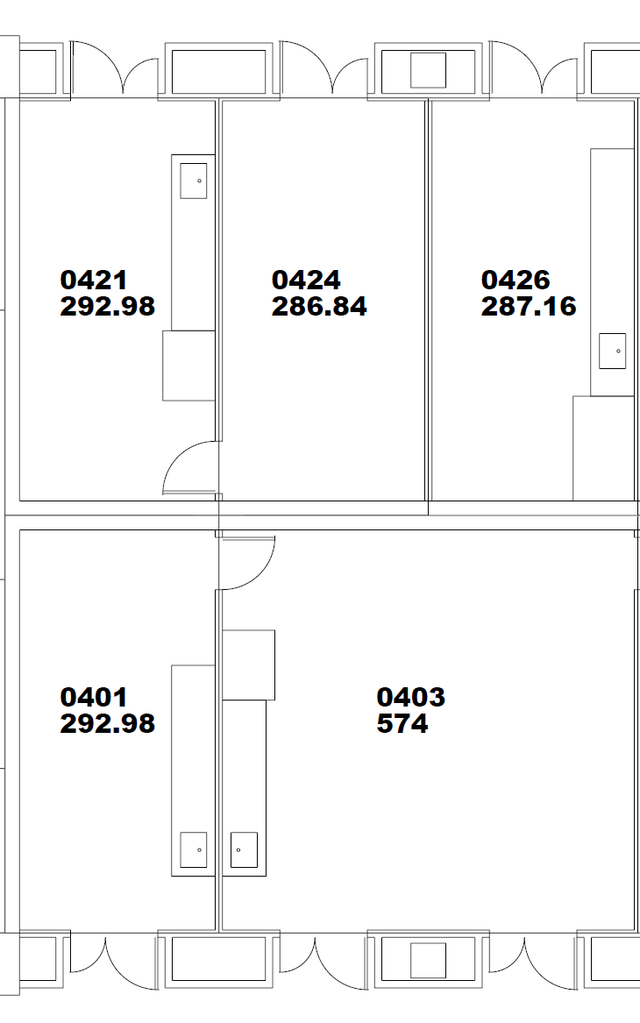
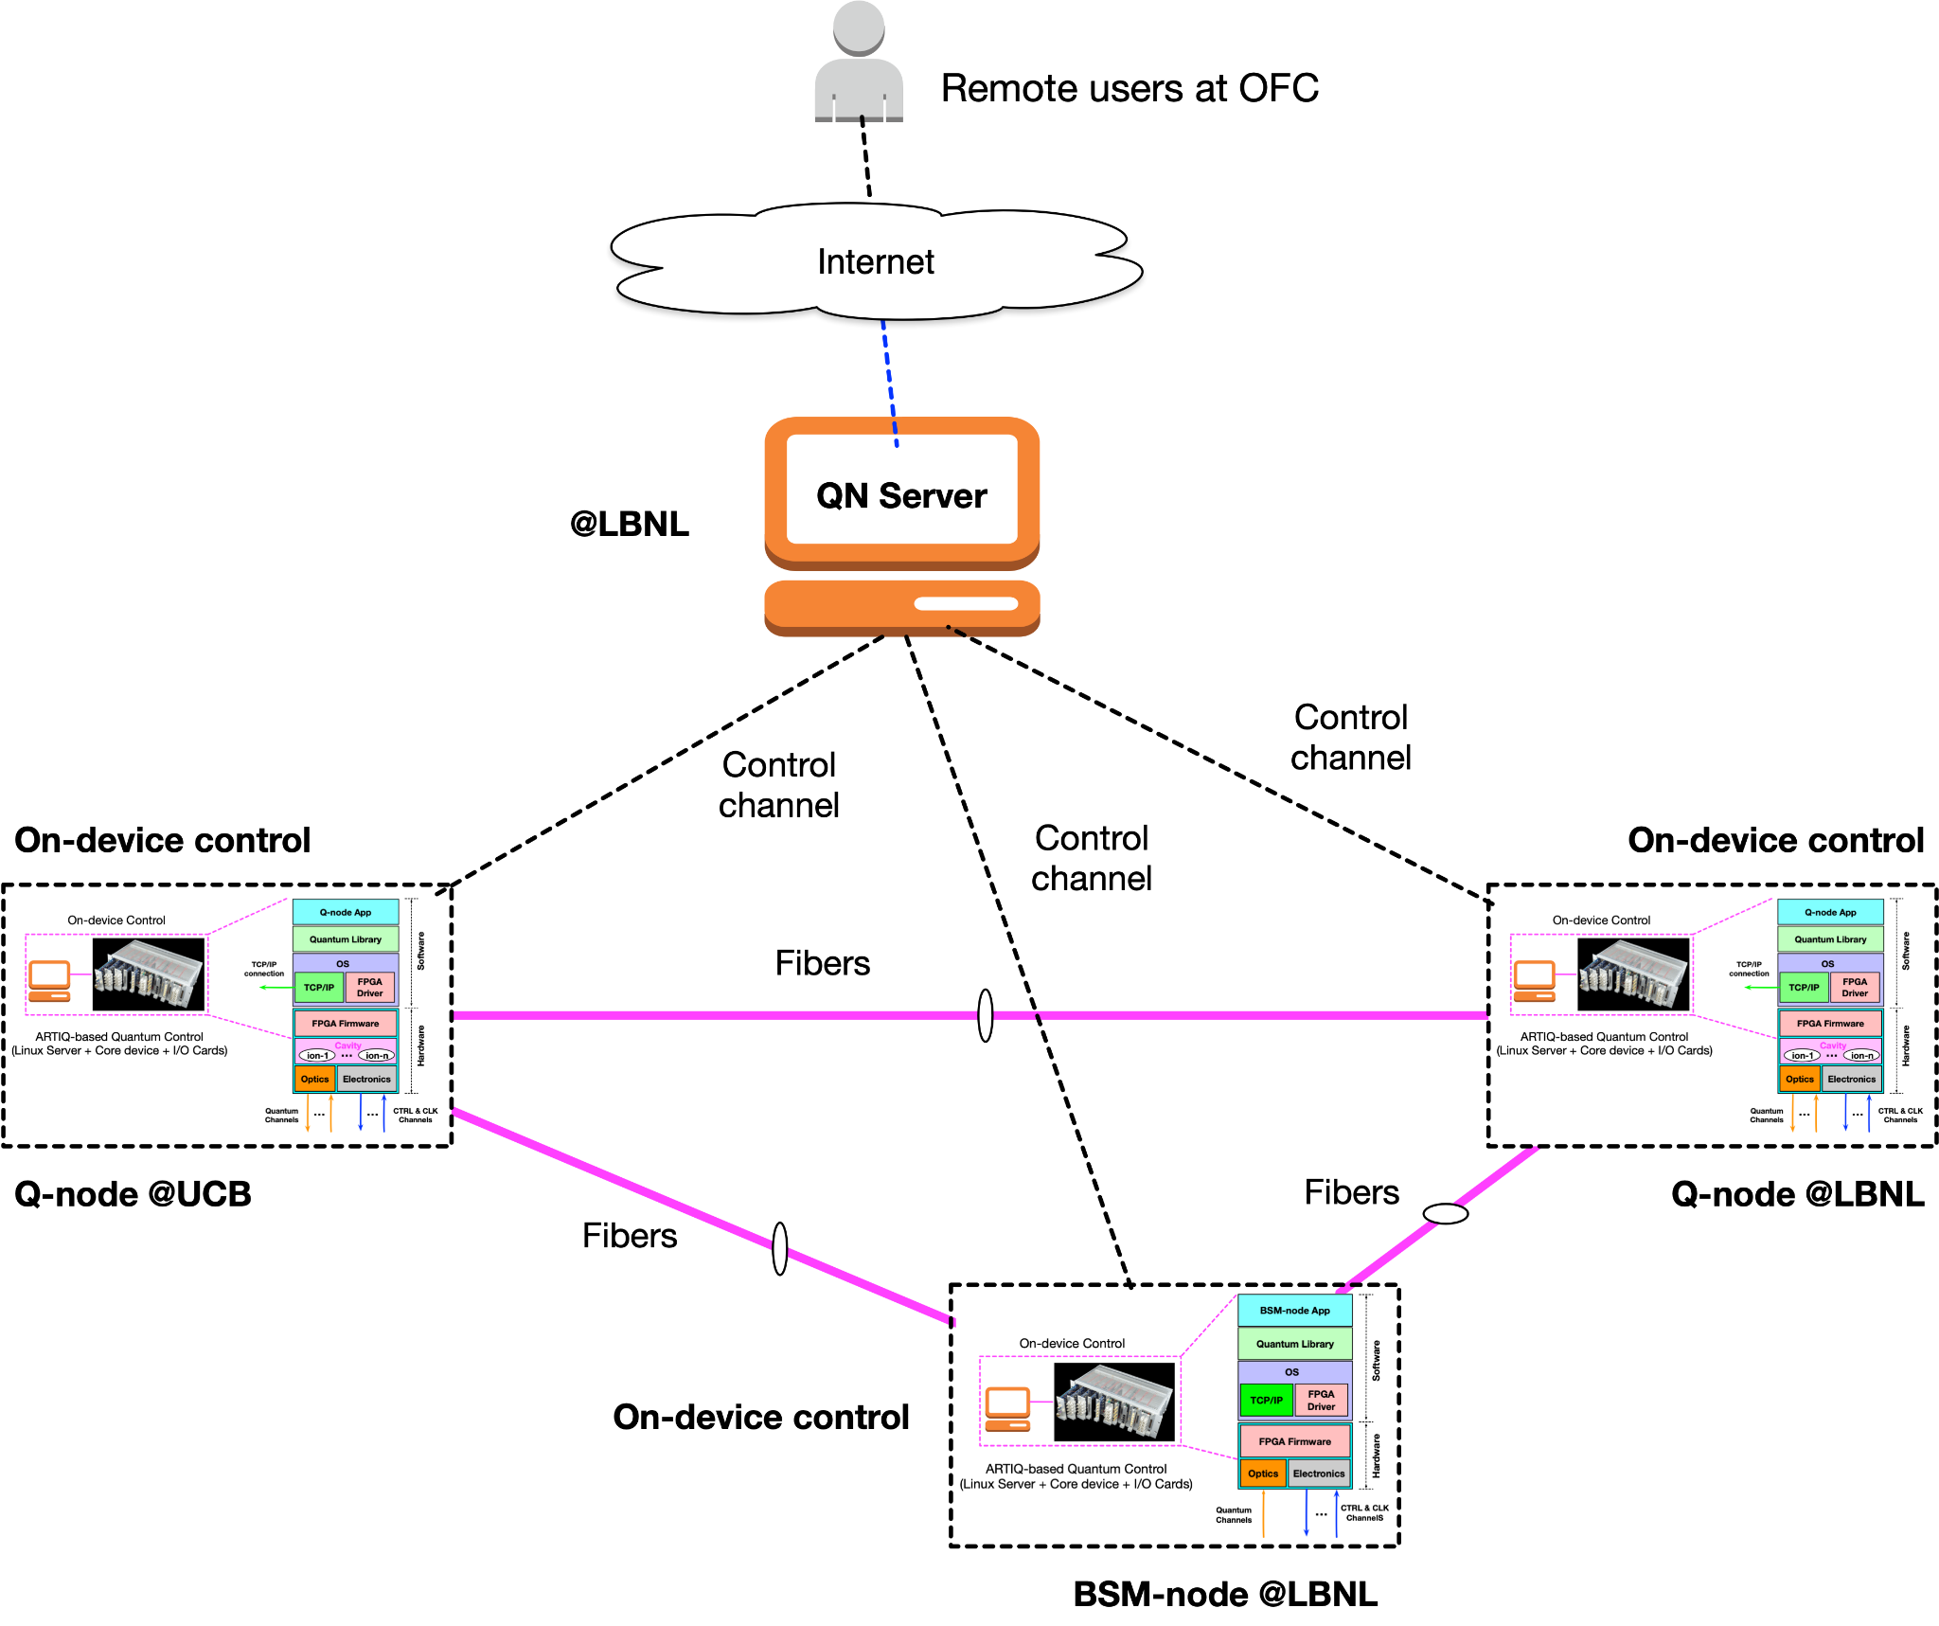
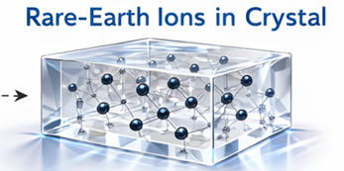
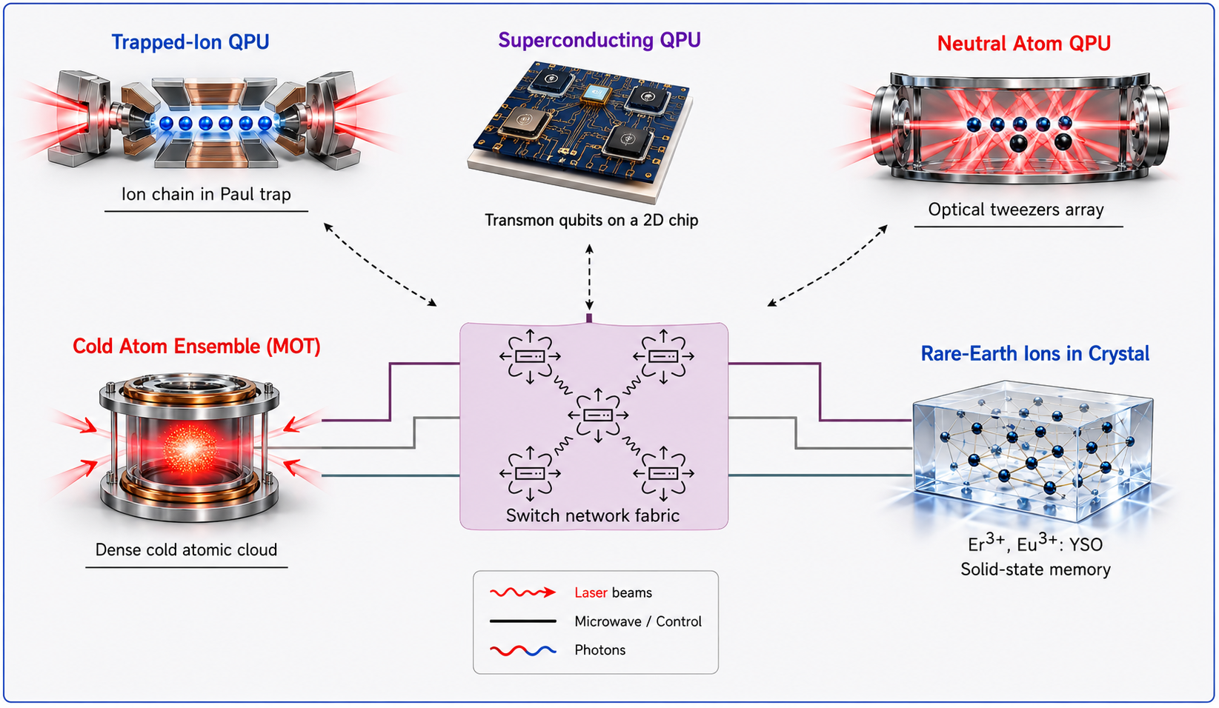
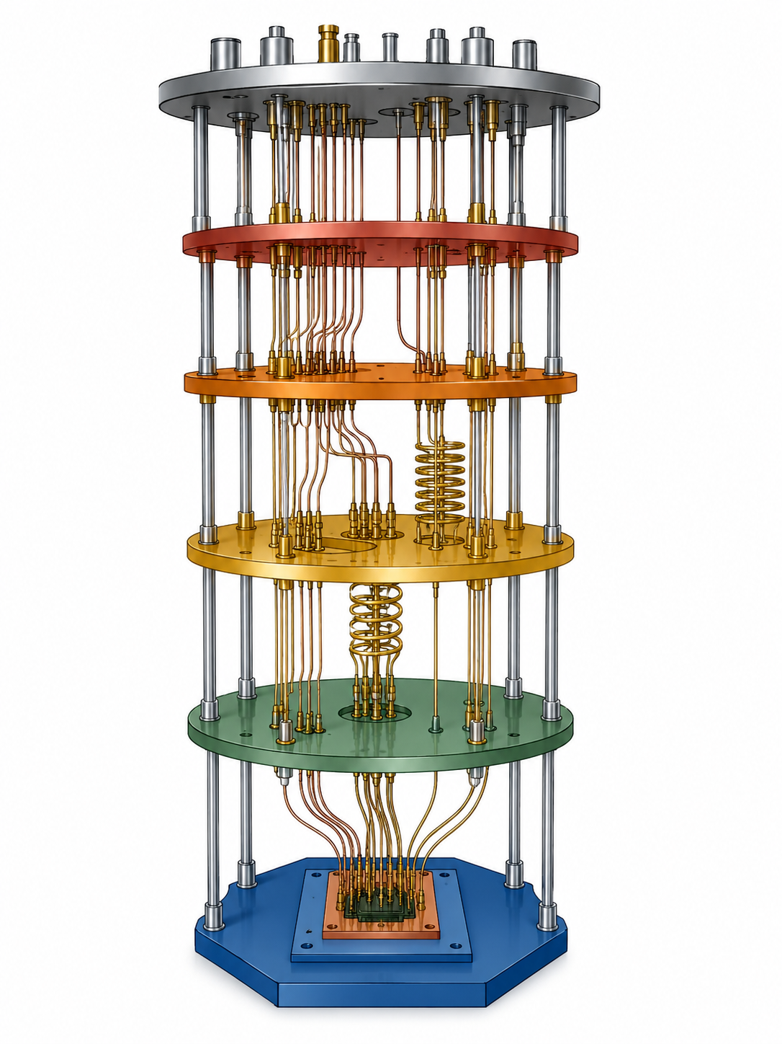


Current capabilities
BERKELEY LAB
Network control
Dilution fridge (FUTURE)
Warm atomic ensemble
(In progress)
Detectors
QFC
Haeffner’s Lab
Lasers
5 km deployed fiber
(In progress)
(In progress)
ESnet Quantum Lab at LBNL
UC BERKELEY
Notes:
To pursue this vision, we are building on a unique set of capabilities that have already been established across Berkeley Lab and UC Berkeley.
At the core of our current quantum networking testbed are two trapped-ion nodes located at LBNL and UC Berkeley, connected through a 5-kilometer deployed fiber link. These nodes are capable of generating high-quality spin–photon entanglement and high-visibility Hong–Ou–Mandel interference, providing the foundation for remote entanglement distribution between matter qubits. We are now building a second and ion-trap node at LBNL integrating these systems with quantum frequency conversion (QFC) technology to translate ion-generated photons into the telecom band, enabling efficient transmission over existing fiber infrastructure.
In parallel, we are expanding the ESnet Quantum Lab into four adjacent laboratory spaces that will host a diverse collection of quantum hardware platforms. On the memory and networking side, we are developing cryogenically cooled thulium-doped lithium niobate crystals and laser-cooled rubidium ensembles, both of which can serve as optical quantum memories and photonic processing elements. We are also integrating Qunnect’s warm atomic ensemble technology, which provides a practical source of entangled photon pairs for quantum networking applications.
On the computing side, we are constructing a neutral-atom quantum processor that will serve as an additional QPU within the testbed. In the longer-term path we aim to build superconducting quantum hardware through a dilution refrigerator infrastructure.
An important feature of this ecosystem is that several of these platforms can be interconnected directly through their native optical transitions, while others will require quantum frequency conversion to achieve interoperability. For example, connecting trapped-ion systems with neutral-atom or solid-state platforms often requires bridging substantial wavelength and bandwidth mismatches, making photonic processing and conversion technologies essential components of the overall architecture.
Complementing the hardware infrastructure, we have developed a comprehensive network control stack capable of automating quantum networking experiments across both local and metropolitan-scale deployments. This control layer provides the orchestration necessary to coordinate distributed quantum resources and will ultimately serve as the foundation for operating heterogeneous quantum networks at scale.

Slide 16


Quantum Network Control
QUANT-NET research paving the path towards architecture, protocols and mechanisms to build a distributed quantum computing (DQC) data center, with error correction
"A two-level control framework for quantum networks" Best paper award, 2025 IEEE International Conference on Quantum Computing and Engineering (QCE), Albuquerque, NM, USA, 2025, pp. 1302-1311, doi: 10.1109/QCE65121.2025.00145.
QUANT-NET control plane software: https://quantnet.lbl.gov/software
Open source!

Slide 17


Distributed quantum computing
in quantum data center
The NetQStack Quantum Data Center Project
Quantum data center
A heterogeneous mix of quantum nodes
Each node features two types of matter qubits
  Computation qubits
  Communication qubits
A BSM pool that consists of multiple BSM units
NetQStack, a software stack that enables distributed quantum computing in a quantum data center
A network-aware quantum compiler
An intelligent quantum controller
NetQStack: toward building a network-integrated computing stack for quantum data centers, The 2nd Workshop on Quantum Networked applications and Protocols (QuNAP), Tokyo, May 18, 2026

Slide 18












Long-term vision
Quantum satellite
Solid-state light matter interface
Interlinking satellite and fibre channels
Long distance quantum repeater
Urban fibre quantum network
Ultracold atoms
Quantum key distribution
Quantum
sensors
Elements of real-world quantum network
UCB (Physics)
Superconducting circuits
5 km
Quantum processor
1 km
UCB (Cory)
Quantum
computers
Berkeley Lab

Slide 19
Extra slides

Slide 20

Envisioned heterogenous architecture
Quantum
Processing
Units (QPUs)
Central
Processing
Units (C-QPU)
Notes:
To realize this vision, we envision an architecture in which multiple Quantum Processing Units (QPUs), including superconducting processors, trapped ions, and neutral-atom systems, are interconnected through a Central Quantum Processing Unit (C-QPU) that provides programmable networking and photonic processing capabilities.
The C-QPU consists of two key elements: a quantum switch fabric and ensemble-based quantum buffers. The switch fabric enables dynamic and reconfigurable interconnections among distributed QPUs, allowing quantum resources to be allocated where and when they are needed. The ensemble-based quantum buffers provide photonic processing functions that are essential for networking dissimilar quantum systems.
These functions include temporal synchronization through heralded quantum memories, as well as bandwidth, wavelength, and spectral-mode conversion using nonlinear optical processes such as three-wave and four-wave mixing. Operating in a highly multiplexed manner, these buffers can simultaneously process many photonic channels, helping bridge the substantial differences that exist among various quantum hardware platforms.
We also believe that advanced photonic switching technologies, such as Cisco's universal switching architecture, could further enhance the capabilities of the C-QPU. In particular, such technologies may enable flexible conversion and routing across different photonic degrees of freedom including time-bin, frequency, polarization, and spatial modes providing an additional layer of interoperability between otherwise incompatible quantum systems.
Ultimately, this architecture seeks to transform photonic interconnects from simple communication links into intelligent quantum networking resources that enable scalable heterogeneous distributed quantum computing.

Slide 21


Interconnecting the nodes via telecom photons
UCB Lab
New lab at LBNL
Quantum frequency conversion
854 nm → 1550 nm
Output photon at 1550 nm
Input photon at 854 nm
Current efficiency ~ 10 %
Target efficiency > 30%
Low-noise operation
Preservation of polarization
Pump field at 1900 nm
Difference frequency generation
Notes:
Trapped ions fullfill the main requirements fo DQC

Slide 22


Quantum network control and scheduling
QUANT-NET control plane software: https://quantnet.lbl.gov/software
Open source!!!
Q-nodes and BSM-nodes are automatically operated and calibrated by local FPGA-based real-time control systems
Remote users make request over quantum network server (QNS) to have entanglement between Q-node via BSMs
Quantum network control schedules the user requests bsed on the avalabilty of the nodes and calibration slots

Slide 23


Bringing all the layers together
Distributed quantum information processing
10 um
Integrated device technology based on a silicon color center
Sipahigil group, Nature Communications 15, 6920 (2024)
T-centers for quantum networking
Leveraging silicon integrated photonics
Telecom-wavelength emission for fiber-based quantum networks
Long-lived spin levels for storage of remote entanglement

Slide 24
Long-term vision
Quantum satellite
Solid-state light matter interface
Interlinking satellite and fibre channels
Long distance quantum repeater
Urban fibre quantum network
Ultracold atoms
Quantum key distribution
Quantum
sensors
Elements of real-world quantum network
UCB (Physics)
Superconducting circuits
5 km
Quantum processor
1 km
UCB (Cory)
Quantum
computers
Berkeley Lab

