Slide 1

Toward a Quantum-Safe AI Supercycle
GÉANT SIG-Quantum meeting – CERN
Marta Buffa – Business Development Manager, Nokia
Nicolas Le Sauze - Head of Research Department, Nokia Bell Labs

Slide 2

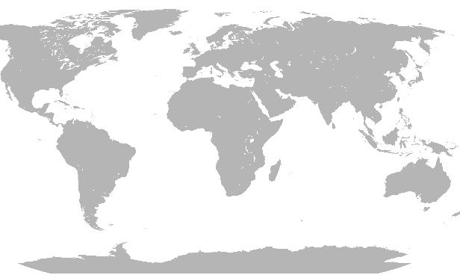


Three stages of one evolution
Quantum App
QKD
Local QAlgo
Dist. QSensors
Dist. Quantum Computing
Control & Management Plane
OOB
Q-KMS
Entanglement Control(Qubit ID, Stitching, QEC, …)
OOB CONTROL PLANE
Entanglement Control
Q-KMS
C-KMS
Q-KMS
Orchestrator
OOB CONTROL PLANE
Site A
Site B
QKD
Site A
QKD
QKD
Site B
Site A
QKD
Site B
QKD
QKD
Data Plane
Data Plane
CLASSICAL NETWORKS
TRANSFORMING WITH AI
QUANTUM SAFE
CLASSICAL NETWORKS
QUANTUM SAFE
CLASSICAL + QUANTUM NETWORKS
Time

Slide 3
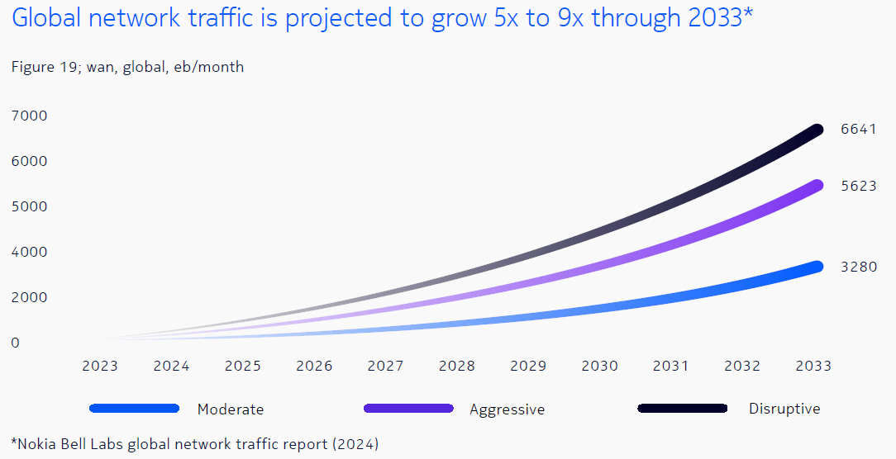

AI is too big for the European internet
Global network traffic is projected to grow 5x to 9x through 2033*
AI adoption
Structural capacity bottleneck​
67% EU Enterprises Using AI
54% Network issue
Infrastructure gap​
81% CSPs cannot meet demand​
Nokia surveyed over 1,000 European business leaders across industries and telecommunication providers to understand how AI is taking root
Cybersecurity #1 deployment area over the next 2–3 years
ahead of automation, customer service, and innovation
63%
Enterprises expect to allocate 16% to 30% of their IT budgets to AI-driven security
50%

Slide 4
Quantum Threats Already Challenging AI Sovereignty
HNDL: the threat to confidentiality
TNFL: the threat to integrity
Harvest Now, Decrypt Later
future decryption of strategic AI assets
In HNDL, adversaries capture encrypted AI traffic today: model weights, training data, inference outputs and decrypt it once quantum capabilities mature.
Trust Now, Forge Later
future decryption of strategic AI assets
In TNFL, they record authentication exchanges to later impersonate nodes or manipulate network behavior.
Authentication
Integrity
Non-repudiation
Confidentiality
Sovereignty not a strategic ambition, but an OPERATIVE URGENCY

Slide 5
The sovereignty paradox
EU leaders say that control data in Europe is extremely important to trust AI infrastructure
EU leaders treating Sovereignty as a core part of their infrastructure strategy
73%
86%
39% prioritize EU cloud providers
If scaled broadly:
private silos destroy economies of scale
fragmentation reduces competitiveness
offshoring exports both data and innovation
40% keep sensitive workloads on-prem
39% open-source models to reduce dependency on foreign providers
But there is an even deeper gap: who controls the encryption keys?

Slide 6

Data Sovereignty in AI era
EU Geopolitical
Sovereignty as strategic autonomy
Europe is investing €200B+ to reduce dependence on foreign compute.
Location sovereignty is necessary but not sufficient.
EU Regulatory
Sovereignty as a market access requirement
True sovereignty is control over cryptographic orchestration across the entire data lifecycle.
Concrete implications:
operational resilience requirements (DORA)
supply chain control (NIS2)
accountability for AI systems (AI Act)
increasing pressure on quantum-readiness / crypto-agility
EU Physical & Architectural
Sovereignty as control of data flows and key control
True sovereignty is :
where the data resides
where the servers are
who controls the lifecycle of cryptographic keys across the entire infrastructure

Slide 7
Data Sovereignty in Nokia Quantum Safe Networks
Classical QS-OOB Control
OUT OF BAND KEY MANAGEMENT
Trusted NODE
SOC
Trusted NODE
OOB key management introduces an independent cryptographic control plane that sits above individual protocols and vendors.
Partner’s
KMS
C-KMS
Orchestrator
Partner’s
KMS
Centralized control and governance
Keys are generated under controlled jurisdiction
Distribution is orchestrated by a trusted system
Control does not depend on external actors
Standardized QS-API
End-to-end lifecycle control
Classical Telecom
Rotation and revocation are centralized
Full lifecycle managed
Encryptors
Encryptors
Resilience and operational responsiveness
Rapid, coordinated response to cryptographic failures
Central control enables fast rekeying and policy updates
C-KMS turns the network into a policy-driven cryptographic system, where data remains protected not because of where it is stored, but because keys are controlled, governed, and never leave the operator’s trust domain.
Crypto-agile
Not dependent on any single algorithm or technology

Slide 8
Three stages of one evolution
Longer term focus in Nokia BL
Quantum App
QKD
Local QAlgo
Dist. QSensors
Dist. Quantum Computing
Control & Management Plane
OOB
Q-KMS
Entanglement Control(Qubit ID, Stitching, QEC, …)
OOB CONTROL PLANE
Entanglement Control
Q-KMS
C-KMS
Q-KMS
Orchestrator
OOB CONTROL PLANE
Site A
Site B
QKD
Site A
QKD
QKD
Site B
Site A
QKD
Site B
QKD
QKD
Data Plane
Data Plane
CLASSICAL NETWORKS
TRANSFORMING WITH AI
QUANTUM SAFE
CLASSICAL NETWORKS
QUANTUM SAFE
CLASSICAL + QUANTUM NETWORKS
Time

Slide 9
Debunking some common misconceptions
Quantum networks are only useful for quantum key distribution
Quantum networks can be used for:
E2E Quantum key distribution
Secure distributing quantum computing
    Scalability and global QDC orchestration
    Distributed Q-Sensors interconnect
    Blind computing
Etc.
Quantum networks are
better / faster / more reliable
Quantum networks do not move data
around, they distribute entanglement:
New network service/network primitives
    Fully distributed process
Application agnostic
    Only latency, throughput & fidelity matter
  Quantum networks extend classical networks, do not replace them

Slide 10







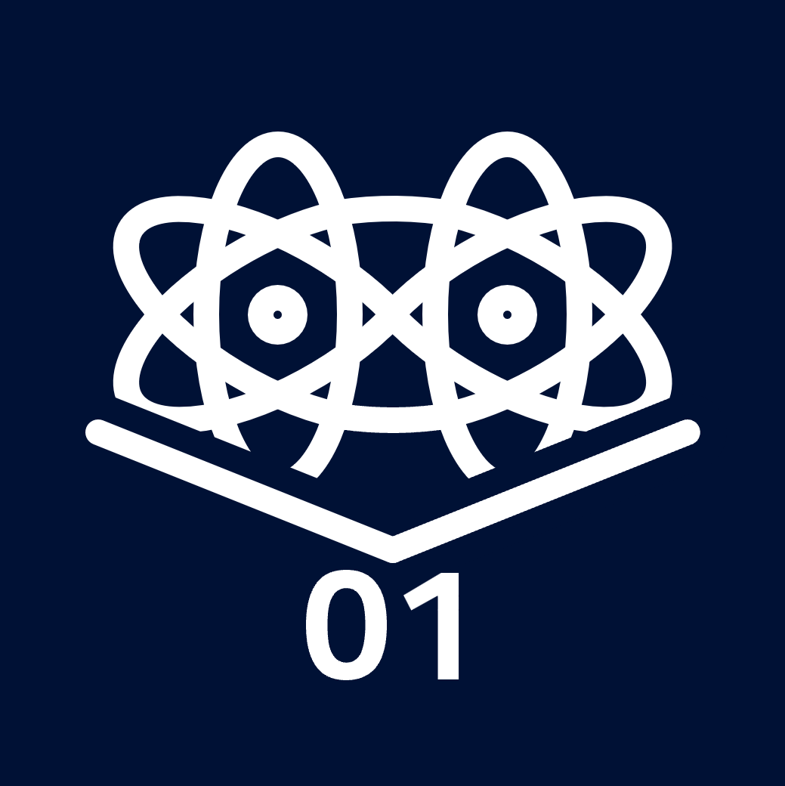

Distributing entanglement
Entanglement creation
Aim: create entangled qubits in two adjacent buffers
Opt. 1: mid-link source
Opt. 2: one source, one receiver
Opt. 3: mid-link interference
All of these require ACK messages asserting photons are well received
Entanglement stitching
Aim: propagate entanglement
Step 1: Bell state measurement
    Destroys the two qubits
    Outputs two classical bits
Step 2: Transmit the two bits
Step 3: Pauli correction
End-to-end propagation
Aim: cascade propagation along path
Entanglement creation
Bell state measurements
Single Pauli correction at the end
Requires identifying paired qubits
Combined in a "consolidation" step
ACK
2 bits
Source
Source
Interference
Transduction
Transduction
Source
Source
Transduction
Bell state
measurement
Pauli
correction
Tight coordination is required between the Q-plane and the classical network used for its control (“p-plane”)

Slide 11
Protocols for quantum networks
Link
Network
Session
Application
Bell state creation
Transmission
Transduction/storage
Bell state measurement
Pauli correction
Error correction
Entanglement distillation
Qubit sampling
Measurement
QPUs
Quantum
Acknowledgement
Consolidation
Distillation post-selection
Bell state certification
Privacy amplification
QKD
Quantum teleportation
Distributed quantum gate
User
Synchronization
Path assignment
Resource reservation
Designing these
protocols is the heart
of our activity
Control

Slide 12
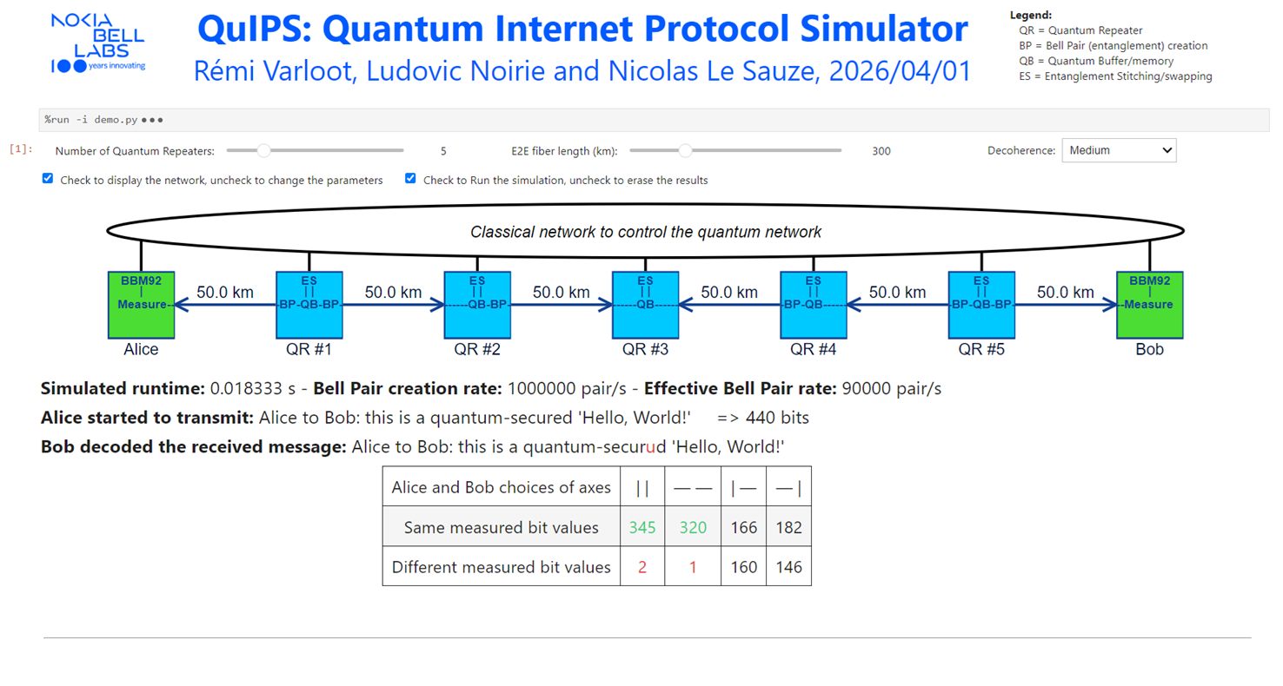
Examples Innovation (1)
In-house QN simulator of the Q- and p-planes for the entanglement propagation
1st use case:
E2E entanglement consumption for a repeater-based QKD protocol
Proposed extension with an enhanced auth. for the classical channel communication
“Authentication Through Error Estimation in QKD””,
Globecom 2023, L. Noirie and R. Varloot

Slide 13
Example innovation: stabilizing the link layer via throttling (2)
The problem: session multiplexing
When handling multiple sessions, nodes must stitch qubits based on their sessions
    Sessions are assigned by the nodes
    Sessions should be assigned post-ACK signal
    Assignments by neighbors must coincide
Results in a global scheduling scheme
    Assumes that qubit availability is reliable
    But losses make them highly unreliable!
  Multiplexing requires a new approach

Slide 14

Example innovation: stabilizing the link layer via throttling (cont’)
The problem: session multiplexing
First-come-first-serve produces a drift
    Accumulates rapidly throughout the network
    End-to-end fidelity is greatly reduced
Solution: stabilize qubit availability
    Use virtual buffers to control availability
    Provides deterministic deliveries
      Allows for session multiplexing!
    Link throughput reduced by only ~1-5%
    Storage time increased by only ~5-10%
Virtual
buffer
Virtual
buffer
Time
Almost a constant delivery rate of qubits ready for consumption by quantum applications

Slide 15
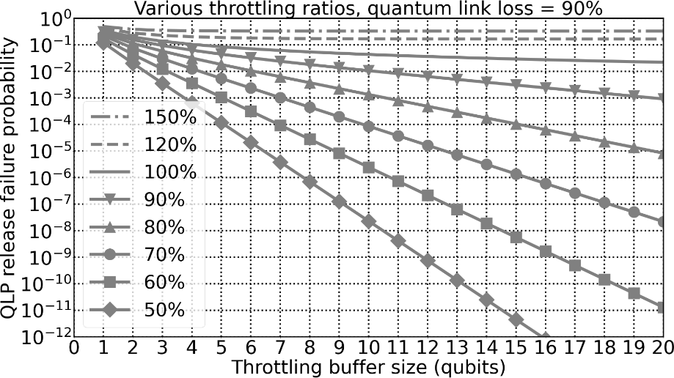

Quantum Link Layer
Performance evaluations
Throttling Protocol for Quantum Links“ ,
accepted at ECOC 2026, L. Noirie and R. Varloot
Quantum link parameter: losses
Additional parameters:
Buffer size B
Throttling ratio $η_{QLP}$
average rate 𝜇 of successful storage of Bell pairs in quantum memories
Performance criteria: Bell pair delivery rate $η_{QLP}$⋅𝜇 and delivery
failure probability 𝜖

Slide 16
Key take-aways
Cybersecurity is a primary pillar of the AI supercycle
which is the 1st stage of the profound transformation
of Quantum Safe Network business
Stage 2 corresponds to securing the p-plane,
using Out-Of-Band control over classical networks
Stage 3 is longer term with the introduction of a
Q-plane, inheriting from the two 1st stages
  Need for specific components/HW
  But also for architecture design and for a dedicated
  protocol stack for E2E entanglement distribution

Slide 17
Toward a Quantum-Safe AI Supercycle
GÉANT SIG-Quantum meeting - CERN
Marta Buffa – Business Development Manager, Nokia
Nicolas Le Sauze - Head of Research Department, Nokia Bell Labs

