Slide 1
Distribution of polarization-entangled photon pairs co-existing with White Rabbit signals over shared optical fiber
SIG Quantum 01/07/2026
Annick Teepe
annick.teepe@cern.ch

Slide 2
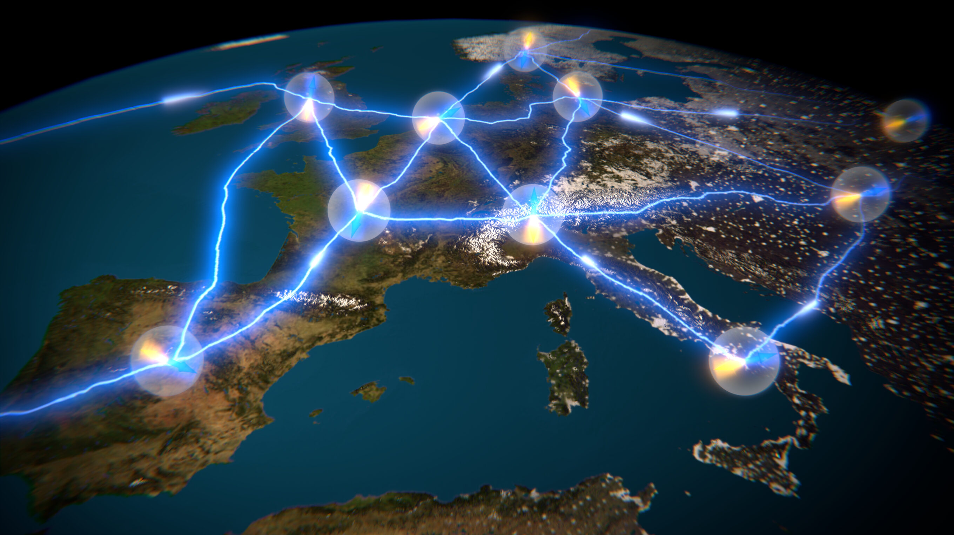
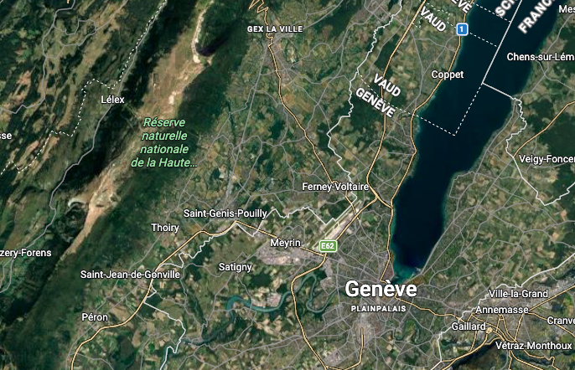


Future Quantum Internet
Towards Entanglement as a service
Network of spatially separated, interconnected nodes
Applications
    - Secure communication
    - Distributed quantum computing
    - Networked quantum metrology
This work : quantum connection between two nodes using non-dark fiber !
Image : European Quantum Internet Alliance
Notes:
Ultimate Goal : Future quantum internet. Not a faster version of what we have today but a complementary network. Moving toward entanglement as a service : this means building a network of spatially separated, interconnected nodes where quantum information is exchanged rather than just classical bits
Applications
Secure comms : using QKD to create links that are physically impossible to intercept
Distributed Q computing : Individual quantum processing units have physical limits on how many qubits they can hold before noise becomes unmanageable. By distributing entanglement between many different of these units, they can opearte as if they were one giant quantum computer.
Networked quantum metrology : linking ultra preciese sensors and atomic clocks to achieve a level of synchronisations that a single instrument cannot reach
This work:
Theory of this big map;
Small step towards it, starting with quantum connection between two nodes in Geneva while classical traffic is present on the fiber.

Slide 3
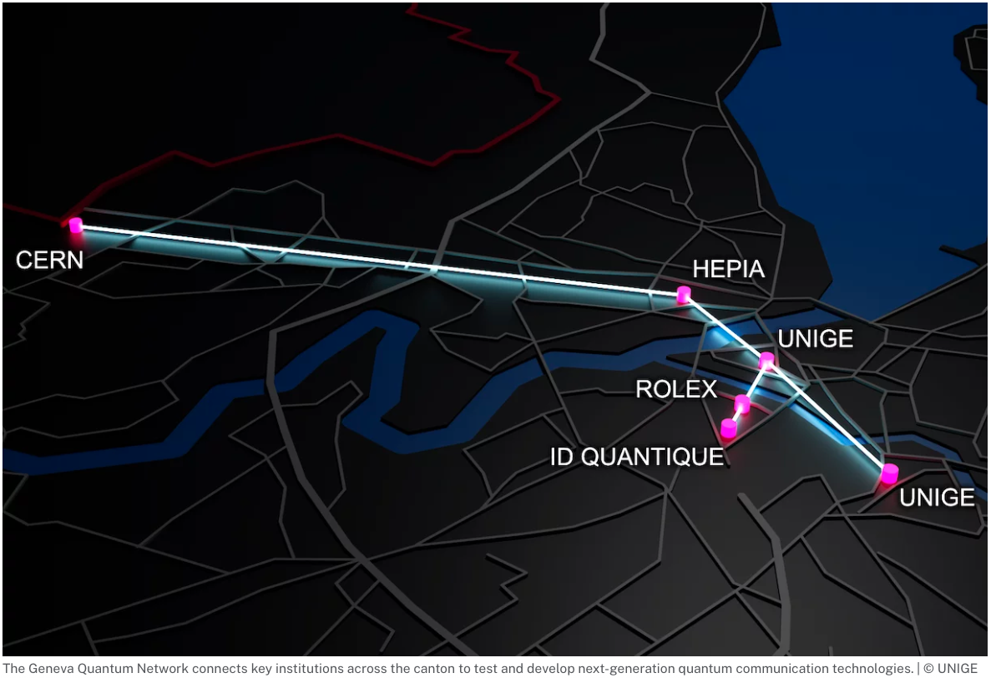
Main challenges in large-scale quantum networks
Transmitting quantum information via photons over long optical fiber links
      Photon losses
      Synchronisation
      Variable transmission conditions
        → transmission time (length changes)
        → polarisation state (vibrations/other)
      Work in low-loss wavelength bands
      ( Telecom C-band & O-band )
Notes:
Metropolitan scale quantum network entails transmitting quantum information via photons on long optical fiber links – like the image here on the right, which shows the recently augurated Geneva Quantum Network.
Three main challenges :
Photon losses - Especially losses of photons in visible wavelength range are great
Synchronisation - Single photon wavepackets can be as short as picoseconds, high-accuracy sync is required
Variable transmission conditions - Changes in environment, such as temperature increase which results in length increase, or vibrations which modify the polarisation state
Solution for photon losses :
Pick low loss wavelengths : telecom C or telecom O band

Slide 4

Main challenges in large-scale quantum networks
Transmitting quantum information via photons over long optical fiber links
      Photon losses
      Synchronisation
      Variable transmission conditions
        → transmission time (length changes)
        → polarisation state (vibrations/other)
      Quantum-Classical Coexistence
multiplexer
Single photons
Notes:
This talk : solution for the next two problems: multiplex White rabbit with quantum signal on the same optical fiber !
White Rabbit is ethernet based , classical optical two-way time transfer protocol, providing sub-ns synchronisation accuracy and picosecond-scale precision
Same fiber = Same environmental conditions
→ WR for synchronisation & as probe !

Slide 5
Today: Quantum Networks at CERN
      Entanglement distribution of polarisation entangled photon pairs co-existing with White Rabbit synchronization signals on the same optical fiber
15xx nm
15xx nm
White Rabbit Switch
White Rabbit Switch
DWDM
DWDM
Source
1320 nm
1320 nm
795 nm
TimeTagger
TimeTagger
Detection
Detection
Alice
Bob
Notes:
This is a 2 node network. All experiments presented here are done in Loop back configuration, meaning Alice and Bob are in the same lab, and the long fiber is going out and in via some path

Slide 6
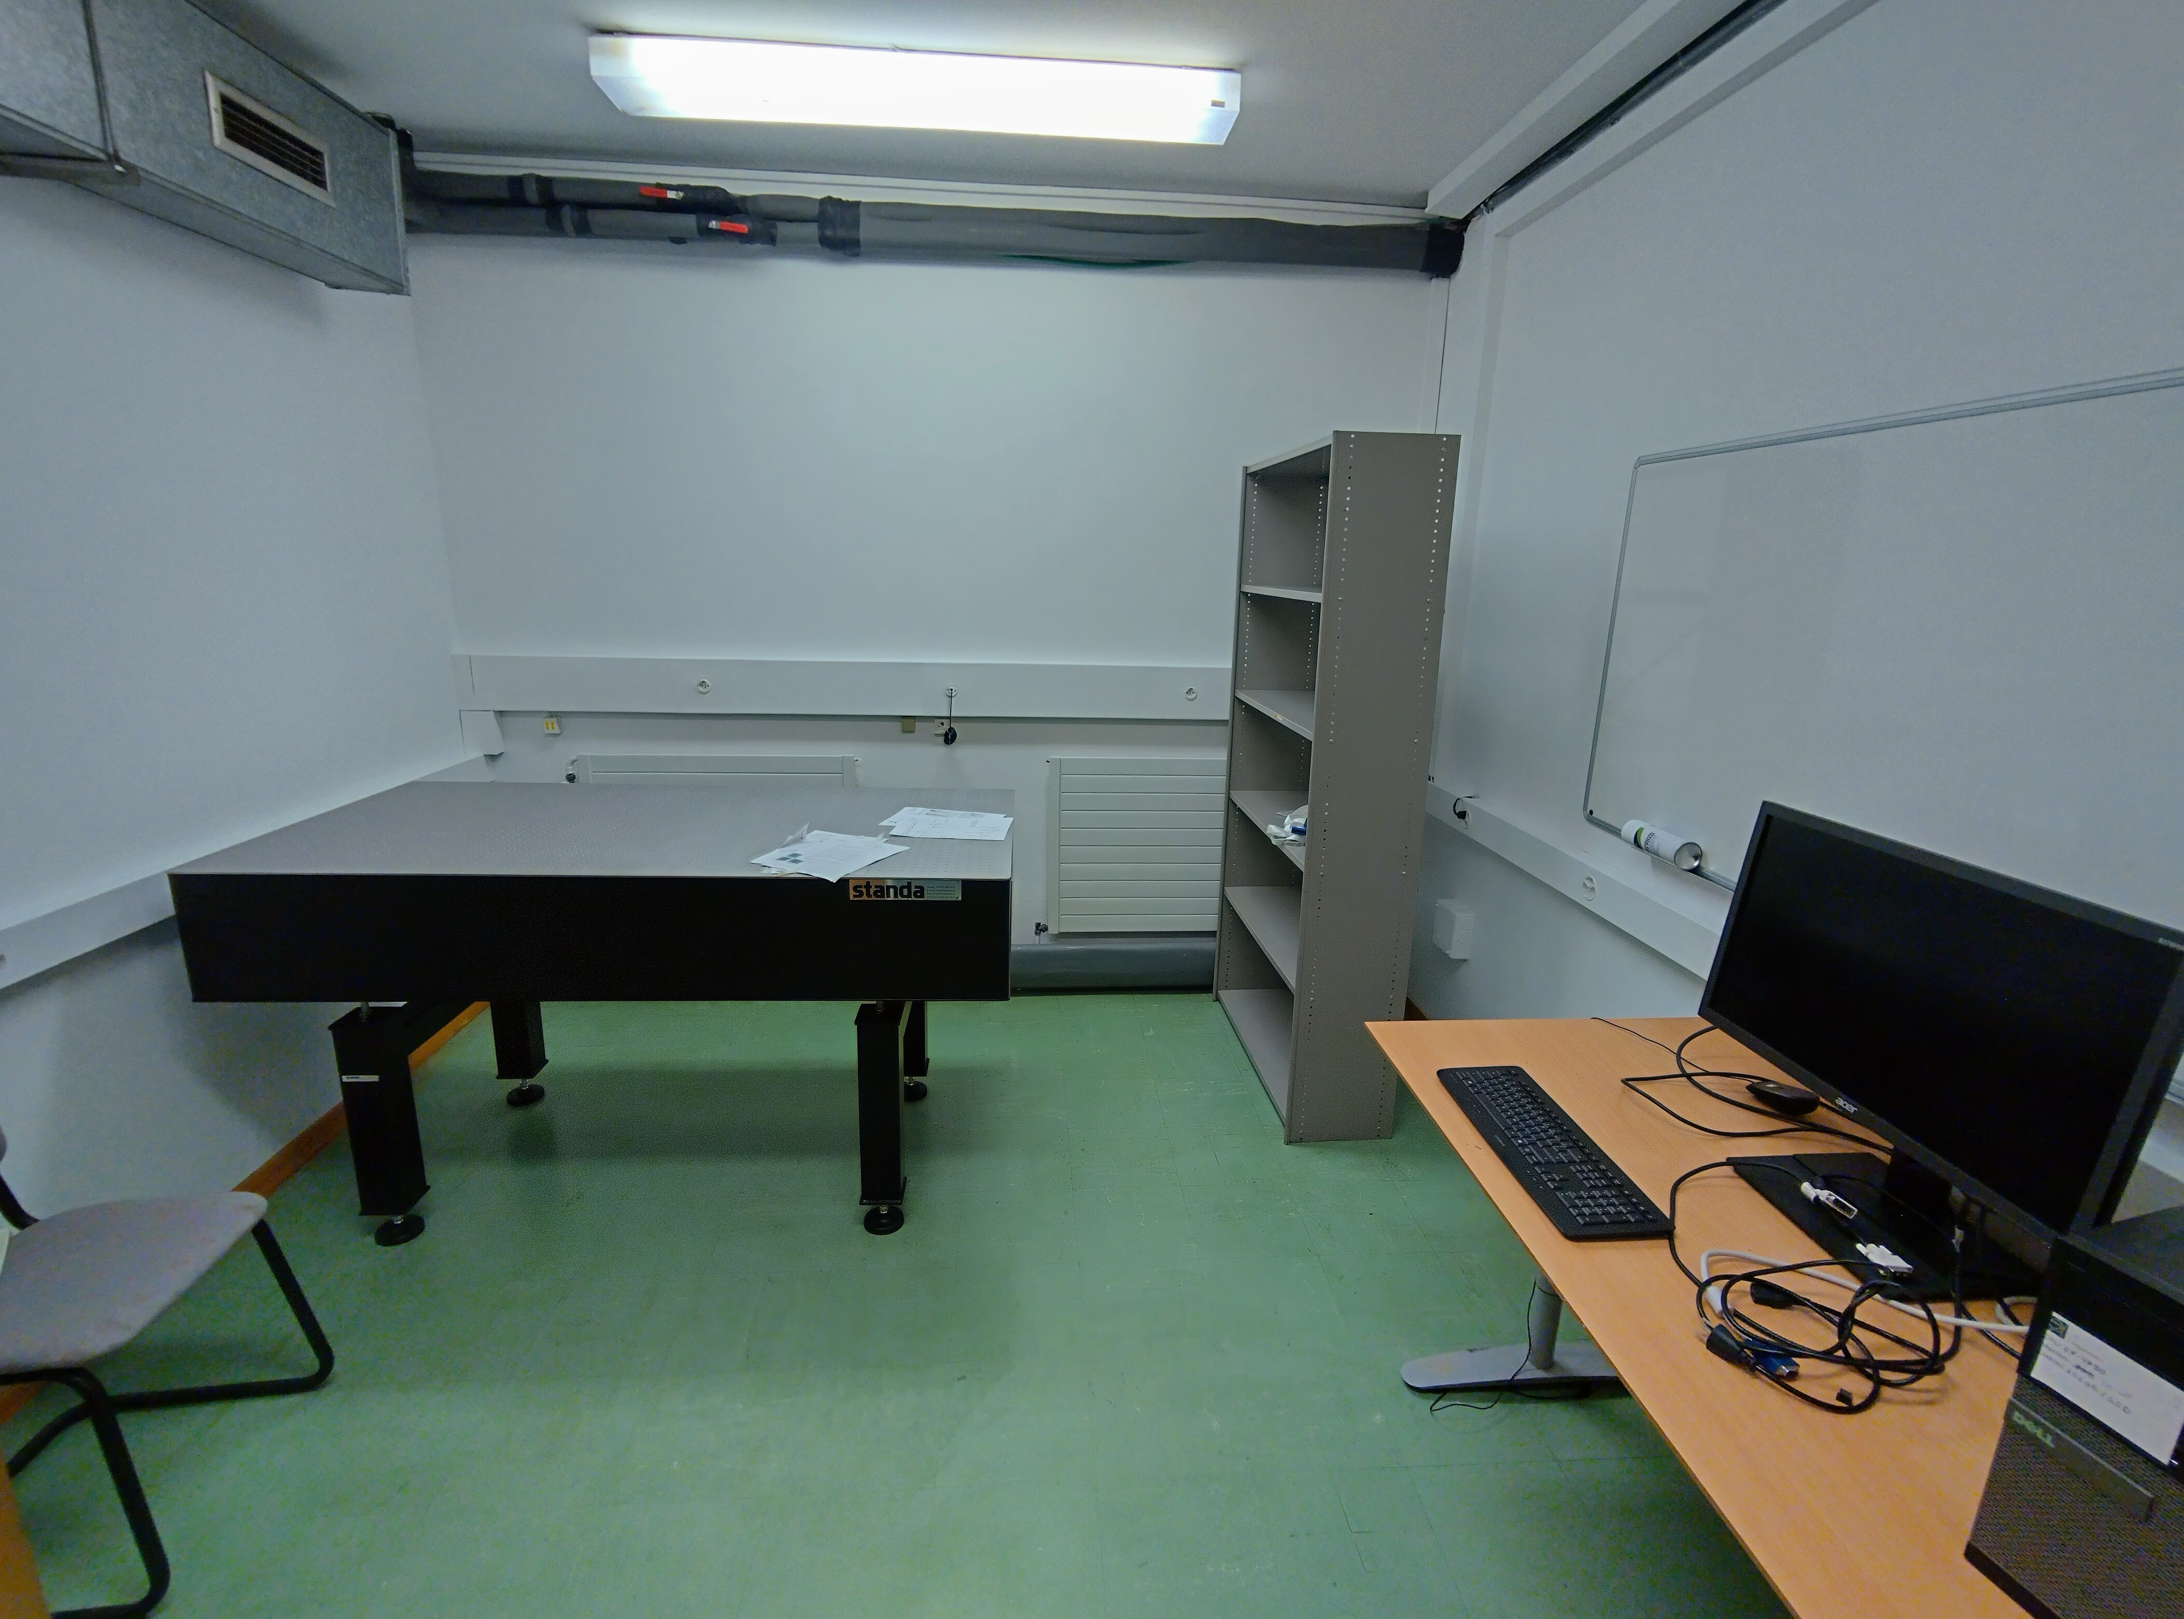
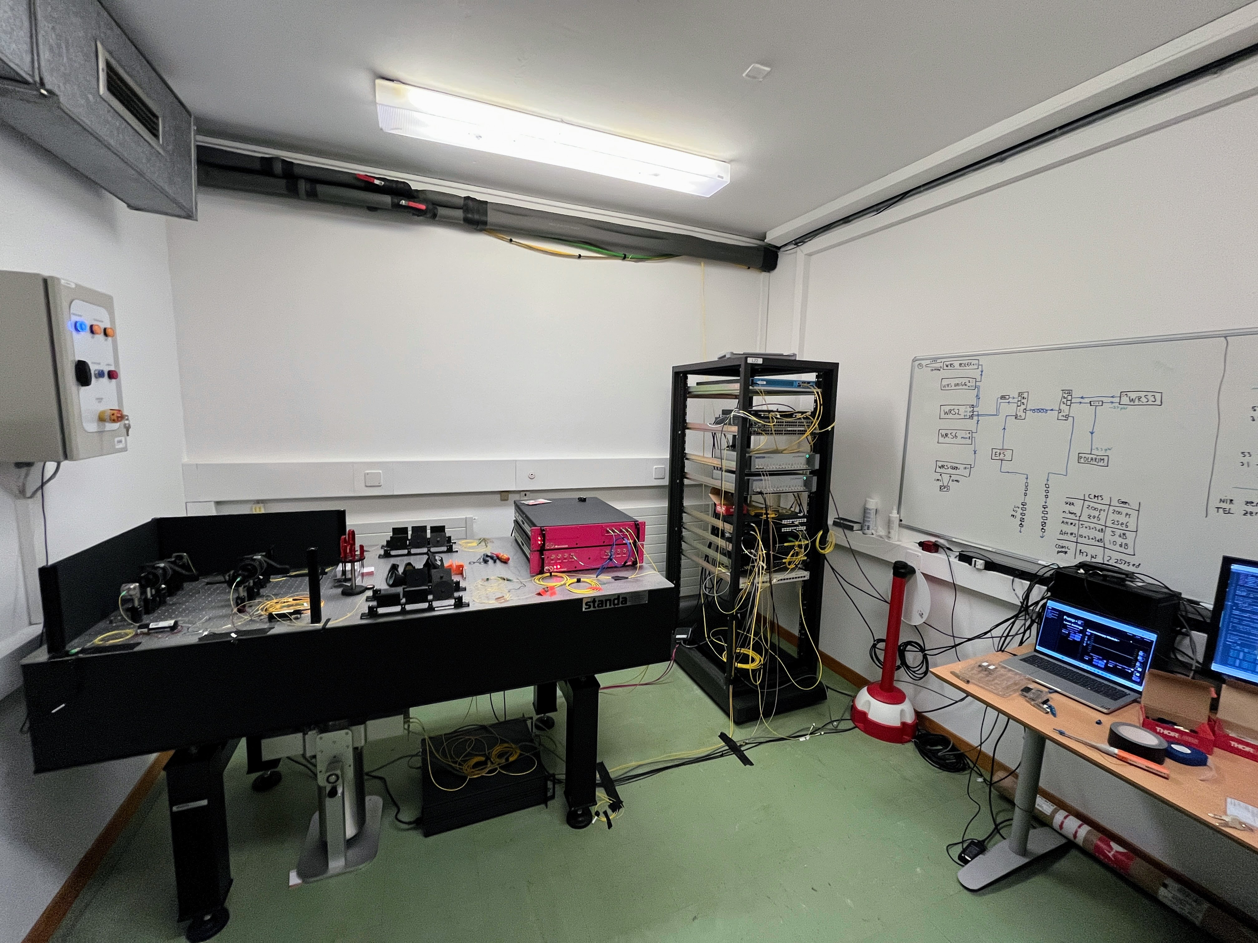
Start at the beginning
Setting up quantum networks lab from scratch!
Notes:
Start at the beginning… An empty room.
Procuring, arranging , installing and testing all equipment
Interlock installation

Slide 7
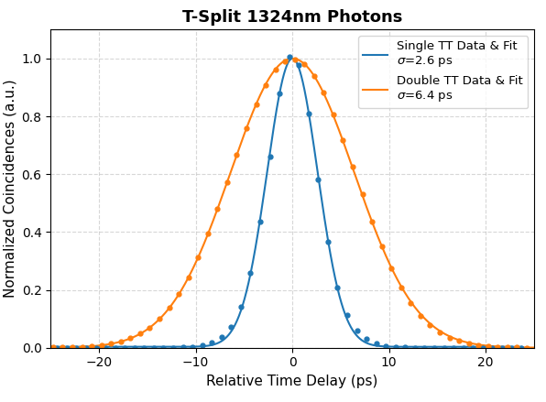
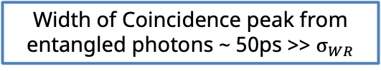

Characterization of WR-induced jitter
Coincidence counts vs time using either a single TimeTagger or two WR-synched TTs
light
Source
Detection
Autocorrelation single TT
RF T-split
TimeTagger
light
Source
Detection
Autocorrelation two TTs
RF T-split
TimeTagger
TimeTagger
$σ_{WR}= \sqrt{σ_{2TT}^{2}−σ_{1TT}^{2}}=$5.8 ps
White Rabbit Switch
White Rabbit Switch
Width of Coincidence peak from entangled photons ~ 50ps >> $σ_{WR}$

Slide 8
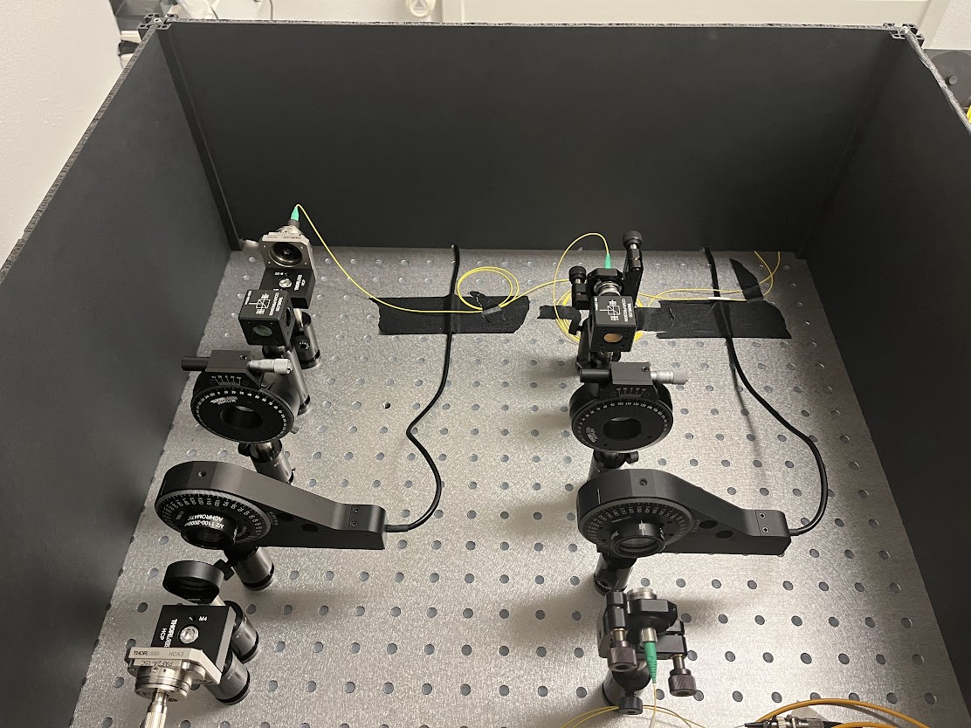

Demonstrating entanglement distribution
Measuring coincidence counts as a function of detection time difference in different polarisation bases
To detectors
Alice
Fiber coupler
Bob
Polarising beamsplitter
Fiber coupler
½ waveplate
Coincidences
Fiber coupler
Laser
Notes:
Coincidence count is defined as an event where both Alice and Bob’s detector click. There will be a peak in coincidences at a detection time difference corresponding to the path length difference separating them.
Coincidence counts in different polarisation bases using free space optics, including waveplates, polarising beamsplitters and fiber couplers

Slide 9
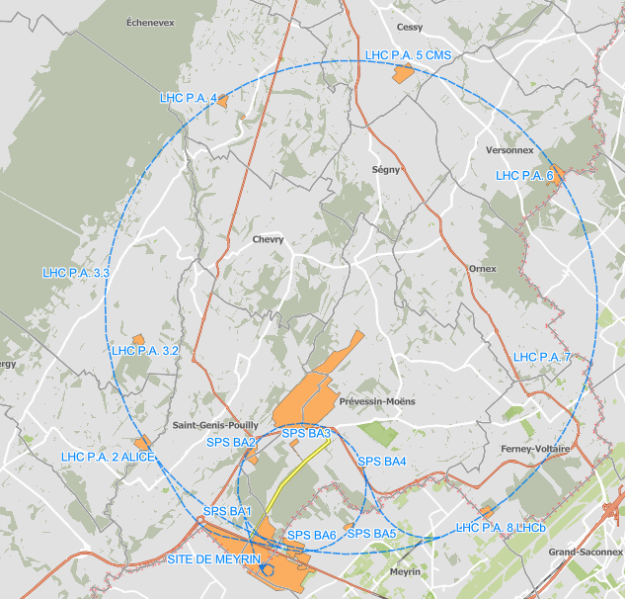
Fiber link (Loop-Back configuration)
29.5km fiber link from lab to CMS site and back
10.94 dB of attenuation (8% transmittance)

Slide 10
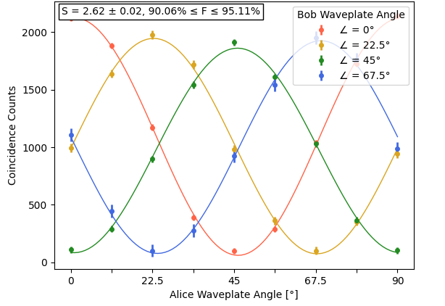
Demonstrating entanglement distribution
1) CHSH test : determine S-parameter (S > 2 means photons were entangled)
Average visibility
V = 0.926+/- 0.0044
CHSH S-parameter
S = 2.62 +/- 0.04
Maximum S = 2√2 ≈ 2.83
Notes:
Entanglement fringe visibility : contrast between max and min each of the four sinusoidals

Slide 11
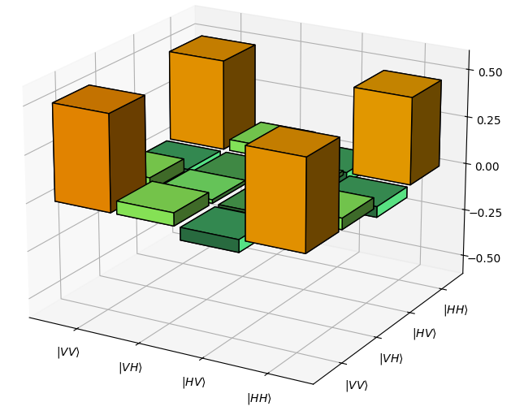
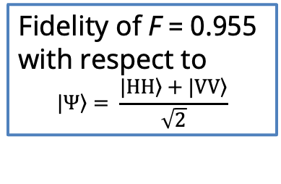
Demonstrating entanglement distribution
2) Quantum State Tomography: full state characterisation
Fidelity of F = 0.955 with respect to
$$\left.|Ψ\right\rangle = \frac{\left.|HH\right\rangle +\left.|VV\right\rangle }{\sqrt{2}}$$
Notes:
Real part of Psi is shown here , demonstrating near perfect fidelity to one of the four Bell states.

Slide 12
Entanglement distribution + Polarization tracking
Polarimeter
White Rabbit Switch
Polarizer
1:1
White Rabbit Switch
15xx nm
15xx nm
DWDM
DWDM
Source
1320 nm
1320 nm
785 nm
TimeTagger
TimeTagger
Detection
Detection
Alice
Bob
Notes:
Setup is expanded. White rabbit is a two-way optical protocol; in the arm that transmits in the direction of the single photons, a polariser is inserted. After demultiplexing the signal, the classical light is split in two, of which one arm is fed to the polarimeter monitoring the polarisation state of the classical (WR) light.

Slide 13
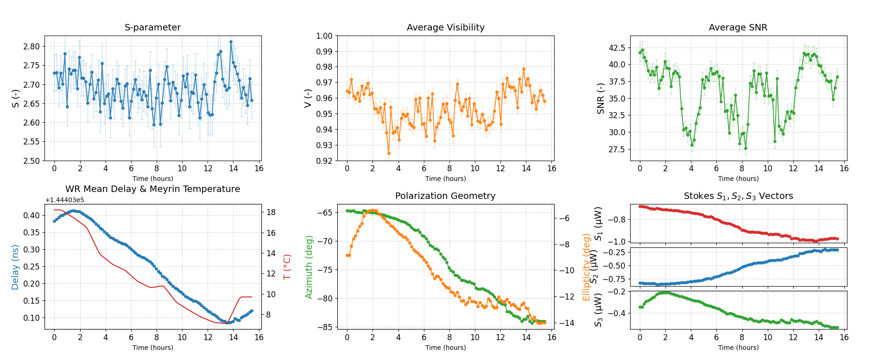
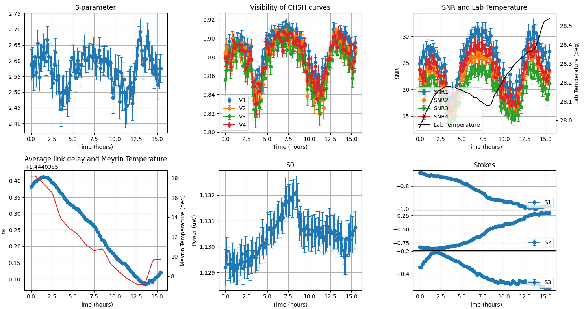
Repeated CHSH tests
Quantum Parameters:
Classical Parameters:
Notes:
Note that the system is only calibrated once before the start of the experiment, not in between !
Quantum parameters:
S-parameter : Bell violation (S > 2) was maintained for over 15 hours, peaking around 2.8, demonstrating non-local entanglement throughout the duration.
Visibility : The average visibility exceeds 92% over the full measurement duration, and peaks at 98%
SNR : the signal to noise ratio shows periodic behaviour : stability of source
Classical parameters:
The average link delay measured in nanoseconds over this link of 30 km clearly follows the day-night temperature curve (right axis), showing a drift of around 300 ps. Temperature changes induce length changes of the optical fiber, thus changes in the delay.
The three stokes parameters, S1 – S3, show slow drifts over the course of time, correpsonding with the temperature fluctuation. As the fiber’s birefringence changes with temperature the polarisation of signals rotates : it acts like a waveplate that is slowly being rotated . S1 and S2 show opposite behaviour, indicating the total degree of polarisation (DOP) remains unchanged.

Slide 14
      Quantum-Classical Coexistence
Outlook
  Move Bob to a physically different location:
  → Alice @ CERN, Bob @ UniGe
  Multiplex more classical traffic
  → management network on same fiber
multiplexer
Single photons
Demonstrate metropolitan scale entanglement distribution with the quantum signal and all classical traffic multiplexed on a single fiber

Slide 15
Questions?
annick.teepe@cern.ch

Slide 16

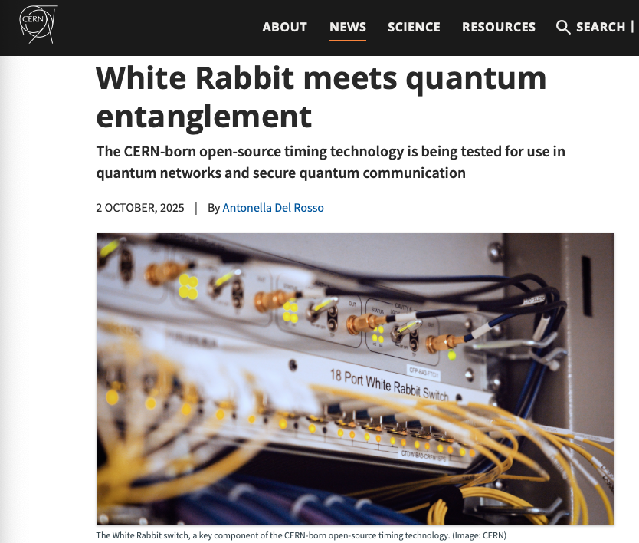
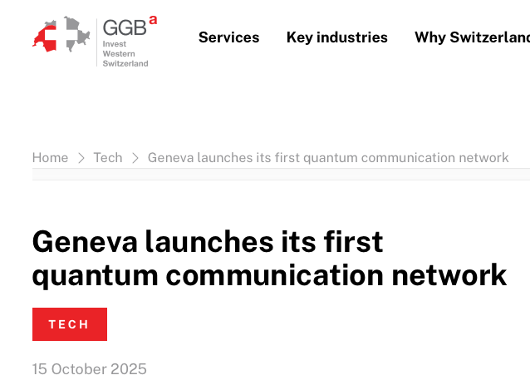
News !

Slide 17
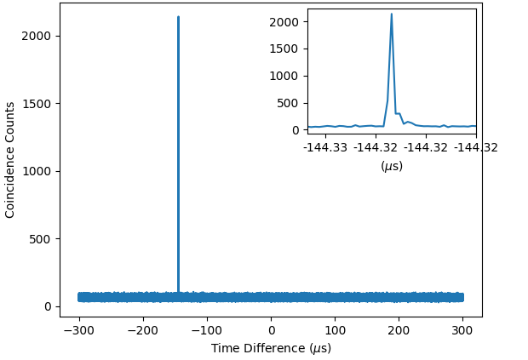
Demonstrating entanglement distribution
1) CHSH test : determine S-parameter (S > 2 means photons were entangled)
For each angle pair:
Measure coincidences as a function of detection time difference
extract the maximum of the coincidence peak
Notes:
Entanglement fringe visibility

