Slide 1
[In-band] Network Telemetry at AmLight
Telemetry and Big Data Workshop
Nov 11th, 2020
Jeronimo Bezerra - IT Associate Director/FIU
Arturo Quintana - Sr. Software Developer/FIU

Slide 2
In-band Network Telemetry (INT) [1]
INT adds metadata to each packet with information that could be used later for troubleshooting activities.
As metadata is exported directly from the Data Plane, Control Plane is not affected:
  Translating: you can track/monitor/evaluate EVERY single packet at line rate.
INT metadata being used at AmLight:
  ingress port id, egress port id, ingress timestamp, egress timestamp, queue id, queue occupancy
2
Network Telemetry @ AmLight || 2020 Telemetry and Big Data Workshop

Slide 3
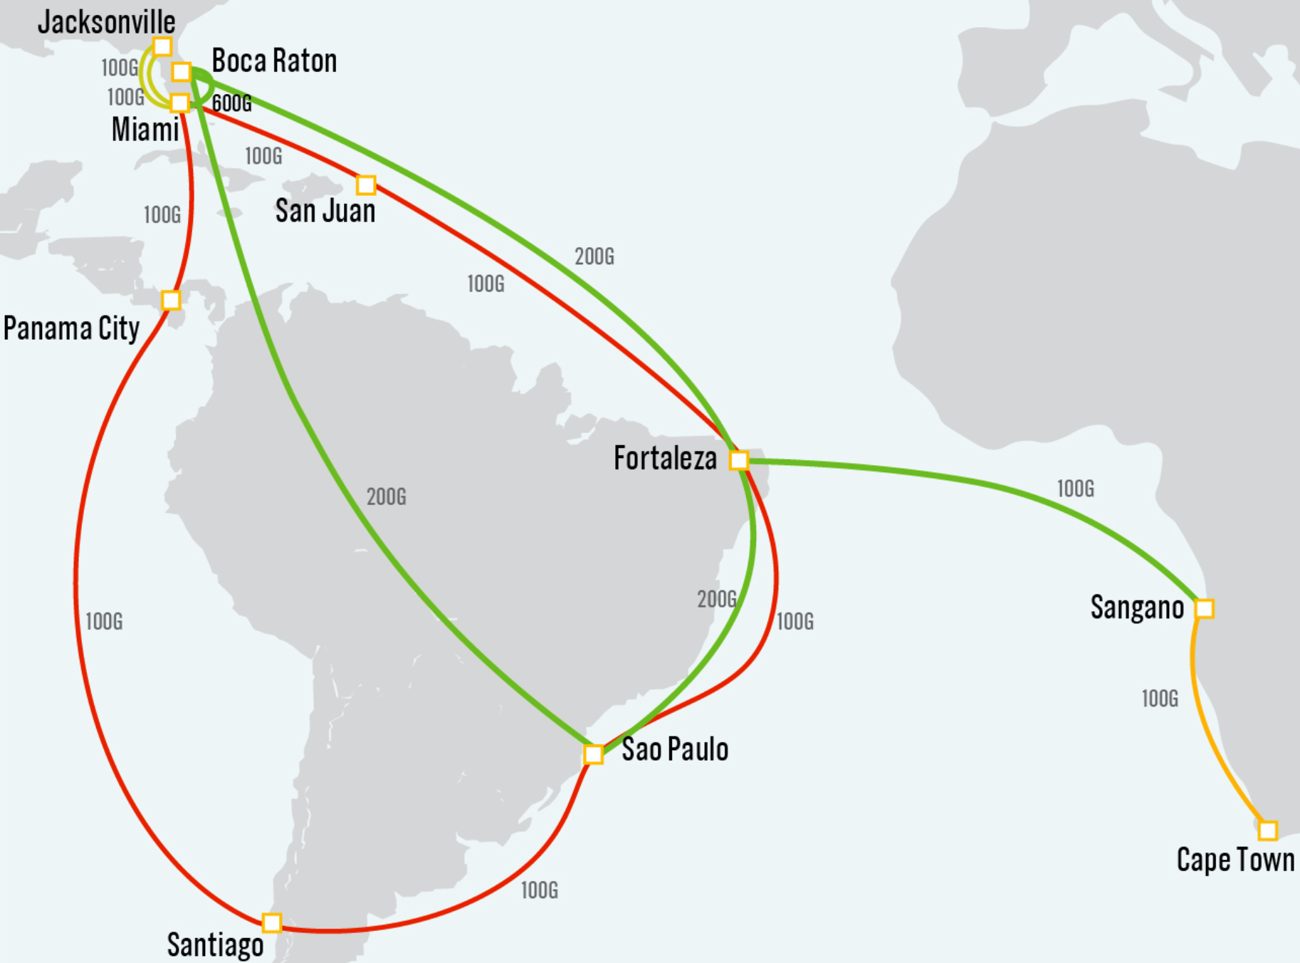
Introduction to AmLight
AmLight Express and Protect (AmLight-ExP) (NSF International Research Network Connections (IRNC) Award #1451018) [2]
680Gbps of upstream capacity between the U.S. and Latin America and 100Gbps to Africa
Production SDN Infrastructure since 2014
NAPs: Florida(2), Brazil(2), Chile, Puerto Rico, Panama, and South Africa
Main motivation for deploying INT: The Vera Rubin Observatory’s SLA
Network Telemetry @ AmLight || 2020 Telemetry and Big Data Workshop
3

Slide 4
Telemetry at AmLight: Vera Rubin Use Case
Supporting the Vera Rubin’s requirements:
  Every 27 seconds throughout the night, the telescope at the Base (Chile) site will take a 6.4GB picture of the sky, process it, generate transient alerts (6.3GB) from this picture, and send the 12.7GB data-set to the Archive site in the U.S.
    From the 27-seconds window, only 5 seconds are available for data transmission [3]
  Multi traffic types with different priorities (db sync, control, general internet traffic)
  Full network visibility is required to mitigate issues in real time.
Network Telemetry @ AmLight || 2020 Telemetry and Big Data Workshop
4

Slide 5
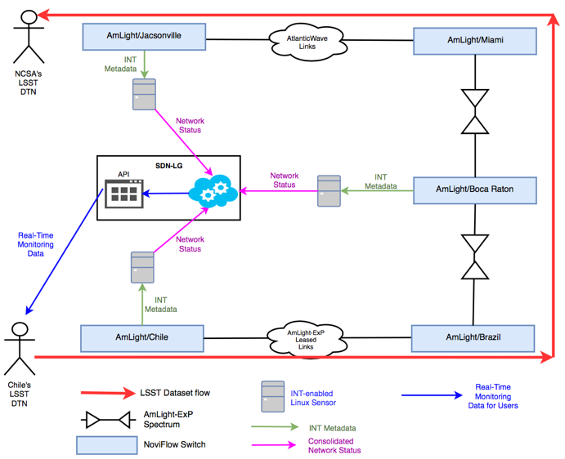
AmLight-INT Project
NSF Award# OAC-1848746
Goals:
  Deploy P4/INT-capable switches
  Deploy INT Collectors (100G hosts) to collect metadata
  Develop a new methodology to collect and export INT data in real time to feed SDN controllers and users with monitoring information
  Create a Network Telemetry Design Pattern to be used by other R&E networks
Network Telemetry @ AmLight || 2020 Telemetry and Big Data Workshop
5

Slide 6
What can we do with INT at AmLight?
Selectively enable network telemetry for specific flows:
  Saves resources
Track path taken in real-time, including egress queues
  “Proof-of-transit”: make sure packets are following the forwarding policies
Track path changes (including LAG port members):
  Ideal to track link flaps and issues with LAG ports
Monitor the delay introduced by each network hop in the path
  Ideal to track per interface and queue high utilization (mitigating micro-bursts)
Monitor all interfaces’ queue’s being used
  Ideal to evaluate the QoS policy in place
Correlate user performance observed with network conditions
  With user’s TCP/IP headers and INT, we can pinpoint why the performance bottleneck is as is
Network Telemetry @ AmLight || 2020 Telemetry and Big Data Workshop
6

Slide 7
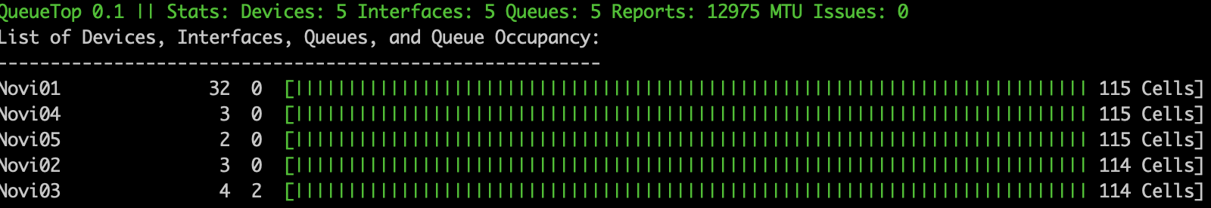
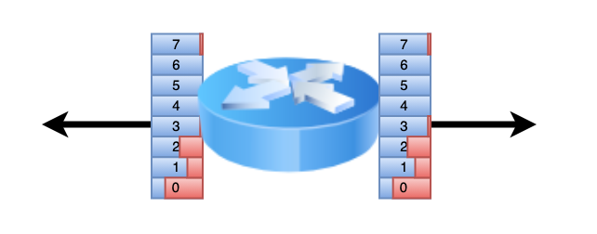
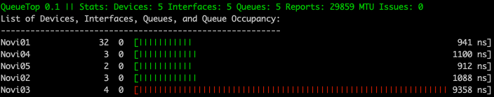
QueueTop – Queue Occupancy Monitor
Monitors all switches’ interfaces’ queues in real time
Network Telemetry @ AmLight || 2020 Telemetry and Big Data Workshop
7

Slide 8
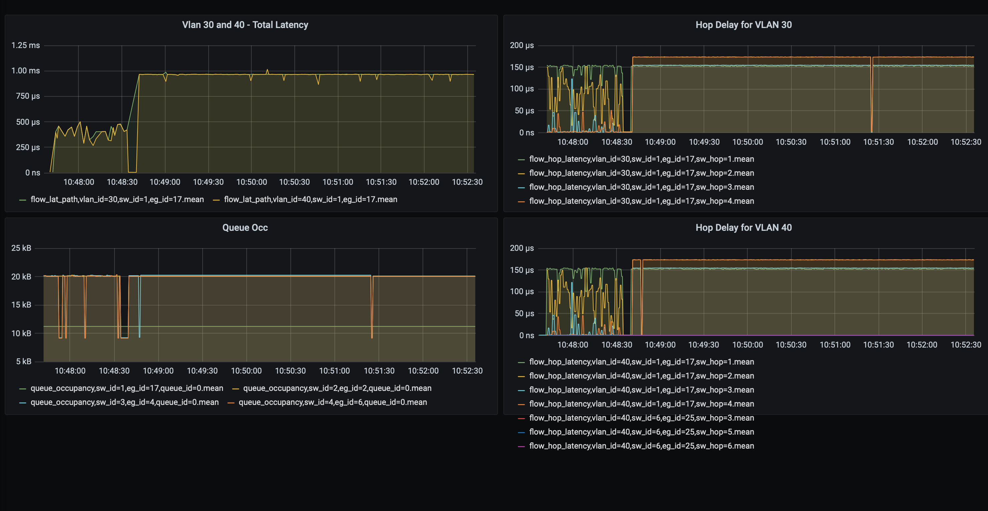
QueueTop + InfluxDB + Grafana
TCP
UDP
TCP
UDP
Network Telemetry @ AmLight || 2020 Telemetry and Big Data Workshop
8

Slide 9
Challenge 1: Receiving telemetry reports
100Gbps with 9000-Bytes packets ➔ ~1.5M packets per second
At AmLight 6-10 switches connect Chile to the U.S.
Telemetry reports have 208-220bytes
Each user packet creates a telemetry report
4.5Gbps of telemetry report for each 100Gbps of traffic
  Single flow/No hashing
Solution in place: eBPF/XDP (eXpress Data Path) [4]
Network Telemetry @ AmLight || 2020 Telemetry and Big Data Workshop

Slide 10
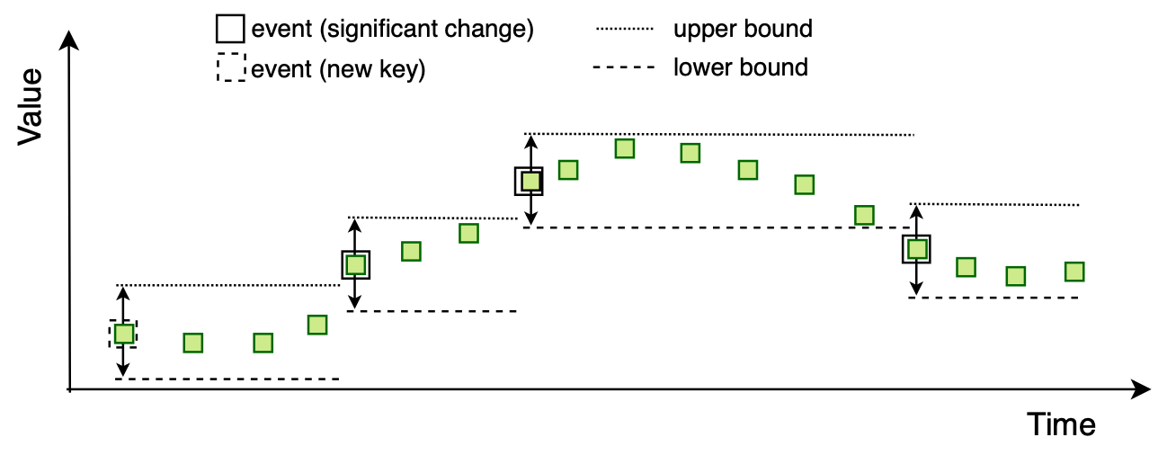
Challenge 2: Storing telemetry reports of interest
Not feasible to save all telemetry reports (yet)
Solution: XDP code only “stores” counters that report a change in the traffic behaviour:
  A queue that increased/decreased more than 20KBytes
  A flow path that changed
  A hop delay or total delay that increased above 2 microseconds
  An egress interface that is using more than 80Gbps
This data is stored using InfluxDB
Result:
  Close to real time processing.
  Not so granular measurements
[5]
Network Telemetry @ AmLight || 2020 Telemetry and Big Data Workshop

Slide 11
Challenge 3: Storing all telemetry reports for future research (ML/AI)
Goal: Store as many telemetry reports as possible for future research to enable ML/AI researchers to have grounding truth for learning algorithms
Each Vera Rubin 5-second 13.6GB data transfer will generate ~337MB of telemetry data.
  1,334 observations/night: 450GB of telemetry data/night
Challenges:
  How to save Gbps of telemetry reports without increasing OPEX (rack space, power consumption, etc.)
  How/Where/How long to store such data?
  How to make it available preserving privacy but without compromising research?
  What data is really necessary from the telemetry report?
  What has to be combined with reports to give context? Topology?
Challenge 3 is wide-open. AmLight is a small team and we are looking for collaborations.
Network Telemetry @ AmLight || 2020 Telemetry and Big Data Workshop

Slide 12
Thank you!
CI Lunch and Learn 2019:
  https://www.youtube.com/watch?v=RRg9uFz9GkA&feature=youtu.be
CI Lunch and Learn 2021:
  Jan 22nd, 2021
  CI Engineering Lunch & Learn Series
    https://www.es.net/science-engagement/ci-engineering-lunch-and-learn-series/
  Demonstration, Interfaces, code
  Challenges and opportunities for collaborations
Network Telemetry @ AmLight || 2020 Telemetry and Big Data Workshop

Slide 13
References
  INT Specification: https://p4.org/assets/INT-current-spec.pdf
  AmLight: http://www.amlight.net
  Bezerra, J., Arcanjo, V., Ibarra, J., Kantor, J., Lambert, R., Kollross, M., Astudillo, A., Sobhani,S., Jaque, S., Petravick, D., Morgan, H., Lopez, L., "International Networking in support of Extremely Large Astronomical Data-centric Operations". Presented at Astronomical Data Analysis Software and Systems (ADASS XXVII) conference, Santiago, Chile, October 22-26, 2017. http://www.adass.org/
  NoviFlow : http://www.noviflow.com
  XDP: https://www.iovisor.org/technology/xdp
  N. V. Tu, J. Hyun, G. Y. Kim, J. Yoo and J. W. Hong, "INTCollector: A High-performance Collector for In-band Network Telemetry," 2018 14th International Conference on Network and Service Management (CNSM), Rome, 2018, pp. 10-18.
Network Telemetry @ AmLight || 2020 Telemetry and Big Data Workshop

Slide 14
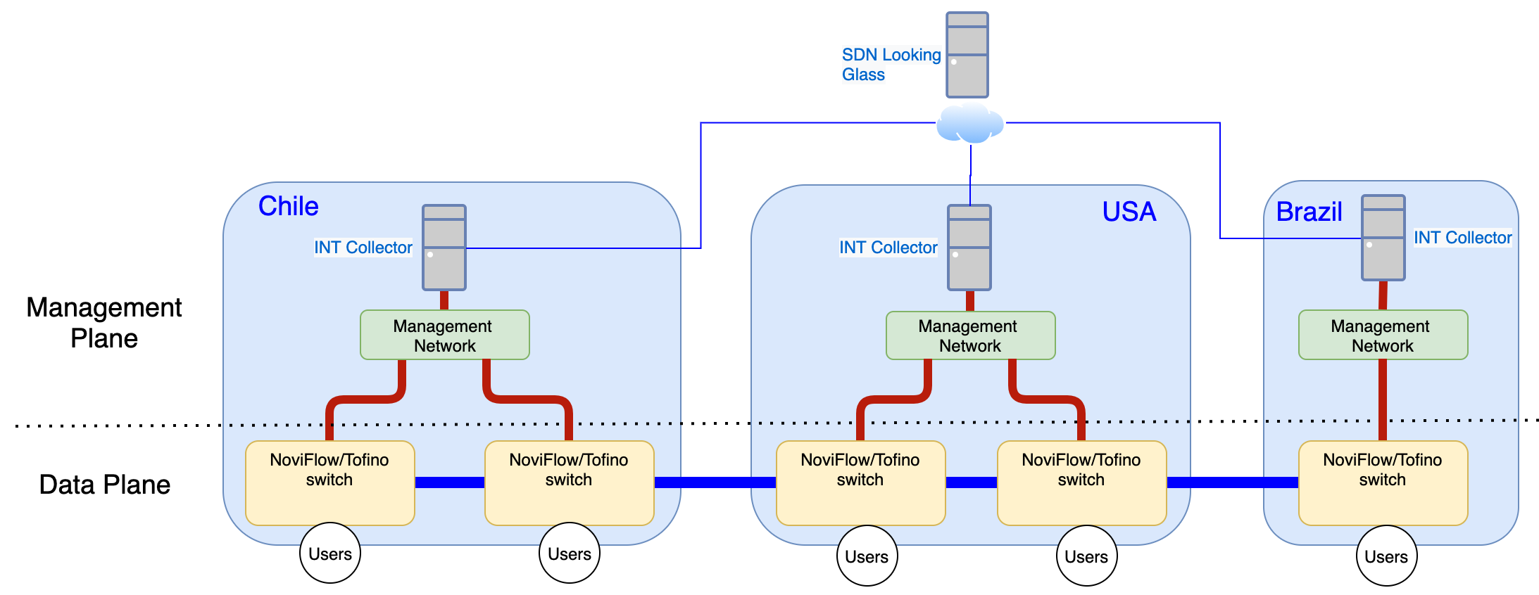
Ongoing Deployment
At each pop, NoviFlow/Tofino switches [4] are being deployed
Each pop has an INTCollector parsing Gbps of telemetry and uploading Kbps of network state of the SDN Looking Glass
A new Control Plane was created to replace the legacy environment using OpenFlow 1.3, gRPC, and P4.
Network Telemetry @ AmLight || 2020 Telemetry and Big Data Workshop
14

