Slide 1
DDoS Detection on
P4 SmartNICs
Marinos Dimolianis, Adam Pavlidis, Vasilis Maglaris
Network Management & Optimal Design Laboratory (NETMODE)
School of Electrical & Computer Engineering
National Technical University of Athens
1st GEANT Telemetry and Big Data Workshop
November 10th, 2020

Slide 2
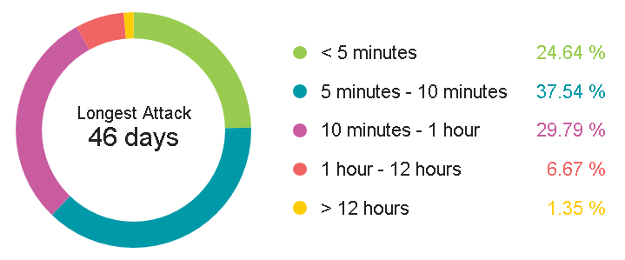
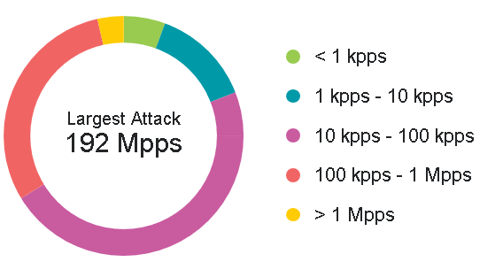
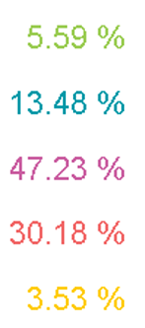
Distributed Denial of Service (DDoS) Attacks
DDoS Statistics¹
Attack Duration
Attack Rate
https://horizon.netscout.com/?atlas=summary (January 2020)

Slide 3
DDoS Attack Detection Mechanisms
sFlow, NetFlow, OpenFlow
  Communication overhead between Network Device and External Collector
In-Network
  Rapid attack detection in the data plane (P4)
  Push-based approach
  Notification to external mitigation systems

Slide 4
Traffic Features & Processing
Traffic Features
Total Number of Unique Flows
Subnet significance i.e. Flows per destination network
Packet Symmetry for TCP/UDP per destination network
Threshold-based DDoS detection in the data plane

Slide 5
P4 DDoS Detection Pipeline (1/5)
Stage 1
  TCP/UDP parsing
Stage 2
  Traffic isolation originating from/destined to Protected Networks (match-action)
  Unique identifier matching packets to protected networks

Slide 6
P4 DDoS Detection Pipeline (2/5)
Stage 3a
  Packet association with time-based epochs (ingress timestamp)
Stage 3b
  New Epoch Initialization (Conditionally)
  Counters, Epoch Index update

Slide 7
P4 DDoS Detection Pipeline (3/5)
Stage 4
  Identification of New Flows (srcIP, dstIP, srcPort, dstPort, Protocol) within an epoch
  Total Flow Counter & Flow Counter per protected network update
  Total number of Unique Flows Condition
  Subnet Significance Condition

Slide 8
P4 DDoS Detection Pipeline (4/5)
Stage 5
  TCP Packet Symmetry Ratio for protected subnet
  UDP Packet Symmetry Ratio for protected subnet
  Packet Symmetry Condition Evaluation

Slide 9
P4 DDoS Detection Pipeline (5/5)
Stage 6
  Metadata headers check
  P4 digest to external mitigation mechanisms
f_d
f_cn
f_p
Packet
Digest
Destination IP
D_ID
Proto
Epoch

Slide 10
Proof of Concept Testbed
P4-enabled Netronome SmartNIC
Netronome SDK
High-performance packet (PF_RING ZC framework)
  Sender
  Receiver
Experimentation
  Accuracy
  Performance

Slide 11
DDoS Detection Accuracy (1/2)
Malicious Traffic – Booters¹ (Booter4 dataset – B4)
Benign Traffic – WIDE Backbone²
  255 Protected Networks
  1 Victim
Experimentation process (1s epochs)
  [0-60s] benign traffic (alarms ignored between [0-30s])
  [60-90s] attack
Malicious Traffic
J.J. Santanna et al. "Booters—An Analysis of DDoS-as-a-Service Attacks", Integrated Network Management (IM), 2015 IFIP/IEEE International Symposium, July 2015
Packet traces from WIDE backbone, available at: https://mawi.wide.ad.jp/mawi

Slide 12

DDoS Detection Accuracy (2/2)
Attack Scenarios
  Underscaled (10% of B4)
  Normal (B4)
  Overscaled (5 x B4)
Accuracy = $\frac{\text{TP}\text{+}\text{TN} }{\text{TP}\text{+}\text{TN}\text{+}\text{FP}\text{+}\text{FN}}$

Slide 13
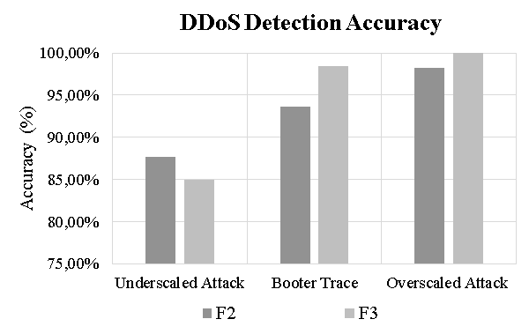

DDoS Detection Accuracy (2/2)
Attack Scenarios
  Underscaled (10% of B4)
  Normal (B4)
  Overscaled (5 x B4)
Accuracy = $\frac{\text{TP}\text{+}\text{TN} }{\text{TP}\text{+}\text{TN}\text{+}\text{FP}\text{+}\text{FN}}$
Detection Mechanisms
  Two-feature case (F2)
  Three-feature case (F3)
1)Total Number of Unique Flows
2) Subnet Significance
3) Packet Symmetry

Slide 14
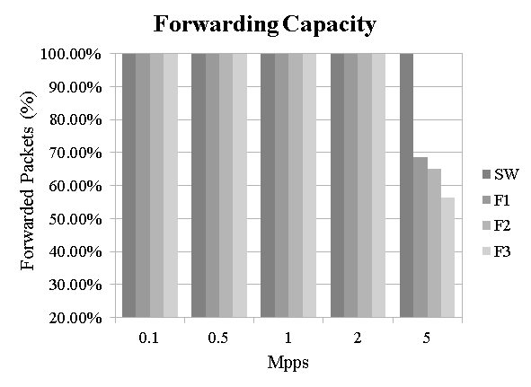
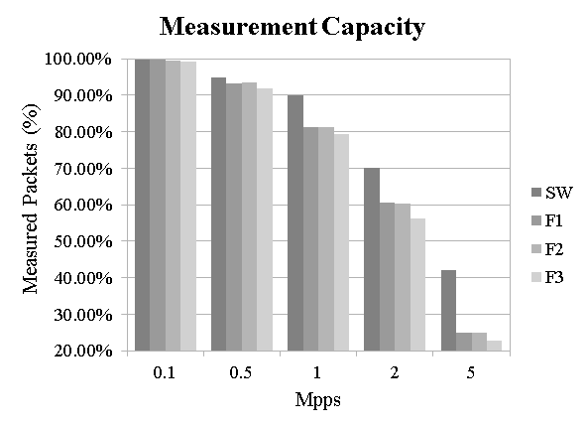
Packet Processing Performance
Stress Testing using:
  Plain Forwarding (SW)
  Singe-Feature (F1)
  Two-feature (F2)
  Three-feature (F3)
Malicious Traffic
P4 Registers
  Accessible in Data Plane
  Problems in High Rates
P4 Counters not accessible
from data plane

Slide 15
Conclusions & Future Directions
Conclusions
DDoS Detection Pipeline in P4
  Rapid Attack detection, Victim Network Identification
  Evaluate Accuracy within realistic attack conditions
  Performance Experiments for high packet rates
Future Work
Sampling impact on detection accuracy and performance
Attack vector identification

Slide 16

Thank you!
Marinos Dimolianis
mdimolianis@netmode.ntua.gr

Slide 17
Backup - Slides

Slide 18
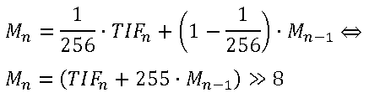


P4 DDoS Detection Pipeline
P4 Limitations - No support for
  Floating Point Arithmetic
  Divisions
Workarounds
  Floating Point approached via upscaling and division (bitwise shifting)
  Fractions in inequalities – Comparison between numerator and denominator

