Slide 1
Towards sFlow Monitoring Dashboards for AI-controlled NRENs
Telemetry and Big Data Workshop (GEANT)
mkiran@es.net
Mariam Kiran*
(and) Kenneth Miller*, Eric Pouyoul*, Ezra Kissel*, Paul Ruth^, Mert Cevik^
*Energy Sciences Network (ESnet), LBNL
^RENCI, Chameleon Cloud Team

Slide 2
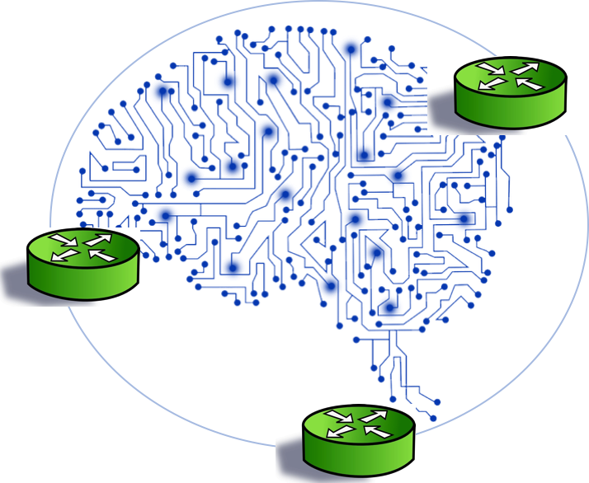
Deep Learning and Artificial Intelligence for High-Performance Networks
(DAPHNE Lab)
Exploring machine learning, deep learning and AI techniques when applied to operational networking and distributed computing problems
https://sites.google.com/lbl.gov/daphne/

Slide 3
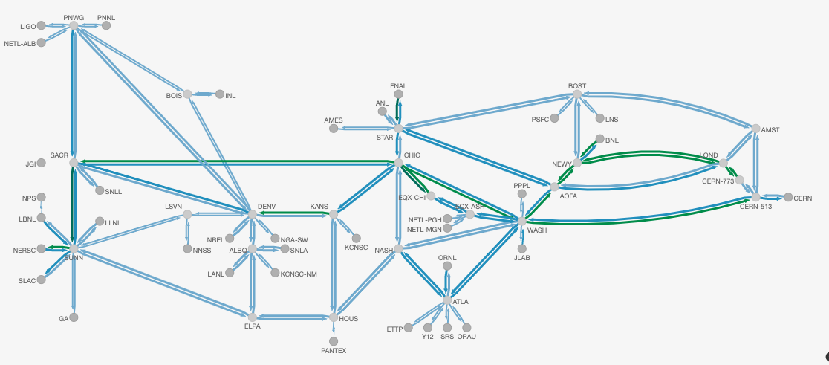
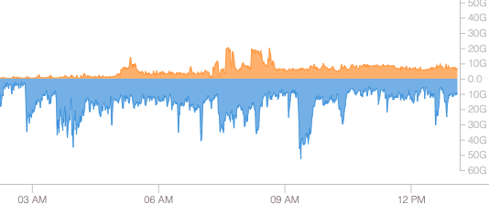
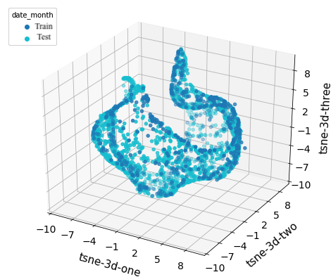
Many Data Sources across the Network
Bro, tcp, etc
PerfSonar
tstat
...
my.es.net
SNMP
Individual site behavior
Traffic surges across sites
netflow

Slide 4
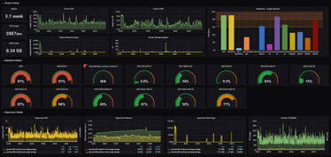
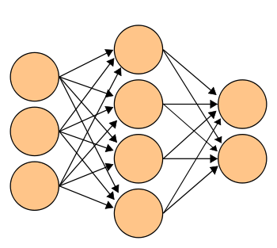
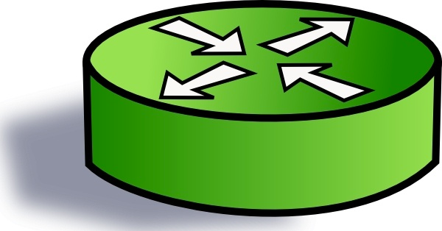

Goal: Adding AI to our Controllers
(Deep Reinforcement learning)
Agent
Reward
State
Action
Environment
Fully connected 3-layer neural network architecture
Custom dashboard
Chicago NU
Chicago
UC
Texas
Washington

Slide 5
But before we work with AI, we need to get our data right!

Slide 6
Understanding what Network Data means
Ps-nersc
Throughput, loss, latency
Ps-sunn
NERSC-crs
SUNN-crs
SNV
NERSC
LBL-crs
Key:
Snmp data is per link
Netflow data end to end
Perfsonar data end to end
LBL
router
Perfsonar host

Slide 7
Setting up experiments on on Chameleon Cloud
Chicago
UC
Texas
Network Layer
Data Collection and Aggregation
Visualization

Slide 8
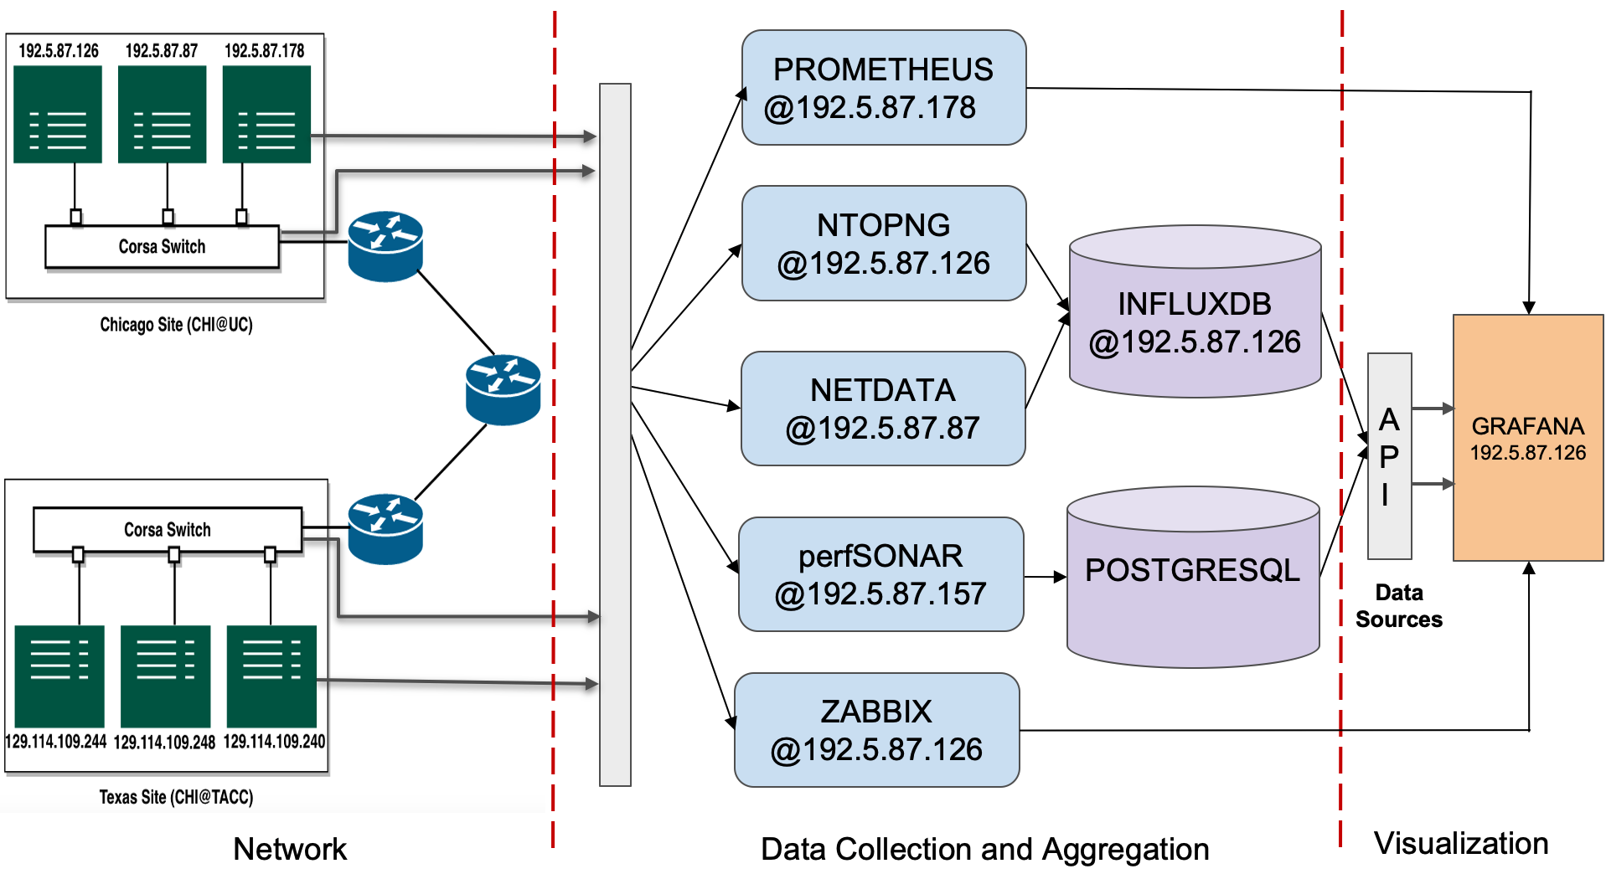
NetGraf Toolkit
Network Layer
Data Collection and Aggregation
(Prometheus, Ntopng, Netdata, Perfsonar, Zabbix)
Visualization
InfluxDB, PosgresSQL, Grafana

Slide 9
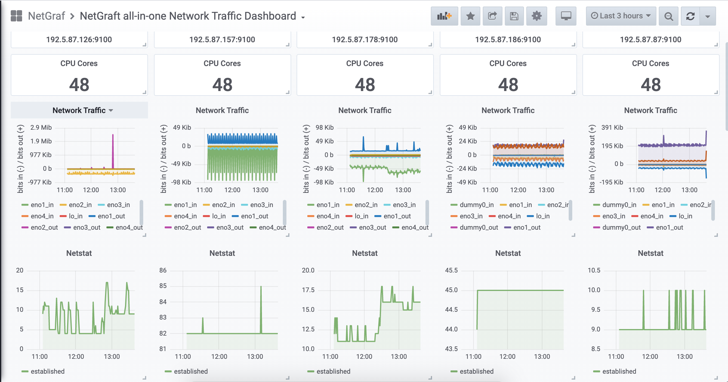
All-in-One Dashboard (shown in Grafana)
This is Good but too much ‘noise’!

Slide 10
Need for sFlow (Better Monitoring)
AI needs clean data to learn decision making
Use port mirroring to collect better data
Mirror traffic to Security Onion node
Host layer
sFlow
(Grafana)
sFlow telemetry
Network layer *
*Turn on sFlow-enabled

Slide 11
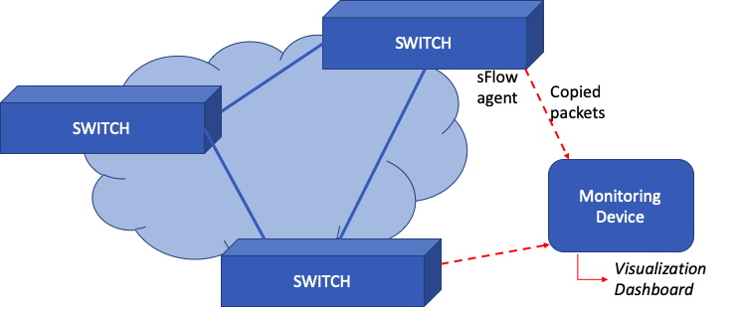
sFlow for Network devices

Slide 12
Next Steps
AI-controller needs setup of sFlow agents on Testbed devices
NetGraf toolkit is available for community to experiment with
  Aimed for researchers needing quick monitoring in real-time
Meanwhile developing more monitoring tools needed for AI, such as DTN-DTN tests and experimentation of other monitoring tools
  Feel free to reach out for collaboration and discussions!
D. Kaur, B. Mohammad, M. Kiran, NetGraf : A collaborative Network Monitoring Stack for Network Experimental Testbeds, Supercomputing 2020

Slide 13
Thankyou for listening!
More information:
  Deep Learning and Artificial Intelligence for High-Performance Networks
  (DAPHNE Lab) (https://sites.google.com/lbl.gov/daphne)

